Slide 1
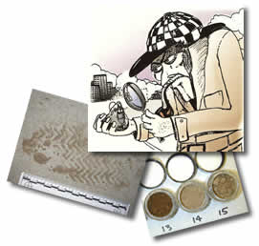
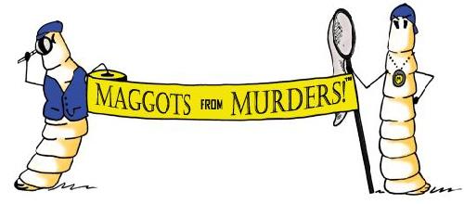
Unit 4: Forensic GEOLOGY

Slide 2
Geology is the study of the earth.
The earth is divided into many layers
Starting with the center of the earth we have the core, which is split into an inner core and an outer core.
The core is thought is be composed mostly of the element iron, with the inner core being solid and the outer core being liquid.
It is the liquid outer core that is thought to be responsible for the earth's magnetic poles.
Next comes the mantle. The mantle is composed of solid rock and is the largest of the layers in volume.
The outer skin of the earth is called the crust. In comparison to that of the other layers, its thick­ness is analogous to that of the skin on an apple.

Slide 3
It is the crust of the earth that we come in contact with everyday.
The soil we walk on has been created by the weathering of the underlying bedrock over a long period of time.
Since crime scenes occur on the surface of the earth, it is common to find the elements present in the earth's crust also present at the crime scene.

Slide 4
The eight most common elements in the earth's crust are:
Oxygen (O),46.6% Calcium (Ca), 3.6%
Silicon (Si), 27.7% Sodium (Na), 2.8%
Aluminum (Al), 8.1% Potassium (K), 2.6%
Iron (Fe),5.0% Magnesium (Mg), 2.1%
The two most common elements in the earth's crust are oxygen and silicon, and together they make up 75% of the crust.

Slide 5
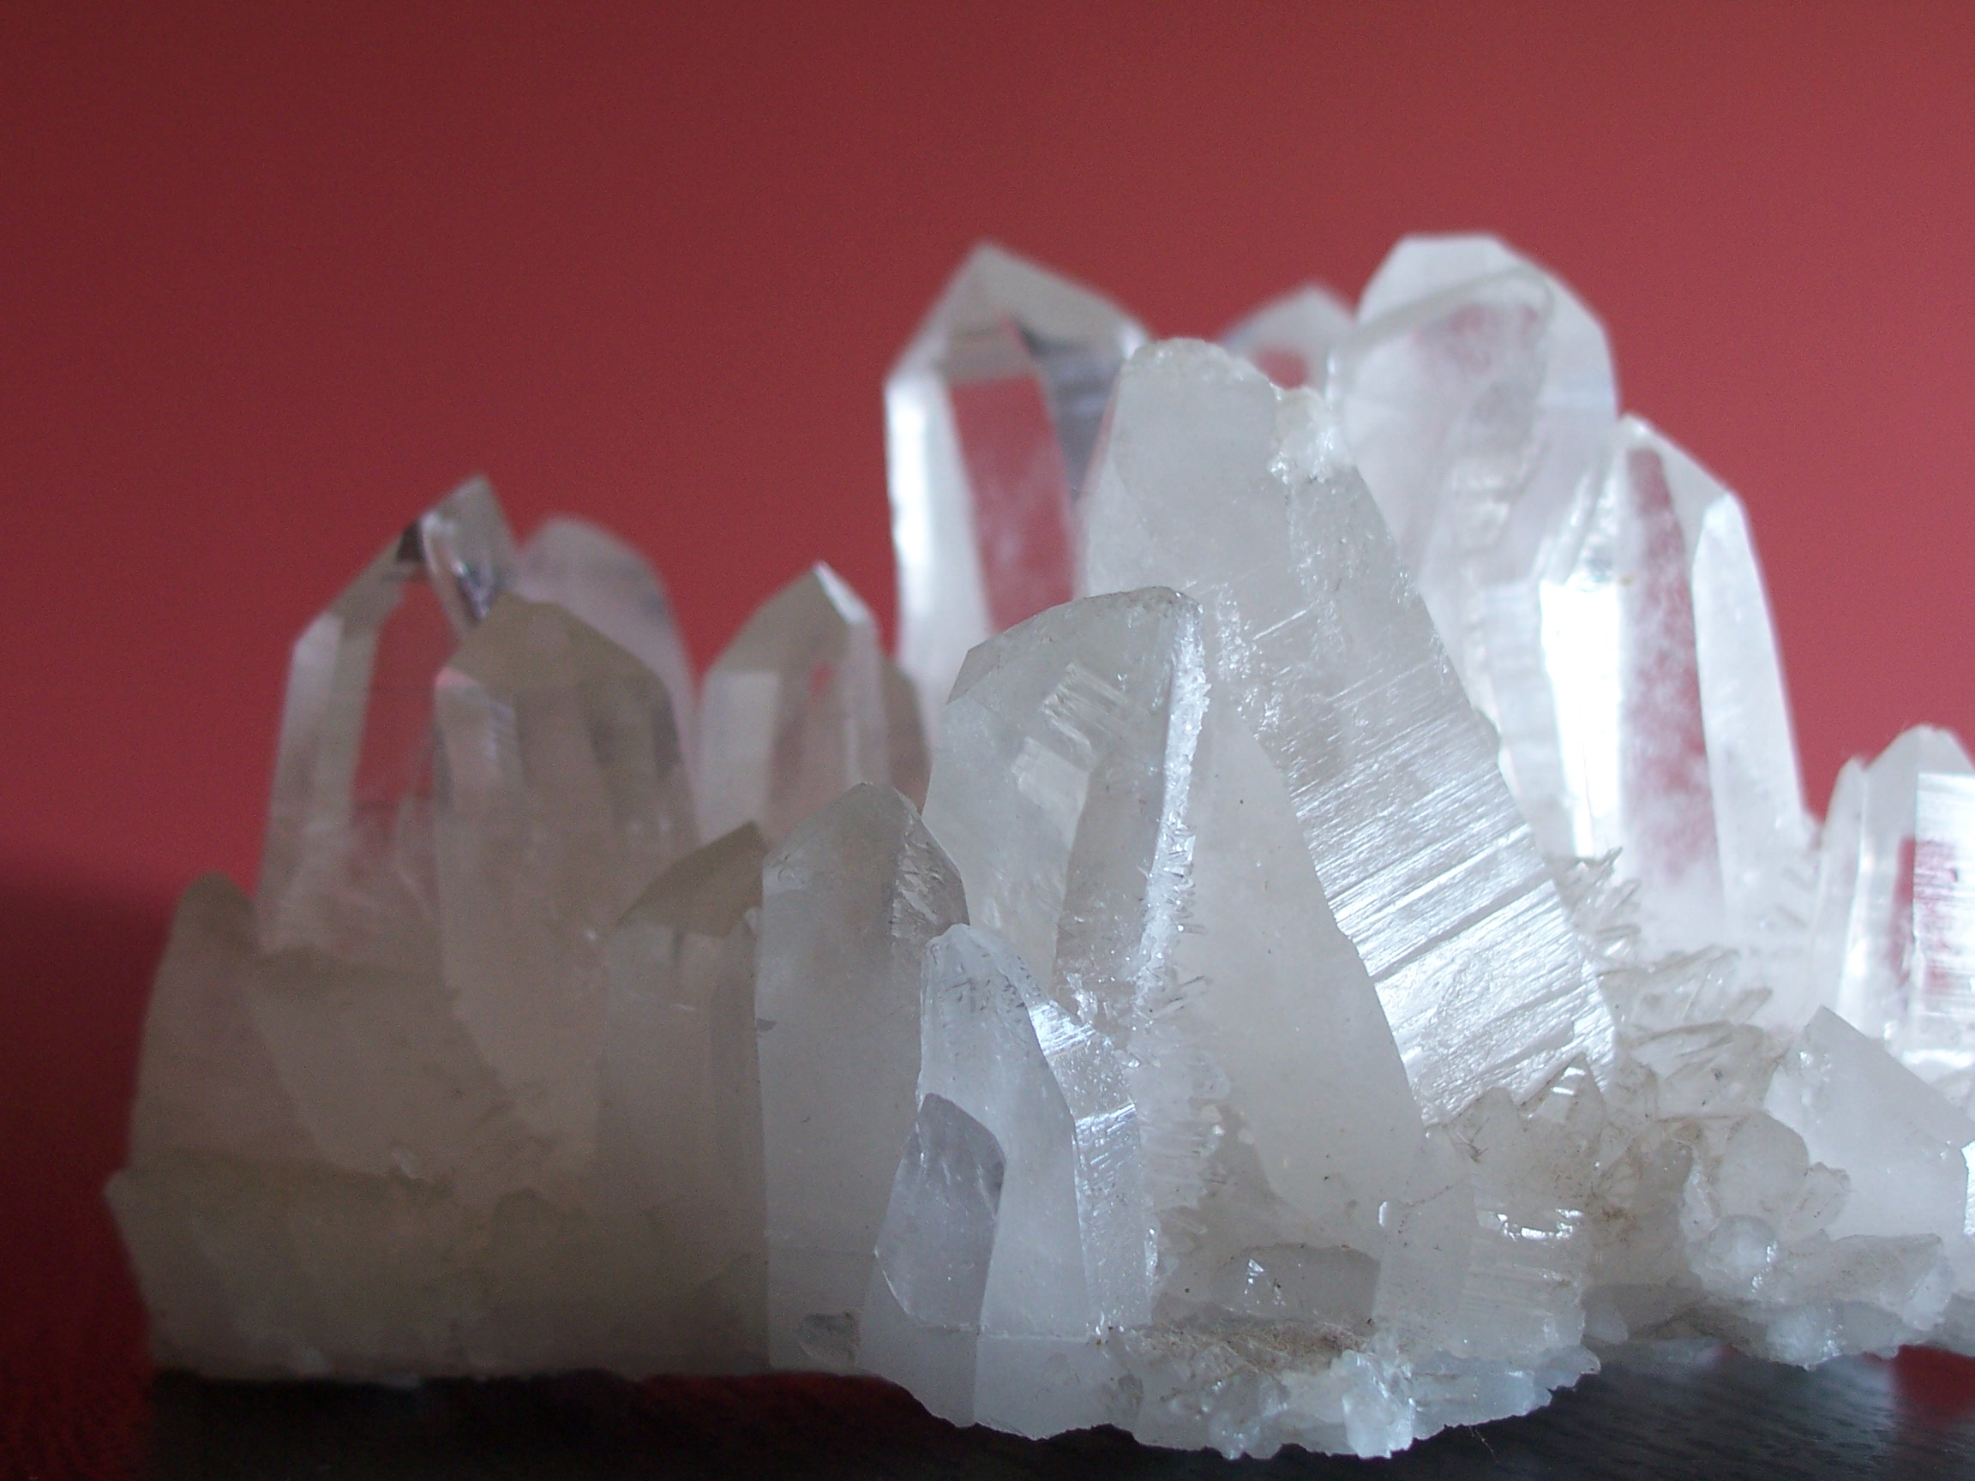
A mineral
is an inorganic chemical compound that is a naturally occurring crystalline solid with a definite chemical composition. The most common mineral in the earth's crust is quartz. Quartz has the chem­ical formula SiO₂.

Slide 6
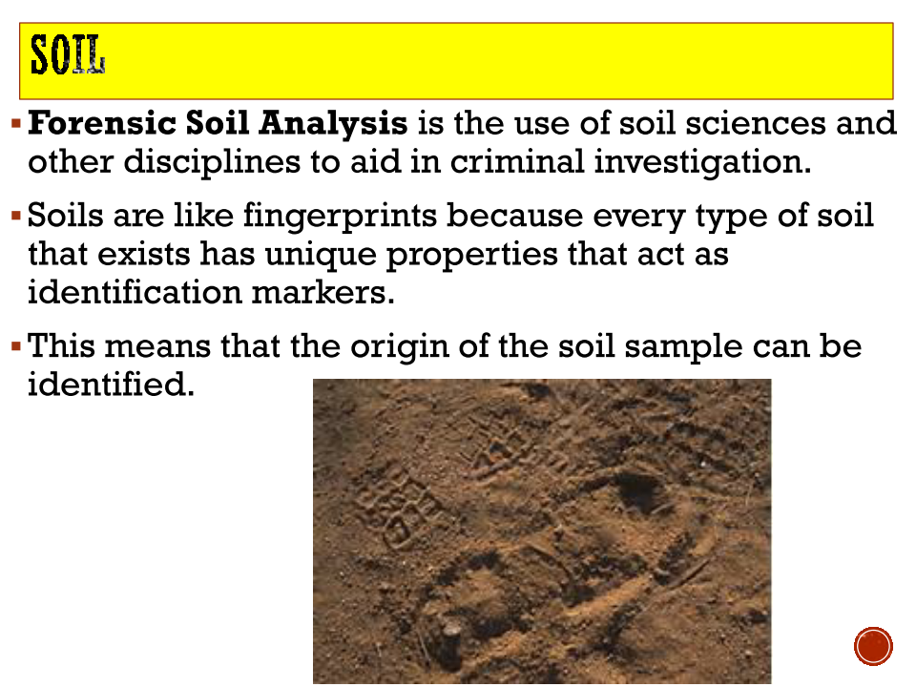

Slide 7
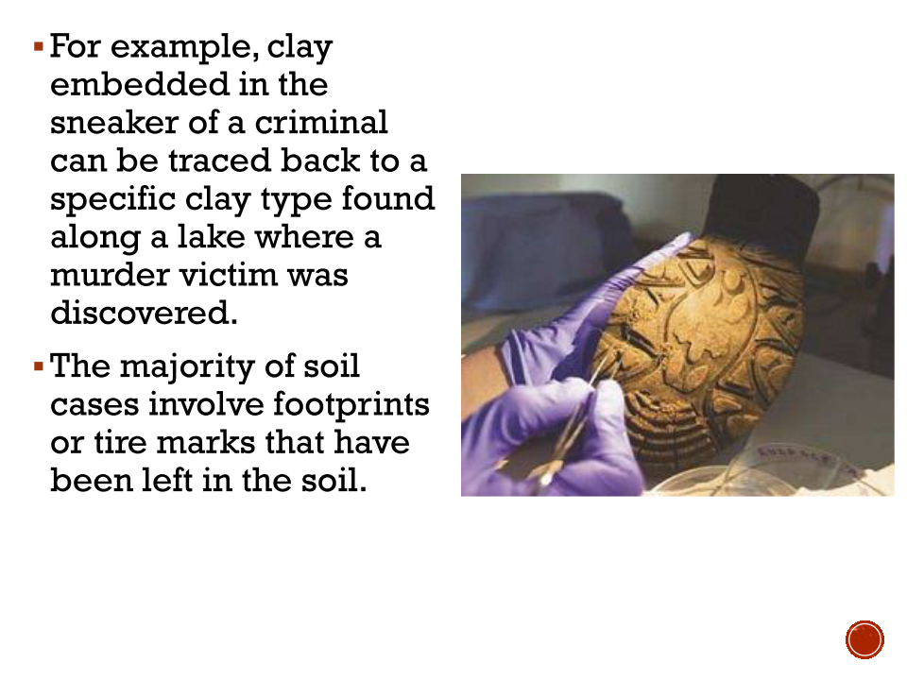

Slide 8
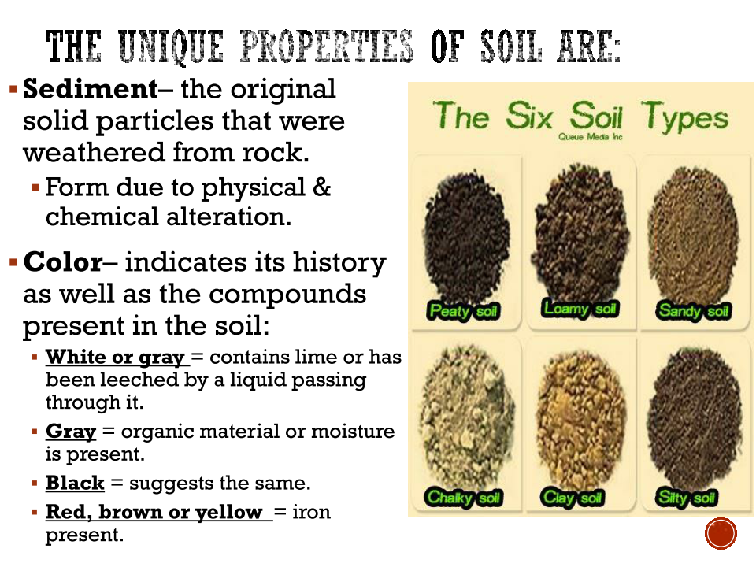

Slide 9
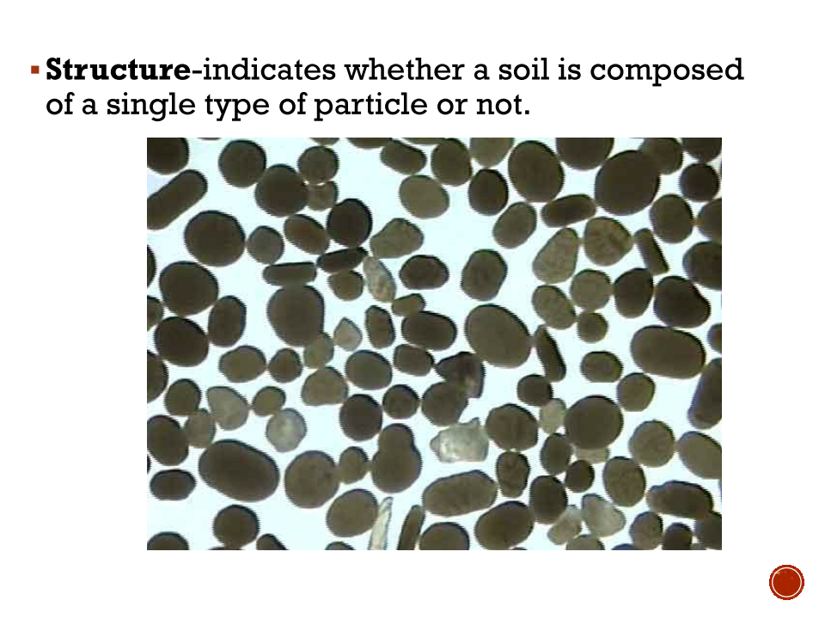

Slide 10
SOIL ANALYSIS:
While thousands of different minerals occur in the earth's crust, only about 40 common minerals are normally found in forensic investi­gations.
These can be transferred by contact to a criminal's shoes, tires, clothing, vehicle, and so on.
Forensic geologists can provide valuable information in the course of an investigation.

Slide 11
They can identify mineral compounds, suggest where they came from, see if the samples are consistent with the scene of the crime, and provide clues about the circumstances of bur­ial.
Soils can also be classified based on color. A sample of soil is thor­oughly dried and then compared to a standard soil color comparison chart.
There are 1100 different classifications of soil color. Samples from a suspect's shoe can be compared to soil samples collected from the crime scene to see if the minerals and the color match.

Slide 12
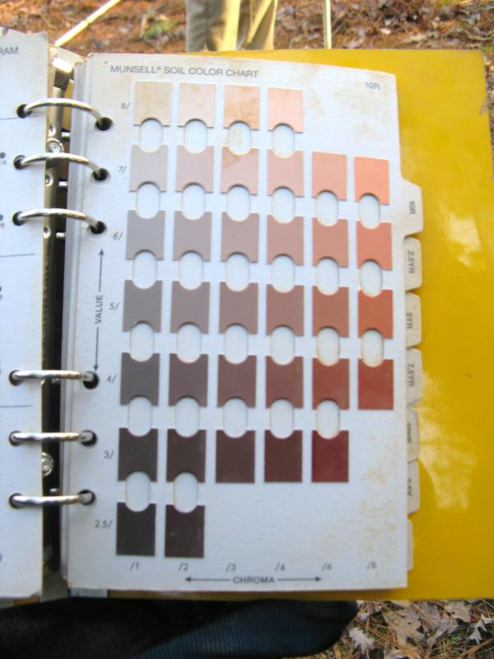
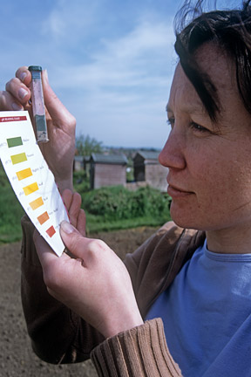

Slide 13
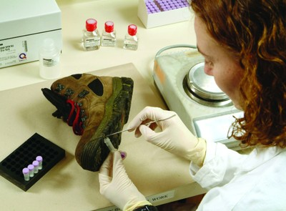
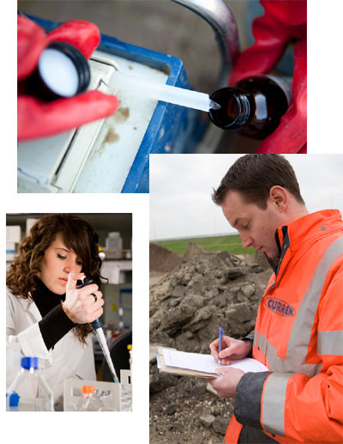
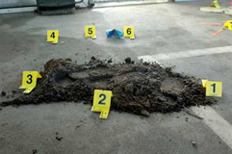
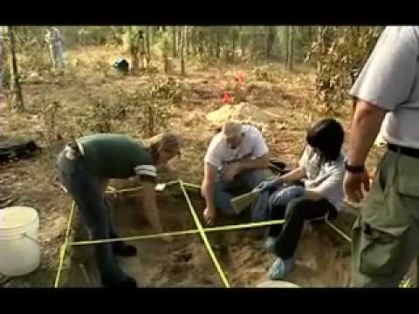

Slide 14
DENSITY GRADIENT TUBE:
A simpler method of comparing two soil samples is to make use of the fact that each mineral has its own unique density.
A tube can be constructed containing a solution of increasing density from top to bottom. This is called a density gradient tube.

Slide 15
The solution is made by mixing two solutions, ethanol (density 0.789 g/mL) and bromo-form (density 2.96 g/mL), in varying proportions.
The solution at the top of the tube has a density of about 0.789, and the density of the solution increases steadily to a value of about 2.96 at the bottom of the tube.
If a small sample of soil is dried, finely ground, and placed in the tube, each mineral will sink to a level where its density is the same as that of the surrounding solution.

Slide 16
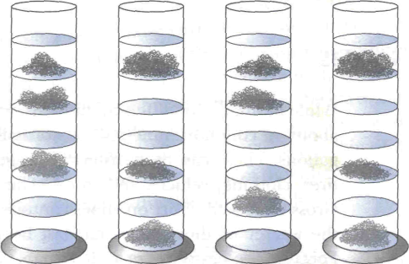
Density Gradient Tubes
Since soil samples from differ­ent locations contain different combinations of the possible minerals, they each produce a unique pattern when placed in density gradient tubes.
Density gradient tubes are also useful in comparing glass sam­ples and other types of evidence that have slightly different densi­ties.
They provide a very powerful visual piece of evidence to the jury, which can see if the patterns match even if they don't under­stand the science behind the demonstration.
Suspect A Suspect B Suspect C Crime scene

Slide 17
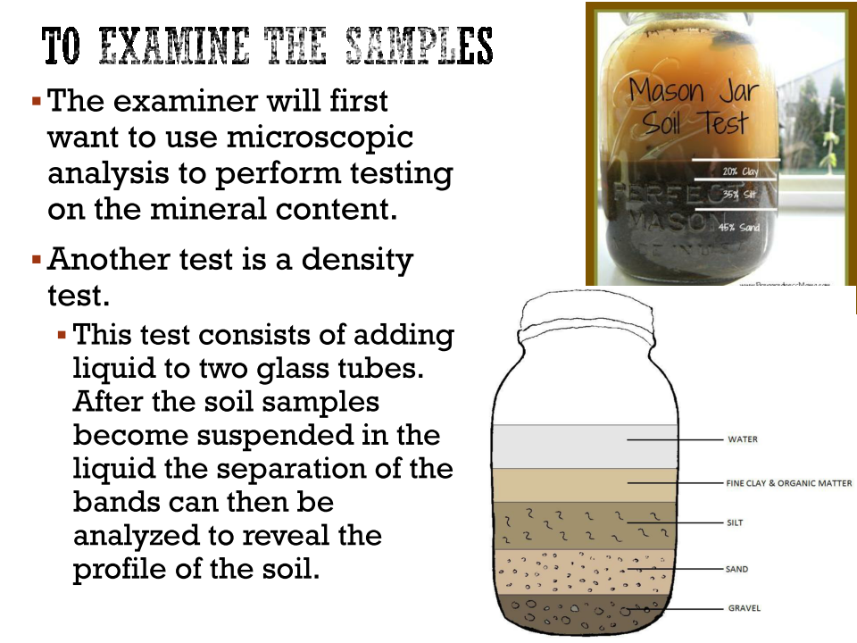

Slide 18
SAMPLE COLLECTION
    When collecting soil samples, it is important for the investigator to collect whole clumps of dirt if possible.
    clumps of dirt often contain layers of different types of soil, which can be read as a history of where someone has been.
    In the case of a hit-and-run accident the violent nature of the impact often causes pieces of dirt to be dis­lodged from the driver's car and left at the crime scene.
    These clumps of dirt often contain layers of dirt indicating different geo­graphical regions over which the car has traveled.
    The investigator should collect whole clumps of dirt from the vehicles of any suspects in the case. When collecting soil samples, the investigator should scrape off whole clumps of dirt right down to the surface of the car.

Slide 19
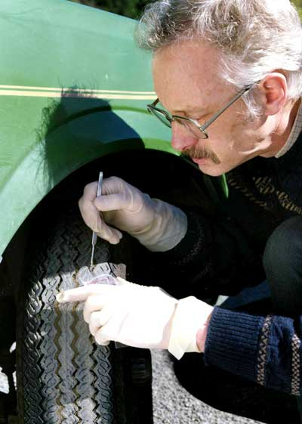
    The best place to collect dirt is from under the wheel wells and from the areas under the car directly behind the tires.
    Layered clumps of dirt can be almost as good as a fingerprint in connecting a suspect's vehicle with a crime scene. These whole clumps should be carefully packaged in separate containers.

Slide 20
    Careful handling, as well as the use of cotton or some other suitable packing material, helps keep the layers intact.
    Soil samples obtained from a suspect's clothing and shoes can also be used to connect the individual with a crime scene.
    Ex If the suspect claims the dirt was from another location, the investigator must be sure to collect soil samples from the alibi location as well. When col­lecting soil samples from an alibi location or crime scene, it is impor­tant to collect several samples in a 100-yd radius to allow for natural variation in the composition of the soil.

Slide 21
The FBI recommends that the following procedure be used when collecting soil samples:
    Collect soil samples as soon as possible.
    Collect samples from the immediate crime scene as well as from any access or escape routes.
    Collect soil samples where there is a noticeable change in color, texture, or composition.
    Collect soil samples at a depth consistent with that where they may have originated.
    Collect soil samples from alibi locations.
Include a map detailing where the soil samples were collected

Slide 22
    Do not scrape soil off clothing or shoes; instead air-dry and pack­age whole items in separate paper bags.
    Carefully remove whole clumps of soil adhering to suspect's vehi­cle, air-dry, and package in separate paper bags.
    Pack to keep lumps intact.
      Through the comparison of soil samples by color and mineral composition a link between the suspect and the crime scene can be established. Alternatively, the evidence may show that the suspect was at an alibi location and not at the crime scene.
show video on air balloons

Slide 23
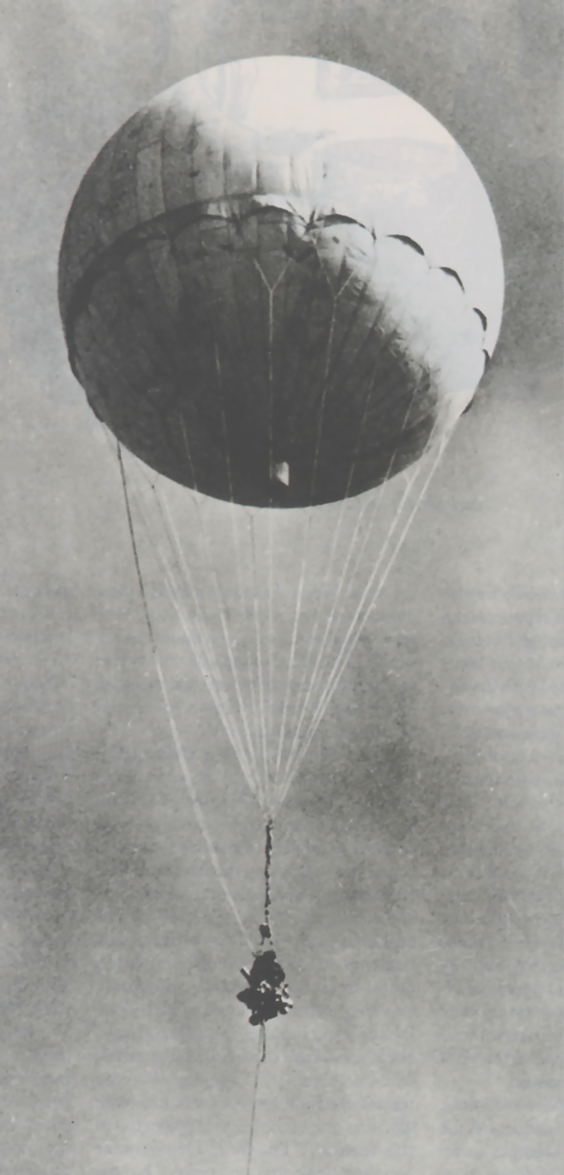
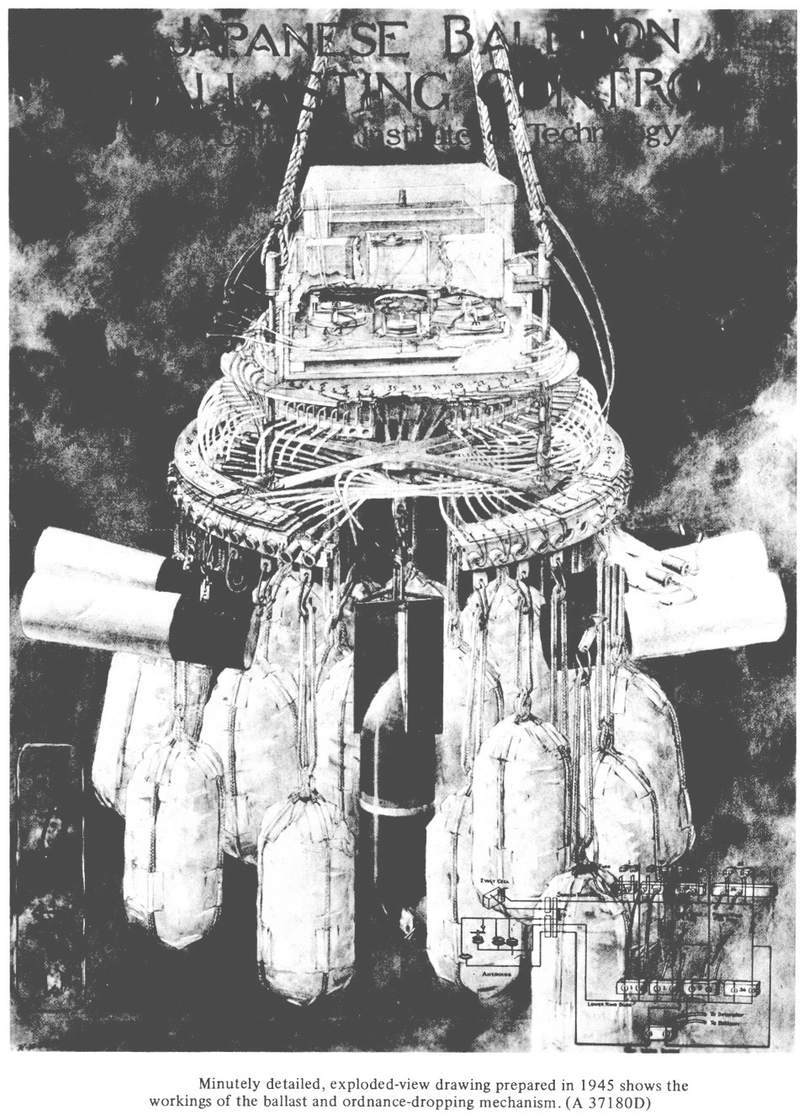

Slide 24
During the Second World War the Japanese conceived the idea of fashioning incendiary bombs and attaching these to balloons which were released with easterly wintertime jet stream winds above 30,000 feet to float 5,000 miles across the north Pacific.
The idea was to have these devices explode over the forested regions of the Pacific Northwest and initiate large forest fires that would hopefully divert U.S. manpower from warfighting in the Pacific theater to combating fires at home.

Slide 25
The balloons were crafted from mulberry paper, glued together with potato flour and filled with expansive hydrogen. They were 33 feet in diameter and could lift approximately 1,000 pounds, but the deadly portion of their cargo was a 33-lb anti-personnel fragmentation bomb,.
The first balloons were launched on November 3, 1944 and began landing in the United States on November 5th (off San Pedro, California) and by the following day (November 6th) were landing as far away as Thermopolis, Wyoming.
285 confirmed landings/sightings were made over a wide area,

Slide 26
Most of the ballast bags were released in the trip across the north Pacific, but a few balloons crashed without exploding and some of the ballast bags were recovered.
All of the bags contained the same type of dark colored sand.

Slide 27
The U.S. government muzzled the media about making any mention of the balloons in fear that whoever was producing them might be encouraged to send more.
On March 5, 1945 a minister’s wife and five Sunday School students on a fishing trip were killed by one of the grounded balloons near Bly, Oregon while attempting to pull it through the forest, back to their camp.
These were the only casualties of the balloon bombs during the war

Slide 28
It was immediately clear that the ballast sand had come from a beach, but where?
Further examination revealed that the sand was devoid of any coral, but contained small mollusk fragments.
In Japan coral grows along the coast of the main island of Honshu as far north as Tokyo Bay, near the 35th Parallel.
They also found foraminifera (known as “forams”), tiny skeletons of microscopic organisms that feed on the ocean bottom.
Some of the foram species identified had only been previously described in Japanese geologic papers dealing with beaches north of Tokyo on the eastern shore of Honshu.

Slide 29
The individual sand grains were found to be of granitic origin, but with an unusual set of trace, or associated, minerals. 52% of those trace minerals were hypersthene, a heavy mineral.
Another mineral called augite was also found in abundance, but was known to be of volcanic origin.
Two other heavy minerals, hornblende and garnet, were varieties thought to be associated with metamorphic source rocks. By now the MGU geologists had narrowed the source area to the northerly thousand miles of Japan’s eastern coasts.
Further detailed study of pre-war Japanese geologic studies allowed them to narrow the source area by 80%.
They determined that the sand samples likely came from either of two locations: a northerly site along the great beach at Shiogama, close to Sentai, Japan; and/or the Ninety-nine League Beach at Ichinomiya, Japan.

Slide 30
One of the first recorded uses of geology in forensic science occurred in 1904
      In this case the famous German criminologist Georg Popp was asked to investigate the murder of Eva Disch. Forensic spe­cialists Murray and Tedrow state:
In October 1904 a dirty handkerchief containing bits of coal, snuff, and grains of the mineral hornblende was found at the murder scene of a seamstress named Eva Disch.
A suspect was. found who used snuff, and worked part-time at both a coal burning gas works and a quarry that had an abundance of the mineral hornblende in the rock that it produced. The suspect also had two layers of dirt in his pant cuffs.
The lower layer matched the soil at the crime scene and the upper layer, char­acterized by a particular type of mica particle, matched the soil found on the path to the victim's home.
When confronted with the evidence the suspect confessed.

Slide 31
Another excellent example of the use of soil in forensic investigation involved the kidnapping and murder of a USDEA agent
1995. While working in Mexico, Enrique Camarena was abducted.
His body was discovered near a known drug trafficker's ranch.
However, the soil found on the dead agent's body did not match that of the location where the body was found.
The FBI finally determined that Special Agent Enrique Camarena's body had origi­nally been taken to the another location, 881 Lope De Vega, where he was murdered.
The house was operated by the Caro-Quintero drug gang, and they disposed of the body at a rival drug gang's ranch to throw the police off track

Slide 32
What is Forensic Entomology
Forensic Entomology is the
Forensic Entomology is the use of the insects, and their arthropod relatives that inhabit decomposing remains to aid legal investigations.

Slide 33
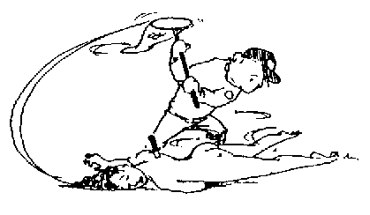
Forensic entomology is the use of insect knowledge in the investigation of crimes

Slide 34
The broad field of forensic entomology is commonly broken down into three general areas:
1. medicolegal
2. urban
3. stored product pests.

Slide 35
medicolegal
The medicolegal section focuses on the criminal component of the legal system and deals with the necrophagous (or carrion) feeding insects that typically infest human remains

Slide 36
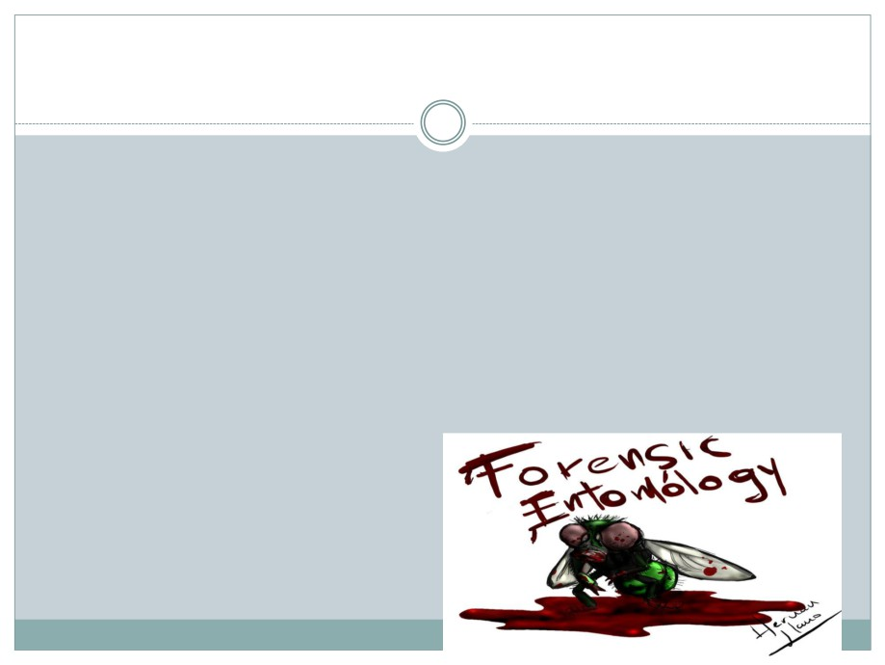
Medicolegal Forensic Entomology
We are mostly concerned with this category.
Often focuses on violent crimes
Determination of the time (postmortem interval or PMI) or
site of human death based on identification of arthropods
collected from or near corpses.
Cases involving possible sudden death.
Traffic accidents with no immediately obvious cause.
Possible criminal misuse of insects.

Slide 37
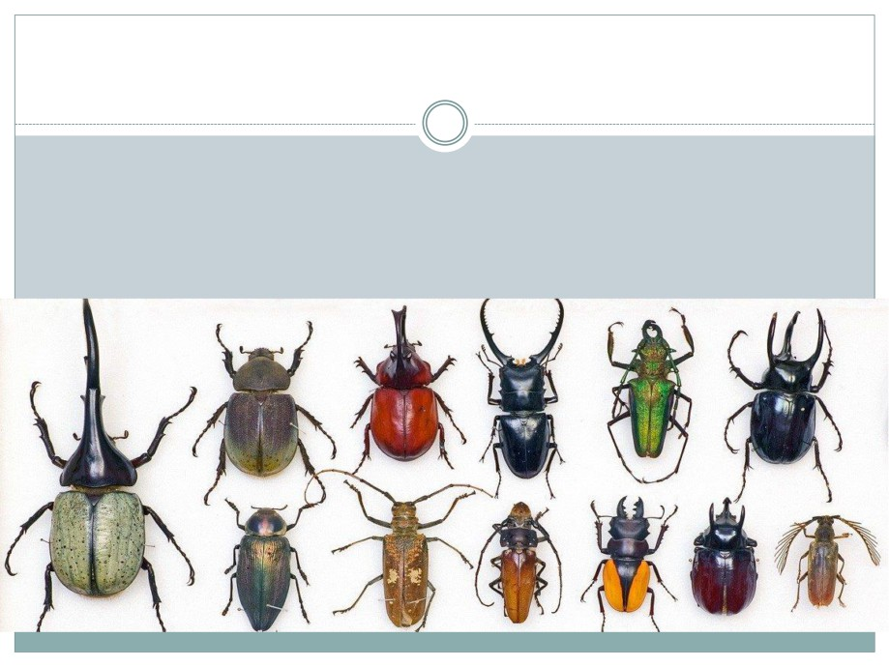
Entomology is mostly used in determining
Time of Death
Insect life cycles are very specific
This can be used to calculate time since death.
This calculation is called Post Mortem Interval (PMI).

Slide 38
urban
The urban aspect deals with the insects that affect man and his immediate environment.
This area has both criminal and civil components as urban pests may feed on both the living and the dead.
The damage caused by their mandibles (or mouthparts) as they feed can produce markings and wounds on the skin that may be misinterpreted as prior abuse..

Slide 39
stored product pests.
Lastly, stored product insects are commonly found in foodstuffs and the forensic entomologist may serve as an expert witness during both criminal and civil proceedings involving food contamination.

Slide 40
How diverse is forensic entomology?
include the detection of abuse in children and neglect of the elderly.
Published cases exist that detail parents intentionally using wasps and bees to sting their children as a form of punishment.
Additionally, entomological evidence has been used to prove neglect and lack of proper care for wounds existing on the elderly under both private and institutional care.

Slide 41
It is theorized that the stings (or mere presence) of bees and wasps may be responsible for a large number of single occupant car accidents that seem to lack a definitive cause.
In addition to automobile accidents, insects have been suspected of causing aircraft crashes through the obstruction of essential instrumentation, and even implicated in the obstruction of fuel lines causing engine failure.
Forensic entomologists are also requested to examine the fragmented remains of insects that have impacted and lodged on the front fascia, windshield, and radiator of automobiles.
Analysis of such remains can yield evidence to the probable path of an automobile through particular areas when pinpointing the location and areas of travel are of unique importance.

Slide 42
Insects can also affect the interpretation of blood spatter pattern analysis.
Roaches simply walking through pooled and splattered blood will produce tracking that may not be readily recognizable to the untrained observer.
Also flies will also feed on the blood and can be tested for suspected poisons.

Slide 43
What information can a forensic entomologist provide at the death scene?
Forensic entomologists are most commonly called upon to determine the postmortem interval or "time since death" in homicide investigations.
The forensic entomologist can use a number of different techniques including species succession, larval weight, larval length, and a more technical method known as the accumulated degree hour technique which can be very precise if the necessary data is available.

Slide 44
A qualified forensic entomologist can also make inferences as to possible postmortem movement of a corpse.
Some flies prefer specific habitats such as a distinct preference for laying their eggs in an outdoor or indoor environment.
Flies can also exhibit preferences for carcasses in shade or sunlit conditions of the outdoor environment.
Therefore, a corpse that is recovered indoors with the eggs or larvae of flies that typically inhabit sunny outdoor locations would indicate that someone returned to the scene of the crime to move and attempt to conceal the body

Slide 45
Similarly, freezing or wrapping of the body may be indicated by an altered species succession of insects on the body.
Anything that may have prevented the insects from laying eggs in their normal time frame will alter both the sequence of species and their typical colonization time.
The complete absence of insects would suggest clues as to the sequence of postmortem events as the body was probably either frozen, sealed in a tightly closed container, or buried very deeply.

Slide 46
Entomological evidence can also help determine the circumstances of abuse and rape.
Victims that are incapacitated (bound, drugged, or otherwise helpless) often have associated fecal and urine soaked clothes or bed dressings.
Such material will attract certain species of flies that otherwise would not be recovered.
Their presence can yield many clues to both antemortem and postmortem circumstances of the crime.

Slide 47
Currently, it is now possible to use DNA technology to recover and identify the blood meals taken by blood feeding insects.
The DNA of human blood can be recovered from the digestive tract of an insect that has fed on an individual.
The presence of their DNA within the insect can place suspects at a known location within a definable period of time and recovery of the victims' blood can also create a link between perpetrator and suspect.

Slide 48
The insects recovered from decomposing human remains can be a valuable tool for toxicological analysis.
It is possible to recover the insect larvae and run standard toxicological analyses on them as you would human tissue.
Toxicological analysis can be successful on insect larvae because their tissues assimilate drugs and toxins that accumulated in human tissue prior to death

Slide 49
Differentiate between PMI and Time of Death:
The two estimates may not always equate.
Post mortem interval is restricted to the time that the
corpse or body has been exposed to an environment which would allow insect activity to begin (usually hours to days after death).
Can be affected by:
Closed windows
Body in box or bag
Cold temperatures
Deeper burial
PMI is typically used to estimate time of death when a
corpse has been dead longer than 24 hours.
Time of death is calculated when the corpse has been death for less than 24 hours.

Slide 50
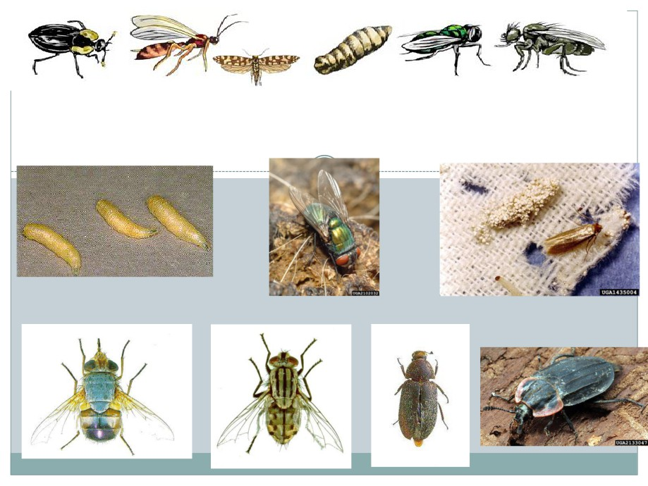
Insects Important to Forensic Entomology
Maggots Green Blow Fly Clothes Moth
Bluebodied blow fly Flesh fly Hide beetle Carrion Beetle

Slide 51
Common arthropods occurring on dead bodies
Many kinds of organisms live by feeding on dead bodies.
In the process, their activities result in the decomposition of the body and the recycling of nutrients.
The dominant groups of organisms involved in decomposition are bacteria, flies, beetles, mites and moths. Other animals, mainly parasitoid wasps, predatory beetles and predatory flies, feed on the animals that feed on the corpse.
A dead body is therefore an ecosystem of its own
The arrival time and growth rates of insects inhabiting corpses are used by forensic scientists to determine the circumstances surrounding suspicious deaths.

Slide 52
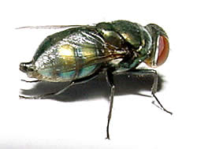
Flies
The larvae of flies (maggots) are the most obvious and abundant fauna present on corpses in the early stages of decomposition.
Most adult blow flies appear a metallic green or blue and are easily recognizable

Slide 53
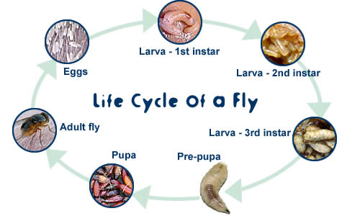
Life cycle of a fly

Slide 54
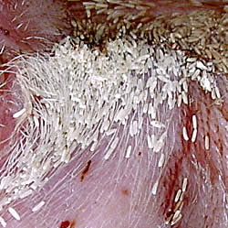
Eggs
present in clumps of up to 300
laying to hatching takes 1 day

Slide 55
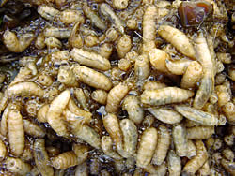
Larva
Larva - 1st instar
initially feeds on fluid exuded from the body
migrates into body
hatching to first moult takes 1 day
Larva - 2nd instar
Moves around in maggot mass
first moult to second moult takes 1 day
Larva - 3rd instar
still moves in mass
greatly increases in size
second moult to pre-pupa takes 2 days

Slide 56
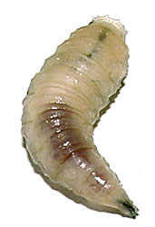
Pre-pupa
migrates away from the corpse seeking a suitable pupation site, (usually in soil)
does not feed
transforms into pupa
pre-pupa to pupa takes 4 days

Slide 57
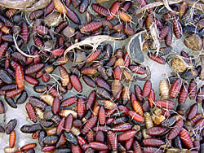
Pupa
resides within puparium
undergoes transformation from larval body form adult fly
does not feed
pupa to emergence takes 10 days

Slide 58
Adult fly
mates on emergence from pupa
feeds on protein from body fluids
lays eggs on corpse
emergence to egg laying takes 2 days

Slide 59
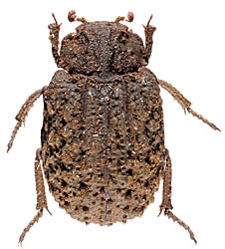
Beetles
The first beetles arrive at a corpse soon after the body begins to putrefy.
In contrast to the flies, beetles have chewing mouthparts and can manage tougher foods than the semi-liquid material that fly larvae are so efficient at exploiting.

Slide 60
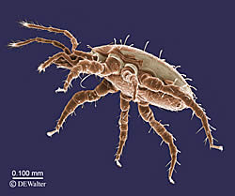
Mites
Many thousands of mites feed on a corpse over the full term of its exposure to the elements.
Gamasid like Macrocheles mites are common in the early stages of decomposition,
while tyroglyphid and Oribatid mites like Rostrozetes mites feed on dry skin in the later stages of decomposition.

Slide 61
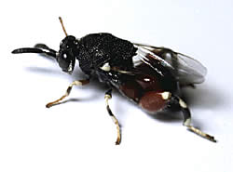
Parasitic wasps
A number of families of wasp lay their eggs inside the larvae or pupae of flies, and are known as parasitoids.
The wasp eggs hatch inside the maggot or fly pupa.
The wasp larvae then feeds on the maggot or pupa, eventually killing it.
The wasp larvae then pupate inside the maggot or fly pupa and emerge as adult wasps.

Slide 62
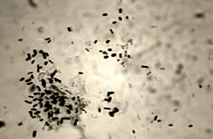
Bacteria
Bacteria involved in the decomposition of animal bodies are heterotrophic, breaking down complex molecules into their constituent elements through respiration or fermentation

Slide 63
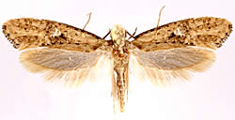
Moths
Some of the familiar clothes moths (Family Tineidae) feed on mammalian hair during their larval stages.
Adult moths lay their eggs on a carcass after all the fly larvae have finished with it.
On hatching, their larvae forage on any hair that remains

Slide 64
Scene observations and weather data.
1). Observations of the scene should note the general habitat and location of the body in reference to vegetation, sun or shade conditions, and its proximity to any open doors or windows if recovered within a structure.
Locations of insect infestations on the body should be documented as well as noting what stages of insects are observed (such as eggs, larvae, pupae, or adults).
It is also useful to document evidence of scavenging from vertebrate animals and predation of eggs and larvae by other insects such

Slide 65
2). Collection of climatological data at the scene. Such data should include:
a). Ambient air temperature at the scene taken approximately at chest height with the thermometer in the shade. DO NOT EXPOSE THERMOMETER TO DIRECT SUNLIGHT!
b). Maggot mass temperature (obtained by placing the thermometer directly into the larval mass center).
c). Ground surface temperature.
d). Temperature at the interface of the body and ground (simply place the thermometer between the two surfaces).
e). Temperature of the soil directly under the body (taken immediately after body removal).

Slide 66
f). Weather data that includes the maximum and minimum daily temperature and rainfall for a period spanning 1-2 weeks before the victims disappearance to 3-5 days after the body was discovered.
Such information can be gathered by contacting the nearest national weather service office

Slide 67
3)Collection of insects from the body at the scene
The first insects that should be collected are the adult flies and beetles.
The collection label should contain the following information:
1). Geographical Location
2). Date and hour of collection
3). Case number
4). Location on the body where removed
5). Name of collector

Slide 68
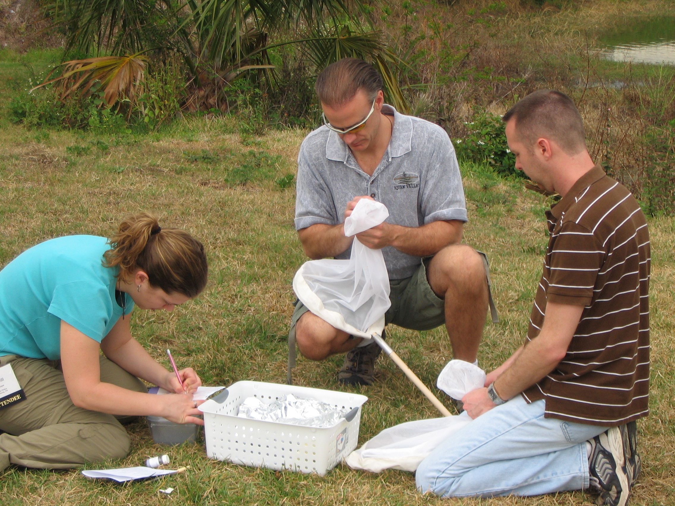
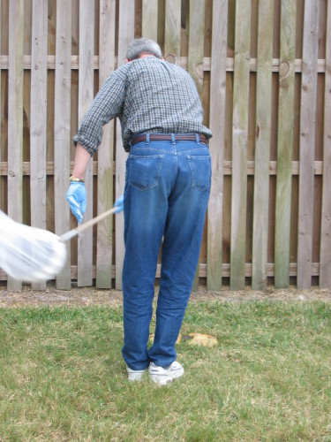
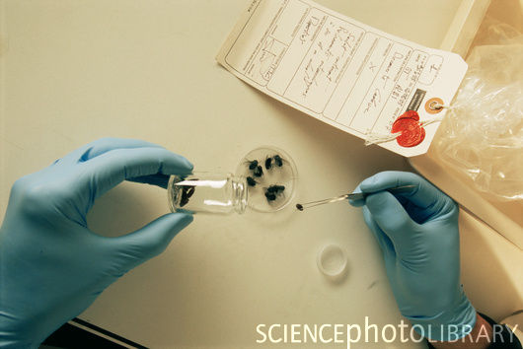
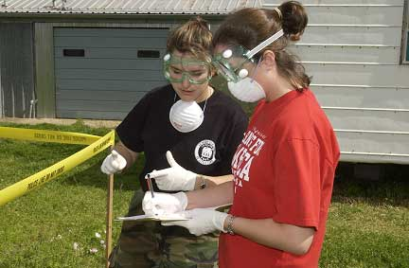

Slide 69
Collection of insects from scene after body removal
Many of the insects that inhabit a corpse will remain on, or buried, in the ground after the body has been removed.
The most forensically important insects undergo a complete development.
There is an egg stage (except for a few insects such as the flesh flies that deposit living larvae) which hatches into a larval form and undergoes a stepwise or incremental growth.
This pattern is caused by the successive molts (shedding of the outer skin that has become too small) that the larva must undergo before it finally enters the inactive pupal stage.
The pupa is simply the hardened outer skin of the last larval stage and the adult will develop inside of this protective skin.

Slide 70
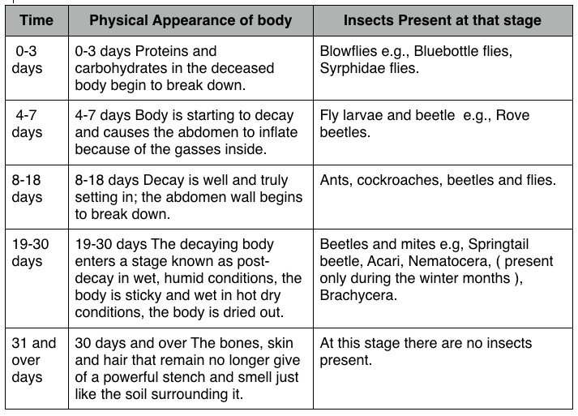

Slide 71
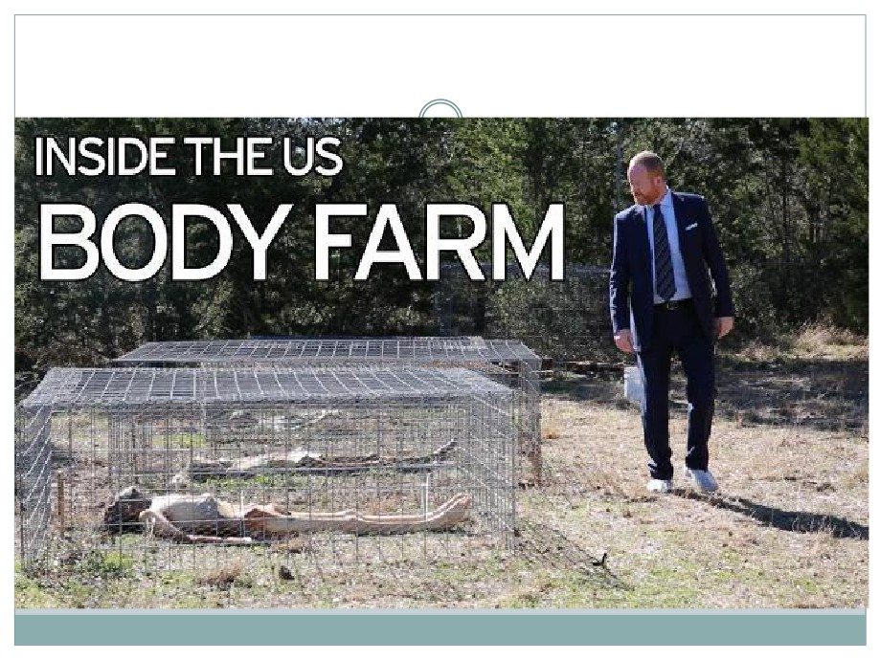
How did we learn what we know about death
and decomposition?

Slide 72
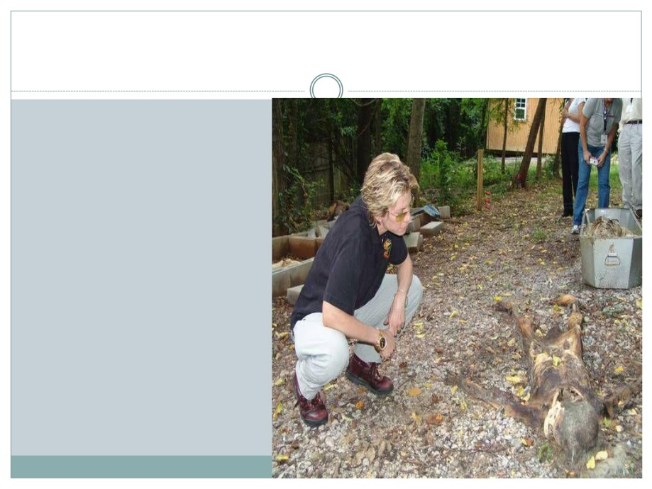
The Body Farm
PRIMARY
GOAL: To
understand the
processes &
timetable of
postmortem
decay, primarily to
improve
determining the
"time since death"
in murder cases.

Slide 73
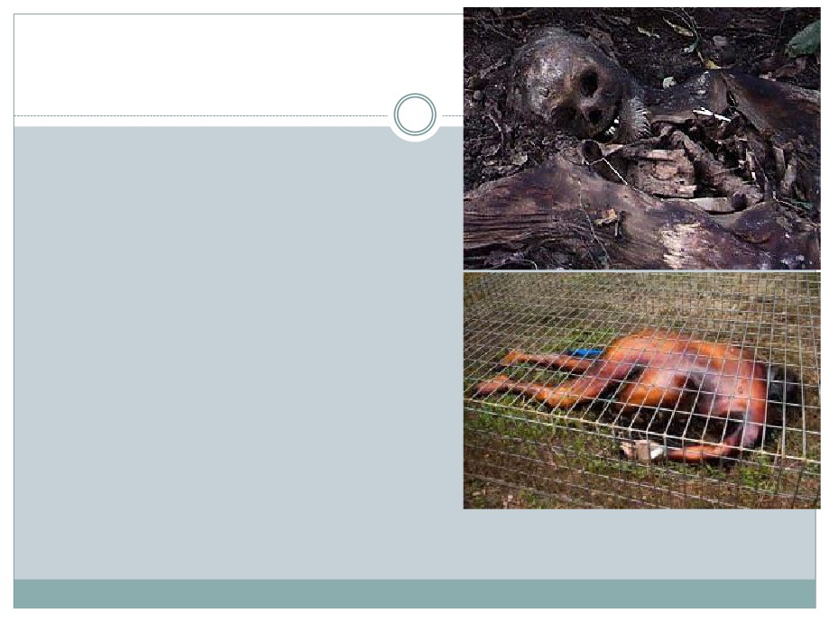
The Body Farm is a
simulation of various
crime scenes using
real human bodies.
Started in 1970-80’s
to study Forensic
Anthropology (the
study of human
decomposition after
death).

Slide 74
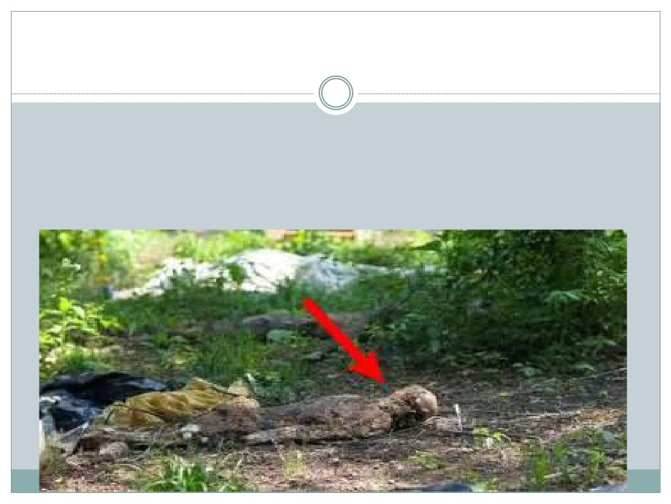
THE BODY FARM
Used by Law Enforcement, Medical Examiners, Entomologists, Cadaver Dogs, Anthropologists & FBI for Crime Scene Training.
The BF uses unclaimed cadavers & volunteers (who
donate their body to science after death)
Used by Law Enforcement, Medical Examiners, Entomologists, Cadaver Dogs, Anthropologists & FBI for Crime Scene Training.
The BF uses unclaimed cadavers & volunteers (who donate their body to science after death)

Slide 75
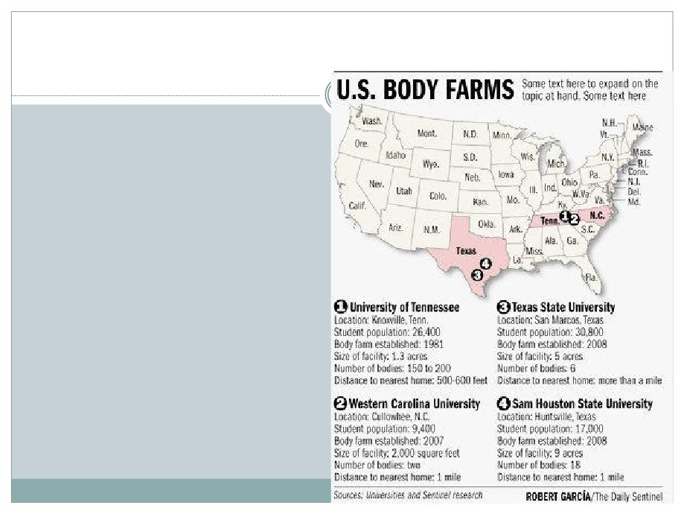
Only 4 Facilities in the U.S.
All are associated with Universities:
○ Univ. of Tennessee
(original)
○ Western Carolina
University (NC)
○ Texas State University
○ Sam Huston State
University (TX)
○ PROPOSED NEW FARM:
○ Mesa State College (CO)

Slide 76
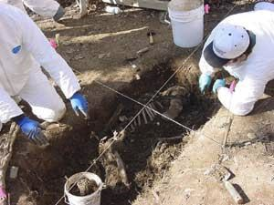
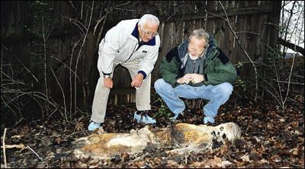
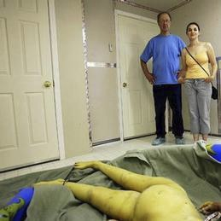
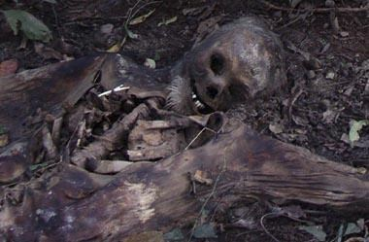
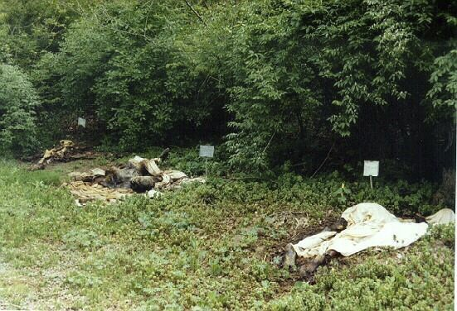
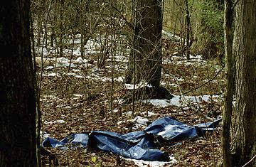
Tour of the Body Farm

Slide 77
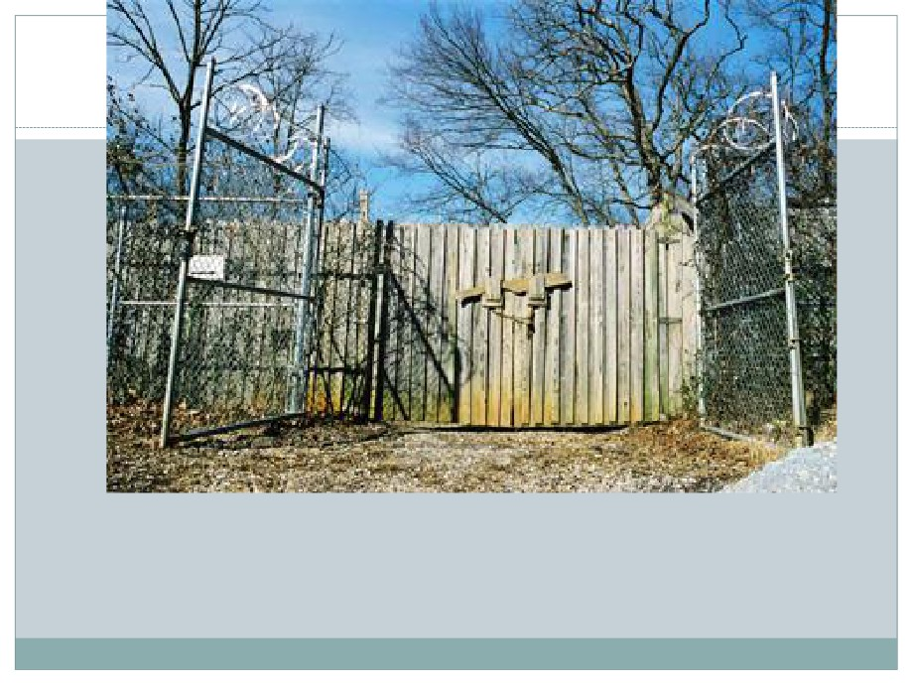
Doorway to death, the main gate of the Anthropology
Research Facility—the “Body Farm”—consists of a
wooden privacy fence inside a chain-link fence
that’s topped with razor wire.

Slide 78

Security is a high priority.
Fences, padlocks, video surveillance cameras, & police patrols safeguard the world’s only human-decomposition research facility.

Slide 79

One research study examined the effects of the elevated
temperatures—and limited insect access—to which a
body in a car would be subjected.

Slide 80

Corpse 1-81 was an elderly white male; he became part
of a pioneering study of insect activity in human
corpses.

Slide 81

Closeup of a recent research subject. After only a few weeks in
the Tennessee summer, the skull is completely bare & many
vertebrae are exposed. The rib cage & pelvis are covered with
dried, leathery skin, but the soft tissues beneath are gone,
consumed by insects & bacteria.

Slide 82

Close-up of a human femur & hip bone, containing an
artificial hip implant. Such orthopedic devices can
help identify an unknown crime victim.

Slide 83

An aerial view of the Body Farm, taken from Patricia
Cornwell’s helicopter. The large wooden tripods are
used for hoisting & weighing bodies as part of a
research study of weight loss during decomposition.

Slide 84

jaw from a research subject held by Dr. Bill Bass,
the founder of the
Body Farm.

Slide 85
Stages of Decomposition
Decomposition of a corpse is a continual process that can take from weeks to years, depending on the environment.
we have divided the process into stages, which are characterized by particular physical conditions of the corpse and the presence of particular animals.
To illustrate the process of decomposition, we use the piglet as the model corpse.

Slide 86

Why Living Pigs
live pig is not outwardly decomposing, but its intestine contains a diversity of bacteria, protozoans and nematodes. Some of these micro-organisms are ready for a new life, should the pig die and lose its ability to keep them under control

Slide 87

Initial decay - 0 to 3 days after death
State of decay
Although the body shortly after death appears fresh from the outside, the bacteria that before death were feeding on the contents of the intestine begin to digest the intestine itself.
They eventually break out of the intestine and start digesting the surrounding internal organs. The body's own digestive enzymes (normally in the intestine) also spread through the body, contributing to its decomposition.

Slide 88

Insect activity
From the moment of death flies are attracted to bodies.
Without the normal defences of a living animal, blowflies and house flies are able to lay eggs around wounds and natural body openings (mouth, nose, eyes, anus, genitalia).
These eggs hatch and move into the body, often within 24 hours.
Blow Fly

Slide 89

Stage 3: Putrefaction - 4 to 10 days after death

Slide 90
State of decay
Bacteria break down tissues and cells, releasing fluids into body cavities.
They often respire in the absence of oxygen and produce various gases People might find these gases foul smelling, but they are very attractive to a variety of insects.
The build up of gas resulting from the intense activity of the multiplying bacteria, creates pressure within the body. This pressure inflates the body and forces fluids out of cells and blood vessels and into the body cavity.
Insect activity
The young maggots move throughout the body, spreading bacteria, secreting digestive enzymes and tearing tissues with their mouth hooks.
The rate of decay increases, and the smells and body fluids that begin to eminate from the body attract more blowflies, flesh flies, beetles and mites.

Slide 91

Stage 4: Black putrefaction - 10 to 20 days after death
The bloated body eventually collapses, leaving a flattened body whose flesh has a creamy consistency. The exposed parts of
The body are black in colour and there is a very strong smell of decay.
A large volume of body fluids drain from the body at this stage and seep into the surrounding soil..
The insects consume the bulk of the flesh and the body temperature increases with their activity. Bacterial decay is still very important.

Slide 92


Stage 4: Black putrefaction - 10 to 20 days after death

Slide 93

Stage 5: Butyric fermentation - 20 to 50 days after death

Slide 94

Stage 5: Butyric fermentation - 20 to 50 days after death
State of decay
All the remaining flesh is removed over this period and the body dries out..
The surface of the body that is in contact with the ground becomes covered with mould as the body ferments.
The reduction in soft food makes the body less palatable to the mouth-hooks of maggots, and more suitable for the chewing mouthparts of beetles.

Slide 95

Stage 6: Dry decay - 50-365 days after death
The body is now dry and decays very slowly. Eventually all the hair disappears leaving the bones only.

Slide 96


Slide 97

Comparison of the Effect of Temperature on
Rate of Decay

Slide 98

Decay Stages - Timing:
Fresh - Day 0 to day 3.
Bloat - Day 4 to day 10.
Putrifaction - Day 10 to day 20.
Butyric Fermentation - Day 20 to
day 50.
Dry Decay - Day 50 to day 365

Slide 99


Slide 100


Slide 101
Decomposition Terms
Autolysis: tissue breakdown due to action of enzymes
Bloating: accumulation of gas produced by bacteria within body’s cavity
Marble: the revealing of weblike pattern of blood vessels in the face, chest abdomen and extremities
Skin-slip: skin and hair slough off of body

Slide 102
Liver Mortis
Discoloration of skin due to gravitational pooling of blood
Indicates whether body was moved
Appears 30 min after death up to 8-12 hrs
Can change or shift for first 6 hrs

Slide 103

This body was not found for a week.
Notice that the skin turns dark. This is due to iron sulfide when hemeglobin is released from the erythrocytes.
The epidermis is beginning to slip free of the dermis on the forehead.
The open wound on the left forehead is due to decomposition, not injury

Slide 104
Moving the body
Pale skin: place of firm contact ( ex shoulder blades)
Reddish tint: high levels of oxygen (poisons, CO death, cold temp)
Deep Purple : poorly oxygenated ( heart failure, asphyxia)

