Slide 2
Symmetry & Body Direction
When studying and describing animals, some basic body characteristics are important. These include:
Animal Body Symmetry - the way body parts are arranged around a center point. (Asymmetry, Bilateral Symmetry, Radial Symmetry)
Directions on the body - used to describe areas on the body of an animal. (Dorsal, Ventral, Anterior, Posterior)

Slide 3
Asymmetry = no symmetry

Slide 4
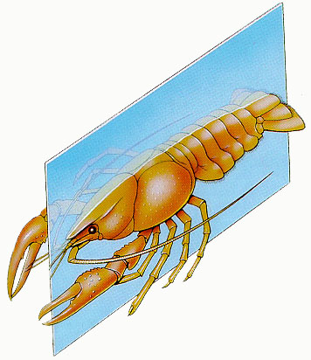
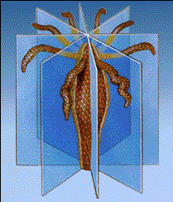
Bilateral and Radial Symmetry
Cephalization = concentration of nerve tissue and sensory organs at the anterior end of a bilateral organism

Slide 5
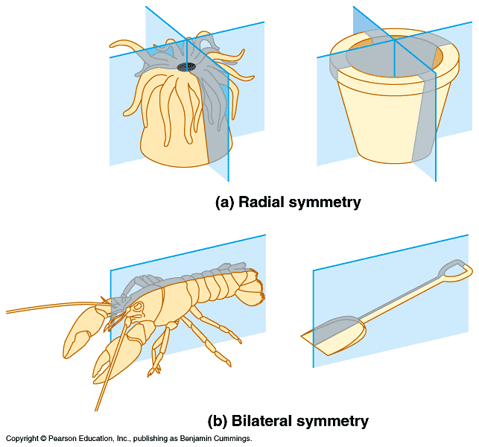

Slide 6
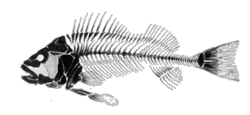
Directions on an animal body:
Dorsal top surface
Anterior front end |  | Posterior hind end
Ventral bottom surface

Slide 7
Directional terminology
Superior: above ex heart is superior to toe
Inferior: below
Anterior: front chest side ex the naval is anterior to the spinal cord
Posterior: back or butt side
Medial: toward the midline
Lateral: away from the midline ex the arms are lateral to the naval
Intermediate: between

Slide 8
Dorsal: backside
Ventral: belly side
Proximal: nearest the point of attachment
Distal: further from the point of attachment
Superficial: toward the surface
Deep: away from the surface ex. The lungs are deep to the sternum

Slide 9
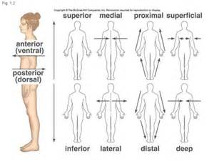

Slide 10
Body Planes:
Sagittal: perpendicular to the ground
Midsagittal: cuts body into 2 equal planes (halves0
Frontal (coronal): divides body into anterior and posterior
Transverse ( horizontal, or cross section): divdies body into superior and inferior

Slide 11
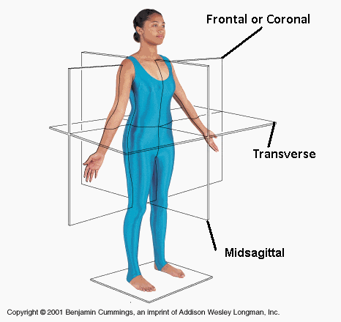

Slide 12
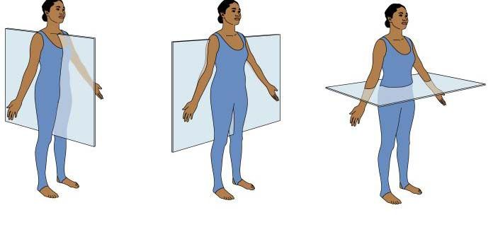

Slide 13
Anatomic terms vary depending on if you are referring to bipedal or Quadra pedal organisms :

Slide 15
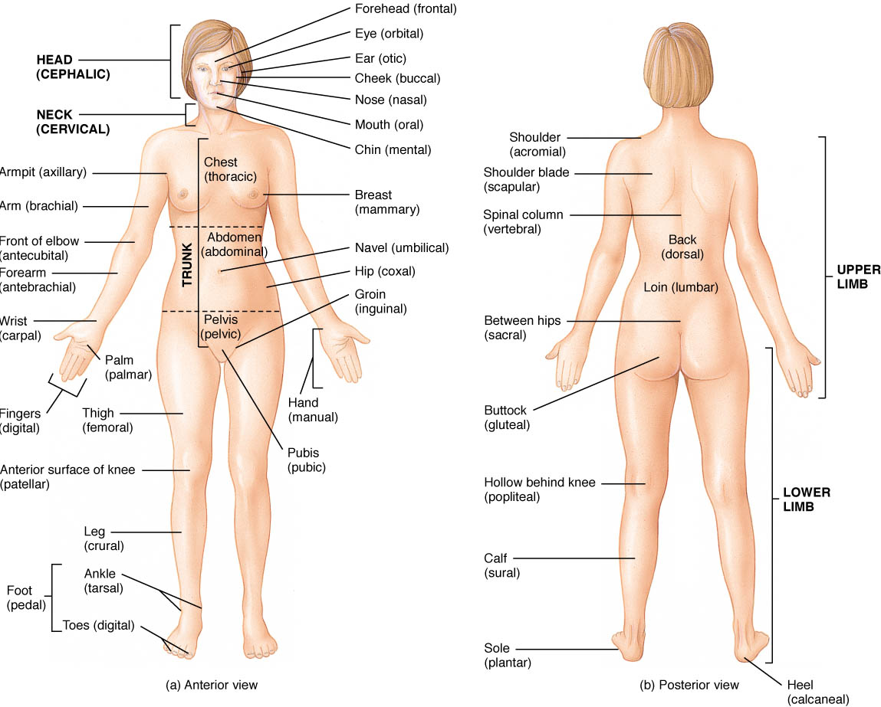

Slide 16
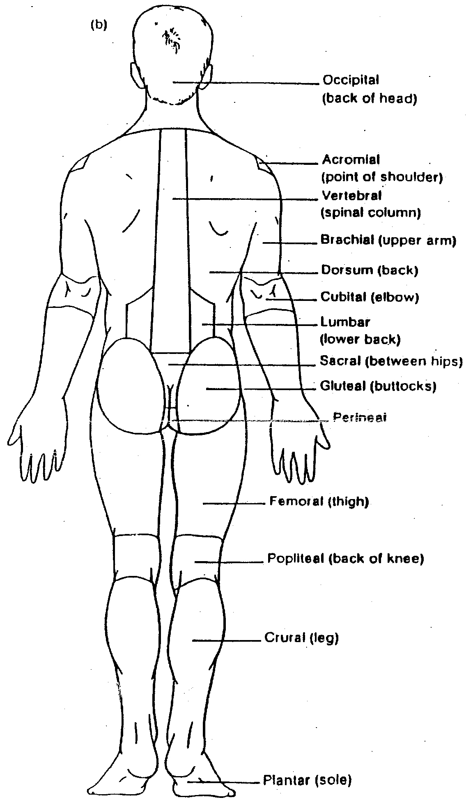

Slide 17
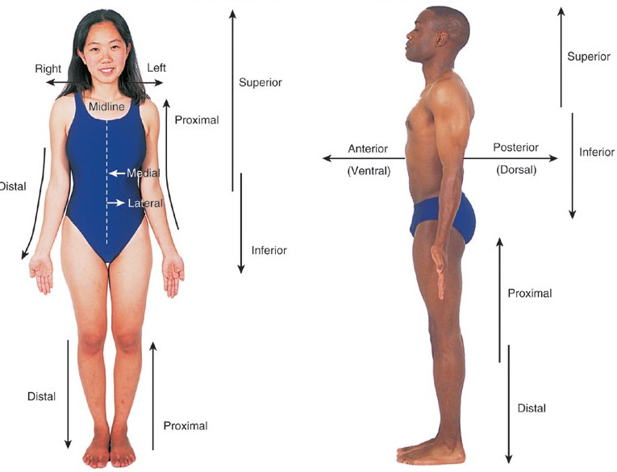
Remember you are dealing with:
the models right and left,
not yours
Anatomical Position

Slide 18
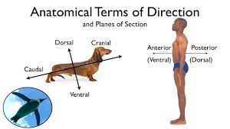

Slide 19
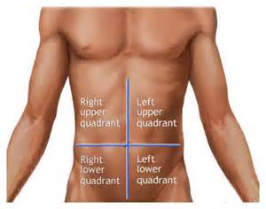
$ body quadrants
4 body quadrants

Slide 20
9 body regions

Slide 21
Body cavities

Slide 22
