Slide 1
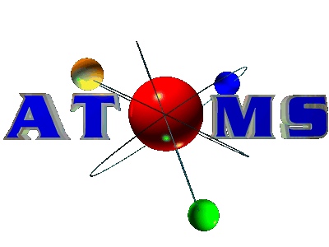
Unit 3: Atom

Slide 2
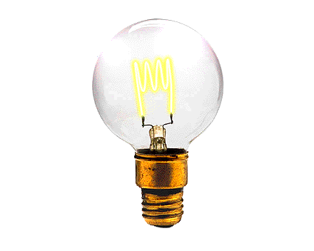
ELECTROMAGNETIC RADIATION

Slide 3
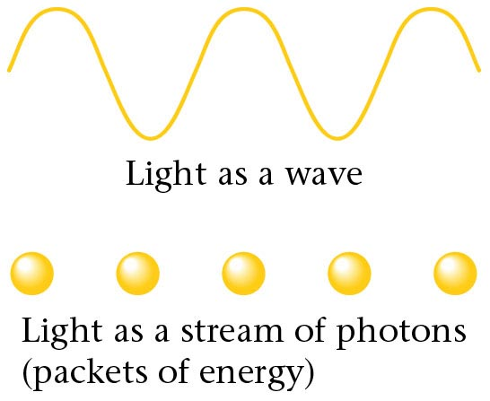
Electromagnetic radiation.

Slide 4
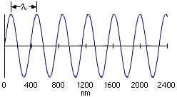
Electromagnetic Radiation
Most subatomic particles behave as PARTICLES and obey the physics of waves.

Slide 5
Electromagnetic Radiation
wavelength
Visible light
Amplitude
wavelength
Node
Ultaviolet radiation

Slide 6
Electromagnetic Radiation
Waves have a frequency
Use the Greek letter “nu”, ν, for frequency, and units are “cycles per sec”
All radiation: λ • ν = c
where c = velocity of light = 3.00 x 10⁸ m/sec

Slide 7

Electromagnetic Spectrum
Long wavelength --> small frequency
Short wavelength --> high frequency
increasing frequency
increasing
wavelength

Slide 8
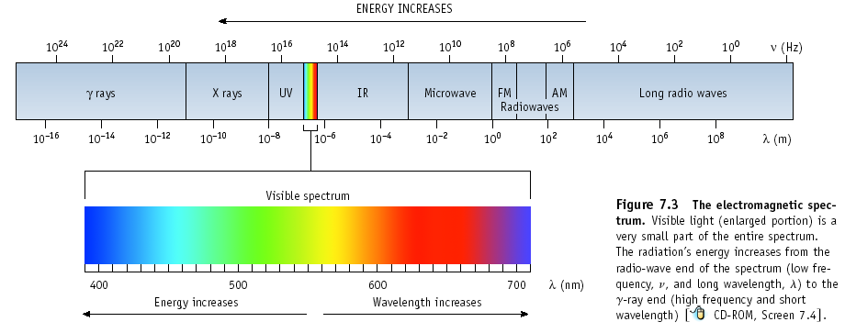
Electromagnetic Spectrum
In increasing energy, ROY G BIV

Slide 9
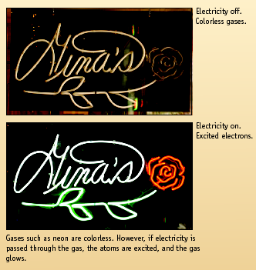
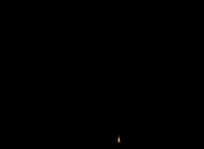

Excited Gases
& Atomic Structure

Slide 10
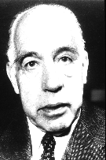
Atomic Line Emission Spectra and Niels Bohr
Bohr’s greatest contribution to science was in building a simple model of the atom. It was based on an understanding of the LINE EMISSION SPECTRA of excited atoms.
Problem is that the model only works for H
Niels Bohr
(1885-1962)

Slide 11
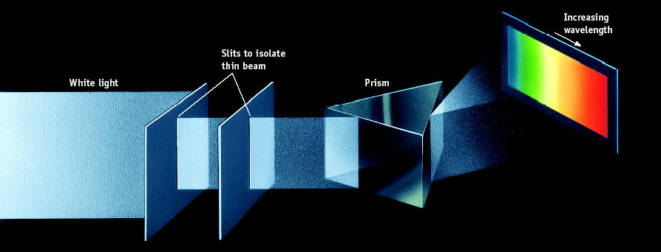
Spectrum of White Light

Slide 12
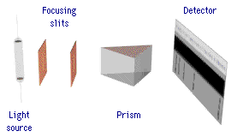
Line Emission Spectra of Excited Atoms
Excited atoms emit light of only certain wavelengths
The wavelengths of emitted light depend on the element.

Slide 13
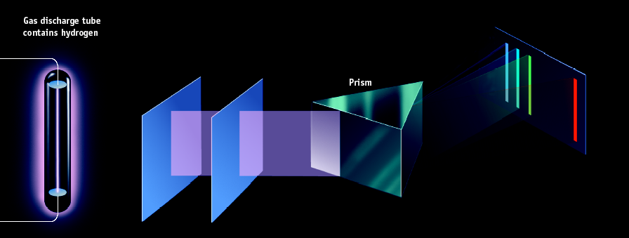
Spectrum of
Excited Hydrogen Gas

Slide 14
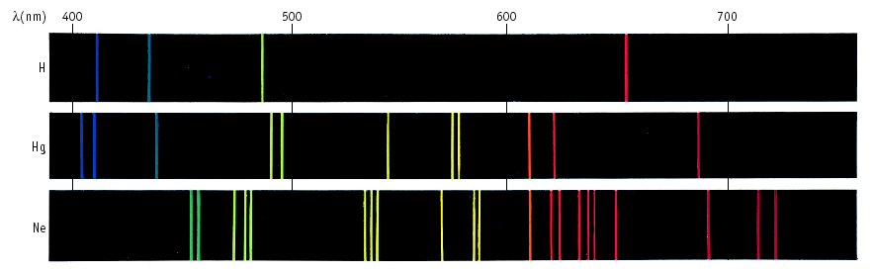
Line Spectra of Other Elements

Slide 15
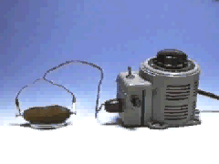
The Electric Pickle
Excited atoms can emit light.
Here the solution in a pickle is excited electrically. The Na⁺ ions in the pickle juice give off light characteristic of that element.

Slide 16

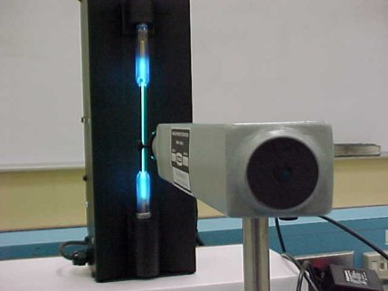
Light Spectrum Lab!
Slit that allows light inside
Line up the slit so that it is parallel with the spectrum tube (light bulb)
Scale

Slide 17
Atomos: Not to Be Cut
The History of the Atom and the Atomic Theory

Slide 18
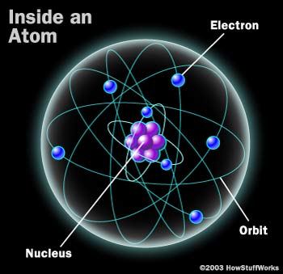
Atomic Models
This model of the atom may look familiar to you. This is the Bohr model. In this model, the nucleus is orbited by electrons, which are in different energy levels.
  A model uses familiar ideas to explain unfamiliar facts observed in nature.
    A model can be changed as new information is collected.

Slide 19

The atomic model has changed throughout the centuries, starting in 400 BC, when it looked like a billiard ball →

Slide 20
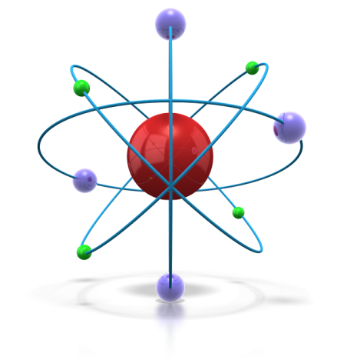
History of Chemistry
Chemistry has been important since ancient times
As early as 400 BC Greek philosophers thought matter could be broken into smaller particles change this text
Egyptians also used chemistry in making embalming fluids
Prior to 1000 BC natural ores were used for making weapons.

Slide 21
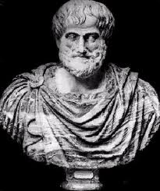
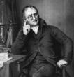
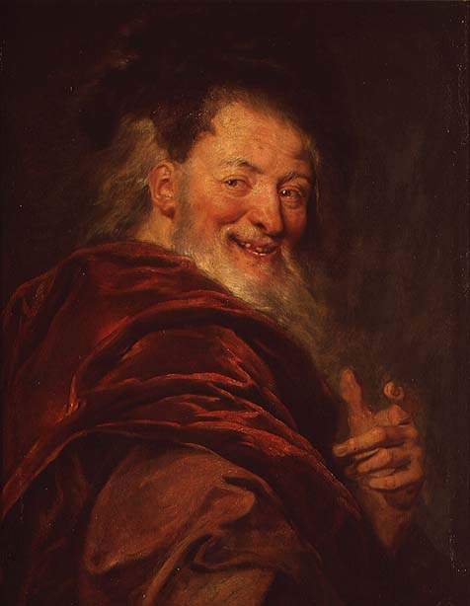
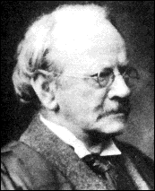
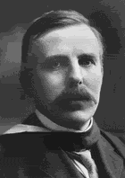
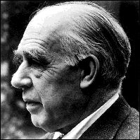
Who are these men?
In this lesson, we’ll learn about the men whose quests for knowledge about the fundamental nature of the universe helped define our views.

Slide 22
Democritus
Greek philosopher
Gave the atom its name
He reasoned that the solidness of the material corresponded to the shape of the atoms involved

Slide 23
Atomos
His theory: Matter could not be divided into smaller and smaller pieces forever, eventually the smallest possible piece would be obtained.
This piece would be indivisible.
He named the smallest piece of matter “atomos,” meaning “not to be cut.”

Slide 24
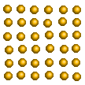
Atomos
To Democritus, atoms were small, hard particles that were all made of the same material but were different shapes and sizes.
Atoms were infinite in number, always moving and capable of joining together.

Slide 25

Τηισ τηεορψ ωασ ιγνορεδ ανδ φοργοττεν φορ μορε τηαν 2000 ψεαρσ!

Slide 26
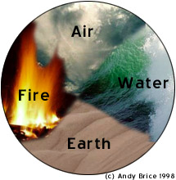
Why?
The eminent philosophers of the time, Aristotle and Plato, had a more respected, (and ultimately wrong) theory.
Aristotle and Plato favored the earth, fire, air and water approach to the nature of matter. Their ideas held sway because of their eminence as philosophers. The atomos idea was buried for approximately 2000 years.

Slide 27
Aristotle (384-322 BC)
Did not believe in the atoms
Because he was so widely respected his views were accepted until the 18th century, even though his beliefs had not been base on experimental evidence
He thought that all materials on Earth were not made of atoms, but of the four elements, Earth, Fire, Water, and Air.

Slide 28

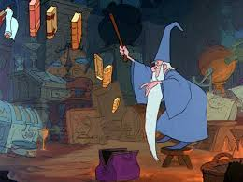
The Next 2000 years of chemistry history were dominated by a pseudoscience called ALCHEMY

Slide 29
Alchemist were often mystics and fakes who were obsessed with the idea of turning cheap metals into gold.
However this period also saw important discoveries:
The elements such as mercury, sulfur and antimony were discovered

Slide 30
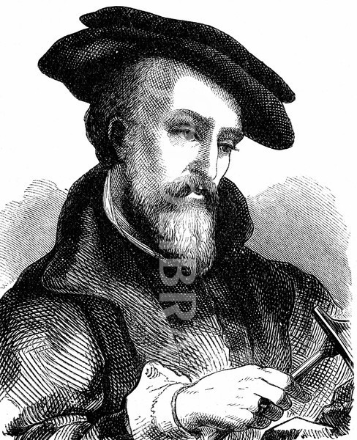
Georg Baur : (german)
In the 16th century developed systematic metallurgy which is the process for extracting metal from ores

Slide 31
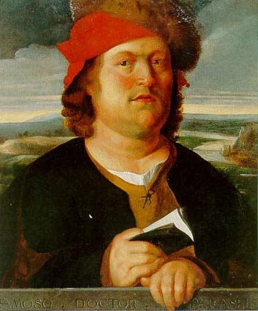
Paracelsus: (swiss)
was a Swiss German^{[3]} Renaissance physician, botanist, alchemist, astrologer, and general occultist
In the 16th century he developed medicinal applications of minerals
He founded the discipline of toxicology.
He is also credited for giving zinc its name, calling it zincum

Slide 32
Paracelsus gained a reputation for being arrogant, and soon garnered the anger of other physicians in Europe. Some even claim he was a habitual drinker..
He attacked conventional academic teachings and publicly burned medical textbooks, denouncing some of his predecessors as quacks and liars
Paracelsus was one of the first medical professors to recognize that physicians required a solid academic knowledge in the natural sciences, especially chemistry

Slide 33
His aid to villages during the plague in the 16th century was for many an act of heroism,
He summarized his own views:
“Many have said of Alchemy, that it is for the making of gold and silver. For me such is not the aim, but to consider only what virtue and power may lie in medicines”

Slide 34
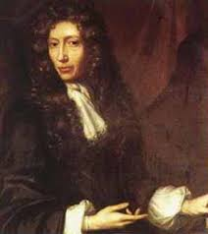
Robert Boyle (1627-1691)
Made his contributions in quantitative chemistry while working on his gas laws ( Boyles law )
Boyle was an alchemist; and believing the transmutation of metals to be a possibility, he carried out experiments in the hope of achieving it;

Slide 35
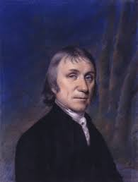
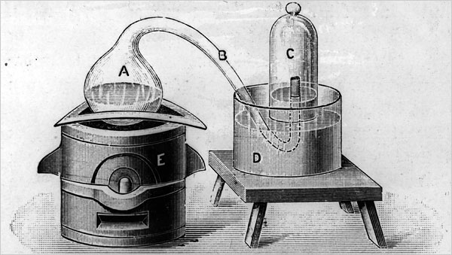
Joseph Priestly: (1733-1804)
Discovered oxygen gas and called it
dephlogisticated air

Slide 36
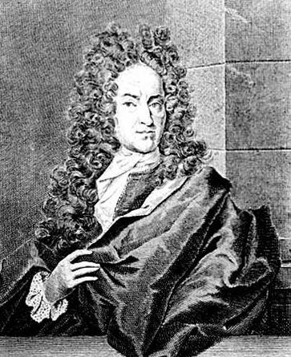
Georg Stahl: (1660-1734)
Suggested that a substance called phlogiston flowed out of burning material, and when the air became saturated with it, the material would stop burning

Slide 37
Fundamental Chemical laws

Slide 38
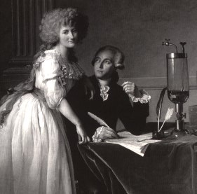
1. Law of conservation of mass
Developed by Antoine Lavosier ( French chemist) considered to be the "Father of Modern Chemistry.
States that matter is neither created nor destroyed by ordinary chemical means

Slide 39
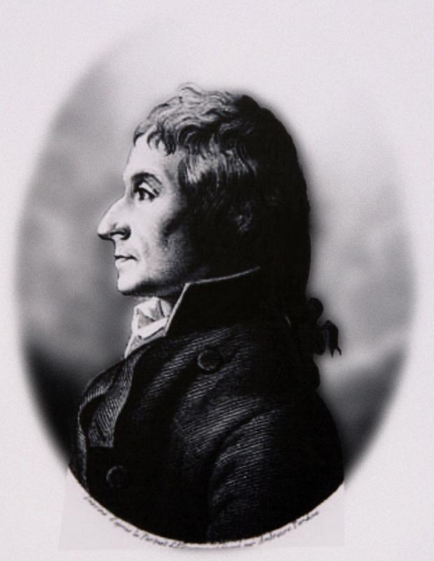
2. Law of definite proportion
Developed by Joseph Proust
Shows that a given compound always contains exactly the same proportions of elements by weight
example, oxygen makes up about ⁸/₉ of the mass of any sample of pure water, while hydrogen makes up the remaining ¹/₉ of the mass
This law along with the law of multiple proportions is the backbone of stoicheometry

Slide 40
3. Law of multiple proportions
Developed by John Dalton
States that if 2 or more different compounds are composed of the same 2 elements, the masses of the 2nd element combined with a certain mass of the 1st element can e expressed as a ratio of small whole numbers
Example H₂0 and H₂O₂

Slide 41
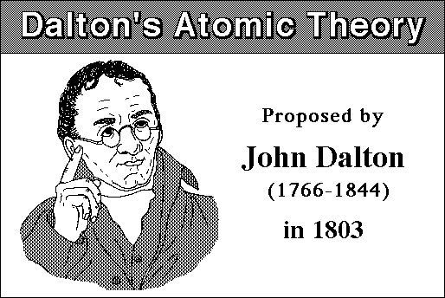
Dalton’s Atomic Theory of Atoms

Slide 42
Dalton’s Model
In the early 1800s, the English Chemist John Dalton performed a number of experiments that eventually led to the acceptance of the idea of atoms.

Slide 43

Dalton’s Theory
He deduced that all elements are composed of atoms. Atoms are indivisible and indestructible particles.
Atoms of the same element are exactly alike.
Atoms of different elements are different.
Compounds are formed by the joining of atoms of two or more elements.

Slide 44
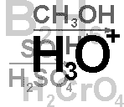
.
This theory became one of the foundations of modern chemistry.

Slide 45
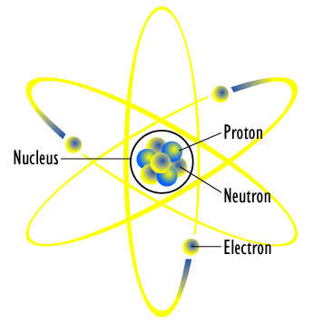
Discovery of the Atomic Nucleus

Slide 46
Thomson’s Plum Pudding Model
In 1897, the English scientist J.J. Thomson provided the first hint that an atom is made of even smaller particles.

Slide 47
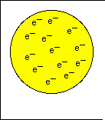
Thomson Model
He proposed a model of the atom that is sometimes called the “Plum Pudding” model.
Atoms were made from a positively charged substance with negatively charged electrons scattered about, like raisins in a pudding.

Slide 48
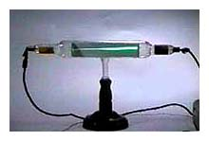
Thomson Model
Thomson studied the passage of an electric current through a gas.
As the current passed through the gas, it gave off rays of negatively charged particles.

Slide 49
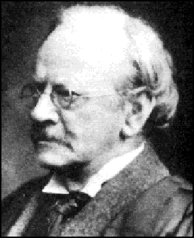
Thomson Model
Where did they come from?
This surprised Thomson, because the atoms of the gas were uncharged. Where had the negative charges come from?

Slide 50

Thomson concluded that the negative charges came from within the atom.
A particle smaller than an atom had to exist.
The atom was divisible!
Thomson called the negatively charged “corpuscles,” today known as electrons.
Since the gas was known to be neutral, having no charge, he reasoned that there must be positively charged particles in the atom.
But he could never find them.

Slide 51
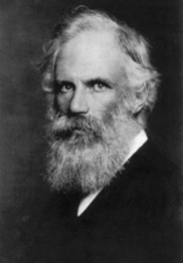
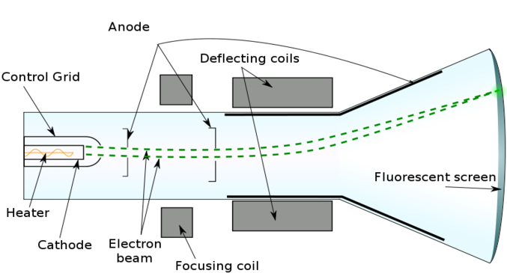
George Stoney
Called the cathode-ray particles electrons
Thomson had referred to them as “corpuscles”

Slide 52
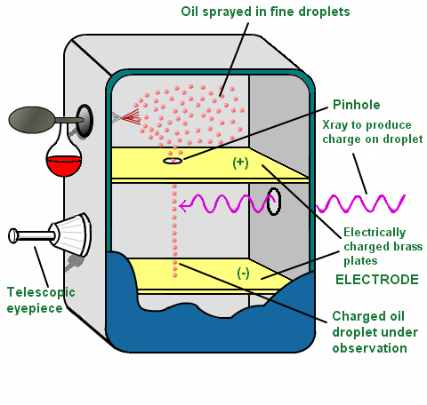
Robert Millikan 1909
He determined the charge of electrons by his Oil Drop Experiment
The experiment entailed observing tiny electrically charged droplets of oil located between two parallel metal surfaces, forming the plates of a capacitor.
The plates were oriented horizontally, with one plate above the other.
A mist of atomized oil drops was introduced through a small hole in the top plate

Slide 53
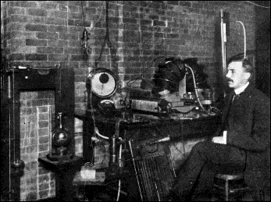
Rutherford’s Gold Foil Experiment
In 1908, the English physicist Ernest Rutherford was hard at work on an experiment that seemed to have little to do with unraveling the mysteries of the atomic structure.

Slide 54
Rutherford’s experiment Involved firing a stream of tiny positively charged particles at a thin sheet of gold foil (2000 atoms thick)

Slide 55
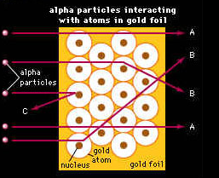
  Most of the positively charged “bullets” passed right through the gold atoms in the sheet of gold foil without changing course at all.
  Some of the positively charged “bullets,” however, did bounce away from the gold sheet as if they had hit something solid. He knew that positive charges repel positive charges.

Slide 56
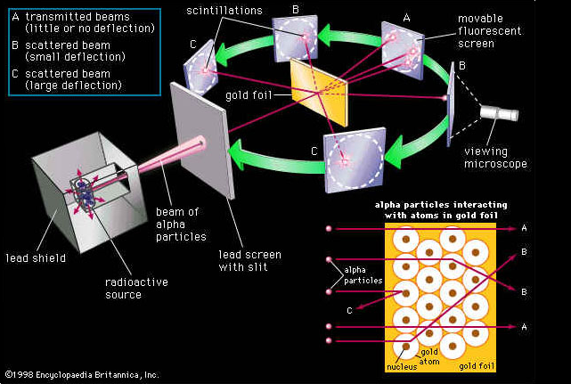

Slide 57
This could only mean that the gold atoms in the sheet were mostly open space. Atoms were not a pudding filled with a positively charged material.
Rutherford concluded that an atom had a small, dense, positively charged center that repelled his positively charged “bullets.” ie protons
He called the center of the atom the “nucleus”
The nucleus is tiny compared to the atom as a whole.

Slide 58
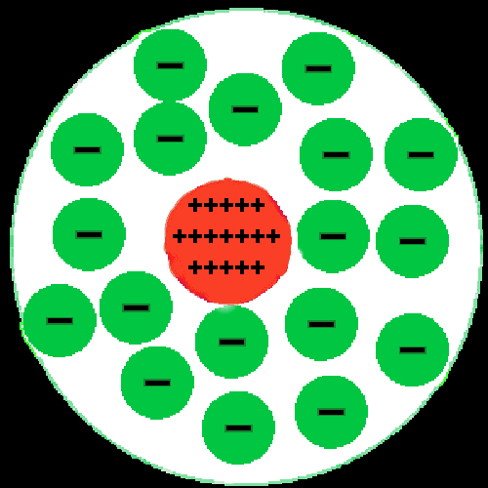
Rutherford
Rutherford reasoned that all of an atom’s positively charged particles were contained in the nucleus. The negatively charged particles were scattered outside the nucleus around the atom’s edge.

Slide 59
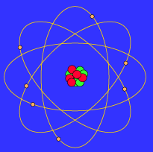
Bohr Model
In 1913, the Danish scientist Niels Bohr proposed an improvement. In his model, he placed each electron in a specific energy level.

Slide 60

Bohr Model
According to Bohr’s atomic model, electrons move in definite orbits around the nucleus, much like planets circle the sun. These orbits, or energy levels, are located at certain distances from the nucleus.

Slide 61
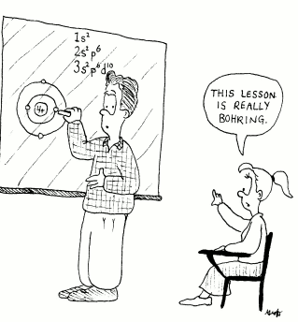

Slide 62
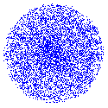
Wave Model

Slide 63

The Wave Model
Today’s atomic model is based on the principles of wave mechanics.
According to the theory of wave mechanics, electrons do not move about an atom in a definite path, like the planets around the sun.

Slide 64
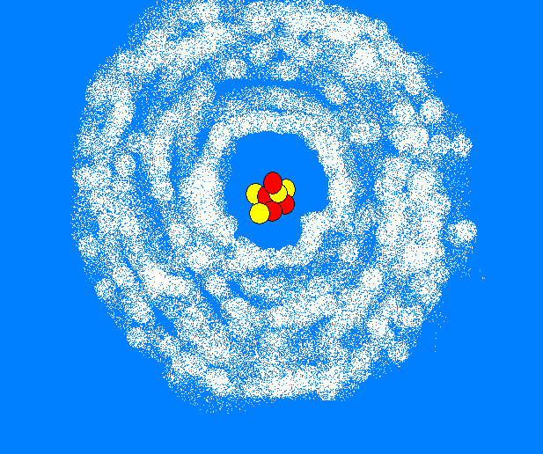
The Wave Model
In fact, it is impossible to determine the exact location of an electron. The probable location of an electron is based on how much energy the electron has.
According to the modern atomic model, at atom has a small positively charged nucleus surrounded by a large region in which there are enough electrons to make an atom neutral.

Slide 65


Louis de Broglie
Discovered the wave nature of electrons
He postulated the wave nature of electrons and suggested that all matter has wave properties .
This concept is known as the de Broglie hypothesis, an example of wave–particle duality , and forms a central part of the theory of quantum mechanics

Slide 66

Werner Heisenberg
Used math to explain the location of the electrons in an atom
His model is called the quantum mechanics model

Slide 67

Heisenberg
oops
Wrong
Heisenberg

Slide 68


Erwin Schrodinger
His model of the atom is called the electron cloud model

Slide 69
Electron Cloud:
A space in which electrons are likely to be found.
Electrons whirl about the nucleus billions of times in one second
They are not moving around in random patterns.
Location of electrons depends upon how much energy the electron has.

Slide 70
Electron Cloud:
Depending on their energy they are locked into a certain area in the cloud.
Electrons with the lowest energy are found in the energy level closest to the nucleus
Electrons with the highest energy are found in the outermost energy levels, farther from the nucleus.

Slide 71

Erwin Schrodinger
Schrödinger's cat Paradox:
a cat, a flask of poison, and a radioactive source are placed in a sealed box. If an internal monitor (e.g. Geiger counter ) detects radioactivity (i.e. a single atom decaying), the flask is shattered, releasing the poison, which kills the cat. The Copenhagen interpretation of quantum mechanics implies that after a while, the cat is simultaneously alive and dead .

Slide 72

James Chadwick 1932 discovered the neutron
Until 1932 it was believed that the atom was only composed of positively charge protons and negatively charged electrons.
Chadwick bombarded hydrogen atoms in paraffin with beryllium emissions, but he also used helium, nitrogen and other elements as targets.
By comparing the energies of recoiling charged particles from different targets, he proved that the beryllium emissions contained a neutral component with a mass equal to a proton

Slide 73


Albert Einstein
Designed a mathematical equation for the model of an atom
This equation connected the mass of an object with its energy

Slide 74

Planck
He deduced the relationship between the

Slide 75


Slide 76


Slide 77
 | Indivisible | Electron | Nucleus | Orbit | Electron Cloud
Greek | X
Dalton | X
Thomson |  | X
Rutherford |  | X | X
Bohr |  | X | X | X
Wave |  | X | X |  | X

Slide 78

Structure of an atom
Atom: The smallest particle of an element that can exist either alone or in a combination with other atoms
Atomic structure: Refers to the identity and arrangement of particles in the atom

Slide 79


Slide 80

An atom refresher
An atom has three parts:
Proton = positive
Neutron = no charge
Electron = negative
The proton & neutron are found in the center of the atom, a place called the nucleus.
The electrons orbit the nucleus.
Picture from http://education.jlab.org/qa/atom_model_03.gif

Slide 81


Slide 82
The nucleus makes up 99.9% mass of atom.
Surrounding the nucleus is a region occupied by negatively charged particles called electrons
Abbreviation for electron is e-

Slide 83
Atomic Number
The number of protons in the nucleus of an atom
-
The identification number of an element
+
+
+
-
-

Slide 84
Mass Number
The total number of protons and neutrons in an atom’s nucleus
Expressed in Atomic Mass Units (amu)
  Each proton or neutron has a mass of 1 amu
What would be the mass number of this atom?
-
+
→ 3
→ 4
+
+
+
-
3 protons + 4 neutrons = a mass number of 7 amu
Why did we not account for the electrons when calculating the mass number?
-

Slide 85

Building Atoms
Using the periodic table be sure you can determine the proton, neutron, and electron for any element given to you.
Atoms | Protons | Neutrons | Electrons
Carbon | 6 | 6 | 6
Beryllium | 4 | 5 | 4
Oxygen | 8 | 8 | 8
Lithium | 3 | 4 | 3
Sodium | 11 | 12 | 11

Slide 86


Atom Builder
Using the interactive website link below, practice building atoms.
http://www.pbs.org/wgbh/aso/tryit/atom/
Using the classzone.com link below, click on the “Build an Atom” simulation and practice building atoms.
http://www.classzone.com/books/ml_sci_physical/page_build.cfm?id=resour_ch1&u=2##

Slide 87
FORCES IN THE ATOM
Gravitational Force
Electromagnetic Force
Strong Force
Weak Force

Slide 88


Gravitational Force
The force of attraction of objects due to their masses
The amount of gravity between objects depends on their masses and the distance between them
These are the weakest forces in nature. Inside the nucleus of an atom the effects are very small compared to the effects due to the other forces

Slide 89
Electromagnetic Force
The force that results from the repulsion of like charges and the attraction of opposites
The force that holds the electrons around the nucleus
+
+
-
+
-
-
Notice how the particles with the same charge move apart and the particles with different charges move together.
Why are neutrons not pictured above?

Slide 90
Strong Force
Notice how the electromagnetic force causes the protons to repel each other but, the strong force holds them together.
The force that holds the atomic nucleus together
The force that counteracts the electromagnetic force
+
+
+
+
works only when protons are very close together…
Would an atom have a nucleus if the strong force did not exist?

Slide 91

Weak Force
This force plays a key role in the possible change of sub-atomic particles.
  For example, a neutron can change into a proton(+) and an electron(-)
The force responsible for radioactive decay.
  Radioactive decay → process in which the nucleus of a radioactive (unstable) atom releases nuclear radiation.
Notice how the original particle changes to something new.
+
n
-
If you need help remembering weak force, just think of…

Slide 92
Isotopes
Atoms that have the same number of protons, but have different numbers of neutrons
Examples
Notice that each of these atoms have one proton; therefore they are all types of hydrogen. They just have a different mass number (# of neutrons).
-
-
+
+
+
-
Hydrogen (Protium)
Hydrogen (Deuterium)
Hydrogen (Tritium)

Slide 93
Isotopes
Protium makes up 99.98% of hydrogen, deuterium .015% and tritium is the radioactive form of hydrogen
Examples
Notice that each of these atoms have one proton; therefore they are all types of hydrogen. They just have a different mass number (# of neutrons: protium 0, deuterium 1, tritium 2.)
-
-
+
+
+
-
Hydrogen (Protium)
Hydrogen (Deuterium)
Hydrogen (Tritium)

Slide 94
2 methods of designating isotopes
To determine the composition of an isotope ex uranium 235 , first look uranium up on the periodic table, the atomic number is 92 thus 92 protons.
Next subtract 92 from the mass number to get the number of neutrons 235-92=143 neutrons
If the atomic mass does not match the mass on the periodic table, it is an isotope

Slide 95
Nuclide: general term for any isotope of all elements
The atomic number is added as a subscript and the mass number is a superscript
Example: ³₁H mass number ²³⁵₉₂U
atomic number

Slide 96
How to Find the atomic mass of a compound
CaCO₃
C₉H₈O₄
Mg(OH)₂
C₇H₅(NO₃)₃
C₆H₇O₂(OH)₃
Ca(H₂PO₄)₂

Slide 97
Atomic Calculation
The molecular formula for sulfuric acid is H₂SO₄. Find the molecular mass of a molecule of sulfuric acid
How many atoms make up the molecule of acetylsalicylic acid formula: C₆H₄(COOH)OCOCH₃

Slide 98
Atomic Mass
The weighted average of the masses of all the naturally occurring isotopes of an element
The average considers the percent abundance of each isotope in nature
Found on the periodic table of elements
Example
What would be the atomic mass (≈) of Hydrogen if these three isotopes
were found in the following percentages (99.9, 0.015, 0) respectively?
-
+
+
+
-
-
Hydrogen (Protium)
Mass # = 1 amu
Hydrogen (Deuterium)
Mass # = 2 amu
Hydrogen (Tritium)
Mass # = 3 amu
If you simply average the three, 2 amu (1 amu + 2 amu + 3 amu/3) would be the atomic mass, but since 99.9% of the Hydrogen is Protium, the atomic mass is around 1 amu (.999 x 1 amu)

Slide 99
Isotope or Different Element
Determine the identity of the element and whether it is an isotope or not
Element D has 6 protons and 7 neutrons
Element F has 7 protons and 7 neutrons
Element X has 17 protons and 18 neutrons
Element Y has 18 protons and 17 neutrons

Slide 100
Relative Atomic mass
In order to set up a relative atomic mass scale one atom must be picked and assigned a relative mass volume
The mass of all other atoms are expressed in relation to this one atom
Carbon 12 atom is that set atom

Slide 101
Carbon 12 is assigned a mass of 12 AMU ( atomic mass units)
Average atomic mass: the average weight of the atomic masses of the naturally occurring isotope of the element

Slide 102
Example:
Naturally occurring copper consists of 69.17% Cu-63 ( atomic mass 62.939) and 30.83% of Cu-65 ( atomic mass 64.927)
Calculate the average atomic mass of copper
(.6917) (62.939) + (.3083) (64.927)=
63.55AMU

Slide 103
Mole, Avogadros number and Molar mass
Avogadro’s number and molar mass provide a basis for relating masses in grams to numbers of atoms
Avogadro’s number = 6.022×10²³
Avogadro’s # is the number of particles in exactly one mole of a pure substance
Molar mass is the mass of one mole of a pure substance

Slide 104
Mole: The amount of a substance that contains an Avogadro’s number of particles or chemicals
One mole of a substance is one molar mass of that substance

Slide 105
Example
Find how many grams of helium are equal to 2 moles of helium. Molar mass of helium is taken as 4.0g
2.0mol He x 4.0g/1mol He =8.0g He
Do more problems on the board

Slide 106
The mole: 3 important concepts
The mole is the SI unit for amount of substance
Mole is the amount of a substance that contains the same number of particles as the number of atoms in exactly 12 g of carbon-12
The mole is a counting unit

Slide 107
Ion
Charged particle that typically results from a loss or gain of electrons
Two types:
  Anion = negatively charged particle
  Cation = positively charged particle
-
-
-
+
= 8
= 8
= 8
+
+
+
+
+
+
-
-
9
-
6
+
+
-
-
Now that this atom of oxygen just gained an electron, it is no longer neutral or an atom. It is now considered an ion (anion). This ion has more electrons (9) than protons (8).
Now that three electrons were lost, the number of electrons (6) and protons (8) is still unbalanced; therefore, it is still an ion, but now it is specifically referred to as a cation.
Currently, this atom of oxygen is neutral because it has an equal number of electrons (8) and protons (8).
-
-
Symbol = O²⁺
Symbol = O¹⁻
Symbol = O

Slide 108
Building Ions
Using the whiteboard and the proton, neutron, and electron pieces, build the following ions, and determine their atomic and mass numbers.
Ions | Protons | Neutrons | Electrons
Carbon (C³¯) | 6 | 6 | 9
Hydrogen (H¹+) | 1 | 0 | 0
Oxygen (O²¯) | 8 | 8 | 10
Lithium (Li³+) | 3 | 4 | 0
Sodium (Na¹¯) | 11 | 12 | 12
Be aware that the atomic and mass numbers are not
impacted by the loss or gain of electrons.

Slide 109


The Atoms Family
1st verse
They’re tiny and they’re teeny,
much smaller than a beany,
They never can be seeny,
The Atoms Family
Chorus:
They are so small ( snap, snap)
They’re round like a ball (snap, snap)
They make up the air
They’re everywhere
Can’t see them at all (snap, snap)

Slide 110
2nd verse
Together they make gases,
and liquids like molasses,
And all the solid masses,
The Atoms family
Chorus:
They are so small ( snap, snap)
They’re round like a ball (snap, snap)
They make up the air
They’re everywhere
Can’t see them at all (snap, snap)

Slide 111
3rd verse
Neutrons can be found,
Where protons hang around;
Electrons they surround
The Atoms Family
Chorus:
They are so small ( snap, snap)
They’re round like a ball (snap, snap)
They make up the air
They’re everywhere
Can’t see them at all (snap, snap)

