Slide 1

Unit 12: Direct Current Circuits

Slide 2

Yes, we all know what electricity is, but exactly what is it?
-where does it come from
-can you see it
-how is it created

Slide 3
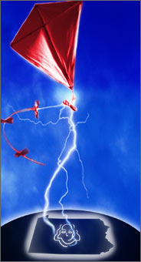
History of Electricity
600 B.C.-Thales discovered static electricity.
1600 - William Gilbert names the force electricity
Mid 1700's - Ben Franklin shows that lightning is made of electricity, and does numerous experiments

Slide 4
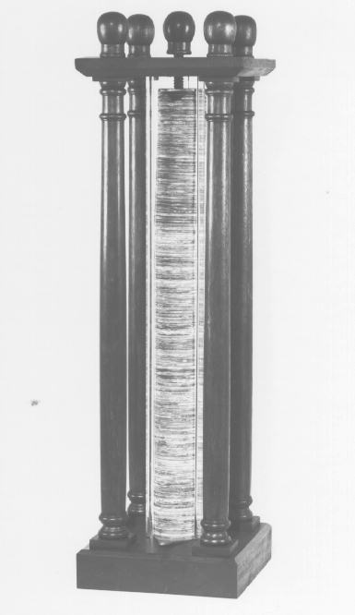
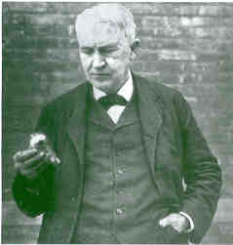
1800 - Volta makes
first battery
1878 - T. Edison creates
electric light bulb

Slide 5
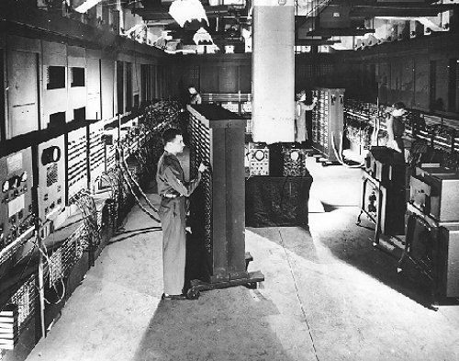
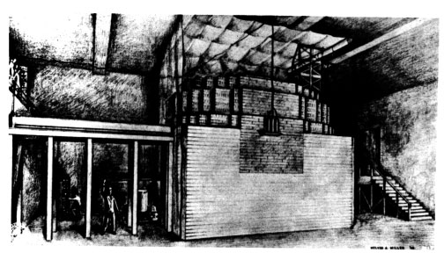
1943 - First computer
(ENIAC) created
1942 - Fermi produces the
first fission reaction

Slide 6

Electricity
Electricity is a force created by a difference in charges (+ & -) due to gained or lost electrons. (an electron is a negatively charged particle.)
When electricity is flowing between two points, this is actually electrons moving from point A to point B. This is called an electrical current.

Slide 7
In order for these electrons to flow, however, there must be a difference in charges (# of electrons built up) between the 2 points. Just like heat flow needs a difference in temperatures.
Electricity always flows from a location with a negative charge to a location with a positive charge. (like charges repel, opposites attract)
- +

Slide 8
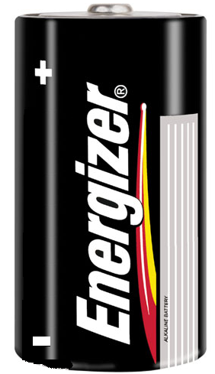
Think of a battery, the top has a + charge and the bottom has a negative charge. So when they are connected, electrons flow from the bottom to the top.

Slide 9
Electricity that moves…
Current: The flow of electrons from one place to another.
Measured in amperes (amps)
One amp = amount of current flowing past a given point per second

Slide 10

Electric Current
Electric current is the flow of electric charge from one place to another.
A closed path through which charge can flow, returning to its starting point, is called an electric circuit.

Slide 11
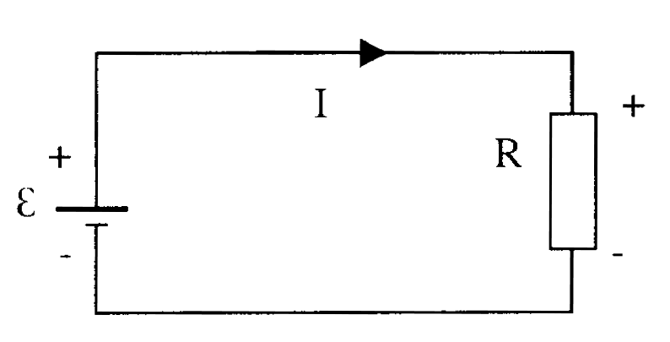
Current
Current is defined as the rate at which charge flows through a surface.
The current is in the same direction as the flow of positive charge (for this course)
Note: The “I” stands
for intensity

Slide 12
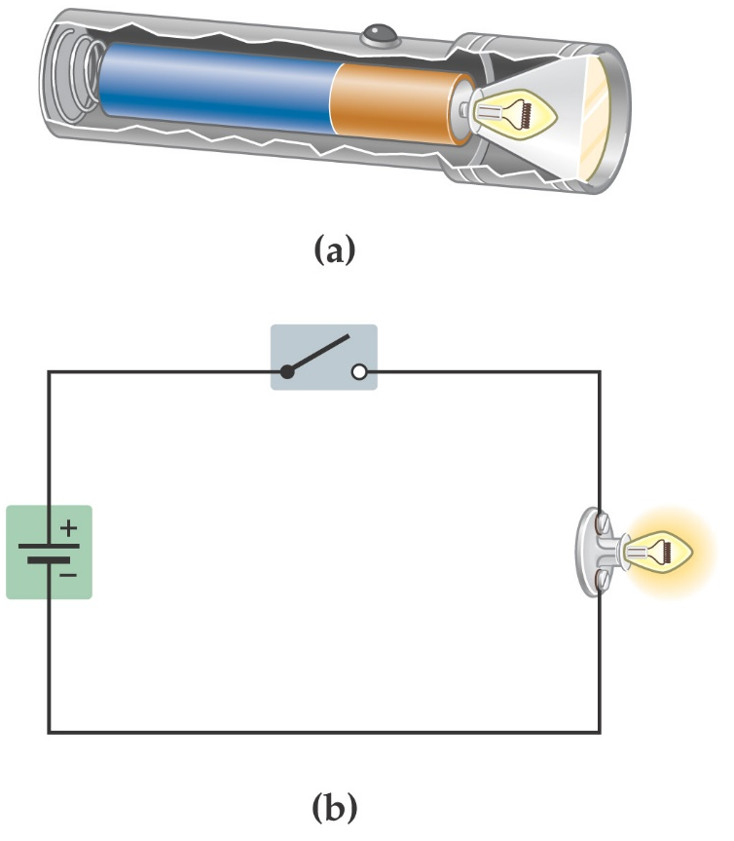
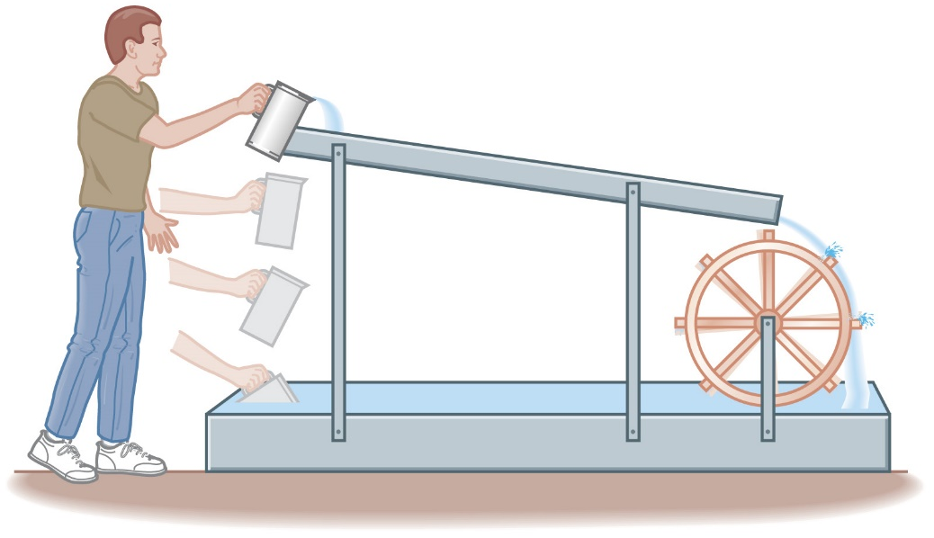
Electric Current
A battery uses chemical reactions to produce a potential difference between its terminals. It causes current to flow through the flashlight bulb similar to the way the person lifting the water causes the water to flow through the paddle wheel.

Slide 13

Electric Current
A battery that is disconnected from any circuit has an electric potential difference between its terminals that is called the electromotive force or emf:
Remember – despite its name, the emf is an electric potential, not a force.
The amount of work it takes to move a charge ΔQ from one terminal to the other is:

Slide 14
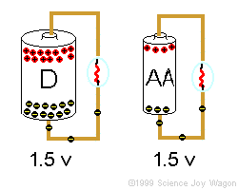
Potential Difference =Voltage=EMF
In a battery, a series of chemical reactions occur in which electrons are transferred from one terminal to another. There is a potential difference (voltage) between these poles.
The maximum potential difference a power source can have is called the electromotive force or (EMF), ε. The term isn't actually a force, simply the amount of energy per charge (J/C or V)

Slide 15
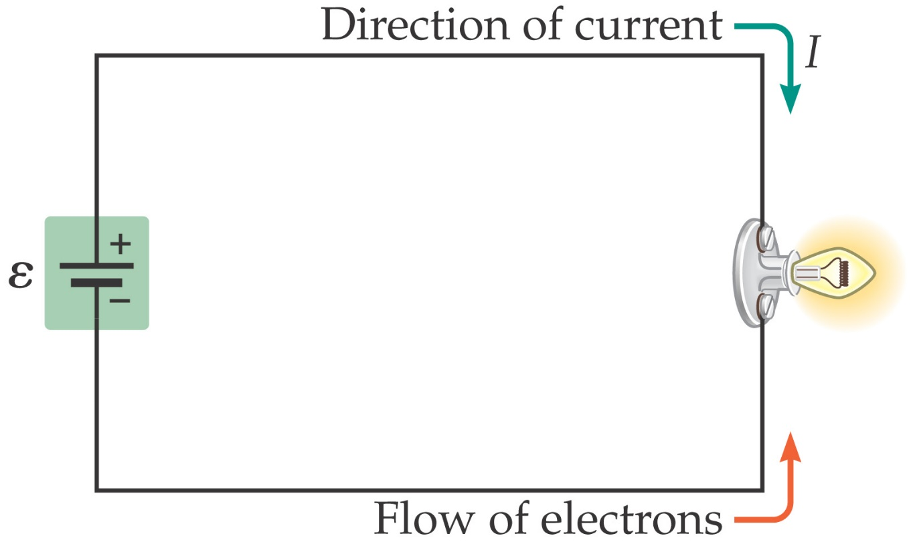
Electric Current
The direction of current flow – from the positive terminal to the negative one – was decided before it was realized that electrons are negatively charged. Therefore, current flows around a circuit in the direction a positive charge
would move; electrons move the other way. However, this does not matter in most circuits.

Slide 16
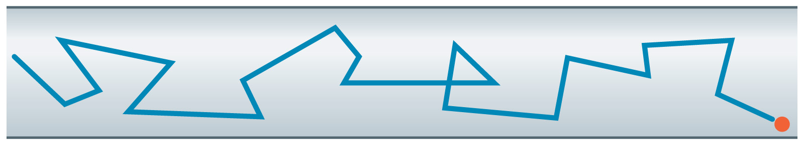
Electric Current
Finally, the actual motion of electrons along a wire is quite slow; the electrons spend most of their time bouncing around randomly, and have only a small velocity component opposite to the direction of the current. (The electric signal propagates much more quickly!)

Slide 17


Slide 18

Drift velocity
The free electrons move in the direction of the accelerating force with an average velocity called drift velocity

Slide 19
Electric Current, cont
The direction of the current is the direction positive charge would flow
  This is known as conventional current direction
    In a common conductor, such as copper, the current is due to the motion of the negatively charged electrons
It is common to refer to a moving charge as a mobile charge carrier
  A charge carrier can be positive or negative

Slide 20

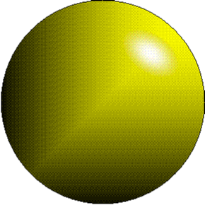
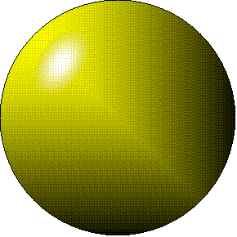
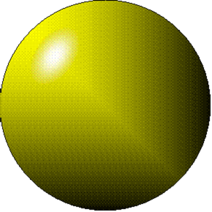
Electric current - electrons moving through a metal wire. Symbol “I”

Slide 21
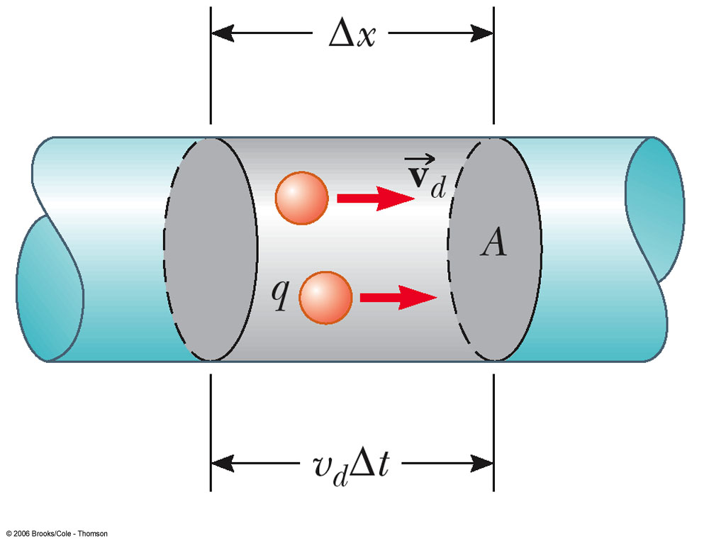
Current and Drift Speed
Charged particles move through a conductor of cross-sectional area A
n is the number of charge carriers per unit volume
n A Δx is the total number of charge carriers

Slide 22
Current and Drift Speed, cont
The total charge is the number of carriers times the charge per carrier, q
  ΔQ = (n A Δx) q
The drift speed, v_{d}, is the speed at which the carriers move
  v_{d} = Δx/ Δt
Rewritten: ΔQ = (n A v_{d} Δt) q
Finally, current, I = ΔQ/Δt = nqv_{d}A

Slide 23

Current and Drift Speed, final
If the conductor is isolated, the electrons undergo random motion
When an electric field is set up in the conductor, it creates an electric force on the electrons and hence a current

Slide 24
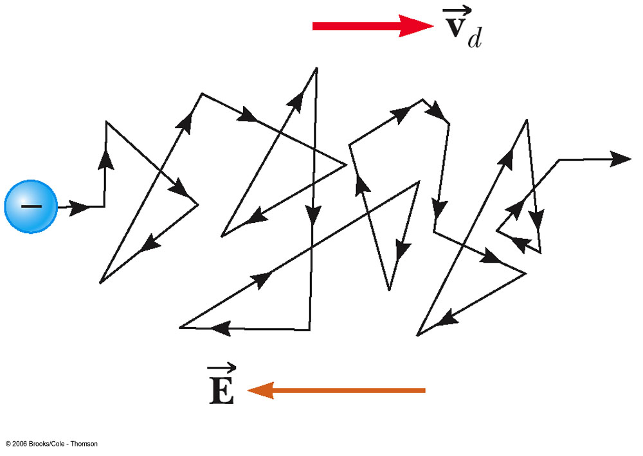
Charge Carrier Motion in a Conductor
The zig-zag black line represents the motion of charge carrier in a conductor
  The net drift speed is small
The sharp changes in direction are due to collisions
The net motion of electrons is opposite the direction of the electric field

Slide 25

Electrons in a Circuit
The drift speed is much smaller than the average speed between collisions
When a circuit is completed, the electric field travels with a speed close to the speed of light
Although the drift speed is on the order of 10⁻⁴ m/s the effect of the electric field is felt on the order of 10⁸ m/s

Slide 26
Sources of emf
The source that maintains the current in a closed circuit is called a source of emf
  Any devices that increase the potential energy of charges circulating in circuits are sources of emf
  Examples include batteries and generators
SI units are Volts
  The emf is the work done per unit charge

Slide 27
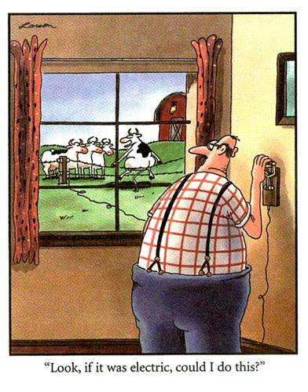


Slide 28
What is Voltage?
The measure of energy given to the charge flowing in a circuit.
The greater the voltage, the greater the force or “pressure” that drives the charge through the circuit.

Slide 29
Difference b/t Volts and Amps
Example – you could say that…
  Amps measure how much water comes out of a hose.
  Volts measure how hard the water comes out of a hose.

Slide 30

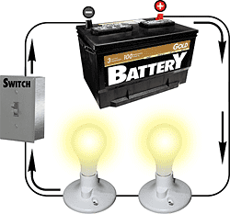
Electrical Current
Amount of Electrical Current ( amps) depends on more than just Voltage, it depends on the Resistance found in the circuit.

Slide 31

What is Resistance?
The opposition to the flow of an electric current, producing heat.
The greater the resistance, the less current gets through.
Good conductors have low resistance.
Measured in ohms.

Slide 32
What Influences Resistance?
Material of wire – aluminum and copper have low resistance
Thickness – the thicker the wire the lower the resistance
Length – shorter wire has lower resistance
Temperature – lower temperature has lower resistance

Slide 33
Resistance
In a conductor, the voltage applied across the ends of the conductor is proportional to the current through the conductor
The constant of proportionality is the resistance of the conductor

Slide 34
Resistance, cont
Units of resistance are ohms (Ω)
  1 Ω = 1 V / A
Resistance in a circuit arises due to collisions between the electrons carrying the current with the fixed atoms inside the conductor

Slide 35
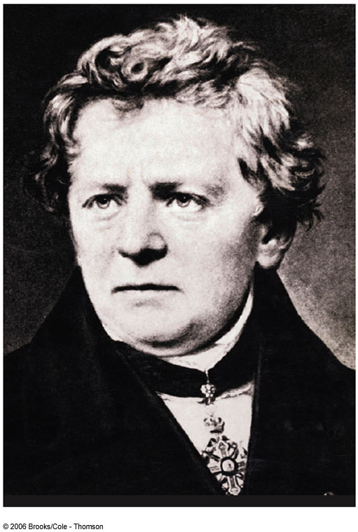
Georg Simon Ohm
1787 – 1854
Formulated the concept of resistance
Discovered the proportionality between current and voltages

Slide 36
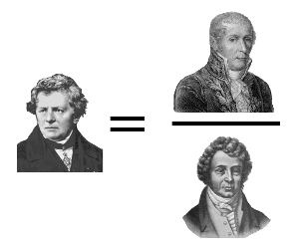
Ohm’s Law
Alessandro Volta
Ohm
Resistance
André-Marie Ampère
Experiments show that for many materials, including most metals, the resistance remains constant over a wide range of applied voltages or currents
This statement has become known as Ohm’s Law
  ΔV = I R
Ohm’s Law is an empirical relationship that is valid only for certain materials
  Materials that obey Ohm’s Law are said to be ohmic

Slide 37
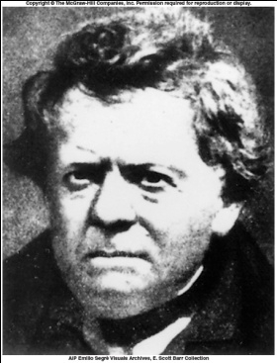
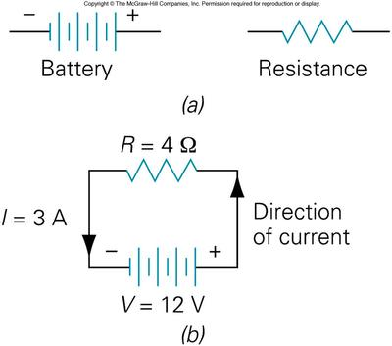
Georg Ohm (1787-1854)
V
I = ----
R
Resistance is a measure of opposition to the flow of charge and is measured in ohms (Ω)

Slide 38
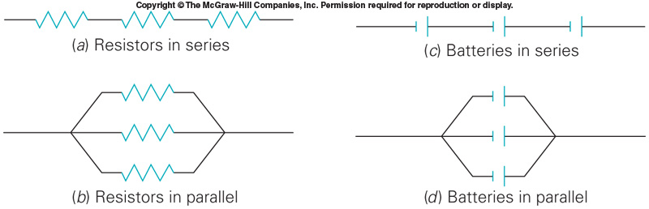

Slide 39
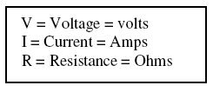
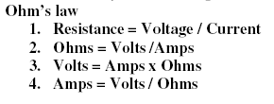
Ohm’s Law: the current in a wire is equal to voltage divided by resistance
Resistance = Voltage / Current
Ohms = Volts / Amps

Slide 40
Practice with Ohm’s Law
Ohms | Volts | Amps
4 | 100 | 25
15 | 150 | 10
2 | 30 | 15
9 | 45 | 5
6 | 48 | 8

Slide 41

Resistance and Ohm’s Law
Two wires of the same length and diameter will have different resistances if they are made of different materials. This property of a material is called the resistivity.

Slide 42
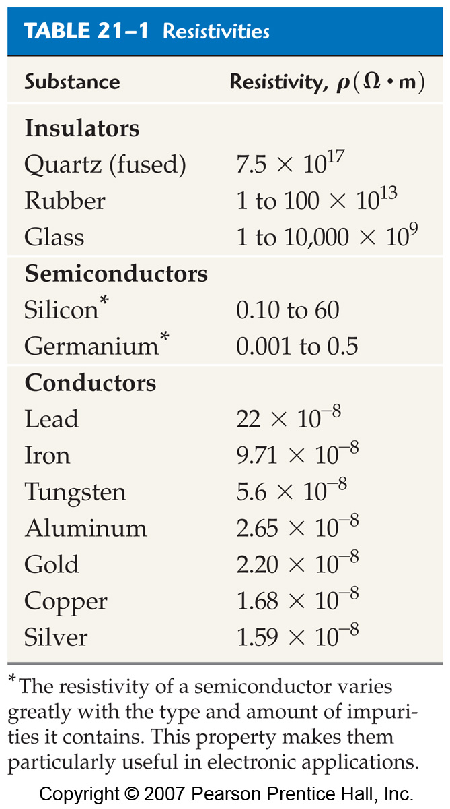
Resistance and Ohm’s Law
The difference between insulators, semiconductors, and conductors can be clearly seen in their resistivities:

Slide 43
Resistance and Ohm’s Law
In general, the resistance of materials goes up as the temperature goes up, due to thermal effects. This property can be used in thermometers.
Resistivity decreases as the temperature decreases, but there is a certain class of materials called superconductors in which the resistivity drops suddenly to zero at a finite temperature, called the critical temperature T_{C}.

Slide 44
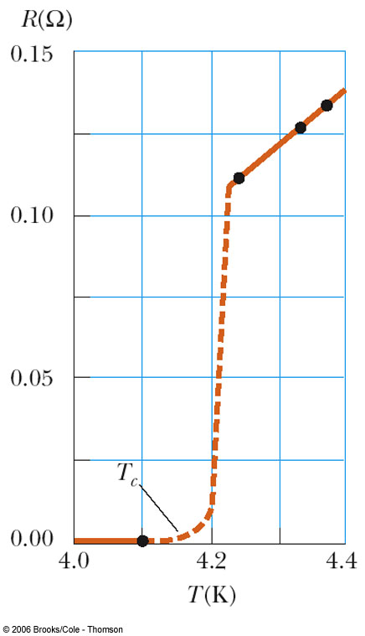
Superconductors
A class of materials and compounds whose resistances fall to virtually zero below a certain temperature, T_{C}
  T_{C} is called the critical temperature
The graph is the same as a normal metal above T_{C}, but suddenly drops to zero at T_{C}

Slide 45
Superconductors, cont
The value of T_{C} is sensitive to
  Chemical composition
  Pressure
  Crystalline structure
Once a current is set up in a superconductor, it persists without any applied voltage
  Since R = 0

Slide 46
How can we control currents?
With circuits.
Circuit: is a path for the flow of electrons. We use wires.

Slide 47
There are 2 types of currents:
Direct Current (DC) – Where electrons flow in the same direction in a wire.

Slide 48
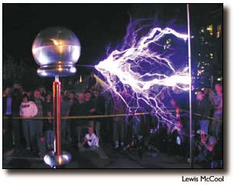


Direct Current (DC)
Examples of direct current include batteries, lightning, and static electricity.

Slide 49
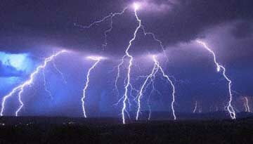
Lightning
Lightning is a form of direct current (DC) produced by static electricity in clouds.
The static is formed when air molecules move past each other (just like clothes in a dryer).

Slide 50
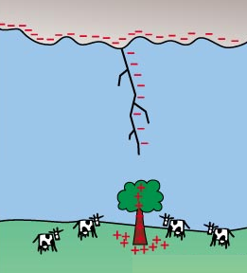


The negative charges group at the bottom of the cloud and transfer electrons to the ground, which has taken on a positive charge.
Why do you think the ground has taken on a positive charge?

Slide 51
There are 2 types of currents:
Alternating Current (AC) – electrons flow in different directions in a wire

Slide 52

Alternating Current (AC)
Household outlets are an example of AC current. They reverse the direction of the current about 120 times per second.

Slide 53

Electricity
D.C.
Direct Current
A.C.
Alternating Current

Slide 54
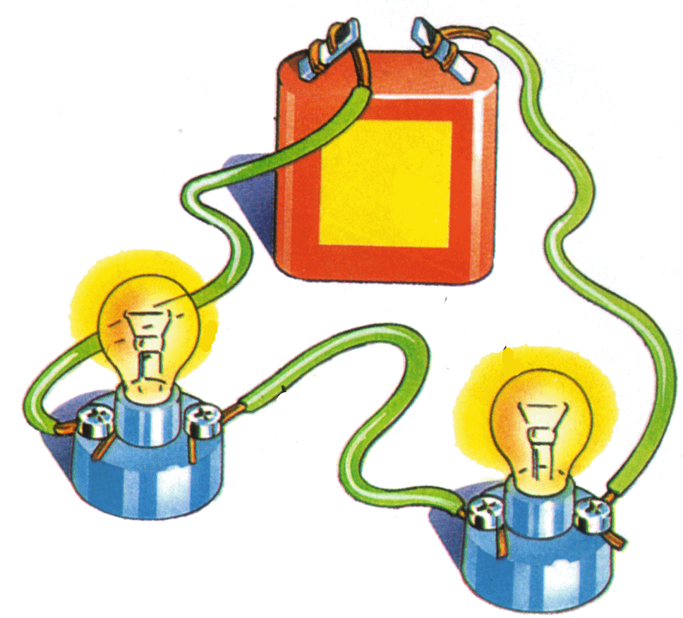
An electric circuit consists of :
Source of electrons:
In a D.C. current = battery
In an A.C. current = generator
Load or resistance:
The device that uses the electric energy. It offers some resistance to flow of electrons

Slide 55
An electric circuit consists of :
Wires
Switch:
Opens and closes the electric circuit
Electricity can only flow through closed circuits

Slide 56
Electric Circuits
A circuit is a pathway along which an electric current can travel, en route to a device.
Locating a device along that pathway will allow it to be powered by the electric current.
There are 2 different types of circuits: series and parallel.

Slide 57
Energy and Power in Electric Circuits
When a charge moves across a potential difference, its potential energy changes:
Therefore, the power it takes to do this is

Slide 58

Energy and Power in Electric Circuits
In materials for which Ohm’s law holds, the power can also be written:
This power mostly becomes heat inside the resistive material.

Slide 59
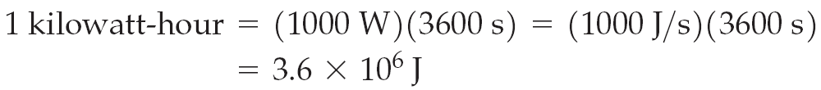
Energy and Power in Electric Circuits
When the electric company sends you a bill, your usage is quoted in kilowatt-hours (kWh). They are charging you for energy use, and kWh are a measure of energy.

Slide 60
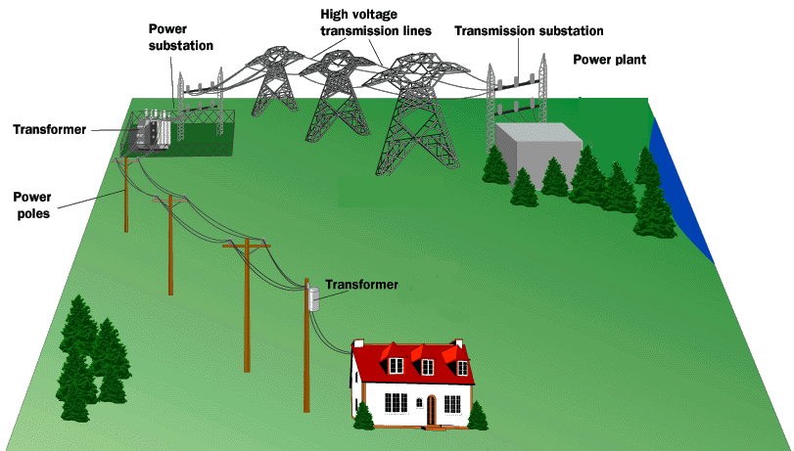
Electrical POWER
We have already learned that POWER is the rate at which work (energy) is done. Circuits that are a prime example of this as batteries only last for a certain amount of time AND we get charged an energy bill each month based on the amount of energy we used over the course of a month…aka POWER.

Slide 61
POWER
It is interesting to see how certain electrical variables can be used to get POWER. Let’s take Voltage and Current for example.

Slide 62
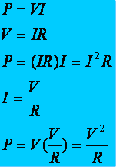
Other useful power formulas
These formulas can also be used! They are simply derivations of the POWER formula with different versions of Ohm's law substituted in.

Slide 63
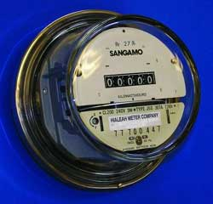
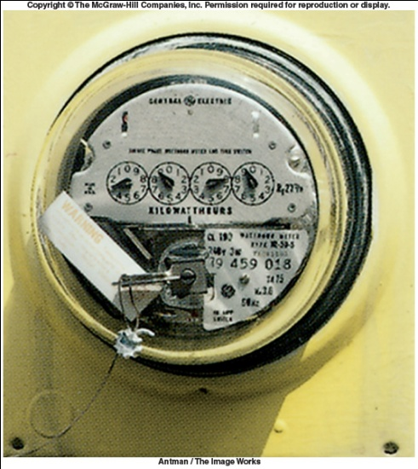
Electric Power
P= IV
The power of an electric current is the rate at which it does work and is equal to the product of the current and the voltage of a circuit:
The unit of electric power is the watt.The commercial unit of electric energy is the kilowatthour (kWh).

Slide 64
Electric Power
Typical Power Ratings
Appliance Power (W)
Stove 12,000
Clothes Dryer 5,000
Heater 2,000
Dishwasher 1,600
Photocopier 1,400
Iron 1,000
Vacuum Cleaner 750
Coffee Maker 700
Refrigerator 400
Portable Sander 200
Fan 150
Personal Computer 150
TV Receiver 120
Fax Transmitter/Receiver 65
Charger for Electric Toothbrush 1

Slide 65
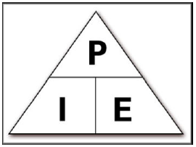
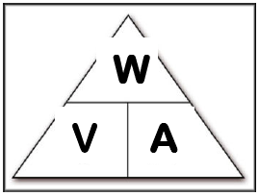
Using Electric Power
Electric power – The measure of the rate at which electricity does work or provides power, and the unit of power is the Watt.
Formula is: Power = Voltage x Current
Formula is: Watts = Volts x Amps
Or Amps = Watts / Volts
Or Volts = Watts / Amps
P = Volts x Amps P = 6 x .5 P = 3 Watts
P = Volts x Amps 500 = 120 x A 500/120 = A 4.17 Amps

Slide 66
Calculating Electrical Energy Cost
Paying for energy – we are charged by the electric company for the power we use.
It is calculated and billed to us by the kilowatt hour.
  1. The formula used is :
  Energy = Power x Time =
  (Volts xCurrent)xTime
  2. The formula used is:
  Kilowatt hours = Kilowatts x Hours

Slide 67
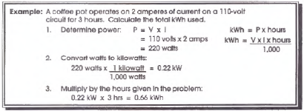

Calculating Electrical Energy Cost

Slide 68

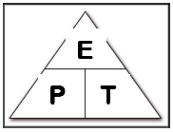
Calculating Electrical Energy Cost
Energy = Power x Time
Energy = (VoltsxCurrent)xTime
E = 110v x 5a x 1hr
E= 550 watts x 1hr
E = .55 kW x 1hr
E = .55 kWh

Slide 69
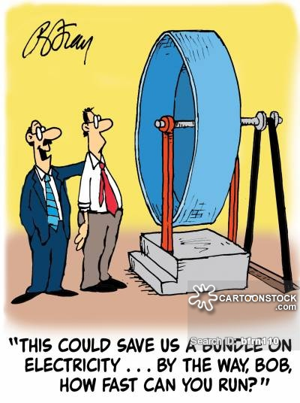

Slide 70
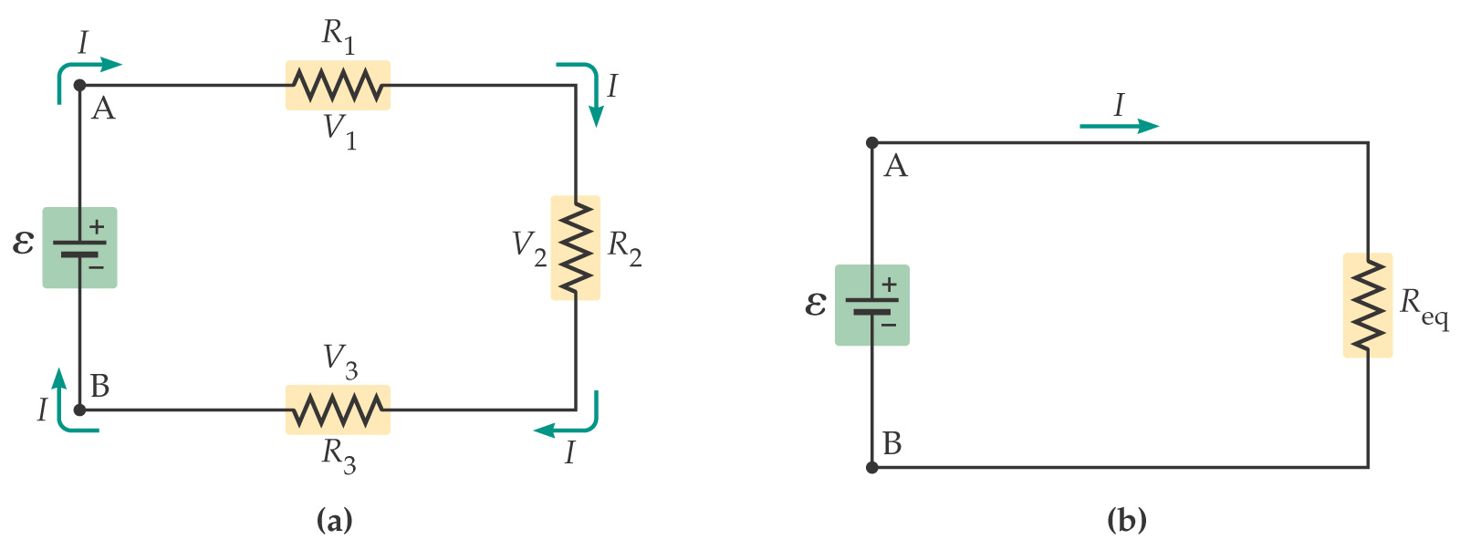
Resistors in Series and Parallel
Resistors connected end to end are said to be in series. They can be replaced by a single equivalent resistance without changing the current in the circuit.

Slide 71
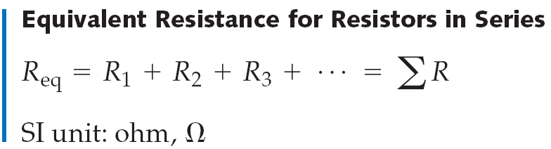
Resistors in Series and Parallel
Since the current through the series resistors must be the same in each, and the total potential difference is the sum of the potential differences across each resistor, we find that the equivalent resistance is:

Slide 72
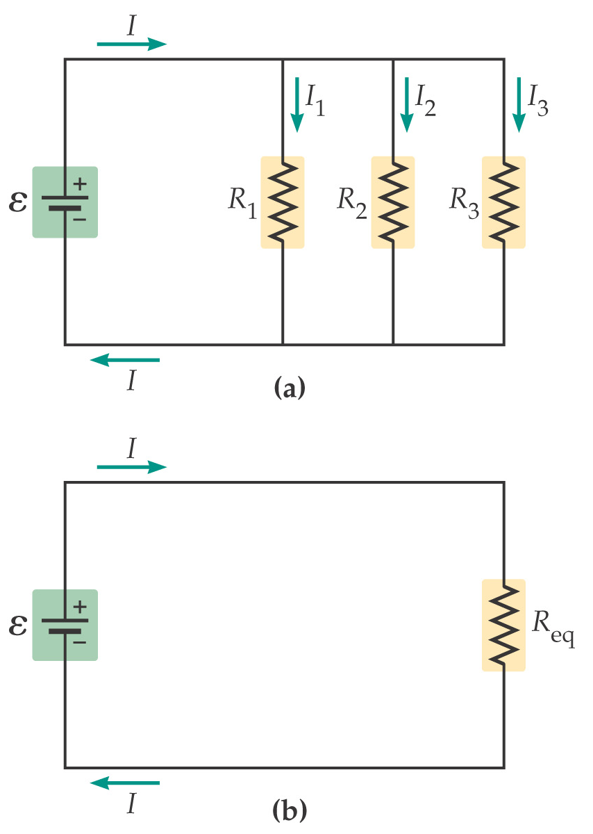
Resistors in Series and Parallel
Resistors are in parallel when they are across the same potential difference; they can again be replaced by a single equivalent resistance:

Slide 73
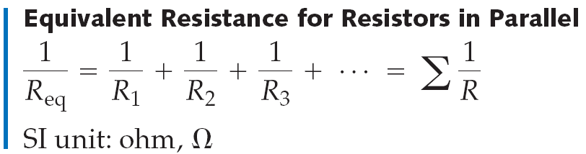
Resistors in Series and Parallel
Using the fact that the potential difference across each resistor is the same, and the total current is the sum of the currents in each resistor, we find:
Note that this equation gives you the inverse of the resistance, not the resistance itself!

Slide 74
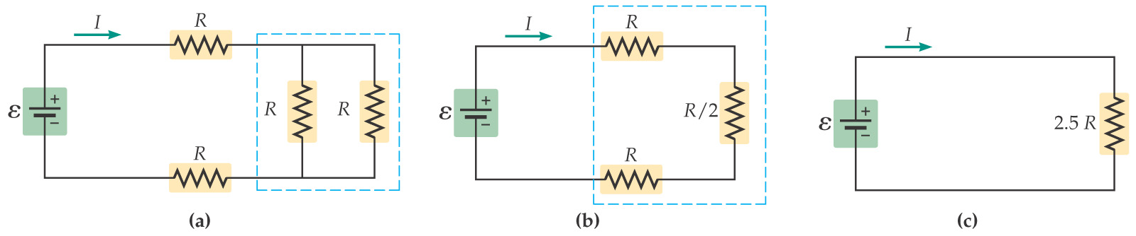
Resistors in Series and Parallel
If a circuit is more complex, start with combinations of resistors that are either purely in series or in parallel. Replace these with their equivalent resistances; as you go on you will be able to replace more and more of them.

Slide 75
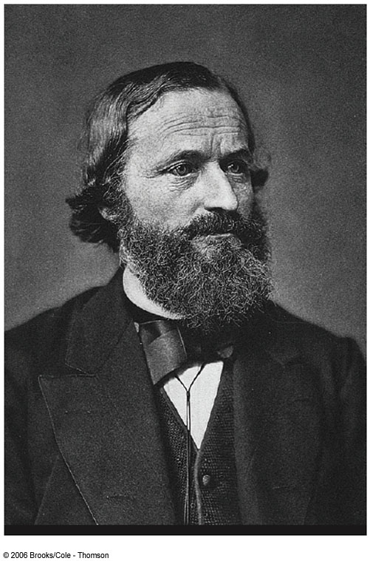
Gustav Kirchhoff
1824 – 1887
Invented spectroscopy with Robert Bunsen
Formulated rules about radiation

Slide 76
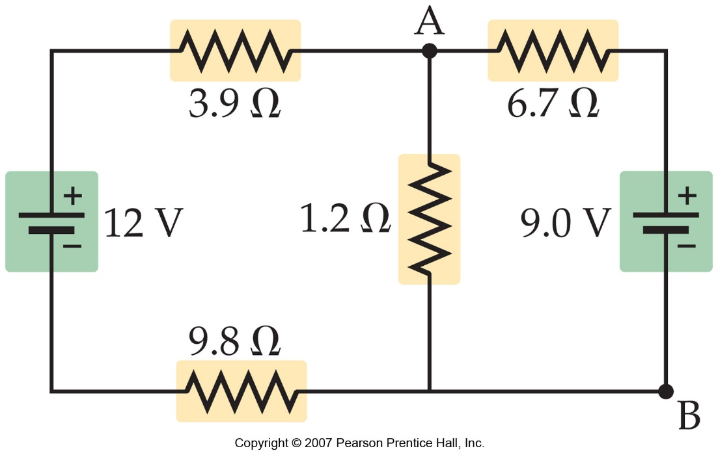
Kirchhoff’s Rules
More complex circuits cannot be broken down into series and parallel pieces.
For these circuits, Kirchhoff’s rules are useful.
The junction rule is a consequence of charge conservation; the loop rule is a consequence of energy conservation.

Slide 77
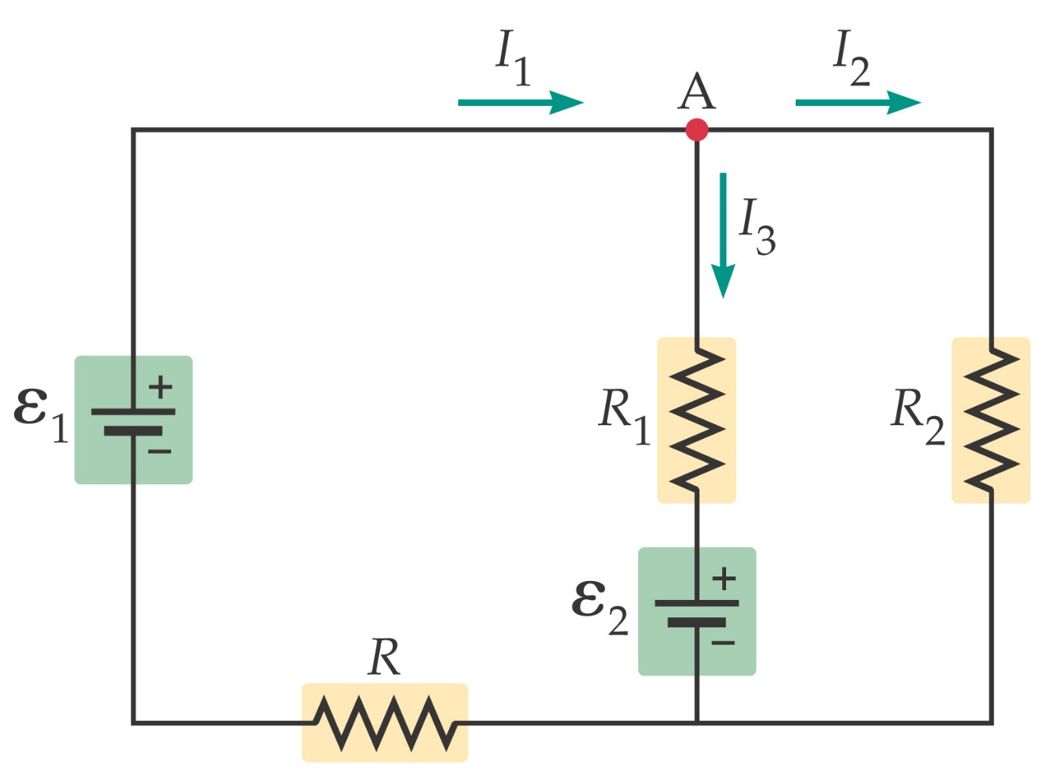

Kirchhoff’s Rules
The junction rule: At any junction, the current entering the junction must equal the current leaving it.

Slide 78


Kirchhoff’s Rules
The loop rule: The algebraic sum of the potential differences around a closed loop must be zero (it must return to its original value at the original point).

Slide 79
Kirchhoff’s Rules
Using Kirchhoff’s rules:
The variables for which you are solving are the currents through the resistors.
You need as many independent equations as you have variables to solve for.
You will need both loop and junction rules.

Slide 80

Circuits Containing Capacitors
Capacitors can also be connected in series or in parallel.
When capacitors are connected in parallel, the potential difference across each one is the same.

Slide 81

Circuits Containing Capacitors
Therefore, the equivalent capacitance is the sum of the individual capacitances:

Slide 82

Circuits Containing Capacitors
Capacitors connected in series do not have the same potential difference across them, but they do all carry the same charge. The total potential difference is the sum of the potential differences across each one.

Slide 83
Circuits Containing Capacitors
Therefore, the equivalent capacitance is
Note that this equation gives you the inverse of the capacitance, not the capacitance itself!
Capacitors in series combine like resistors in parallel, and vice versa.

Slide 84

2RC Circuits
In a circuit containing only batteries and capacitors, charge appears almost instantaneously on the capacitors when the circuit is connected. However, if the circuit contains resistors as well, this is not the case.

Slide 85
RC Circuits
Using calculus, it can be shown that the charge on the capacitor increases as:
Here, τ is the time constant of the circuit:
And is the final charge on the capacitor, Q.

Slide 86

RC Circuits
Here is the charge vs. time for an RC circuit:

Slide 87

RC Circuits
It can be shown that the current in the circuit has a related behavior:

Slide 88

Ammeters and Voltmeters
A voltmeter measures the potential drop between two points in a circuit. It therefore is connected in parallel; in order to minimize the effect on the circuit, it should have as large a resistance as possible.

Slide 89

Summary
Ohm’s law:
Relation of resistance to resistivity:
Resistivity generally increases with temperature.
The resistance of a superconductor drops suddenly to zero at the critical temperature, T_{C}.

Slide 90
Summary
Power in an electric circuit:
If the material obeys Ohm’s law,
Energy equivalent of one kilowatt-hour:
Equivalent resistance for resistors in series:

Slide 91

Summary
Inverse of the equivalent resistance of resistors in series:
Junction rule: All current that enters a junction must also leave it.
Loop rule: The algebraic sum of all potential charges around a closed loop must be zero.

Slide 92

Summary
Equivalent capacitance of capacitors connected in parallel:
Inverse of the equivalent capacitance of capacitors connected in series:

Slide 93

Summary
Charging a capacitor:
Discharging a capacitor:

Slide 94

Summary
Ammeter: measures current. Is connected in series. Resistance should be as small as possible.
Voltmeter: measures voltage. Is connected in parallel. Resistance should be as large as possible.

Slide 95
Ways to Wire Circuits
There are 2 basic ways to wire a circuit. Keep in mind that a resistor could be ANYTHING ( bulb, toaster, ceramic material…etc)
Series – One after another
Parallel – between a set of junctions and parallel to each other

Slide 96


Schematic Diagrams
A schematic diagram uses symbols to show electrical circuits and wiring.

Slide 97


Schematic Symbols
Before you begin to understand circuits you need to be able to draw what they look like using a set of standard symbols understood anywhere in the world
For the battery symbol, the LONG line is considered to be the POSITIVE terminal and the SHORT line , NEGATIVE.
The VOLTMETER and AMMETER are special devices you place IN or AROUND the circuit to measure the VOLTAGE and CURRENT.

Slide 98


The Voltmeter and Ammeter
The voltmeter and ammeter cannot be just placed anywhere in the circuit. They must be used according to their DEFINITION.
Current goes THROUGH the ammeter
Since a voltmeter measures voltage or POTENTIAL DIFFERENCE it must be placed ACROSS the device you want to measure. That way you can measure the CHANGE on either side of the device.
Voltmeter is drawn ACROSS the resistor
Since the ammeter measures the current or FLOW it must be placed in such a way as the charges go THROUGH the device.

Slide 99


Simple Circuit
When you are drawing a circuit it may be a wise thing to start by drawing the battery first, then follow along the loop (closed) starting with positive and drawing what you see.

Slide 100


Series Circuit
A series circuit is one which has only 1 pathway for electricity to flow. All devices are located along this single pathway, and any break in the circuit will stop the flow of electricity.
Ex.: old type Christmas tree lights

Slide 101
Series Circuit

Slide 102

Series Circuit
In in series circuit, the resistors are wired one after another. Since they are all part of the SAME LOOP they each experience the SAME AMOUNT of current. In figure, however, you see that they all exist BETWEEN the terminals of the battery, meaning they SHARE the potential (voltage).

Slide 103

Series Circuit
As the current goes through the circuit, the charges must USE ENERGY to get through the resistor. So each individual resistor will get its own individual potential voltage). We call this VOLTAGE DROP.
Note: They may use the terms “effective” or “equivalent” to mean TOTAL!

Slide 104

Example
A series circuit is shown to the left.
What is the total resistance?
What is the total current?
What is the current across EACH resistor?
What is the voltage drop across each resistor?( Apply Ohm's law to each resistor separately)
R(series) = 1 + 2 + 3 = 6Ω
ΔV=IR 12=I(6) I = 2A
They EACH get 2 amps!
V_{1Ω}=(2)(1)= 2 V V_{3Ω}=(2)(3)= 6V V_{2Ω}=(2)(2)= 4V
Notice that the individual VOLTAGE DROPS add up to the TOTAL!!

Slide 105


Parallel Circuits
A parallel circuit has multiple paths which the electricity can travel down, with different devices along the different paths.
If one pathway is open or broken, the others can still carry electricity.
Ex.: newer Christmas tree lights, household circuits

Slide 106


Parallel Circuit
In a parallel circuit, we have multiple loops. So the current splits up among the loops with the individual loop currents adding to the total current
It is important to understand that parallel circuits will all have some position where the current splits and comes back together. We call these JUNCTIONS.
The current going IN to a junction will always equal the current going OUT of a junction.
Junctions

Slide 107
Parallel Circuit
Notice that the JUNCTIONS both touch the POSTIVE and NEGATIVE terminals of the battery. That means you have the SAME potential difference down EACH individual branch of the parallel circuit. This means that the individual voltages drops are equal.
ΔV
This junction touches the POSITIVE terminal
This junction touches the NEGATIVE terminal

Slide 108
Parallel Circuit

Slide 109

Example
To the left is an example of a parallel circuit.
a) What is the total resistance?
b) What is the total current?
c) What is the voltage across EACH resistor?
d) What is the current drop across each resistor? (Apply Ohm's law to each resistor separately)
2.20 Ω
3.64 A
8 V each!
Notice that the individual currents ADD to the total.
1.6 A
1.14 A
0.90 A

Slide 110



Compound (Complex) Circuits
Many times you will have series and parallel in the SAME circuit.
Solve this type of circuit from the inside out.
WHAT IS THE TOTAL RESISTANCE?

Slide 111
Compound (Complex) Circuits
Suppose the potential difference (voltage) is equal to 120V. What is the total current?
1.06 A
What is the VOLTAGE DROP across the 80Ω resistor?
84.8 V

Slide 112

Compound (Complex) Circuits
What is the current across the 100Ω and 50Ω resistor?
What is the VOLTAGE DROP across the 100Ω and 50Ω resistor?
0.352 A
Add to 1.06A
35.2 V Each!
0.704 A

Slide 113


Slide 114





Slide 115

Switch 1
Switch 2
Lamp 1
Lamp 2

Slide 116

A circuit breaker is a device which prevents too much electricity from flowing through a circuit. Breakers can be reset usually with the flip of a switch.

Slide 117


Fuses do the same thing as a breaker, but they use a small wire connector which will burn out if the flow of electricity is too high. Fuses usually have to be replaced after they burn out. Fuses are often found in electric appliances also.

Slide 118



A Capacitor holds a charge on its plates.

Slide 119


Thermocouple: changes heat energy into electrical energy. 2 Types:
1. Dry Cell – the electrolyte is not really dry; but is a paste
  Standard AA, C, D type batteries, electrolyte is a paste. The “+” terminal is zinc

Slide 120




2. Wet cell
Wet Cell – the electrolyte is a liquid (car battery)
  In a car battery, Electrolyte is sulfuric acid the “+” terminal is lead oxide and the “-“ terminal is lead metal

Slide 121

X-Men: Storm

Slide 122
Storm
where does storm get her energy needed to perform her superhuman feat
In the X-men movies, the mutant Storm is able to generate a bolt of lightning at will.
The energy released in a normal lightning bolt is about 500 million joules, which is equivalent to 120,000 food calories.
To produce even a single lightning bolt, Storm would have to eat at least 60 times the recommended daily amount for an adult female

