Slide 1
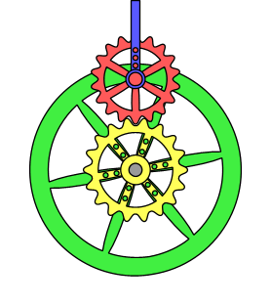

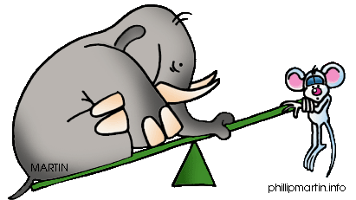
Physics Unit 5: Conservation of Energy and Momentum
Work & Machines

Slide 2
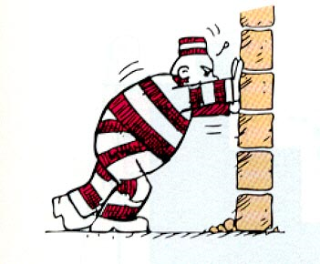
What is Work?
Work is force exerted on an object that causes the object to move some distance
Force without moving a distance yields NO WORK!!
Work = Force x Distance
SI Unit for work is the Joule
1 Joule = 1Newton x 1 Meter

Slide 3
2 Conditions must be met in order for work to be done:
1. Magnitude of the force in the direction of displacement
2. Force must make an object move in the same direction as the force ( displacement of the object)
Work does not involve time
Work only involves an applied force and movement of an object in the direction of the force

Slide 4
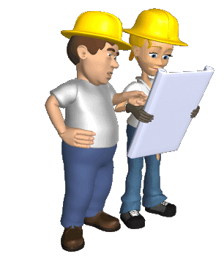
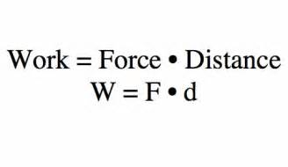
Measuring work:
Work is measured in Newton-meters (N-m)
1N-m = 1 joule = 1 unit of work
The force that is applied to do work is called effort force
The force that resists motion is called resistance force

Slide 5

How much work performed:
How much work is performed if you apply 85 newtons of force on a box causing it to move 3 meters:
    W = F x D
    W = 85N x 3m = 255 Nm
    255 J = 255 Nm
How much work is performed if you apply 37 newtons of force and move a wagon 4.3 meters?
    W = F x D
    W = 37N x 4.3m = 159.1 Nm
    159.1 J = 159.1 Nm
How much work is performed if you apply 118 newtons of force on a car that is stuck in the mud and doesn’t move?:
    W = F x D
    W = 118N x 0m = 0 Nm
    0J =0Nm You might be tired from pushing but no work was done!!

Slide 6

How much force required:
How much force was required to move an object 3 meters if 75 Joules of work were expended?
  Formula: Work = Force x Distance
  Need to solve for Force, w= 75 J & D=3M
  75 J = F x 3M
  75 NM / 3M = F
  75 NM / 3M = F
  25N = F

Slide 7

Work Physics definition
The work done by the applied force FA is equal to the product of F, the component of FA in the direction of the displacement, and d which is the distance through which the mass moves
W = FA cos θ
W= FA Δd cos θ

Slide 8
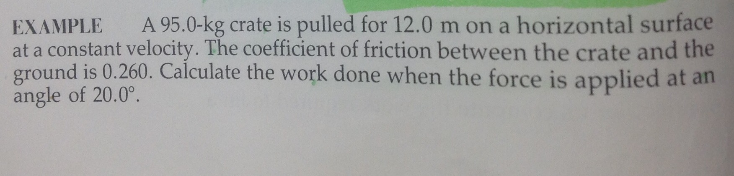
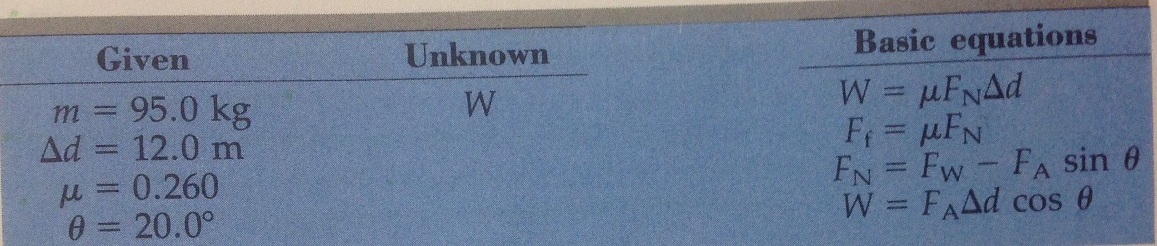

Slide 9

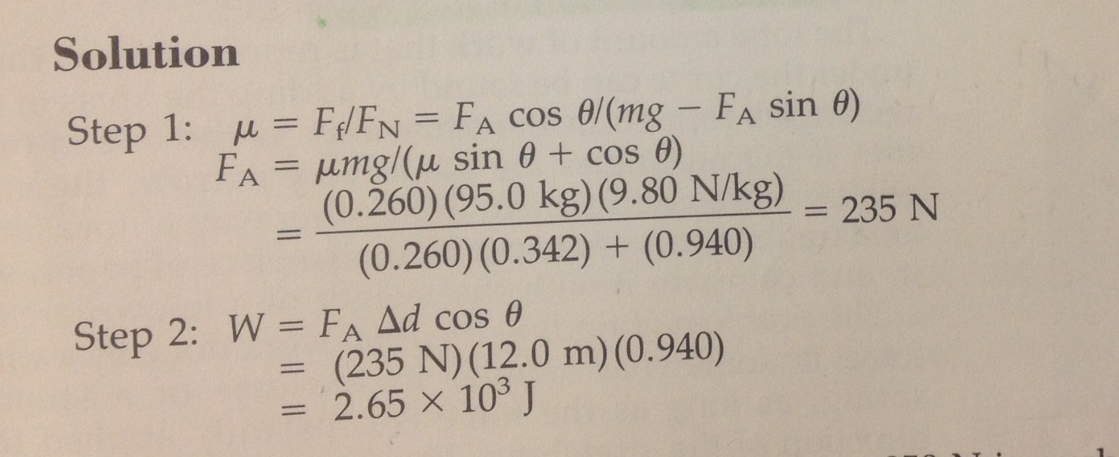
Solution

Slide 10
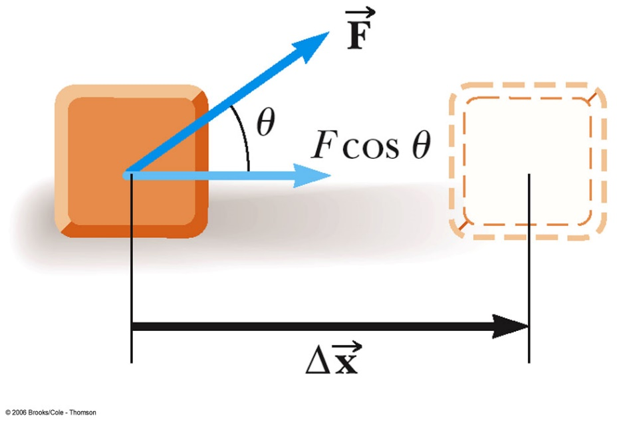
Work, cont.
  F is the magnitude of the force
  Δ x is the magnitude of the object’s displacement
  θ is the angle between

Slide 11

Work Cont. Units of Work
This gives no information about
  the time it took for the displacement to occur
  the velocity or acceleration of the object
Work is a scalar quantity
SI
  Newton • meter = Joule
    N • m = J
    J = kg • m² / s²
US Customary
  foot • pound
    ft • lb

Slide 12
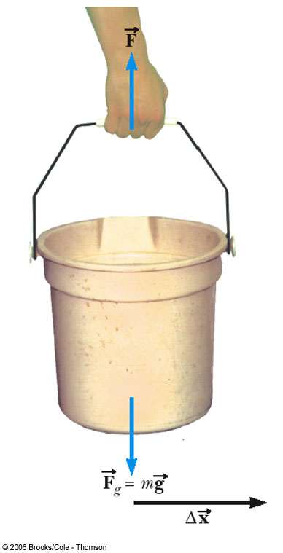
More About Work
The work done by a force is zero when the force is perpendicular to the displacement
  cos 90° = 0
If there are multiple forces acting on an object, the total work done is the algebraic sum of the amount of work done by each force

Slide 13
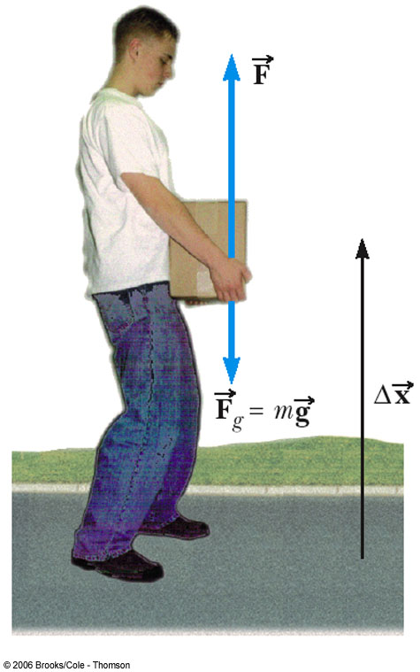
Work Can Be Positive or Negative
Positive if the force and the displacement are in the same direction
Work is positive when lifting the box
Negative if the force and the displacement are in the opposite direction
Work would be negative if lowering the box
  The force would still be upward, but the displacement would be downward

Slide 14
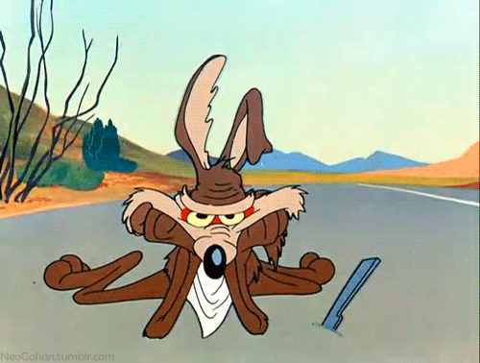
When Work is Zero
Displacement is horizontal
Force is vertical
cos 90° = 0

Slide 15
Work and Dissipative Forces
Work can be done by friction
The energy lost to friction by an object goes into heating both the object and its environment
  Some energy may be converted into sound
For now, the phrase “Work done by friction” will denote the effect of the friction processes on mechanical energy alone

Slide 16
The Work Energy Theorem
Up to this point we have learned Kinematics and Newton's Laws. Let 's see what happens when we apply BOTH to our new formula for WORK!
We will start by applying Newton's second law!
Using Kinematic #3!
An interesting term appears called KINETIC ENERGY or the ENERGY OF MOTION!

Slide 17
The Work Energy Theorem
And so what we really have is called the WORK-ENERGY THEOREM. It basically means that if we impart work to an object it will undergo a CHANGE in speed and thus a change in KINETIC ENERGY. Since both WORK and KINETIC ENERGY are expressed in JOULES, they are EQUIVALENT TERMS!
" The net WORK done on an object is equal to the change in kinetic energy of the object."

Slide 18
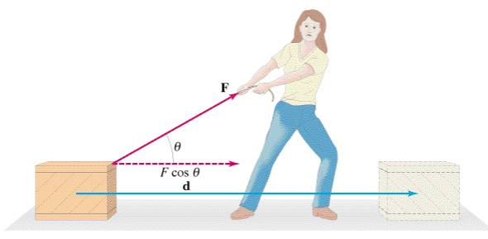
Example
Suppose the woman in the figure above applies a 50 N force to a 25-kg box at an angle of 30 degrees above the horizontal. She manages to pull the box 5 meters.
Calculate the WORK done by the woman on the box
The speed of the box after 5 meters if the box started from rest.
4.16 m/s
216.5 J

Slide 19
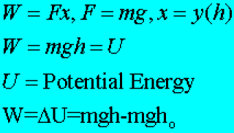
Lifting mass at a constant speed
Suppose you lift a mass upward at a constant speed, Δv = 0 & ΔK=0. What does the work equal now?
Since you are lifting at a constant speed, your APPLIED FORCE equals the WEIGHT of the object you are lifting.
Since you are lifting you are raising the object a certain “y” displacement or height above the ground.
When you lift an object above the ground it is said to have POTENTIAL ENERGY

Slide 20

Work in Rotary Motion
Rotary motion, also referred to as rotational motion or circular motion, is physical motion that happens when an object rotates or spins on an axis. This type of motion is analyzed in much the same way as linear motion.
Use the principles of radian measure to compute work done in rotary motion
W= Fr Δ θ or W= T Δ θ T = Fr

Slide 21
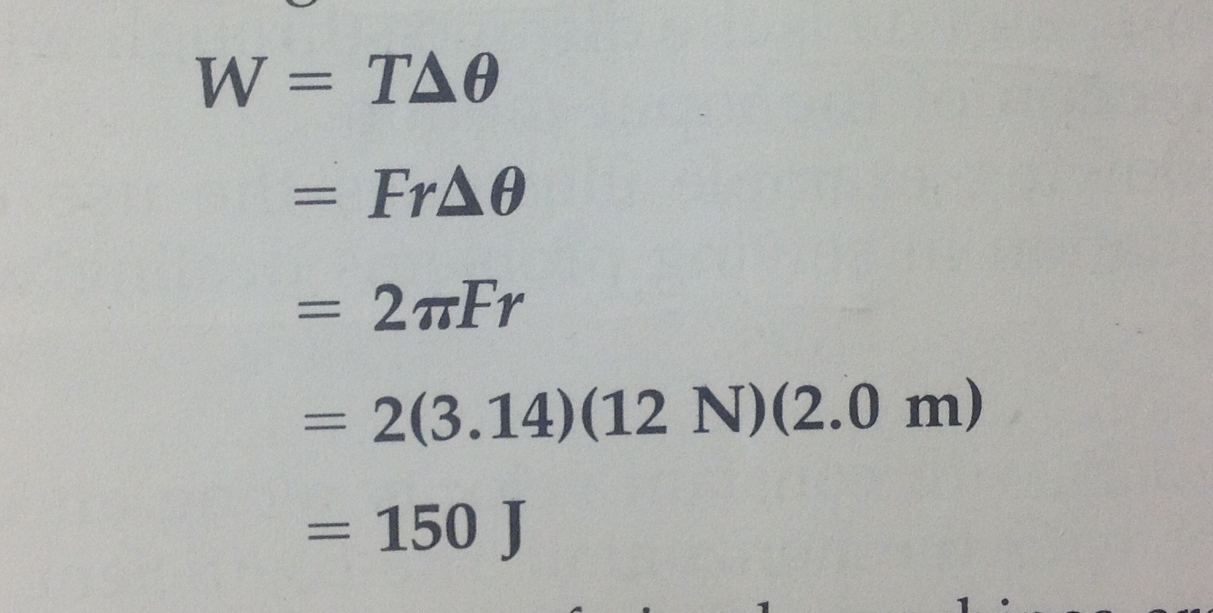
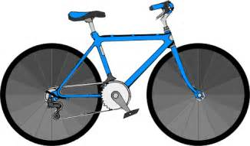
The radius of a wheel is 2m and a force of 12N is applied tangentially to it. The work done in a single revolution is?

Slide 22
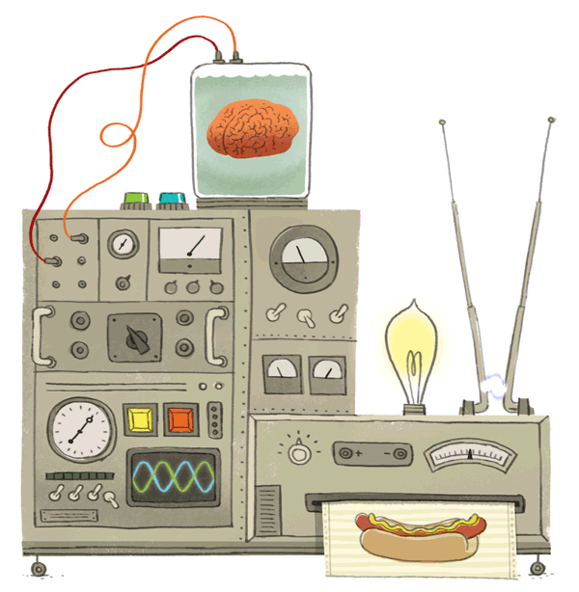
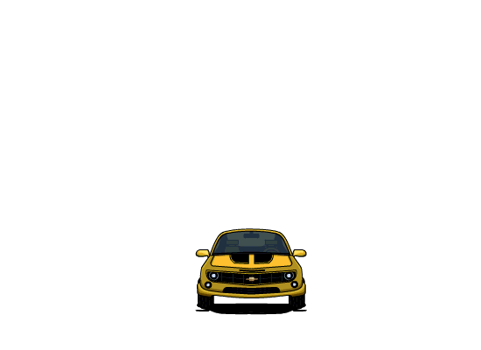
Machines
Machine
  device that makes work easier
  changes the size and/or direction of the exerted force

Slide 23
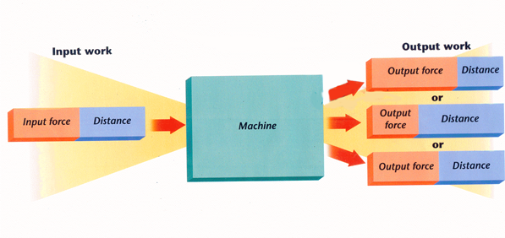

Slide 24
When a machine is used, 2 forces are always involved:
Effort Force (F_{e})
  force applied to the machine
  “what you do”
Resistance Force (F_{r})
  force applied by the machine
  “what the machine does”

Slide 25
Force
Effort Force
F_{E}
Resistance Force
F_{R}

Slide 26
Work
Work Input (W_{in})
  work done on a machine
W_{in} = F_{e} × d_{e}
Work Output (W_{out})
  work done by a machine
W_{out} = F_{r} × d_{r}

Slide 27
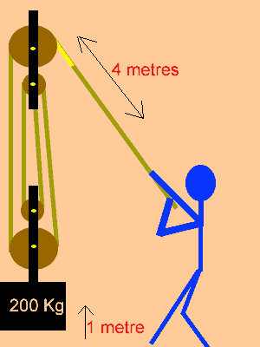
Work
While machines make work easier, they do not multiply work, they only multiply force.
So work output can never be greater than work input

Slide 28
Work
Conservation of Energy
  can never get more work out than you put in
  trade-off between force and distance
W_{in} = W_{out}
F_{e} × d_{e} = F_{r} × d_{r}

Slide 29
Efficiency
Efficiency
  measure of how completely work input is converted to work output
  always less than 100% due to friction

Slide 30
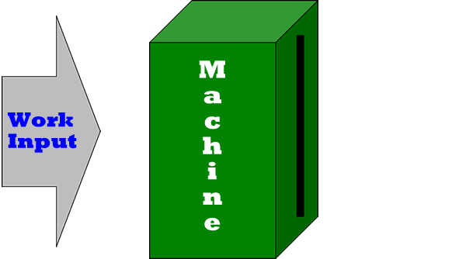
Efficiency
The efficiency of a machine can never be greater than 100% because work output can never be greater than work input

Slide 31
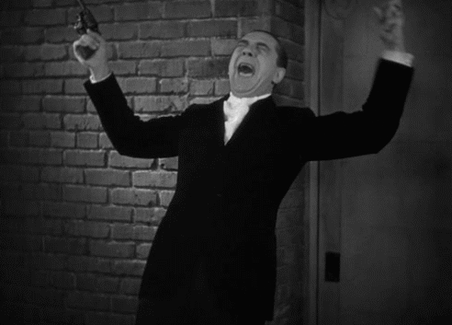
Efficiency
If a machine has a high efficiency, it means that much Work input has changed to work output
If there is a low efficiency, It means that much work input is lost

Slide 32

Efficiency
A worker exerts a force of 500 N to push a 1500 N sofa 4.0 m along a ramp that is 1.0 m high. What is the ramp’s efficiency?
:Work
W_{in} = (500N)(4.0m) = 2000 J
W_{out} = (1500N)(1.0m) = 1500 J
E = 1500 J × 100%
2000 J
E = 75%
GIVEN:
Fe = 500 N
de = 4.0 m
Fr = 1500 N
dr = 1.0 m
500N
4.0m
1.0m
1500N

Slide 33
Work
In an ideal machine...
W_{in} = W_{out}
But in the real world…
  some energy is lost as friction
W_{in} > W_{out}

Slide 34
Mechanical Advantage
Mechanical Advantage (MA)
  number of times a machine increases the effort force
MA > 1 : force is increased
MA < 1 : distance is increased
MA = 1 : only direction is changed

Slide 35
Mechanical Advantage
A worker applies an effort force of 20 N to open a window with a resistance force of 500 N. What is the crowbar’s MA?
GIVEN:
F_{e} = 20 N
F_{r} = 500 N
MA = ?
WORK:
MA = F_{r} ÷ F_{e}
MA = (500 N) ÷ (20 N)
MA = 25
F_{r}
MA
F_{e}

Slide 36
Mechanical Advantage
Find the effort force needed to lift a 2000 N rock using a jack with a mechanical advantage of 10.
GIVEN:
F_{e} = ?
F_{r} = 2000 N
MA = 10
WORK:
F_{e} = F_{r} ÷ MA
F_{e} = (2000 N) ÷ (10)
F_{e} = 200 N
F_{r}
MA
F_{e}

Slide 37

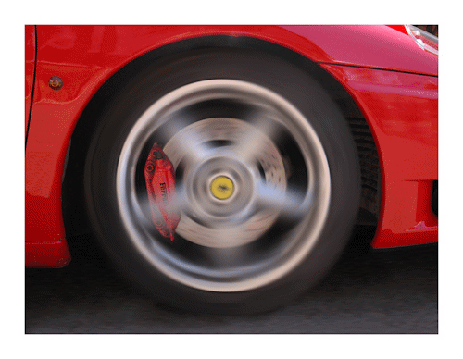
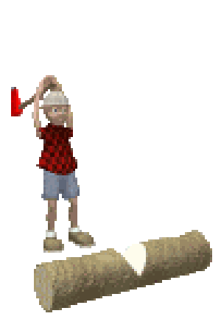
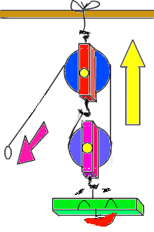
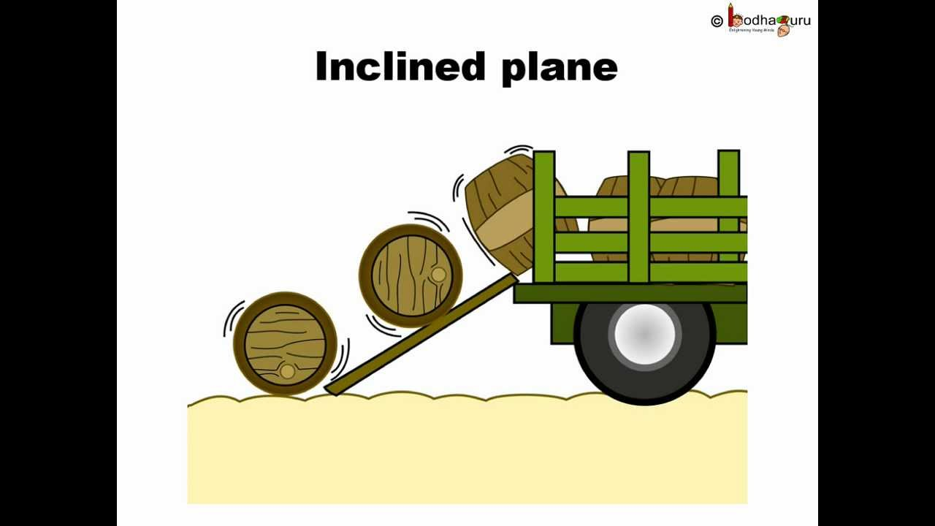
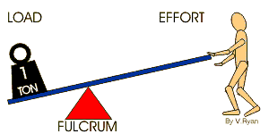
M.A.
A machine’s mechanical advantage is the number of times a force exerted on a machine is multiplied.
Ideal Mechanical Advantage has no units ( they cancel each other out when doing the math problem
IMA = output force / input force

Slide 38
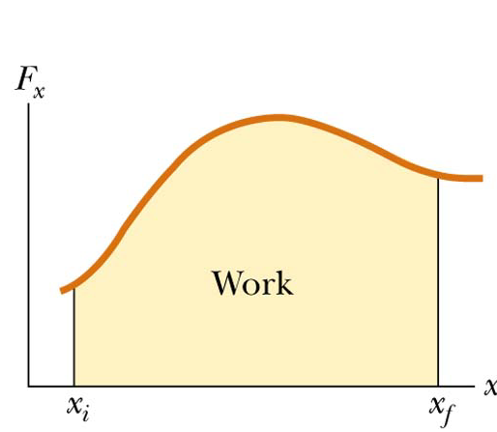
Work Done by Varying Forces
The work done by a variable force acting on an object that undergoes a displacement is equal to the area under the graph of F versus x

Slide 39
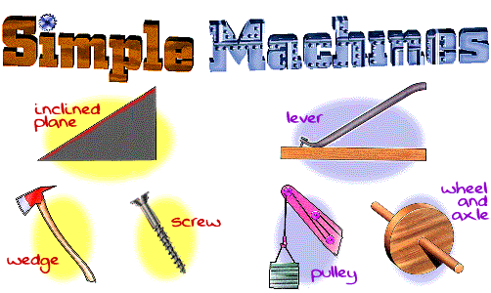
Simple Machines: 6 types

Slide 40
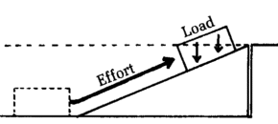
D. Inclined Plane
The M.A. of an inclined plane is the length divided by the height
Because the length of the plane can never be shorter than its height, the M.A. of an inclined plane can never be less than one
h
l

Slide 41


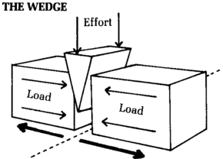
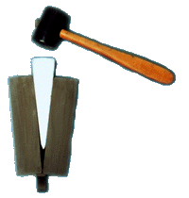
Wedge
Wedge
  a moving inclined plane with 1 or 2 sloping sides
The longer and thinner the wedge, the less F_{E}
Required to overcome the F_{R}

Slide 42
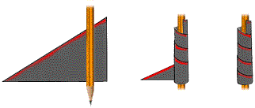
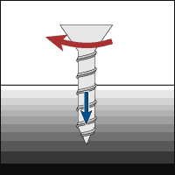
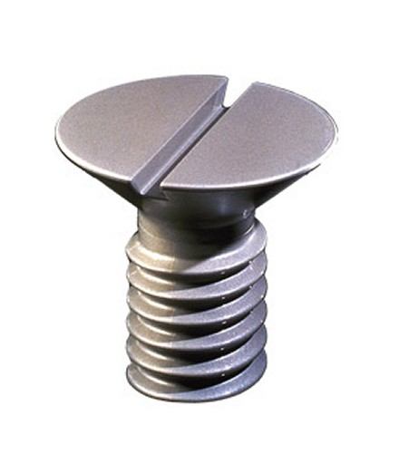
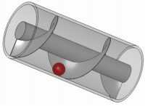
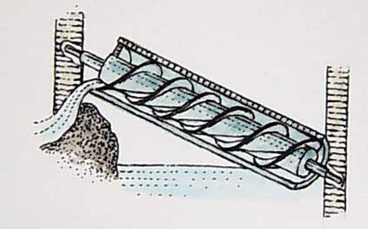
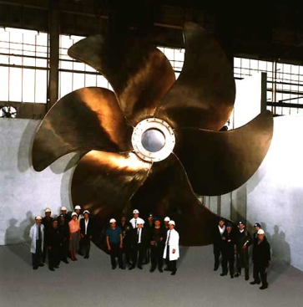

Screw
an inclined plane wrapped around a cylinder
A screw can convert a rotational force (torque) to a linear force and vice versa.

Slide 43


Screw
Screw
  inclined plane wrapped in a spiral around a cylinder
  It multiplies an F_{E} by acting thru a long effort distance
The closer the threads, the greater the M.A.

Slide 44
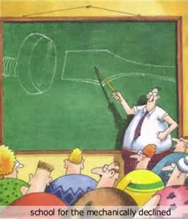

Slide 45

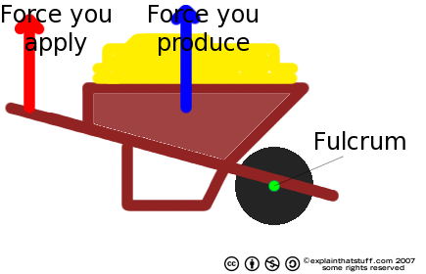
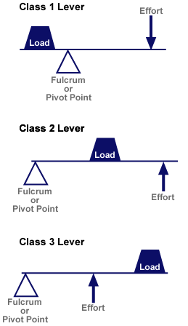
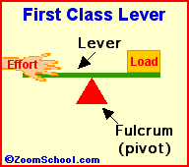
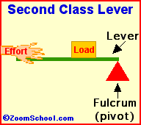
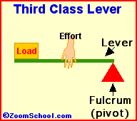
Lever
Any tool that pries something loose is a lever.

Slide 46
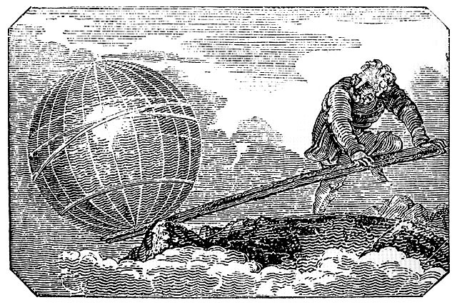
A. Lever
Lever
  a bar that is free to pivot about a fixed point, or fulcrum
Resistance
arm
Effort arm
Fulcrum
Engraving from Mechanics Magazine, London, 1824
“Give me a place to stand and I will move the Earth.”
– Archimedes

Slide 47
A. Lever
Ideal Mechanical Advantage (IMA)
  frictionless machine
Effort arm length
Resistance
arm length
  L_{e} must be greater than L_{r} in order to multiply the force.

Slide 48

Problems
You use a 160 cm plank to lift a large rock. If the rock is 20 cm from the fulcrum, what is the plank’s IMA?
GIVEN:
L_{r} = 20 cm
L_{e} = 140 cm
IMA = ?
WORK:
IMA = L_{e} ÷ L_{r}
IMA = (140 cm) ÷ (20 cm)
IMA = 7
L_{e}
20cm
L_{r}
160cm
IMA

Slide 49
Problems
You need to lift a 150 N box using only 15 N of force. How long does the lever need to be if the resistance arm is 0.3m?
GIVEN:
F_{r} = 150 N
F_{e} = 15 N
L_{r} = 0.3 m
L_{e} = ?
MA = 10
WORK:
L_{e} = IMA · L_{r}
L_{e} = (10)(0.3)
L_{e} = 3 m
Total length = L_{e} + L_{r}
Total length = 3.3 m
0.3m
15N
?
150N
L_{e}
IMA
L_{r}

Slide 50
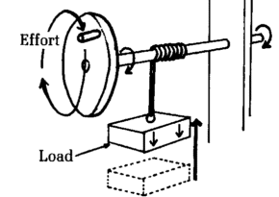
C. Wheel and Axle
Ideal Mechanical Advantage (IMA)
  effort force is usu. applied to wheel
  axle moves less
  distance but with
  greater force
effort radius
Wheel radius
resistance radius
Axle radius

Slide 51
Problems
A crank on a pasta maker has a radius of 20 cm. The turning shaft has a radius of 5 cm. What is the IMA of this wheel and axle?
GIVEN:
r_{e} = 20 cm
r_{r} = 5 cm
IMA = ?
WORK:
IMA = r_{e} ÷ r_{r}
IMA = (20 cm) ÷ (5 cm)
IMA = 4
r_{e}
5 cm
20 cm
IMA
r_{r}

Slide 52
Problems
A steering wheel requires a mechanical advantage of 6. What radius does the wheel need to have if the steering column has a radius of 4 cm?
GIVEN:
IMA = 6
r_{e} = ?
r_{r} = 4 cm
WORK:
r_{e} = IMA · r_{r}
r_{e} = (6)(4 cm)
r_{e} = 24 cm
r_{e}
r_{e}
r_{r}
IMA
r_{r}

Slide 53
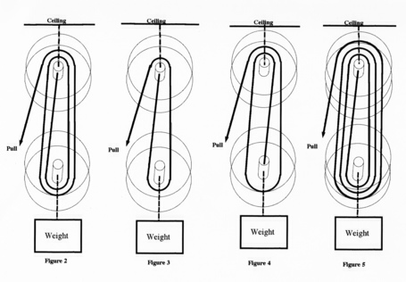
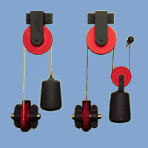
Pulley
In a pulley, a cord wraps around a wheel.
As the wheel rotates, the cord moves in either direction. Now, attach a hook to the cord, and you can use the wheel's rotation to raise and lower objects.
IMA of a pulley system = the number of ropes that support the weight of the object

Slide 54
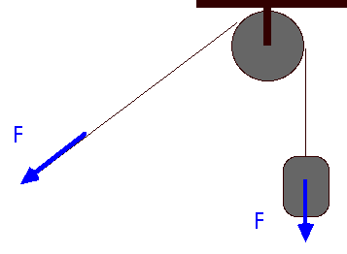
Pulley
Pulley
  grooved wheel with a rope or chain running along the groove
  a “flexible first-class lever”
F
L_{e}
L_{r}

Slide 55
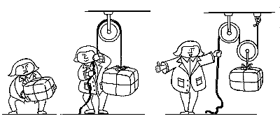
Pulley
Ideal Mechanical Advantage (IMA)
  equal to the number of supporting ropes
IMA = 0
IMA = 1
IMA = 2

Slide 56

Fixed Pulley: a pulley attached to a wall
Fixed Pulley
  IMA = 1
  does not increase force
  changes direction of force

Slide 57

Movable Pulley: Is hung on a rope so it moves with effort force
Movable Pulley
  IMA = 2
  increases force
  doesn’t change direction

Slide 58

Pulley
Block & Tackle
  combination of fixed & movable pulleys
  increases force (IMA = 4)
  may or may not change direction

Slide 59



A. Compound Machines
Compound Machine
  combination of 2 or more simple machines

Slide 60

Actually all 6 machines are variations of 2 basic types:
1. Lever: ex the pulley and wheel and axle are forms of lever
2. Inclined Planes: ex the wedge and screw are modifications of incline planes

Slide 61
Efficiency
Although a machine can be used to multiply force, it cannot multiply work.
Physics formula for Efficiency
Efficiency = Fw Δh
FA Δd
Fw = weight of object
Δh = height through which it is lifted
Δd = distance FA acts

Slide 62

A crate is pulled 2m with constant velocity along an incline that makes an angle of 15 degrees with the horizontal. The coefficient of friction between the crate and the plane is 0.160 Calculate the efficiency that is achieved in this procedure

Slide 63

Solution

Slide 64

Power
Power
  rate at which work is done
  measured in watts (W)
P: power (W)
W: work (J)
t: time (s)

Slide 65


Power
Power depends on 3 factors:
Displacement of object
Force in the direction of the displacement
Time required
Time is involved
Power is measured in watts (w)
Unit of power is N-m per second or joule per second (watt)
1000watts =I kilowatt
750 watts = I horsepower

Slide 66

Horse Power = 746 watts

Slide 67




Power
P= F Δd
Δt

Slide 68

Example

Slide 69
Power in Rotary Motion
By using radian measure, we can compute the power involved in rotary motion the same way we calculated the work done in rotary motion
P= T Δ θ so P = Tw
Δ t w = angular velocity
The power required to maintain rotary motion against an opposing torque is the product of the torque maintaining and the constant angular velocity

Slide 70

& Energy

Slide 71


Energy
– the ability to do work or cause a change.
  work is the transfer of energy
  SI unit for energy is the same as the SI unit for work – Joule

Slide 72
Wherever you are sitting as you read this, changes are taking place—lightbulbs are heating the air around them, the wind might be rustling leaves, or sunlight might be glaring off a nearby window.
Every change that occurs—large or small—involves energy.

Slide 73

Different Forms of Energy
Energy has several different forms.
Is the chemical energy stored in food the same as the energy that comes from the Sun or the energy stored in gasoline?

Slide 74







Different Forms of Energy
6 different types:
  Mechanical
  Thermal Energy
  Chemical Energy
  Electrical Energy
  Electromagnetic Energy
  Nuclear Energy

Slide 75





Mechanical Energy
associated w/ the motion (kinetic) or position of an object (potential)
Kinetic Energy exists whenever an object which has mass is in motion with some velocity. Everything you see moving about has kinetic energy.
Potential Energy exists whenever an object which has mass has a position within a force field. The most everyday example of this is the position of objects in the earth's gravitational field.
GPE = Weight x Height

Slide 76

Two main types of energy: Kinetic and Gravitational Potential
  Kinetic Energy: the energy of motion
  Gravitational Potential Energy: Energy stored for use at a later time

Slide 77

Gravitational Potential Energy
The potential energy acquired by an object equals the work done against gravity or other forces to place it in position
EP= F Δd
Or
EP = mgΔh

Slide 78

Gravitational Potential Energy
Anything that can fall has stored energy called gravitational potential energy.
Gravitational potential energy (GPE) is energy stored by objects due to their position above Earth’s surface.
Gravitational potential energy can be calculated from the following equation.
On Earth the acceleration of gravity is 9.8 m/s², and has the symbol g.

Slide 79





Slide 80

Changing GPE
According to the equation for gravitational potential energy, the GPE of an by increasing its height above the ground.
If two objects are at the same height, then the object with the larger mass has more gravitational potential energy.

Slide 81
GPE
A 3kg crow is perched on a tree limb 20m above the ground. What is the crow’s GPE
GIVEN:
m = 3kg
h = 20m
g = 9.8 m/s²
GPE = ?
WORK:
GPE = (M)(g)(H)
GPE = 3x9.8x20
GPE = 588J

Slide 82

EX A 50 kg mass of steel is raised 5.om its gravitational potential energy would be?
EP = mgΔh
EP = 5okg x 9.8m/s ^{x 5.o m}
EP = 2.5 x 10³ J

Slide 83

Potential Energy:
Energy stored for use at a later time
2 Types:
  Elastic Potential Energy:
    Energy stored in springs, bow and arrow, stretched elastic or rubber bands.
    Associated w/ objects that can be stretched or compressed.
  Gravitational Potential Energy:
    Height and weight dependant (notice its weight, NOT mass!)
    GPE = work done to lift and object to a height
    GPE = Weight x Height (remember that weight = mass x 9.8 m/s2)
    GPE = mass x 9.8 m/s2 x Height
GPE = 100 N x 300 m = 30,000 Nm = 30,000 Joules

Slide 84

Potential Energy
Since this man is lifting the package upward at a CONSTANT SPEED, the kinetic energy is NOT CHANGING. Therefore the work that he does goes into what is called the ENERGY OF POSITION or POTENTIAL ENERGY.
All potential energy is considering to be energy that is STORED!
h
mg

Slide 85
Potential Energy
The man shown lifts a 10 kg package 2 meters above the ground. What is the potential energy given to the package by the man?
h
196 J

Slide 86
Suppose you throw a ball upward
What does work while it is flying through the air?
Is the CHANGE in kinetic energy POSITIVE or NEGATIVE?
Is the CHANGE in potential energy POSITIVE or NEGATIVE?
GRAVITY
NEGATIVE
POSITIVE

Slide 87

Elastic Potential Energy
If you stretch a rubber band and let it go, it sails across the room. It gains kinetic energy.
As it flies through the air, it has kinetic energy due to its motion.
Where did this kinetic energy come from?
The stretched rubber band had energy stored as elastic potential energy.
Elastic potential energy is energy stored by something that can stretch or compress, such as a rubber band or spring.

Slide 88

Kinetic Energy
Kinetic Energy (KE)
  energy in the form of motion
  depends on mass and velocity
  if you double the velocity, you increase KE by four
Which has the most KE?
80 km/h truck
Which has the least KE?
80 km/h
50 km/h motorcycle
50 km/h
80 km/h

Slide 89

Kinetic Energy (KE)
The SI unit of energy is the joule, abbreviated J.
If you dropped a softball from a height of about 0.5m, it would have a kinetic energy of about one joule before it hit the floor.

Slide 90
Kinetic Energy
A crow with a mass of 3kg starts to chase a hawk and flies at a velocity of 6m/s what is his Kinetic Energy
GIVEN:
m = 3kg
v = 6 m/s
KE = ?
WORK:
KE = 1/2mxv²
KE = ½ (3kg)(6m/s)²
KE = 54 J
KE
V2
½ M

Slide 91

Calculating Kinetic Energy
Kinetic Energy: the energy of motion
The amount of kinetic energy depends on the objects mass and velocity
Energy is transferred during work
  The more work one does on an object…
  The more energy one imparts on the object
When mass is doubled; Kinetic Energy is doubled
When velocity is doubled; Kinetic Energy is quadrupled!!

Slide 92






What’s the Kinetic Energy?
What is the Kinetic Energy (in Joules) of an object with a mass of 10 kg and a velocity of 10 m/s?
When mass is doubled; Kinetic Energy is doubled
When velocity is doubled; Kinetic Energy is quadrupled!!

Slide 93
Kinetic Energy in Rotary Motion
When only the net force and torque are considered in rotary motion equations, all of the work done to produce rotation appears as kinetic energy.
So the formula
EK = ½ Iw² I = rotating inertia
EK =1/2mv² + ½ Iw²

Slide 94


Slide 95
Elastic Potential energy
The potential energy in a stretched or compressed elastic object. Ex rubber band
Gravity is not involved in the measurement of elastic potential energy
Instead the work required to stretch or compress the object is dependent upon a property of the object known as force constant
Ex spring
The force constant does not change for a spedivid spring as long as the spring is not permanently distorted

Slide 96
Elastic Potential energy
F = k Δd k = force constant
Δd = distance the force is applied
Can be rewritten as a potential energy equation:
EP = 1/2k (Δd)²

Slide 97

Work and Kinetic Energy
An object’s kinetic energy can also be thought of as the amount of work the moving object could do in coming to rest
  The moving hammer has kinetic energy and can do work on the nail

Slide 98

Work and Gravitational Potential Energy
PE = mgy
Units of Potential Energy are the same as those of Work and Kinetic Energy

Slide 99


Energy Conversion and Conservation
Most forms of energy can be converted from one type to another.
One of the most common energy conversions involves changing potential energy to kinetic energy or vice versa

Slide 100


Energy Conversions

Slide 101


C. Conservation of Energy
PE ⇔ KE
View pendulum animation.
View roller coaster animation.

Slide 102

ENERGY IS CONSERVED
The law of conservation of mechanical energy states: Energy cannot be created or destroyed, only transformed!
Energy Before
Energy After
Am I moving? If yes,
K_{o}
Am I above the ground? If yes, U_{o}
Am I moving? If yes,
K
Am I above the ground? If yes, U

Slide 103

Conservation of Energy
Law of Conservation of Energy
  Energy may change forms, but it cannot be created or destroyed under ordinary conditions.
EX:
  PE → KE
  mechanical → thermal
  chemical → thermal

Slide 104

Conservation of Energy
A
B
C
.
D
In Figure A, a pendulum is released from rest at some height above the ground position.
It has only potential energy.
In Figure B, a pendulum is still above the ground position, yet it is also moving.
It has BOTH potential energy and kinetic energy.
In Figure C, a pendulum is at the ground position and moving with a maximum velocity.
In Figure D, the pendulum has reached the same height above the ground position as A.
It has only potential energy.

Slide 105

Example of Law of Conservation of energy

Slide 106


Law of the Conservation of Energy
Developed by Antoine Lavosier
states that energy cannot be created or destroyed. It simply changes from one form into another

Slide 107

Energy consistently changes forms

Slide 108

Energy consistently changes forms
Am I above the ground?
Am I moving?
NO, h = 0, U = 0 J
Yes, v = 8 m/s, m = 60 kg
Position | m | v | U | K | ME
1 | 60 kg | 8 m/s
(= U+K)
0 J
1920 J
1920 J

Slide 109

Energy consistently changes forms
Energy Before
= Energy After
K_{O}
= U + K
= (60)(9.8)(1) + (.5)(60)v²
1920= 588 + 30v²
= 30v²
44.4 = v²
v = 6.66 m/s
Position | m | v | U | K | ME
1 | 60 kg | 8 m/s | 0 J | 1920 J | 1920 J
2 | 60 kg
6.66 m/s
588 J
1332 J
1920 J

Slide 110

Energy consistently changes forms
Am I moving at the top?
No, v = 0 m/s
E_{B} = E_{A}
Using position 1
K_{o} = U
= mgh
1920 =(60)(9.8)h
h = 3.27 m
Position | m | v | U | K | ME
1 | 60 kg | 8 m/s | 0 J | 1920 J | 1920 J
2 | 60 kg | 6.66 m/s | 588 J | 1332 J | 1920 J
3 | 60 kg |  |  |  | 1920 J
0 m/s
1920 J
0 J

Slide 111
Conservative forces
Gravitational forces and elastic forces are called conservative forces because they conform to the law of conservation of mechanical energy
There are forces that produce deviations from the law of conservation of energy. Ex friction
These are called nonconservative or dissipative forces
The reason friction is a dissipative force is that it produces a form of energy (heat) that is not mechanical

Slide 112
Nonconservative Forces and Energy
In equation form:
The energy can either cross a boundary or the energy is transformed into a form of non-mechanical energy such as thermal energy

Slide 113

Momentum
All moving objects have momentum
Momentum is equal o the mass of an object multiplied by its velocity.
Momentum = mass x velocity
P = mv (p= momentum)
substituting Newton's 2nd law we get the equation:
F= m Δv
Δt

Slide 114
Momentum
An objects momentum depends on both its mass and velocity
Ex stopping distance of a car is directly related to its momentum ( how fast it is moving and the mass of the car)

Slide 115
Impulse
The product of a force and the time interval during which it acts, F Δt
Is called impulse
Impulse equals change in momentum
The equation tells us that when a force is applied to a body, the body’s rate of change of momentum is equal to the force
Since the equation is a vector equation, the body’s rate of change of momentum is in the direction of the force
F= m Δv
Δt

Slide 116



Slide 117

Impulse Applied to Auto Collisions
The most important factor is the collision time or the time it takes the person to come to a rest
  This will reduce the chance of dying in a car crash
Ways to increase the time
  Seat belts
  Air bags

Slide 118

Air Bags
The air bag increases the time of the collision
It will also absorb some of the energy from the body
It will spread out the area of contact
  decreases the pressure
  helps prevent penetration wounds

Slide 119

Conservation of Momentum:
  When two or more objects interact (collide) the total momentum before the collision is equal to the total momentum after the collision
Notes:
119

Slide 120

Conservation of Momentum:
When no net external forces are acting on a system of objects, the total vector momentum of a system remains constant

Slide 121

Law of conservation of momentum
The total momentum of any object or group of objects remains the same unless outside forces act on the object.

Slide 122

Momentum – 2 moving objects
During this collision the speed of both box cars changes. The total momentum remains constant before & after the collision. The masses of both cars is the same so the velocity of the red car is transferred to the blue car.
Notes:
122

Slide 123

Momentum – 1 moving object
During this collision the speed red car is transferred to the blue car. The total momentum remains constant before & after the collision. The masses of both cars is the same so the velocity of the red car is transferred to the blue car.
Notes:
123

Slide 124

Momentum – 2 connected objects
After this collision, the coupled cars make one object w/ a total mass of 60,000 kg. Since the momentum after the collision must equal the momentum before, the velocity must change. In this case the velocity is reduced from 10 m/sec. to 5 m/sec.
Notes:
124

Slide 125

Example problems: Momentum
A motorcycle has a mass of 250 kg and a velocity of 68 m/s, what is it’s momentum?
Solution:
Momentum = mass x velocity
250 kg x 68 m/s = 17000kg m/s

Slide 126

Example problems: Momentum
A 10-kg wagon has a speed of 25 m/s. What is its momentum?
Solution:
10 kg x 25 m/s = 250 kg m/s
Momentum = mass x velocity

Slide 127

Example problems: Momentum
A 10.0 kg dog chasing a rabbit north at 6.0 m/s has a momentum of?
Solution:
Momentum = mass x velocity
10kg x 6 m/s = 60 kgm/s

Slide 128

Example Problem Momentum
A large truck loaded with scrap steel weighs 14 metric tons and is traveling north on the interstate heading for Chicago. It has been averaging 48 hm/h for the journey and has traveled over 1450 km so far. It has just stopped to refuel. What is its current momentum?
Solution:
0 (zero) kg•m/s
Remember it is not moving

Slide 129
Conservation of Momentum,
Mathematically:
  Momentum is conserved for the system of objects
  The system includes all the objects interacting with each other
  Assumes only internal forces are acting during the collision
  Can be generalized to any number of objects

Slide 130
Types of Collisions
Momentum is conserved in any collision
Inelastic collisions ( objects stick together)
  Kinetic energy is not conserved
    Some of the kinetic energy is converted into other types of energy such as heat, sound, work to permanently deform an object
  Perfectly inelastic collisions occur when the objects stick together
    Not all of the KE is necessarily lost

Slide 131

More Types of Collisions
Elastic collision
  both momentum and kinetic energy are conserved
Actual collisions
  Most collisions fall between elastic and perfectly inelastic collisions

Slide 132

More About Perfectly Inelastic Collisions
When two objects stick together after the collision, they have undergone a perfectly inelastic collision
Conservation of momentum becomes

Slide 133

Some General Notes About Collisions
Momentum is a vector quantity
  Direction is important
  Be sure to have the correct signs

Slide 134
More About Elastic Collisions
Both momentum and kinetic energy are conserved
Typically have two unknowns
Solve the equations simultaneously

Slide 135
Elastic Collisions, cont.
A simpler equation can be used in place of the KE equation

Slide 136
Summary of Types of Collisions
In an elastic collision, both momentum and kinetic energy are conserved
In an inelastic collision, momentum is conserved but kinetic energy is not
In a perfectly inelastic collision, momentum is conserved, kinetic energy is not, and the two objects stick together after the collision, so their final velocities are the same

Slide 137

Example a 1.2 Kg cart that has an eastward velocity of 0.50 m/s collides head on in elastically with a 1.60 kg cart having a westward velocity of 0.70 m/s. Disregarding the slowing down effects of friction, calculate the new velocity (speed and direction) if two cart system

Slide 138

Solution

Slide 139


Example:
A ball moving eastward with a speed of 0.70 m/s hits a stationary ball of equal mass in an elastic collision. After the collision, the second ball moves away in a direction 30 degrees north of east. Calculate the speed of this ball

Slide 140

Solution:

Slide 141


Angular Momentum
Is unchanged unless a net external torque acts on it
This is due to the law of conservation of angular momentum

Slide 142

Angular momentum
If the distribution of mass of a rotating object is changed, its angular velocity changes so that the angular momentum remains constant
Ex skater spinning on the ice with arms folded turns wit constant angular velocity, If she extend her harms her rotational inertia increases
Since angular momentum is conserved, her angular velocity must increase

Slide 143
Angular Momentum Basic Equation
Where L is angular momentum, I is the moment of inertia, and omega is the angular velocity.
The angular velocity can be related to the linear velocity, v,
if you know the radius, r, from the center of rotation by using the
equation w = v/r.
However, the moment of inertia for any object is determined by three factors: its mass, its shape, and the axis of rotation.

Slide 144

Angular Momentum Example Problem
What is the angular momentum around the catcher of a baseball thrown at 40 m/s? The weight of the baseball is 145 grams and on a wild pitch the catcher has extended his arm 1.25 m from his center of rotation.
L = mrv = (.145 kg)(1.25 m)(40 m/s) = 7.25 kgm^2/s

Slide 145


Angular Momentum in the Real World
When quarterbacks throw the football, they impart a spin with their fingers, so that the ball spins rapidly as it flies through the air. Football fans call a good pass a tight spiral

Slide 146

Angular Momentum in the Real World
The pretty spiral pattern around the muzzle's exit hole are grooves cut into the barrel of a gun

Slide 147

Angular Momentum in the Real World
The Hubble Space Telescope floats freely in space.

Slide 148


Armageddon
KE = ½(3 x 10²⁰ kg) (460 m/s)²
KE = 3x 10²⁵ J

Slide 149
Armageddon
This is among cinema's worst physics offenders.
Let's try to tackle one of its most hilarious distortions of reality, the one at its core--that a nuclear warhead placed on an asteroid the size of Texas could successfully blow it apart, preventing a catastrophic collision with Earth.
Let's ignore the fact that asteroids don't have fault lines, and if they did, they would not be easily detectable.

Slide 150
Let's also put aside the fact that the prescribed 800-foot-deep hole in a Lone Star-size asteroid (Texas is 700 miles wide) would barely even scratch the surface only get you 0.0004 percent of the way to the center.
Or that Bruce Willis and friends miss their landing site by 26 miles, presumably putting keeping them away from the "fault line" anyway.
Let's just focus on the amount of kinetic energy needed to blow an asteroid apart, and for its two massive halves (approximately 3 x 10²⁵ kg each) to move far enough (one Earth-radius perpendicular to the impact trajectory) to miss the Earth in the three hour and 56 minute timeframe that marks this mission's absolute deadline.

Slide 151
Granted, this calculation assumes a ton of ideal conditions, which almost certainly wouldn't exist.
But even in a perfect scenario, a total kinetic energy of 3 x 1025 J would be necessary to separate the asteroid halves and propel them at the required 460 m/s.
The biggest warhead built to date has a yield of 100 megatons, or 4.1 x 10^17 J.
That's one one-hundred-millionth of the energy Bruce would need to save Earth--making this flick a bomb in more ways than one.

Slide 152


Conservation of Momentum: Dodgeball
Peter La Fleur and White Goodman are facing off in this dodgeball match.
What was the velocity of Peter’s dodge ball?

Slide 153



