Slide 1
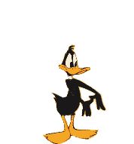
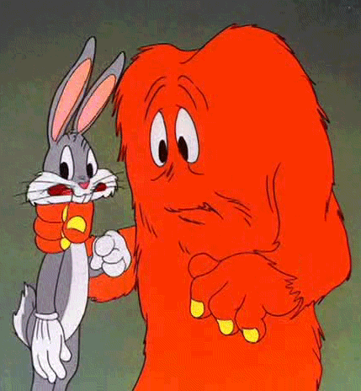

Unit 13:
Magnetism and Electromagnetism

Slide 2
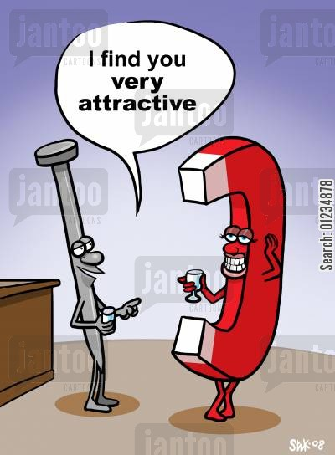
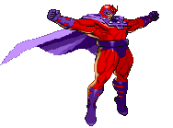
Magnet: any substance that can attract iron or other magnetic material
Magnetism: a force of attraction or repulsion due to an arrangement of electrons

Slide 3
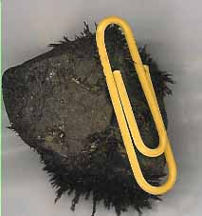
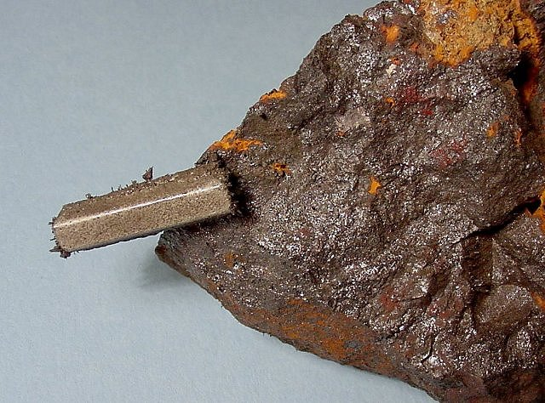
Magnets
A special stone first discovered <2000 years ago in Greece, in a region called “Magnesia”, attracted iron, they called it “magnetite” hence the “magnet” name.
2. About 1000 years ago they noticed that a hanging magnet always pointed to the North Star A.K.A “Lodestar”. Hence the other name for naturally occurring magnets – “lodestone”

Slide 4
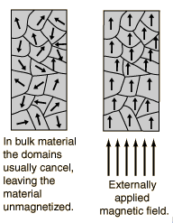
Inside a Magnet
When domains are randomly arranged – forces cancel each other out. – no net magnetic affect
When domains have their magnetic affect in alignment - forces are additive and create a strong magnetic affect

Slide 5
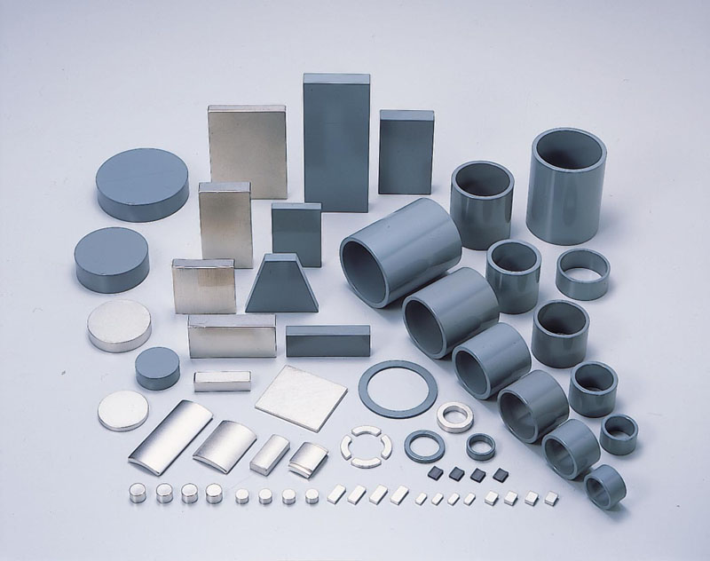
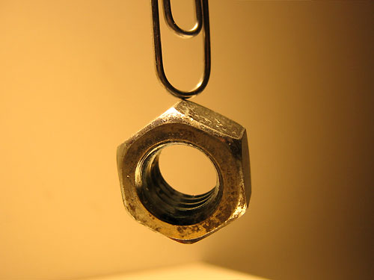
Making Magnets
Since Magnetism and electricity are so closely related, it is relatively easy to make magnets
Temporary magnets – materials that become magnetized while in contact w/ strong magnets – ie a paperclip is able to pick up more paper clips when stuck to a strong magnet
Permanent magnets – materials that maintain their magnetism when the magnet is removed from it.

Slide 6
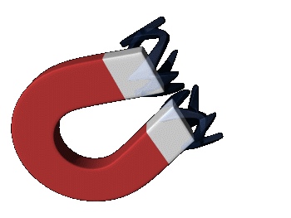
3 Types of magnets:
Natural magnet: ex magnetite
Temporary magnets: ex soft iron
Permanent magnets: stay magnetic ex iron , nickel
The simplest kind of magnet is a straight iron bar magnet
The process by which a material is made into a magnet is called magnetic induction

Slide 7
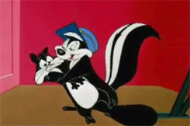
Magnets
Poles of a magnet are the ends where objects are most strongly attracted
  Two poles, called north and south
Like poles repel each other and unlike poles attract each other
  Similar to electric charges
Magnetic poles cannot be isolated
  If a permanent magnetic is cut in half repeatedly, you will still have a north and a south pole
  This differs from electric charges
  There is some theoretical basis for monopoles, but none have been detected

Slide 8

More About Magnetism
An unmagnetized piece of iron can be magnetized by stroking it with a magnet
  Somewhat like stroking an object to charge an object
Magnetism can be induced
  If a piece of iron, for example, is placed near a strong permanent magnet, it will become magnetized

Slide 9
Types of Magnetic Materials
Soft magnetic materials, such as iron, are easily magnetized
  They also tend to lose their magnetism easily
Hard magnetic materials, such as cobalt and nickel, are difficult to magnetize
  They tend to retain their magnetism

Slide 10
Sources of Magnetic Fields
The region of space surrounding a moving charge includes a magnetic field
  The charge will also be surrounded by an electric field
A magnetic field surrounds a properly magnetized magnetic material

Slide 11
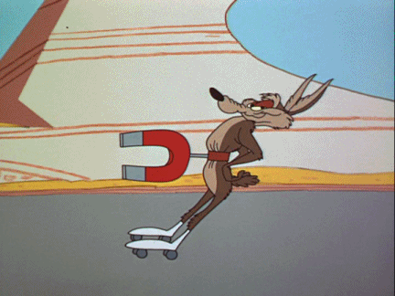
Magnetic Fields
A vector quantity
Symbolized by
Direction is given by the direction a north pole of a compass needle points in that location
Magnetic field lines can be used to show how the field lines, as traced out by a compass, would look

Slide 12
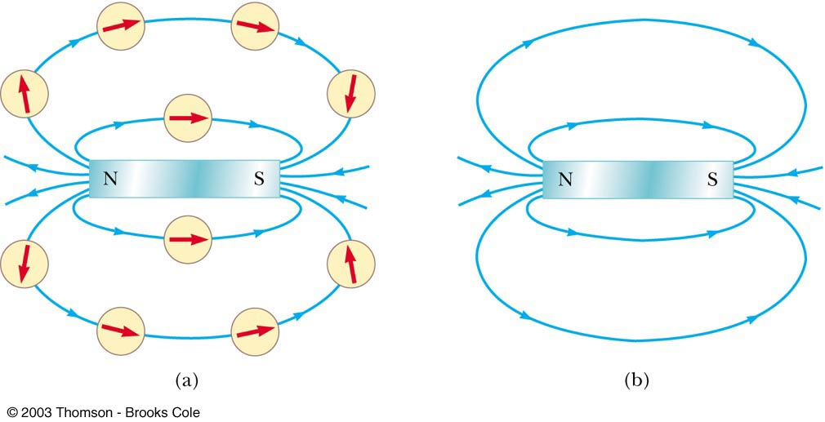
Magnetic Field Lines, sketch
A compass can be used to show the direction of the magnetic field lines (a)
A sketch of the magnetic field lines (b)

Slide 13
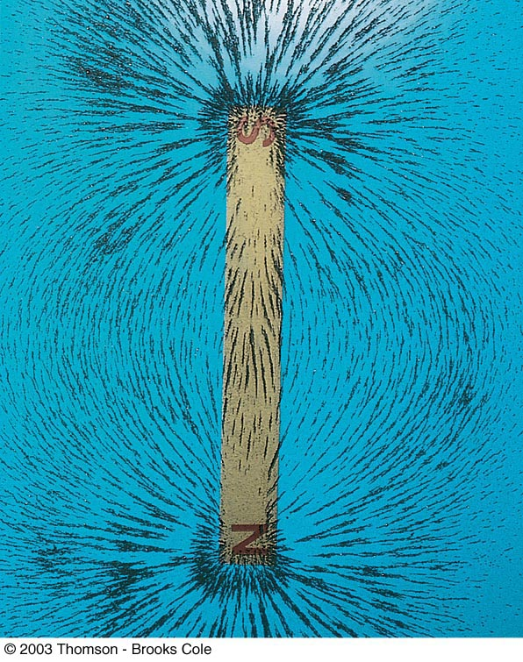
Magnetic Field Lines, Bar Magnet
Iron filings are used to show the pattern of the magnetic field lines
The direction of the field is the direction a north pole would point

Slide 14
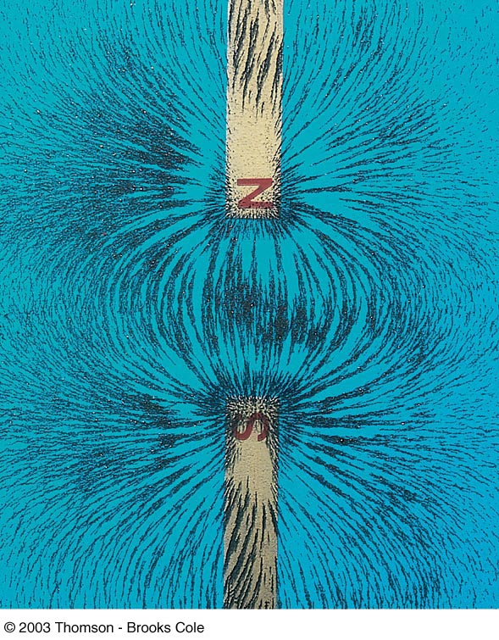
Magnetic Field Lines, Unlike Poles
Iron filings are used to show the pattern of the magnetic field lines
The direction of the field is the direction a north pole would point
  Compare to the magnetic field produced by an electric dipole

Slide 15
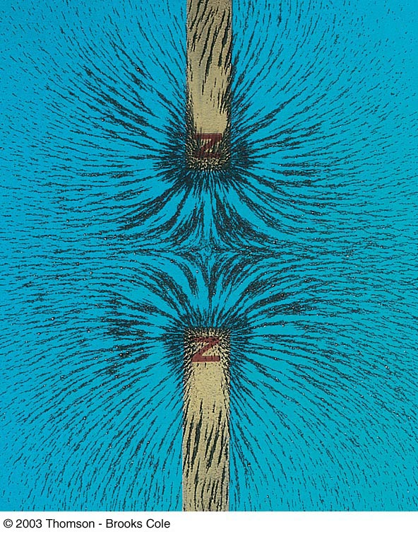
Magnetic Field Lines, Like Poles
Iron filings are used to show the pattern of the electric field lines
The direction of the field is the direction a north pole would point
  Compare to the electric field produced by like charges

Slide 16
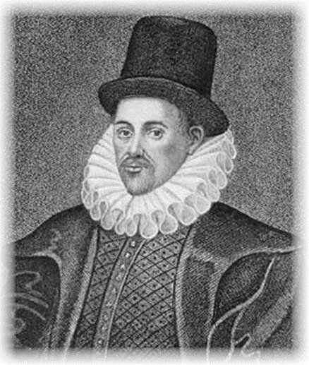
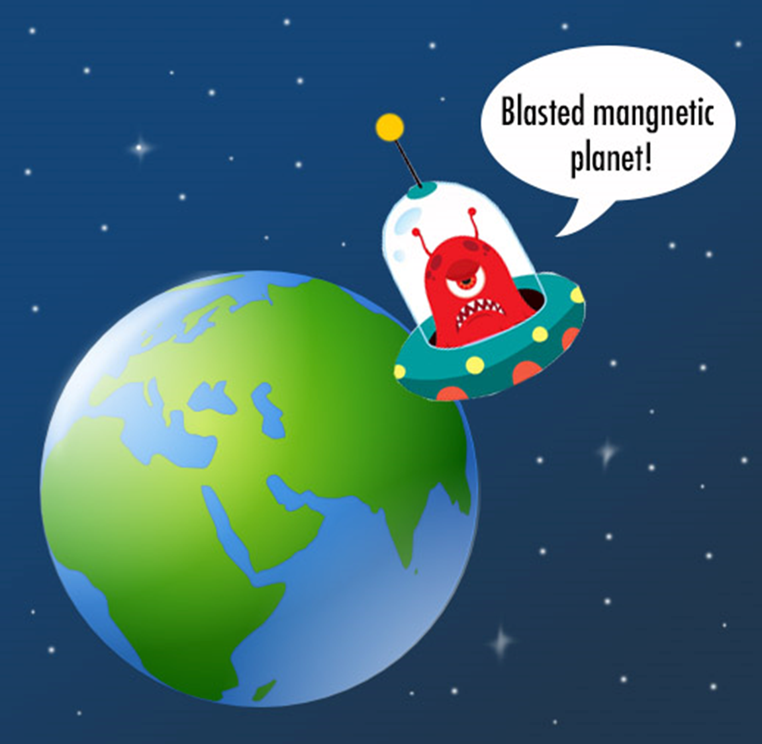
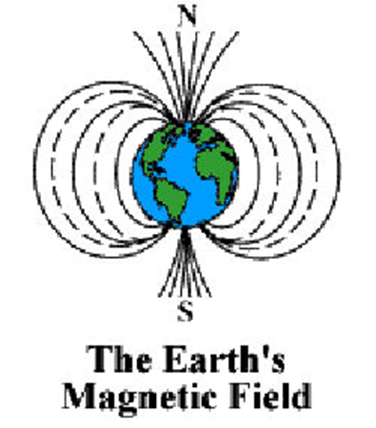
Earth as a magnet
In 1600 William Gilbert proposed the idea that the Earth was a magnet
Today we know this is true and the region o the Earth’s magnetic field is called the magnetosphere

Slide 17
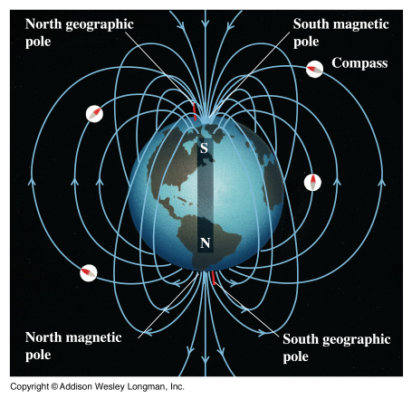
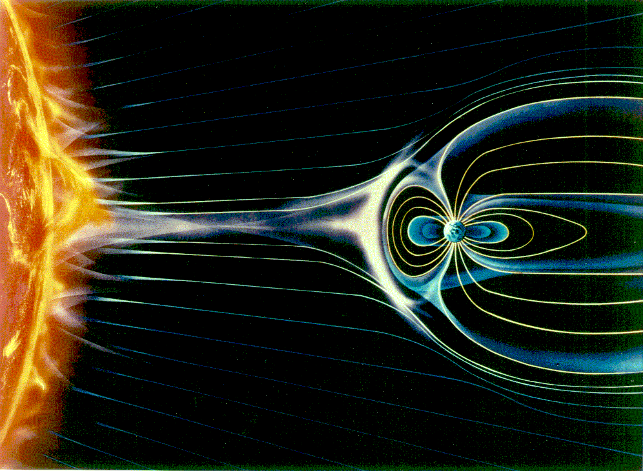
Magnetic Earth
Earth’s core is Iron – Earth is a giant magnet
Earth’s magnetic north pole is not the same as Earth’s axis north pole. It is about 1250 km (776 miles) away from the true north pole
The angle between true north and magnetic north is the magnetic declination.

Slide 18
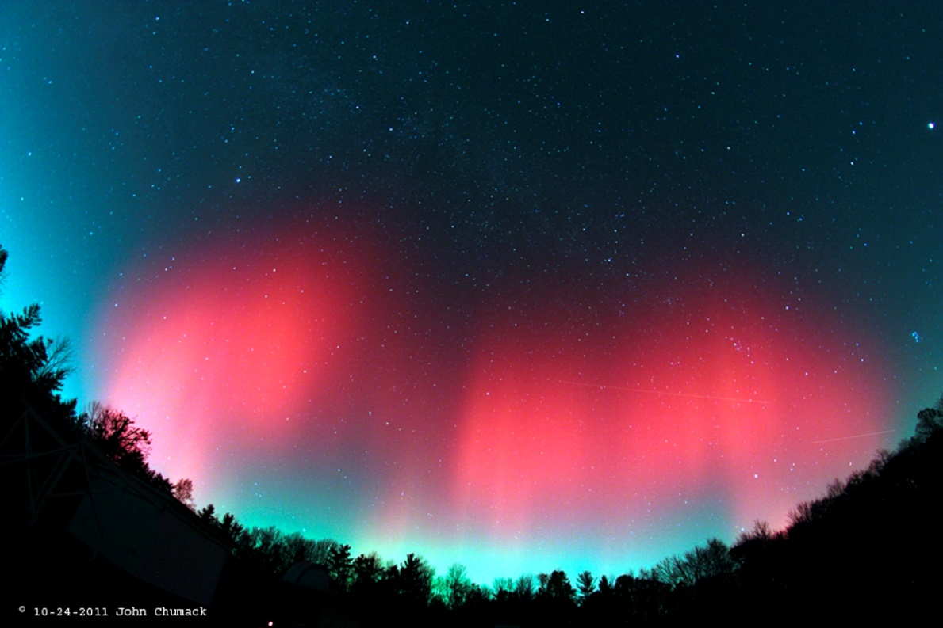

Auroras:
Provide colorful displays of light against the sky in the dark and provide evidence of how the Earth behaves as a giant magnet in space

Slide 19
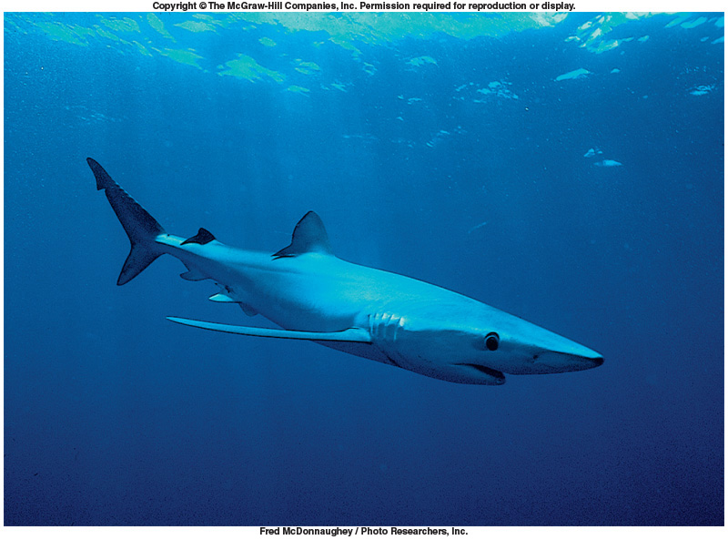
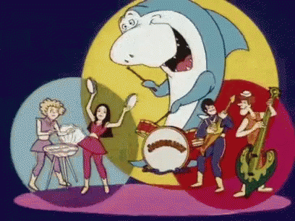
Earth as a magnet
Sharks navigate with the help of the earth’s magnetic field. They detect the field using electromagnetic induction.

Slide 20


Earth’s Magnetic Field
The Earth’s geographic north pole corresponds to a magnetic south pole
The Earth’s geographic south pole corresponds to a magnetic north pole
  Strictly speaking, a north pole should be a “north-seeking” pole and a south pole a “south-seeking” pole

Slide 21
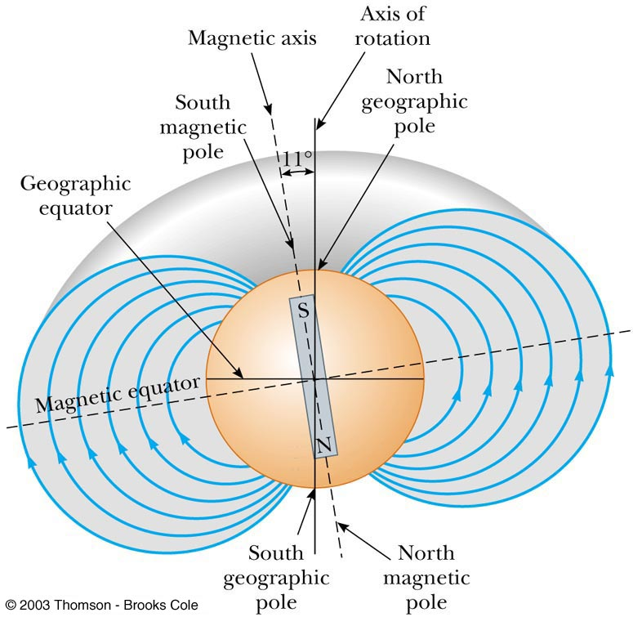
Earth’s Magnetic Field
The Earth’s magnetic field resembles that achieved by burying a huge bar magnet deep in the Earth’s interior

Slide 22
Dip Angle of Earth’s Magnetic Field
If a compass is free to rotate vertically as well as horizontally, it points to the earth’s surface
The angle between the horizontal and the direction of the magnetic field is called the dip angle
  The farther north the device is moved, the farther from horizontal the compass needle would be
    The compass needle would be horizontal at the equator and the dip angle would be 0°
    The compass needle would point straight down at the south magnetic pole and the dip angle would be 90°

Slide 23
More About the Earth’s Magnetic Poles
The dip angle of 90° is found at a point just north of Hudson Bay in Canada
  This is considered to be the location of the south magnetic pole
The magnetic and geographic poles are not in the same exact location
  The difference between true north, at the geographic north pole, and magnetic north is called the magnetic declination
    The amount of declination varies by location on the earth’s surface

Slide 24
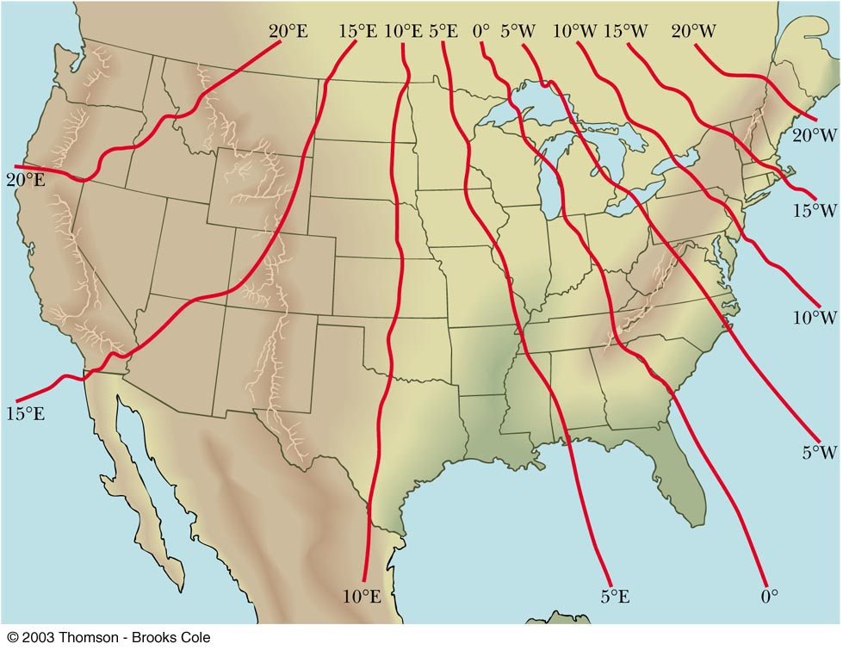
Earth’s Magnetic Declination

Slide 25
Source of the Earth’s Magnetic Field
There cannot be large masses of permanently magnetized materials since the high temperatures of the core prevent materials from retaining permanent magnetization
The most likely source of the Earth’s magnetic field is believed to be electric currents in the liquid part of the core

Slide 26
Reversals of the Earth’s Magnetic Field
The direction of the Earth’s magnetic field reverses every few million years
  Evidence of these reversals are found in basalts resulting from volcanic activity
  The origin of the reversals is not understood

Slide 27
Magnetic Fields
When moving through a magnetic field, a charged particle experiences a magnetic force
  This force has a maximum value when the charge moves perpendicularly to the magnetic field lines
  This force is zero when the charge moves along the field lines

Slide 28
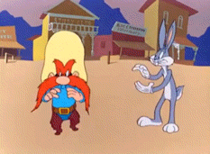
Magnetic Fields, cont
One can define a magnetic field in terms of the magnetic force exerted on a test charge moving in the field with velocity
  Similar to the way electric fields are defined

Slide 29
Units of Magnetic Field
The SI unit of magnetic field is the Tesla (T)
  Wb is a Weber
The cgs unit is a Gauss (G)
  1 T = 10⁴ G

Slide 30

A Few Typical B Values
Conventional laboratory magnets
  25000 G or 2.5 T
Superconducting magnets
  300000 G or 30 T
Earth’s magnetic field
  0.5 G or 5 x 10⁻⁵ T

Slide 31
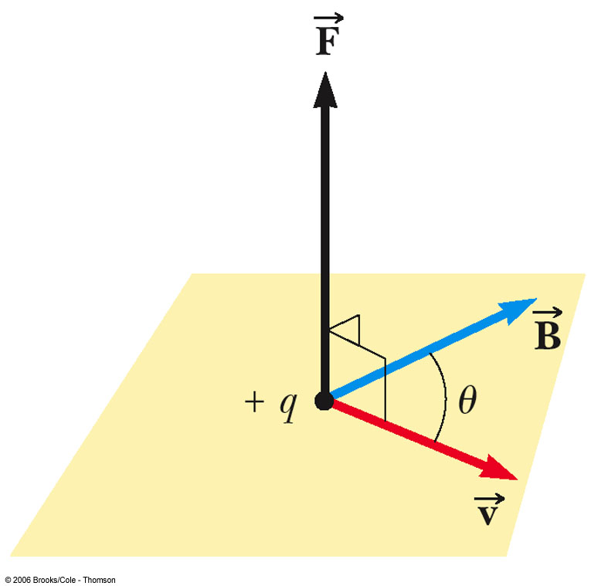
Finding the Direction of Magnetic Force
Experiments show that the direction of the magnetic force is always perpendicular to both and
F_{max} occurs when is perpendicular to
F = 0 when is parallel to

Slide 32
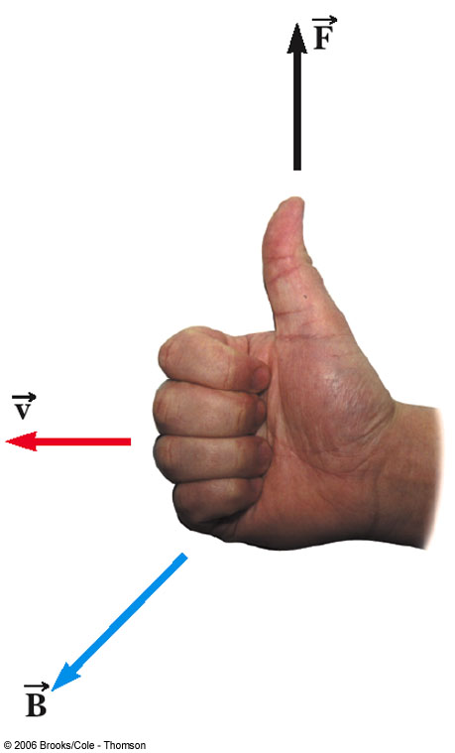
Right Hand Rule #1
Place your fingers in the direction of
Curl the fingers in the direction of the magnetic field,
Your thumb points in the direction of the force, , on a positive charge
  If the charge is negative, the force is opposite that determined by the right hand rule

Slide 33
Magnetic Force on a Current Carrying Conductor
A force is exerted on a current-carrying wire placed in a magnetic field
  The current is a collection of many charged particles in motion
The direction of the force is given by right hand rule #1

Slide 34
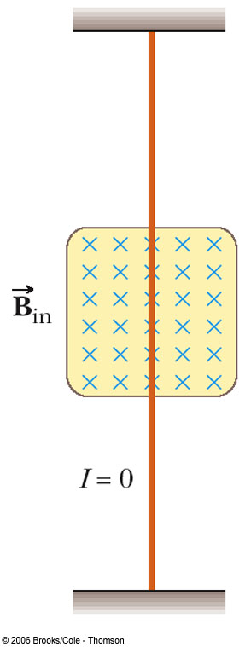
Force on a Wire
The blue x’s indicate the magnetic field is directed into the page
  The x represents the tail of the arrow
Blue dots would be used to represent the field directed out of the page
  The • represents the head of the arrow
In this case, there is no current, so there is no force

Slide 35
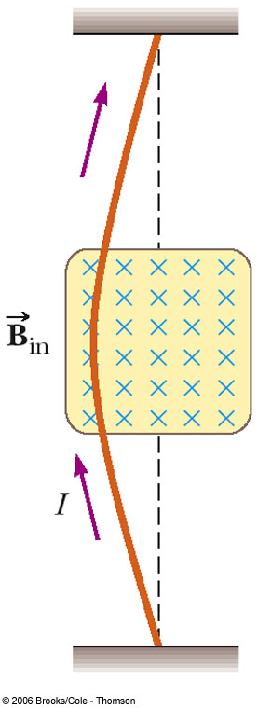
Force on a Wire, cont
B is into the page
The current is up the page
The force is to the left

Slide 36
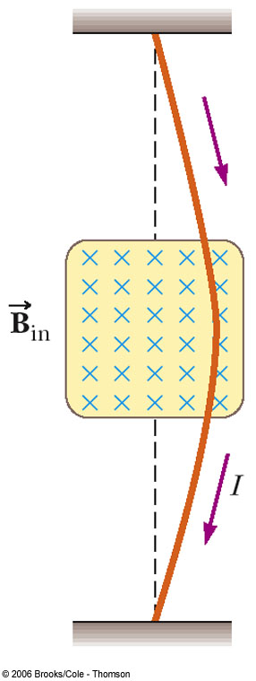
Force on a Wire, final
B is into the page
The current is down the page
The force is to the right

Slide 37
Force on a Wire, equation
The magnetic force is exerted on each moving charge in the wire
The total force is the sum of all the magnetic forces on all the individual charges producing the current
F = B I ℓ sin θ
  θ is the angle between and the direction of I
  The direction is found by the right hand rule, placing your fingers in the direction of I instead of

Slide 38
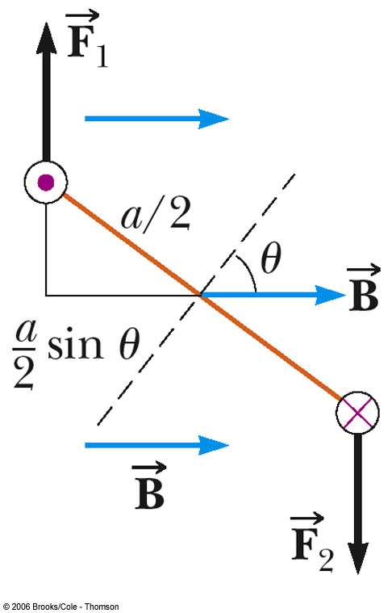
Torque on a Current Loop
  Applies to any shape loop
  N is the number of turns in the coil
  Torque has a maximum value of NBIA
    When θ = 90°
  Torque is zero when the field is parallel to the plane of the loop

Slide 39

Magnetic Moment
The vector is called the magnetic moment of the coil
Its magnitude is given by μ = IAN
The vector always points perpendicular to the plane of the loop(s)
The angle is between the moment and the field
The equation for the magnetic torque can be written as τ = μB sinθ

Slide 40
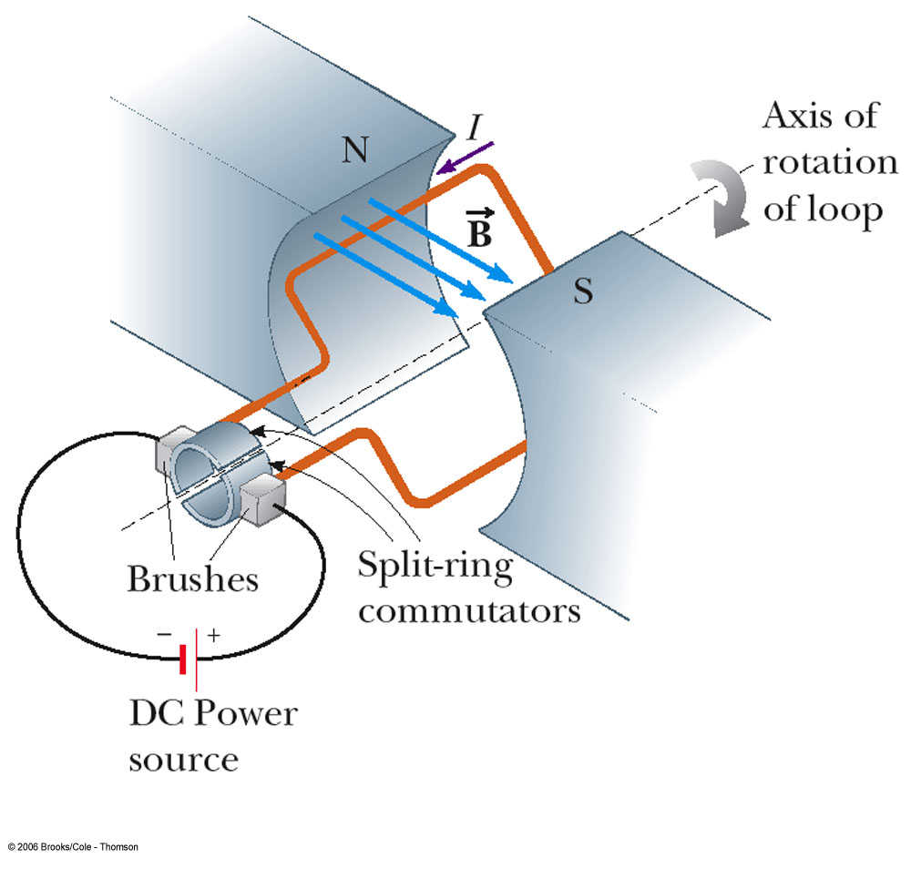
Electric Motor
An electric motor converts electrical energy to mechanical energy
  The mechanical energy is in the form of rotational kinetic energy
An electric motor consists of a rigid current-carrying loop that rotates when placed in a magnetic field

Slide 41
Electric Motor, 2
The torque acting on the loop will tend to rotate the loop to smaller values of θ until the torque becomes 0 at θ = 0°
If the loop turns past this point and the current remains in the same direction, the torque reverses and turns the loop in the opposite direction

Slide 42
Electric Motor, 3
To provide continuous rotation in one direction, the current in the loop must periodically reverse
  In ac motors, this reversal naturally occurs
  In dc motors, a split-ring commutator and brushes are used
    Actual motors would contain many current loops and commutators

Slide 43
Electric Motor, final
Just as the loop becomes perpendicular to the magnetic field and the torque becomes 0, inertia carries the loop forward and the brushes cross the gaps in the ring, causing the current loop to reverse its direction
  This provides more torque to continue the rotation
  The process repeats itself

Slide 44
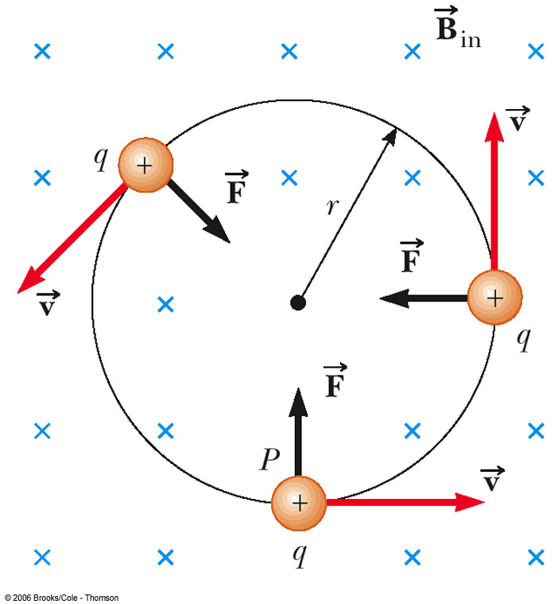
Force on a Charged Particle in a Magnetic Field
Consider a particle moving in an external magnetic field so that its velocity is perpendicular to the field
The force is always directed toward the center of the circular path
The magnetic force causes a centripetal acceleration, changing the direction of the velocity of the particle

Slide 45
Force on a Charged Particle
Equating the magnetic and centripetal forces:
Solving for r:
  r is proportional to the momentum of the particle and inversely proportional to the magnetic field
  Sometimes called the cyclotron equation

Slide 46
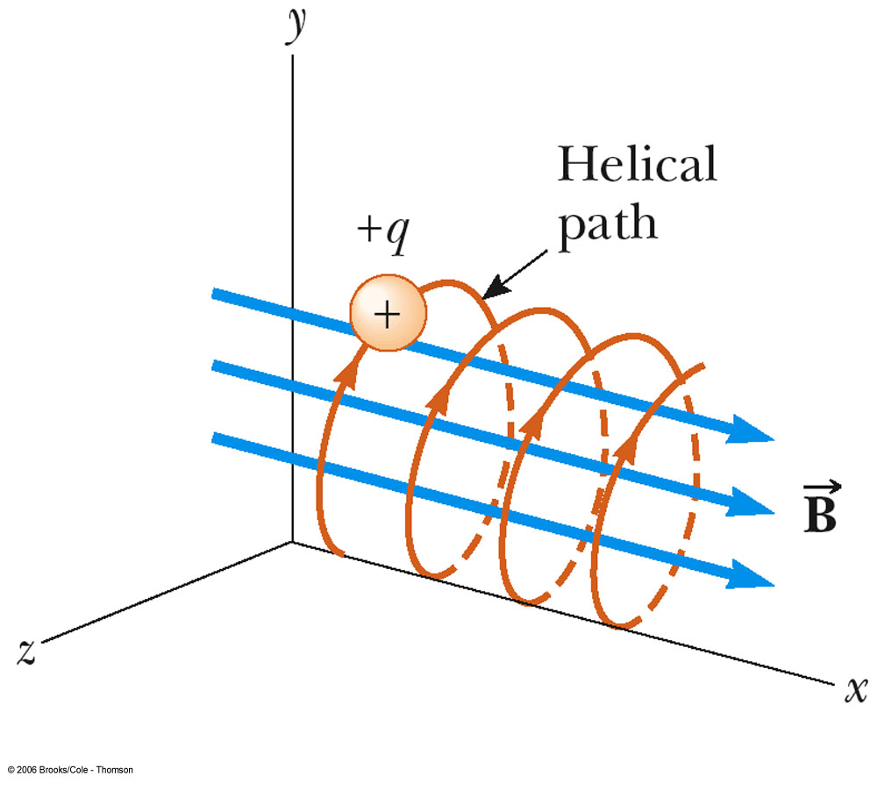
Particle Moving in an External Magnetic Field
If the particle’s velocity is not perpendicular to the field, the path followed by the particle is a spiral
  The spiral path is called a helix

Slide 47
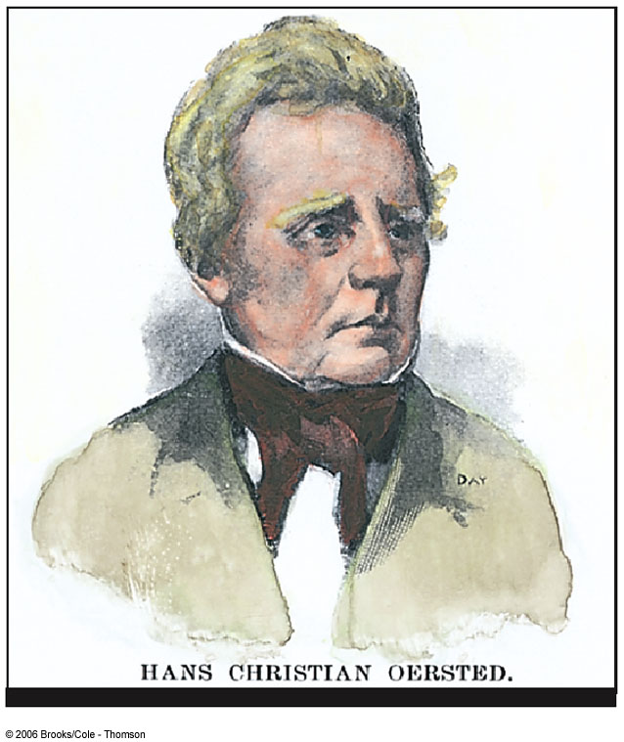
Hans Christian Oersted
1777 – 1851
Best known for observing that a compass needle deflects when placed near a wire carrying a current
  First evidence of a connection between electric and magnetic phenomena

Slide 48
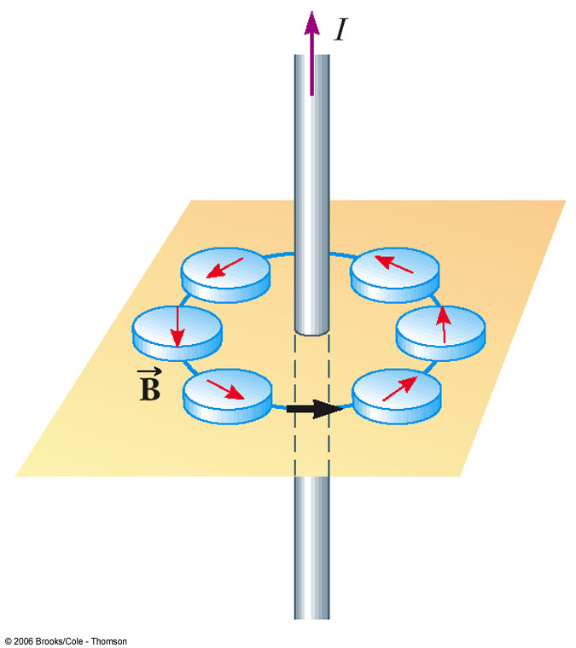
Magnetic Fields –
Long Straight Wire
A current-carrying wire produces a magnetic field
The compass needle deflects in directions tangent to the circle
  The compass needle points in the direction of the magnetic field produced by the current

Slide 49
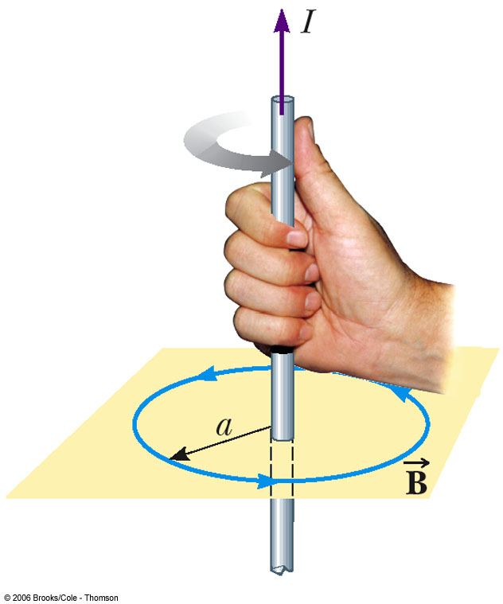
Direction of the Field of a Long Straight Wire
Right Hand Rule #2
  Grasp the wire in your right hand
  Point your thumb in the direction of the current
  Your fingers will curl in the direction of the field

Slide 50
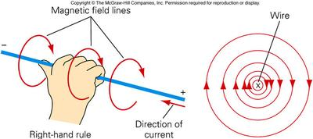
Oersted’s Experiment
According to the right-hand rule, the electron current in a wire and the magnetic field it generates are perpendicular to each other.

Slide 51
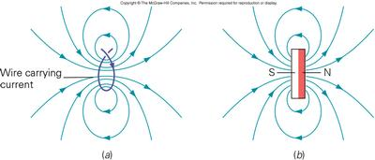
Oersted’s Experiment
All magnetic fields originate from moving electric charges. A magnetic field appears only when relative motion is present between an electric charge and an observer. Electric and magnetic fields are different aspects of a single electromagnetic field.

Slide 52
Magnitude of the Field of a Long Straight Wire
The magnitude of the field at a distance r from a wire carrying a current of I is
µ_{o} = 4 π x 10⁻⁷ T.m / A
  µ_{o} is called the permeability of free space

Slide 53
Ampère’s Law
André-Marie Ampère found a procedure for deriving the relationship between the current in an arbitrarily shaped wire and the magnetic field produced by the wire
Ampère’s Circuital Law
  ΣB|| Δℓ = µ_{o} I
  Sum over the closed path

Slide 54
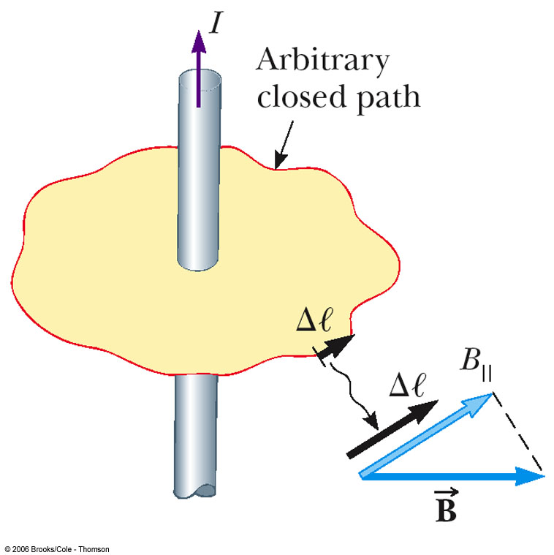
Ampère’s Law, cont
Choose an arbitrary closed path around the current
Sum all the products of B|| Δℓ around the closed path

Slide 55
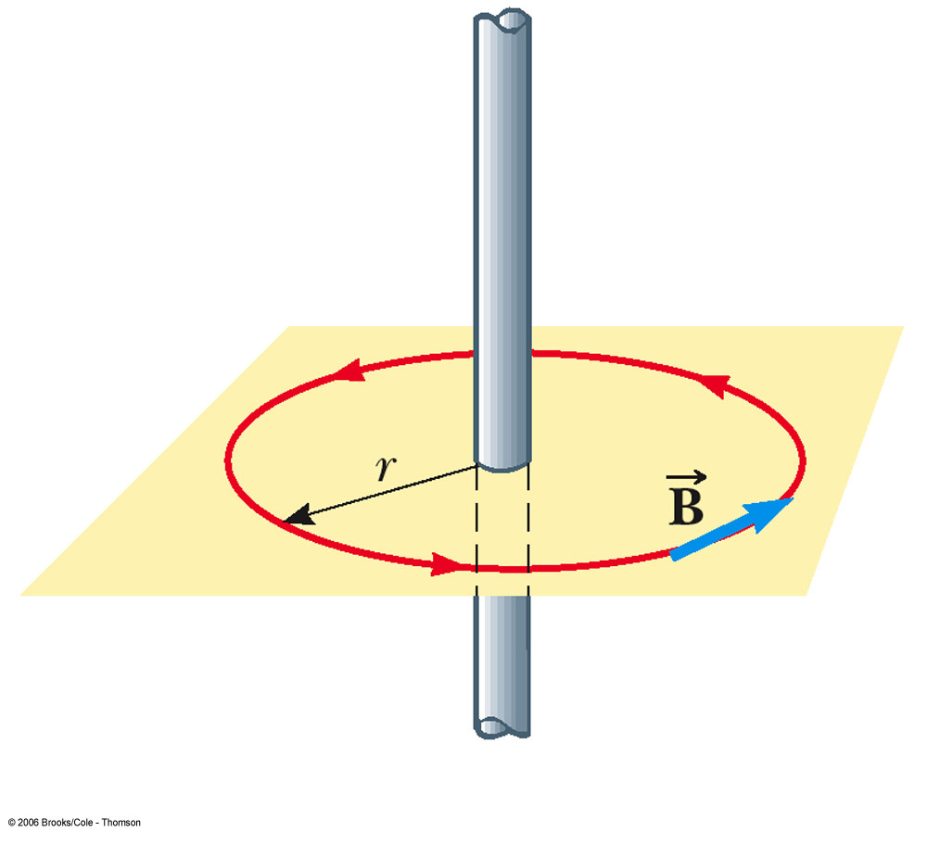
Ampère’s Law to Find B for a Long Straight Wire
Use a closed circular path
The circumference of the circle is 2 π r
  This is identical to the result previously obtained

Slide 56
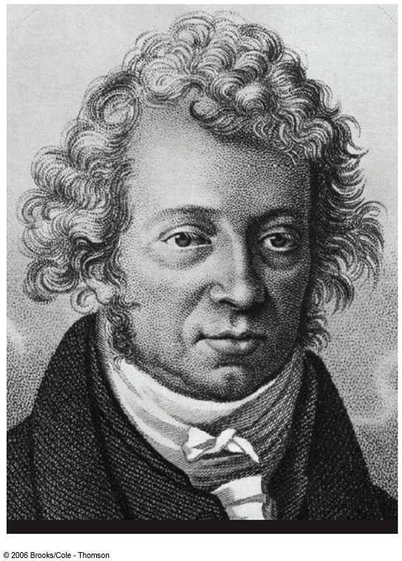
André-Marie Ampère
1775 – 1836
Credited with the discovery of electromagnetism
  Relationship between electric currents and magnetic fields
Mathematical genius evident by age 12

Slide 57
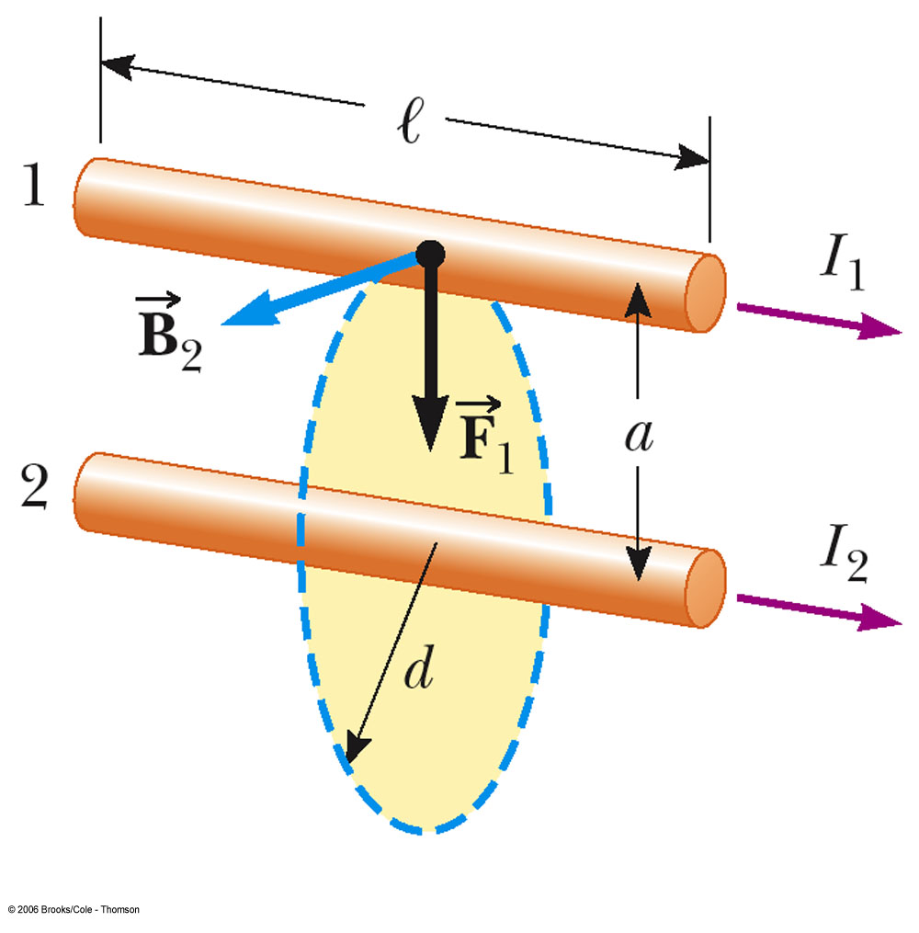
Magnetic Force Between Two Parallel Conductors
The force on wire 1 is due to the current in wire 1 and the magnetic field produced by wire 2
The force per unit length is:

Slide 58
Force Between Two Conductors, cont
Parallel conductors carrying currents in the same direction attract each other
Parallel conductors carrying currents in the opposite directions repel each other

Slide 59
Defining Ampere and Coulomb
The force between parallel conductors can be used to define the Ampere (A)
  If two long, parallel wires 1 m apart carry the same current, and the magnitude of the magnetic force per unit length is 2 x 10⁻⁷ N/m, then the current is defined to be 1 A
The SI unit of charge, the Coulomb (C), can be defined in terms of the Ampere
  If a conductor carries a steady current of 1 A, then the quantity of charge that flows through any cross section in 1 second is 1 C

Slide 60
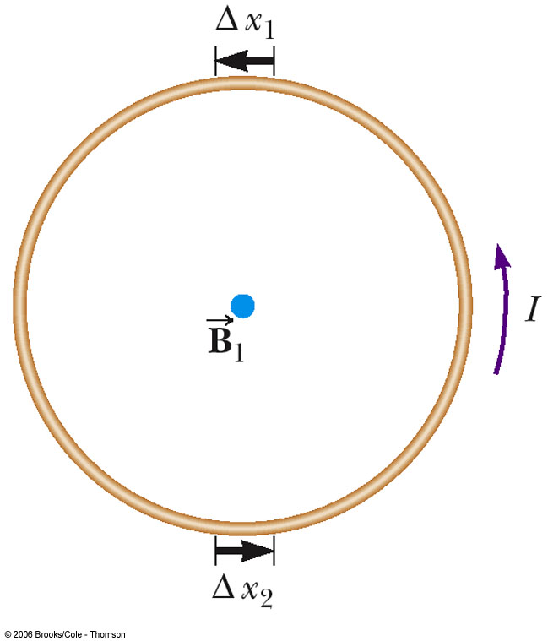
Magnetic Field of a Current Loop
The strength of a magnetic field produced by a wire can be enhanced by forming the wire into a loop
All the segments, Δx, contribute to the field, increasing its strength

Slide 61
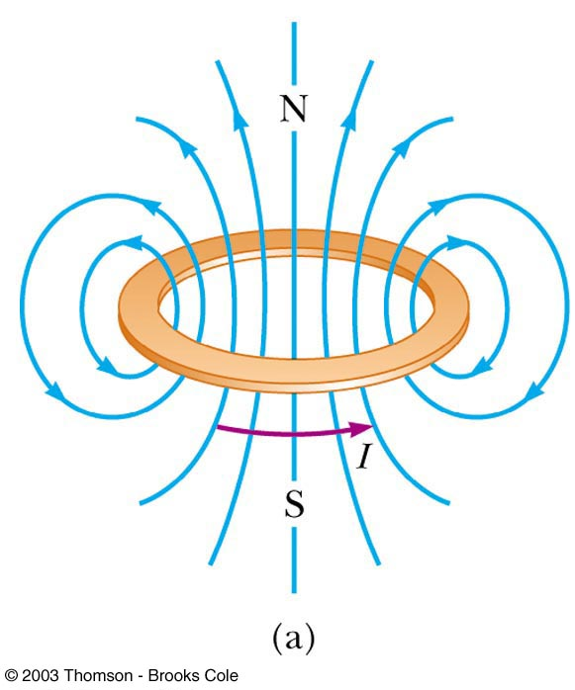
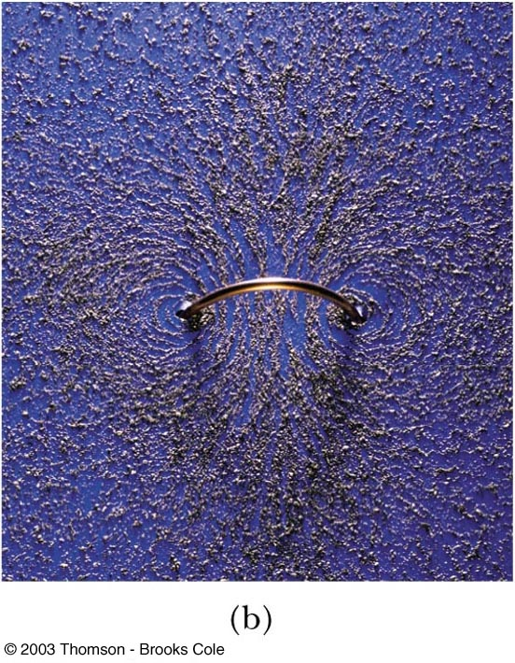
Magnetic Field of a Current Loop – Total Field

Slide 62
Magnetic Field of a Current Loop – Equation
The magnitude of the magnetic field at the center of a circular loop with a radius R and carrying current I is
With N loops in the coil, this becomes

Slide 63
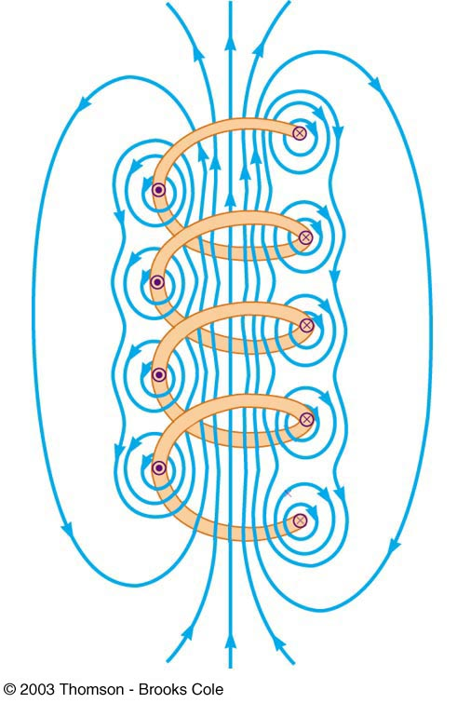
Magnetic Field of a Solenoid
If a long straight wire is bent into a coil of several closely spaced loops, the resulting device is called a solenoid
It is also known as an electromagnet since it acts like a magnet only when it carries a current

Slide 64
Magnetic Field of a Solenoid, 2
The field lines inside the solenoid are nearly parallel, uniformly spaced, and close together
  This indicates that the field inside the solenoid is nearly uniform and strong
The exterior field is nonuniform, much weaker, and in the opposite direction to the field inside the solenoid

Slide 65
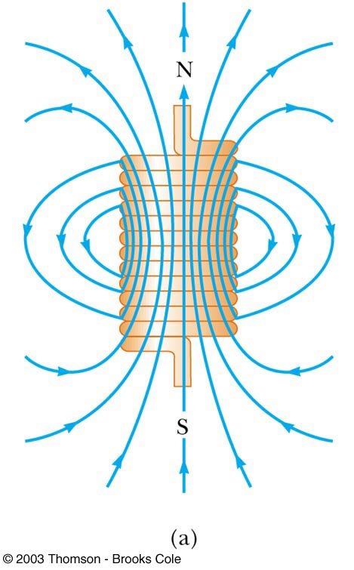

Magnetic Field in a Solenoid, 3
The field lines of the solenoid resemble those of a bar magnet

Slide 66
Magnetic Field in a Solenoid, Magnitude
The magnitude of the field inside a solenoid is constant at all points far from its ends
B = µ_{o} n I
  n is the number of turns per unit length
  n = N / ℓ
The same result can be obtained by applying Ampère’s Law to the solenoid

Slide 67

Magnetic Field in a Solenoid from Ampère’s Law
A cross-sectional view of a tightly wound solenoid
If the solenoid is long compared to its radius, we assume the field inside is uniform and outside is zero
Apply Ampère’s Law to the blue dashed rectangle

Slide 68
Magnetic Effects of Electrons – Orbits
An individual atom should act like a magnet because of the motion of the electrons about the nucleus
  Each electron circles the atom once in about every 10⁻¹⁶ seconds
  This would produce a current of 1.6 mA and a magnetic field of about 20 T at the center of the circular path
However, the magnetic field produced by one electron in an atom is often canceled by an oppositely revolving electron in the same atom

Slide 69
Magnetic Effects of Electrons – Orbits, cont
The net result is that the magnetic effect produced by electrons orbiting the nucleus is either zero or very small for most materials

Slide 70

Magnetic Effects of Electrons – Spins
Electrons also have spin
  The classical model is to consider the electrons to spin like tops
  It is actually a quantum effect

Slide 71
Magnetic Effects of Electrons – Spins, cont
The field due to the spinning is generally stronger than the field due to the orbital motion
Electrons usually pair up with their spins opposite each other, so their fields cancel each other
  That is why most materials are not naturally magnetic

Slide 72
Magnetic Effects of Electrons – Domains
In some materials, the spins do not naturally cancel
  Such materials are called ferromagnetic
Large groups of atoms in which the spins are aligned are called domains
When an external field is applied, the domains that are aligned with the field tend to grow at the expense of the others
  This causes the material to become magnetized

Slide 73


Domains, cont
Random alignment, a, shows an unmagnetized material
When an external field is applied, the domains aligned with B grow, b

Slide 74
Domains and Permanent Magnets
In hard magnetic materials, the domains remain aligned after the external field is removed
  The result is a permanent magnet
    In soft magnetic materials, once the external field is removed, thermal agitation causes the materials to quickly return to an unmagnetized state
With a core in a loop, the magnetic field is enhanced since the domains in the core material align, increasing the magnetic field

Slide 75


Michael Faraday 1831
Michael Faraday (1791-1867) built the first electric motor and discovered magnetic induction.

Slide 76

What is E/M Induction?
Electromagnetic Induction is the process of using magnetic fields to produce voltage, and in a complete circuit, a current.
Michael Faraday first discovered it, using some of the works of Hans Christian Oersted. His work started at first using different combinations of wires and magnetic strengths and currents, but it wasn't until he tried moving the wires that he got any success.
It turns out that electromagnetic induction is created by just that - the moving of a conductive substance through a magnetic field.

Slide 77

Magnetic Induction
As the magnet moves back and forth a current is said to be INDUCED in the wire.

Slide 78

Magnetic Flux
The first step to understanding the complex nature of electromagnetic induction is to understand the idea of magnetic flux.
B
A
Flux is a general term associated with a FIELD that is bound by a certain AREA. So MAGNETIC FLUX is any AREA that has a MAGNETIC FIELD passing through it.
We generally define an AREA vector as one that is perpendicular to the surface of the material. Therefore, you can see in the figure that the AREA vector and the Magnetic Field vector are PARALLEL. This then produces a DOT PRODUCT between the 2 variables that then define flux.

Slide 79

Magnetic Flux – The DOT product
How could we CHANGE the flux over a period of time?
We could move the magnet away or towards (or the wire)
We could increase or decrease the area
We could ROTATE the wire along an axis that is PERPENDICULAR to the field thus changing the angle between the area and magnetic field vectors.

Slide 80

Faraday’s Law
Faraday learned that if you change any part of the flux over time you could induce a current in a conductor and thus create a source of EMF (voltage, potential difference). Since we are dealing with time here were a talking about the RATE of CHANGE of FLUX, which is called Faraday’s Law.

Slide 81


Useful Applications
The Forever Flashlight uses the Faraday Principle of Electromagnetic Energy to eliminate the need for batteries. The Faraday Principle states that if an electric conductor, like copper wire, is moved through a magnetic field, electric current will be generated and flow into the conductor.

Slide 82

Applications of Faraday’s Law – Electric Guitar
A vibrating string induces an emf in a coil
A permanent magnet inside the coil magnetizes a portion of the string nearest the coil
As the string vibrates at some frequency, its magnetized segment produces a changing flux through the pickup coil
The changing flux produces an induced emf that is fed to an amplifier

Slide 83

Applications of Faraday’s Law – Apnea Monitor
The coil of wire attached to the chest carries an alternating current
An induced emf produced by the varying field passes through a pick up coil
When breathing stops, the pattern of induced voltages stabilizes and external monitors sound an alert

Slide 84

Useful Applications
AC Generators use Faraday’s law to produce rotation and thus convert electrical and magnetic energy into rotational kinetic energy. This idea can be used to run all kinds of motors. Since the current in the coil is AC, it is turning on and off thus creating a CHANGING magnetic field of its own. Its own magnetic field interferes with the shown magnetic field to produce rotation.

Slide 85

Transformers
Probably one of the greatest inventions of all time is the transformer. AC Current from the primary coil moves quickly BACK and FORTH (thus the idea of changing!) across the secondary coil. The moving magnetic field caused by the changing field (flux) induces a current in the secondary coil.
If the secondary coil has MORE turns than the primary you can step up the voltage and runs devices that would normally need MORE voltage than what you have coming in. We call this a STEP UP transformer.
We can use this idea in reverse as well to create a STEP DOWN transformer.

Slide 86

Microphones
A microphone works when sound waves enter the filter of a microphone. Inside the filter, a diaphragm is vibrated by the sound waves which in turn moves a coil of wire wrapped around a magnet. The movement of the wire in the magnetic field induces a current in the wire. Thus sound waves can be turned into electronic signals and then amplified through a speaker.

Slide 87
Example
A coil with 200 turns of wire is wrapped on an 18.0 cm square frame. Each turn has the same area, equal to that of the frame, and the total resistance of the coil is 2.0Ω . A uniform magnetic field is applied perpendicularly to the plane of the coil. If the field changes uniformly from 0 to 0.500 T in 0.80 s, find the magnitude of the induced emf in the coil while the field has changed as well as the magnitude of the induced current.
Why did you find the ABSOLUTE VALUE of the EMF?
What happened to the “ – “ that was there originally?
4.05 V
2.03 A

Slide 88

Lenz’s Law
Lenz's law gives the direction of the induced emf and current resulting from electromagnetic induction. The law provides a physical interpretation of the choice of sign in Faraday's law of induction, indicating that the induced emf and the change in flux have opposite signs.
Lenz’s Law
In the figure above, we see that the direction of the current changes. Lenz’s Law helps us determine the DIRECTION of that current.

Slide 89

Lenz’s Law & Faraday’s Law
Let’s consider a magnet with it’s north pole moving TOWARDS a conducting loop.
DOES THE FLUX CHANGE?
DOES THE FLUX INCREASE OR DECREASE?
WHAT SIGN DOES THE “Δ” GIVE YOU IN FARADAY’S LAW?
DOES LENZ’S LAW CANCEL OUT?
What does this mean?
Yes!
Increase
Positive
B_{induced}
NO
This means that the INDUCED MAGNETIC FIELD around the WIRE caused by the moving magnet OPPOSES the original magnetic field. Since the original B field is downward, the induced field is upward! We then use the curling right hand rule to determine the direction of the current.

Slide 90


Lenz’s Law
The INDUCED current creates an INDUCED magnetic field of its own inside the conductor that opposes the original magnetic field.
Since the induced field opposes the direction of the original it attracts the magnet upward slowing the motion caused by gravity downward.
A magnet is dropped down a conducting tube.
The magnet INDUCES a current above and below the magnet as it moves.
If the motion of the magnet were NOT slowed this would violate conservation of energy!

Slide 91

Lenz’s Law
Let’s consider a magnet with it’s north pole moving AWAY from a conducting loop.
DOES THE FLUX CHANGE?
DOES THE FLUX INCREASE OR DECREASE?
WHAT SIGN DOES THE “Δ” GIVE YOU IN FARADAY’S LAW?
DOES LENZ’S LAW CANCEL OUT?
What does this mean?
Yes!
Decreases
negative
yes
B_{induced}
In this case, the induced field DOES NOT oppose the original and points in the same direction. Once again use your curled right hand rule to determine the DIRECTION of the current.

Slide 92
Lenz’ Law, Final Note
When applying Lenz’ Law, there are two magnetic fields to consider
  The external changing magnetic field that induces the current in the loop
  The magnetic field produced by the current in the loop

Slide 93

Application – Tape Recorder
A magnetic tape moves past a recording and playback head
  The tape is a plastic ribbon coated with iron oxide or chromium oxide
To record, the sound is converted to an electrical signal which passes to an electromagnet that magnetizes the tape in a particular pattern
To playback, the magnetized pattern is converted back into an induced current driving a speaker

Slide 94
In summary
Faraday’s Law is basically used to find the MAGNITUDE of the induced EMF. The magnitude of the current can then be found using Ohm’s Law provided we know the conductor’s resistance.
Lenz’s Law is part of Faraday’s Law and can help you determine the direction of the current provided you know HOW the flux is changing

Slide 95

Motional EMF – The Rail Gun
A railgun consists of two parallel metal rails (hence the name) connected to an electrical power supply. When a conductive projectile is inserted between the rails (from the end connected to the power supply), it completes the circuit. Electrons flow from the negative terminal of the power supply up the negative rail, across the projectile, and down the positive rail, back to the power supply.
In accordance with the right-hand rule, the magnetic field circulates around each conductor. Since the current is in opposite direction along each rail, the net magnetic field between the rails (B) is directed vertically. In combination with the current (I) across the projectile, this produces a magnetic force which accelerates the projectile along the rails. There are also forces acting on the rails attempting to push them apart, but since the rails are firmly mounted, they cannot move. The projectile slides up the rails away from the end with the power supply.

Slide 96

Motional Emf
There are many situations where motional EMF can occur that are different from the rail gun. Suppose a bar of length, L, is pulled to right at a speed, v, in a magnetic field, B, directed into the page. The conducting rod itself completes a circuit across a set of parallel conducting rails with a resistor mounted between them.

Slide 97
Motional EMF
In the figure, we are applying a force this time to the rod. Due to Lenz’s Law the magnetic force opposes the applied force. Since we know that the magnetic force acts to the left and the magnetic field acts into the page, we can use the RHR to determine the direction of the current around the loop and the resistor.

Slide 98

Example
An airplane with a wing span of 30.0 m flies parallel to the Earth’s surface at a location where the downward component of the Earth’s magnetic field is 0.60 x10⁻⁴ T. Find the difference in potential between the wing tips is the speed of the plane is 250 m/s.
0.45 V
In 1996, NASA conducted an experiment with a 20,000-meter conducting tether. When the tether was fully deployed during this test, the orbiting tether generated a potential of 3,500 volts. This conducting single-line tether was severed after five hours of deployment. It is believed that the failure was caused by an electric arc generated by the conductive tether's movement through the Earth's magnetic field.

Slide 99

Electromagnets
An electromagnet is a temporary magnet made by passing an electric current through a wire coiled around a metal core.
Electromagnets have 2 advantages over normal magnets:
1. They can be turned on
and off.
2. Their strength can vary
based on the amount of
current flowing.

Slide 100


Examples of electromagnets include cranes in scrap yards, telegraphs, and certain types of doorbells.

Slide 101
What is a generator?
Generator – a machine that changes mechanical energy to electrical energy
Usually use moving magnets to create currents in coils of wire.

Slide 102
Generators
Alternating Current (AC) generator
  Converts mechanical energy to electrical energy
  Consists of a wire loop rotated by some external means
  There are a variety of sources that can supply the energy to rotate the loop
    These may include falling water, heat by burning coal to produce steam

Slide 103

AC Generators, cont
Basic operation of the generator
  As the loop rotates, the magnetic flux through it changes with time
  This induces an emf and a current in the external circuit
  The ends of the loop are connected to slip rings that rotate with the loop
  Connections to the external circuit are made by stationary brushes in contact with the slip rings

Slide 104

AC Generators, final
The emf generated by the rotating loop can be found by
  ε =2 B ℓ v⊥=2 B ℓ sin θ
If the loop rotates with a constant angular speed, ω, and N turns
  ε = N B A ω sin ω t
ε = ε_{max} when loop is parallel to the field
ε = 0 when when the loop is perpendicular to the field

Slide 105

DC Generators
Components are essentially the same as that of an ac generator
The major difference is the contacts to the rotating loop are made by a split ring, or commutator

Slide 106

DC Generators, cont
The output voltage always has the same polarity
The current is a pulsing current
To produce a steady current, many loops and commutators around the axis of rotation are used
  The multiple outputs are superimposed and the output is almost free of fluctuations

Slide 107
Motors
Motors are devices that convert electrical energy into mechanical energy
  A motor is a generator run in reverse
A motor can perform useful mechanical work when a shaft connected to its rotating coil is attached to some external device

Slide 108

Joseph Henry
1797 – 1878
First director of the Smithsonian
First president of the Academy of Natural Science
First to produce an electric current with a magnetic field
Improved the design of the electro-magnetic and constructed a motor
Discovered self-inductance

Slide 109


Slide 110



Electrical & Mechanical energy
1. Magnetic forces repel when alike and attract when opposite
2. Electric current in a wire produces a magnetic field
3. Therefore a magnet can move a wire when it is charged just as it moves a magnet

Slide 111

Mechanical & Electrical Energy
Mechanical energy – energy associated w/ movement (kinetic) or position (potential)
Electrical energy – energy associated w/ electrical current
Energy is changed from one form to another
  When a current carrying wire is placed in a magnetic field, electrical energy is converted into mechanical energy ( a motor is made)

Slide 112



Galvanometers
Tool used to measure small currents
A coil of wire in a magnetic field causes a torque when a current passes thru it.
The coil is attached to a pointer and a spring so as the current increases the amount of deflection is proportional to the current.

Slide 113



Electric Motors
Converts electrical energy into mechanical energy
How they work:
  a. The current induces a magnetic field in the wire.
  b. As the motor turns the forces push up on one side and down on the other
  c. The side that was pushed down on the right is now pushed up on the left and it begins to cycle over and over.

Slide 114



Generating Electric Current
Induction of electric current - making a current flow in a wire
  1. Moving a coil of wire up and down in a magnetic field or
  2. Moving a magnetic field up and down through a coil of wire

Slide 115


Transformers
A transformer is a device composed of two unconnected coils, usually wrapped around a soft iron core, that can increase or decrease the voltage of ac current.

Slide 116


6-19. Transformers
A transformer is used to step the voltage down and the current up (P=IV) so that we can use it. Low power is desired for the transport of electricity long distances to avoid loss of energy to heat loss. Transformers must use AC current.
A moving coil activated by voice vibrations is used as a microphone. The coil induces a current in the magnet that can be amplified or recorded.

Slide 117


Transformers
The AC which comes from your household outlets usually has a voltage of about 120V.
The voltage of the power lines outside, however, is much higher. Before entering your house, the electricity from the power lines must pass through a transformer. This is a device which can increase or decrease the voltage which exists between 2 points.

Slide 118


Transformers outside your house make the voltage in your outlets safe for household appliances.
Occasionally a lightning strike make take out a transformer, and send a power surge into your house.

Slide 119


Step-up & step-down transformers
Transformers can also increase the voltage between 2 points.
An amplifier and a stun gun are examples
of step-up transformers.

Slide 120

The step-down transformer shown below has 8 coils of wire on the primary side and 4 coils going out on the secondary side. If this transformer is hooked up to a typical household outlet, how many volts will be produced?

Slide 121

The experimental Japanese Maglev train uses magnetic forces for both support and propulsion.

Slide 122

An electric motor uses the sideways push of a magnetic field to turn a current-carrying wire loop. Electric motors use a commutator to change the direction of the current in the loop. Alternating current electric motors do not use commutators.

Slide 123

Magneto
X-man Magneto can create extremely powerful magnetic fields at will. Sine magnetic fields are produced by electric currents, we can roughly approximate the current that might be coursing through Magneto
Lets say he uses his energy to lift a 1,000 kg car 10 meters off the ground. Potential energy =mgh
=(9.8)(10,000) (10)
= close to 100,000 J not good for his heart

Slide 124

That’s All Folks

