Slide 1
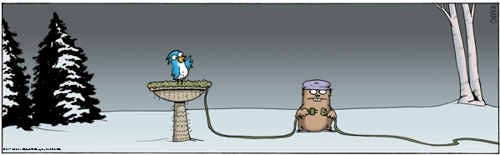
Unit: 11: Electrostatics

Slide 2
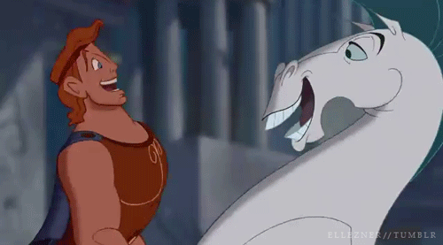
First Observations – Greeks
Observed electric and magnetic phenomena as early as 700 BC
  Found that amber, when rubbed, became electrified and attracted pieces of straw or feathers
    Also discovered magnetic forces by observing magnetite attracting iron

Slide 3
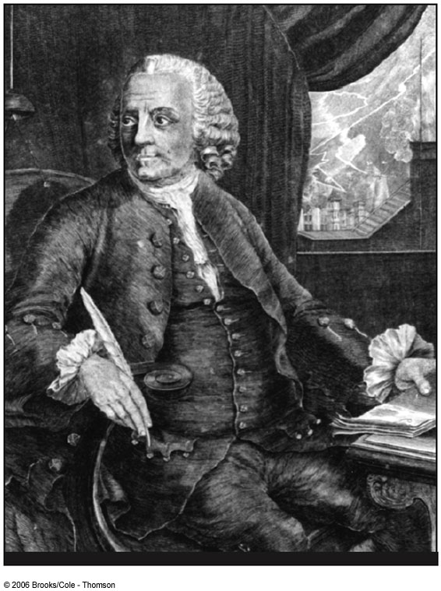
Benjamin Franklin
Believed there is only one kind of electric fluid, which is present in all bodies.
According to this theory, an object picks up an electric charge when some of this fluid is transferred from one body to another.

Slide 4
Benjamin Franklin
When an object is rubbed, it either gains or loses electricity and thereby picks up either a positive or negative charge. Objects with opposite charges attract each other; those with the same charge repel.

Slide 5
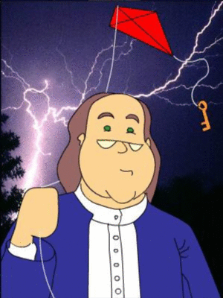
Benjamin Franklin.
Much of the language used to describe electricity was proposed by either Benjamin Franklin.
Franklin introduced the words plus, minus, positive, negative, charge, and battery.

Slide 6
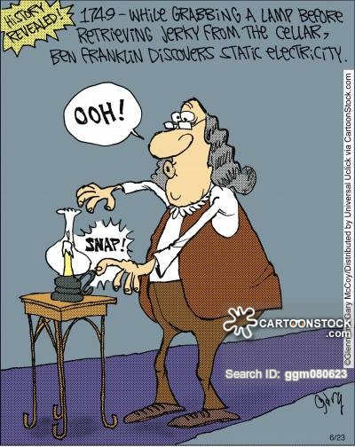
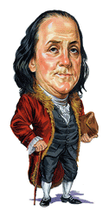

Slide 7
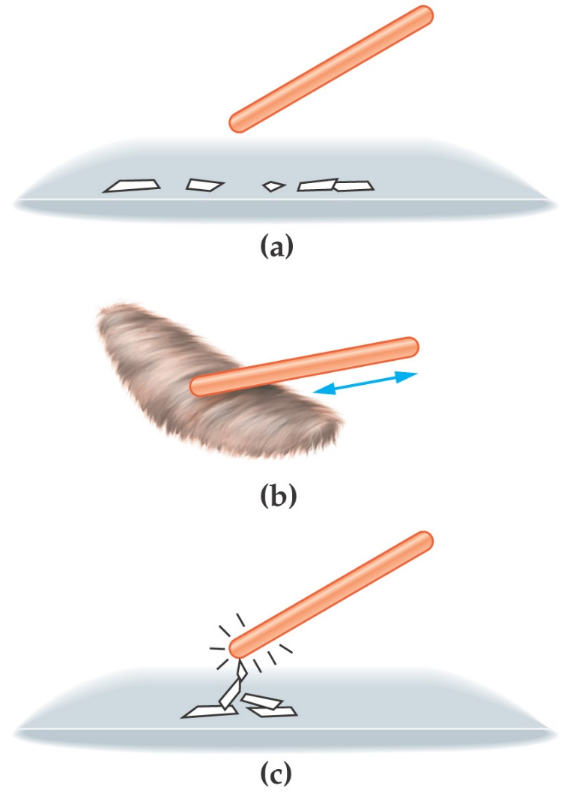
Electric Charge
The effects of electric charge were first observed as static electricity:
After being rubbed on a piece of fur, an amber rod acquires a charge and can attract small objects.
Notes:
7

Slide 8

Electrification
The process that produces electric charges on an object
Because the electric charge is confined to the object and is not moving, it is called an electrostatic charge

Slide 9
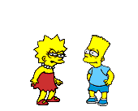
Basic Law of Electrostatics:
Objects that are similarly charged repel each other; and objects that are oppositely charged attract each other

Slide 10
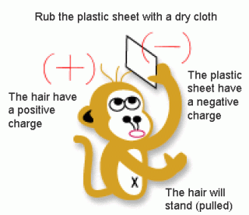
Static Electricity
Is stationary electricity in the form of an electric charge at rest
Is commonly produced by friction between 2 surfaces in close contact

Slide 11
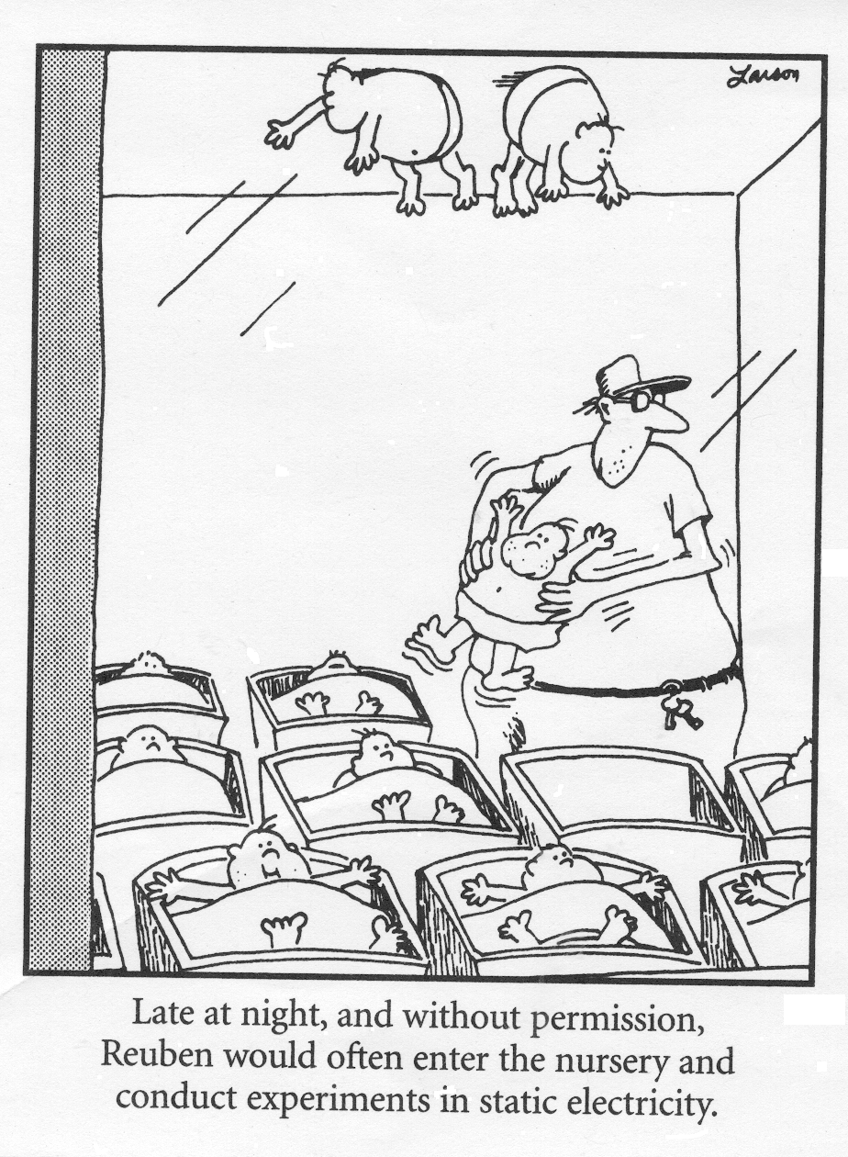
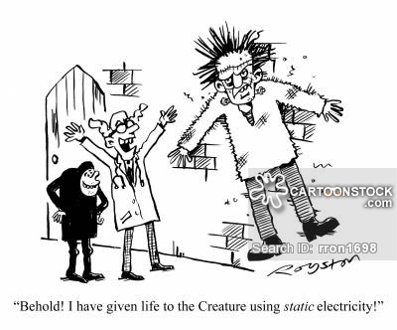

Slide 12
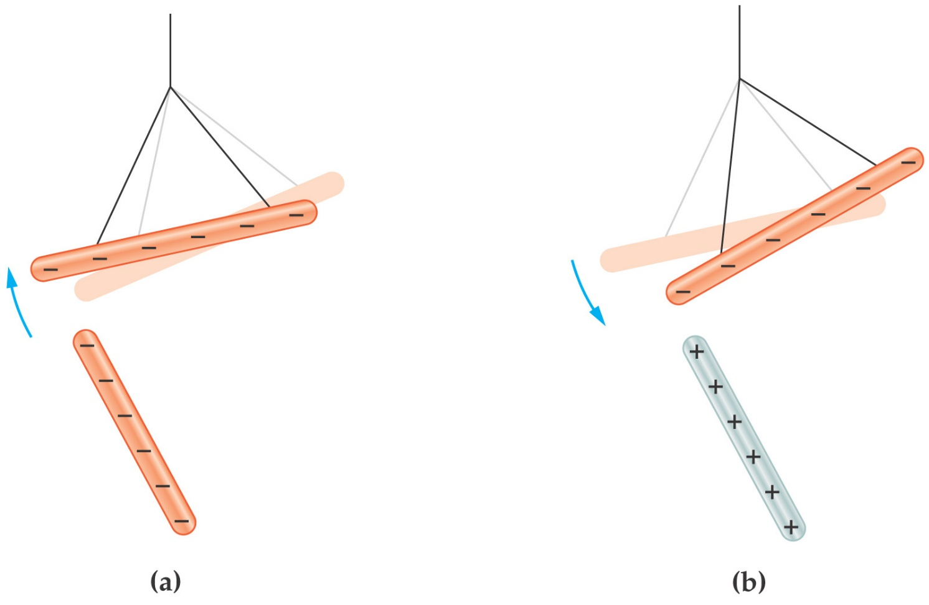
Electric Charge
Charging both amber and glass rods shows that there are two types of electric charge; like charges repel and opposites attract.
Notes:
12

Slide 13

Electric Charge and Matter
All electrons have exactly the same charge (negative); the charge on the proton (in the atomic nucleus) has the same magnitude but the opposite sign ( positive charge):
Notes:
13

Slide 14
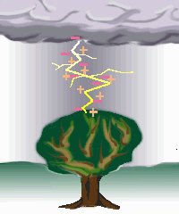
Electric Charge
“Charge” is a property of subatomic particles.
Facts about charge:
There are 2 types basically, positive (protons) and negative (electrons)
LIKE charges REPEL and OPPOSITE charges ATTRACT
Charges are symbolic of fluids in that they can be in 2 states, STATIC or DYNAMIC.

Slide 15
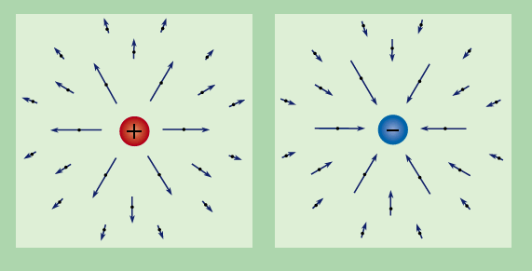
Electric Charge – The specifics
The symbol for CHARGE is “q”
The unit is the COULOMB(C), named after Charles Coulomb
If we are talking about a SINGLE charged particle such as 1 electron or 1 proton we are referring to an ELEMENTARY charge and often use, e , to symbolize this.
Some important constants:
Particle | Charge | Mass
Proton | 1.6x10⁻¹⁹ C | 1.67 x10⁻²⁷ kg
Electron | 1.6x10⁻¹⁹ C | 9.11 x10⁻³¹ kg
Neutron | 0 | 1.67 x10⁻²⁷ kg

Slide 16
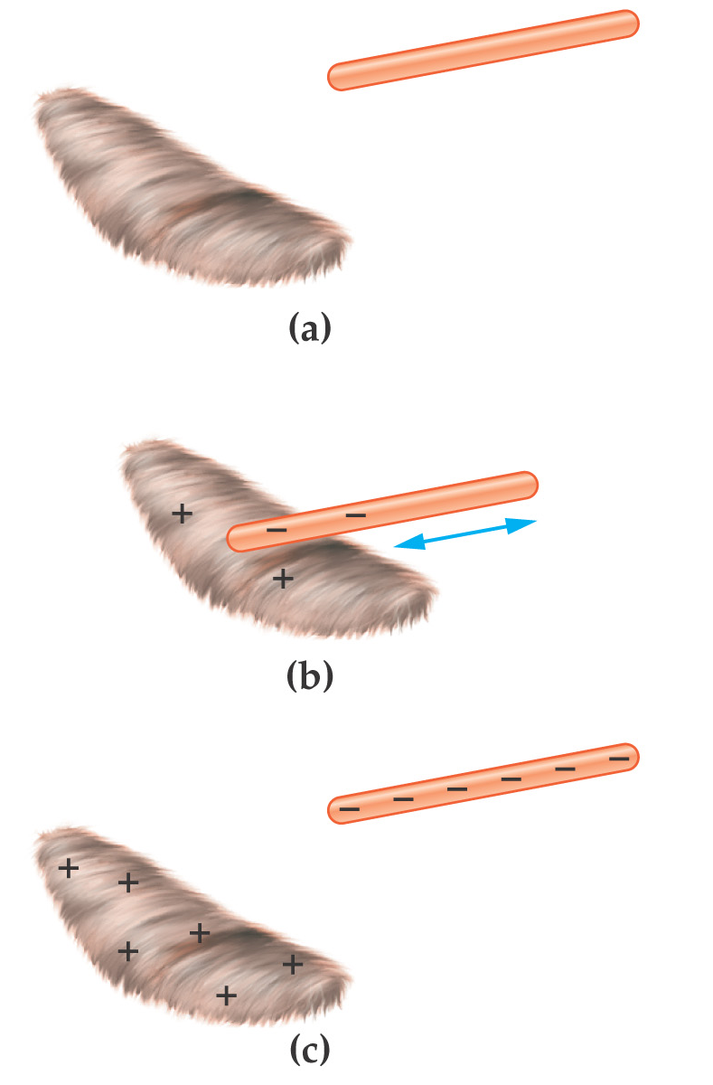
Electric Charge
When an amber rod is rubbed with fur, some of the electrons on the atoms in the fur are transferred to the amber:
All charged states result from the transfer of outer shell electrons from one object to another
Electric charge is a scalar quantity
Notes:
16

Slide 17
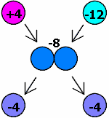
Charge is “CONSERVED”
Charge cannot be created or destroyed only transferred from one object to another. Even though these 2 charges attract initially, they repel after touching. Notice the NET charge stays the same.

Slide 18
Electric Charge
We find that the total electric charge of the universe is a constant:
Electric charge is conserved.
Also, electric charge is quantized in units of e.
The atom that has lost an electron is now positively charged – it is a positive ion
The atom that has gained an electron is now negatively charged – it is a negative ion
Notes:
18

Slide 19
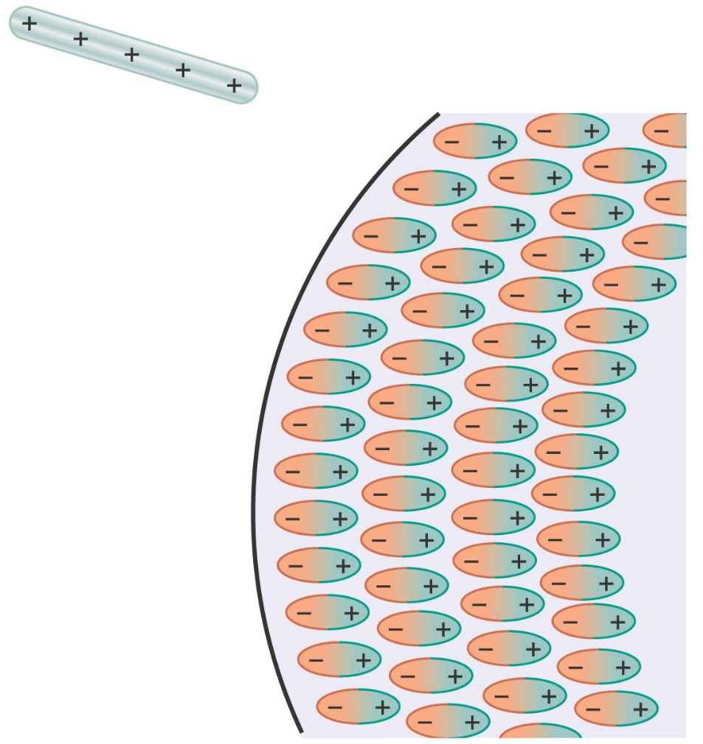
Electric Charge
Some materials can become polarized – this means that their atoms rotate in response to an external charge. This is how a charged object can attract a neutral one.
Notes:
19

Slide 20
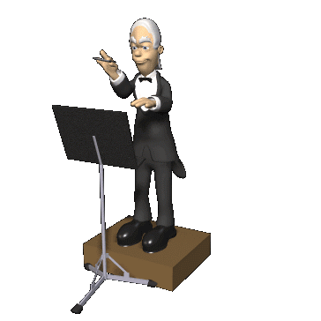
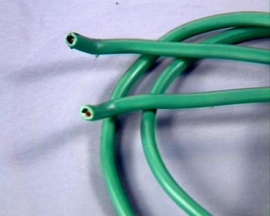
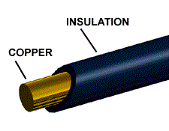
Conductors and Insulators
The movement of charge is limited by the substance the charge is trying to pass through. There are generally 2 types of substances.
Conductors: Allow charge to move readily though it.
Insulators: Restrict the movement of the charge
Conductor = Copper Wire
Insulator = Plastic sheath

Slide 21
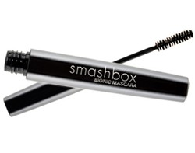
Charging and Discharging
There are basically 2 ways you can charge something.
Charge by friction
Induction
“BIONIC is the first-ever ionic formula mascara. The primary ingredient in BIONIC is a chain molecule with a positive charge. The friction caused by sweeping the mascara brush across lashes causes a negative charge. Since opposites attract, the positively charged formula adheres to the negatively charged lashes for a dramatic effect that lasts all day.”

Slide 22
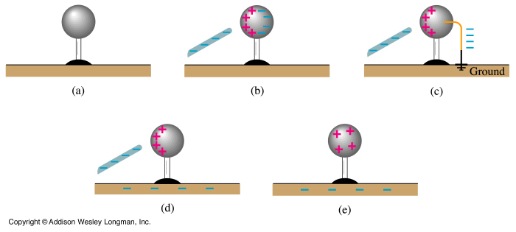
Induction and Grounding
The second way to charge something is via INDUCTION, which requires NO PHYSICAL CONTACT.
We bring a negatively charged rod near a neutral sphere. The protons in the sphere localize near the rod, while the electrons are repelled to the other side of the sphere. A wire can then be brought in contact with the negative side and allowed to touch the GROUND. The electrons will always move towards a more massive objects to increase separation from other electrons, leaving a NET positive sphere behind.

Slide 23
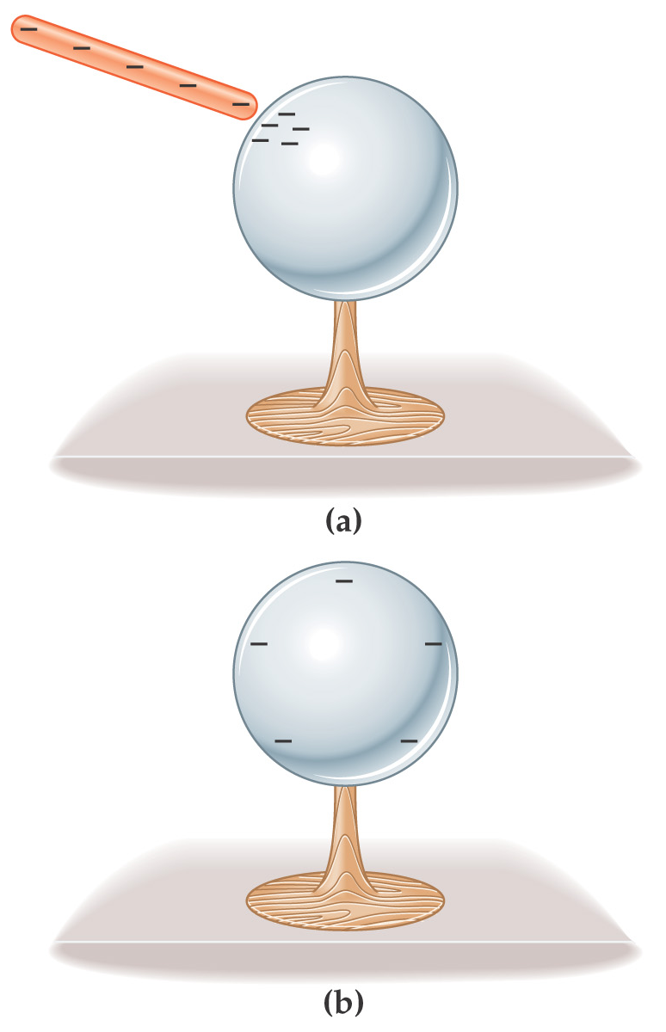
Insulators and Conductors
If a conductor carries excess charge, the excess is distributed over the surface of the conductor.
Notes:
23

Slide 24
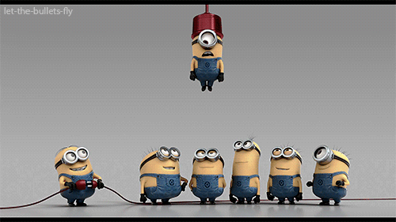
Insulators and Conductors
Semiconductors have properties intermediate between conductors and insulators; their properties change with their chemical composition.
Silicon and germanium are examples of semiconductors
Photoconductive materials become conductors when light shines on them.
Notes:
24

Slide 25
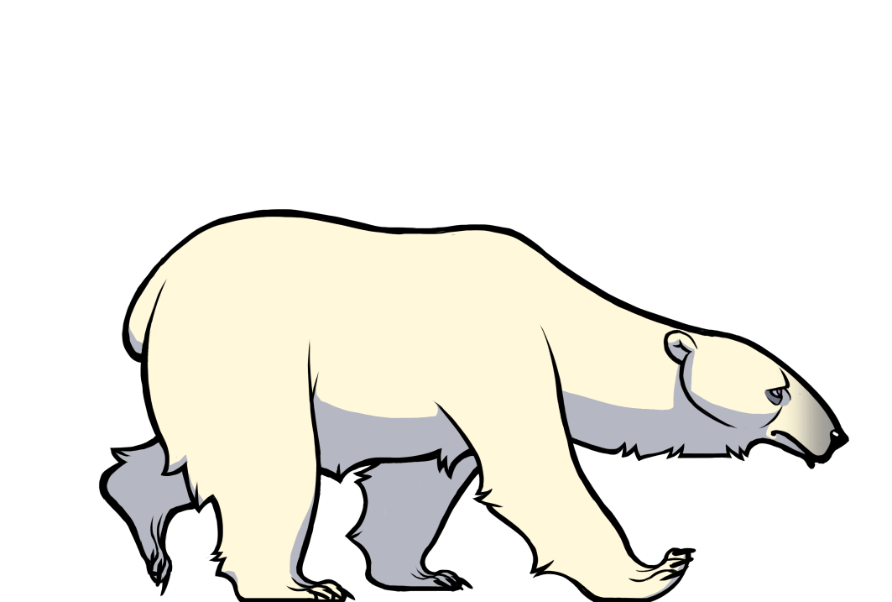
Polarization
In most neutral atoms or molecules, the center of positive charge coincides with the center of negative charge
In the presence of a charged object, these centers may separate slightly
  This results in more positive charge on one side of the molecule than on the other side
This realignment of charge on the surface of an insulator is known as polarization

Slide 26

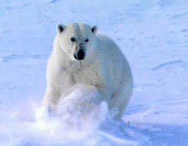
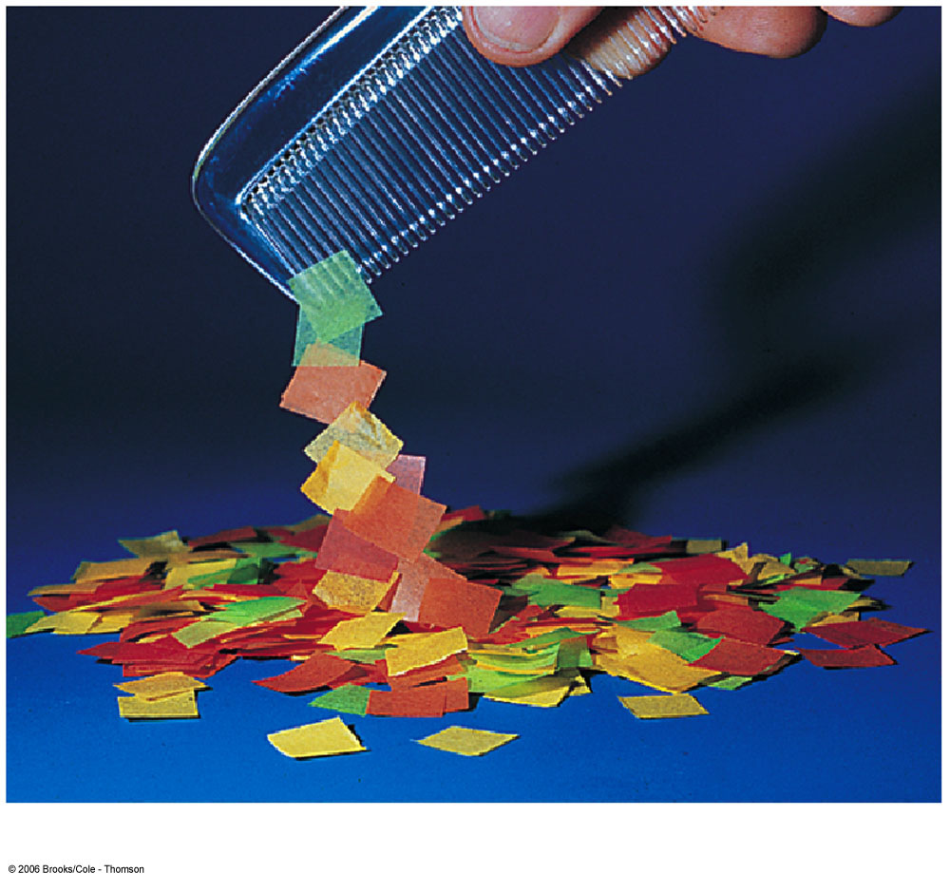
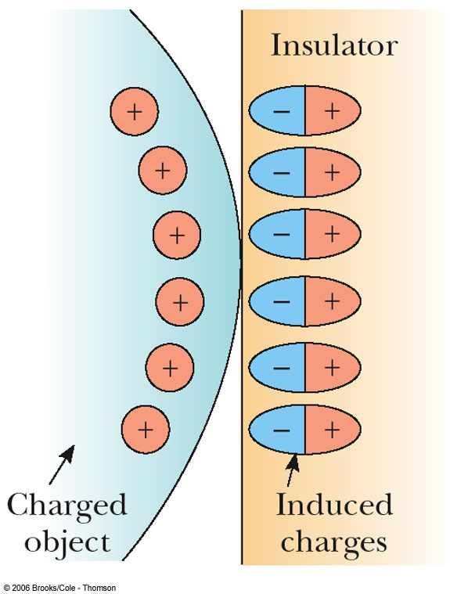
Examples of
Polarization
The charged object (on the left) induces charge on the surface of the insulator
A charged comb attracts bits of paper due to polarization of the paper

Slide 27
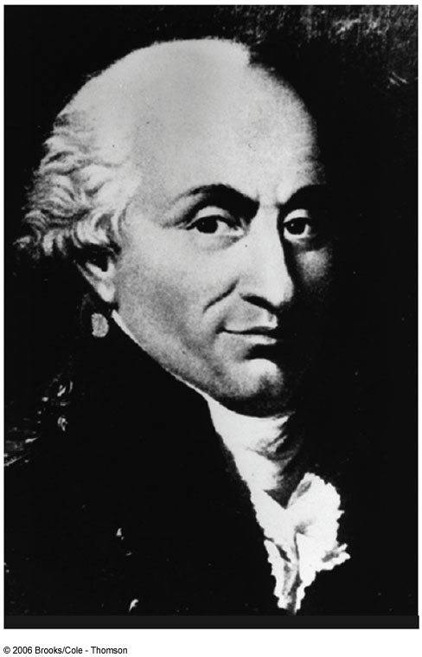
Charles Coulomb
1736 – 1806
Studied electrostatics and magnetism
Investigated strengths of materials
  Identified forces acting on beams

Slide 28
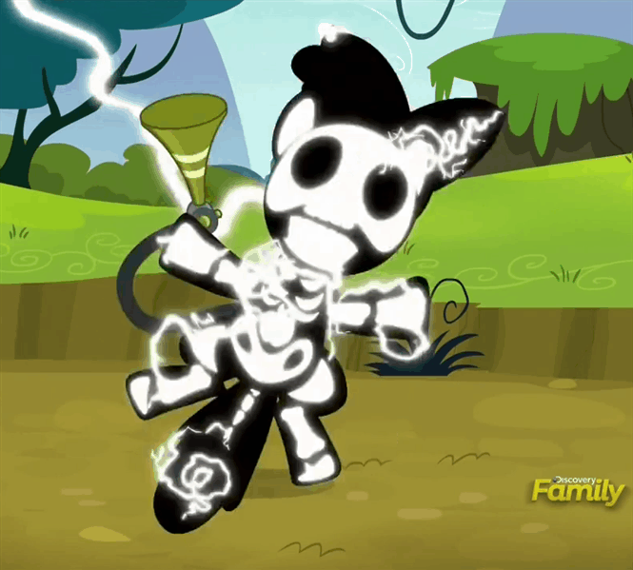
Coulomb’s Law
The force between 2 point charges is directly proportional to the product of their magnitudes and inversely proportional to the square of the distance between them

Slide 29

Coulomb’s Law:
Coulomb shows that an electrical force has the following properties:
  It is along the line joining the two particles and inversely proportional to the square of the separation distance, r, between them
  It is proportional to the product of the magnitudes of the charges, |q₁|and |q₂|on the two particles
  It is attractive if the charges are of opposite signs and repulsive if the charges have the same signs

Slide 30
Coulomb’s Law, cont.
Mathematically,
k_{e} is called the Coulomb Constant
  k_{e} = 8.9875 x 10⁹ N m²/C²
Typical charges can be in the µC range
  Remember, Coulombs must be used in the equation
Remember that force is a vector quantity
Applies only to point charges

Slide 31
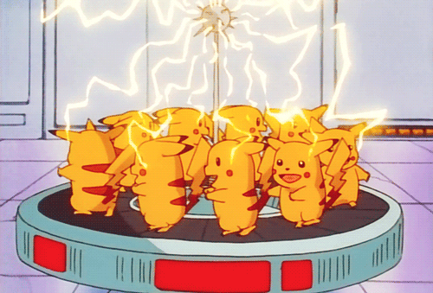
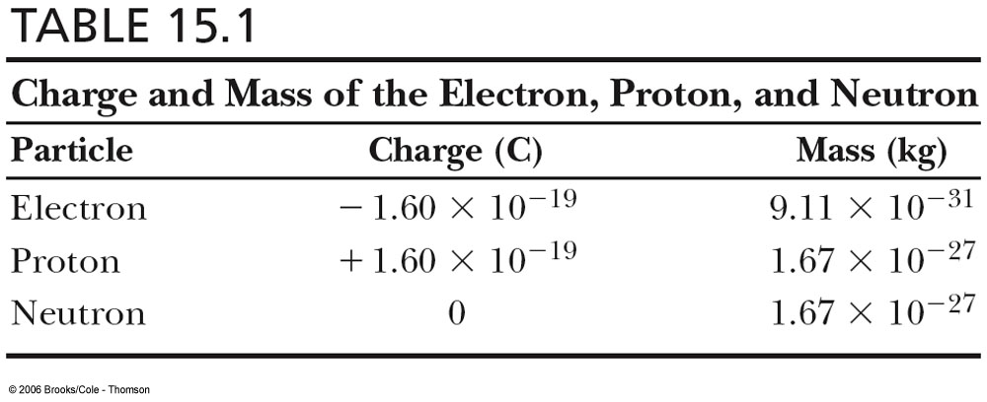
Characteristics of Particles

Slide 32
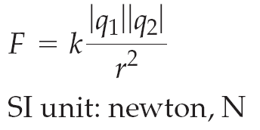
Coulomb’s Law
Coulomb’s law gives the force between two point charges:
The force is along the line connecting the charges, and is attractive if the charges are opposite, and repulsive if the charges are like.
Notes:
32

Slide 33
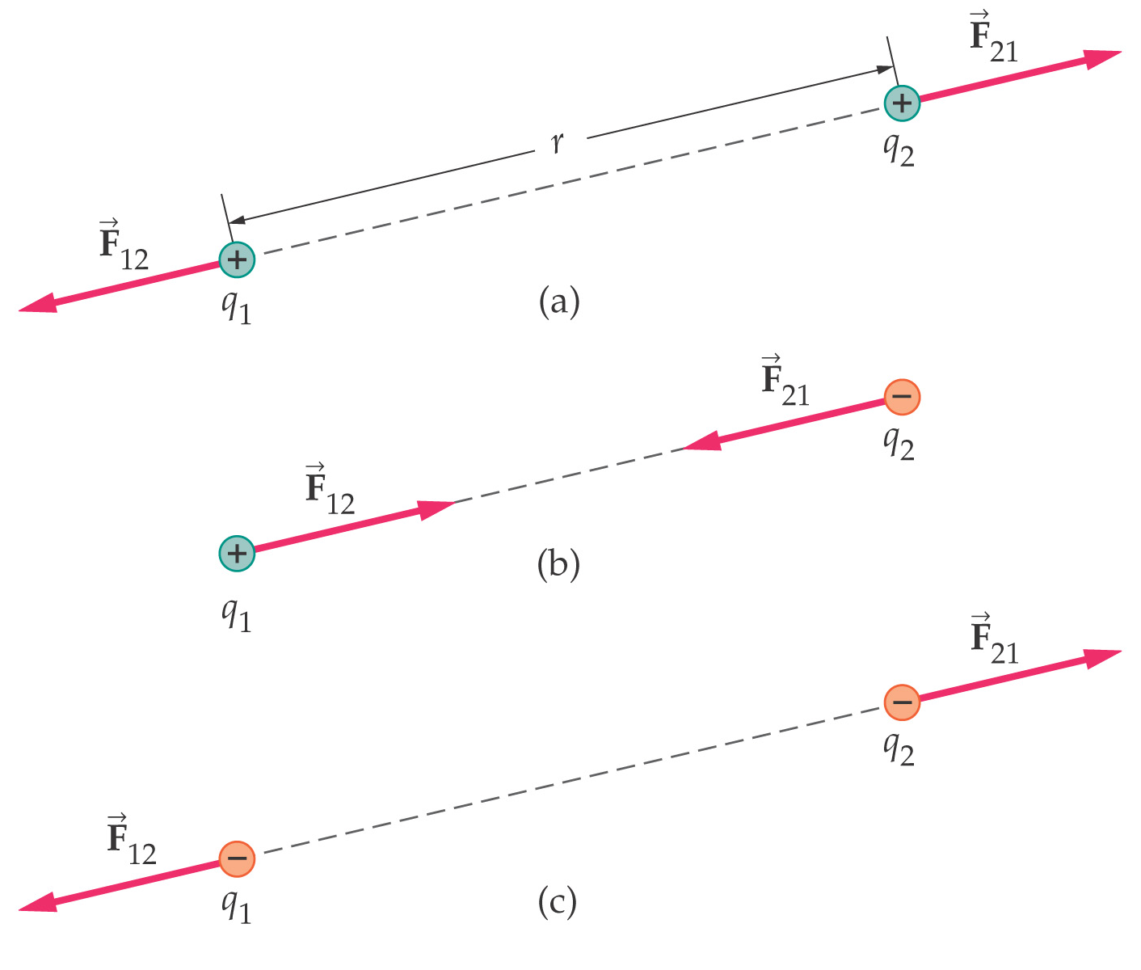
Coulomb’s Law
The forces on the two charges are action-reaction forces.
Notes:
33

Slide 34
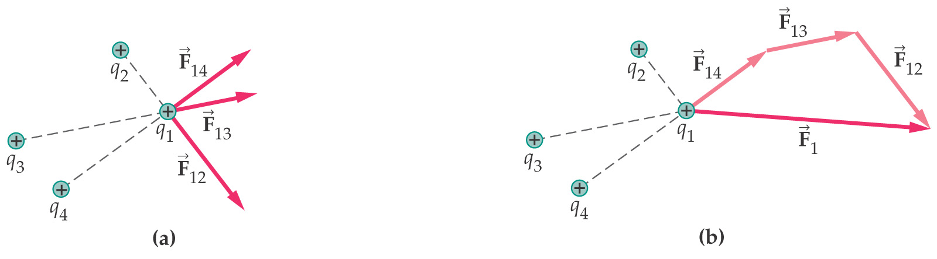
Coulomb’s Law
If there are multiple point charges, the forces add by superposition.
Notes:
34

Slide 35
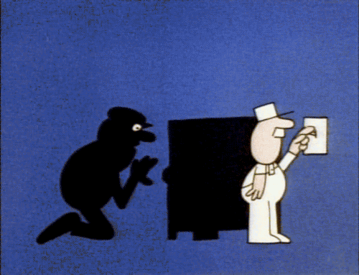
Coulomb’s Law
Coulomb’s law is stated in terms of point charges, but it is also valid for spherically symmetric charge distributions, as long as the distance is measured from the center of the sphere.
Notes:
35

Slide 36
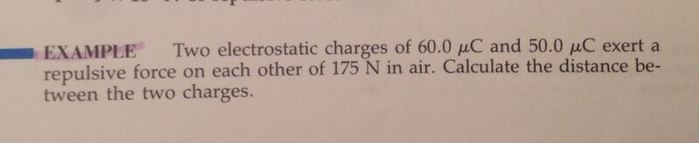

Slide 37
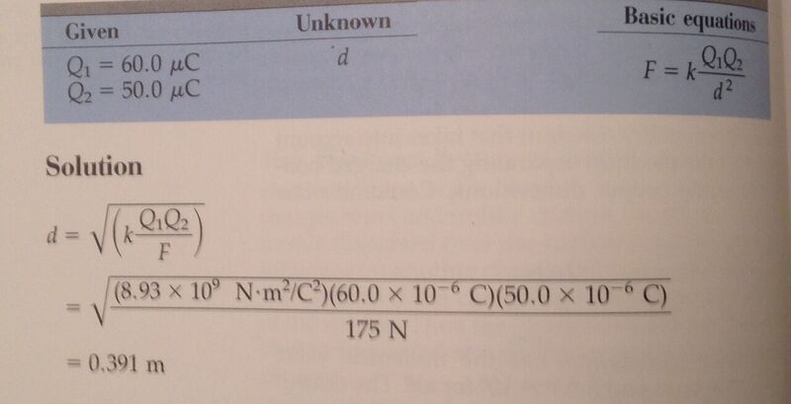

Slide 38
Electrical Forces are Field Forces
This is the second example of a field force
  Gravity was the first
Remember, with a field force, the force is exerted by one object on another object even though there is no physical contact between them
There are some important similarities and differences between electrical and gravitational forces

Slide 39
Electrical Force Compared to Gravitational Force
Both are inverse square laws
The mathematical form of both laws is the same
  Masses replaced by charges
Electrical forces can be either attractive or repulsive
Gravitational forces are always attractive
Electrostatic force is stronger than the gravitational force

Slide 40

The Superposition Principle
The resultant force on any one charge equals the vector sum of the forces exerted by the other individual charges that are present.
  Remember to add the forces as vectors

Slide 41
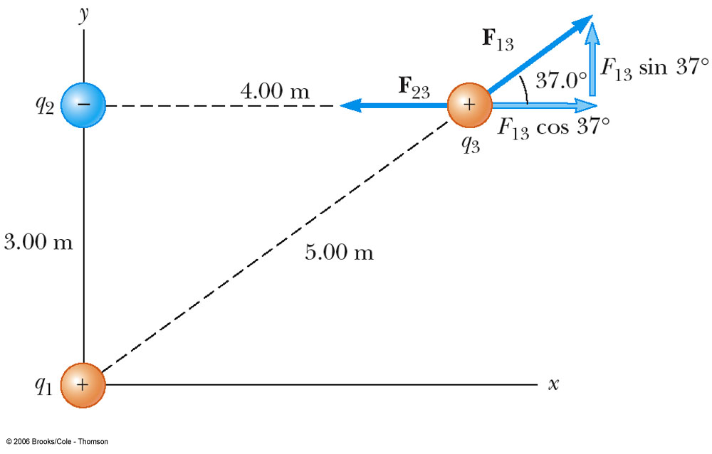
Superposition Principle Example
The force exerted by q₁ on q₃ is
The force exerted by q₂ on q₃ is
The total force exerted on q₃ is the vector sum of
and

Slide 42
Electrical Field
Maxwell developed an approach to discussing fields
An electric field is said to exist in the region of space around a charged object
  When another charged object enters this electric field, the field exerts a force on the second charged object

Slide 43
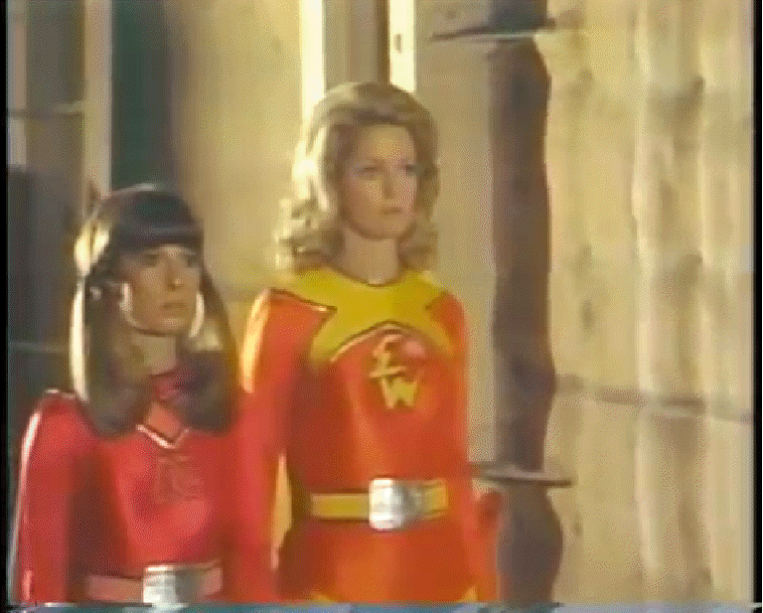
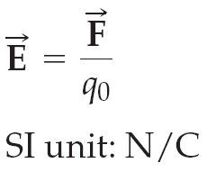
The Electric Field
Definition of the electric field:
Electric field exist in a region of space if an electric charge placed in that region is subject to an electric force
Here, q₀ is a “test charge” – it serves to allow the electric force to be measured, but is not large enough to create a significant force on any other charges.
Notes:
43

Slide 44
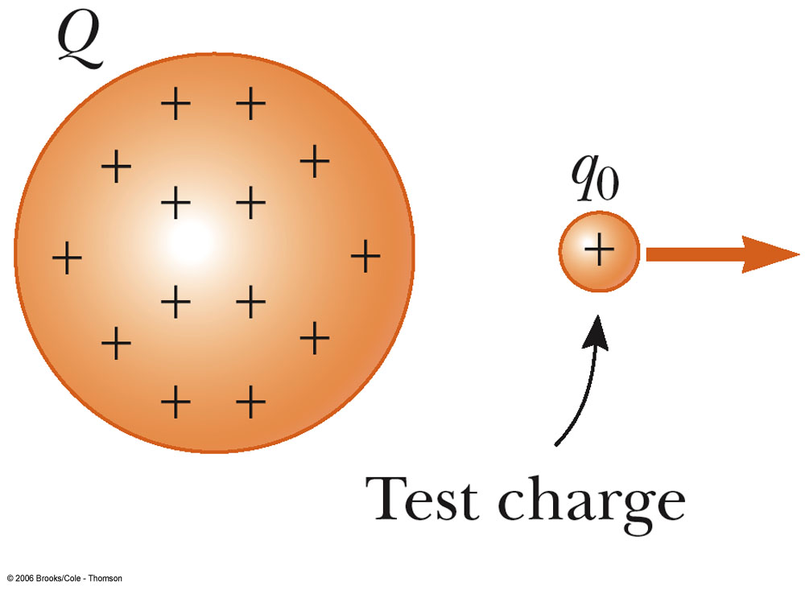
Electric Field, cont.
A charged particle, with charge Q, produces an electric field in the region of space around it
A small test charge, q_{o}, placed in the field, will experience a force

Slide 45
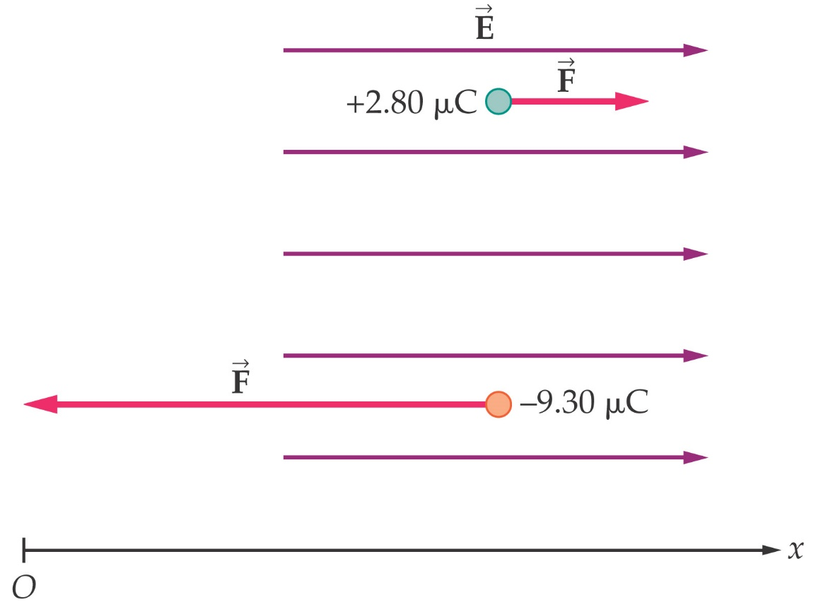
The Electric Field
If we know the electric field, we can calculate the force on any charge:
The direction of the force depends on the sign of the charge – in the direction of the field for a positive charge, opposite to it for a negative one.
Notes:
45

Slide 46
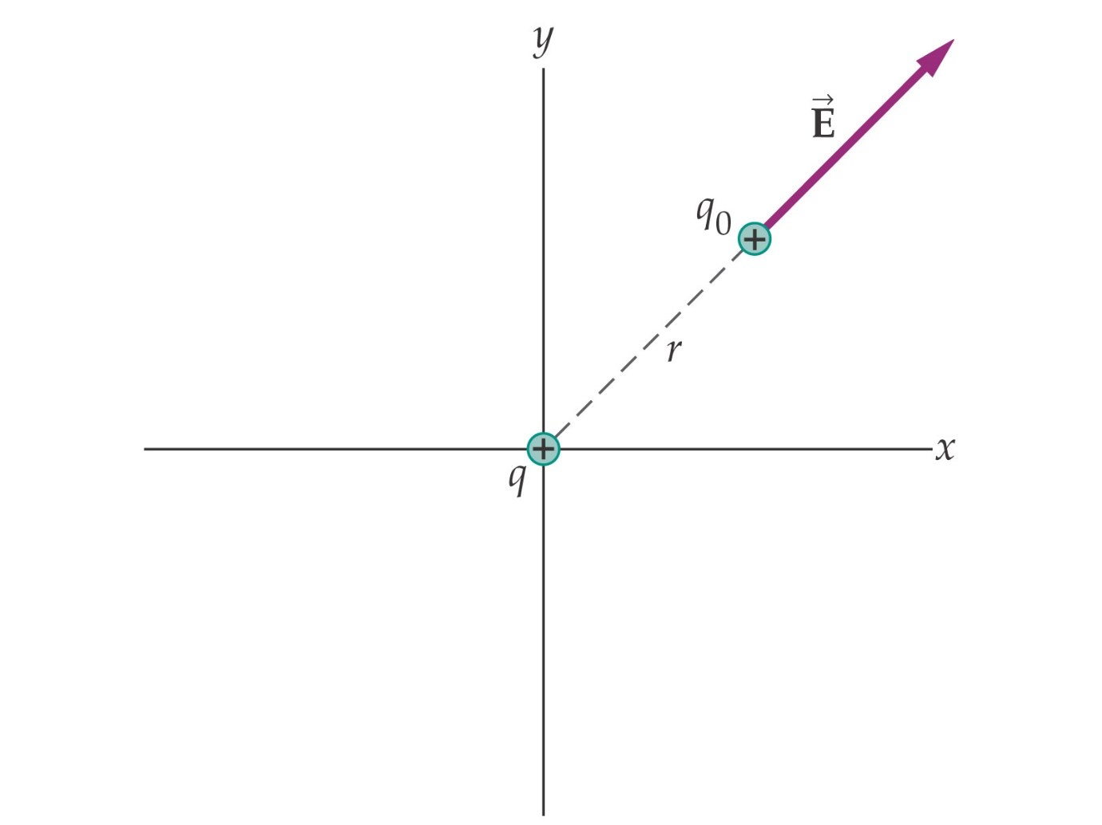
The Electric Field
The electric field of a point charge points radially away from a positive charge and towards a negative one.
Notes:
46

Slide 47
Electric Field
Mathematically,
SI units are N / C
Use this for the magnitude of the field
The electric field is a vector quantity
The direction of the field is defined to be the direction of the electric force that would be exerted on a small positive test charge placed at that point

Slide 48
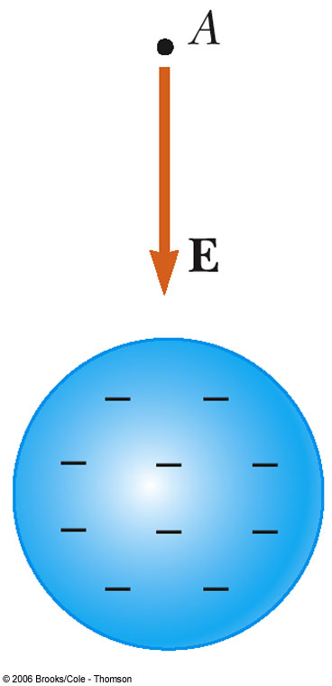
Direction of Electric Field
The electric field produced by a negative charge is directed toward the charge
  A positive test charge would be attracted to the negative source charge

Slide 49
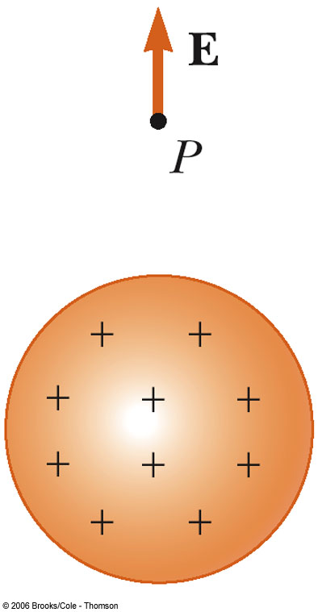
Direction of Electric Field, cont
The electric field produced by a positive charge is directed away from the charge
  A positive test charge would be repelled from the positive source charge

Slide 50
More About a Test Charge and The Electric Field
The test charge is required to be a small charge
  It can cause no rearrangement of the charges on the source charge
The electric field exists whether or not there is a test charge present
The Superposition Principle can be applied to the electric field if a group of charges is present

Slide 51
Electric Field Lines
A convenient aid for visualizing electric field patterns is to draw lines pointing in the direction of the field vector at any point
These are called electric field lines and were introduced by Michael Faraday

Slide 52
Electric Field Lines, cont.
The field lines are related to the field in the following manners:
  The electric field vector, , is tangent to the electric field lines at each point
  The number of lines per unit area through a surface perpendicular to the lines is proportional to the strength of the electric field in a given region

Slide 53
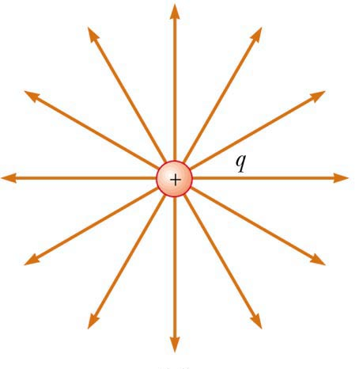
Electric Field Line Patterns
Point charge
The lines radiate equally in all directions
For a positive source charge, the lines will radiate outward

Slide 54
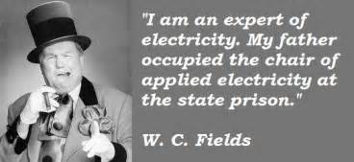
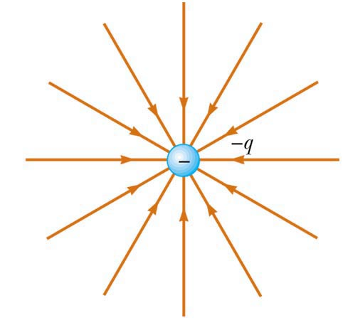
Electric Field Line Patterns
For a negative source charge, the lines will point inward

Slide 55
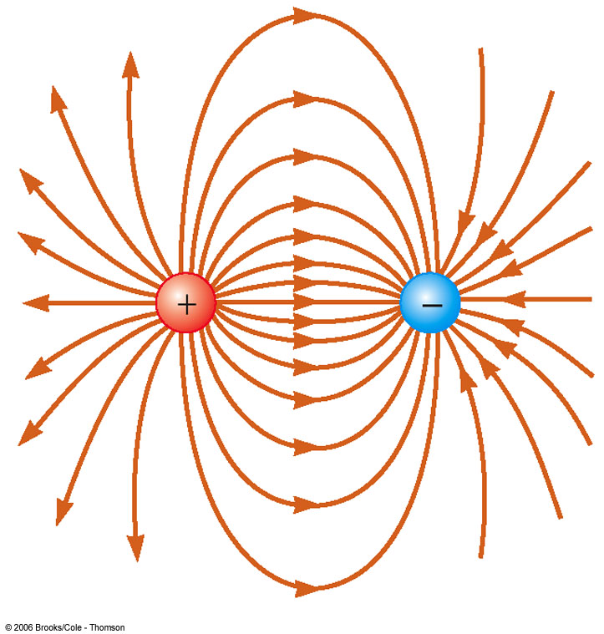
Electric Field Line Patterns
An electric dipole consists of two equal and opposite charges
The high density of lines between the charges indicates the strong electric field in this region

Slide 56

Electric Field Line Patterns
Two equal but like point charges
At a great distance from the charges, the field would be approximately that of a single charge of 2q
The bulging out of the field lines between the charges indicates the repulsion between the charges
The low field lines between the charges indicates a weak field in this region

Slide 57

Electric Field Patterns
Unequal and unlike charges
Note that two lines leave the +2q charge for each line that terminates on -q

Slide 58

Electric Field Lines
Electric field lines are a convenient way of visualizing the electric field.
Electric field lines:
Point in the direction of the field vector at every point
Start at positive charges or infinity
End at negative charges or infinity
Are more dense where the field is stronger
Notes:
58

Slide 59

Rules for Drawing Electric Field Lines
The lines for a group of charges must begin on positive charges and end on negative charges
  In the case of an excess of charge, some lines will begin or end infinitely far away
The number of lines drawn leaving a positive charge or ending on a negative charge is proportional to the magnitude of the charge
No two field lines can cross each other

Slide 60

The Electric Field
Just as electric forces can be superposed, electric fields can as well.
Notes:
60

Slide 61

Electric Field Lines
The charge on the right is twice the magnitude of the charge on the left (and opposite in sign), so there are twice as many field lines, and they point towards the charge rather than away from it.
Notes:
61

Slide 62

Electric Field Lines
Combinations of charges. Note that, while the lines are less dense where the field is weaker, the field is not necessarily zero where there are no lines. In fact, there is only one point within the figures below where the field is zero – can you find it?
Notes:
62

Slide 63

Electric Field Lines
A parallel-plate capacitor consists of two conducting plates with equal and opposite charges. Here is the electric field:
Notes:
63

Slide 64


Slide 65

Electric Fields and WORK
In order to bring two like charges near each other work must be done. In order to separate two opposite charges, work must be done. Remember that whenever work gets done, energy changes form.
As the monkey does work on the positive charge, he increases the energy of that charge. The closer he brings it, the more electrical potential energy it has. When he releases the charge, work gets done on the charge which changes its energy from electrical potential energy to kinetic energy. Every time he brings the charge back, he does work on the charge. If he brought the charge closer to the other object, it would have more electrical potential energy. If he brought 2 or 3 charges instead of one, then he would have had to do more work so he would have created more electrical potential energy. Electrical potential energy could be measured in Joules just like any other form of energy.

Slide 66

Electric Fields and WORK
Consider a negative charge moving in between 2 oppositely charged parallel plates initial KE=0 Final KE= 0, therefore in this case Work = ΔPE
We call this ELECTRICAL potential energy, U_{E}, and it is equal to the amount of work done by the ELECTRIC FORCE, caused by the ELECTRIC FIELD over distance, d, which in this case is the plate separation distance.
Is there a symbolic relationship with the FORMULA for gravitational potential energy?

Slide 67


Electric Force
The electric force between 2 objects is symbolic of the gravitational force between 2 objects. RECALL:

Slide 68
Electric Forces and Newton’s Laws
.
Example: An electron is released above the surface of the Earth. A second electron
directly below it exerts an electrostatic force on the first electron just great enough to cancel out the gravitational force on it. How far below the first electron is the second?
Electric Forces and Fields obey Newton’s Laws
F_{e}
e
mg
5.1 m
r = ?
e

Slide 69
Electric Forces and Vectors
Electric Fields and Forces are ALL vectors, thus all rules applying to vectors must be followed.
Consider three point charges, q₁ = 6.00 x10⁻⁹ C (located at the origin),q₃ = 5.00x10⁻⁹ C, and q₂ = -2.00x10⁻⁹ C, located at the corners of a RIGHT triangle. q₂ is located at y= 3 m while q₃ is located 4m to the right of q₂. Find the resultant force on q₃.
4m
Which way does q2 push q3?
Which way does q1 push q3?
q2
q3
3m
F_{on 3 due to 1}
5m
θ
q1
F_{on 3 due to 2}
θ = 37
q3
θ= tan⁻¹(3/4)

Slide 70
Example Cont’
4m
q2
q3
3m
F_{on 3 due to 1}
5m
θ
q1
F_{on 3 due to 2}
F_{3,1}sin37
θ = 37
θ= tan⁻¹(3/4)
q3
F_{3,1}cos37
5.6 x10⁻⁹ N
7.34x10⁻⁹ N
1.1x10⁻⁸ N
64.3 degrees above the +x

Slide 71

Electric Fields
By definition, the are “LINES OF FORCE”
Some important facts:
An electric field is a vector
Always is in the direction that a POSITIVE “test” charge would move
The amount of force PER “test” charge
If you placed a 2nd positive charge (test charge), near the positive charge shown above, it would move AWAY.
If you placed that same charge near the negative charge shown above it would move TOWARDS.

Slide 72
Electric Fields and Newton’s Laws
Once again, the equation for ELECTRIC FIELD is symbolic of the equation for WEIGHT just like coulomb’s law is symbolic of Newton’s Law of Gravitation.
The symbol for Electric Field is, “E”. And since it is defined as a force per unit charge he unit is Newtons per Coulomb, N/C.
NOTE: the equations above will ONLY help you determine the MAGNITUDE of the field or force. Conceptual understanding will help you determine the direction.
The “q” in the equation is that of a “test charge”.

Slide 73
Example
An electron and proton are each placed at rest in an external field of 520 N/C. Calculate the speed of each particle after 48 ns
What do we know
m_{e}=9.11 x 10⁻³¹ kg
m_{p}= 1.67 x10⁻²⁷ kg
q_{both}=1.6 x10⁻¹⁹ C
v_{o} = 0 m/s
E = 520 N/C
t = 48 x 10⁻⁹ s
8.32 x10⁻¹⁹ N
9.13x10¹³ m/s/s
4.98 x10¹⁰ m/s/s
4.38 x10⁶ m/s
2.39 x10³ m/s

Slide 74

An Electric Point Charge
As we have discussed, all charges exert forces on other charges due to a field around them. Suppose we want to know how strong the field is at a specific point in space near this charge the calculate the effects this charge will have on other charges should they be placed at that point.
TEST CHARGE
POINT CHARGE

Slide 75
Example
A -4x10⁻¹²C charge Q is placed at the origin. What is the magnitude and direction of the electric field produced by Q if a test charge were placed at x = -0.2 m ?
0.2 m
E
0.899 N/C
E
-Q
E
Towards Q to the right
E
Remember, our equations will only give us MAGNITUDE. And the electric field LEAVES POSITIVE and ENTERS NEGATIVE.

Slide 76

Electric Field of a Conductor
A few more things about electric fields, suppose you bring a conductor NEAR a charged object. The side closest to which ever charge will be INDUCED the opposite charge. However, the charge will ONLY exist on the surface. There will never be an electric field inside a conductor. Insulators, however, can store the charge inside.
There must be a negative charge on this side OR this side was induced positive due to the other side being negative.
There must be a positive charge on this side

Slide 77

Shielding and Charge by Induction
Since excess charge on a conductor is free to move, the charges will move so that they are as far apart as possible. This means that excess charge on a conductor resides on its surface, as in the upper diagram.
Notes:
77

Slide 78


Shielding and Charge by Induction
When electric charges are at rest, the electric field within a conductor is zero.
Notes:
78

Slide 79

Shielding and Charge by Induction
The electric field is always perpendicular to the surface of a conductor – if it weren’t, the charges would move along the surface.
Notes:
79

Slide 80

Shielding and Charge by Induction
The electric field is stronger where the surface is more sharply curved.
Notes:
80

Slide 81


Shielding and Charge by Induction
A conductor can be charged by induction, if there is a way to ground it.
This allows the like charges to leave the conductor; if the conductor is then isolated before the rod is removed, only the excess charge remains.
Notes:
81

Slide 82


Van de Graaff
Generator
An electrostatic generator designed and built by Robert J. Van de Graaff in 1929
Charge is transferred to the dome by means of a rotating belt
Eventually an electrostatic discharge takes place

Slide 83

Electric Flux and Gauss’s Law
Electric flux is a measure of the electric field perpendicular to a surface:
Notes:
83

Slide 84

Electric Flux and Gauss’s Law
Gauss’s law states that the electric flux through a closed surface is proportional to the charge enclosed by the surface:
Notes:
84

Slide 85


Electric Flux and Gauss’s Law
Gauss’s law can be used to find the electric field in systems with simple configurations.
Notes:
85

Slide 86

Summary
Electrons have a negative charge, and protons a positive charge, of magnitude
Unit of charge: Coulomb, C
Charge is conserved, and quantized in units of e
Insulators do not allow electrons to move between atoms; conductors allow conduction electrons to flow freely
Notes:
86

Slide 87
Summary of
The force between electric charges is along the line connecting them
Like charges repel, opposites attract
Coulomb’s law gives the magnitude of the force:
Forces exerted by several charges add as vectors
Notes:
87

Slide 88
Summary
A spherical charge distribution behaves from the outside as though the total charge were at its center
Electric field is the force per unit charge; for a point charge:
Electric fields created by several charges add as vectors
Notes:
88

Slide 89
Summary
Electric field lines help visualize the electric field
Field lines point in the direction of the field; start on + charges or infinity; end on – charges or infinity; are denser where is greater
Parallel-plate capacitor: two oppositely charged, conducting parallel plates
Excess charge on a conductor is on the surface
Electric field within a conductor is zero (if charges are static)
Notes:
89

Slide 90

Summary
A conductor can be charged by induction
Conductors can be grounded
Electric flux through a surface:
Gauss’s law:
Notes:
90

Slide 91

Electrical Energy, Potential and Capacitance

Slide 92
Electric Potential
Here we see the equation for gravitational potential energy.
Instead of gravitational potential energy we are talking about ELECTRIC POTENTIAL ENERGY
A charge will be in the field instead of a mass
The field will be an ELECTRIC FIELD instead of a gravitational field
The displacement is the same in any reference frame and use various symbols
Putting it all together!
Question: What does the LEFT side of the equation mean in words?
The amount of Energy per charge!

Slide 93

Energy per charge
The amount of energy per charge has a specific name and it is called, VOLTAGE or ELECTRIC POTENTIAL (difference). Why the “difference”?

Slide 94

Understanding “Difference”
Let’s say we have a proton placed between a set of charged plates. If the proton is held fixed at the positive plate, the ELECTRIC FIELD will apply a FORCE on the proton (charge). Since like charges repel, the proton is considered to have a high potential (voltage) similar to being above the ground. It moves towards the negative plate or low potential (voltage). The plates are charged using a battery source where one side is positive and the other is negative. The positive side is at 9V, for example, and the negative side is at 0V. So basically the charge travels through a “change in voltage” much like a falling mass experiences a “change in height. (Note: The electron does the opposite)

Slide 95

BEWARE!!!!!!
W is Electric Potential Energy (Joules)
is not
V is Electric Potential (Joules/Coulomb)
a.k.a Voltage, Potential Difference

Slide 96

The “other side” of that equation?
Since the amount of energy per charge is called Electric Potential, or Voltage, the product of the electric field and displacement is also VOLTAGE
This makes sense as it is applied usually to a set of PARALLEL PLATES.
ΔV=Ed
ΔV
E
d

Slide 97

Example
A pair of oppositely charged, parallel plates are separated by 5.33 mm. A potential difference of 600 V exists between the plates. (a) What is the magnitude of the electric field strength between the plates? (b) What is the magnitude of the force on an electron between the plates?
113,207.55 N/C
1.81x10⁻¹⁴ N

Slide 98
Example
Calculate the speed of a proton that is accelerated from rest through a potential difference of 120 V
1.52x10⁵ m/s

Slide 99

Electric Potential of a Point Charge
Up to this point we have focused our attention solely to that of a set of parallel plates. But those are not the ONLY thing that has an electric field. Remember, point charges have an electric field that surrounds them.
So imagine placing a TEST CHARGE out way from the point charge. Will it experience a change in electric potential energy? YES!
Thus is also must experience a change in electric potential as well.

Slide 100
Electric Potential
Let’s use our “plate” analogy. Suppose we had a set of parallel plates symbolic of being “above the ground” which has potential difference of 50V and a CONSTANT Electric Field.
+++++++++++
ΔV = ? From 1 to 2
ΔV = ? From 2 to 3
ΔV = ? From 3 to 4
ΔV = ? From 1 to 4
1
25 V
0 V
2
3
0.5d, V=
d
E
25 V
12.5 V
4
0.25d, V=
12.5 V
37.5 V
----------------
Notice that the “ELECTRIC POTENTIAL” (Voltage) DOES NOT change from 2 to 3. They are symbolically at the same height and thus at the same voltage. The line they are on is called an EQUIPOTENTIAL LINE. What do you notice about the orientation between the electric field lines and the equipotential lines?

Slide 101

Equipotential Lines
So let’s say you had a positive charge. The electric field lines move AWAY from the charge. The equipotential lines are perpendicular to the electric field lines and thus make concentric circles around the charge. As you move AWAY from a positive charge the potential decreases. So V1>V2>V3.
Now that we have the direction or visual aspect of the equipotential line understood the question is how can we determine the potential at a certain distance away from the charge?
r
V(r) = ?

Slide 102
Electric Potential of a Point Charge
Why the “sum” sign?
Voltage, unlike Electric Field, is NOT a vector! So if you have MORE than one charge you don’t need to use vectors. Simply add up all the voltages that each charge contributes since voltage is a SCALAR.
WARNING! You must use the “sign” of the charge in this case.

Slide 103

Potential of a point charge
Suppose we had 4 charges each at the corners of a square with sides equal to d.
If I wanted to find the potential at the CENTER I would SUM up all of the individual potentials.

Slide 104
Electric field at the center? ( Not so easy)
If they had asked us to find the electric field, we first would have to figure out the visual direction, use vectors to break individual electric fields into components and use the Pythagorean Theorem to find the resultant and inverse tangent to find the angle
So, yea….Electric Potentials are NICE to deal with!
E_{resultant}

Slide 105
Example
An electric dipole consists of two charges q₁ = +12nC and q₂ = -12nC, placed 10 cm apart as shown in the figure. Compute the potential at points a,b, and c.
-899 V

Slide 106
Example cont’
1926.4 V
0 V
Since direction isn’t important, the electric potential at “c” is zero. The electric field however is NOT. The electric field would point to the right.

Slide 107

Applications of Electric Potential
Is there any way we can use a set of plates with an electric field? YES! We can make what is called a Parallel Plate Capacitor and Store Charges between the plates!
Storing Charges- Capacitors
A capacitor consists of 2 conductors of any shape placed near one another without touching. It is common; to fill up the region between these 2 conductors with an insulating material called a dielectric. We charge these plates with opposing charges to
set up an electric field.

Slide 108

Capacitors in Kodak Cameras
Capacitors can be easily purchased at a local Radio Shack and are commonly found in disposable Kodak Cameras. When a voltage is applied to an empty capacitor, current flows through the capacitor and each side of the capacitor becomes charged. The two sides have equal and opposite charges. When the capacitor is fully charged, the current stops flowing. The collected charge is then ready to be discharged and when you press the flash it discharges very quickly released it in the form of light.
Cylindrical Capacitor

Slide 109
Capacitance
In the picture below, the capacitor is symbolized by a set of parallel lines. Once it's charged, the capacitor has the same voltage as the battery (1.5 volts on the battery means 1.5 volts on the capacitor) The difference between a capacitor and a battery is that a capacitor can dump its entire charge in a tiny fraction of a second, where a battery would take minutes to completely discharge itself. That's why the electronic flash on a camera uses a capacitor -- the battery charges up the flash's capacitor over several seconds, and then the capacitor dumps the full charge into the flash tube almost instantly

Slide 110

Measuring Capacitance
Let’s go back to thinking about plates!
The unit for capacitance is the FARAD, F.

Slide 111

Capacitor Geometry
The capacitance of a capacitor depends on HOW you make it.

Slide 112
Capacitor Problems
What is the AREA of a 1F capacitor that has a plate separation of 1 mm?
Is this a practical capacitor to build?
NO! – How can you build this then?
The answer lies in REDUCING the AREA. But you must have a CAPACITANCE of 1 F. How can you keep the capacitance at 1 F and reduce the Area at the same time?
1.13x10⁸ m²
10629 m
Add a DIELECTRIC!!!

Slide 113
Dielectric
Remember, the dielectric is an insulating material placed between the conductors to help store the charge. In the previous example we assumed there was NO dielectric and thus a vacuum between the plates.
All insulating materials have a dielectric constant associated with it. Here now you can reduce the AREA and use a LARGE dielectric to establish the capacitance at 1 F.

Slide 114

Using MORE than 1 capacitor
Let’s say you decide that 1 capacitor will not be enough to build what you need to build. You may need to use more than 1. There are 2 basic ways to assemble them together
Series – One after another
Parallel – between a set of junctions and parallel to each other.

Slide 115
Capacitors in Series
Capacitors in series each charge each other by INDUCTION. So they each have the SAME charge. The electric potential on the other hand is divided up amongst them. In other words, the sum of the individual voltages will equal the total voltage of the battery or power source.

Slide 116

Capacitors in Parallel
In a parallel configuration, the voltage is the same because ALL THREE capacitors touch BOTH ends of the battery. As a result, they split up the charge amongst them.

Slide 117

Capacitors “STORE” energy
Anytime you have a situation where energy is “STORED” it is called POTENTIAL. In this case we have capacitor potential energy, U_{c}
Suppose we plot a V vs. Q graph. If we wanted to find the AREA we would MULTIPLY the 2 variables according to the equation for Area.
A = bh
When we do this we get Area = VQ
Let’s do a unit check!
Voltage = Joules/Coulomb
Charge = Coulombs
Area =
ENERGY

Slide 118
Potential Energy of a Capacitor
Since the AREA under the line is a triangle, the ENERGY(area) =1/2VQ
This energy or area is referred as the potential energy stored inside a capacitor.
Note: The slope of the line is the inverse of the capacitance.
most common form

Slide 119

Enemy of the State: Right! Faraday Cage
Kudos to another unlikely laws-of-physics abider: the Will Smith vehicle Enemy of the State.
In it, a kooky ex-National Security Agency operative played by Gene Hackman lives and works in something he calls "the Jar," a structure surrounded by a copper mesh that he claims keeps the NSA's prying eyes off him because of its imperviousness to radio frequencies.

Slide 120
Enemy of the State
As you've probably discovered yourself while in a building constructed with certain types of reinforced concrete, some materials metals have a knack for soaking up static electrical fields and sappping your cellphone reception--and copper is one of them.
Whether built intentionally or not, this type of metallic shield is called a Faraday cage, after lifetime physics-hall-of-fame member Michael Faraday.
Put simply, copper's conductivity effectively cancels out most electrical fields that come into contact with it, keeping the area inside a radio-free zone.
Since the mesh surrounding Hackman's "Jar" is particularly fine, and because most radio and television waves have a wavelength of five meters or more, they aren't able to penetrate.
Come on in, Will, you're safe here!

