Slide 1
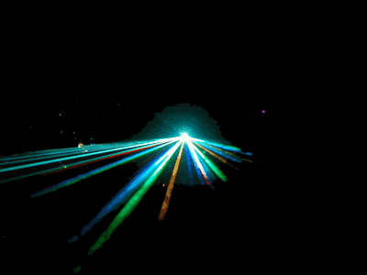
Unit 10: Nature of Light

Slide 2
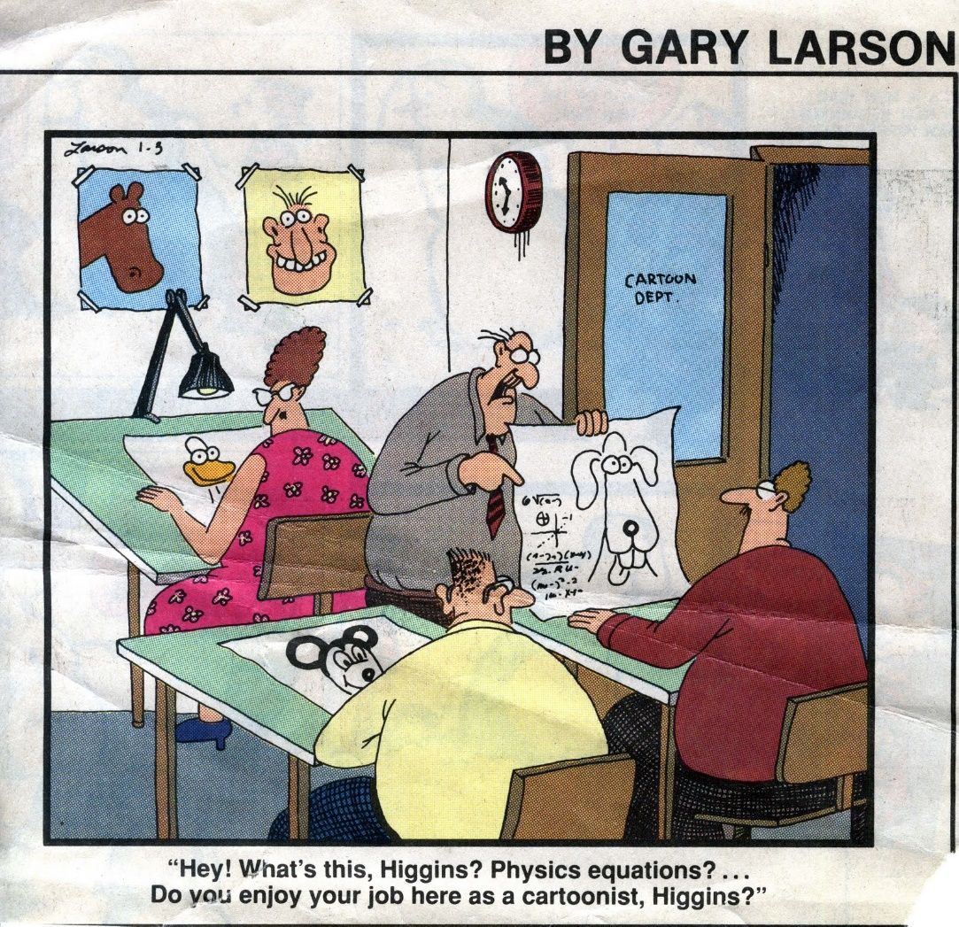

Slide 3
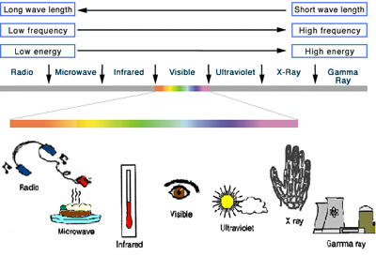
Facts about Light
It is a form of Electromagnetic Energy
It is a part of the Electromagnetic Spectrum and the only part we can really see

Slide 4
Facts about Light
The speed of light, c, is constant in a vacuum.
Light can be:
REFLECTED
ABSORBED
REFRACTED
Light is an electromagnetic wave in that it has wave like properties which can be influenced by electric and magnetic fields.

Slide 5

A Brief History of Light
1000 AD
  It was proposed that light consisted of tiny particles
Newton
  Used this particle model to explain reflection and refraction
Huygens
  1678
  Explained many properties of light by proposing light was wave-like

Slide 6
A Brief History of Light, cont
Young
  1801
  Strong support for wave theory by showing interference
Maxwell
  1865
  Electromagnetic waves travel at the speed of light

Slide 7
A Brief History of Light, final
Planck
  EM radiation is quantized
    Implies particles
  Explained light spectrum emitted by hot objects
Einstein
  Particle nature of light
  Explained the photoelectric effect

Slide 8

The Particle Nature of Light
“Particles” of light are called photons
Each photon has a particular energy
  E = h ƒ
  h is Planck’s constant
    h = 6.63 x 10⁻³⁴ J s
  Encompasses both natures of light
    Interacts like a particle
    Has a given frequency like a wave

Slide 9
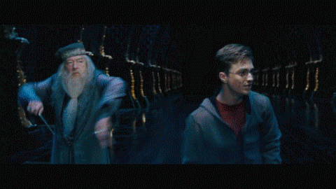
Dual Nature of Light
Experiments can be devised that will display either the wave nature or the particle nature of light
  In some experiments light acts as a wave and in others it acts as a particle
Nature prevents testing both qualities at the same time

Slide 10
Geometric Optics – Using a Ray Approximation
Light travels in a straight-line path in a homogeneous medium until it encounters a boundary between two different media
The ray approximation is used to represent beams of light
A ray of light is an imaginary line drawn along the direction of travel of the light beams

Slide 11
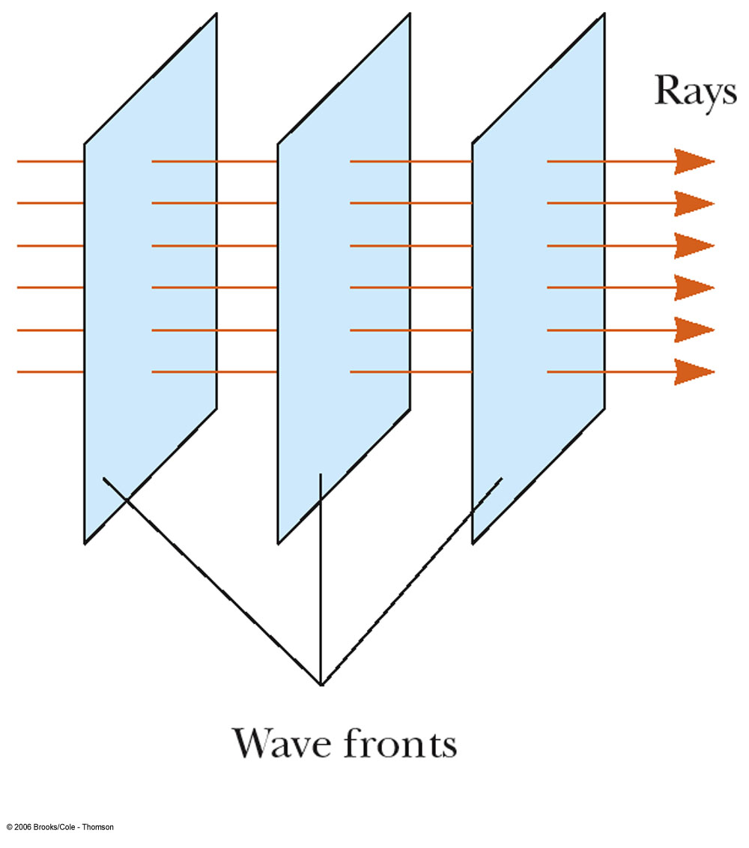
Ray Approximation
A wave front is a surface passing through points of a wave that have the same phase and amplitude
The rays, corresponding to the direction of the wave motion, are perpendicular to the wave fronts

Slide 12
Reflection of Light
A ray of light, the incident ray, travels in a medium
When it encounters a boundary with a second medium, part of the incident ray is reflected back into the first medium
  This means it is directed backward into the first medium

Slide 13
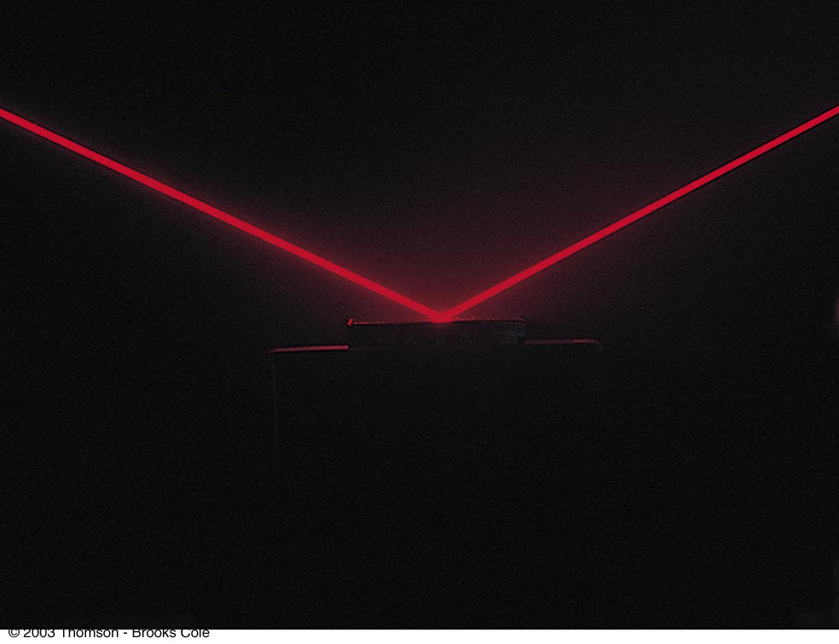
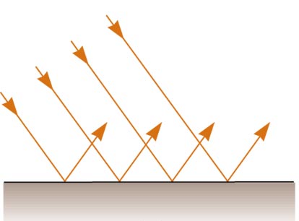
Specular
Reflection
Specular reflection is reflection from a smooth surface
The reflected rays are parallel to each other
All reflection in this text is assumed to be specular

Slide 14
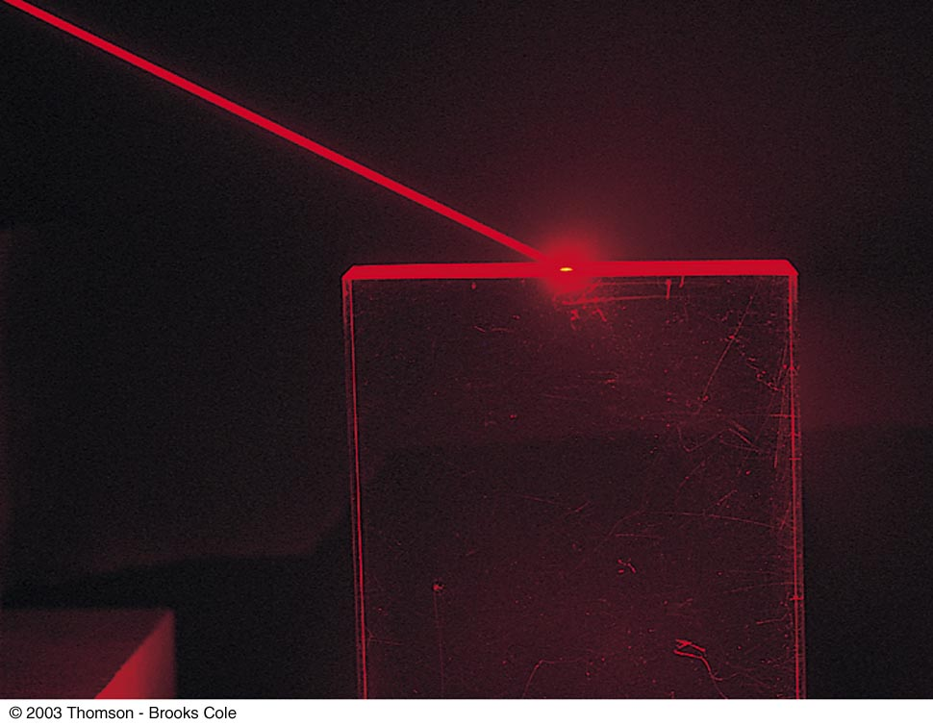
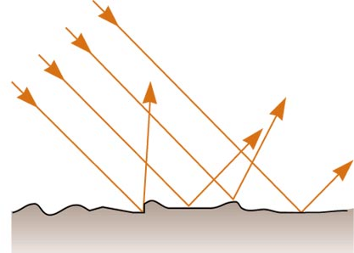
Diffuse
Reflection
Diffuse reflection is reflection from a rough surface
The reflected rays travel in a variety of directions
Diffuse reflection makes the dry road easy to see at night

Slide 15

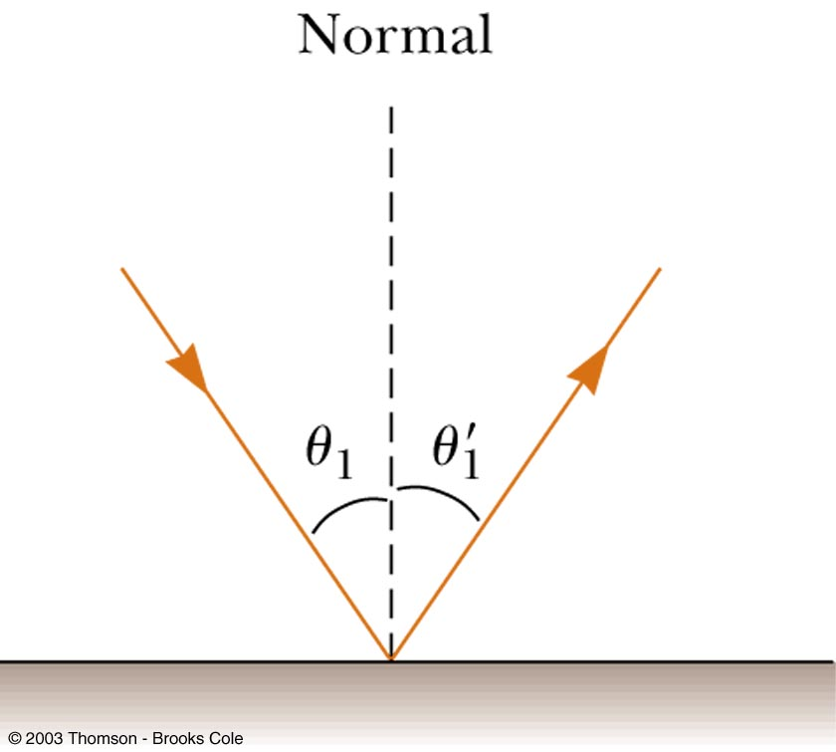
Law of Reflection
The normal is a line perpendicular to the surface
  It is at the point where the incident ray strikes the surface
The incident ray makes an angle of θ₁ with the normal
The reflected ray makes an angle of θ₁’ with the normal

Slide 16
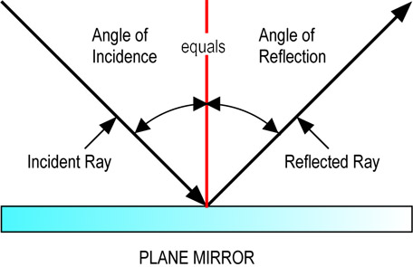
Law of Reflection, cont
The angle of reflection is equal to the angle of incidence
θ₁= θ₁’

Slide 17
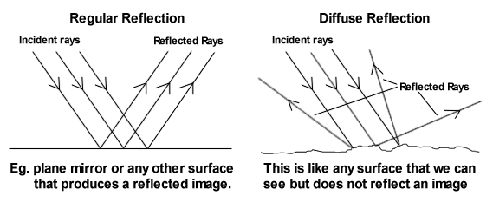
Kinds of Reflections
You see objects because light is reflected, bounced off of it.
Law of Reflection: Angle of incidence equals the angle of reflection–
  Angle coming in = angle going off
Regular Reflection: reflection off smooth surface – a mirror
Diffuse Reflection: Irregular or bumpy, uneven surface – wall

Slide 18
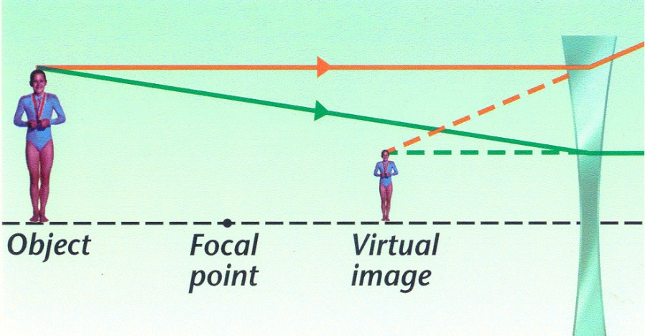
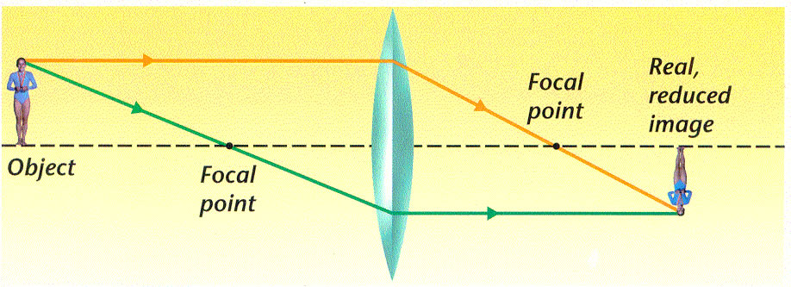
Real or Virtual?
Image: a copy of an object formed by reflected or refracted light
Virtual image: right side up appears to be coming from behind the mirror.
Real Image: is formed when reflected light rays actually meet at a point. The image is upside down (inverted),

Slide 19
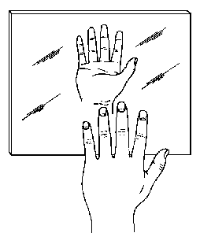
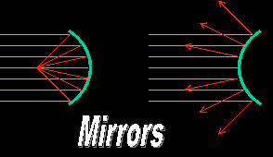
3 Types of Mirrors
Plane Mirror: a flat mirror – produces an image that is right side (virtual) up and the same size as the original object –
Concave Mirror: a mirror with a surface curved inward like a “cave” or a bowl.
  Light reflected comes together to meet at a Focal Point.
  Can produce virtual or real images
Convex Mirrors:
  A mirror w/ a curved surface facing outward
  Reflected rays appear to come from a focal point behind the mirror
  Images formed are always Virtual
Concave mirror
Convex mirror
Plane mirror

Slide 20
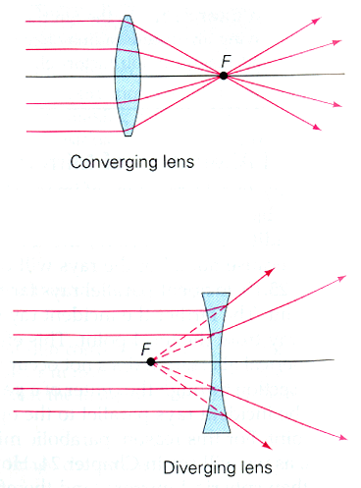
Lens – Concave & Convex
Lenses – a curved piece of material used to bend light
  Concave lenses: as light passes through, they are bent away from the center
    Images produced are only virtual, not real
  Convex lenses: cause light passing through to bend toward the focal point.
    The images produced depends on the position of the object
Convex Lens
Concave Lens

Slide 21
Notation for Mirrors and Lenses
The object distance is the distance from the object to the mirror or lens
  Denoted by p
The image distance is the distance from the image to the mirror or lens
  Images are formed at the point where rays actually intersect or appear to originate
  Denoted by q
The lateral magnification of the mirror or lens is the ratio of the image height to the object height
  Denoted by M

Slide 22
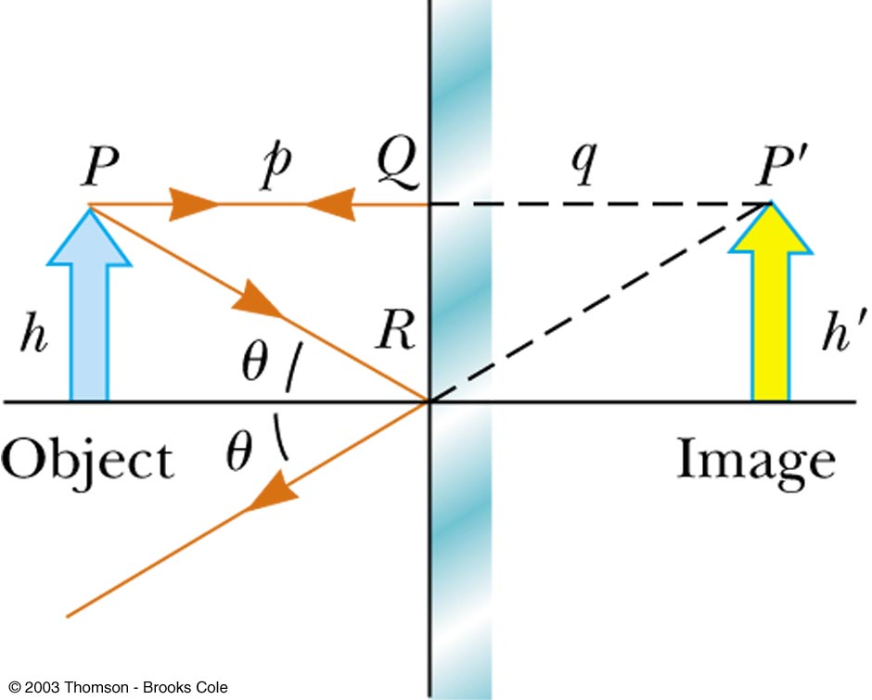
Flat Mirror
Simplest possible mirror
Properties of the image can be determined by geometry
One ray starts at P, follows path PQ and reflects back on itself
A second ray follows path PR and reflects according to the Law of Reflection

Slide 23
Properties of the Image Formed by a Flat Mirror
The image is as far behind the mirror as the object is in front
  q = p
The image is unmagnified
  The image height is the same as the object height
    h’ = h and M = 1
The image is virtual
The image is upright
  It has the same orientation as the object
There is an apparent left-right reversal in the image

Slide 24
Spherical Mirrors
A spherical mirror has the shape of a segment of a sphere
A concave spherical mirror has the silvered surface of the mirror on the inner, or concave, side of the curve
A convex spherical mirror has the silvered surface of the mirror on the outer, or convex, side of the curve

Slide 25
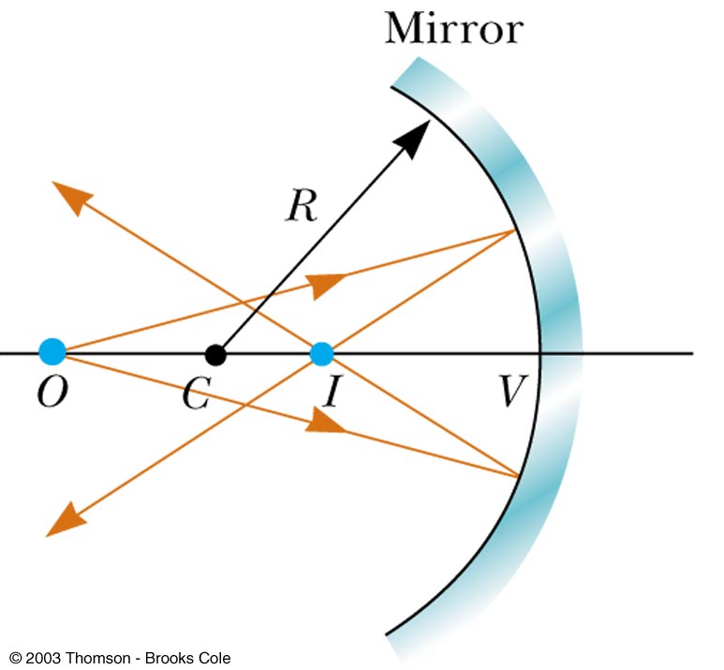
Concave Mirror, Notation
The mirror has a radius of curvature of R
Its center of curvature is the point C
Point V is the center of the spherical segment
A line drawn from C to V is called the principle axis of the mirror

Slide 26
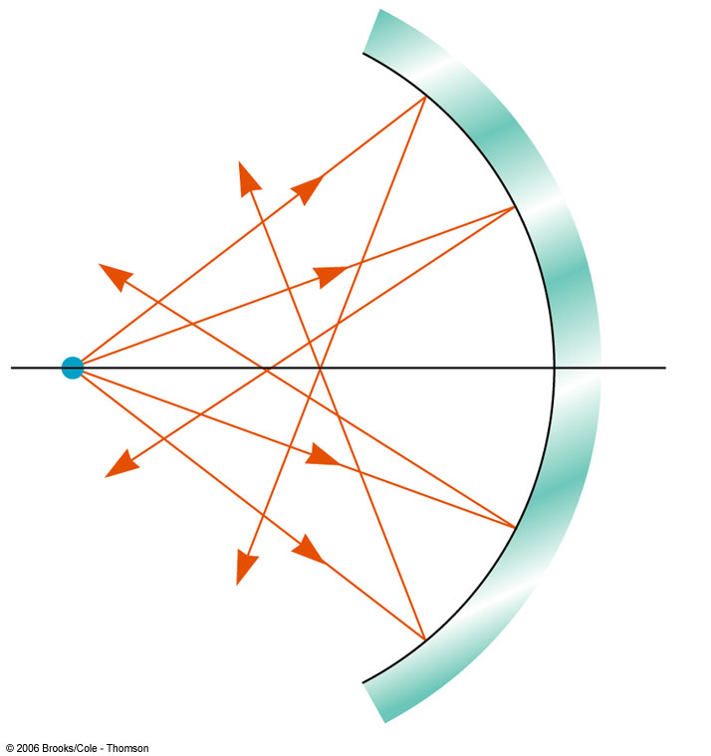
Spherical Aberration
Rays are generally assumed to make small angles with the mirror
When the rays make large angles, they may converge to points other than the image point
This results in a blurred image
This effect is called spherical aberration

Slide 27
Image Formed by a Concave Mirror
Geometry can be used to determine the magnification of the image
  h’ is negative when the image is inverted with respect to the object

Slide 28
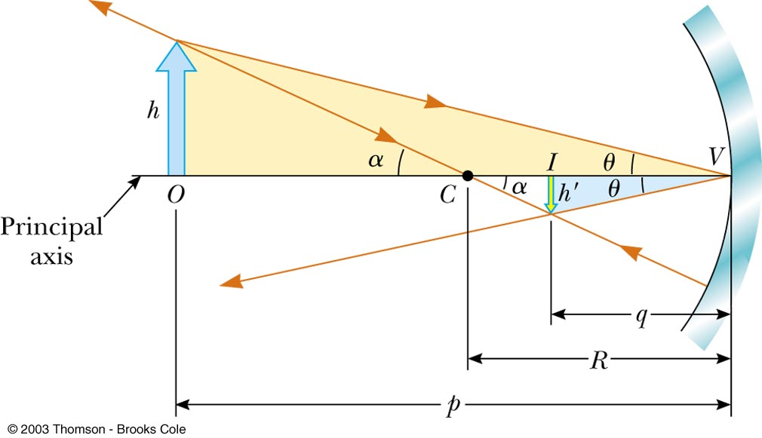
Image Formed by a Concave Mirror
Geometry shows the relationship between the image and object distances
  This is called the mirror equation

Slide 29
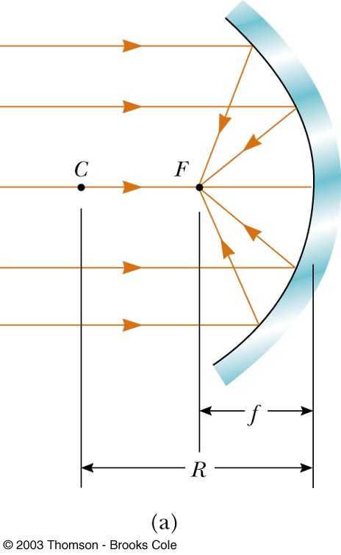
Focal Length
If an object is very far away, then p=∞ and 1/p = 0
Incoming rays are essentially parallel
In this special case, the image point is called the focal point
The distance from the mirror to the focal point is called the focal length
  The focal length is ½ the radius of curvature

Slide 30
Focal Point and Focal Length, cont
The focal point is dependent solely on the curvature of the mirror, not by the location of the object
f = R / 2
The mirror equation can be expressed as

Slide 31
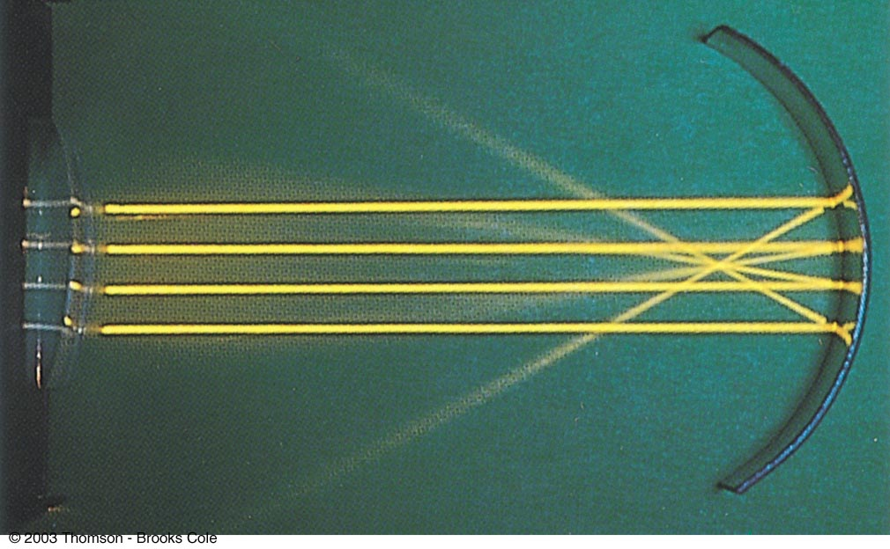
Focal Length Shown by Parallel Rays

Slide 32
Convex Mirrors
A convex mirror is sometimes called a diverging mirror
The rays from any point on the object diverge after reflection as though they were coming from some point behind the mirror
The image is virtual because it lies behind the mirror at the point where the reflected rays appear to originate
In general, the image formed by a convex mirror is upright, virtual, and smaller than the object

Slide 33
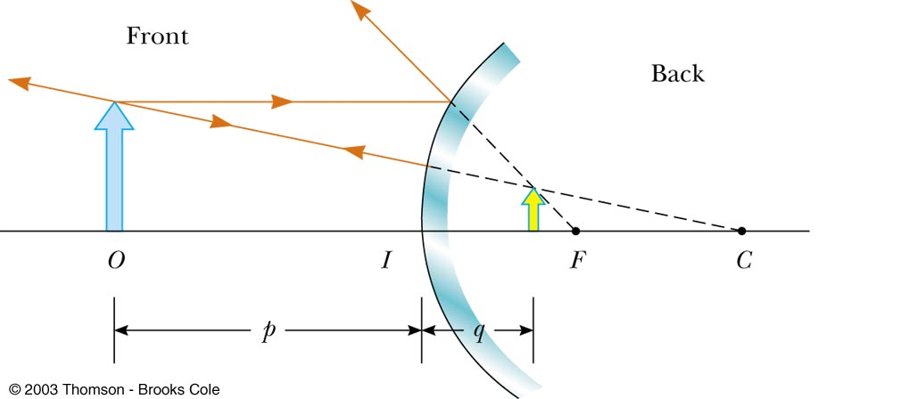
Image Formed by a Convex Mirror

Slide 34
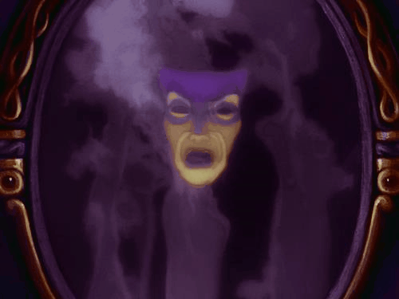
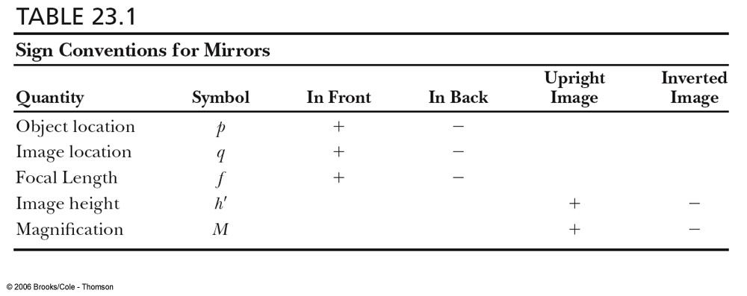
Sign Conventions for Mirrors

Slide 35
Ray Diagrams
A ray diagram can be used to determine the position and size of an image
They are graphical constructions which tell the overall nature of the image
They can also be used to check the parameters calculated from the mirror and magnification equations

Slide 36
Drawing A Ray Diagram
To make the ray diagram, you need to know
  The position of the object
  The position of the center of curvature
Three rays are drawn
  They all start from the same position on the object
The intersection of any two of the rays at a point locates the image
  The third ray serves as a check of the construction

Slide 37
The Rays in a Ray Diagram
Ray 1 is drawn parallel to the principle axis and is reflected back through the focal point, F
Ray 2 is drawn through the focal point and is reflected parallel to the principle axis
Ray 3 is drawn through the center of curvature and is reflected back on itself

Slide 38
Notes About the Rays
The rays actually go in all directions from the object
The three rays were chosen for their ease of construction
The image point obtained by the ray diagram must agree with the value of q calculated from the mirror equation

Slide 39
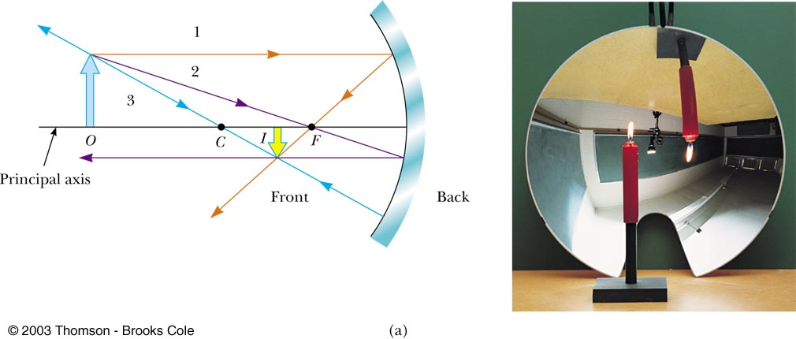
Ray Diagram for Concave Mirror, p > R
The object is outside the center of curvature of the mirror
The image is real
The image is inverted
The image is smaller than the object

Slide 40
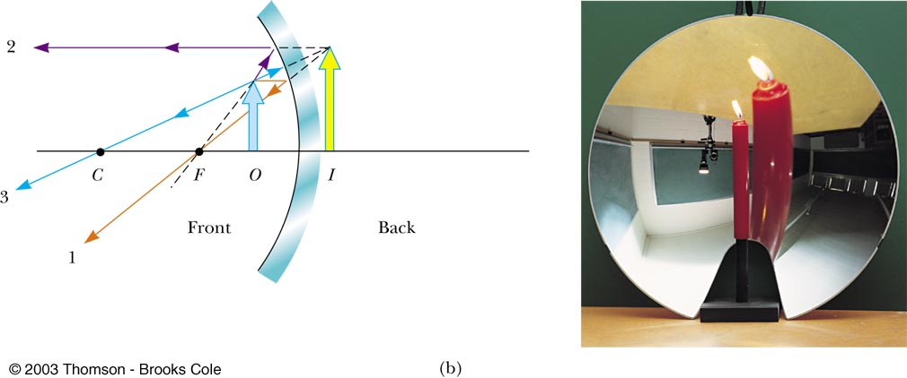
Ray Diagram for a Concave Mirror, p < f
The object is between the mirror and the focal point
The image is virtual
The image is upright
The image is larger than the object

Slide 41
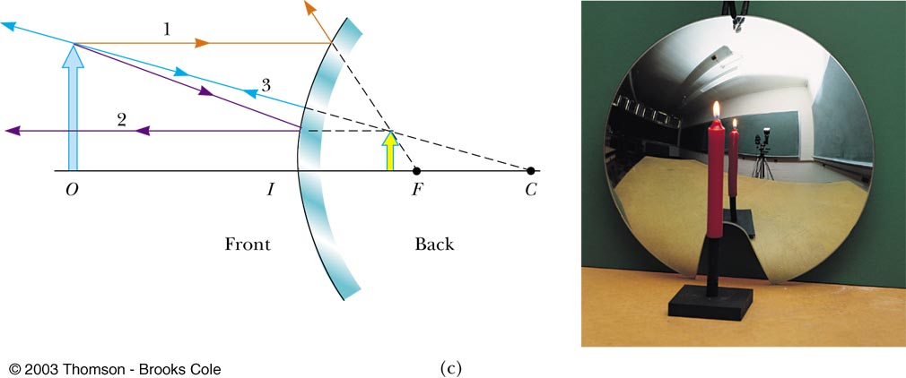
Ray Diagram for a Convex Mirror
The object is in front of a convex mirror
The image is virtual
The image is upright
The image is smaller than the object

Slide 42

Notes on Images
With a concave mirror, the image may be either real or virtual
  When the object is outside the focal point, the image is real
  When the object is at the focal point, the image is infinitely far away
  When the object is between the mirror and the focal point, the image is virtual
With a convex mirror, the image is always virtual and upright
  As the object distance increases, the virtual image gets smaller

Slide 43
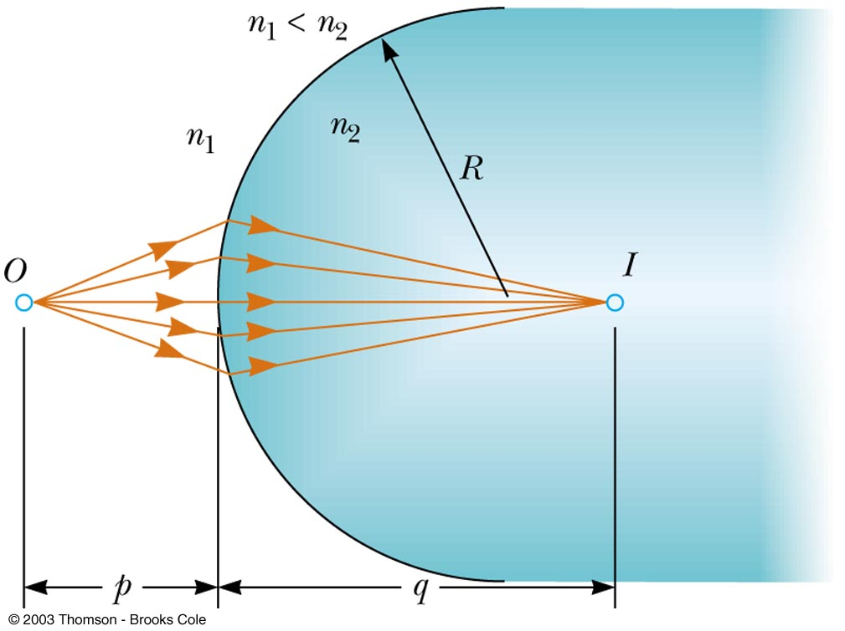
Images Formed by Refraction
Rays originate from the object point, O, and pass through the image point, I
When n₂ > n₁,
Real images are formed on the side opposite from the object

Slide 44
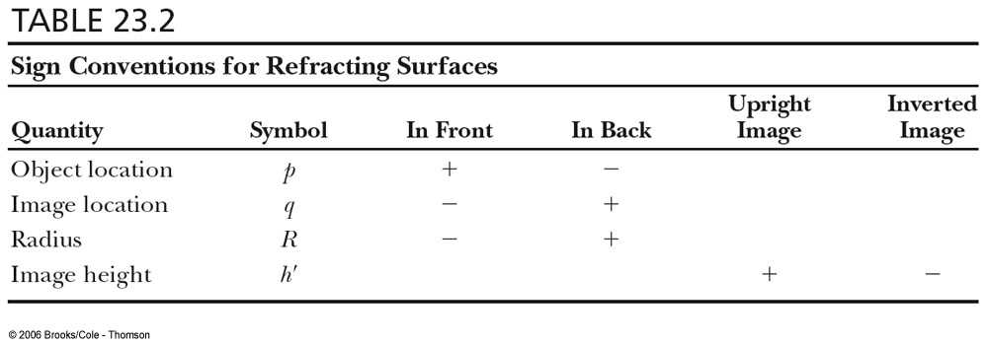
Sign Conventions for Refracting Surfaces

Slide 45
Focal Length of Lenses
The focal length, ƒ, is the image distance that corresponds to an infinite object distance
  This is the same as for mirrors
A thin lens has two focal points, corresponding to parallel rays from the left and from the right
  A thin lens is one in which the distance between the surface of the lens and the center of the lens is negligible

Slide 46
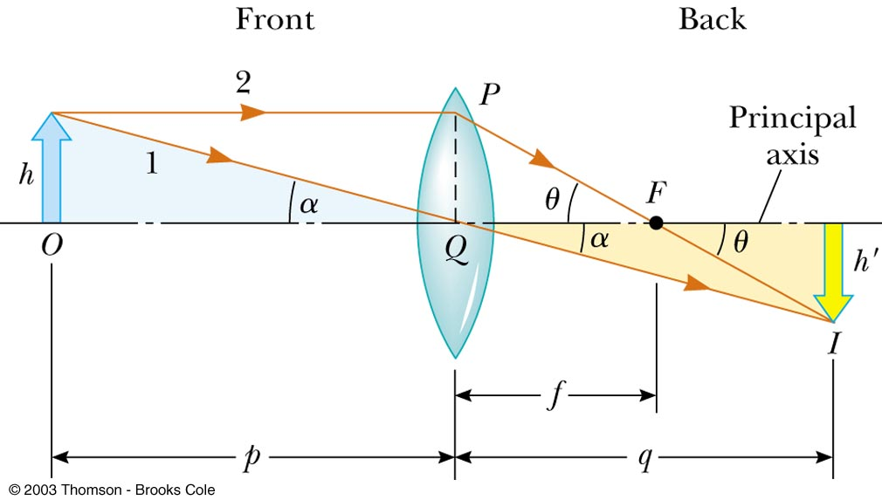
Lens Equations
The geometric derivation of the equations is very similar to that of mirrors

Slide 47
Lens Equations
The equations can be used for both converging and diverging lenses
  A converging lens has a positive focal length
  A diverging lens has a negative focal length

Slide 48
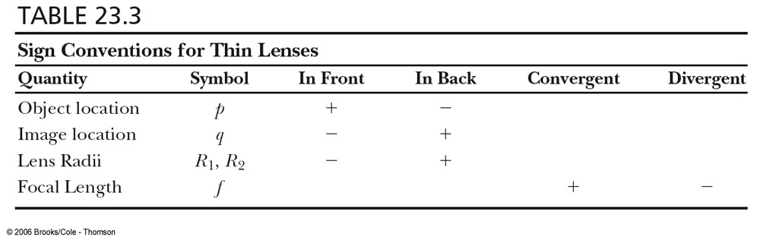

Sign Conventions for Thin Lenses

Slide 49
Focal Length for a Lens
The focal length of a lens is related to the curvature of its front and back surfaces and the index of refraction of the material
This is called the lens maker’s equation

Slide 50

The Mirror/Lens Equation
Is there any OTHER way to predict image characteristics besides the ray diagram? YES!
One way is to use the MIRROR/LENS equation to CALCULATE the position of the image.

Slide 51
Mirror/Lens Equation
Assume that a certain concave spherical mirror has a focal length of 10.0 cm. Locate the image for an object distance of 25 cm and describe the image’s characteristics.
16.67
cm
What does this tell us? First we know the image is BETWEEN “C” & “f”. Since the image distance is POSITIVE the image is a REAL IMAGE.
Real image = positive image distance
Virtual image = negative image distance
What about the size and orientation?

Slide 52
Magnification Equation
To calculate the orientation and size of the image we use the MAGNIFICATION EQUATION.
Here is how this works:
If we get a POSITIVE magnification, the image is UPRIGHT.
If we get a NEGATIVE magnification, the image is INVERTED
If the magnification value is GREATER than 1, the image is ENLARGED.
If the magnification value is LESS than 1, the image is REDUCED.
If the magnification value is EQUAL to 1, the image is the SAME SIZE as the object.
Using our previous data we see that our image was INVERTED, and REDUCED.

Slide 53
Example
Assume that a certain concave spherical mirror has a focal length of 10.0 cm. Locate the image for an object distance of 5 cm and describe the image’s characteristics.
-10 cm
Characteristics?
VIRTUAL (opposite side)
Enlarged
Upright
2x

Slide 54
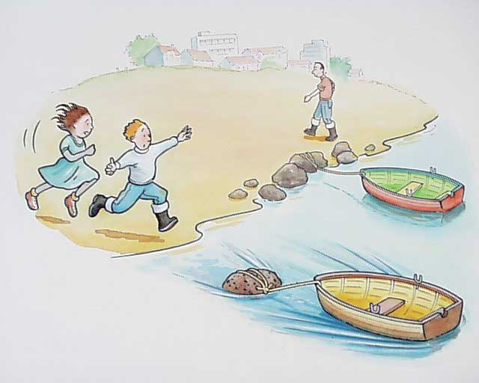
Refraction
Refraction is based on the idea that LIGHT is passing through one MEDIUM into another. The question is, WHAT HAPPENS?
Suppose you are running on the beach with a certain velocity when you suddenly need to run into the water. What happens to your velocity?
IT CHANGES!
Refraction Fact #1: As light goes from one medium to another, the velocity CHANGES!

Slide 55
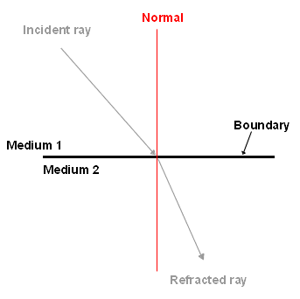
Refraction
Suppose light comes from air, which in this case will be considered to be a vacuum, strikes a boundary at some angle of incidence measured from a normal line ,and goes into water.
The ratio of the two speeds can be compared.
The denominator in this case will ALWAYS be smaller and produce a unitless value greater or equal to 1. This value is called the new medium’s INDEX OF REFRACTION, n.
All substances have an index of refraction and can be used to identify the material.

Slide 56
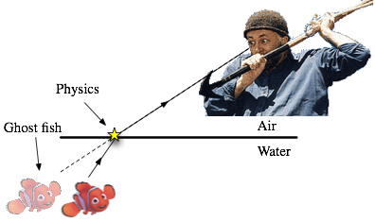
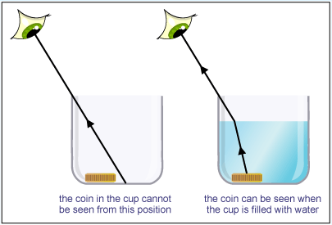
Refraction
Suppose you decide to go spear fishing, but unfortunately you aren’t having much luck catching any fish.
The cause of this is due to the fact that light BENDS when it reaches a new medium. The object is NOT directly in a straight line path, but rather it’s image appears that way. The actual object is on either side of the image you are viewing.
Refraction Fact #2: As light goes from one medium to another, the path CHANGES!

Slide 57
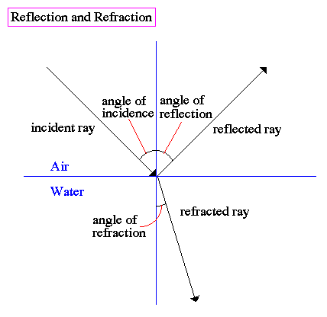
Refraction
What EXACTLY is light doing when it reaches a new medium? We don’t want you to think ALL of the light refracts.
Some of the light REFLECTS off the boundary and some of the light REFRACTS through the boundary.
Angle of incidence = Angle of Reflection
Angle of Incidence > or < the Angle of refraction depending on the direction of the light

Slide 58
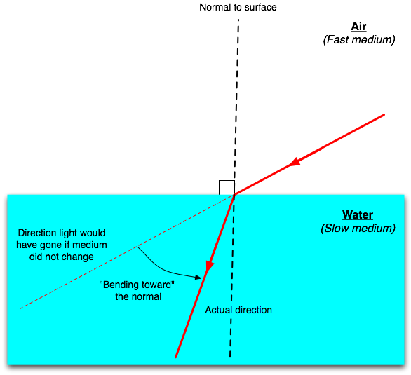
Refraction – Going from Air to Water
The index of refraction, n, for air (vacumm) is equal to 1. The index of refraction for water is 1.33.
If you are going from a LOW “n” to a HIGH “n”, your speed DECREASES and the angle BENDS TOWARDS the normal

Slide 59
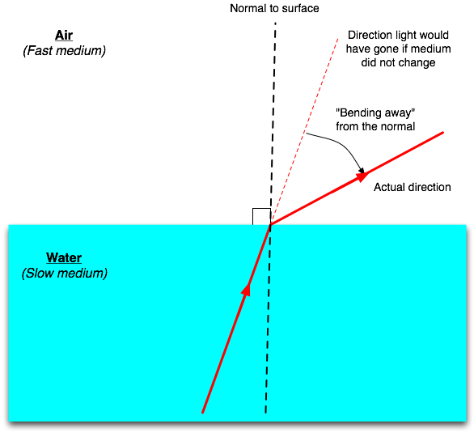
Refraction – Going from Water into Air
The index of refraction, n, for air (vacumm) is equal to 1. The index of refraction for water is 1.33.
If you are going from a HIGH “n” to a LOW “n”, your speed INCREASES and the angle BENDS AWAY the normal
Note: If the angles are EQUAL, then the “n” must be equal for each. The ray will pass straight through.

Slide 60

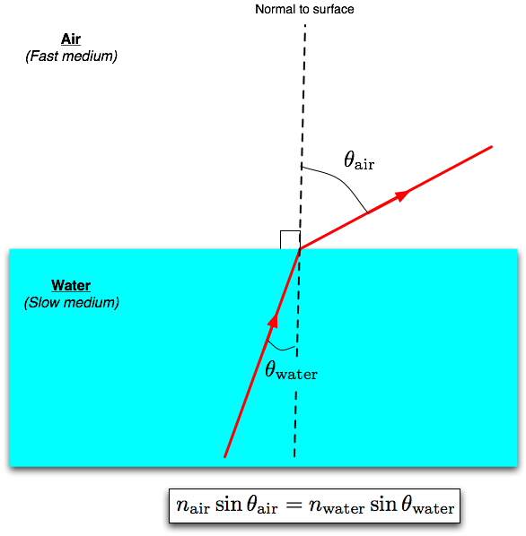
Refraction – Snell’s Law
A scientist by the name of Snell discovered that the ratios of the index’s and the ratio of the sine of the angles are the same value!

Slide 61
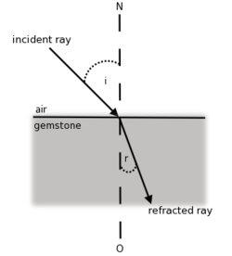
Example
The refractive index of the gemstone, Aquamarine, is 1.577. Suppose a ray of light strikes a horizontal boundary of the gemstone with an angle of incidence of 23 degrees from air.
Calculate the SPEED of light in Aquamarine
1.90 x 10⁸ m/s
Calculate the angle of refraction within Aquamarine
14.34 degrees

Slide 62
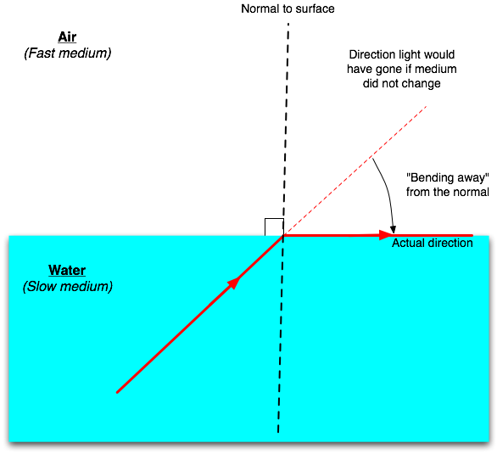
Total Internal Reflection
There is a special type of refraction that can occur ONLY when traveling from a HIGH “n” medium to a LOW “n” medium.
Suppose we are traveling FROM water and going into air. Should the ANGLE OF INCIDENCE get TOO LARGE, the angle of refraction will EQUAL 90 DEGREES. We call this special angle of incidence the CRITICAL ANGLE, θ_{c}, for that material (water in this case)

Slide 63
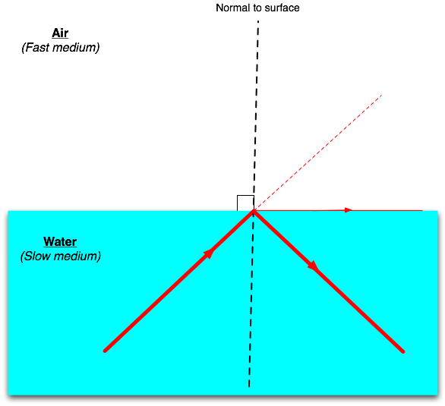
Total Internal Reflection
If we EXCEED the critical angle, for that material, the ray will reflect INTERNALLY within the material. We call this idea TOTAL INTERNAL REFLECTION.
In this figure, the angle of incidence EXCEEDS the critical angle for water and the ray reflects according to the law of reflection at the boundary.

Slide 64
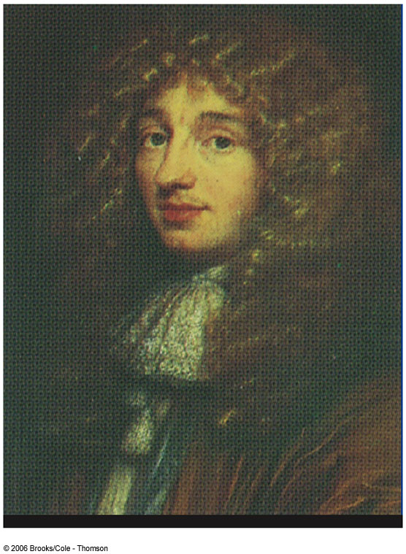
Christian Huygens
1629 – 1695
Best known for contributions to fields of optics and dynamics
Deduced the laws of reflection and refraction
Explained double refraction

Slide 65
Huygen’s Principle
Huygen assumed that light is a form of wave motion rather than a stream of particles
Huygen’s Principle is a geometric construction for determining the position of a new wave at some point based on the knowledge of the wave front that preceded it

Slide 66

Huygen’s Principle, cont
All points on a given wave front are taken as point sources for the production of spherical secondary waves, called wavelets, which propagate in the forward direction with speeds characteristic of waves in that medium
  After some time has elapsed, the new position of the wave front is the surface tangent to the wavelets

Slide 67
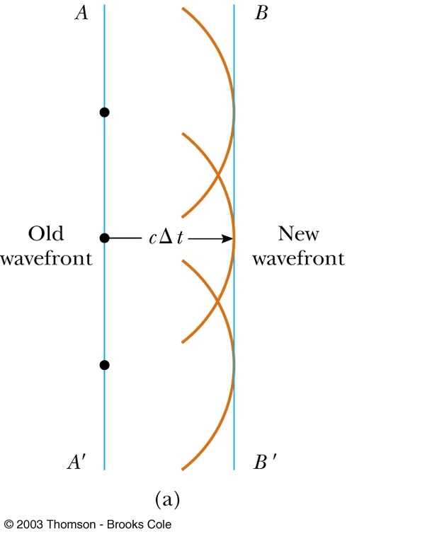
Huygen’s Construction for a Plane Wave
At t = 0, the wave front is indicated by the plane AA’
The points are representative sources for the wavelets
After the wavelets have moved a distance cΔt, a new plane BB’ can be drawn tangent to the wavefronts

Slide 68
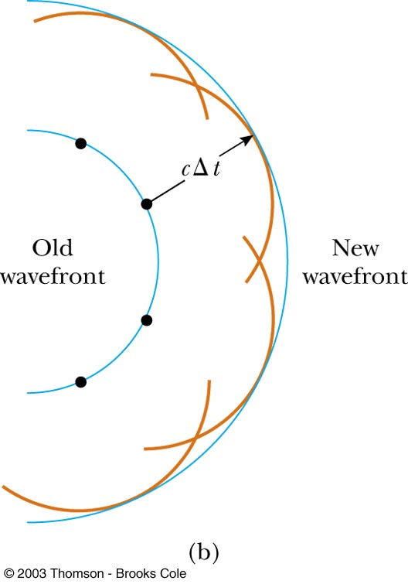
Huygen’s Construction for a Spherical Wave
The inner arc represents part of the spherical wave
The points are representative points where wavelets are propagated
The new wavefront is tangent at each point to the wavelet

Slide 69
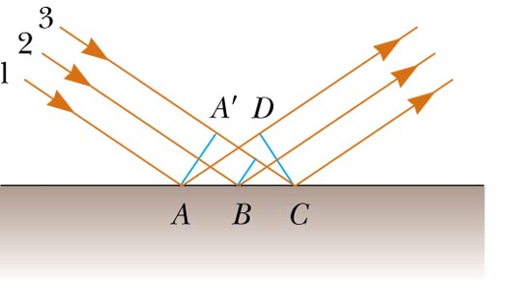
Huygen’s Principle and the Law of Reflection
The Law of Reflection can be derived from Huygen’s Principle
AA’ is a wave front of incident light
The reflected wave front is CD

Slide 70
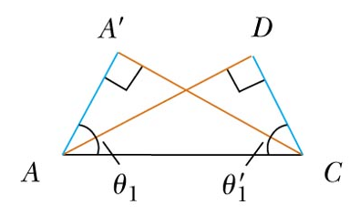
Huygen’s Principle and the Law of Reflection, cont
Triangle ADC is congruent to triangle AA’C
θ₁ = θ₁’
This is the Law of Reflection

Slide 71
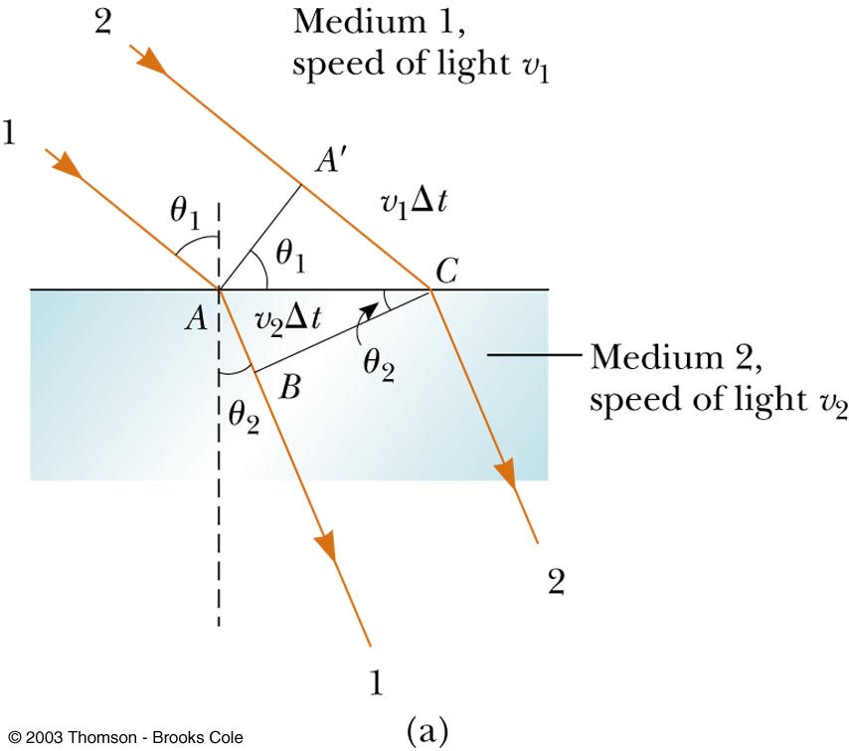
Huygen’s Principle and the Law of Refraction
In time Δt, ray 1 moves from A to B and ray 2 moves from A’ to C
From triangles AA’C and ACB, all the ratios in the Law of Refraction can be found
  n₁ sin θ₁ = n₂ sin θ₂

Slide 72


Total Internal Reflection
Total internal reflection can occur when light attempts to move from a medium with a high index of refraction to one with a lower index of refraction
  Ray 5 shows internal reflection

Slide 73


Critical Angle
A particular angle of incidence will result in an angle of refraction of 90°
  This angle of incidence is called the critical angle

Slide 74
The Critical Angle
So the question is , how can you calculate the critical angle? Remember, it is when the refracted ray is equal to 90 degrees
θ_{c}

Slide 75

Example
Suppose a light ray is traveling in heavy flint glass( n = 1.65) and once it strikes the boundary, enters air. Calculate the critical angle for flint glass.
37.3 degrees

Slide 76
Refraction of Light
When a ray of light traveling through a transparent medium encounters a boundary leading into another transparent medium, part of the ray is reflected and part of the ray enters the second medium
The ray that enters the second medium is bent at the boundary
  This bending of the ray is called refraction

Slide 77

Refraction of Light, cont
The incident ray, the reflected ray, the refracted ray, and the normal all lie on the same plane
The angle of refraction, θ₂, depends on the properties of the medium

Slide 78
The Index of Refraction
When light passes from one medium to another, it is refracted because the speed of light is different in the two media
The index of refraction, n, of a medium can be defined

Slide 79

Index of Refraction, cont
For a vacuum, n = 1
For other media, n > 1
n is a unitless ratio

Slide 80

Frequency Between Media
As light travels from one medium to another, its frequency does not change
  Both the wave speed and the wavelength do change
  The wavefronts do not pile up, nor are created or destroyed at the boundary, so ƒ must stay the same

Slide 81
Index of Refraction Extended
The frequency stays the same as the wave travels from one medium to the other
v = ƒ λ
The ratio of the indices of refraction of the two media can be expressed as various ratios

Slide 82

Some Indices of Refraction

Slide 83


Refraction in a Prism
The amount the ray is bent away from its original direction is called the angle of deviation, δ
Since all the colors have different angles of deviation, they will spread out into a spectrum
  Violet deviates the most
  Red deviates the least

Slide 84


Prism Spectrometer
A prism spectrometer uses a prism to cause the wavelengths to separate
The instrument is commonly used to study wavelengths emitted by a light source

Slide 85

Using Spectra to Identify Gases
All hot, low pressure gases emit their own characteristic spectra
The particular wavelengths emitted by a gas serve as “fingerprints” of that gas
Some uses of spectral analysis
  Identification of molecules
  Identification of elements in distant stars
  Identification of minerals

Slide 86

The Rainbow
A ray of light strikes a drop of water in the atmosphere
It undergoes both reflection and refraction
  First refraction at the front of the drop
    Violet light will deviate the most
    Red light will deviate the least

Slide 87


The Rainbow, 2
At the back surface the light is reflected
It is refracted again as it returns to the front surface and moves into the air
The rays leave the drop at various angles
  The angle between the white light and the violet ray is 40°
  The angle between the white light and the red ray is 42°

Slide 88

Observing the Rainbow
If a raindrop high in the sky is observed, the red ray is seen
A drop lower in the sky would direct violet light to the observer
The other colors of the spectra lie in between the red and the violet

Slide 89

Superposition ..AKA….Interference
One of the characteristics of a WAVE is the ability to undergo INTERFERENCE. There are TWO types.
We call these waves IN PHASE.
We call these waves OUT OF PHASE.

Slide 90

Diffraction
When light OR sound is produced by TWO sources a pattern results as a result of interference.

Slide 91


Interference Patterns
Diffraction is normally taken to refer to various phenomena which occur when a wave encounters an obstacle. It is described as the apparent bending of waves around small obstacles and the spreading out of waves past small openings

Slide 92

Diffraction – The Central Maximum
Suppose you had TWO sources each being allowed to emit a wave through a small opening or slit.
The distance between the slits denoted by, d.
The distance from the slit spacing to the screen is denoted by the letter, L.
If two waves go through the slit and then proceed straight ahead to the screen, they both cover the SAME DISTANCE and thus will have constructive interference. Their amplitudes will build and leave a very bright intense spot on the screen. We call this the CENTRAL MAXIMUM.

Slide 93


Diffraction – The Central Maximum
Figure 1
Figure 2
Here is the pattern you will see. Notice in figure 2 that there are several bright spots and dark areas in between. The spot in the middle is the BRIGHTEST and thus the CENTRAL MAXIMUM. We call these spots FRINGES.
Notice we have additional bright spots, yet the intensity is a bit less. We denote these additional bright spots as ORDERS. So the first bright spot on either side of the central maximum is called the FIRST ORDER BRIGHT FRINGE. Figure 1 represents the intensity of the orders as we move farther from the bright central maximum.

Slide 94
Diffraction – Orders, m
We use the letter, m, to represent the ORDER of the fringe from the bright central.
Second Order
Bright Fringe
m = 2
Second Order
Bright Fringe
m = 2
First Order
Bright Fringe
m = 1
First Order
Bright Fringe
m = 1
Central
Maximum
It is important to understand that we see these bright fringes as a result of CONSTRUCTIVE INTERFERENCE.

Slide 95
Diffraction – Bright Fringes
The reason you see additional bright fringes is because the waves CONSTRUCTIVELY build.
There is a difference however in the intensity as you saw in the previous slide.
As you can see in the picture, the BLUE WAVE has to travel farther than the RED WAVE to reach the screen at the position shown. For the BLUE WAVE and the RED WAVE to build constructively they MUST be IN PHASE.
Here is the question: HOW MUCH FARTHER DID THE BLUE WAVE HAVE TO TRAVEL SO THAT THEY BOTH HIT THE SCREEN IN PHASE?

Slide 96

Diffraction – Path difference
Notice that these 2 waves are IN PHASE. When they hit they screen they both hit at the same relative position, at the bottom of a crest.
How much farther did the red wave have to travel?
Exactly – ONE WAVELENGTH
λ
The call this extra distance the PATH DIFFERENCE. The path difference and the ORDER of a fringe help to form a pattern.

Slide 97

Diffraction – Path Difference
2λ
2λ
1λ
1λ
The bright fringes you see on either side of the central maximum are multiple wavelengths from the bright central. And it just so happens that the multiple is the ORDER.
Therefore, the PATH DIFFERENCE is equal to the ORDER times the WAVELENGTH
P.D. = mλ
(Constructive)

Slide 98

Diffraction – Dark Fringes
We see a definite DECREASE in intensity between the bright fringes. In the pattern we visible notice the DARK REGION. These are areas where DESTRUCTIVE INTERFERENCE has occurred. We call these areas DARK FRINGES or MINIMUMS.

Slide 99

Diffraction – Dark Fringes
First Order
Dark Fringe
m = 1
First Order
Dark Fringe
m = 1
ZERO Order
Dark Fringe
m = 0
ZERO Order
Dark Fringe
m = 0
Central
Maximum
It is important to understand that we see these dark fringes as a result of DESTRUCTIVE INTERFERENCE.

Slide 100

Diffraction – Dark Fringes
On either side of the bright central maximum we see areas that are dark or minimum intensity.
Once again we notice that the BLUE WAVE had to travel farther than the RED WAVE to reach the screen. At this point , however, they are said to destructively build or that they are OUT OF PHASE.
Here is the question: HOW MUCH FARTHER DID THE BLUE WAVE HAVE TO TRAVEL SO THAT THEY BOTH HIT THE SCREEN OUT OF PHASE?

Slide 101

Diffraction – Path difference
Notice that these 2 waves are OUT OF PHASE. When they hit they screen they both hit at the different relative positions, one at the bottom of a crest and the other coming out of a trough. Thus their amplitudes SUBTRACT.
How much farther did the red wave have to travel?
Exactly – ONE HALF OF A WAVELENGTH
0.5 λ
The call this extra distance the PATH DIFFERENCE. The path difference and the ORDER of a fringe help to form another pattern.

Slide 102
Diffraction – Path Difference
1.5λ
1.5λ
The dark fringes you see on either side of the central maximum are multiple wavelengths from the bright central. And it just so happens that the multiple is the ORDER.
0.5λ
0.5λ
Therefore, the PATH DIFFERENCE is equal to the ORDER plus a HALF, times A WAVELENGTH
P.D. = (m+1/2)λ
(Destructive)

Slide 103
Path Difference - Summary
P.D. = mλ
For CONSTRUCTIVE INTERFERENCE or MAXIMUMS use:
For DESTRUCTIVE INTERFERENCE or MINIMUMS use:
P.D. = (m+1/2)λ
Where “m”, is the ORDER. Refer to slides 7 and 12.

Slide 104
Young’s Experiment
In 1801, Thomas Young successfully showed that light does produce an interference pattern. This famous experiment PROVES that light has WAVE PROPERTIES.
Suppose we have 2 slits separated by a distance, d and a distance L from a screen. Let point P be a bright fringe.
We see in the figure that we can make a right triangle using, L, and y, which is the distance a fringe is from the bright central. We will use an angle, θ, from the point in the middle of the two slits.
We can find this angle using tangent!
P
y
d
θ
B.C.
L

Slide 105
Diffraction – Another way to look at “path difference”
This right triangle is SIMILAR to the one made by y & L.
P
θ
θ
B.C.
d
d
P.D.
P.D. = dsinθ
P.D.
Notice the blue wave travels farther. The difference in distance is the path difference.

Slide 106
Similar Triangles lead to a path difference
y
θ
d
These angles
Are EQUAL.
L
dsinθ
θ

Slide 107
Diffraction – Putting it all together
Path difference is equal to the following:
mλ
(m+1/2)λ
dsinθ
Therefore, we can say:
Will be used to find the
angle!

Slide 108

Example
A viewing screen is separated from a double slit source by 1.2 m. The distance between the two slits is 0.030 mm. The second -order bright fringe ( m=2) is 4.5 cm from the central maximum. Determine the wavelength of light.
2.15 degrees
5.62x10⁻⁷ m

Slide 109
Example
A light with wavelength, 450 nm, falls on a diffraction grating (multiple slits). On a screen 1.80 m away the distance between dark fringes on either side of the bright central is 4.20 mm. a) What is the separation between a set of slits? b) How many lines per meter are on the grating?
0.067 degrees
0.0001924 m
5197.2 lines/m

Slide 110





Optical Instruments

Slide 111

Optical Instruments
Analysis generally involves the laws of reflection and refraction
Analysis uses the procedures of geometric optics
To explain certain phenomena, the wave nature of light must be used

Slide 112

The Camera
The single-lens photographic camera is an optical instrument
Components
  Light-tight box
  Converging lens
    Produces a real image
  Film behind the lens
    Receives the image

Slide 113

Camera Operation
Proper focusing leads to sharp images
  The lens-to-film distance will depend on the object distance and on the focal length of the lens
The shutter is a mechanical device that is opened for selected time intervals
Most cameras have an aperture of adjustable diameter to further control the intensity of the light reaching the film
  With a small-diameter aperture, only light from the central portion reaches the film, and spherical aberration is minimized

Slide 114

Camera, f-numbers
The ƒ-number of a camera is the ratio of the focal length of the lens to its diameter
  ƒ-number = f/D
  The ƒ-number is often given as a description of the lens “speed”
    A lens with a low f-number is a “fast” lens

Slide 115
Camera, f-numbers, cont
Increasing the setting from one ƒ-number to the next higher value decreases the area of the aperture by a factor of 2
The lowest ƒ-number setting on a camera corresponds to the aperture wide open and the maximum possible lens area in use
Simple cameras usually have a fixed focal length and a fixed aperture size, with an ƒ-number of about 11
  Most cameras with variable ƒ-numbers adjust them automatically

Slide 116
Simple Magnifier
A simple magnifier consists of a single converging lens
This device is used to increase the apparent size of an object
The size of an image formed on the retina depends on the angle subtended by the eye

Slide 117

The Size of a Magnified Image
When an object is placed at the near point, the angle subtended is a maximum
  The near point is about 25 cm
When the object is placed near the focal point of a converging lens, the lens forms a virtual, upright, and enlarged image

Slide 118
Angular Magnification
Angular magnification is defined as
The angular magnification is at a maximum when the image formed by the lens is at the near point of the eye
  q = - 25 cm
  Calculated by

Slide 119
Magnification by a Lens
With a single lens, it is possible to achieve angular magnification up to about 4 without serious aberrations
With multiple lenses, magnifications of up to about 20 can be achieved
  The multiple lenses can correct for aberrations

Slide 120


Compound Microscope
A compound microscope consists of two lenses
  Gives greater magnification than a single lens
  The objective lens has a short focal length, ƒ_{o}<1 cm
  The ocular lens (eyepiece) has a focal length, ƒ_{e}, of a few cm

Slide 121

Compound Microscope, cont
The lenses are separated by a distance L
  L is much greater than either focal length
The approach to analysis is the same as for any two lenses in a row
  The image formed by the first lens becomes the object for the second lens
The image seen by the eye, I₂, is virtual, inverted and very much enlarged

Slide 122
Magnifications of the Compound Microscope
The lateral magnification of the microscope is
The angular magnification of the eyepiece of the microscope is
The overall magnification of the microscope is the product of the individual magnifications

Slide 123



Slide 124
Other Considerations with a Microscope
The ability of an optical microscope to view an object depends on the size of the object relative to the wavelength of the light used to observe it
  For example, you could not observe an atom (d ≈ 0.1 nm) with visible light (λ≈ 500 nm)

Slide 125

Telescopes
Two fundamental types of telescopes
  Refracting telescope uses a combination of lenses to form an image
  Reflecting telescope uses a curved mirror and a lens to form an image
Telescopes can be analyzed by considering them to be two optical elements in a row
  The image of the first element becomes the object of the second element

Slide 126


Refracting Telescope
The two lenses are arranged so that the objective forms a real, inverted image of a distant object
The image is near the focal point of the eyepiece
The two lenses are separated by the distance ƒ_{o} + ƒ_{e} which corresponds to the length of the tube
The eyepiece forms an enlarged, inverted image of the first image

Slide 127
Angular Magnification of a Telescope
The angular magnification depends on the focal lengths of the objective and eyepiece
Angular magnification is particularly important for observing nearby objects
  Very distant objects still appear as a small point of light

Slide 128
Disadvantages of Refracting Telescopes
Large diameters are needed to study distant objects
Large lenses are difficult and expensive to manufacture
The weight of large lenses leads to sagging which produces aberrations

Slide 129

Reflecting Telescope
Helps overcome some of the disadvantages of refracting telescopes
  Replaces the objective lens with a mirror
  The mirror is often parabolic to overcome spherical aberrations
In addition, the light never passes through glass
  Except the eyepiece
  Reduced chromatic aberrations

Slide 130

Reflecting Telescope, Newtonian Focus
The incoming rays are reflected from the mirror and converge toward point A
  At A, a photographic plate or other detector could be placed
A small flat mirror, M, reflects the light toward an opening in the side and passes into an eyepiece

Slide 131

Examples of Telescopes
Reflecting Telescopes
  Largest in the world are 10 m diameter Keck telescopes on Mauna Kea in Hawaii
  Largest single mirror in US is 5 m diameter on Mount Palomar in California
Refracting Telescopes
  Largest in the world is Yerkes Observatory in Wisconsin
    Has a 1 m diameter

Slide 132

Reflecting Telescopes
Largest in the world are 10 m diameter Keck telescopes on Mauna Kea in Hawaii

Slide 133
Resolution
The ability of an optical system to distinguish between closely spaced objects is limited due to the wave nature of light
If two sources of light are close together, they can be treated as non-coherent sources
Because of diffraction, the images consist of bright central regions flanked by weaker bright and dark rings

