Slide 1
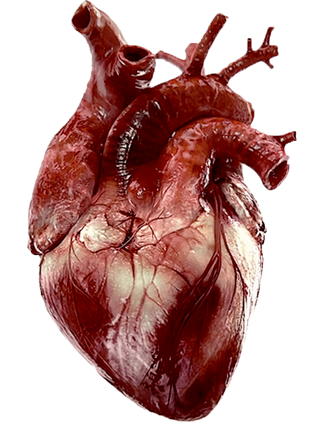
Sheep Heart
Anatomy

Slide 3
