Slide 1
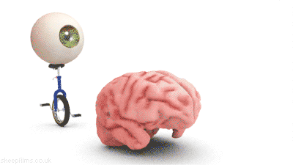
Sheep Brain
Anatomy

