Slide 1
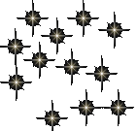
Unit 6:Life, Death and Characteristics of Stars

Slide 2
The Amazing Power of Starlight
Just by analyzing the light received from a star, astronomers can retrieve information about a star’s
Total energy output
Surface temperature
Radius
Chemical composition
Velocity relative to Earth
Rotation period

Slide 3
Black Body Radiation (1)
The light from a star is usually concentrated in a rather narrow range of wavelengths.
The spectrum of a star’s light is approximately a thermal spectrum called a black body spectrum.
A perfect black body emitter would not reflect any radiation. Thus the name “black body”.

Slide 4
The Color Index (1)
The color of a star is measured by comparing its brightness in two different wavelength bands:
The blue (B) band and the visual (V) band.
We define B-band and V-band magnitudes just as we did before for total magnitudes (remember: a larger number indicates a fainter star).
B band
V band

Slide 5
The Color Index (2)
We define the Color Index
B – V
(i.e., B magnitude – V magnitude).
The bluer a star appears, the smaller the color index B – V.
The hotter a star is, the smaller its color index B – V.

Slide 6
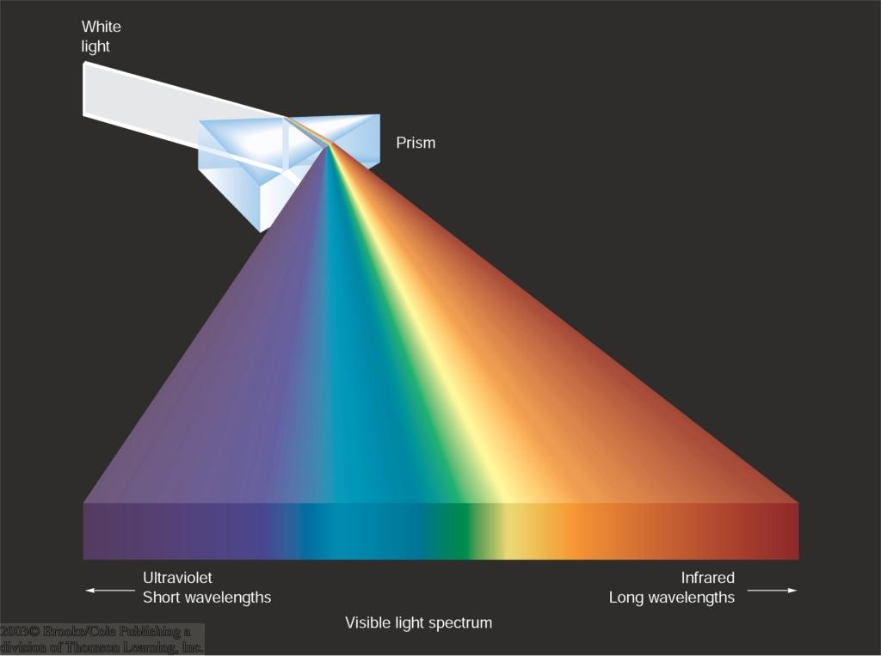
Light and Matter
Spectra of stars are more complicated than pure blackbody spectra.
 characteristic lines, called absorption lines.
To understand those lines, we need to understand atomic structure and the interactions between light and atoms.

Slide 7
Atomic Structure
An atom consists of an atomic nucleus (protons and neutrons) and a cloud of electrons surrounding it.
Almost all of the mass is contained in the nucleus, while almost all of the space is occupied by the electron cloud.

Slide 8
Atomic Density
If you could fill a teaspoon just with material as dense as the matter in an atomic nucleus, it would weigh ~ 2 billion tons!!

Slide 9
Different Kinds of Atoms
The kind of atom depends on the number of protons in the nucleus.
Different numbers of neutrons ↔ different isotopes
Most abundant: Hydrogen (H), with one proton (+ 1 electron).
Next: Helium (He), with 2 protons (and 2 neutrons + 2 el.).
Helium 4

Slide 10
Electron Orbits
Electron orbits in the electron cloud are restricted to very specific radii and energies.
r₃, E₃
r₂, E₂
r₁, E₁
These characteristic electron energies are different for each individual element.

Slide 11
Atomic Transitions
An electron can be kicked into a higher orbit when it absorbs a photon with exactly the right energy.
E_{ph} = E₃ – E₁
E_{ph} = E₄ – E₁
Wrong energy
The photon is absorbed, and
the electron is in an excited state.
(Remember that E_{ph} = h*f)
All other photons pass by the atom unabsorbed.

Slide 12
Kirchhoff’s Laws of Radiation (1)
A solid, liquid, or dense gas excited to emit light will radiate at all wavelengths and thus produce a continuous spectrum.

Slide 13
Kirchhoff’s Laws of Radiation (2)
2. A low-density gas excited to emit light will do so at specific wavelengths and thus produce an emission spectrum.
Light excites electrons in atoms to higher energy states
Transition back to lower states emits light at specific frequencies

Slide 14
Kirchhoff’s Laws of Radiation (3)
3. If light comprising a continuous spectrum passes through a cool, low-density gas, the result will be an absorption spectrum.
Light excites electrons in atoms to higher energy states
Frequencies corresponding to the transition energies are absorbed from the continuous spectrum.

Slide 15
The Spectra of Stars
Inner, dense layers of a star produce a continuous (blackbody) spectrum.
Cooler surface layers absorb light at specific frequencies.
=> Spectra of stars are absorption spectra.

Slide 16
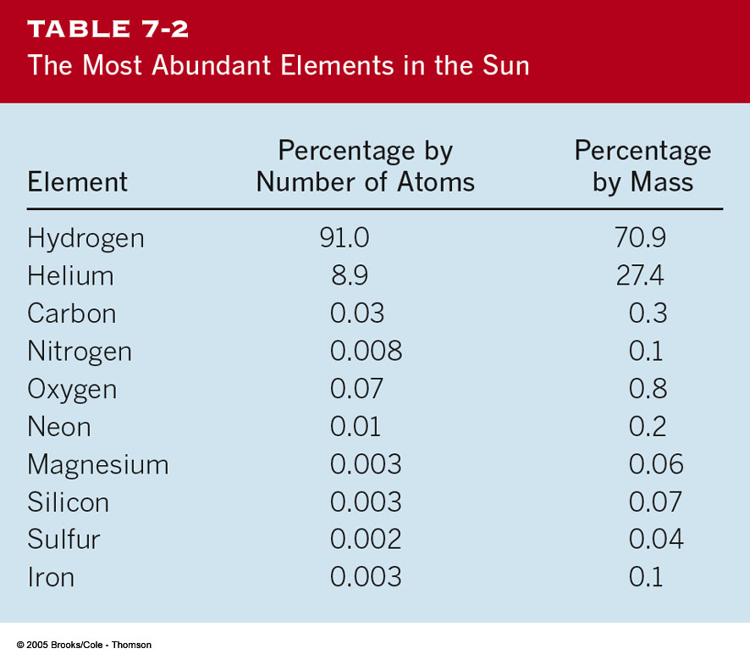
Analyzing Absorption Spectra
Each element produces a specific set of absorption (and emission) lines.
Comparing the relative strengths of these sets of lines, we can study the composition of gases.
By far the most abundant elements in the Universe

Slide 17
Lines of Hydrogen
Most prominent lines in many astronomical objects: Balmer lines of hydrogen

Slide 18
The Balmer Lines
n = 1
n = 4
Transitions from 2nd to higher levels of hydrogen
n = 5
n = 3
n = 2
H_{α}
H_{β}
H_{γ}
The only hydrogen lines in the visible wavelength range.
2nd to 3rd level = H_{α} (Balmer alpha line)
2nd to 4th level = H_{β} (Balmer beta line)
…

Slide 19
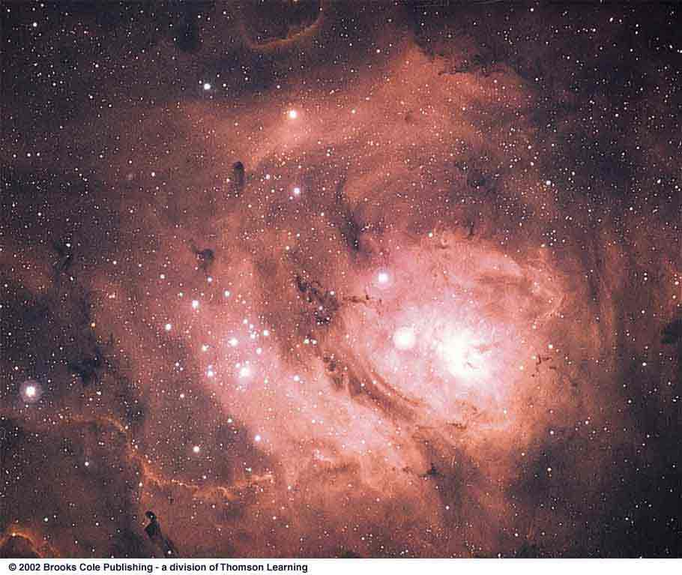
Observations of the H-Alpha Line
Emission nebula, dominated by the red Hα line.

Slide 20
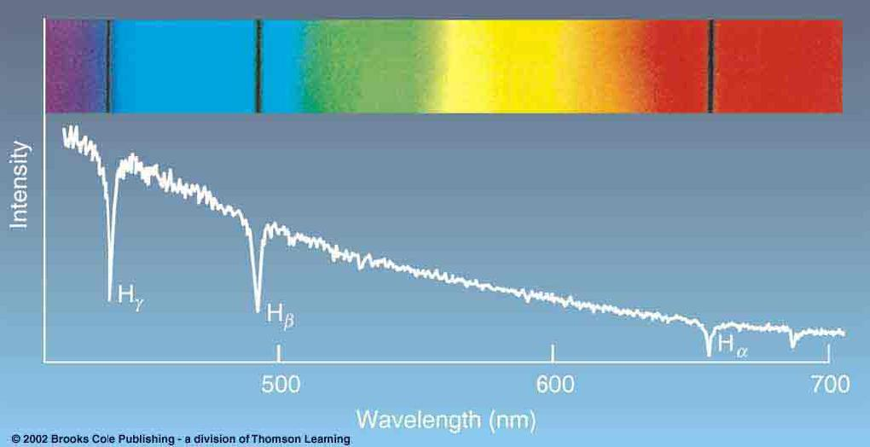
Absorption Spectrum Dominated by Balmer Lines
Modern spectra are usually recorded digitally and represented as plots of intensity vs. wavelength

Slide 21
The Balmer Thermometer
Balmer line strength is sensitive to temperature:
Most hydrogen atoms are ionized => weak Balmer lines
Almost all hydrogen atoms in the ground state (electrons in the n = 1 orbit) => few transitions from n = 2 => weak Balmer lines

Slide 22
Measuring the Temperatures of Stars
Comparing line strengths, we can measure a star’s surface temperature!

Slide 23
Spectral Classification of Stars (1)
Different types of stars show different characteristic sets of absorption lines.
Temperature

Slide 24
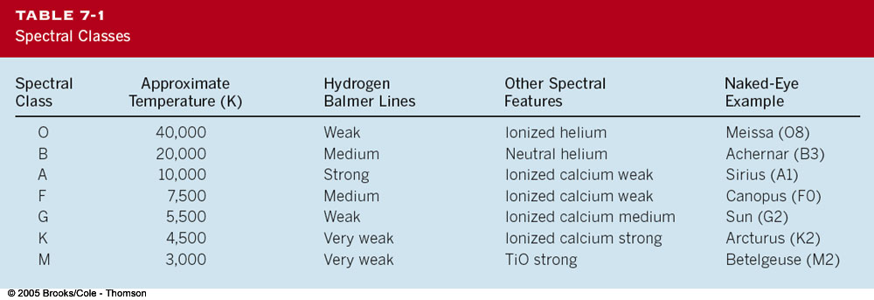
Spectral Classification of Stars (2)
Mnemonics to remember the spectral sequence:
Oh | Oh | Only
Be | Boy, | Bad
A | An | Astronomers
Fine | F | Forget
Girl/Guy | Grade | Generally
Kiss | Kills | Known
Me | Me | Mnemonics

Slide 25
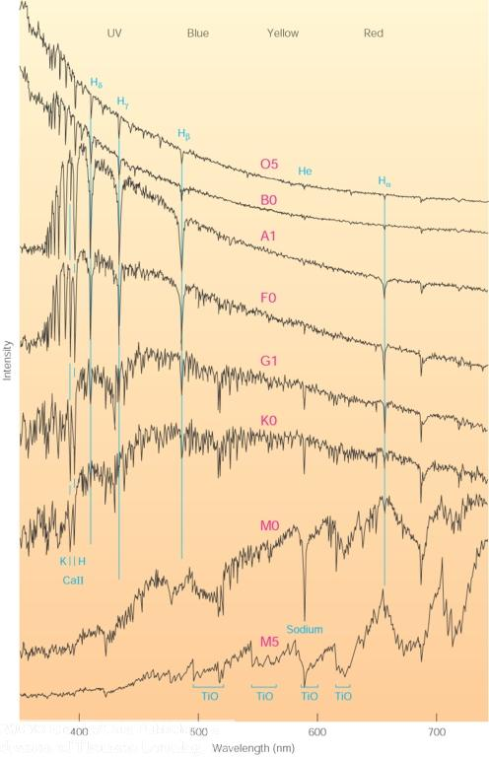
Stellar Spectra
O
B
A
F
Surface temperature
G
K
M

Slide 26
The Composition of Stars
From the relative strength of absorption lines (carefully accounting for their temperature dependence), one can infer the composition of stars.

Slide 27
The Doppler Effect
The light of a moving source is blue/red shifted by
Δλ/λ₀ = v_{r}/c
λ₀ = actual wavelength emitted by the source
Δλ = Wavelength change due to Doppler effect
v_{r} = radial velocity
Blue Shift (to higher frequencies)
Red Shift (to lower frequencies)
v_{r}

Slide 28
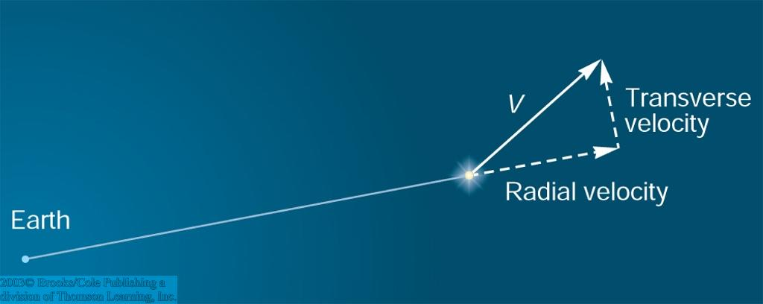
The Doppler Effect (2)
The Doppler effect allows us to measure the source’s radial velocity.
v_{r}

Slide 29
The Doppler Effect (3)
Take λ₀ of the H_{α} (Balmer alpha) line:
λ₀ = 656 nm
Assume, we observe a star’s spectrum with the H_{α} line at λ = 658 nm. Then,
Δλ = 2 nm.
We find Δλ/λ₀ = 0.003 = 3*10⁻³
Thus,
v_{r}/c = 0.003,
or
v_{r} = 0.003*300,000 km/s = 900 km/s.
The line is red shifted, so the star is receding from us with a radial velocity of 900 km/s.

Slide 30
Doppler Broadening
In principle, line absorption should only affect a very unique wavelength.
In reality, also slightly different wavelengths are absorbed.
↔ Lines have a finite width; we say:
they are broadened.
Blue shifted abs.
Red shifted abs.
One reason for broadening: The Doppler effect!
v_{r}
Observer
v_{r}
Atoms in random thermal motion

Slide 31
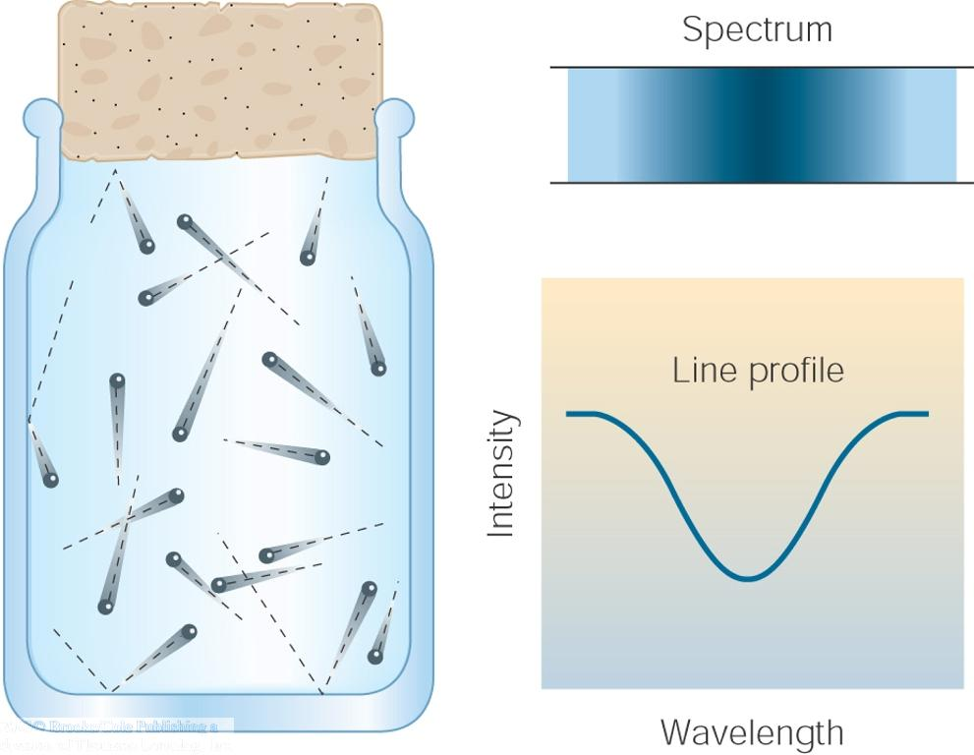
Line Broadening
Higher Temperatures
Higher thermal velocities
⬄ broader lines
Doppler Broadening is usually the most important broadening mechanism.

Slide 32
Distances to Stars
d in parsec (pc) p in arc seconds
__
1
d =
p
Trigonometric Parallax:
Star appears slightly shifted from different positions of the Earth on its orbit
1 pc = 3.26 LY
The farther away the star is (larger d), the smaller the parallax angle p.

Slide 33
The Trigonometric Parallax
Example:
Nearest star, α Centauri, has a parallax of p = 0.76 arc seconds
d = 1/p = 1.3 pc = 4.3 LY
With ground-based telescopes, we can measure parallaxes p ≥ 0.02 arc sec
=> d ≤ 50 pc
This method does not work for stars farther away than 50 pc.

Slide 34
Proper Motion
In addition to the periodic back-and-forth motion related to the trigonometric parallax, nearby stars also show continuous motions across the sky.
These are related to the actual motion of the stars throughout the Milky Way, and are called proper motion.

Slide 35
Intrinsic Brightness/ Absolute Magnitude
The more distant a light source is, the fainter it appears.

Slide 36
Intrinsic Brightness / Absolute Magnitude (2)
More quantitatively:
The flux received from the light is proportional to its intrinsic brightness or luminosity (L) and inversely proportional to the square of the distance (d):
L
__
F ~
d²
Star A
Star B
Earth
Both stars may appear equally bright, although star A is intrinsically much brighter than star B.

Slide 37
Distance and Intrinsic Brightness
Example:
Recall that:
Betelgeuse
Magn. Diff. | Intensity Ratio
1 | 2.512
2 | 2.512*2.512 = (2.512)² = 6.31
… | …
5 | (2.512)⁵ = 100
App. Magn. m_{V} = 0.41
Rigel
For a magnitude difference of 0.41 – 0.14 = 0.27, we find an intensity ratio of (2.512)^{0.27} = 1.28
App. Magn. m_{V} = 0.14

Slide 38
Distance and Intrinsic Brightness (2)
Rigel is appears 1.28 times brighter than Betelgeuse,
But Rigel is 1.6 times further away than Betelgeuse
Betelgeuse
Thus, Rigel is actually (intrinsically) 1.28*(1.6)² = 3.3 times brighter than Betelgeuse.
Rigel

Slide 39
Absolute Magnitude
To characterize a star’s intrinsic brightness, define Absolute Magnitude (M_{V}):
Absolute Magnitude = Magnitude that a star would have if it were at a distance of 10 pc.

Slide 40
Absolute Magnitude (2)
Back to our example of Betelgeuse and Rigel:
Betelgeuse
 | Betelgeuse | Rigel
m_{V} | 0.41 | 0.14
M_{V} | -5.5 | -6.8
d | 152 pc | 244 pc
Rigel
Difference in absolute magnitudes: 6.8 – 5.5 = 1.3
=> Luminosity ratio = (2.512)^{1.3} = 3.3

Slide 41
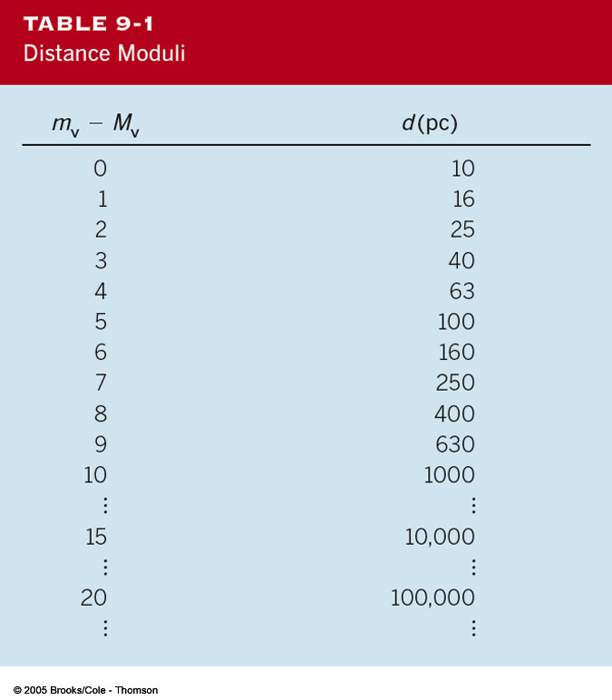
The Distance Modulus
If we know a star’s absolute magnitude, we can infer its distance by comparing absolute and apparent magnitudes:
Distance Modulus
= m_{V} – M_{V}
= -5 + 5 log₁₀(d [pc])
Distance in units of parsec
Equivalent:
d = 10^{(mV – MV + 5)/5} pc

Slide 42
The Size (Radius) of a Star
We already know: flux increases with surface temperature (~ T⁴); hotter stars are brighter.
But brightness also increases with size:
A
Star B will be brighter than star A.
B
Absolute brightness is proportional to radius squared, L ~ R².
Quantitatively: L = 4 π R² σ T⁴
Surface flux due to a blackbody spectrum
Surface area of the star

Slide 43
Example: Star Radii
Polaris has just about the same spectral type (and thus surface temperature) as our sun, but it is 10,000 times brighter than our sun.
Thus, Polaris is 100 times larger than the sun.
This causes its luminosity to be 100² = 10,000 times more than our sun’s.

Slide 44
Organizing the Family of Stars: The Hertzsprung-Russell Diagram
We know:
Stars have different temperatures, different luminosities, and different sizes.
To bring some order into that zoo of different types of stars: organize them in a diagram of
Luminosity
versus
Temperature (or spectral type)
Absolute mag.
Hertzsprung-Russell Diagram
Luminosity
or
Temperature
Spectral type: O B A F G K M

Slide 45
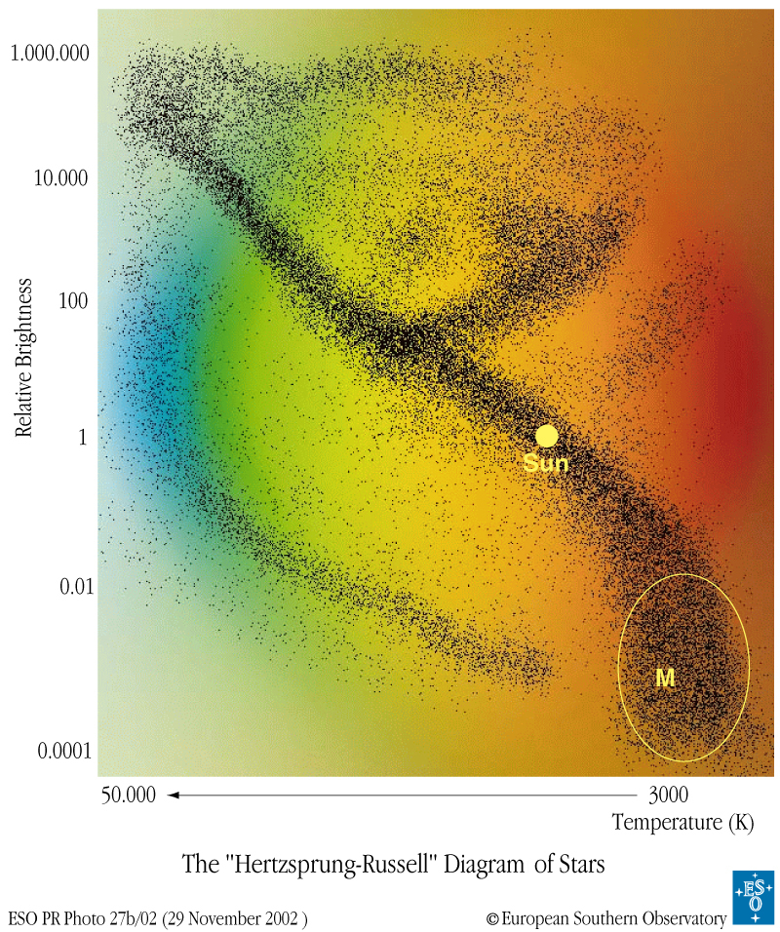
The Hertzsprung-Russell Diagram
Most stars are found along the Main Sequence

Slide 46
The Hertzsprung-Russell Diagram (2)
Same temperature, but much brighter than MS stars
 Must be much larger
Stars spend most of their active life time on the Main Sequence (MS).
 Giant Stars
Same temp., but fainter → Dwarfs

Slide 47
The Radii of Stars in the Hertzsprung-Russell Diagram
Rigel
Betelgeuse
10,000 times the sun’s radius
Polaris
100 times the sun’s radius
Sun
As large as the sun
100 times smaller than the sun

Slide 48
Luminosity Classes
Ia Bright Supergiants
Ia
Ib
Ib Supergiants
II
II Bright Giants
III
III Giants
IV
IV Subgiants
V
V Main-Sequence Stars

Slide 49
Example Luminosity Classes
Our Sun: G2 star on the Main Sequence: G2V
Polaris: G2 star with Supergiant luminosity: G2Ib

Slide 50
Spectral Lines of Giants
Pressure and density in the atmospheres of giants are lower than in main sequence stars.
=> Absorption lines in spectra of giants and supergiants are narrower than in main sequence stars
=> From the line widths, we can estimate the size and luminosity of a star.
 Distance estimate (spectroscopic parallax)

Slide 51
Binary Stars
More than 50 % of all stars in our Milky Way are not single stars, but belong to binaries:
Pairs or multiple systems of stars which orbit their common center of mass.
If we can measure and understand their orbital motion, we can estimate the stellar masses.

Slide 52
The Center of Mass
center of mass = balance point of the system.
Both masses equal => center of mass is in the middle, r_{A} = r_{B}.
The more unequal the masses are, the more it shifts toward the more massive star.

Slide 53
Estimating Stellar Masses
Recall Kepler’s 3rd Law:
P_{y}² = a_{AU}³
Valid for the Solar system: star with 1 solar mass in the center.
We find almost the same law for binary stars with masses M_{A} and M_{B} different from 1 solar mass:
a_{AU}³
____
M_{A} + M_{B} =
P_{y}²
(M_{A} and M_{B} in units of solar masses)

Slide 54
Examples: Estimating Mass
a) Binary system with period of P = 32 years and separation of a = 16 AU:
16³
____
M_{A} + M_{B} = = 4 solar masses.
32²
b) Any binary system with a combination of period P and separation a that obeys Kepler’s 3. Law must have a total mass of 1 solar mass.

Slide 55
Visual Binaries
The ideal case:
Both stars can be seen directly, and their separation and relative motion can be followed directly.

Slide 56
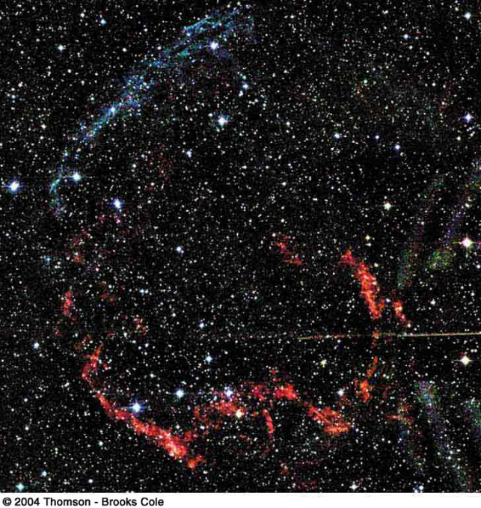
The End of a Star’s Life
When all the nuclear fuel in a star is used up, gravity will win over pressure and the star will die.
High-mass stars will die first, in a gigantic explosion, called a supernova.
Less massive stars will die in a less dramatic event, called a nova

Slide 57
Red Dwarfs
Stars with less than ~ 0.4 solar masses are completely convective.
Mass
 Hydrogen and helium remain well mixed throughout the entire star.
 No phase of shell “burning” with expansion to giant.
Star not hot enough to ignite He burning.

Slide 58
Sunlike Stars
Sunlike stars (~ 0.4 – 4 solar masses) develop a helium core.
Mass
 Expansion to red giant during H burning shell phase
 Ignition of He burning in the He core
 Formation of a degenerate C,O core

Slide 59
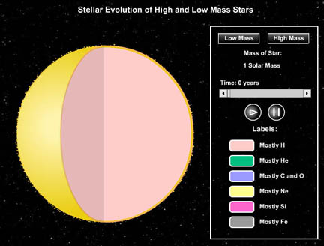
Inside Stars
(SLIDESHOW MODE ONLY)

Slide 60
Mass Loss From Stars
Stars like our sun are constantly losing mass in a stellar wind ( solar wind).
The more massive the star, the stronger its stellar wind.
Far-infrared
WR 124

Slide 61
The Final Breaths of Sun-Like Stars: Planetary Nebulae
Remnants of stars with ~ 1 – a few M_{sun}
Radii: R ~ 0.2 - 3 light years

Expanding at ~10 – 20 km/s ( Doppler shifts)
Less than 10,000 years old
Have nothing to do with planets!
The Helix Nebula

Slide 62
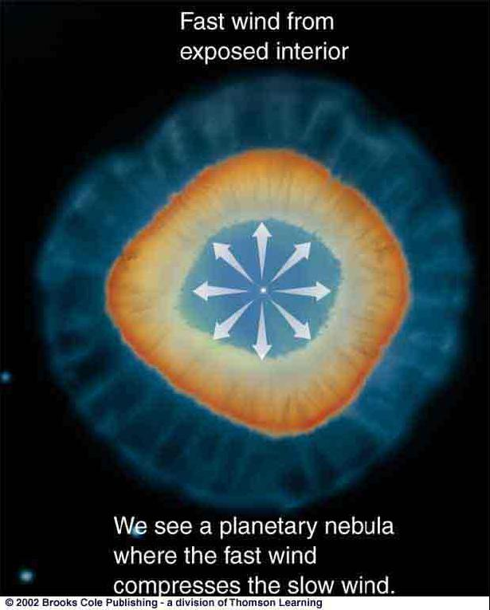
The Formation of Planetary Nebulae
Two-stage process:
Slow wind from a red giant blows away cool, outer layers of the star
The Ring Nebula in Lyra
Fast wind from hot, inner layers of the star overtakes the slow wind and excites it => Planetary Nebula

Slide 63
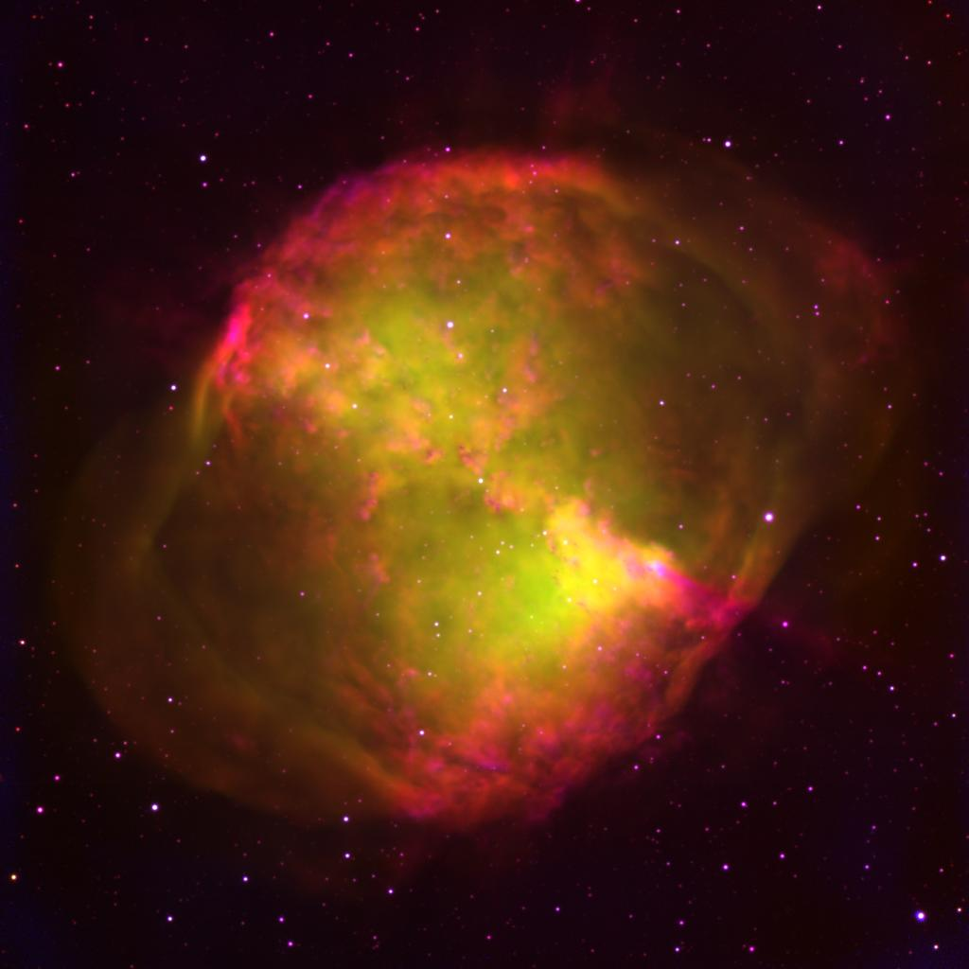
The Dumbbell Nebula in Hydrogen and Oxygen Line Emission

Slide 64
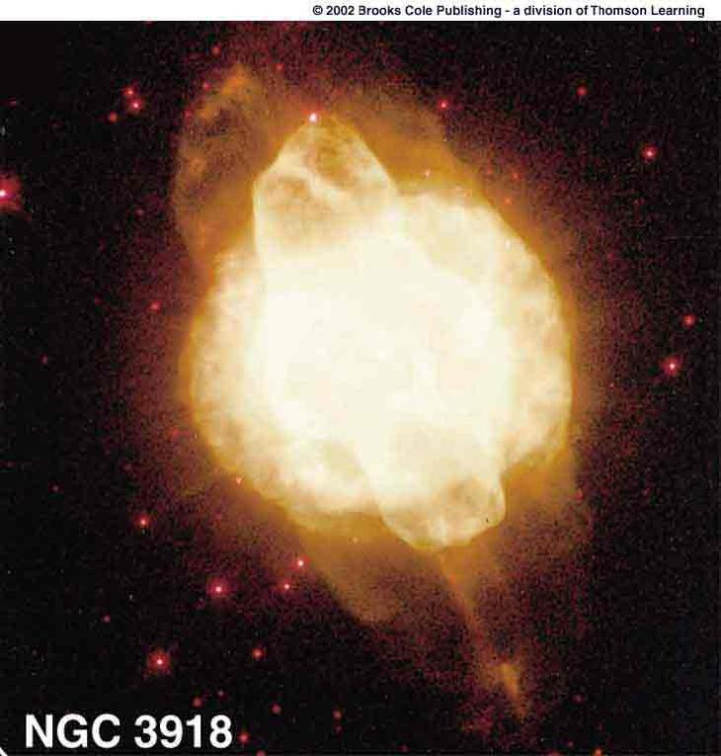
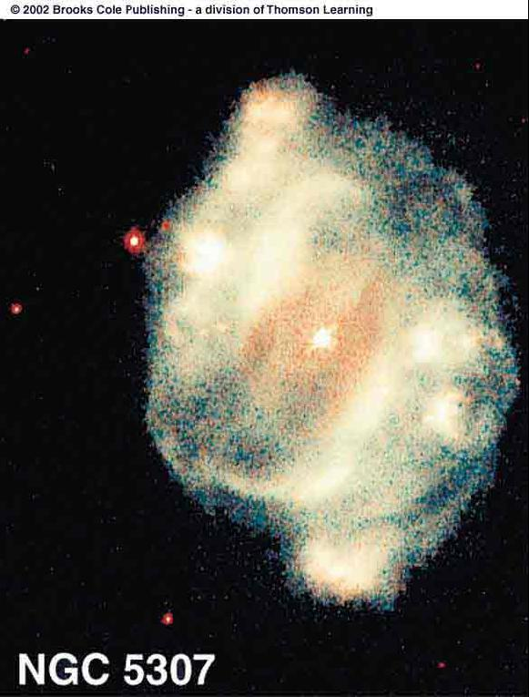
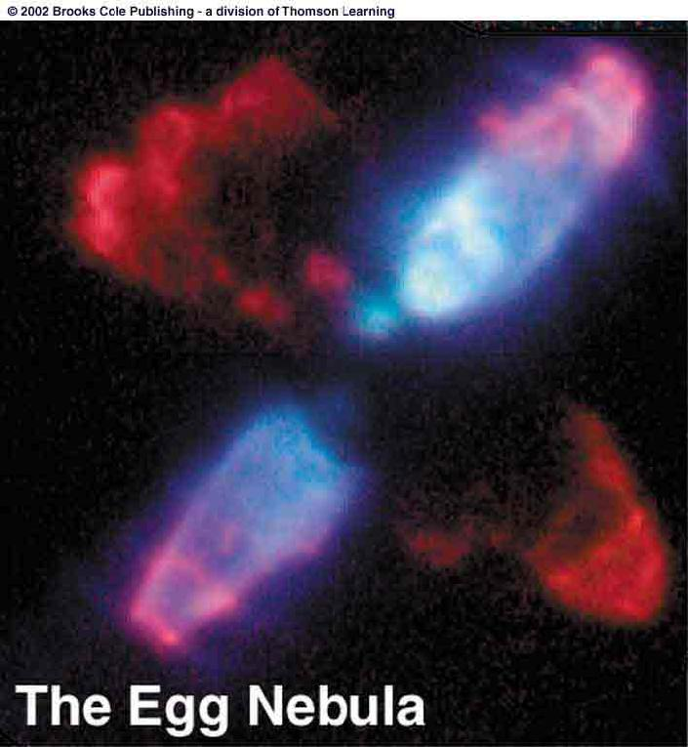
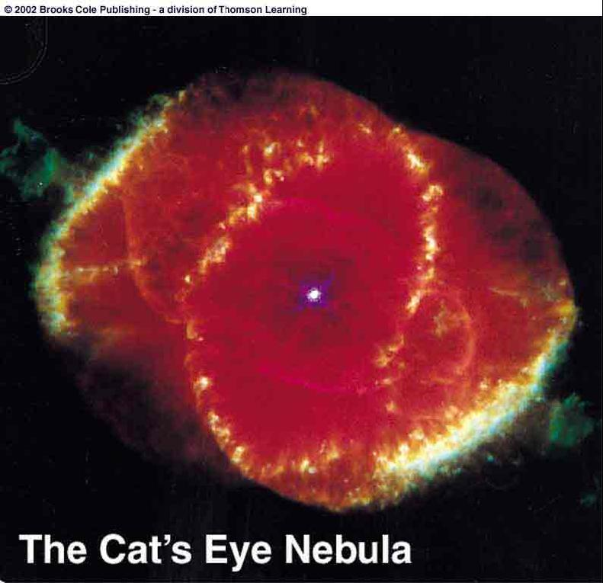
Planetary Nebulae
Often asymmetric, possibly due to
Stellar rotation
Magnetic fields
Dust disks around the stars
The Butterfly Nebula

Slide 65
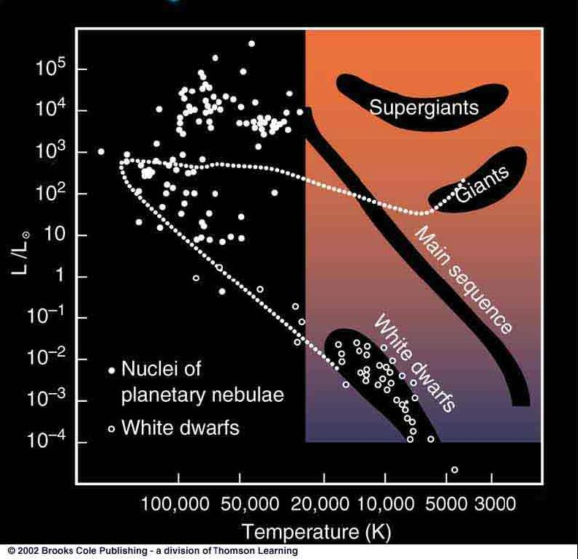
The Remnants of Sun-Like Stars: White Dwarfs
Sunlike stars build up a Carbon-Oxygen (C,O) core, which does not ignite Carbon fusion.
He-burning shell keeps dumping C and O onto the core. C,O core collapses and the matter becomes degenerate.
 Formation of a White Dwarf

Slide 66
White Dwarfs
Degenerate stellar remnant (C,O core)
Extremely dense: 1 teaspoon of WD material: mass ≈ 16 tons!!!
Chunk of WD material the size of a beach ball would outweigh an ocean liner!
White Dwarfs:
Mass ~ M_{sun}
Temp. ~ 25,000 K
Luminosity ~ 0.01 L_{sun}

Slide 67
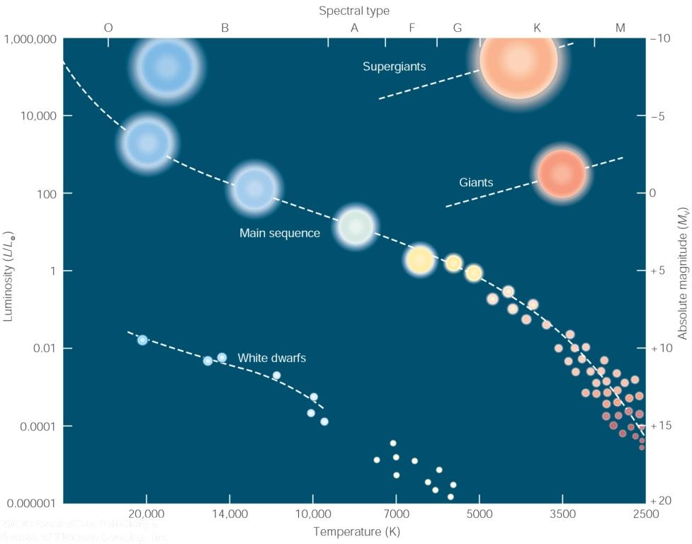
White Dwarfs (2)
Low luminosity; high temperature => White dwarfs are found in the lower left corner of the Hertzsprung-Russell diagram.

Slide 68
The Chandrasekhar Limit
The more massive a white dwarf, the smaller it is.
 Pressure becomes larger, until electron degeneracy pressure can no longer hold up against gravity.
WDs with more than ~ 1.4 solar masses can not exist!

Slide 69
Mass Transfer in Binary Stars
In a binary system, each star controls a finite region of space, bounded by the Roche Lobes (or Roche surfaces).
Lagrange points = points of stability, where matter can remain without being pulled towards one of the stars.
Matter can flow over from one star to another through the Inner Lagrange Point L1.

Slide 70
Recycled Stellar Evolution
Mass transfer in a binary system can significantly alter the stars’ masses and affect their stellar evolution.

Slide 71
White Dwarfs in Binary Systems
X-ray emission
T ~ 10⁶ K
Binary consisting of WD + MS or Red Giant star => WD accretes matter from the companion
Angular momentum conservation => accreted matter forms a disk, called accretion disk.
Matter in the accretion disk heats up to ~ 1 million K => X-ray emission => “X-ray binary”.

Slide 72
Nova Explosions
Hydrogen accreted through the accretion disk accumulates on the surface of the WD
Very hot, dense layer of non-fusing hydrogen on the WD surface
Nova Cygni 1975
Explosive onset of H fusion
Nova explosion

Slide 73
Recurrent Novae
T Pyxidis
In many cases, the mass transfer cycle resumes after a nova explosion.
R Aquarii
 Cycle of repeating explosions every few years – decades.

Slide 74
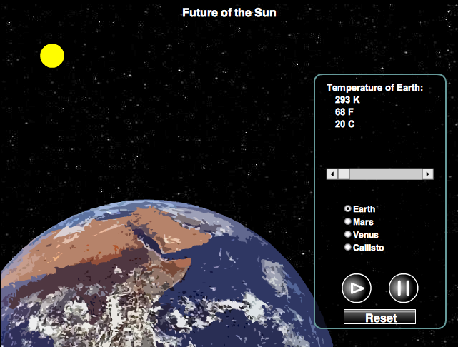
Future of the Sun
(SLIDESHOW MODE ONLY)

Slide 75
The Fate of Our Sun and the End of Earth
Sun will expand to a Red giant in ~ 5 billion years
Expands to ~ Earth’s radius
Earth will then be incinerated!
Sun may form a planetary nebula (but uncertain)
Sun’s C,O core will become a white dwarf

Slide 76
The Deaths of Massive Stars: Supernovae
Final stages of fusion in high-mass stars (> 8 M_{sun}), leading to the formation of an iron core, happen extremely rapidly: Si burning lasts only for ~ 1 day.
Iron core ultimately collapses, triggering an explosion that destroys the star:
A Supernova

Slide 77
Observations of Supernovae
Supernovae can easily be seen in distant galaxies.

Slide 78
Type I and II Supernovae
Core collapse of a massive star: Type II Supernova
If an accreting White Dwarf exceeds the Chandrasekhar mass limit, it collapses, triggering a Type Ia Supernova.
Type I: No hydrogen lines in the spectrum
Type II: Hydrogen lines in the spectrum

Slide 79
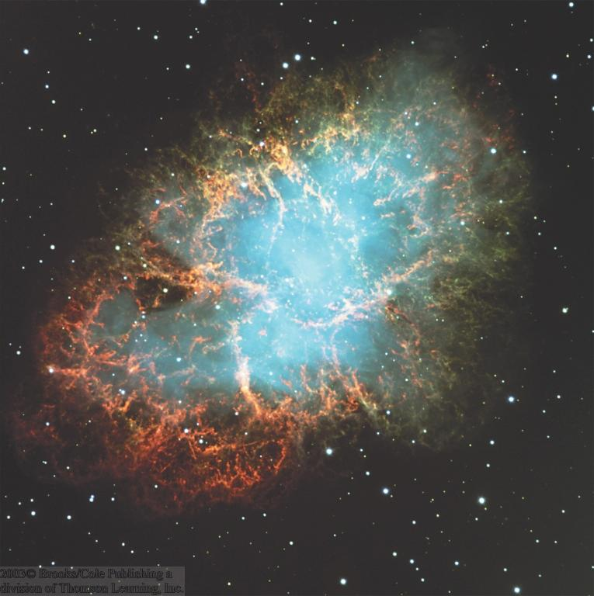
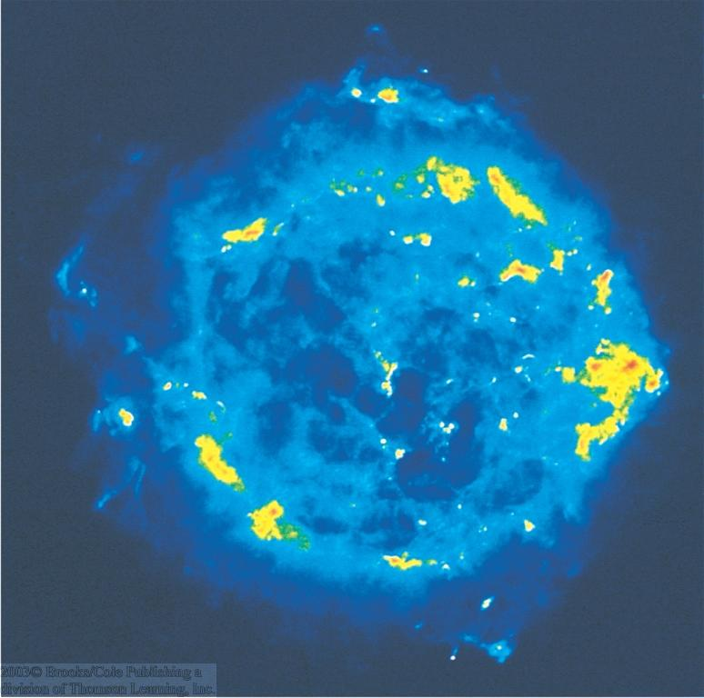
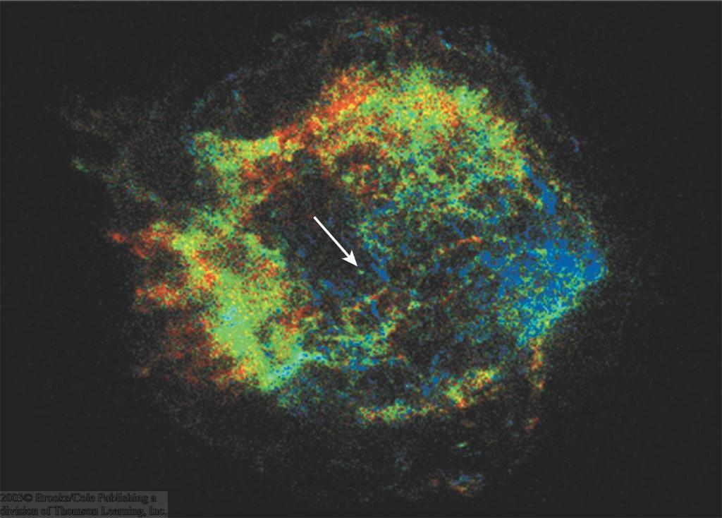
Supernova Remnants
X-rays
The Crab Nebula:
Remnant of a supernova observed in a.d. 1054
Cassiopeia A
Optical
The Veil Nebula
The Cygnus Loop

Slide 80
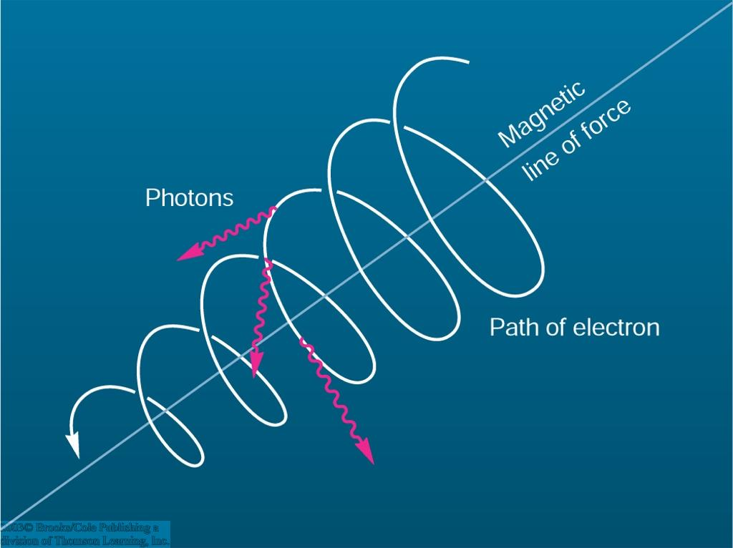
Synchrotron Emission and Cosmic-Ray Acceleration
The shocks of supernova remnants accelerate protons and electrons to extremely high, relativistic energies.
“Cosmic Rays”
In magnetic fields, these relativistic electrons emit
Synchrotron Radiation.

Slide 81
The Famous Supernova of 1987: SN 1987A
Before
At maximum
Unusual type II Supernova in the Large Magellanic Cloud in Feb. 1987

Slide 82
The Remnant of SN 1987A
Ring due to SN ejecta catching up with pre-SN stellar wind; also observable in X-rays.

