Slide 1
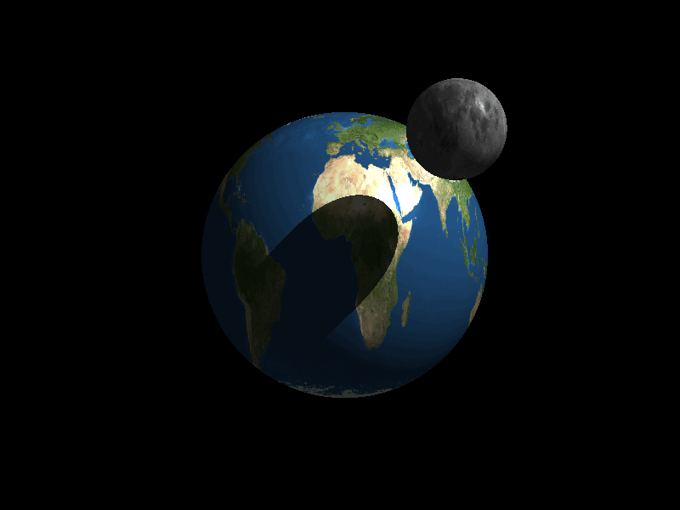
Unit 3: Earth and Moon

Slide 2
The Earth as a Planet
What makes Earth unique?
What characteristics does Earth share with the other planets of the Solar System?

Slide 3
“There’s no place like home…”
Earth is the 3rd planet (i.e. “Rock”) from the Sun.
Earth is the 5th largest planet in the Solar System.
Earth has one satellite, The Moon.
Earth orbits the Sun every 365.245 days, which is why there is a Leap Year every fourth year.

Slide 4

“As the World Turns…”
Earth is over 70% water.
Earth is the only planet that has all three phases of water…solid, liquid, and gas.
Earth has a Nickel-Iron core, which produces its magnetic field and affects compass directions.

Slide 5
Factoids
Pictures of Earth did not come into existence until the last 100 years.
The tectonic plates of Earth move at a pace of 5 cm per year.

Slide 6


Due to the Earth’s rotation and tilted axis, the Northern Hemisphere has the opposite season of the Southern Hemisphere.
(Summer in N.H.) (Winter in S.H.)

Slide 7
Also the wind patterns are different in each hemispheres, which is due to the Coriolis Effect.
The winds move in a counterclockwise manner in the Northern Hemisphere and a clockwise manner in the Southern Hemisphere.
Reference: http://www.usatoday.com/weather/resources/basics/coriolis-understanding.htm

Slide 8
“The Atmosphere: Layer by Layer”
The Exosphere is the outermost layer that fades into space. Color #10 gray!
The Thermosphere is the outermost layer and makes up .001% of the total atmosphere. Please color #9 red!

Slide 9
The Ionosphere is the next layer. It is where the Aurora Borealis and the Aurora Australis take place. The solar wind’s charged particles collide with the free electrons in this layer to produce the auroras. Color this layer green!
The Mesosphere is the layer that follows,and it is the coldest layer of the atmosphere. Blue is the color you need to proceed.

Slide 10
The Stratosphere is the next layer, and this is the area where high–flying aircraft can fly well, due to horizontal winds. The Ozone layer is also contained in this layer. Let this layer be yellow.

Slide 11
The layer of the atmosphere that we live in is the Troposphere. Almost all of the Earth’s atmospheric gases (75% to be exact) are found in this layer. It runs from sea level to 7 miles up, which means that Mount Everest is even in this layer of the atmosphere. Purple is a nice color to use now.

Slide 12
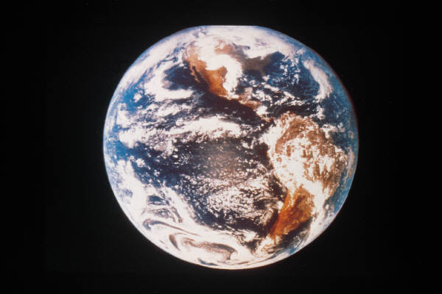
Diameter: 12.756.3 km
Mass:
5.976 x 10²⁴ kg

Slide 13
More Factoids…
Gravity: 1 g
Avg. Temps.:
0ºF – 100ºF
Pressure: 1 atm
Atmosphere make-up:
77% N₂,
21% O₂, and
2% traces of Ar, CO₂, and H₂O vapor
Length of Day:
24 hours (approx.)
Length of Year:
365-366 days
Soil (if any): firm, good for crops
Wind speed:
0-50 mph, some storms

Slide 14


Features:
polar ice caps, oceans and lakes of liquid water, trees mountains, plants, volcanoes, humans, animals, and natural resources (oil, coal, metals, etc.)
Hazards:
Earthquakes, volcanic eruptions, hurricanes, tsunamis, typhoons, mudslides, tornadoes, avalanches, electrical storms

Slide 15

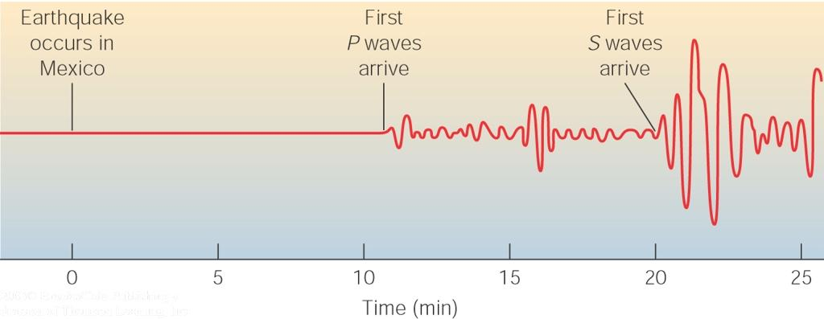
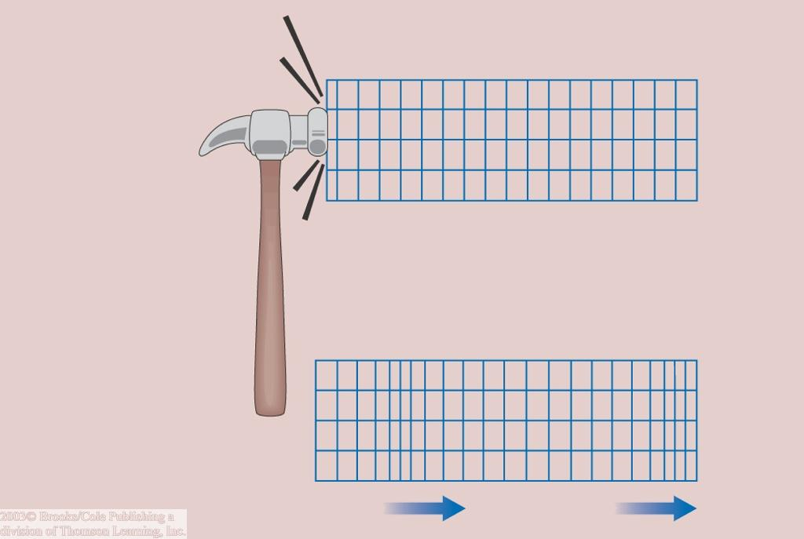
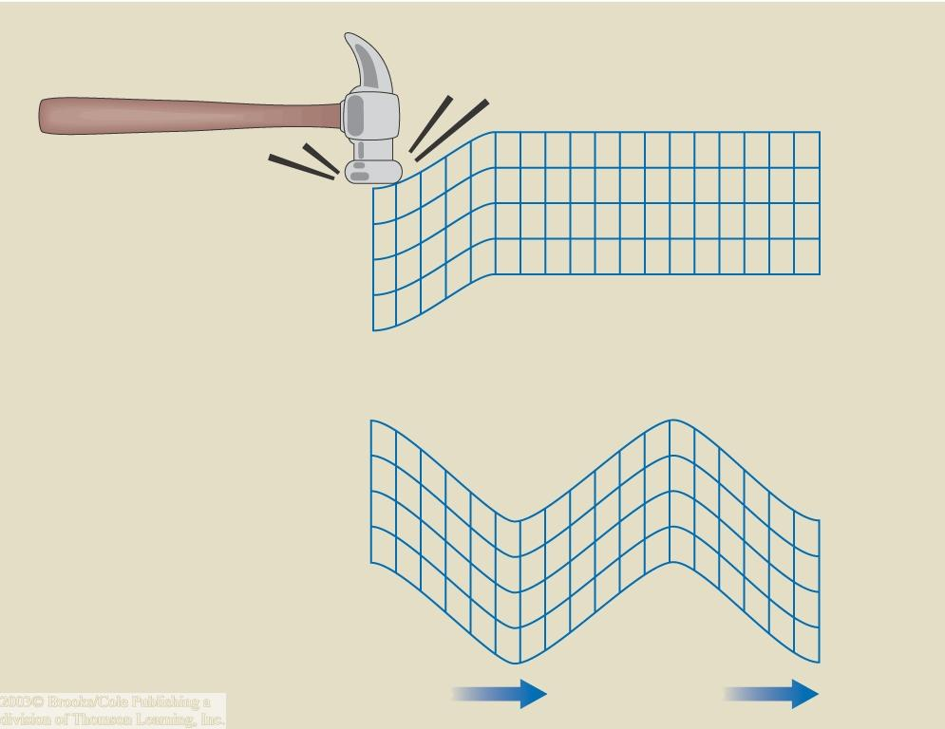
Earth’s Interior
Direct exploration of Earth’s interior (e.g. drilling) is impossible.
Earth’s interior can be explored through seismology:
earthquakes produce seismic waves.
Two types of seismic waves:
Pressure waves:
Shear waves:
Particles vibrate back and forth
Particles vibrate up and down

Slide 16
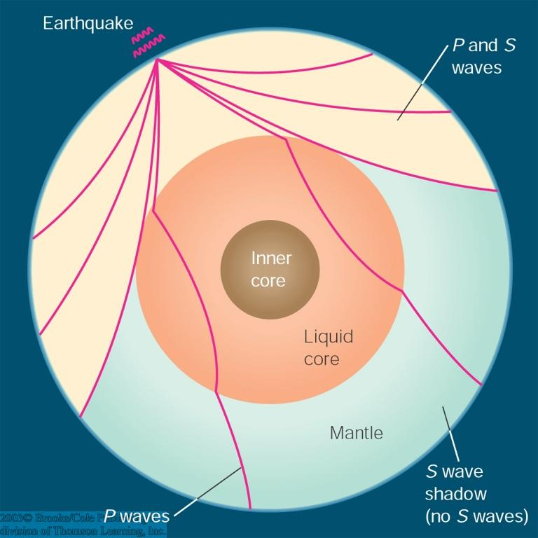
Seismology
Seismic waves do not travel through Earth in straight lines or at constant speed.
They are bent by or bounce off transitions between different materials or different densities or temperatures.
Such information can be analyzed to infer the structure of Earth’s interior.

Slide 17
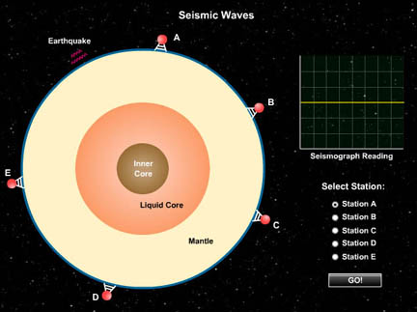

Seismic Waves
(SLIDESHOW MODE ONLY)

Slide 18
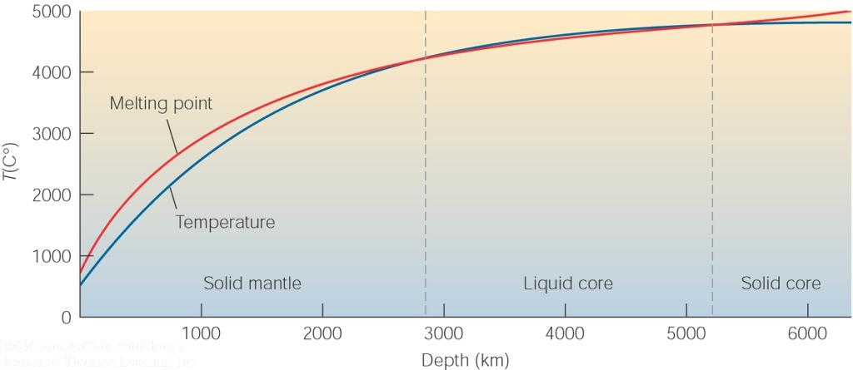
Earth’s Interior (2)
Solid crust
Basic structure:
Solid mantle
Liquid core
Solid inner core
Earth’s interior gets hotter towards the center.
Earth’s core is as hot as the sun’s surface; metals are liquid.
Melting point increases with increasing pressure towards the center
Melting point = temperature at which an element melts (transition from solid to liquid)
=> Inner core becomes solid

Slide 19
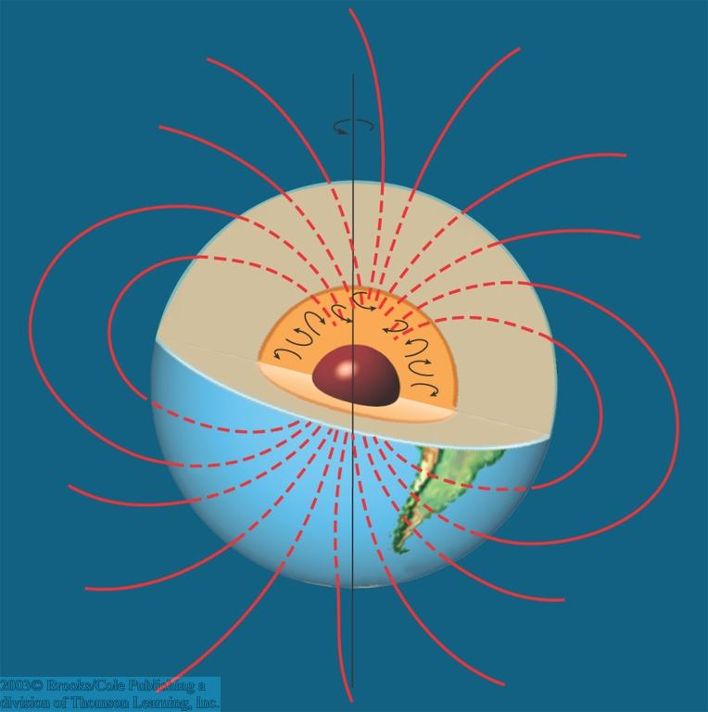
Earth’s Magnetic Field
Earth’s core consists mostly of iron + nickel: high electrical conductivity
Convective motions and rotation of the core generate a dipole magnetic field

Slide 20
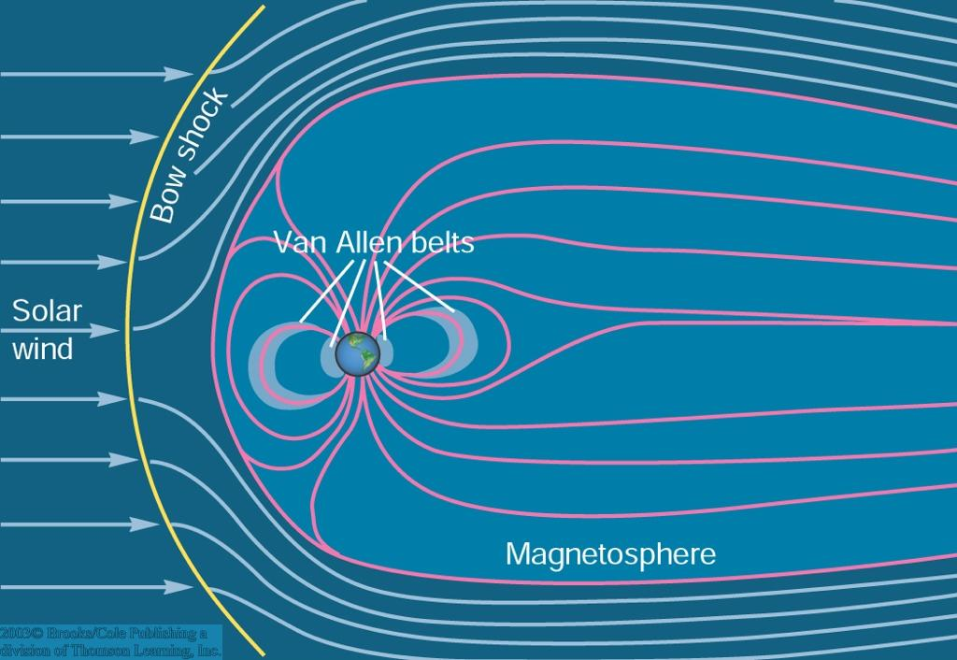
The Role of Earth’s Magnetic Field
Earth’s magnetic field protects Earth from high-energy particles coming from the sun (solar wind).
Surface of first interaction of solar wind with Earth’s magnetic field = Bow shock
Region where Earth’s magnetic field dominates = magnetosphere
Some high-energy particles leak through the magnetic field and produce a belt of high-energy particles around Earth: Van Allen belts

Slide 21
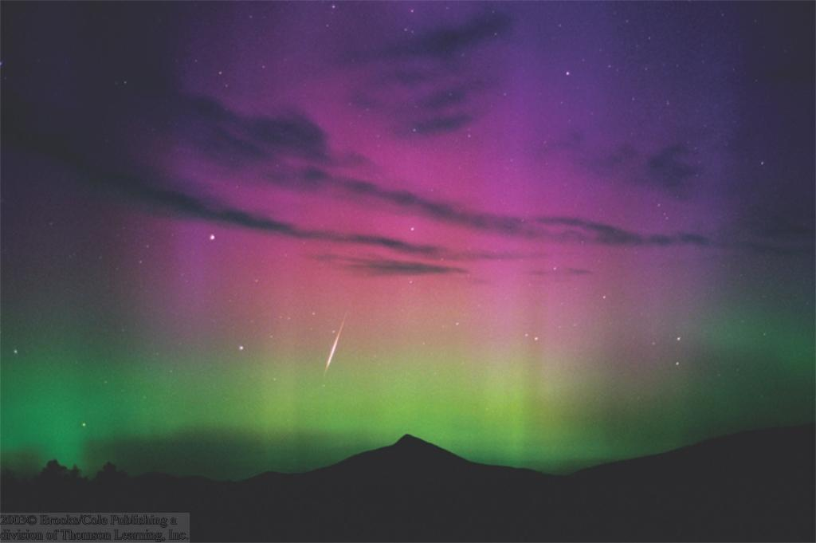
The Aurora (Polar Light)
As high-energy particles leak into the lower magnetosphere, they excite molecules near the Earth’s magnetic poles, causing the aurora

Slide 22
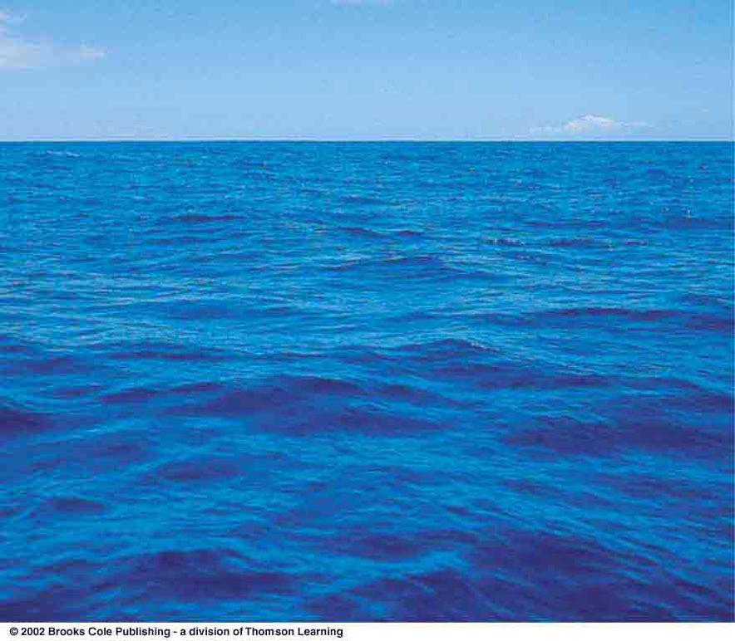
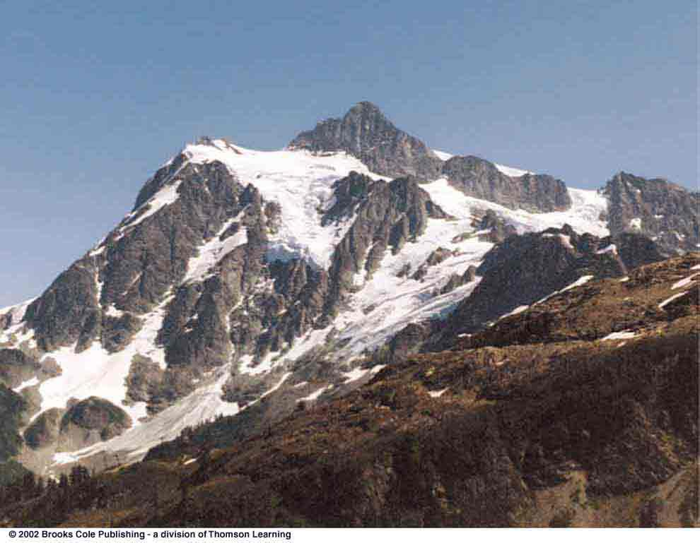
The Active Earth
About 2/3 of Earth’s surface is covered by water.
Mountains are relatively rapidly eroded away by the forces of water.

Slide 23
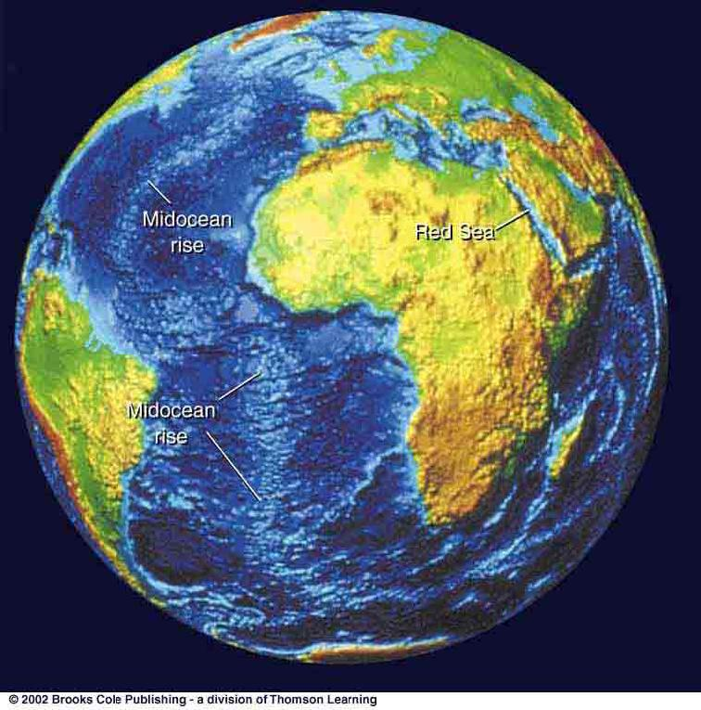
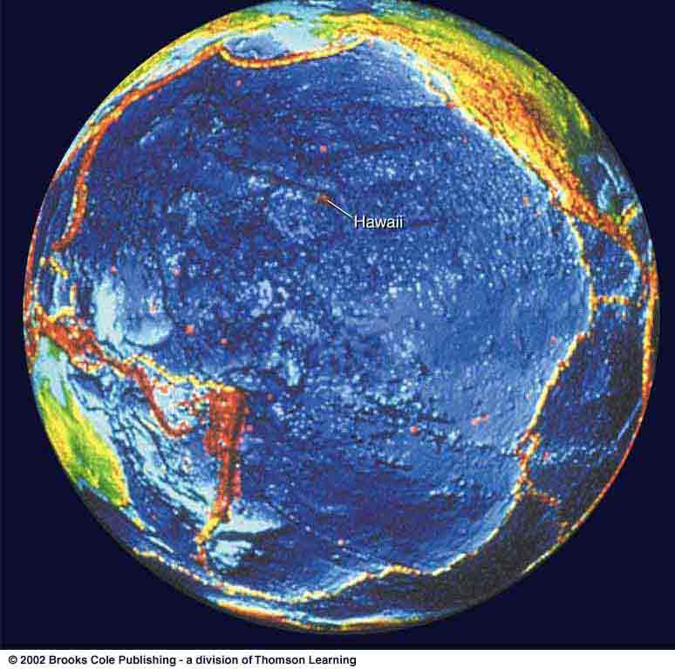
Tectonic Plates
Earth’s crust is composed of several distinct tectonic plates, which are in constant motion with respect to each other → Plate tectonics
Evidence for plate tectonics can be found on the ocean floor
… and in geologically active regions all around the Pacific

Slide 24
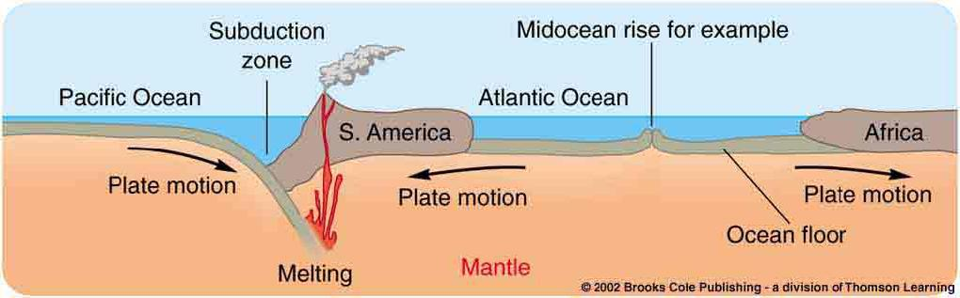
Plate Tectonics
Tectonic plates move with respect to each other.
Where plates move toward each other, plates can be pushed upward and downward → formation of mountain ranges, some with volcanic activity, earthquakes
Where plates move away from each other, molten lava can rise up from below → volcanic activity

Slide 25
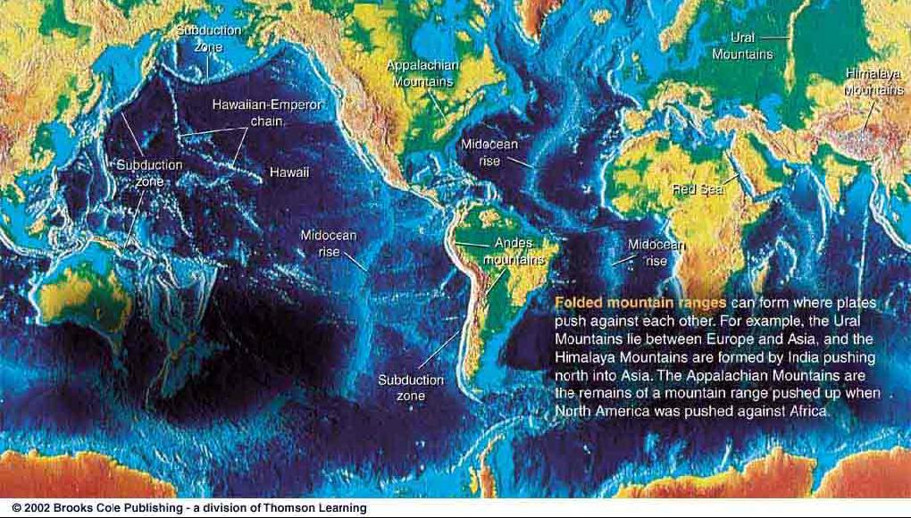
Active Zones Resulting from Plate Tectonics
Volcanic hot spots due to molten lava rising up at plate boundaries or through holes in tectonic plates

Slide 26
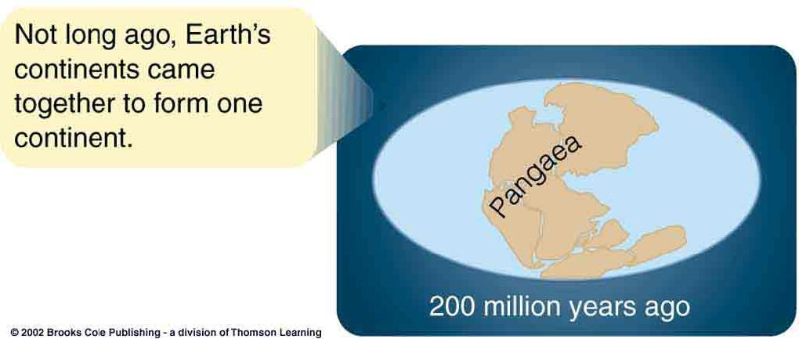
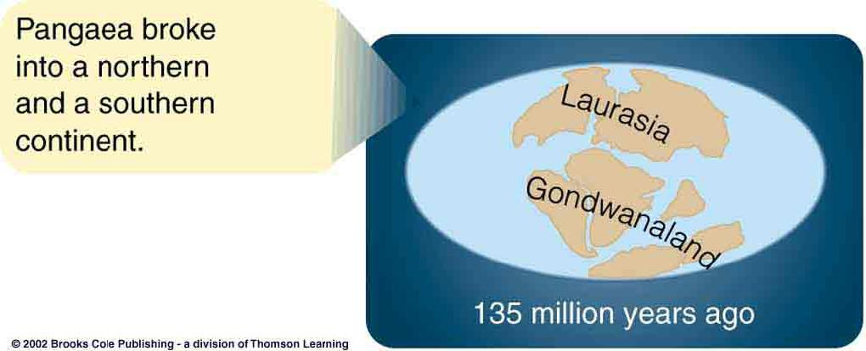
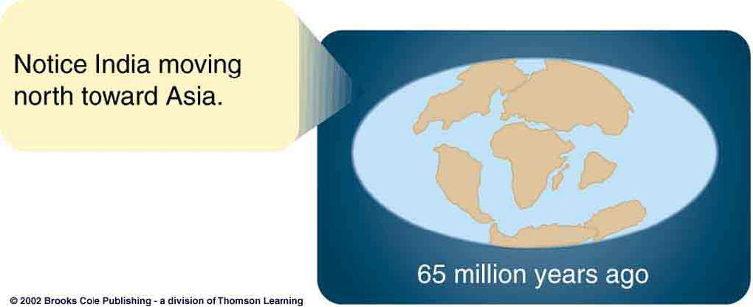
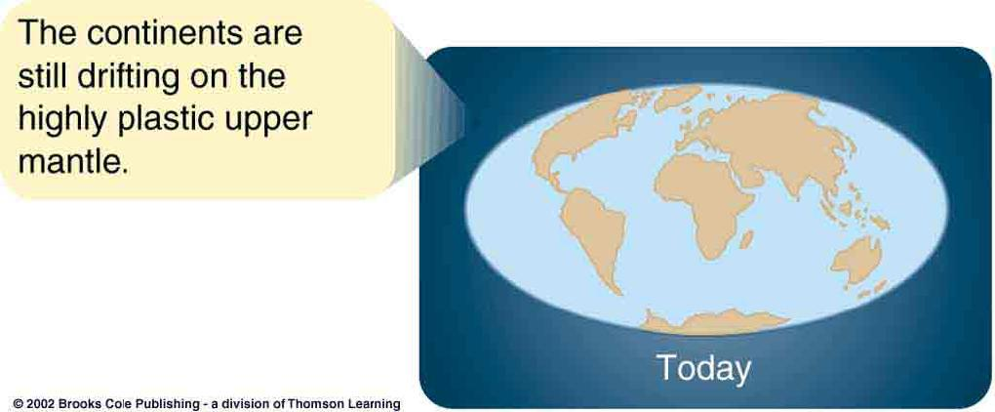
Earth’s Tectonic History

Slide 27
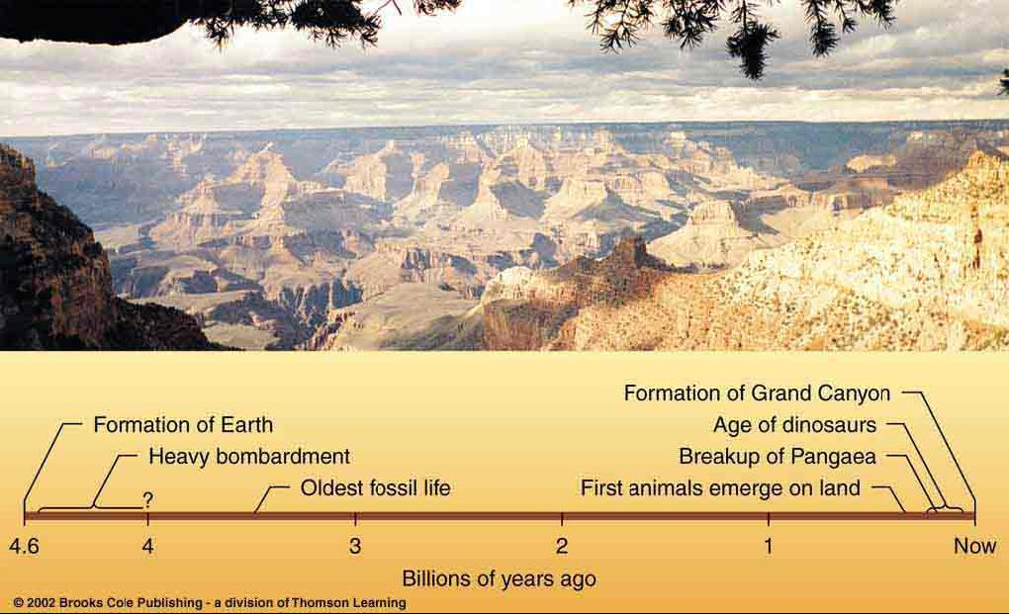
History of Geological Activity
Surface formations visible today have emerged only very recently compared to the age of Earth.

Slide 28
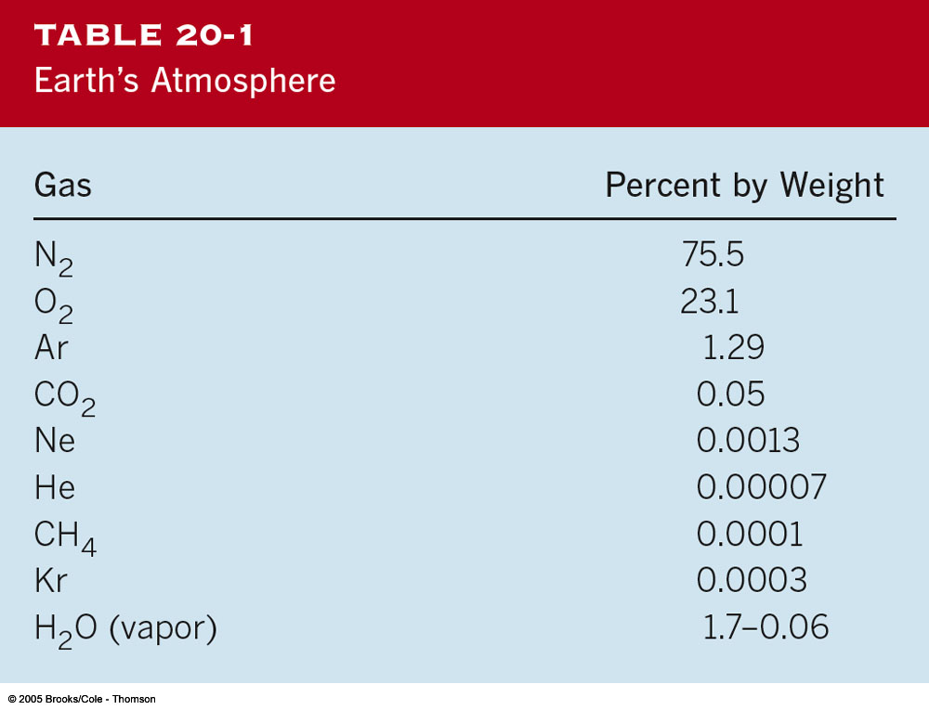
The Atmosphere
Earth had a primeval atmosphere from remaining gasses captured during formation of Earth
Atmospheric composition severely altered (→ secondary atmosphere) through a combination of two processes:
1) Outgassing: Release of gasses bound in compounds in the Earth’s interior through volcanic activity
2) Later bombardment with icy meteoroids and comets

Slide 29
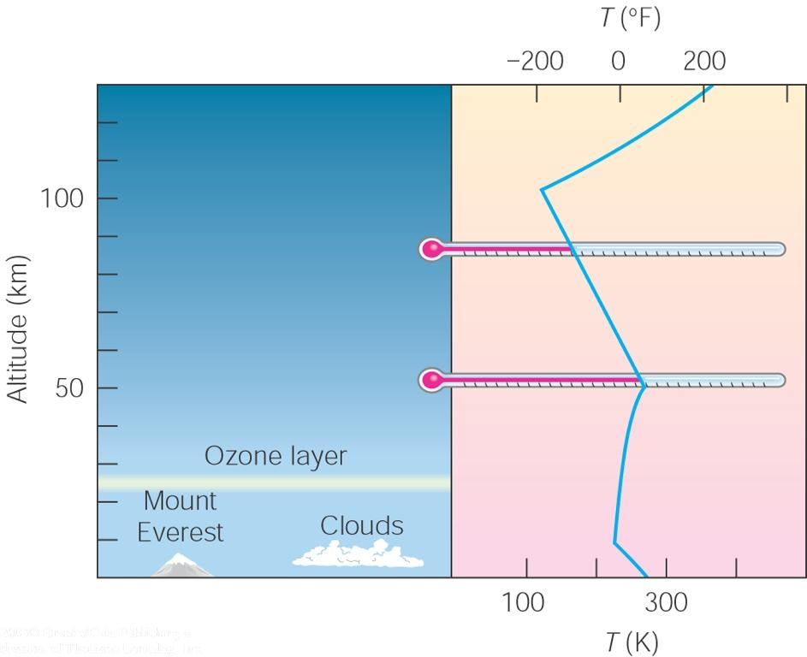
The Structure of Earth’s Atmosphere
Composition of Earth’s atmosphere is further influenced by:
The ozone layer is essential for life on Earth since it protects the atmosphere from UV radiation
Chemical reactions in the oceans,
Energetic radiation from space (in particular, UV)
Presence of life on Earth
The temperature of the atmosphere depends critically on its albedo = percentage of sun light that it reflects back into space
Depends on many factors, e.g., abundance of water vapor in the atmosphere

Slide 30
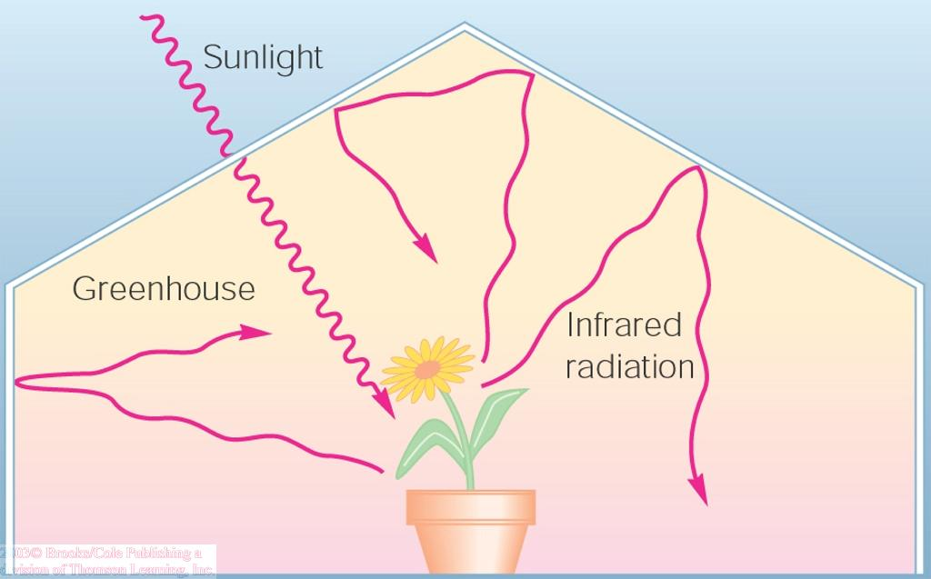
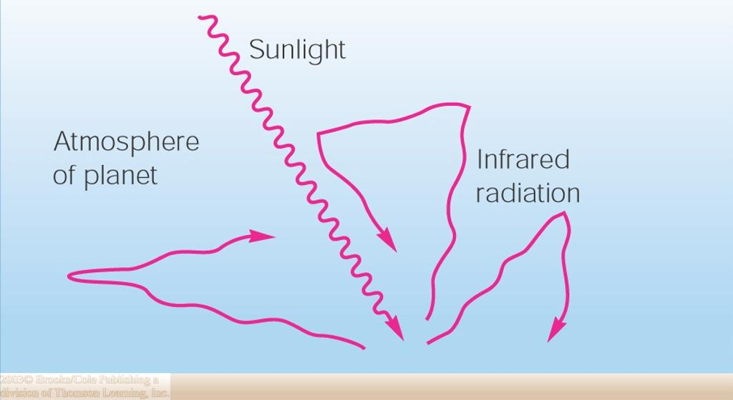
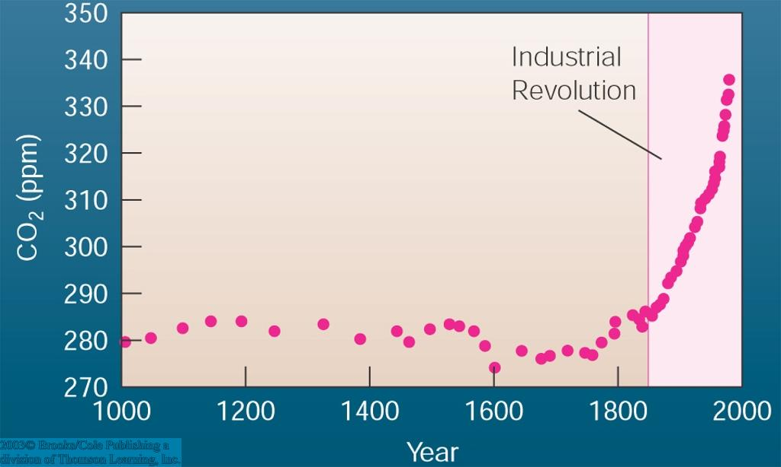
Human Effects on Earth’s Atmosphere
1) The Greenhouse Effect
Earth’s surface is heated by the sun’s radiation.
Heat energy is re-radiated from Earth’s surface as infrared radiation.
CO₂, but also other gases in the atmosphere, absorb infrared light
→ Heat is trapped in the atmosphere.
This is the Greenhouse Effect.
The Greenhouse Effect occurs naturally and is essential to maintain a comfortable temperature on Earth,
but human activity, in particular CO₂ emissions from cars and industrial plants, is drastically increasing the concentration of greenhouse gases.

Slide 31
Global Warming
Human activity (CO₂ emissions + deforestation) is drastically increasing the concentration of greenhouse gases.
As a consequence, beyond any reasonable doubt, the average temperature on Earth is increasing.
This is called Global Warming
Leads to melting of glaciers and polar ice caps (→ rising sea water levels) and global climate changes, which could ultimately make Earth unfit for human life!

Slide 32
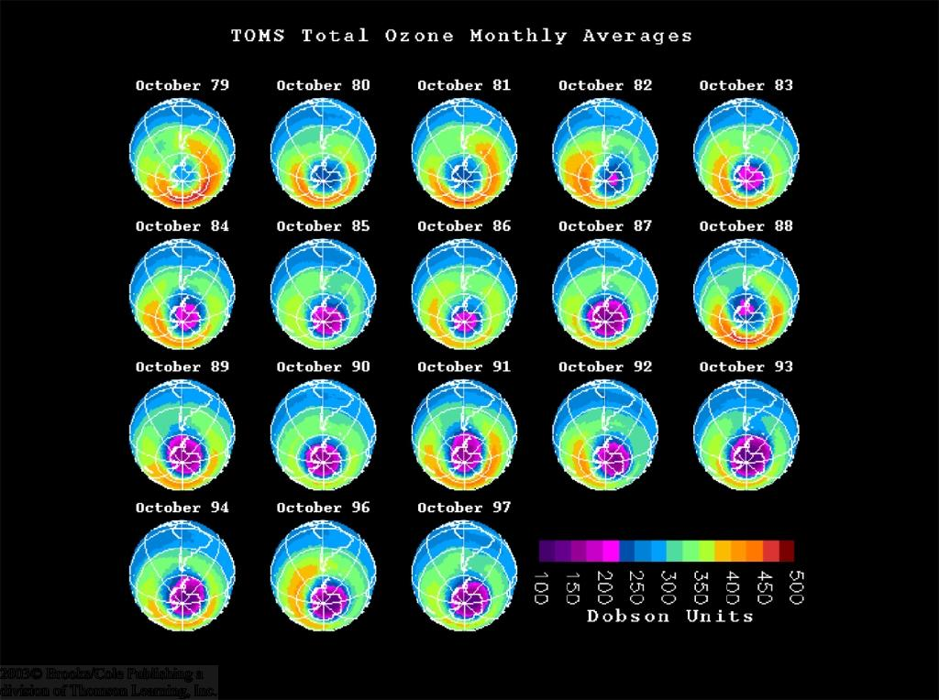
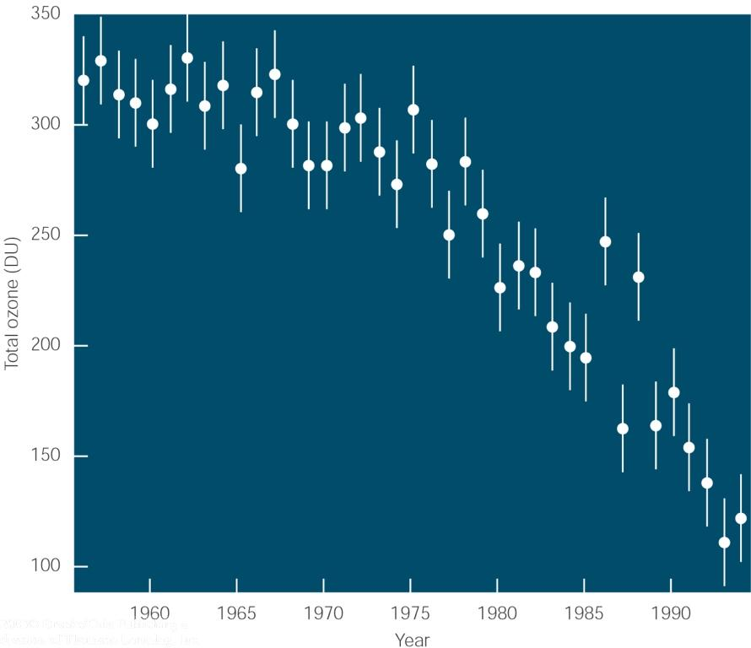
Human Effects on the Atmosphere (2)
2) Destruction of the Ozone Layer
Ozone (= O₃) absorbs UV radiation, (which has damaging effects on human and animal tissue).
Chlorofluorocarbons (CFCs) (used, e.g., in industrial processes, refrigeration and air conditioning) destroy the Ozone layer.
Destruction of the ozone layer as a consequence of human activity is proven (e.g., growing ozone hole above the Antarctic);
Must be stopped and reversed by reducing CFC use, especially in developed countries!

Slide 33

The Earth’s Lone Satellite:
The Moon

Slide 34
Facts about the Moon
The Moon is a satellite and only reflects light from the Sun. It does NOT provide any light on its own.
It is Earth’s closest neighbor in space, and it is roughly 240,000 miles from the Earth most of the time.
It has a Nickel-Core, and there are four different theories that exist which try to explain the origin of Earth’s only satellite.

Slide 35
Facts cont.
The Moon “wobbles,” a term called libration, which makes it possible for humans to see roughly 51% of the Moon’s surface. However, the Moon does have a “Dark Side” so to speak. There is a side of the Moon that we NEVER see without lunar visits or satellite mapping.
The Moon has many different features, including mare (“seas” or lava-formed plains), terra (highlands), craters (created from asteroid and meteorite impacts), and mons (mountains).

Slide 36
Examples of Features
“Seas” – Mare Tranquillitatis
“Sea of Tranquility”
(where Apollo XI landed)
Mare Serenitatis
“Sea of Serenity”
“Mons” – Montes Apenninus
“Apennine Mts.” like on Earth
Montes Alpes
“Alps Mts.” like on Earth
Craters – Archimedes, Copernicus, and Tycho (All large ones are named after famous dead scientists, scholars and artists. Small ones tend to have common first names.)

Slide 37
Four Theories about Moon’s Origin
Theory One is Nebular Contraction or Condensation Theory that says the Earth and Moon were produced or created at the same time in the same or close nebulas during the creation of the Solar System.
Theory Two is the Capture Theory, in which the Earth’s gravity pulled the Moon in while it was passing near Earth.

Slide 38
Theories cont.
Theory Three is the Fission Theory, in which the Moon split apart of the primordial Earth while it was forming and stayed close by due to Earth’s gravity.
Theory Four (the one scientists lean towards) is the Collision Theory in which an asteroid or something large in size hit the primordial Earth forcing back of the remnants (orbiting clouds of debris) soon clustered together over time to become our Moon.

Slide 39
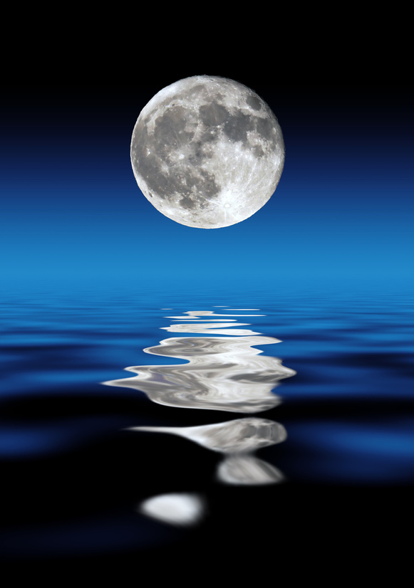
Spring and Neap Tides
Spring Tides:
These are the highest tides that occur on Earth.
They occur during Full Moons and New Moons in the monthly Lunar Cycle.
These tides are especially high whenever the Moon is at perigee in its annual rotation around the Earth.
Neap Tides:
These are the tides that occur which are lower than usual.
They occur during the First Quarter Moon and Last Quarter Moon phases.
These tides are especially LOW whenever the Moon is at apogee in its annual rotation around the Earth.

Slide 40
The Moon Phases
Over the course a month, actually 29.5 days, the Moon goes through its different phases.
Each phase will be shown and the day in the cycle that it appears. Please draw each phase, the day and name that is shown on the following slides.

Slide 41

Moon Phases
New Moon
The Moon is in front of the Sun, and the “Dark Side of the Moon” receives the Sun’s light.
Day 0-1

Slide 42
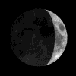
Waxing Crescent
The Moon is backlit by the Sun as it approaches one quarter of its cycle completion.
Days 2-6

Slide 43
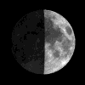
First Quarter
One quarter of the Lunar Cycle is complete, but only HALF of the Moon is lit. (Name indicates portion of cycle completed not amount of light shown!)
Day 7.4

Slide 44
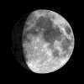
Waxing Gibbous
The Moon is getting brighter and brighter as it is approaching Full Moon and it is positioning itself across from the Sun with the Earth in the middle.
Days 8-13

Slide 45
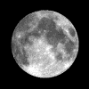
Full Moon
The Moon is halfway through its cycle. The Moon is fully-lit by the Sun, and it is directly across from the Sun with the Earth in the middle.
Day 14.8

Slide 46
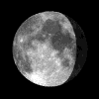
Waning Gibbous
The Moon is starting to darken again. It is over halfway through its cycle.
Days 15-21

Slide 47
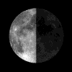
Last Quarter
The Moon is now three-fourths, 75%, through its cycle. It is in its “last quarter” before the New Moon repeats.
Day 22.1

Slide 48
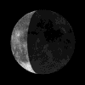
Waning Crescent
The Moon is almost completely dark again. Less and less light is being shown, and the Moon repositions itself between the Earth and the Sun.
Days 23-28

Slide 49
New Moon
It’s Day 29.5, and the New Moon reappears. The Cycle has officially ended and officially begins again.

Slide 50
Have you ever heard the saying…
“Once in a Blue Moon”?
That is actually a real phenomenon. During the course of a year, it is possible to have 13 Full Moons. In the case of a 13-Full-Moon year, one month has two full moons. When a month has TWO FULL MOONS, the second Full Moon is called the Blue Moon!

Slide 51
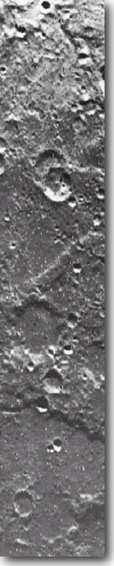
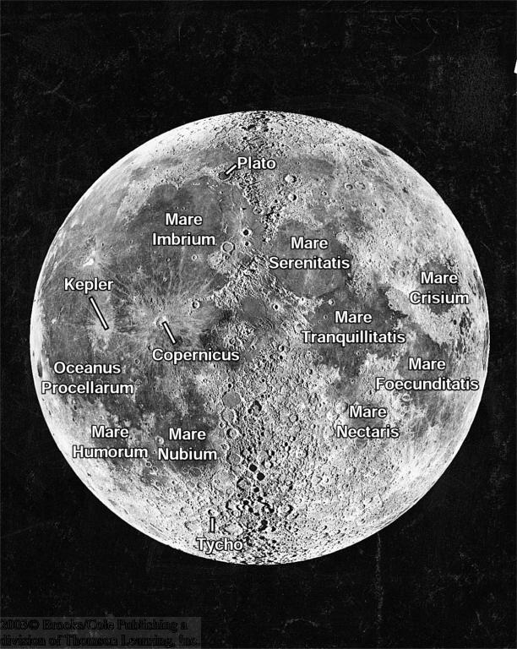
The Moon: The View from Earth
From Earth, we always see the same side of the moon.
Moon rotates around its axis in the same time that it takes to orbit around Earth:
Tidal coupling:
Earth’s gravitation has produced tidal bulges on the moon;
Tidal forces have slowed rotation down to same period as orbital period

Slide 52
Lunar Surface Features
Two dramatically different kinds of terrain:
Highlands: Mountainous terrain, scarred by craters
Lowlands: ~ 3 km lower than highlands; smooth surfaces:
Maria (pl. of mare):
Basins flooded by lava flows

Slide 53
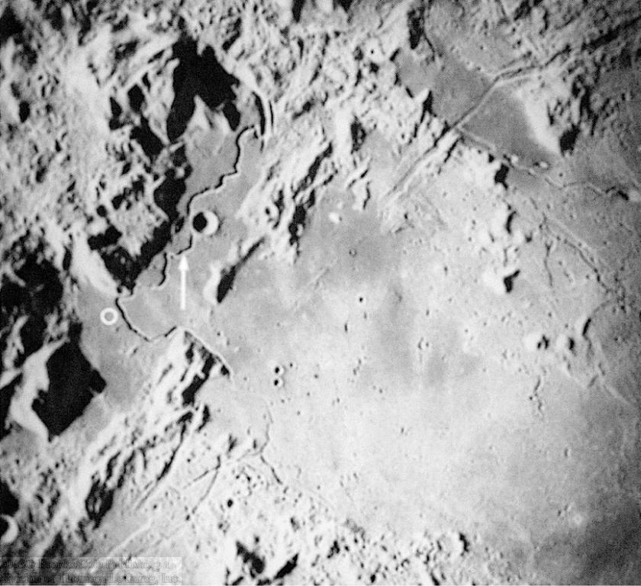
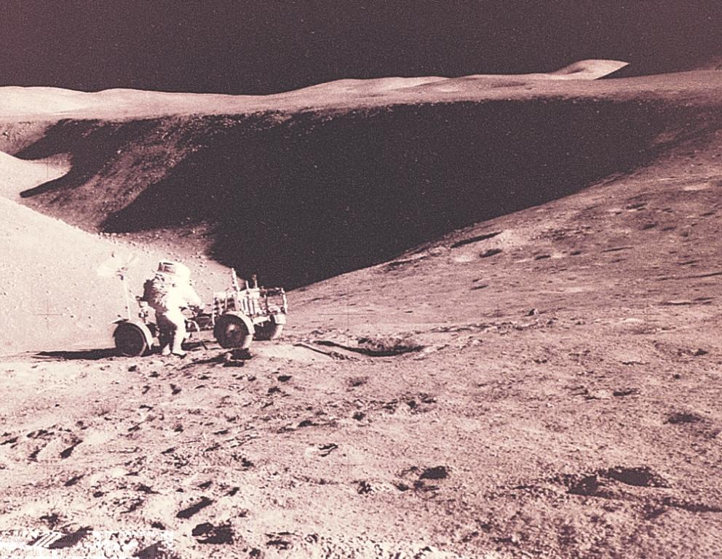
Highlands and Lowlands
Sinuous rilles = remains of ancient lava flows
May have been lava tubes which later collapsed due to meteorite bombardment.
Apollo 15 landing site

Slide 54
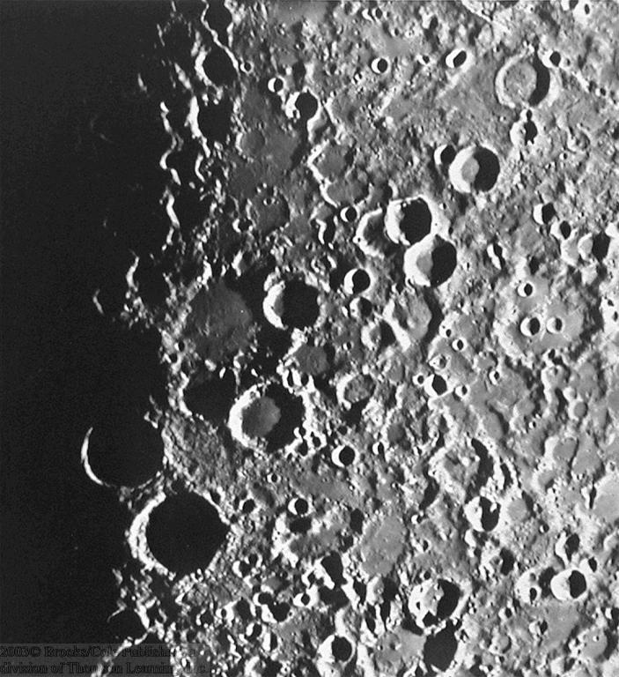
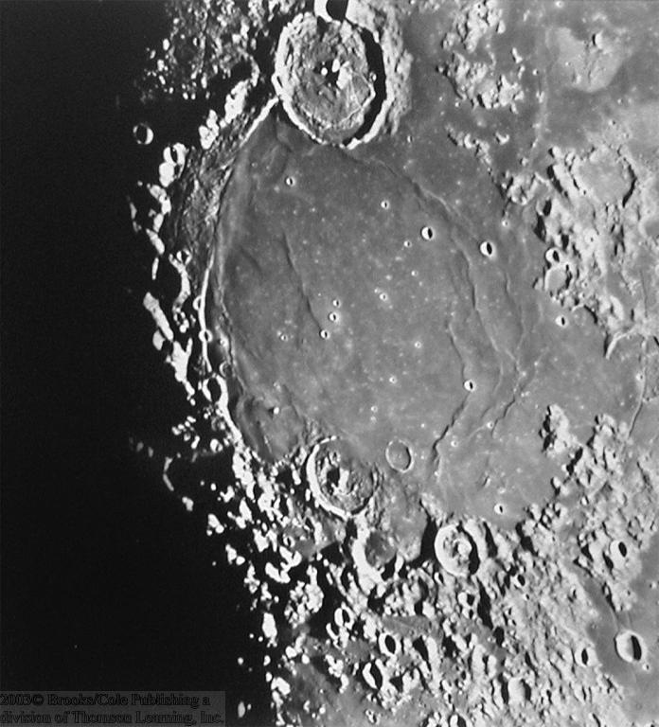
The Highlands
Saturated with craters
Older craters partially obliterated by more recent impacts
… or flooded by lava flows

Slide 55
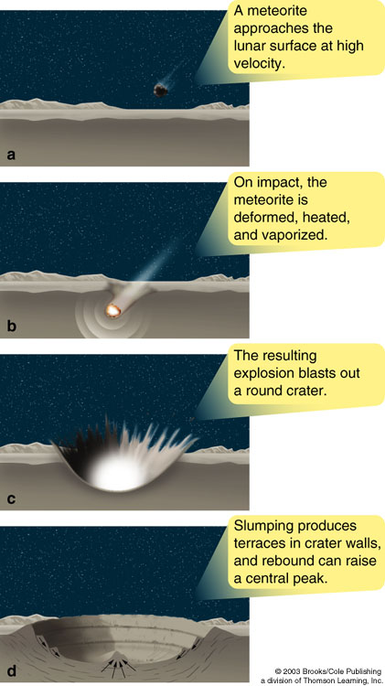
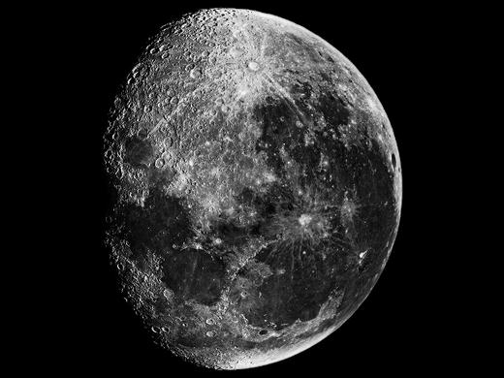
Impact Cratering
Impact craters on the moon can be seen easily even with small telescopes.
Ejecta from the impact can be seen as bright rays originating from young craters

Slide 56
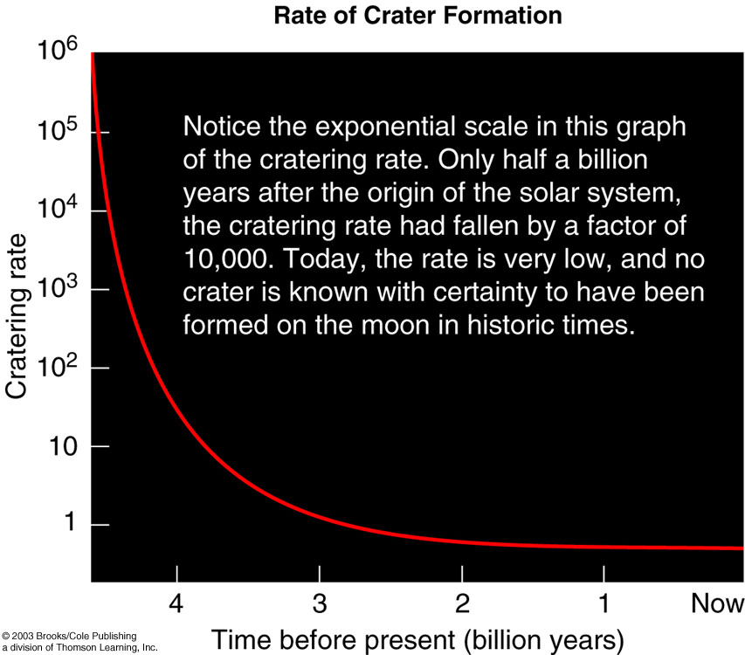
History of Impact Cratering
Rate of impacts due to interplanetary bombardment decreased rapidly after the formation of the solar system.
Most craters seen on the moon’s (and Mercury’s) surface were formed within the first ~ 1/2 billion years.

Slide 57
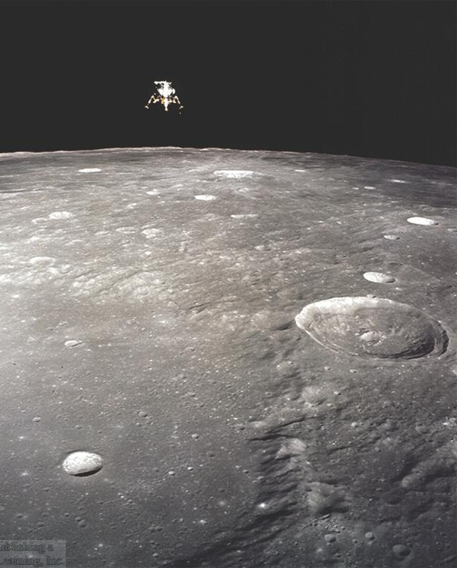
Missions to the Moon
Major challenges:
Need to carry enough fuel for:
in-flight corrections,
descent to surface,
re-launch from the surface,
return trip to Earth;
need to carry enough food and other life support for ~ 1 week for all astronauts on board.
Solution:
only land a small, light lunar module;
Lunar module (LM) of Apollo 12 on descent to the surface of the moon
leave everything behind that is no longer needed.

Slide 58
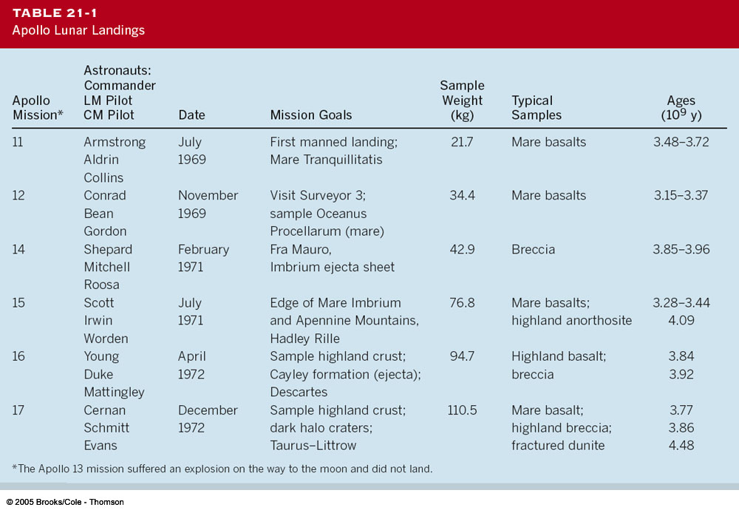
The Apollo Missions

Slide 59
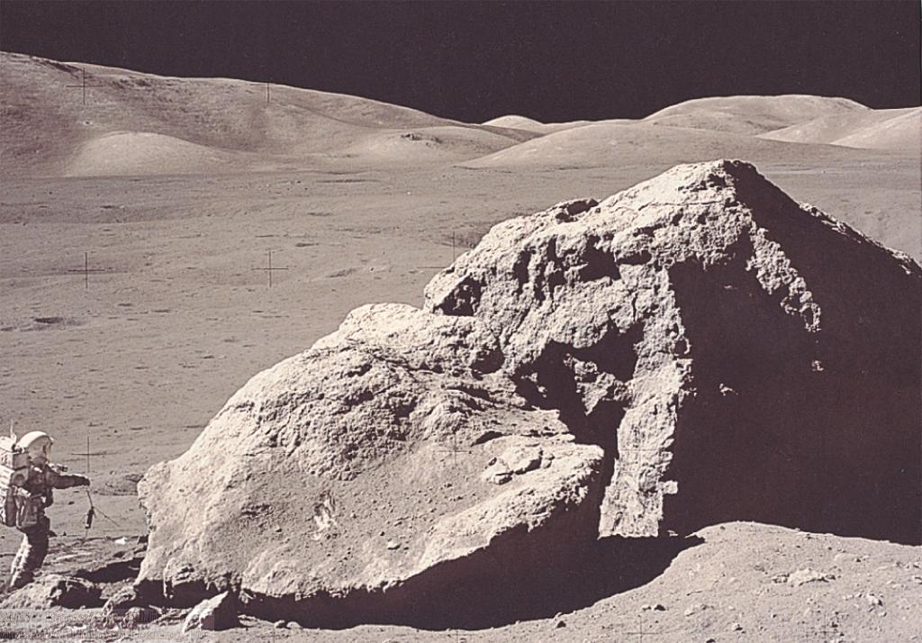
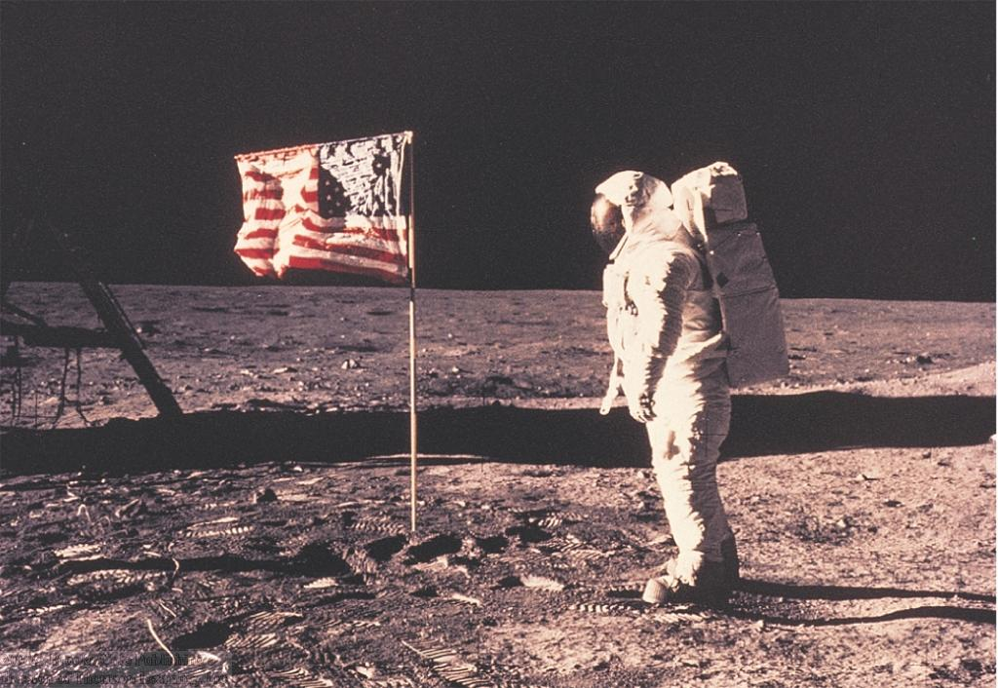
Apollo Landing Sites
First Apollo missions landed on safe, smooth terrain.
Later missions explored more varied terrains.
Apollo 17: Taurus-Littrow; lunar highlands
Apollo 11: Mare Tranquilitatis; lunar lowlands

Slide 60

Apollo Landing Sites (2)
Selected to sample as wide a variety as possible of different lowland and highland terrains.
Lowlands (maria)
Highlands

Slide 61



Moon Rocks
All moon rocks brought back to Earth are igneous (= solidified lava)
No sedimentary rocks => No sign of water ever present on the moon.
Different types of moon rocks:
Vesicular
(= containing holes from gas bubbles in the lava) basalts, typical of dark rocks found in maria
Breccias (= fragments of different types of rock cemented together), also containing anorthosites (= bright, low-density rocks typical of highlands)
Older rocks become pitted with small micrometeorite craters

Slide 62

The History of the Moon
Moon is small; low mass → rapidly cooling off; small escape velocity → no atmosphere → unprotected against meteorite impacts.
Moon must have formed in a molten state (“sea of lava”);
Heavy rocks sink to bottom; lighter rocks at the surface
No magnetic field → small core with little metallic iron.
Surface solidified ~ 4.6 – 4.1 billion years ago.
Alan Shepard (Apollo 14) analyzing a moon rock, probably ejected from a distant crater.
Heavy meteorite bombardment for the next ~ 1/2 billion years.

Slide 63


Formation of Maria
Impacts of heavy meteorites broke the crust and produced large basins that were flooded with lava

Slide 64

Formation of Maria (2)
Major impacts forming maria might have ejected material over large distances.
Apollo 14
Large rock probably ejected during the formation of Mare Imbrium (beyond the horizon!)

Slide 65

Origin of Mare Imbrium
Terrain opposite to Mare Imbrium is jumbled by seismic waves from the impact.

Slide 66



The Origin of Earth’s Moon
Early (unsuccessful) hypotheses:
Fission hypothesis:
Break-up of Earth during early period of fast rotation
Problems: No evidence for fast rotation; moon’s orbit not in equatorial plane
capture hypothesis:
Capture of moon that formed elsewhere in the solar system
Condensation hypothesis:
Problem: Requires succession of very unlikely events
Condensation at time of formation of Earth
Problem: Different chemical compositions of Earth and moon

Slide 67

Modern Theory of Formation of the Moon
The Large-Impact Hypothesis
Impact heated material enough to melt it
→ consistent with “sea of magma”
Collision not head-on
→ Large angular momentum of Earth-moon system
Collision after differentiation of Earth’s interior
→ Different chemical compositions of Earth and moon

