Slide 1
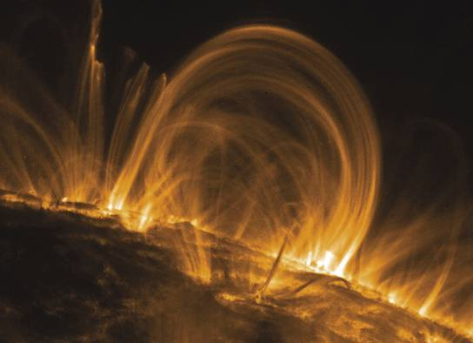
unit 5: Sun and Star formation

Slide 2
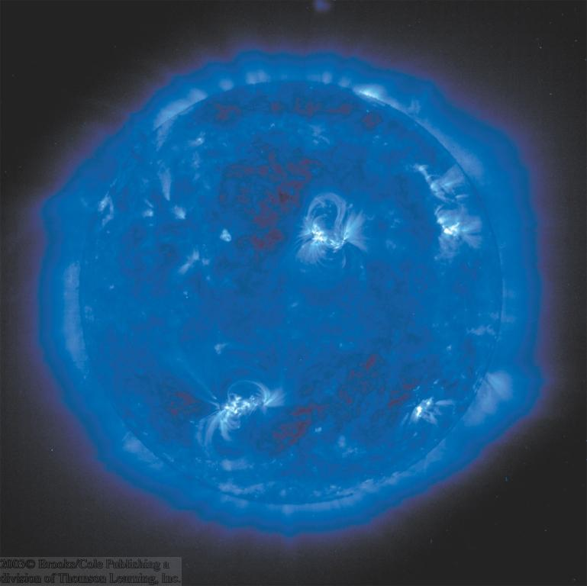
General Properties
Average star
Spectral type G2
Only appears so bright because it is so close.
Absolute visual magnitude = 4.83 (magnitude if it were at a distance of 32.6 light years)
109 times Earth’s diameter
333,000 times Earth’s mass
Consists entirely of gas (av. density = 1.4 g/cm³)
Central temperature = 15 million ⁰K
Surface temperature = 5800 ⁰K

Slide 4
Very Important Warning:
Never look directly at the sun through a telescope or binoculars!!!
This can cause permanent eye damage – even blindness.
Use a projection technique or a special sun viewing filter.

Slide 5
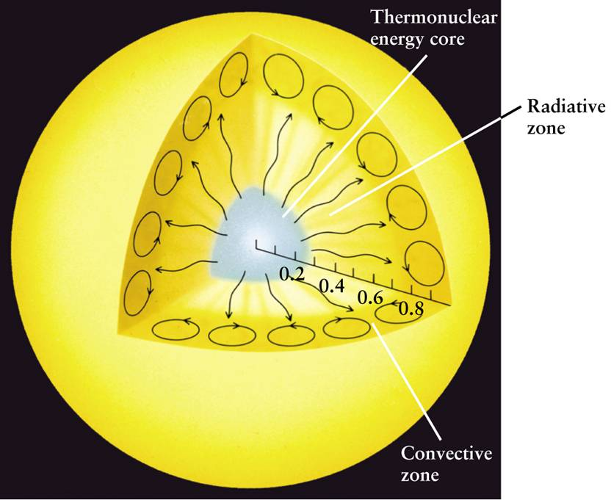
INTERIOR of the Sun – 3 layers

Slide 6
The Solar Atmosphere
Only visible during solar eclipses
Apparent surface of the sun
Heat Flow
Temp. incr. inward
Solar interior

Slide 7
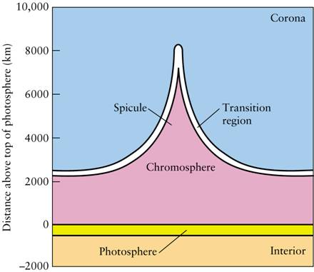
ATMOSPHERE of the Sun – 3 layers

Slide 8
Layers of the Sun
Sun’s interior
Core – where hydrogen fusion happens.
Radiative zone – energy carried toward surface by radiation (as light).
Convective zone – energy carried toward surface by convection (as heat).
Sun’s atmosphere
Photosphere – lowest layer – emits visible light – what we see.
Chromosphere – middle layer – transparent.
Corona – upper layer – transparent.

Slide 9
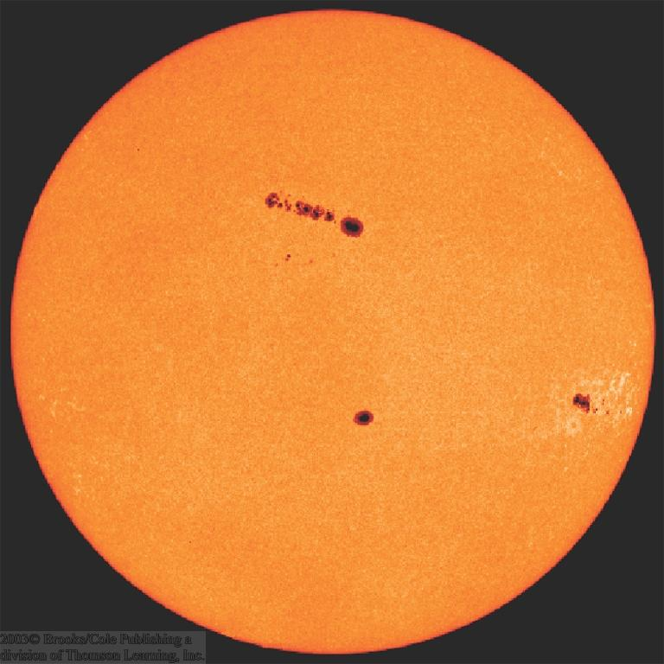
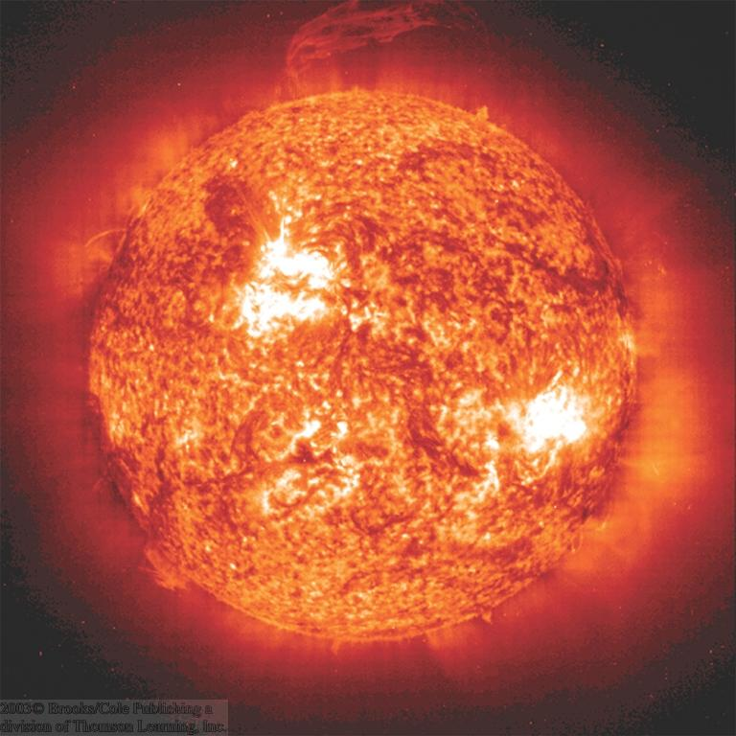
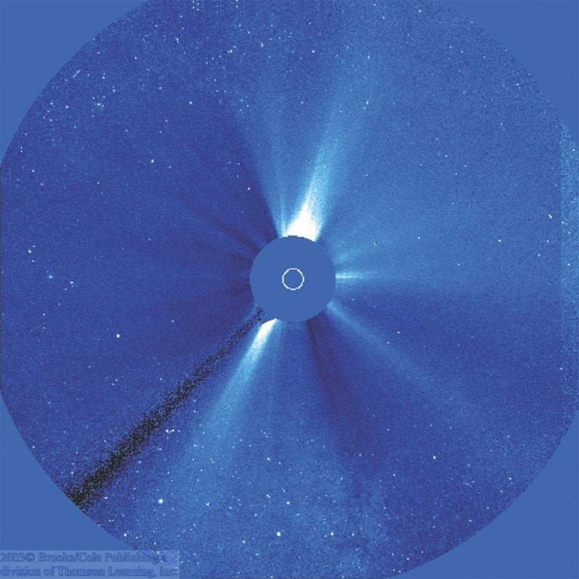
The Layers of the Solar Atmosphere
Visible
Sun Spot Regions
Ultraviolet
Photosphere
Corona
Chromosphere
Coronal activity, seen in visible light

Slide 10
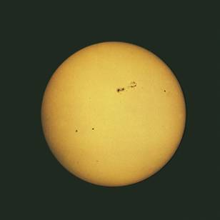
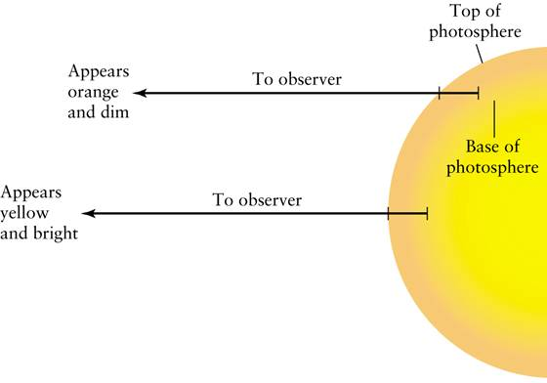
The bright visible surface of the Sun is called the photosphere.
When looking at the Sun, the edges appear orange and darker than the central yellow region. This is known as limb darkening.

Slide 11
The Photosphere
Apparent surface layer of the sun
Depth ≈ 500 km
Temperature ≈ 5800 ºK
Highly opaque (H⁻ ions)
Absorbs and re-emits radiation produced in the solar interior
The solar corona

Slide 12
Energy Transport in the Photosphere
Energy generated in the sun’s center must be transported outward.
In the photosphere, this happens through
Convection:
Cool gas sinking down
Bubbles of hot gas rising up
≈ 1000 km
Bubbles last for ≈ 10 – 20 min.

Slide 13
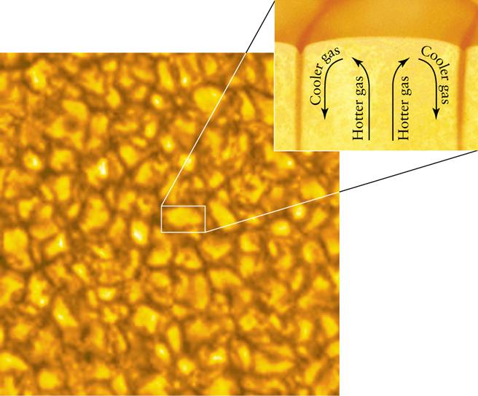
Upon closer inspection, the Sun has a marbled pattern called granulation, caused by the convection of gases just beneath the photosphere.

Slide 14
Granulation
… is the visible consequence of convection

Slide 15
The Chromosphere
Region of sun’s atmosphere just above the photosphere.
Visible, UV, and X-ray lines from highly ionized gases
Temperature increases gradually from ≈ 4500 ºK to ≈ 10,000 ºK, then jumps to ≈ 1 million ºK
Filaments
Transition region
Chromospheric structures visible in Hα emission (filtergram)

Slide 16
The Chromosphere (2)
Spicules: Filaments of cooler gas from the photosphere, rising up into the chromosphere.
Visible in Hα emission.
Each one lasting about 5 – 15 min.

Slide 17
The Magnetic Carpet of the Corona
Corona contains very low-density, very hot (1 million ºK) gas
Coronal gas is heated through motions of magnetic fields anchored in the photosphere below (“magnetic carpet”)
Computer model of the magnetic carpet

Slide 19
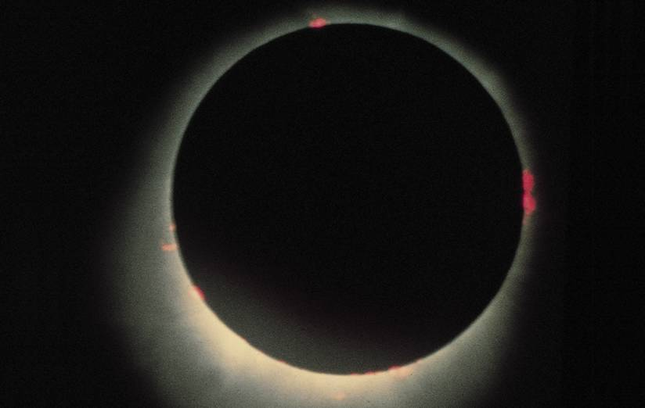
During an eclipse, sometimes you can see the layers of the Sun’s atmosphere just above the photosphere, which emits only certain wavelengths of light, resulting in a reddish appearance. We call this the sphere of color, or chromosphere.

Slide 20
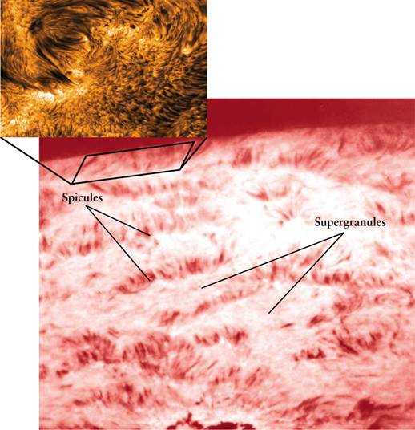
The solar chromosphere is characterized by jets of gas extending upward called spicules.

Slide 21
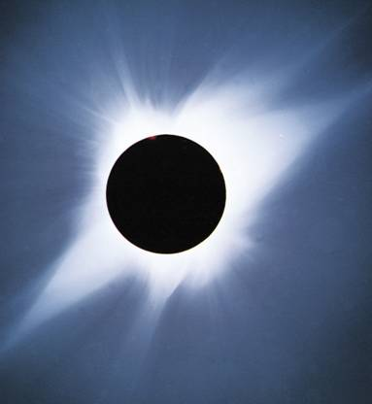
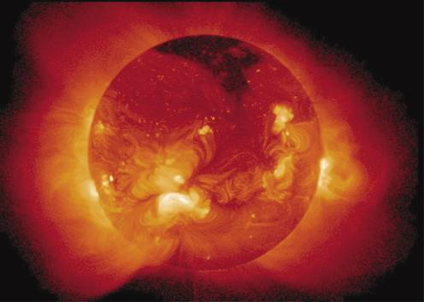
THE SOLAR CORONA – source of the Solar Wind
This x-ray image shows the million-degree gases.
Seen in visible light during an eclipse.

Slide 22
The Solar Wind
Constant flow of particles from the sun.
Velocity ≈ 300 – 800 km/s
Sun is constantly losing mass:
10⁷ tons/year
(≈ 10⁻¹⁴ of its mass per year)

Slide 23
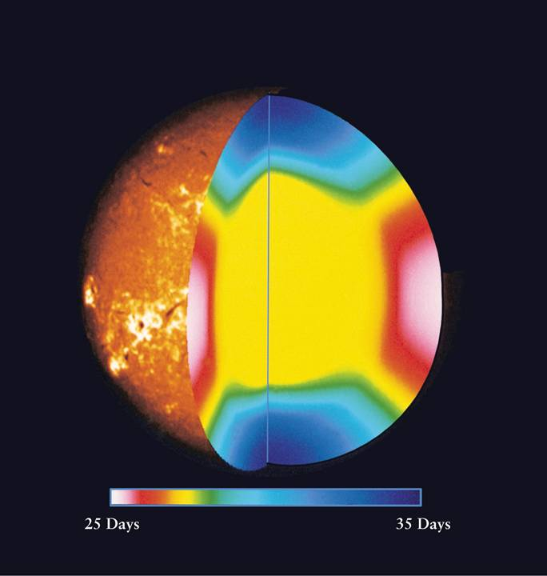
The Sun undergoes differential rotation.
The rotation period of the Sun’s gases varies from 25 days in the equatorial region to 35 days near the solar poles.

Slide 24
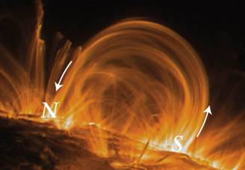
Therefore, the magnetic field lines of the Sun become intertwined after several rotations, creating regions of intense magnetic fields and thus producing sunspots and other spectacular features.

Slide 25
The Sun’s Magnetic Field Creates Different Features
Sunspots – areas of concentrated magnetic field lines.
Prominences – magnetic loops above sunspots, can carry plasma (hot ionized gas).
Flares – twisted magnetic field lines relax and release huge amounts of X-rays.
Coronal Mass Ejections (CMEs) – twisted magnetic field lines relax and release huge amounts of plasma (up to 4 million mph).

Slide 26
Magnetic Fields in Sun Spots
Magnetic fields on the photosphere can be measured through the Zeeman effect
 Sun Spots are related to magnetic activity on the photosphere

Slide 27
Sun Spots (3)
Magnetic field in sun spots is about 1000 times stronger than average.
Magnetic North Poles
Magnetic South Poles
In sun spots, magnetic field lines emerge out of the photosphere.

Slide 28
Magnetic Field Lines
Magnetic North Pole
Magnetic South Pole
Magnetic Field Lines

Slide 29
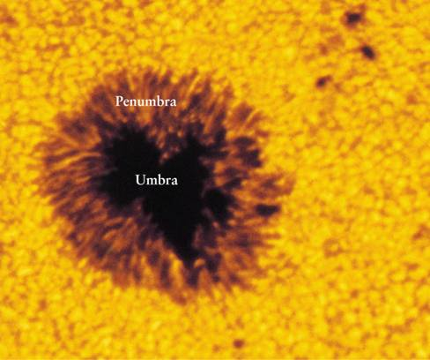
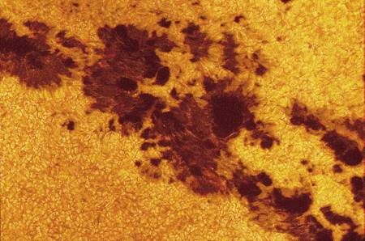
Sunspots
Overlapping sunspots
Sunspots have two regions: the inner, darker umbra and the outer penumbra.

Slide 30
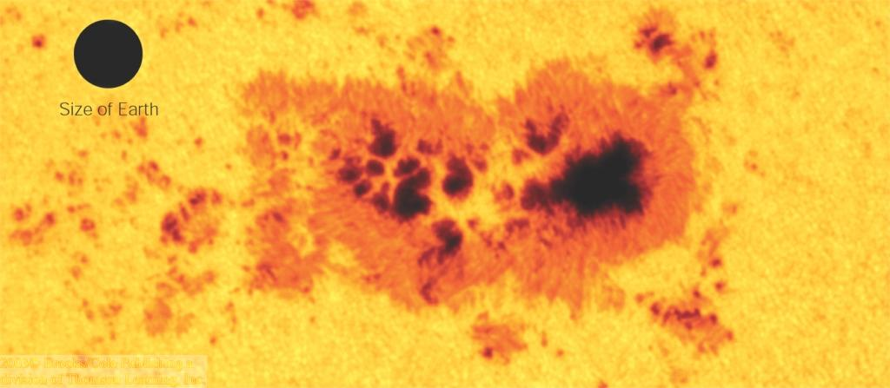
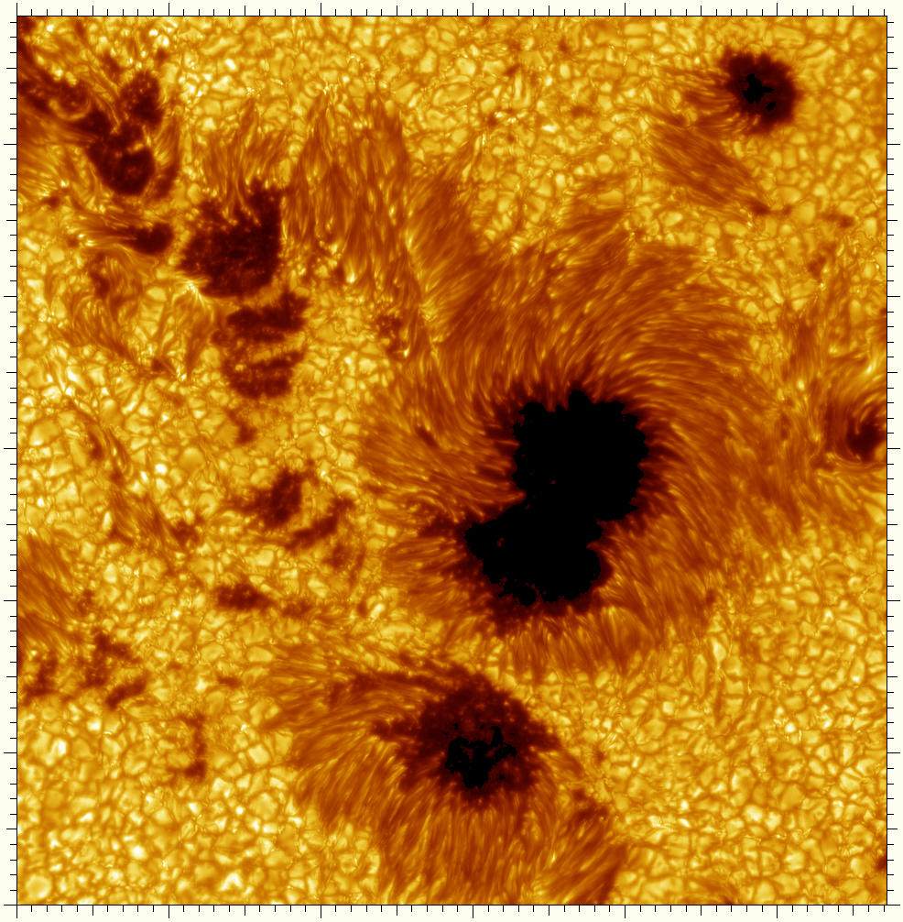
Sun Spots
Cooler regions of the photosphere (T ≈ 4240 K).
Only appear dark against the bright sun. Would still be brighter than the full moon when placed on the night sky!

Slide 31
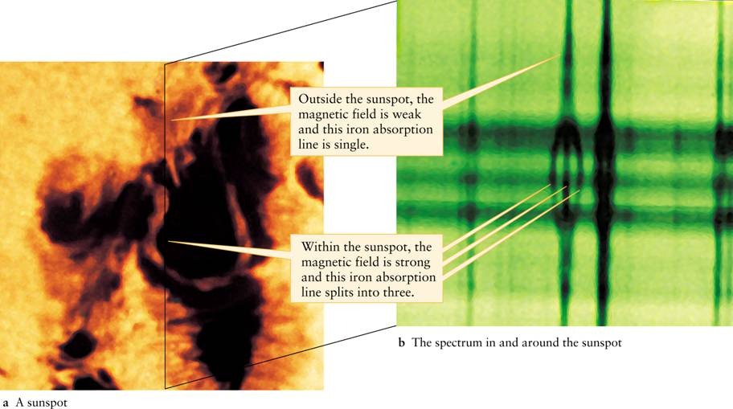
Sunspots are regions of intense magnetic fields

Slide 32
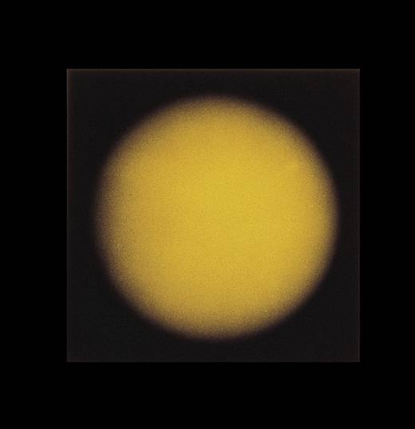
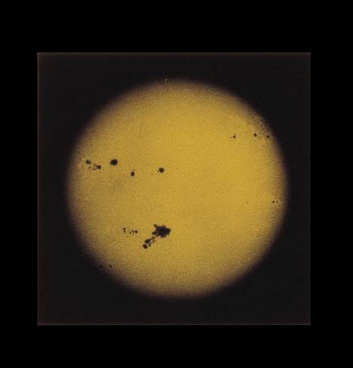
The number of sunspots on the photosphere varies over an eleven-year cycle.
Sunspot Maximum
Sunspot Minimum

Slide 33
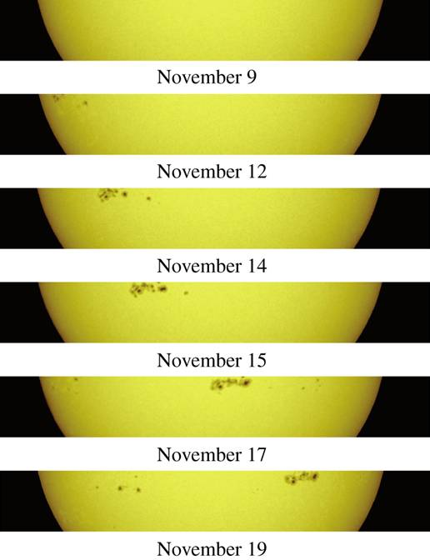
Sunspots can be used to determine the rate of the sun’s rotation.

Slide 34
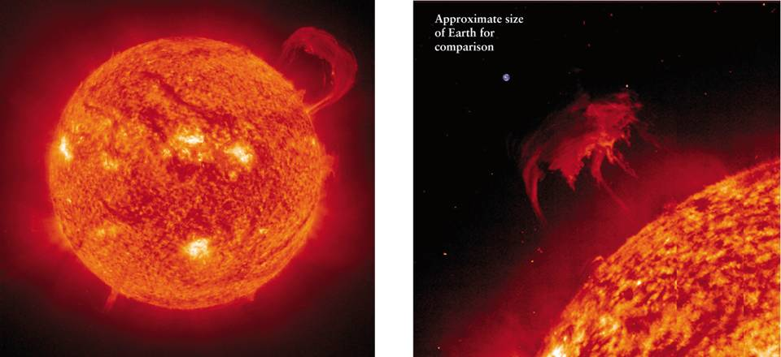
Ionized gases trapped by magnetic fields form prominences that arc far above the solar surface.
Sometimes these gases are ejected into space.

Slide 35
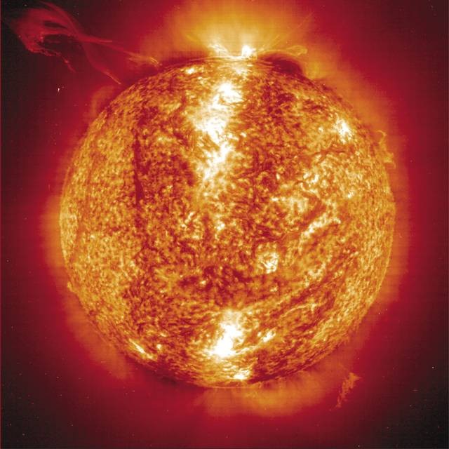
Violent eruptions called solar flares release huge amounts of X-rays. Solar flares are often associated with coronal mass ejections.

Slide 36
On the sun, coronal mass ejections occur when solar magnetic field lines snake around each other, forming the letter "S". Usually, they go past each other. But if they connect, it's like a short circuit. The mid-section breaks loose and drives out a coronal mass ejection.

Slide 37
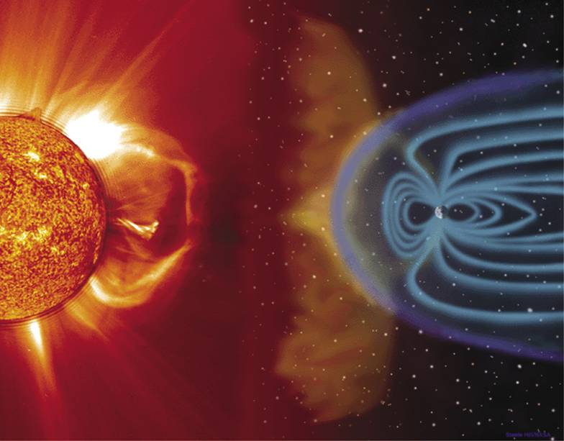
Coronal Mass Ejections (CMEs) typically expel 2 trillion tons of plasma at up to 4 million mph.
An x-ray view of a coronal mass ejection
It reaches Earth two to four days later, and is fortunately deflected by our magnetic field.

Slide 38
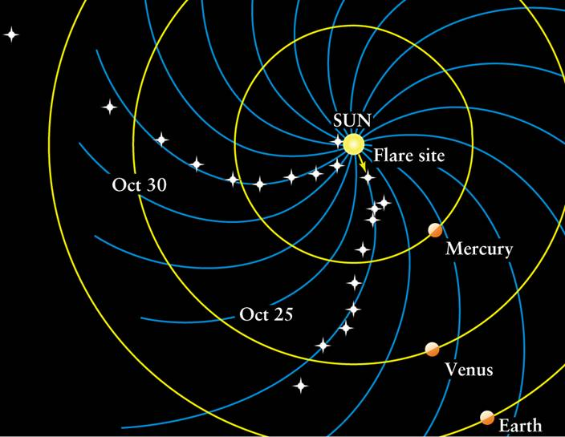
By following the trails of gases released during a coronal mass ejection, we can map the Sun’s magnetic field.

Slide 39
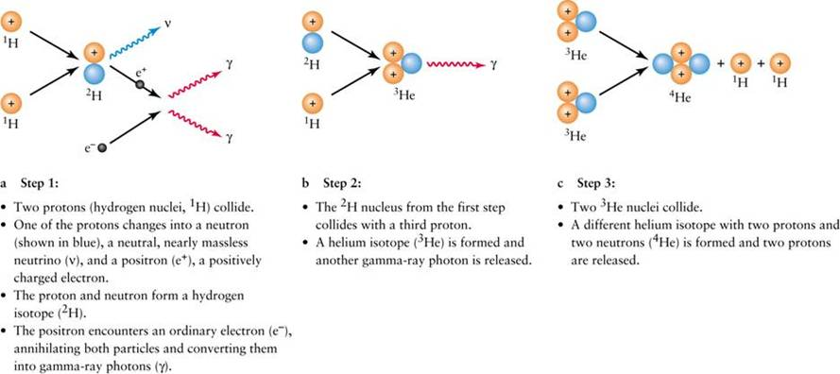
The Sun is powered by thermonuclear fusion, which converts hydrogen into helium. Matter gets turned into energy in the process.
E = mc²

Slide 40
Fusion of Hydrogen into Helium E = mc²

Slide 41
The Sun’s interior is held stable by a balance between radiation pressure forces and gravity, in a condition called hydrostatic equilibrium.
GRAVITY – pulls in
RADIATION PRESSURE FROM
HYDROGEN FUSION –
pushes out

Slide 42
THE SOLAR INTERIOR

Slide 43
Helioseismology
The solar interior is opaque (i.e. it absorbs light) out to the photosphere.
Only way to investigate solar interior is through Helioseismology
= analysis of vibration patterns visible on the solar surface:
Approx. 10 million wave patterns!

Slide 44
The Solar Cycle
After 11 years, North/South order of leading/trailing sun spots is reversed
11-year cycle
Reversal of magnetic polarity
=> Total solar cycle = 22 years

Slide 45
The Solar Cycle (2)
Maunder Butterfly Diagram
Sun spot cycle starts out with spots at higher latitudes on the sun
Evolve to lower latitudes (towards the equator) throughout the cycle.

Slide 46
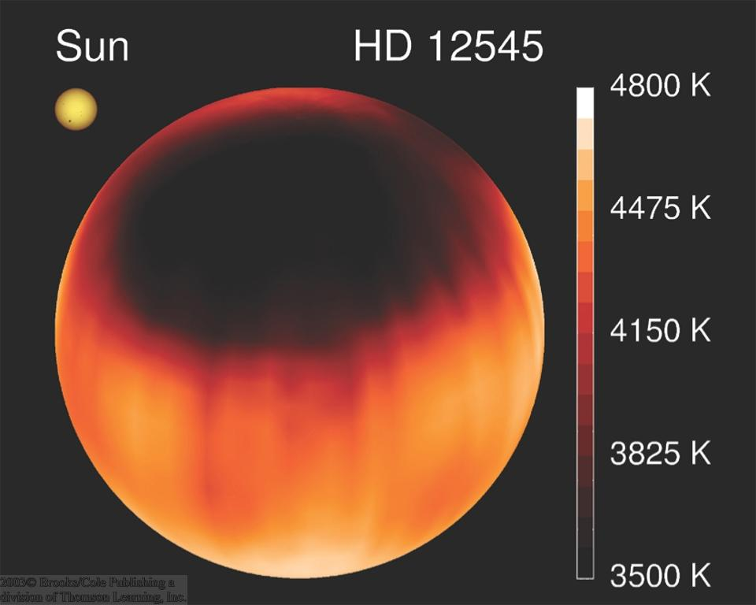
Star Spots?
Image constructed from changing Doppler shift measurements
Other stars might also have sun spot activity:

Slide 47
The Sun’s Magnetic Dynamo
The sun rotates faster at the equator than near the poles.
This differential rotation might be responsible for magnetic activity of the sun.

Slide 48
Magnetic Loops
Magnetic field lines

Slide 49
The Sun’s Magnetic Cycle
After 11 years, the magnetic field pattern becomes so complex that the field structure is re-arranged.
 New magnetic field structure is similar to the original one, but reversed!
 New 11-year cycle starts with reversed magnetic-field orientation

Slide 50
The Maunder Minimum
The sun spot number also fluctuates on much longer time scales:
Historical data indicate a very quiet phase of the sun, ~ 1650 – 1700: The Maunder Minimum

Slide 51
Magnetic Cycles on Other Stars
H and K line emission of ionized Calcium indicate magnetic activity also on other stars.

Slide 52
Prominences
Relatively cool gas (60,000 – 80,000 ºK)
May be seen as dark filaments against the bright background of the photosphere
Looped Prominences: gas ejected from the sun’s photosphere, flowing along magnetic loops

Slide 53
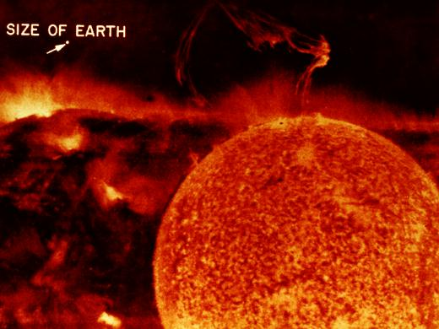
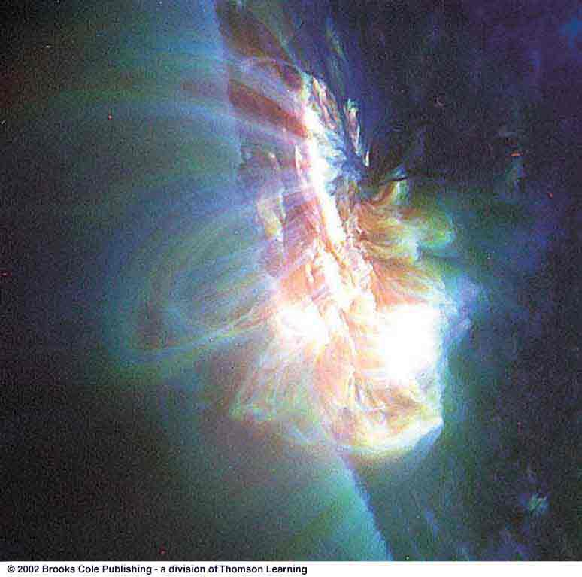
Eruptive Prominences
(Ultraviolet images)
Extreme events (solar flares) can significantly influence Earth’s magnetic field structure and cause northern lights (aurora borealis).

Slide 54
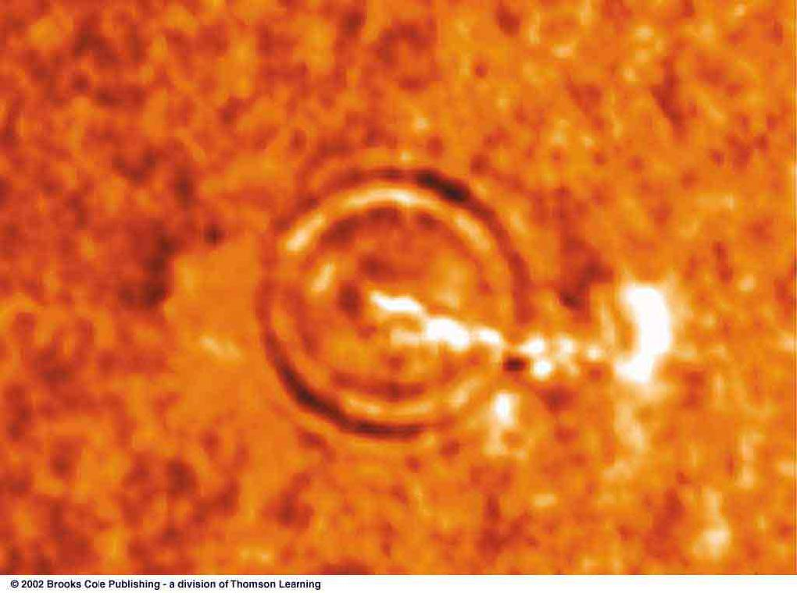
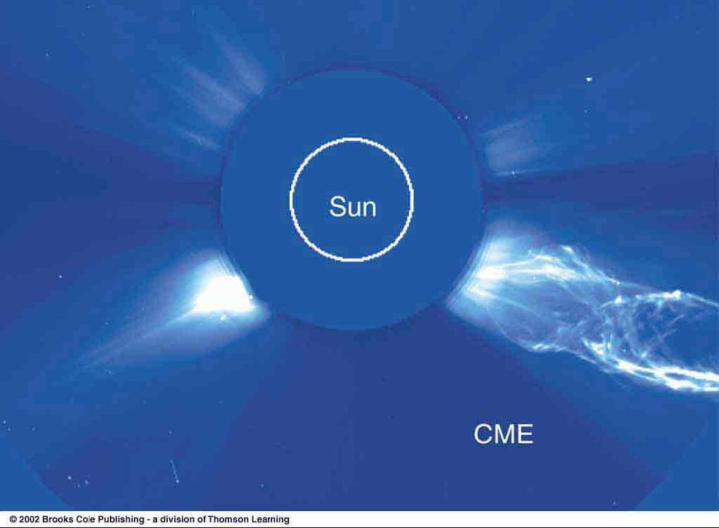
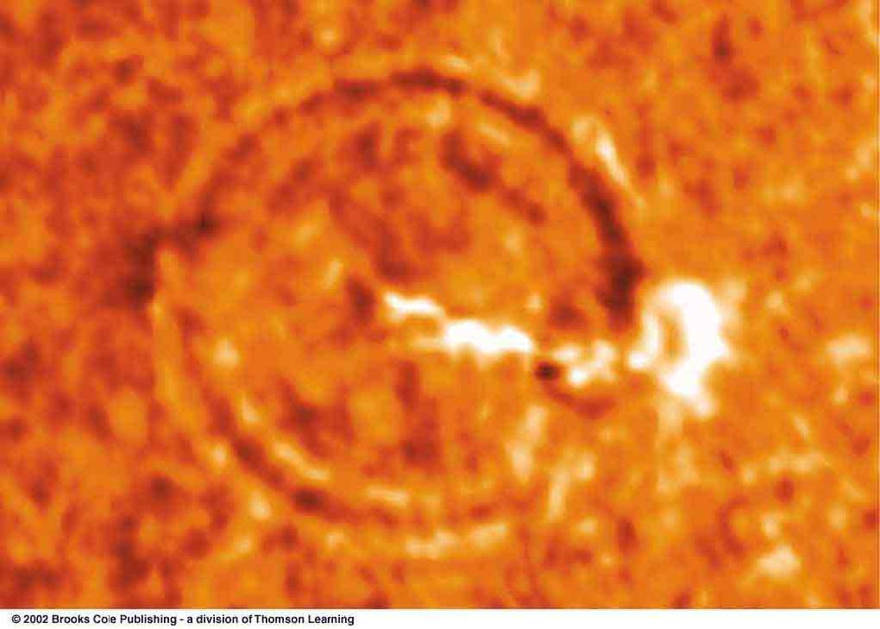
Space Weather
~ 5 minutes
Solar Aurora
Sound waves produced by a solar flare
Coronal mass ejections

Slide 55
Coronal Holes
X-ray images of the sun reveal coronal holes.
These arise at the foot points of open field lines and are the origin of the solar wind.

Slide 56
Energy Production
Energy generation in the sun (and all other stars):
Binding energy due to strong force = on short range, strongest of the 4 known forces: electromagnetic, weak, strong, gravitational
Nuclear Fusion
= fusing together 2 or more lighter nuclei to produce heavier ones.
Nuclear fusion can produce energy up to the production of iron;
For elements heavier than iron, energy is gained by nuclear fission.

Slide 57
Energy Generation in the Sun: The Proton-Proton Chain
Basic reaction:
4 ¹H  ⁴He + energy
Need large proton speed (⬄ high temperature) to overcome Coulomb barrier (electromagnetic repulsion between protons).
4 protons have 0.048*10⁻²⁷ kg (= 0.7 %) more mass than ⁴He.
T ≥ 10⁷ ⁰K = 10 million ⁰K
Energy gain = Δm*c²
= 0.43*10⁻¹¹ J
per reaction.
Sun needs 10³⁸ reactions, transforming 5 million tons of mass into energy every second, to resist its own gravity.

Slide 58
The Solar Neutrino Problem
The solar interior can not be observed directly because it is highly opaque to radiation.
But neutrinos can penetrate huge amounts of material without being absorbed.
Early solar neutrino experiments detected a much lower flux of neutrinos than expected ( the “solar neutrino problem”).
Recent results have proven that neutrinos change (“oscillate”) between different types (“flavors”), thus solving the solar neutrino problem.
Davis solar neutrino experiment

Slide 59
WHAT DID YOU THINK?
How does the mass of the Sun compare with that of the rest of the Solar System?
The Sun contains almost all (99.85%) of the Solar System’s mass.
Are there stars nearer the Earth than the Sun is?
No, the Sun is our closest star.
Does the Sun have a solid and liquid interior like the Earth?
No, the Sun is composed of hot gases.

Slide 60
WHAT DID YOU THINK?
What is the surface of the Sun like?
The Sun has no solid surface, and no solid or liquids anywhere. The surface we see is composed of hot, churning gases.
Does the Sun rotate?
The Sun’s surface rotates differentially; once every 35 days near its poles, and once every 25 days near its equator.
What makes the Sun shine?
Thermonuclear fusion in the Sun’s core.

Slide 61
The Life Cycle of Stars
Dense, dark clouds, possibly forming stars in the future
Aging supergiant
Young stars, still in their birth nebulae

Slide 62
Giant Molecular Clouds
Barnard 68
Infrared
Visible
Star formation collapse of the cores of giant molecular clouds: Dark, cold, dense clouds obscuring the light of stars behind them.

(More transparent in infrared light.)

Slide 63
Parameters of Giant Molecular Clouds
Size: r ~ 50 pc
Mass: > 100,000 M_{sun}
Temp.: a few ⁰K
Dense cores:
R ~ 0.1 pc
M ~ 1 M_{sun}
Much too cold and too low density to ignite thermonuclear processes
Clouds need to contract and heat up in order to form stars.

Slide 64
Contraction of Giant Molecular Cloud Cores
Horse Head Nebula
Thermal Energy (pressure)
Magnetic Fields
Rotation (angular momentum)
Turbulence
 External trigger required to initiate the collapse of clouds to form stars.

Slide 65
Shocks Triggering Star Formation
Trifid Nebula
Globules = sites where stars are being born right now!

Slide 66
Sources of Shock Waves Triggering Star Formation (1)
Previous star formation can trigger further star formation through:
a) Shocks from supernovae (explosions of massive stars):
Massive stars die young => Supernovae tend to happen near sites of recent star formation

Slide 67
Sources of Shock Waves Triggering Star Formation (2)
Previous star formation can trigger further star formation through:
b) Ionization fronts of hot, massive O or B stars which produce a lot of UV radiation:
Massive stars die young => O and B stars only exist near sites of recent star formation

Slide 68
Sources of Shock Waves Triggering Star Formation (3)
Giant molecular clouds are very large and may occasionally collide with each other
c) Collisions of giant molecular clouds.

Slide 69
Sources of Shock Waves Triggering Star Formation (4)
d) Spiral arms in galaxies like our Milky Way:
Spirals’ arms are probably rotating shock wave patterns.

Slide 70
Protostars
Protostars = pre-birth state of stars:
Hydrogen to Helium fusion not yet ignited
Still enshrouded in opaque “cocoons” of dust => barely visible in the optical, but bright in the infrared.

Slide 71
Heating By Contraction
As a protostar contracts, it heats up:
Free-fall contraction
→ Heating

Slide 72
Protostellar Disks
Conservation of angular momentum leads to the formation of protostellar disks  birth place of planets and moons

Slide 73
Protostellar Disks and Jets – Herbig Haro Objects
Disks of matter accreted onto the protostar (“accretion disks”) often lead to the formation of jets (directed outflows; bipolar outflows): Herbig Haro Objects

Slide 74
Protostellar Disks and Jets – Herbig Haro Objects (2)
Herbig Haro Object HH34

Slide 75
Protostellar Disks and Jets – Herbig Haro Objects (3)
Herbig Haro Object HH30

Slide 76
From Protostars to Stars
Star emerges from the enshrouding dust cocoon
Ignition of H  He fusion processes

Slide 77
Evidence of Star Formation
Nebula around S Monocerotis:
Contains many massive, very young stars,
including T Tauri Stars: strongly variable; bright in the infrared.

Slide 78
Evidence of Star Formation (2)
Smaller, sunlike stars, probably formed under the influence of the massive star
Young, very massive star
Optical
Infrared
The Cone Nebula

Slide 79
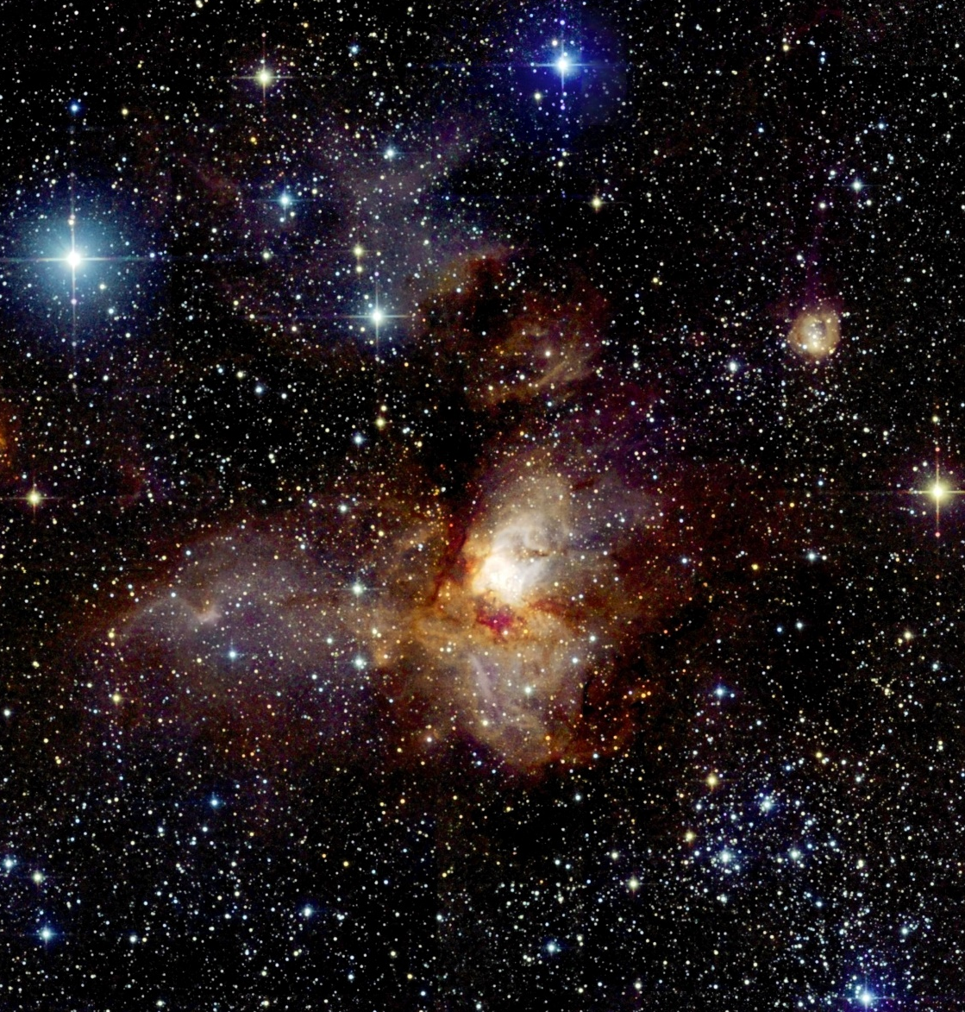
Evidence of Star Formation (3)
Star Forming Region RCW 38

Slide 80
Globules
Bok Globules:
~ 10 to 1000 solar masses;
Contracting to form protostars

Slide 81
Globules (2)
Evaporating Gaseous Globules (“EGGs”): Newly forming stars exposed by the ionizing radiation from nearby massive stars

Slide 82
Open Clusters of Stars
Large masses of Giant Molecular Clouds => Stars do not form isolated, but in large groups, called Open Clusters of Stars.
Open Cluster M7

Slide 83
Open Clusters of Stars (2)
Large, dense cluster of (yellow and red) stars in the foreground; ~ 50 million years old
Scattered individual (bright, white) stars in the background; only ~ 4 million years old

Slide 84
The Source of Stellar Energy
Recall from our discussion of the sun:
Stars produce energy by nuclear fusion of hydrogen into helium.
In the sun, this happens primarily through the proton-proton (PP) chain

Slide 85
The CNO Cycle
In stars slightly more massive than the sun, a more powerful energy generation mechanism than the PP chain takes over:
The CNO Cycle.

Slide 86
Energy Transport
Energy generated in the star’s center must be transported to the surface.
Inner layers:
Radiative energy transport
Outer layers (including photosphere):
Convection
Bubbles of hot gas rising up
Cool gas sinking down
Gas particles of solar interior
γ-rays

Slide 87
Stellar Structure
Energy transport via convection
Sun
Energy transport via radiation
Flow of energy
Energy generation via nuclear fusion
Basically the same structure for all stars with approx. 1 solar mass or less.
Temperature, density and pressure decreasing

Slide 88
Hydrostatic Equilibrium
Imagine a star’s interior composed of individual shells.
Within each shell, two forces have to be in equilibrium with each other:
Gravity, i.e. the weight from all layers above
Outward pressure from the interior

Slide 89
Hydrostatic Equilibrium (2)
Outward pressure force must exactly balance the weight of all layers above everywhere in the star.
This condition uniquely determines the interior structure of the star.
This is why we find stable stars on such a narrow strip (Main Sequence) in the Hertzsprung-Russell diagram.

Slide 90
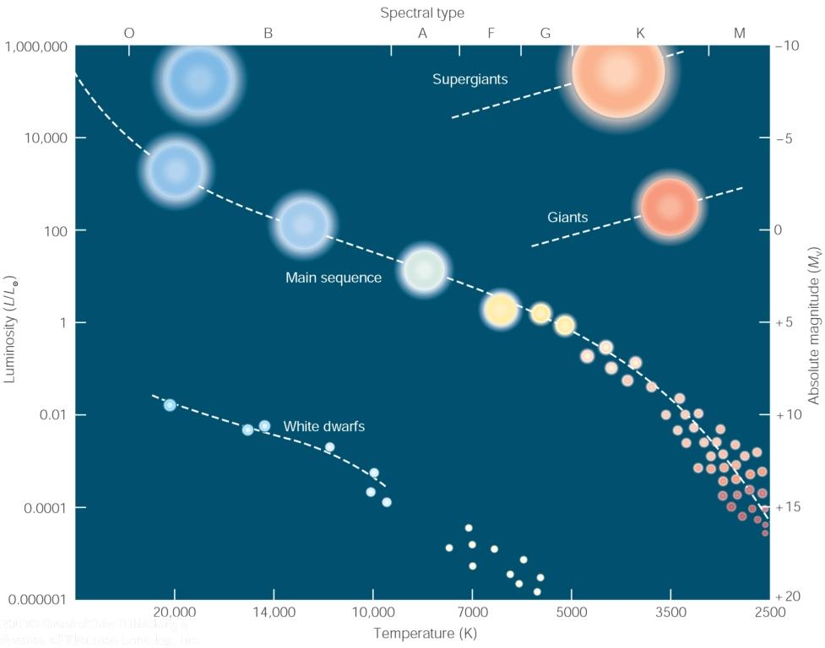
H-R Diagram (showing Main Sequence)

Slide 91
Energy Transport Structure
Inner convective, outer radiative zone
Inner radiative, outer convective zone
CNO cycle dominant
PP chain dominant

Slide 92
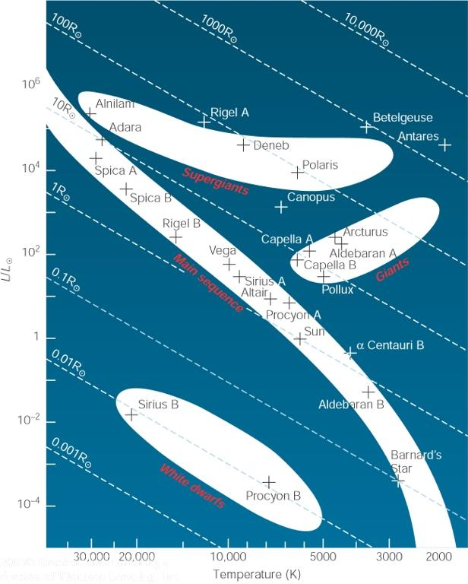
Summary: Stellar Structure
Convective Core, radiative envelope;
Energy generation through CNO Cycle
Sun
Mass
Radiative Core, convective envelope;
Energy generation through PP Cycle

Slide 93
The Orion Nebula: An Active Star-Forming Region

Slide 94
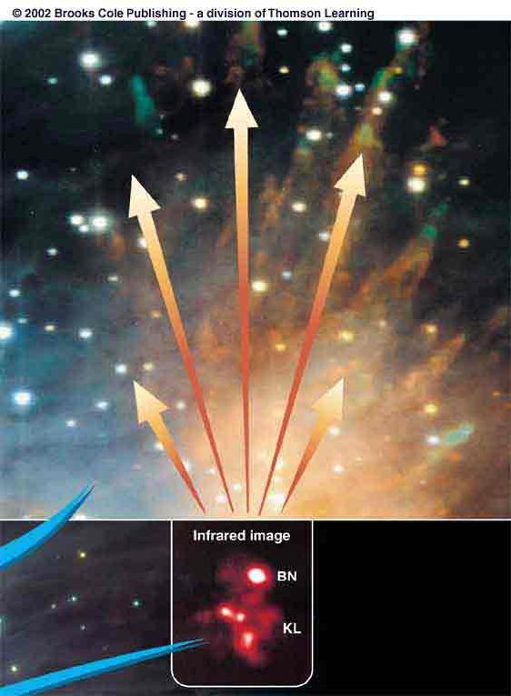
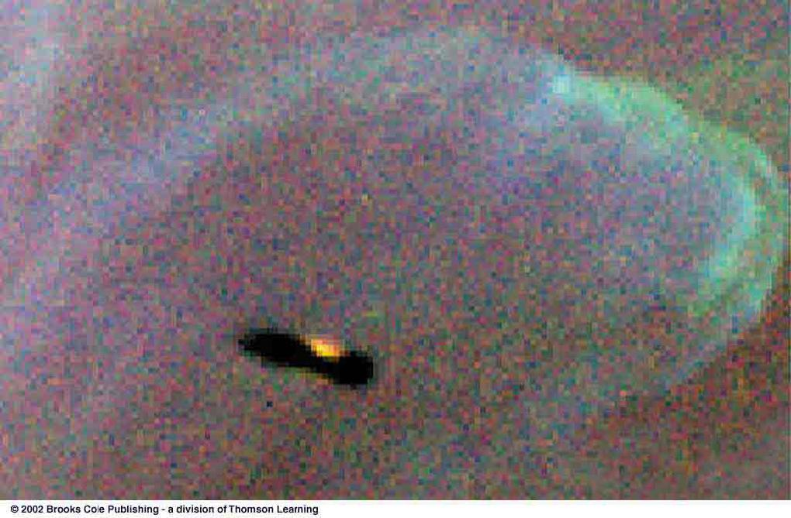
In the Orion Nebula
The Becklin-Neugebauer Object (BN): Hot star, just reaching the main sequence
Kleinmann-Low nebula (KL): Cluster of cool, young protostars detectable only in the infrared
B3
B1
B1
O6
Visual image of the Orion Nebula
Protostars with protoplanetary disks

