Slide 1
Our Solar System
(An Introductory Tour)

Slide 2
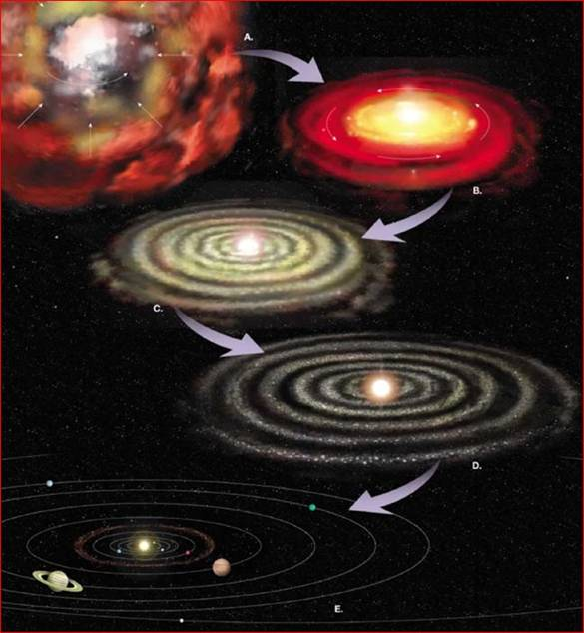
Solar System Formation
Thanks
to
Mary
Oshana

Slide 3
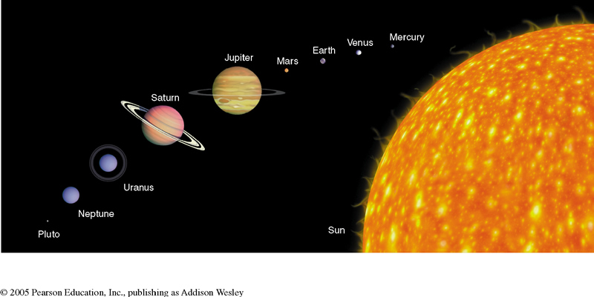

Slide 4
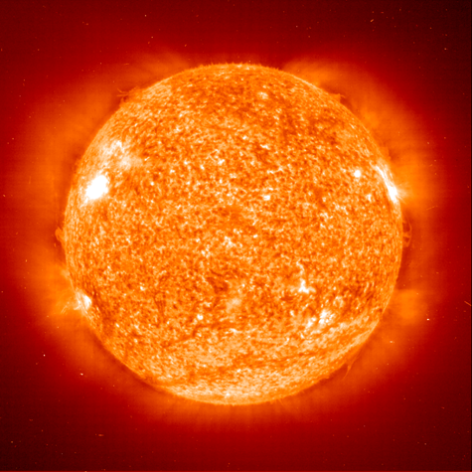
Our Favorite Star

Slide 5
What are some of the various Hypothesis for the formation of our solar system

Slide 6
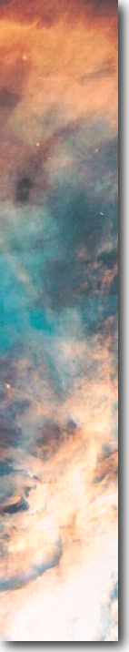
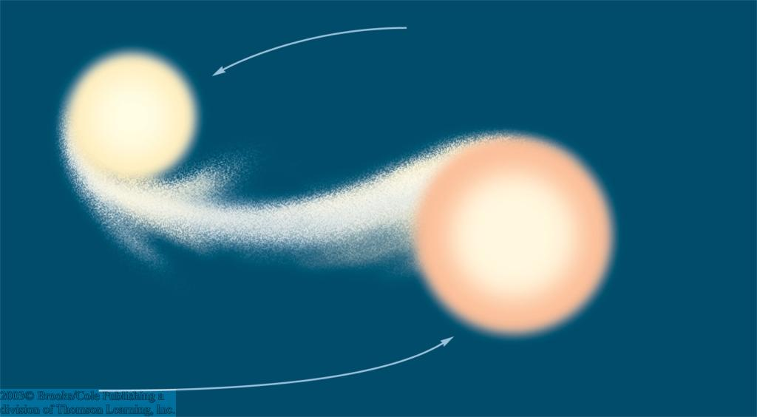
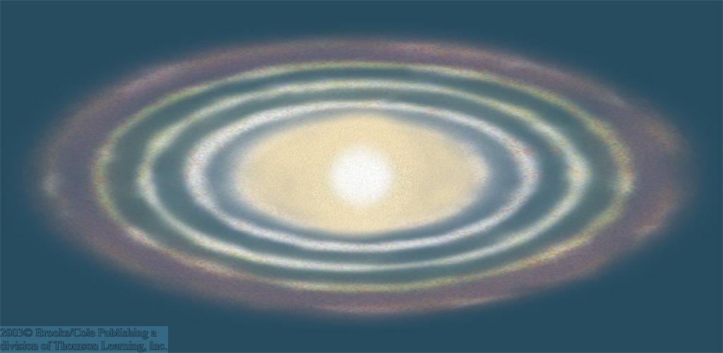
Early Hypotheses
catastrophic hypotheses, e.g., passing star hypothesis:
Star passing the sun closely tore material out of the sun, from which planets could form (no longer considered)
Catastrophic hypotheses predict: Only few stars should have planets!
evolutionary hypotheses, e.g., Laplace’s nebular hypothesis:
Rings of material separate from the spinning cloud, carrying away angular momentum of the cloud → cloud could contract further (forming the sun)
Evolutionary hypotheses predict: Most stars should have planets!

Slide 7
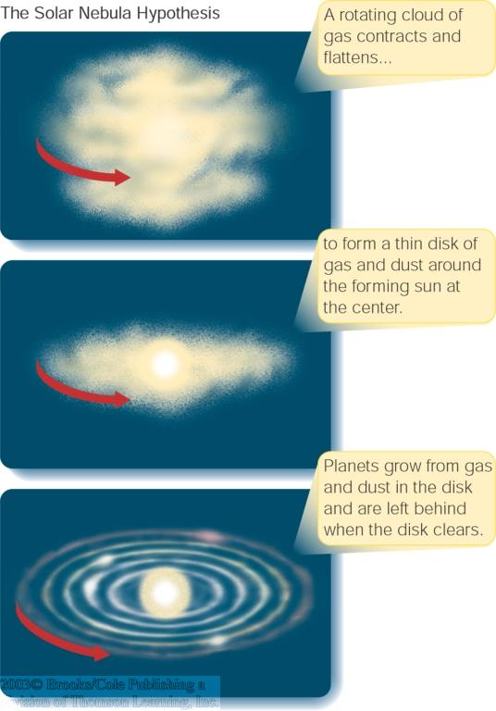
The Solar Nebula Hypothesis
Basis of modern theory of planet formation.
Planets form at the same time from the same cloud as the star.
Planet formation sites observed today as dust disks of T Tauri stars.
Sun and our Solar system formed ~ 5 billion years ago.

Slide 8
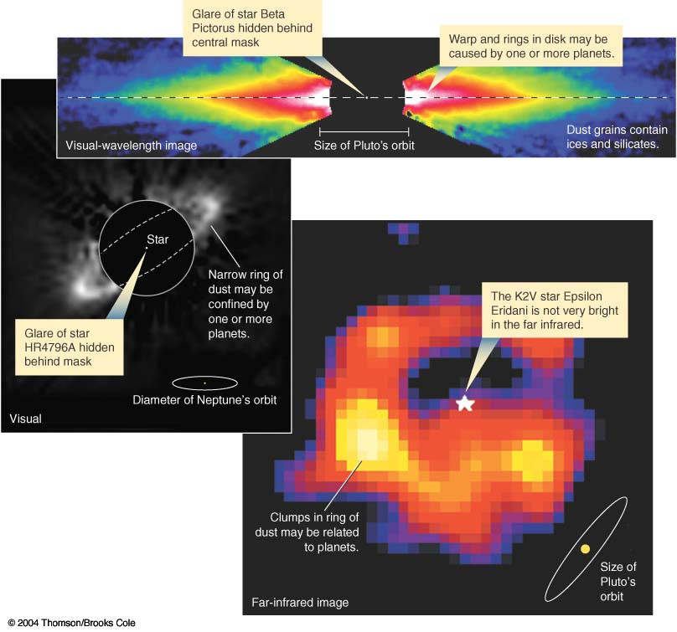
Extrasolar Planets
Modern theory of planet formation is evolutionary
→ Many stars should have planets!
→ planets orbiting around other stars = “Extrasolar planets”
Extrasolar planets can not be imaged directly.
Detection using same methods as in binary star systems:
Look for “wobbling” motion of the star around the common center of mass.

Slide 9
What is a planet?
In August of 2007 the International Astronomical Union redefined what a planet is (no official scientific definition of a "planet" existed before). A planet:
Is a body that orbits the sun (this definition only applies to our Solar System)
Is large enough for its own gravity to make it round
And has "cleared its neighborhood" of smaller objects
So a new the category of dwarf planet was created, which currently includes Pluto, Eris*, and Ceres**.
*Eris is the largest known dwarf planet in the Solar System and the ninth largest body known to orbit the Sun. Its distance from the Sun is 97 AU.
**Ceres is the smallest identified dwarf planet in the Solar System and,
because it’s the largest asteroid, the only dwarf planet in the asteroid belt.

Slide 10
What is a Dwarf Planet?
Celestial body orbiting the Sun
Massive enough to be rounded by its own gravity
BUT has NOT cleared its neighboring region of planetesimals
Is not a satellite
A plutoid is a dwarf planet beyond the orbit of Neptune

Slide 11
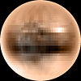

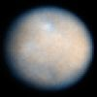


Only 5 Dwarf Planets recognized so far but there may be as many as 200
Pluto, approximate
true color
Makemake,
(Artist’s conception)
Ceres, seen through
(Hubble telescope)
Eris, seen through
(Hubble telescope)
Haumea, with its 2 moons,
Hi‘iaka and Namaka
(Artist’s conception)
Notes:
Ask student to identify which dwarf planets are plutoids

Slide 12
3. What are Small Solar System Bodies?
Neither a planet nor a dwarf planet
All other objects orbiting the Sun
    All minor planets except dwarf planets
    Asteroids (except Ceres, the largest)
    Comets
Not massive enough to be rounded by its own gravity

Slide 13
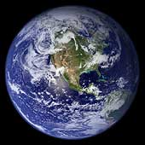
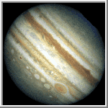
Terrestrial vs. Gaseous Planets
Terrestrial
Gaseous
Jupiter, Saturn, Uranus, Neptune
Gaseous, has more He and H
  Less dense (Saturn would float)
Larger
Spaced farther apart
Farther from the Sun
Mercury, Venus, Earth, Mars
Rocky
  More dense
Smaller
More closely spaced
Closer to the Sun
Notes:
NOTES: He = helium; H = hydrogen

Slide 14
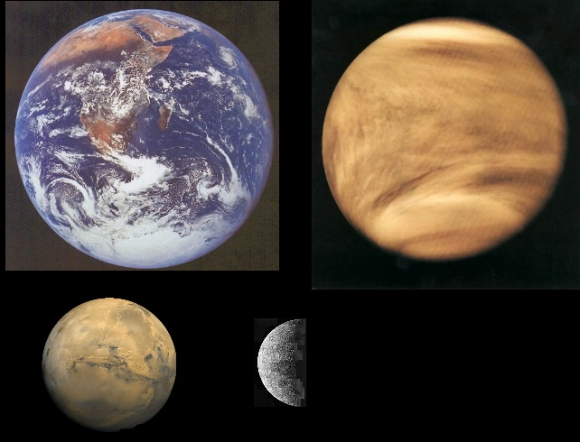
Terrestrial Planets
Mars
Venus
Mercury
From Nick Strobel’s Astronomy Notes at www.astronomynotes.com
Notes:
From http://www.astronomynotes.com/solarsys/s2.htm
This page was copied from Nick Strobel's Astronomy Notes. Go to his site at www.astronomynotes.com for the updated and corrected version.

Slide 15
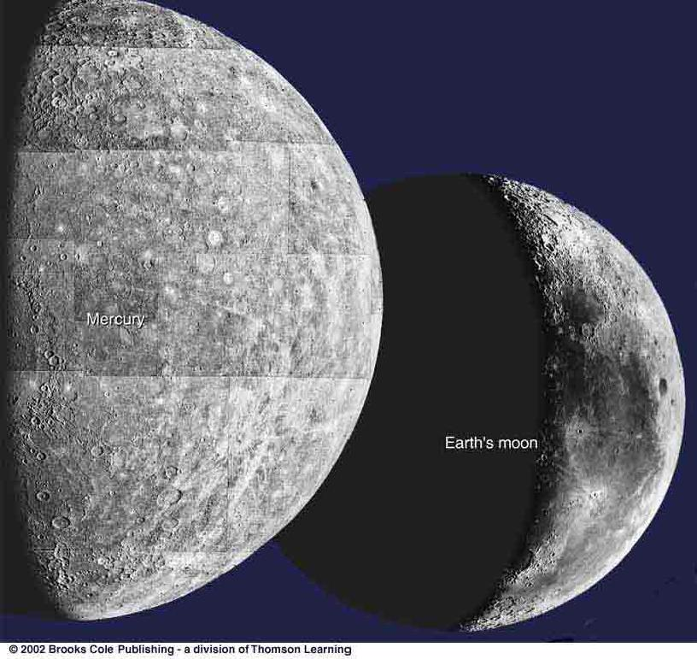
Craters on Planets’ Surfaces
Craters (like on our Moon’s surface) are common throughout the Solar System.
Not seen on Jovian planets because they don’t have a solid surface.

Slide 16
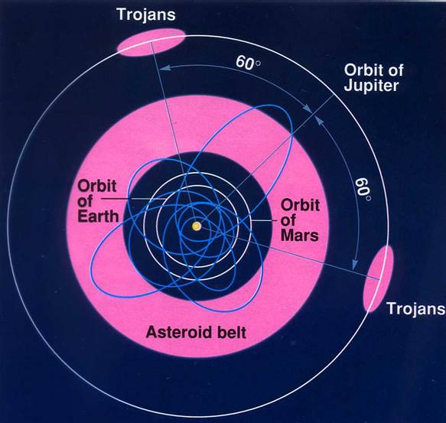
The Asteroid Belt

Slide 17
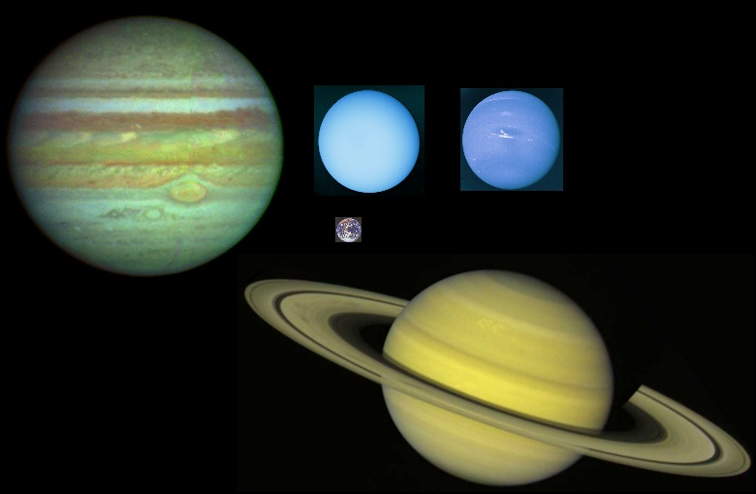
Jovian Planets, or Gas Giants
Uranus
Neptune
Saturn
Jupiter
From Nick Strobel’s Astronomy Notes at www.astronomynotes.com
Notes:
From http://www.astronomynotes.com/solarsys/s2.htm
This page was copied from Nick Strobel's Astronomy Notes. Go to his site at www.astronomynotes.com for the updated and corrected version.

Slide 18
Pluto – a dwarf planet
Pluto is weird.
It’s not very big, and its orbit is very strange.
It’s not a gas giant – it seems to be made of rock and ice.
Maybe it was captured by Neptune.
Some astronomers say it isn’t really a planet.

Slide 19
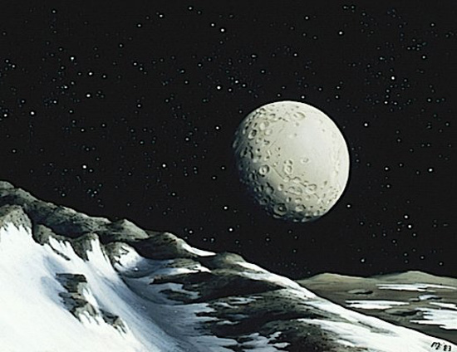
Pluto (seen from Charon)

Slide 20
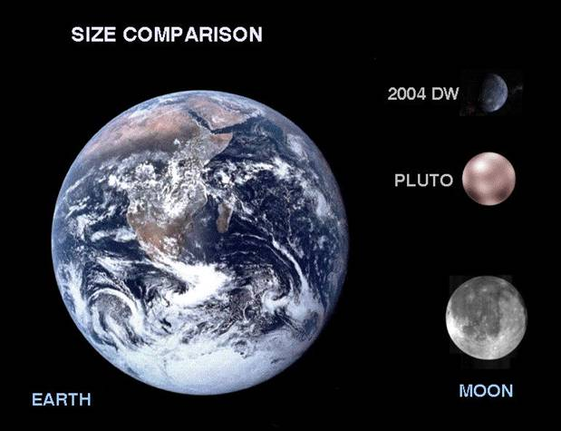
How Big is Pluto ?

Slide 21
WHAT’S OUT THERE
BEYOND
PLUTO ??

Slide 22
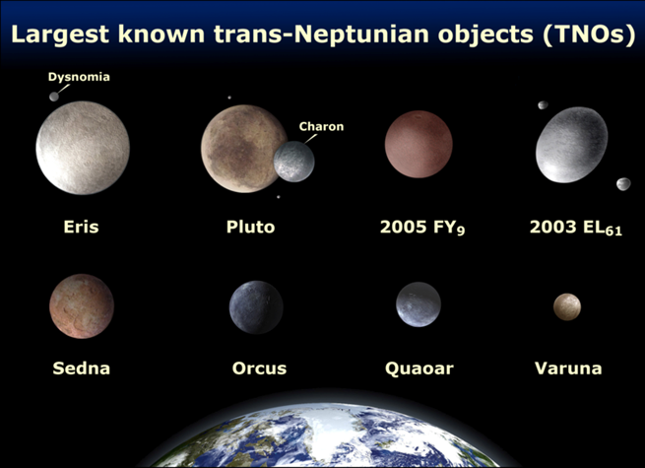
Trans-Neptune Objects (TNOs)
Thanks to Marty Mulroe

Slide 23
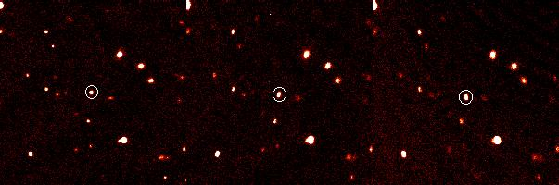
Eris – a dwarf planet
(formerly 2003 UB313)

Slide 24
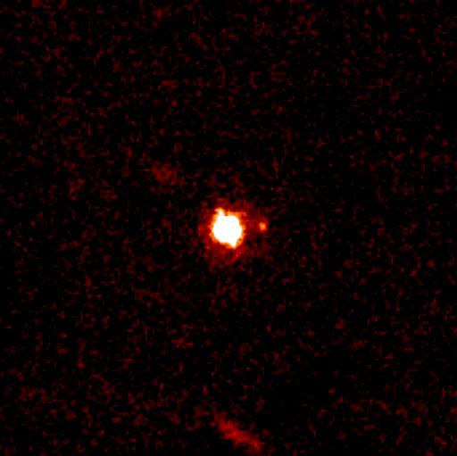
Eris and Dysnomia
Thanks to Marty Mulroe

Slide 25
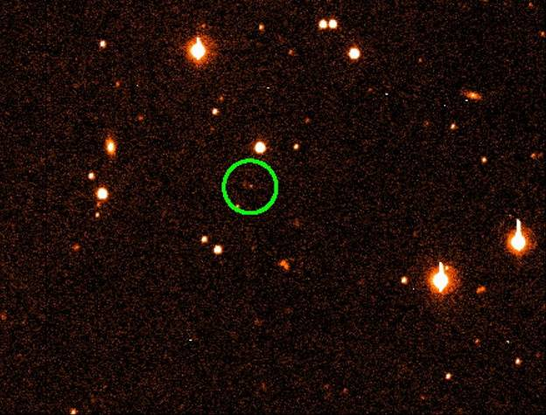
Sedna (Nov 2003)

Slide 26
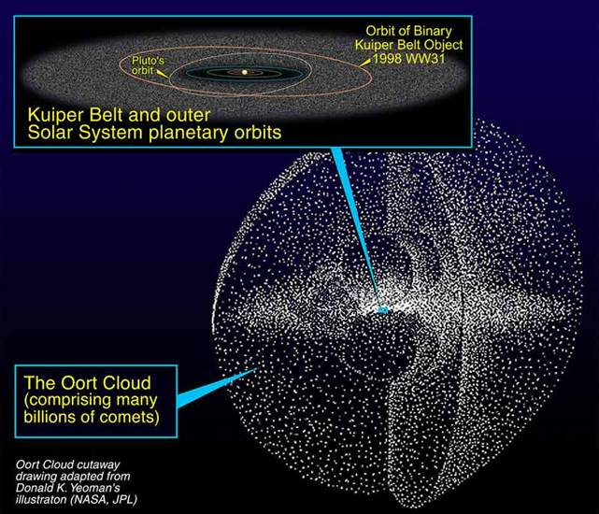
Oort Cloud = Comets

Slide 27
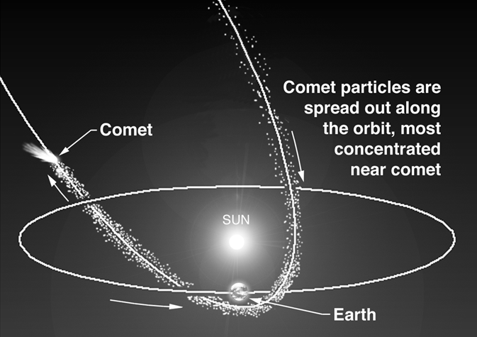
Orbit of a Comet

Slide 28
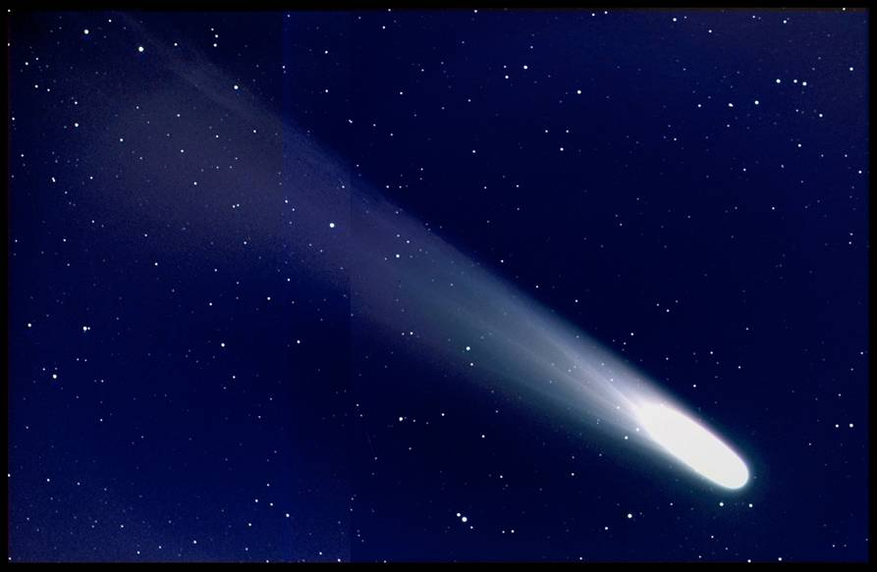
Comet

Slide 29
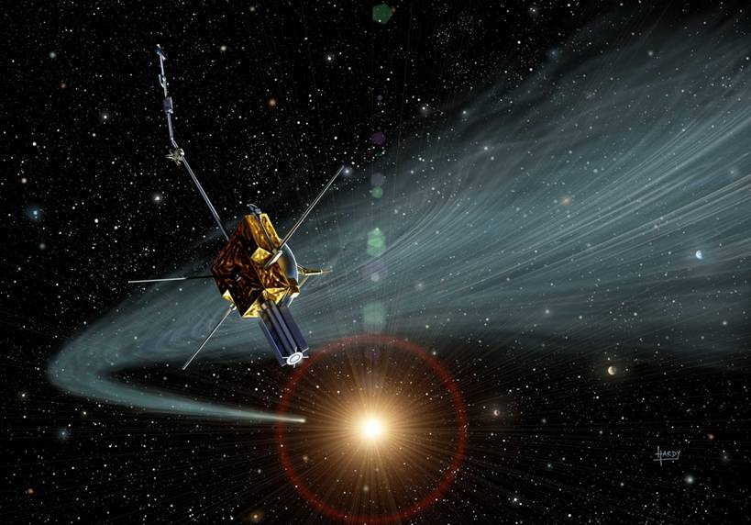
Tail of a Comet

Slide 30
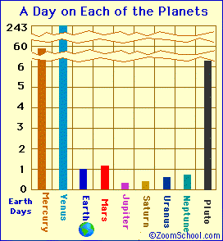
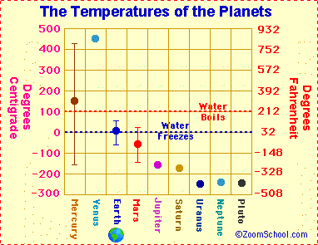
Do you see patterns or anomalies in these data?
Notes:
ANSWERS: Students may notice planets in the middle of the solar system have less extreme temperatures and shorter days compared to those closest and farthest from the sun. Venus’ data is very extreme compared to its neighbors. Pluto’s long day also stands out compared to its neighbors.
From http://www.enchantedlearning.com/subjects/astronomy/planets/

Slide 31
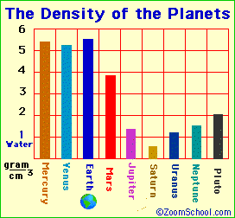
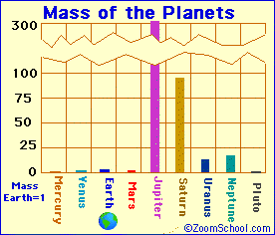
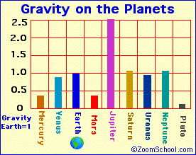
On which planet would you weigh the most?
Notes:
From http://www.enchantedlearning.com/subjects/astronomy/planets/

Slide 32
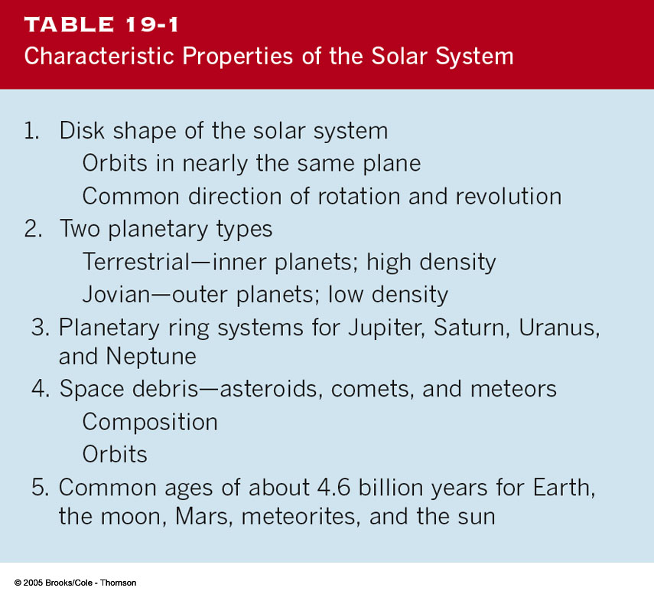
Our Solar System

Slide 33
WHAT DID YOU KNOW?
How many stars are there in the solar system?
Only one star, the Sun.

Slide 34
WHAT DID YOU KNOW?
Is Pluto always the farthest planet from the Sun?
No. Pluto’s orbit is highly eccentric, bringing the planet inside Neptune’s orbit for about 20 years every 250 years.
What typical shapes do moons have?
Most look roughly like potatoes.
Have any Earth-like planets been discovered orbiting Sun-like stars?
No. Nearly all the planets orbiting Sun-like stars are Jupiter-like gas giants.

Slide 35
WHAT DO YOU THINK?
Which of the two planets, Mercury (the closest planet to the Sun) or Earth, has the coolest temperature?
Which planet is most similar to Earth?
What is the composition of the clouds surrounding Venus?
Does Mars have liquid water on its surface today?
Is life known to exist on Mars today?

Slide 36
You will discover…
that Mercury is a Sun-scorched planet with a heavily cratered surface and a substantial iron core
that Venus is perpetually shrouded in thick, poisonous clouds and mostly covered by gently rolling hills
that Mars is the inspiration for scientific and popular speculation about extraterrestrial life

Slide 37
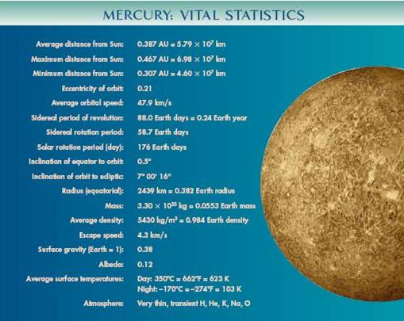

Slide 38
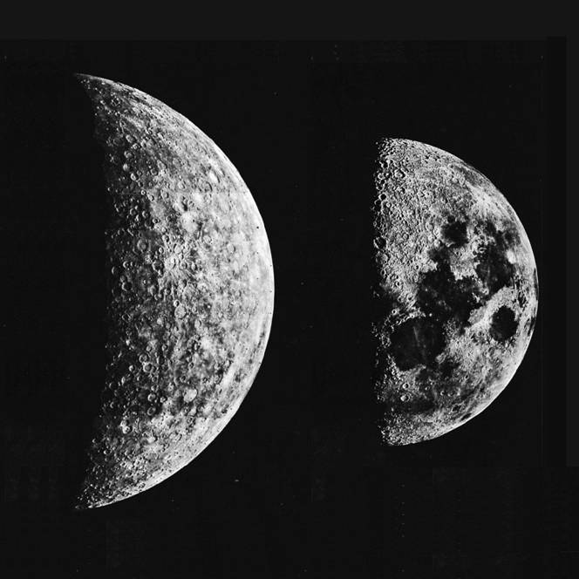
Mercury is only Slightly Larger
than the Moon
OUR MOON
MERCURY

Slide 39
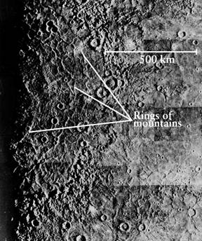
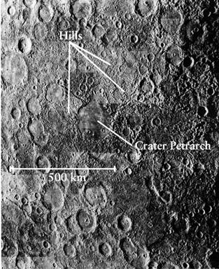
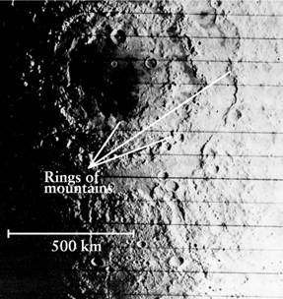
Impact craters on Mercury have similar features to those on the Moon.
CRATERS ON BOTH MERCURY AND THE MOON HAVE RINGS OF MOUNTAINS SURROUNDING THEM
MERCURY
Jumbled hills surrounding the Caloris Impact Basin
OUR MOON

Slide 40
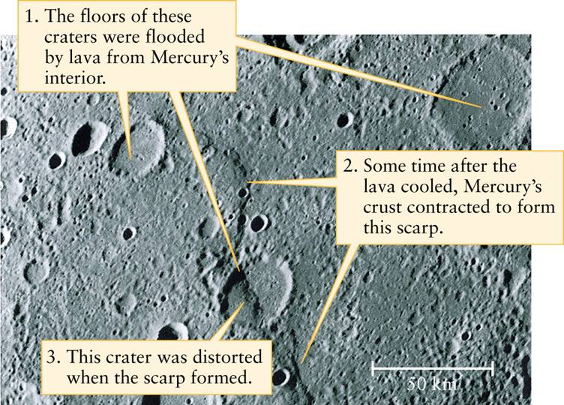
Mercury also has numerous long cliffs, called scarps, believed to have formed when the planet cooled

Slide 41
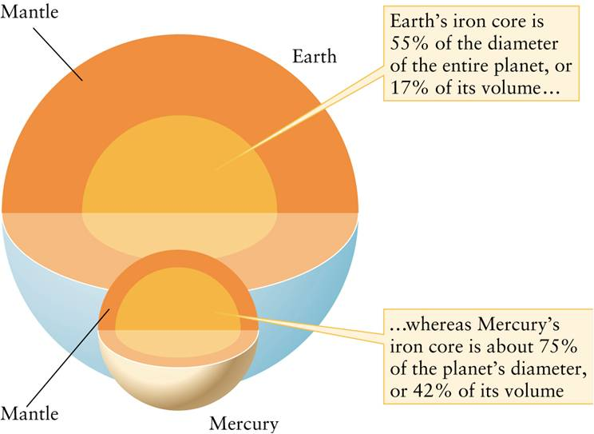
Mercury’s iron core takes up a much larger percentage of its volume than that of Earth.

Slide 42
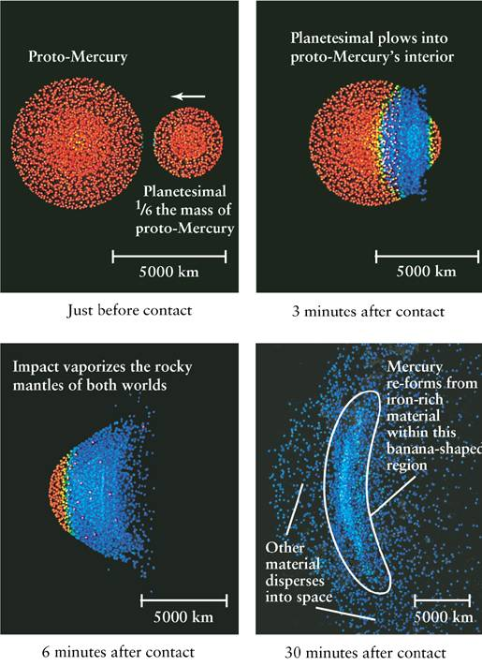
One possible theory to explain Mercury’s high iron content is a collision with a massive asteroid that stripped Mercury of most of its rocky mantle.

Slide 43
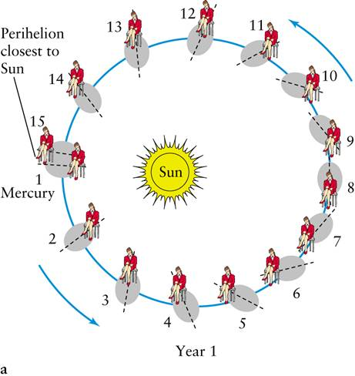
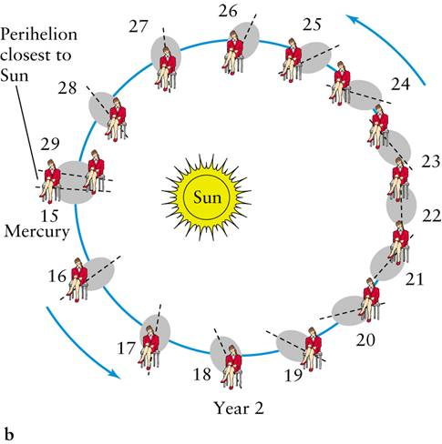
Mercury’s rotation is coupled with its orbital period around the Sun. There are three sidereal rotations of Mercury for every two orbits around the Sun. This unique combination makes a “solar day” on Mercury last two Mercury years.

Slide 44
Other Mercury Stuff
Mercury has a magnetic field 1% as strong as Earth’s, but its source is not known.
Mercury has no permanent atmosphere. Why is that?
Mercury’s surface temperature range is the biggest in the Solar System:
  Noon = 700 K (800 F)
  Night = 100 K (-280 F)

Slide 45
New Space Mission to Mercury
The Messenger spacecraft was launched in 2004, and will reach Mercury orbit in 2011.
On its way to Mercury, Messenger will loop around Venus twice and around Mercury three times. Then it will enter orbit around Mercury.
Why are we making Messenger do loops around Venus and Mercury?

Slide 46
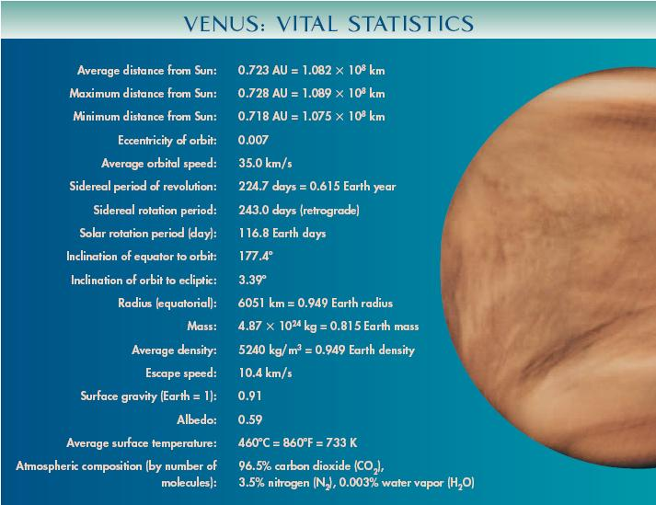

Slide 47
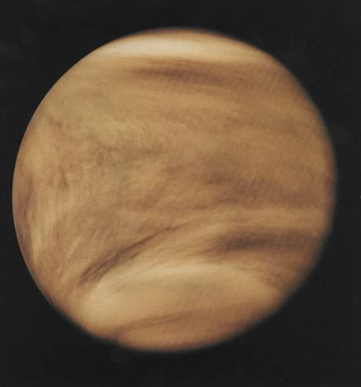
The Clouds of Venus
Venus is covered with a dense layer of clouds that hides its surface.
Unlike the benign water vapor clouds on Earth, these clouds contain large amounts of sulfur dust and sulfur compounds, giving them a yellow-orange color.
The clouds on Venus are made of concentrated sulfuric acid.

Slide 48
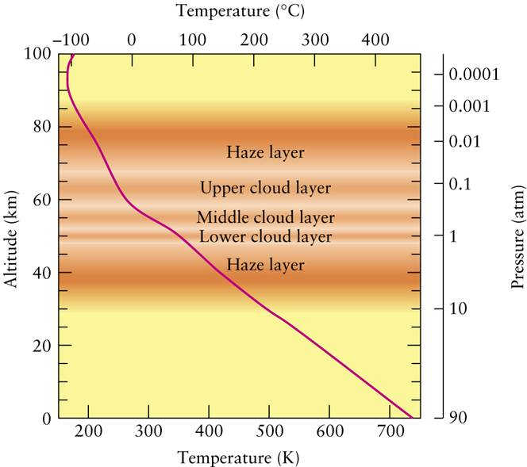
We see dramatic increases in both pressure and temperature as we approach the surface of Venus.
At the surface, the temperature is an astounding 860°F, even hotter than Mercury.

Slide 49
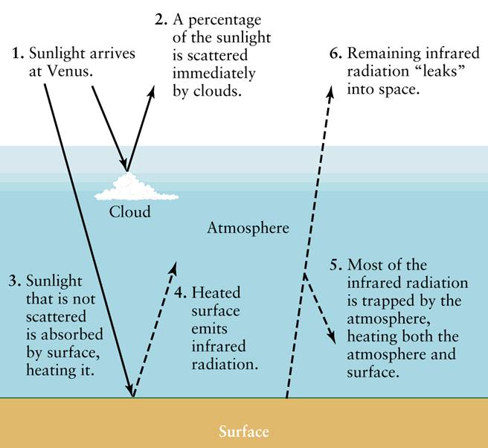
The extreme heating of Venus’ surface is caused by the greenhouse effect
The carbon dioxide in the atmosphere of Venus acts as a “greenhouse,” trapping the heat from the Sun underneath and the temperature rising until finally thermal equilibrium is reached…when the surface is 860°F!

Slide 50
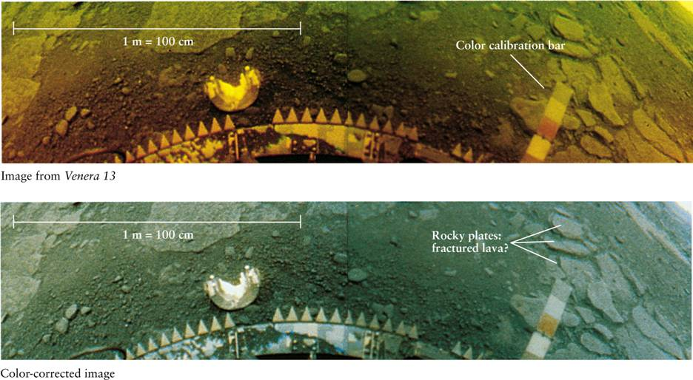
This image of Venus’s surface from the Soviet spacecraft Venera 13 shows rock plates that may be fractured lava.
Unfortunately, this craft was destroyed by the intense pressure and extreme temperatures on the Venusian surface.

Slide 51
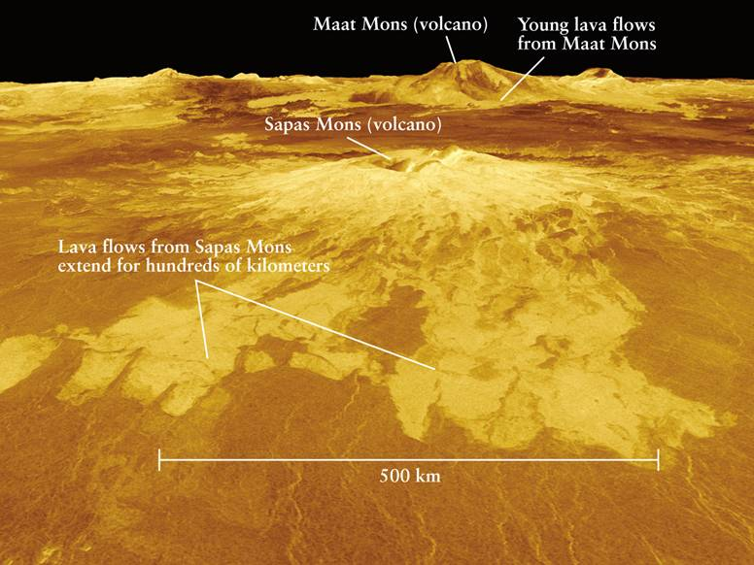
The Magellan spacecraft, in an orbit around Venus, was able to “see through” the thick clouds using radar, giving us the best view of our sister planet.

Slide 52
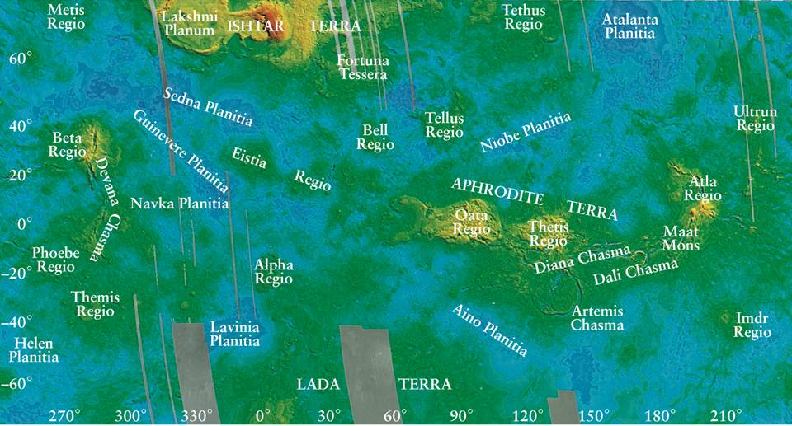
This false color map of Venus, equivalent to a topographical map of Earth, shows the large-scale surface features of the planet.

Slide 53
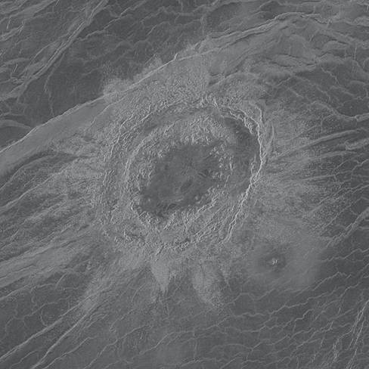

A global view of Venus using radar images from the Magellan spacecraft
The craters found on Venus tend to be in clusters.
This suggests that they were formed from a large single piece of falling debris that was broken up by Venus’s atmosphere.

Slide 54


Slide 55


Mars has been the Center of Speculation about Extraterrestrial Life
People feared an attack from Mars, like this one portrayed in “The War of the Worlds.”
Early telescope images showed features which were perceived as irrigation canals.

Slide 56

Topographical Map of Mars

Slide 57

What are these ?

Slide 58

The Martian surface includes broad towering volcanoes, vast windswept plains, and enormous canyons.
Valles Marineris is a vast canyon stretchimg over about one-fifth the circumference of Mars (as wide as the United States).

Slide 59

Mars also has volcanoes. The largest of these is Olympus Mons. It covers an area the size of Missouri and rises three times higher than Mount Everest.

Slide 60

Thanks to
Will Lynch

Slide 61

Thanks
to
Will
Lynch

Slide 62

Impact Craters on Mars
Most of these craters are found in the Southern Hemisphere, suggesting that the Northern Hemisphere has been resurfaced.

Slide 63


The Martian surface also has some unusual features
Apparent “face” on the Martian surface.
22 years later, with improved technology, the feature looks more natural.

Slide 64

Martian Seasons
Mars is tilted on its axis by 25.19° (nearly the same as Earth) and the hemispheres experience seasons that can be observed by examining the polar caps.
Large ice cap made mostly of frozen carbon dioxide (dry ice)
The dry ice sublimates, leaving a much smaller polar cap

Slide 65

Water Ice – North Pole – Phoenix Lander

Slide 66


Although it is sometimes blue, the Martian sky generally takes on a rust color because of dust particles blown into the atmosphere by strong winds.

Slide 67


High winds create dust devils on the Martian surface.
DARK STREAKS SHOW THE PATH OF DUST DEVILS
A DUST DEVIL FROM ABOVE

Slide 68

By studying the rocks found in the craters on Mars, we hope to gain insight into the history of Martian water.
The crater Endurance, photographed by the Martian rover “Opportunity”

Slide 69


The winding canyons found on the Martian surface are similar to those found in river beds on Earth, suggesting that liquid water once flowed on Mars.
Martian winding canyon, photographed by the Viking orbiter
The Yangtze River in China has similar features

Slide 70



Surface features believed to be ancient waterways
A dried riverbed
An ancient lake
Sedimentation

Slide 71



Layers of rock laid down by water
Hematite black rocks, usually formed in water
Gullies in crater walls

Slide 72

Did Mars once support life? Is there life there now?
Viking’s mechanical arms collect samples of the Martian soil to analyze its chemical makeup and to search for possible signs of microscopic life.

Slide 73

SNC meteorites are believed to have come from Mars, because their chemistry is consistent with that of the Martian climate. These would have been ejected from Mars during a major impact.
These rocks show possible fossils of microbial life. However, they also have possible non-biological explanations.

Slide 74

The two moons of Mars, Deimos and Phobos, are small and non-spherical in shape. These are planetesimals captured by Mars.

Slide 75


Slide 76


Slide 77
WHAT DID YOU THINK?
Which of the two planets, Mercury (the closest planet to the Sun) or Earth, has the coolest temperature?
The daytime temperature of Mercury is much higher than on Earth, but the nighttime temperature of Mercury is much lower than on Earth.
Which planet is most similar to Earth?
Venus is most similar in size, chemistry, and distance from the Sun. Mars is most similar in its length of day, seasons, erosion, and in having water ice.
What is the composition of the clouds surrounding Venus?
The clouds are made primarily of sulfuric acid.

Slide 78
WHAT DID YOU THINK?
Does Mars have liquid water on its surface today?
No, but there are strong indications that it had liquid water in the past.
Is life known to exist on Mars today?
No current life has yet been discovered on Mars.

Slide 79
WHAT DO YOU THINK?
Is Jupiter a “failed star?”
What is Jupiter’s Great Red Spot?
Does Jupiter have continents and oceans?
Is Saturn the only planet with rings?
Are the rings of Saturn solid?
Do all moons rise and set as seen from their respective planets?

Slide 80
You will discover…
that Jupiter is an active, vibrant, multicolored world more massive than all the other planets combined
that Jupiter has a diverse system of moons
that Saturn has a spectacular system of thin flat rings and numerous moons
what Uranus and Neptune have in common and how they differ from Jupiter and Saturn
that tiny Pluto and its moon Charon orbit each other in synchronous rotation

Slide 81


Slide 82



Jupiter
Largest and most massive planet in the solar system:
Contains almost 3/4 of all planetary matter in the solar system.
Most striking features visible from Earth: Multi-colored cloud belts
Explored in detail by several space probes:
Visual image
Pioneer 10, Pioneer 11, Voyager 1, Voyager 2, Galileo
Infrared false-color image

Slide 83
The Mass of Jupiter
Mass can be inferred from the orbit of Io, the innermost of the 4 Galilean Moons:
Io
Moon
Jupiter
Earth
Relative sizes, distances, and times to scale
1 s corresponds to 10 hr in real time.
Using Kepler’s third law → M_{Jupiter} = 318 M_{Earth}

Slide 84

Jupiter’s Interior
From radius and mass → Average density of Jupiter ≈ 1.34 g/cm³
=> Jupiter can not be made mostly of rock, like earthlike planets.
→ Jupiter consists mostly of hydrogen and helium.
T ~ 30,000 K
Due to the high pressure, hydrogen is compressed into a liquid, and even metallic state.

Slide 85

The Chemical Composition of
Jupiter and Saturn

Slide 86
Jupiter’s Rotation
Jupiter is the most rapidly rotating planet in the solar system:
Rotation period slightly less than 10 hr.
Centrifugal forces stretch Jupiter into a markedly oblate shape.

Slide 87

Jupiter’s Magnetic Field
Discovered through observations of decimeter (radio) radiation
Magnetic field at least 10 times stronger than Earth’s magnetic field.
Magnetosphere over 100 times larger than Earth’s.
Extremely intense radiation belts:
Very high energy particles can be trapped; radiation doses corresponding to ~ 100 times lethal doses for humans!

Slide 88

Aurorae on Jupiter
Just like on Earth, Jupiter’s magnetosphere produces aurorae concentrated in rings around the magnetic poles.
~ 1000 times more powerful than aurorae on Earth.

Slide 89

Jupiter’s clouds move in east-west bands
Reddish-colored belts alternate with white-colored zones.

Slide 90


Against the background of zones and belts, turbulent swirling cloud patterns, called white and brown ovals, form.
The Great Red Spot is a huge typhoon-like storm of swirling gasses that has lasted for at least 300 years and in which two Earths could fit side to side.

Slide 91

The cloud speeds on Jupiter vary with latitude, an effect called differential rotation. Near the poles, the rotation period of Jupiter’s atmosphere is five minutes longer than that at the equator.
POLAR REGION ROTATION TIME
9 hours 55minutes
EQUATORIAL REGION ROTATION TIME
9hours 50minutes

Slide 92

Jupiter’s Atmosphere
Jupiter’s liquid hydrogen ocean has no surface:
Gradual transition from gaseous to liquid phases as temperature and pressure combine to exceed the critical point.
Jupiter shows limb darkening → hydrogen atmosphere above cloud layers.
Only very thin atmosphere above cloud layers;
transition to liquid hydrogen zone ~ 1000 km below clouds.

Slide 93

Jupiter’s Atmosphere (2): Clouds
Three layers of clouds:
1. Ammonia (NH₃) crystals
2. Ammonia hydrosulfide
3. Water crystals

Slide 94


The Cloud Belts on Jupiter (2)
Just like on Earth, high-and low-pressure zones are bounded by high-pressure winds.
Jupiter’s Cloud belt structure has remained unchanged since humans began mapping them.

Slide 95

The Great Red Spot
Several bright and dark spots mixed in with cloud structure.
Largest and most prominent: The Great Red Spot.
Has been visible for over 330 years.
Formed by rising gas carrying heat from below the clouds, creating a vast, rotating storm.
~ 2 D_{Earth}

Slide 96


The Great Red Spot (2)
Structure of Great Red Spot may be determined by circulation patterns in the liquid interior

Slide 97


Jupiter’s Ring
Galileo spacecraft image of Jupiter’s ring, illuminated from behind
Not only Saturn, but all four gas giants have rings.
Jupiter’s ring: dark and reddish; only discovered by Voyager 1 spacecraft.
Composed of microscopic particles of rocky material
Location: Inside Roche limit, where larger bodies (moons) would be destroyed by tidal forces.
Ring material can’t be old because radiation pressure and Jupiter’s magnetic field force dust particles to spiral down into the planet.
Rings must be constantly re-supplied with new dust.

Slide 98

Comparison of Jupiter’s and Saturn’s Atmospheres

Slide 99

Astronomers believe that the belts and zones are created by a combination of the planet’s convection and its rapid differential rotation.
However, evidence gathered by the Cassini spacecraft contradicts earlier assumptions about the temperatures of the gases in the zones and belts. More evidence is needed to uncover the true nature of these patterns.

Slide 100


Comet Shoemaker-Levy’s Collision with Jupiter
The comet was ripped into 21 fragments by gravitational tides from Jupiter.
VISIBLE LIGHT
ULTRA VIOLET
These fragments exploded into huge fireballs and left dark spots at the impact sites that lasted for months.

Slide 101


Slide 102
Interiors of the Galilean Moons

Slide 103


Io
Io, the closest moon to Jupiter, is covered with many active volcanoes.
Tidal forces from Jupiter and the other Galilean moons keep Io’s interior heated.

Slide 104


Europa
Europa houses liquid water under its icy surface.
Scars on Europa’s surface are believed to be caused by rising warmed ice.

Slide 105

Ganymede
Ganymede, the largest satellite in the solar system, is even larger than Mercury.
These images of Ganymede’s largest feature, a huge, dark, circular region called Galileo Regio, show deep furrows in the moon’s icy crust.

Slide 106


Callisto
A huge asteroid impact still marks the surface of Callisto.
Faint rings were the result of a huge impact
These images show spires containing both ice and dark material.

Slide 107



Other Objects in the Jupiter System
Jupiter has at least 59 other, much smaller asteroid-like moons. Four of these (below) are closer to Jupiter than Io.
Tenuous ringlets (above) were discovered by Voyager I.
Two torus-shaped regions of electrically-charges gas particles called plasmas (above)

Slide 108

Thanks to
Ciara McHugh

Slide 109


Slide 110

Saturn, like Jupiter, has
bands of belts and zones
There is much less contrast between the belts and zones on Saturn than on Jupiter.
Also, there is very little swirling structure in Saturn’s clouds.

Slide 111

Two Storms Merging on Saturn

Slide 112

The interiors of Jupiter and Saturn are similar in structure.
However, with less mass, Saturn does not convert as much of its hydrogen into liquid.

Slide 113

Our view of Saturn’s rings during its 30-year revolution around the Sun
At some points in its orbit, we see the full face of the rings, and sometimes the rings disappear when we see them edge-on.

Slide 114

Saturn
Mass: ~ 1/3 of mass of Jupiter
Radius: ~ 16 % smaller than Jupiter
Av. density: 0.69 g/cm³ → Would float in water!
Rotates about as fast as Jupiter, but is twice as oblate → No large core of heavy elements.
Mostly hydrogen and helium; liquid hydrogen core.
Saturn radiates ~ 1.8 times the energy received from the sun.
Probably heated by liquid helium droplets falling towards center.

Slide 115

Saturn’s Magnetosphere
Magnetic field ~ 20 times weaker than Jupiter’s
→ weaker radiation belts
Magnetic field not inclined against rotation axis
→ Aurorae centered around poles of rotation

Slide 116

Saturn’s Atmosphere
Cloud-belt structure, formed through the same processes as on Jupiter,
but not as distinct as on Jupiter; colder than on Jupiter.

Slide 117

Saturn’s Atmosphere (2)
Three-layered cloud structure, just like on Jupiter
Main difference to Jupiter:
Fewer wind zones, but much stronger winds than on Jupiter:
Winds up to ~ 500 m/s near the equator!

Slide 118

Saturn’s Rings
A Ring
Ring consists of 3 main segments: A, B, and C Ring
B Ring
separated by empty regions: divisions
C Ring
Rings can’t have been formed together with Saturn because material would have been blown away by particle stream from hot Saturn at time of formation.
Cassini Division
Rings must be replenished by fragments of passing comets & meteoroids.

Slide 119

Composition of Saturn’s Rings
Rings are composed of ice particles
moving at large velocities around Saturn, but small relative velocities (all moving in the same direction).

Slide 120


Shepherd Moons
Some moons on orbits close to the rings focus the ring material, keeping the rings confined.

Slide 121


Saturn’s Ring System Contains
Numerous Thin Ringlets
This apparent gap in the rings contains even more ringlets.
Close inspection reveals that there are thousands of ringlets making up the rings.

Slide 122

Saturn’s rings – natural color – from Cassini

Slide 123

The F ring is kept in place by the combined effect of two small satellites, one on either side.
These satellites are called shepherd satellites.

Slide 124


Detailed Views of Saturn’s F Ring

Slide 125

Dark spokes move around Saturn’s rings.
These are believed to be caused by electrically-charges particles interacting with Saturn’s magnetic field.

Slide 126

Saturn has Many Diverse Moons
MIMAS
ENCELADUS
TETHYS
DIONE
RHEA

Slide 127

Enceladus – Ice Plumes

Slide 128

Enceladus – Ice Plumes
(false color)

Slide 129

SATURN’S BIGGEST MOON – TITAN
Titan has an atmosphere three times thicker than that of Earth. It is composed of nitrogen, methane and a variety of carbon-hydrogen compounds called hydrocarbons. The Huygens Probe landed there.

Slide 130

Huygens on Titan

Slide 131



Images of Titan’s Surface from the Cassini Spacecraft

Slide 132

Map of Titan – courtesy of the Cassini robot spacecraft

Slide 133

Titan’s lakes – north polar regions – made of methane and ethane (hydrocarbons)

Slide 134

Rhea’s Rings
Thanks to Frank Lato

Slide 135
Rhea’s Rings
New observations by a spacecraft suggest Saturn's second-largest moon may be surrounded by rings. If confirmed, it would the first time a ring system has been found around a moon.
The international Cassini spacecraft detected what appeared to be a large debris disk around the 950-mile-wide moon Rhea during a flyby in 2005. Scientists proposed that the halo likely contained particles ranging from the size of grains to boulders.

Slide 136


Slide 137
Uranus and Neptune
are Comparable in Size
EARTH ON THE SAME SCALE
URANUS
NEPTUNE

Slide 138


Uranus
Chance discovery by William Herschel in 1781,
while scanning the sky for nearby objects with measurable parallax: discovered Uranus as slightly extended object, ~ 3.7 arc seconds in diameter.

Slide 139

Uranus’s axis of rotation is tilted on its side, making seasonal changes drastic.

Slide 140

The Motion of Uranus
Very unusual orientation of rotation axis: Almost in the orbital plane.
97.9º
19.18 AU
Possibly result of impact of a large planetesimal during the phase of planet formation.
Large portions of the planet exposed to “eternal” sunlight for many years, then complete darkness for many years!

Slide 141



The Atmosphere of Uranus
Like other gas giants: No surface.
Gradual transition from gas phase to fluid interior.
Mostly H; 15 % He, a few % Methane, ammonia and water vapor.
Optical view from Earth: Blue color due to methane, absorbing longer wavelengths
Cloud structures only visible after artificial computer enhancement of optical images taken from Voyager spacecraft.

Slide 142

The Structure of Uranus’ Atmosphere
Only one layer of Methane clouds (in contrast to 3 cloud layers on Jupiter and Saturn).
3 cloud layers in Jupiter and Saturn form at relatively high temperatures that occur only very deep in Uranus’ atmosphere.
Uranus’ cloud layer difficult to see because of thick atmosphere above it.
Also shows belt-zone structure
→ Belt-zone cloud structure must be dominated by planet’s rotation, not by incidence angle of sun light!

Slide 143

Cloud Structure of Uranus
Hubble Space Telescope image of Uranus shows cloud structures not present during Voyager’s passage in 1986.
→ Possibly due to seasonal changes of the cloud structures.

Slide 144

The interiors of Uranus and Neptune are both believed to have the same layers.

Slide 145

The magnetic fields of Earth, Jupiter, and Saturn nearly align with their respective rotation axes.
In contrast, the magnetic and geographic poles of Uranus and Neptune differ greatly.

Slide 146


The Discovery of Uranus’s Dark Rings
A planet’s orbit sometimes places it between a star and the Earth. When this occurs, we refer to it as an occultation.
During an occultation of a star by Uranus, the starlight intensity was noticed to decrease both before and after the planet’s disk crossed. This was due to the rings surrounding the planet.

Slide 147


The Moons and Rings of Uranus
The rings of Uranus are much darker than those of Saturn.
There are many fine dust particles between the main rings.
The moon Miranda’s patchwork surface suggests that huge chunks of rocks and ice came back together after a huge impact.

Slide 148

Neptune
Discovered in 1846 at position predicted from gravitational disturbances on Uranus’s orbit by J. C. Adams and U. J. Leverrier.
Blue-green color from methane in the atmosphere
4 times Earth’s diameter; 4 % smaller than Uranus

Slide 149


The Atmosphere of Neptune
The “Great Dark Spot”
Cloud-belt structure with high-velocity winds; origin not well understood.
Darker cyclonic disturbances, similar to Great Red Spot on Jupiter, but not long-lived.
White cloud features of methane ice crystals

Slide 150


Neptune’s Atmosphere
The Great Dark Spot was a surprising find on a planet where it was thought that temperatures were too cold to sustain such storms.
Ultraviolet images reveal a band-like structure similar to Jupiter and Saturn.

Slide 151

Like Uranus, Neptune is Surrounded
by Thin, Dark Rings

Slide 152


Neptune’s moon Triton has a retrograde orbit around the planet, suggesting it was captured by Neptune.
A possible frozen water
ice lake

Slide 153


Slide 154


Pluto was Discovered as it Moved against the Background of Stars
Pluto’s moon Charon was originally thought to be a defect in the images of Pluto.

Slide 155

Pluto and Charon are about the same size. They are locked in a mutual synchronous orbit in which the same sides of Pluto and Charon always face each other.
These images from the Hubble Space Telescope are the best we have of Pluto and Charon.

Slide 156

Two More Moons – Nix and Hydra

Slide 157


Slide 158


Slide 159
WHAT DID YOU THINK?
Is Jupiter a “failed star”?
No. Jupiter has 75 times too little mass to shine as a star.
What is Jupiter’s Great Red Spot?
A long-lived, oval cloud circulation similar to a hurricane on Earth.
Does Jupiter have continents and oceans?
No. The only solid matter in Jupiter is its core.

Slide 160
WHAT DID YOU THINK?
Is Saturn the only planet with rings?
No. Jupiter, Uranus and Neptune also have rings.
Are the rings of Saturn solid?
No. The rings are composed of thin, closely spaced ringlets consisting of particles of ice and ice-coated rocks.
Do all moons rise and set as seen from their respective planets?
No. The one exception is Pluto’s moon Charon, which remains over the same place on Pluto at all times.

