Slide 1
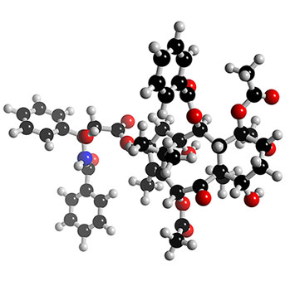
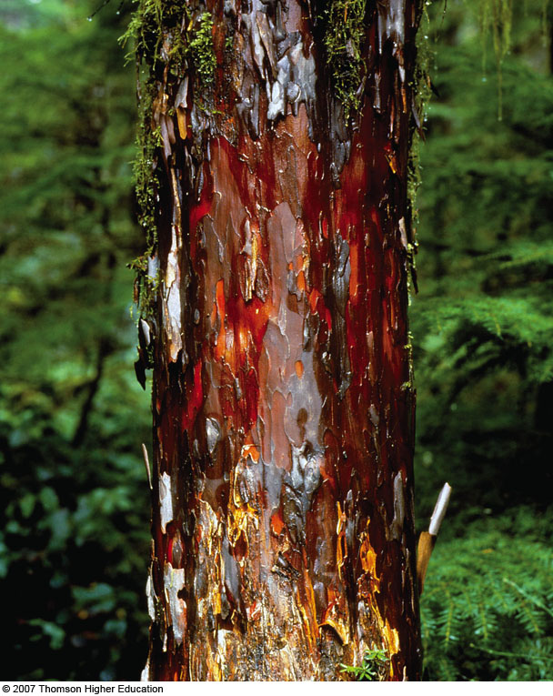
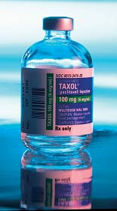
Unit 1: Matter and
The Nature of Chemistry

Slide 2

The Bible is the only source of truth and should be the foundation upon which scientific evidence is studied

Slide 3
Matthew 7:24-27
“Anyone who listens to my teaching and follows it is wise, like a person who builds a house on solid rock. 25 Though the rain comes in torrents and the floodwaters rise and the winds beat against that house, it won’t collapse because it is built on bedrock. 26 But anyone who hears my teaching and doesn’t obey it is foolish, like a person who builds a house on sand. 27 When the rains and floods come and the winds beat against that house, it will collapse with a mighty crash.”
If we build on the Rock (Jesus), our lives will withstand every storm of life, and our success in science will be

Slide 4
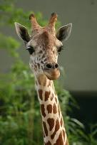
In every Science discipline, a scientist has the potential to bring glory to the Lord
“Whatever you do, work heartily, as for the Lord and not for men”
Colossians 3:23-24
The goal of science is to investigate and understand the natural world created by God, to explain events in the natural world as seen through the eyes of a follower of Christ , and to use those explanations to make useful predictions, and to aid our fellow man.
Jesus replied: “ ‘Love the Lord your God with all your heart and with all your soul and with all your mind.’ This is the first and greatest commandment. And the second is like it: ‘Love your neighbor as yourself.’ Matthew 22: 36-40

Slide 5
Chemistry
Chemistry is the study of the structure, composition & properties of matter and its transformations from one form to another.
Matter is anything that has mass and occupies space.
Chemistry is everywhere!

Slide 6
Natural Science falls into 2 general categories:
Biological sciences: concerned primarily with living things
Physical science: concerned primarily with nonliving things
Which category would chemistry be listed as?

Slide 7
Applications of Chemistry
Chemical reactions are involved in:
Biological Processes: medical, pharmaceutical & biotechnology industries
Atmospheric Phenomena: ozone depletion, acid rain, climate change (global warming)
Energy Production & Consumption: petroleum & alternative energy industries
Making New Materials: polymer, computer & clothing industries, etc.

Slide 8
Branches of Chemistry
Many major areas of study for specialization
Several career opportunities
Also used in many other jobs

Slide 9
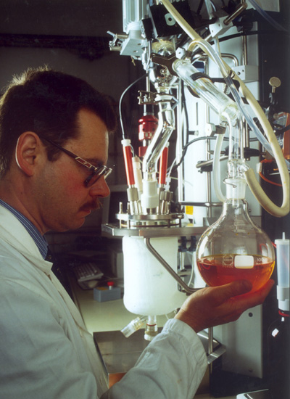
1. Organic Chemistry
Organic is the study of matter that contains carbon
Organic chemists study the structure, function, synthesis, and identity of carbon compounds
Useful in petroleum industry, pharmaceuticals, polymers

Slide 10
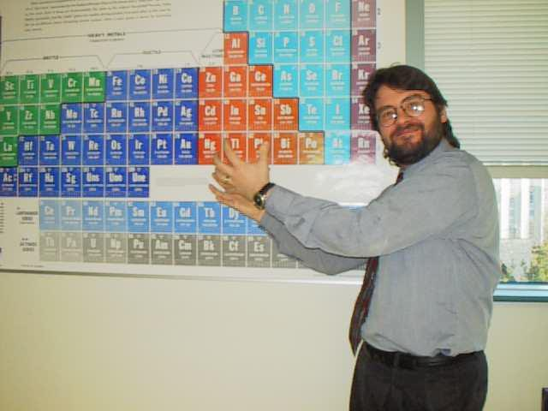
2. Inorganic Chemistry
Inorganic is the study of matter that does NOT contain carbon
Inorganic chemists study the structure, function, synthesis, and identity of non-carbon compounds
Polymers, Metallurgy

Slide 11
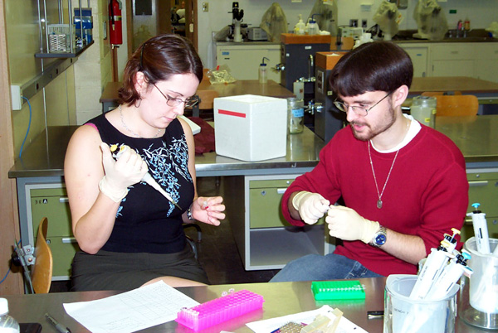
3. Biochemistry
Biochemistry is the study of chemistry in living things
Cross between biology and chemistry
Pharmaceuticals and genetics

Slide 12

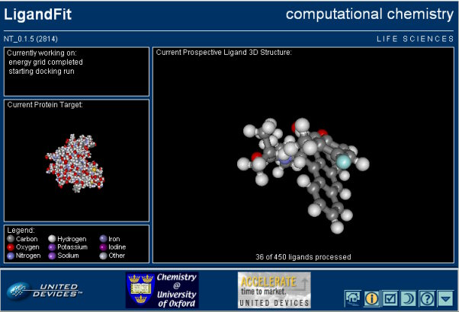
4. Physical Chemistry
HONK if you passed p-chem
Physical chemistry is the physics of chemistry… the forces of matter
Much of p-chem is computational
Develop theoretical ideas for new compounds

Slide 13
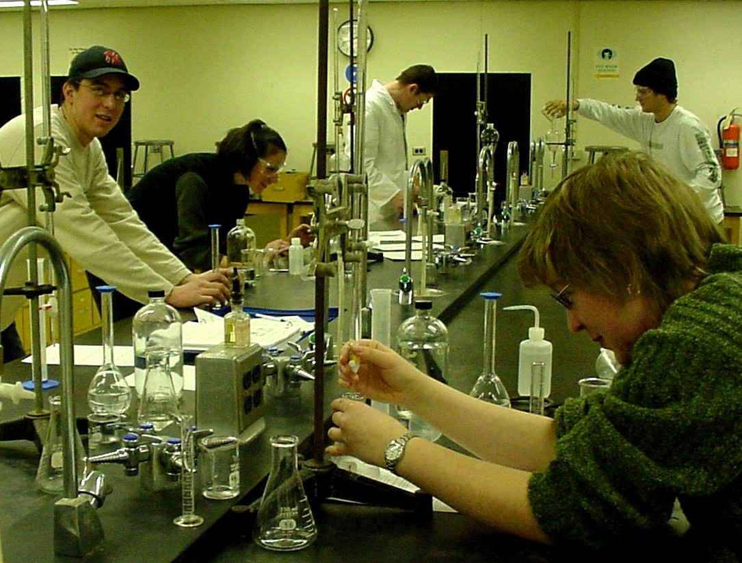

5. Analytical Chemistry
Analytical chemistry is the study of high precision measurement
Find composition and identity of chemicals
Forensics, quality control, medical tests

Slide 14
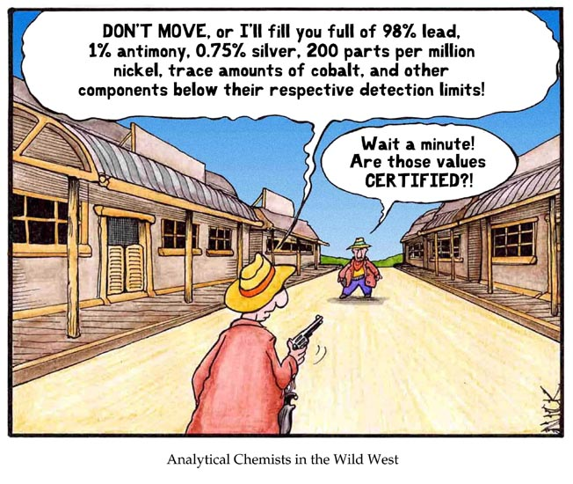

Slide 15
The Scientific Method
A logical approach to the solution of a problem, that lends itself to investigations by observation, generalization, theorizing and testing

Slide 16
Steps in the Scientific method
observe and state a problem
Form a hypothesis
Test the hypothesis
Record and analyze data
Form a conclusion
Replicate the work

Slide 17

Introduction to Science
and the Scientific Method
© Amy Brown Science

Slide 18
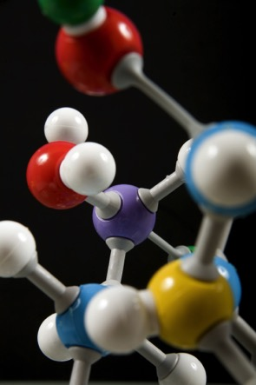
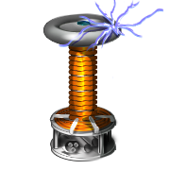
What is Science?
The goal of science is to investigate and understand the natural world, to explain events in the natural world, and to use those explanations to make useful predictions.
1. Science deals only with the natural world.
3. Scientists propose ___________ that can be _____ by examining evidence.
explanations
2. Scientists:
tested
collect and organize information in a careful, orderly way, looking for patterns and connections between events.
4. Science is an organized way of using evidence to learn about the natural world.

Slide 19



How is Science Done?
Science begins with an __________.
This is the process of gathering information about events or processes in a careful, orderly way.
observation
Data is the information gathered from making observations.

Slide 20
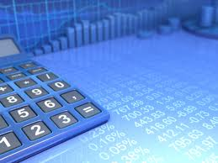
There are two types of data:
Quantitative data are:
numbers and are obtained by counting or measuring.
Qualitative data are:
descriptions and involve characteristics that cannot be counted.

Slide 21
A hypothesis is a scientific explanation for a set of observations.
A hypothesis must be stated in a way that makes it “testable”. The hypothesis is just a possible answer to a question, and it must be thoroughly tested.

Slide 22

Scientific Methods
The scientific method is:
A series of steps used by scientists to solve a problem or answer a question.
The Steps to the Scientific Method:
Observation / Asking a Question
Form a Hypothesis
Design a Controlled Experiment
Record and Analyze Results
Draw Conclusions

Slide 23
The Scientific Method
A logical approach to the solution of a problem, that lends itself to investigations by observation, generalization, theorizing and testing

Slide 24
Steps in the Scientific method
observe and state a problem
Form a hypothesis
Test the hypothesis
Record and analyze data
Form a conclusion
Replicate the work

Slide 25
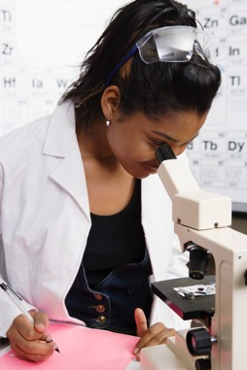

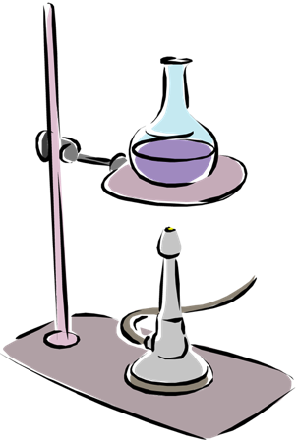
Step 1:
Observation / Asking a Question
Step 2: Form a Hypothesis
Hypothesis
A problem or a question must first be identified.
A possible explanation to the question or problem.
It is simply a prediction and has not yet been proven or disproven.
It must be stated in a way that is testable.
A statement is considered “testable” if evidence can be collected that either does or does not support it.
How much water can a root hair absorb?
Why does a plant stem bend toward the light?
What effect does temperature have on heart rate?

Slide 26
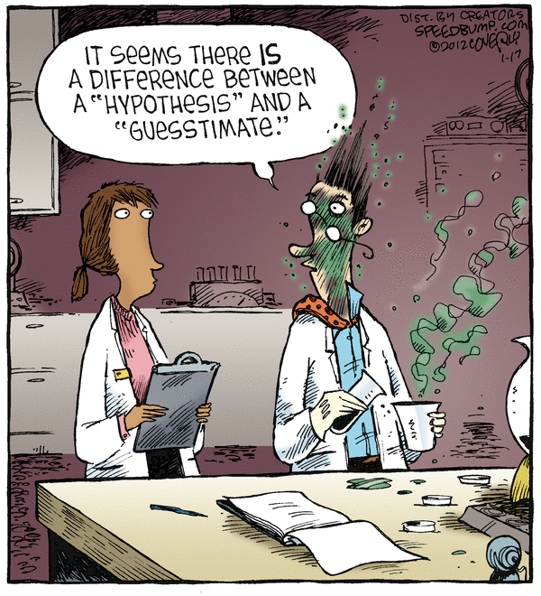
Hypothesis
No hypothesis, theory or law is ever free from being tested
Hypothesis should be written in an “If…..then” form
“If fertilizer is used, then the crops will produce more.”
This allows for the hypothesis to be either accepted or rejected, no gray areas

Slide 27
Step 3: Designing a Controlled Experiment
1. The factors in an experiment that can be changed are called variables. Some examples of variables would be: Changing the temperature, the amount of light present, time, concentration of solutions used.
2. A controlled experiment works with one variable at a time. If several variables were changed at the same time, the scientist would not know which variable was responsible for the observed results.
3. In a “controlled experiment” only one variable is changed at a time. All other variables should be unchanged or “controlled.”
control group
4. An experiment is based on the comparison between a _____________ with an __________________.
experimental group
a) These two groups are identical except for one factor.
b) The control group serves as the comparison. It is the same as the experiment group, except that the one variable that is being tested is removed.
c) The experimental group shows the effect of the variable that is being tested.

Slide 28
For an experiment to be valid, it should contain a control setup, a variable, and an experimental setup
Control setup: The part of the experiment that does not contain the variable
Experimental setup: the part of the experiment that does contain the variable
Variable: the single factor that is isolated and tested
A valid experiment contains only one variable ,

Slide 29
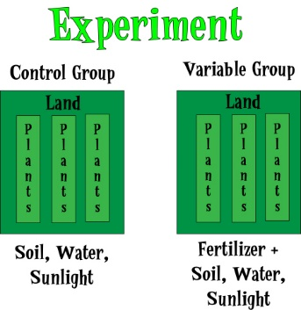

Slide 30
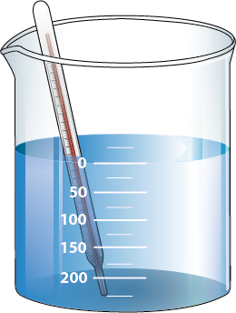
both beakers are same size, same amount of water, identical thermometers, beaker a has antifreeze added to it
What is the variable in the experiment?
What is the control setup?
What is the experimental setup?
Beaker A Beaker B

Slide 31
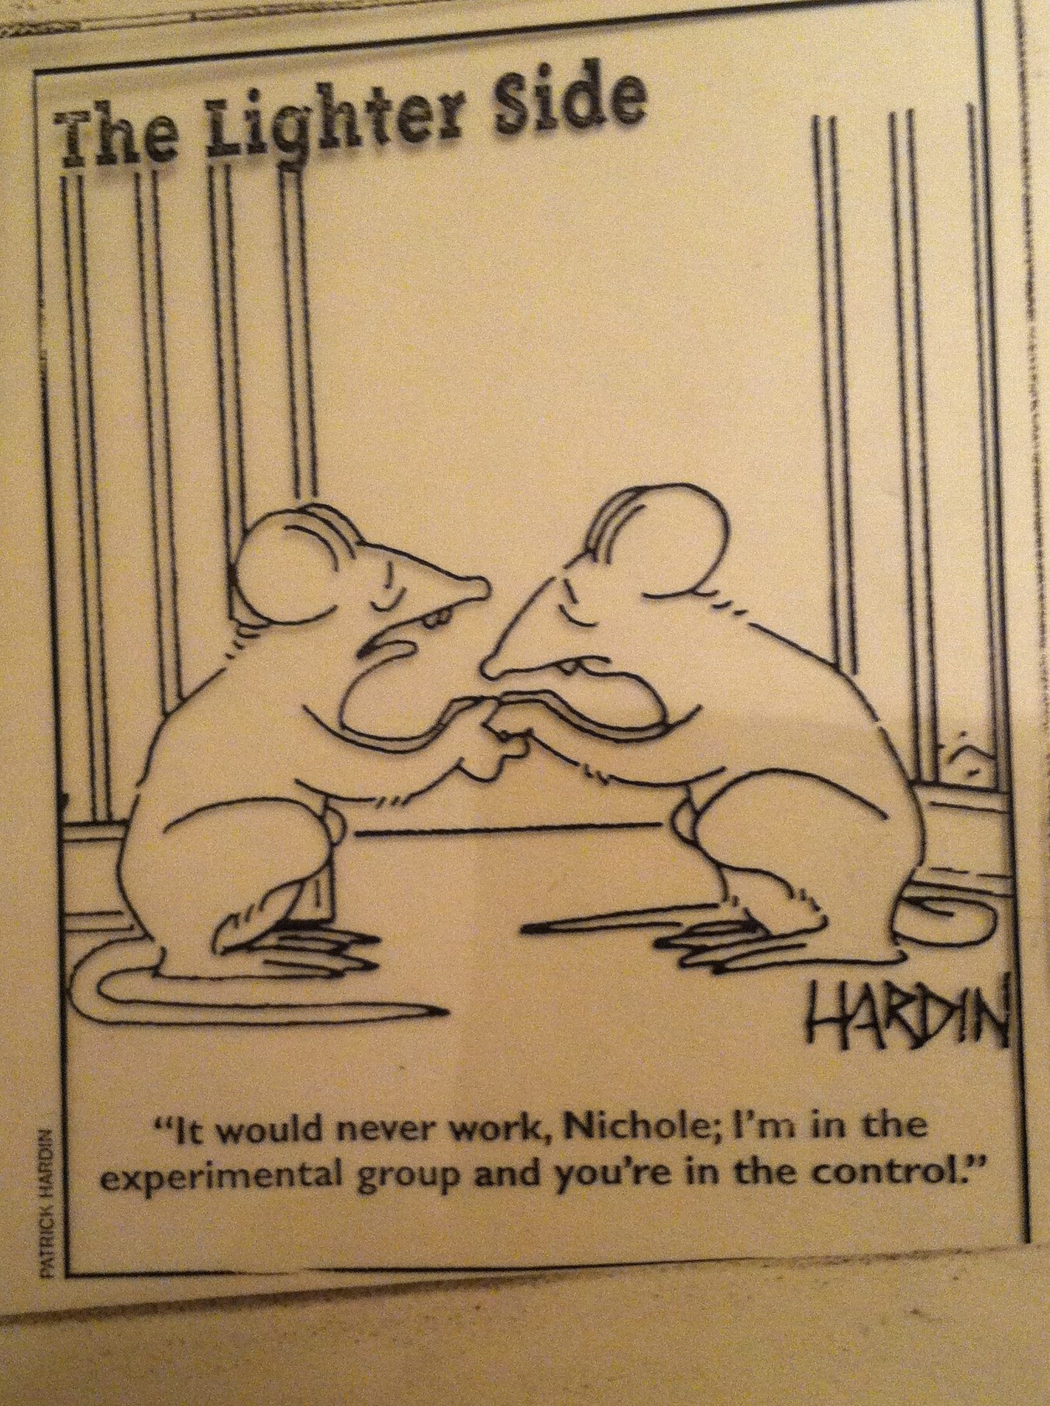

Slide 32
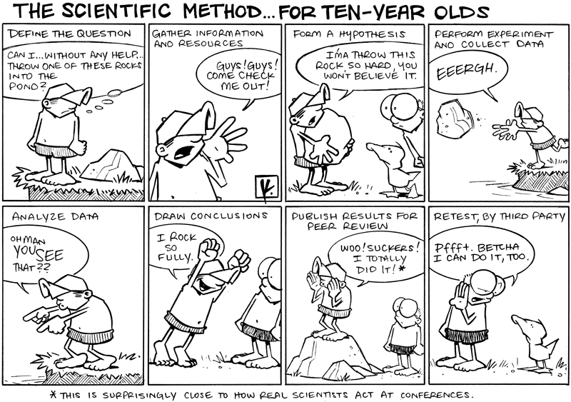

Slide 33
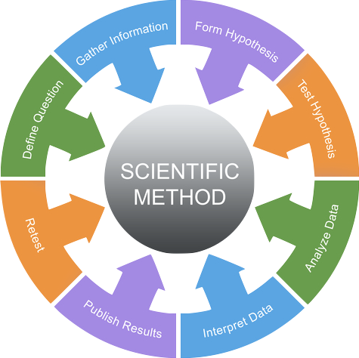
Example: In order to test the effectiveness of a new vaccine, 50 volunteers are selected and divided into two groups. One group will be the control group and the other will be the experimental group. Both groups are given a pill to take that is identical in size, shape, color and texture.
Describe the control group.
Describe the experimental group.
What variables are kept constant?
What variable is being changed?
Even though the volunteers are given identical looking pills, the control group will not actually receive the vaccine.
This group will receive the vaccine.
The size, shape, color, and texture of the pill.
Whether or not the pill contains the vaccine.

Slide 34
There are two variables in an experiment:
c) In the above example, what is the independent variable?
a) The independent variable is the variable that is deliberately changed by the scientist.
It is the addition of the vaccine to the pills that were given to the volunteers.
b) The dependent variable is the one observed during the experiment. The dependent variable is the data we collect during the experiment. This data is collected as a result of changing the independent variable.
d) In the above example, what is the dependent variable?
The observed health of the people receiving the pills.

Slide 35
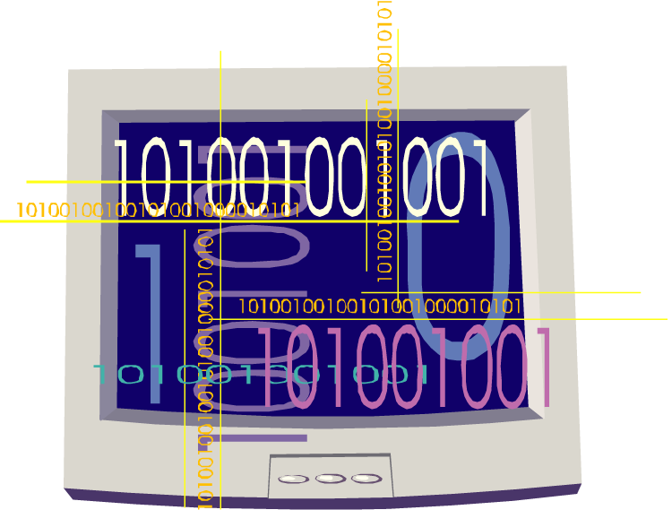
Step 4: Recording and Analyzing Results
1. The data that has been collected must be organized and analyzed to determine whether it is reliable.
2. Does the data support or not support the hypothesis?

Slide 36
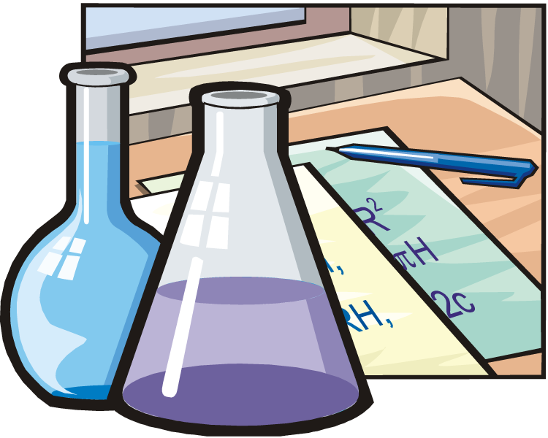
Step 5: Drawing Conclusions
The evidence from the experiment is used to determine if the hypothesis is supported or not supported.
Experiments must be repeated over and over. When repeated, the results should always be the same before a valid conclusion can be reached.

Slide 37

Forming a Theory
A theory may be formed after the hypothesis has been tested many times and is supported by much evidence.
Theory:
A broad and comprehensive statement of what is thought to be true.
A theory is supported by considerable evidence.

Slide 38
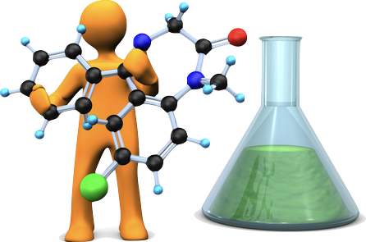
Practice Problem:
You want to determine the effect of a certain fertilizer on the growth of orchids grown in a greenhouse. Materials that are available to you include: greenhouse, 100 orchid plants, water, fertilizer, and soil. You want to know if the orchids will grow best with a weak concentration of fertilizer, a medium concentration of fertilizer, or a high concentration of fertilizer. How will you design an experiment to test different concentrations of this fertilizer?
State your hypothesis:
Possible answer:
I predict that the orchids will grow best with a medium concentration of fertilizer.

Slide 39

How will you set up a controlled experiment?
Here is one possibility:
The 100 plants will be divided into 4 groups as follows:
Group 1: 25 plants will receive plain water.
Group 2: 25 plants will receive a weak concentration of fertilizer.
The plants will be watered daily.
Over a period of a month, the plants will be measured to see which ones grew the tallest.
Group 3: 25 plants will receive a medium concentration of fertilizer.
Group 4: 25 plants will receive a high concentration of fertilizer.

Slide 40

Control Group
Experimental Group
What is the control group in this experiment?
The control group consists of the 25 plants that are receiving plain water.
What is the experimental group in this experiment?
The experimental group consists of the 75 plants that are receiving various concentrations of fertilizer.

Slide 41
In a “controlled experiment”, all variables must be kept constant except the one variable that is being changed.
What variables must be kept constant in this experiment?
All plants must receive the same amount of fluid each day.
All plants are grown in pots of equal size.
All plants are grown at the same temperature.
All plants receive the same amount of sunlight.
What variable is being changed in this experiment?
The variable being changed is the amount of fertilizer received by each group of plants.

Slide 42
After one month of measuring the orchids, the following data is obtained:
Group 1 (Control Group): Grew to an average height of 15 cm.
Group 2 (Weak conc.): Grew to an average height of 35 cm.
Group 3 (Medium conc.): Grew to an average height of 28 cm.
Group 4 (High conc.): Grew to an average height of 10 cm.
Is your hypothesis supported or not supported by these results?
We hypothesized that the orchids would grow best with a medium concentration of fertilizer.
The results do not support this.
The results do not support our hypothesis.

Slide 43
After one month of measuring the orchids, the following data is obtained:
Group 1 (Control Group): Grew to an average height of 15 cm.
Group 2 (Weak conc.): Grew to an average height of 35 cm.
Group 3 (Medium conc.): Grew to an average height of 28 cm.
Group 4 (High conc.): Grew to an average height of 10 cm.
What is your conclusion based on these results?
Orchids grow best with a weak concentration of fertilizer.
At medium to high concentrations, plant growth is inhibited.

Slide 44
Analysis Questions
Why is it important to have a large sample size in any experiment?
It is important to test a large sample in order to get a true picture of the results of the experiment. If the sample size is too small, an inaccurate conclusion may be reached. Results obtained by testing a large number of individuals would be much more accurate than if only a few individuals had been tested.

Slide 45
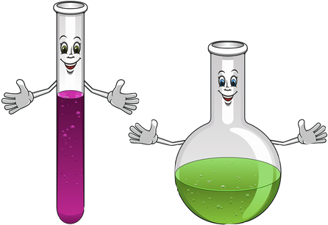
Analysis Questions
Why is it important to repeat the experiment many times?
Experiments should be repeated to see if the same results are obtained each time. This gives validity to the test results.

Slide 46

Analysis Questions
What is the importance of the control?
The control shows what will happen when the experimental factor is omitted. Without the control, there would be no basis for comparison and you would not know how the experimental factor affected the results.

Slide 47

Analysis Questions
How is a theory different than a hypothesis?
A hypothesis is an “educated guess” that is testable through observations and experimentation. A theory is a broad statement of what is believed to be true based on many experiments and considerable amounts of data.

Slide 48

Analysis Questions
Why is it so important that a scientist accurately describes the procedure used in the experiment?
It allows other scientists to repeat the experiment and verify the results.

Slide 49

Analysis Questions
What is the difference between the independent and the dependent variables in an experiment?
The independent variable is the variable that is deliberately changed by the scientist. The dependent variable is the one observed during the experiment. The dependent variable is the data we collect during the experiment.

Slide 50
Analysis Questions
In a “controlled experiment”, why must all of the variables, except one, be kept constant throughout the experiment?
If several variables were changed at the same time, the scientist would not know which variable was responsible for the observed results.

Slide 51
c) Law
After a series of experiments, a researcher may see a relationship or a regularity in the results. If this relationship can be stated clearly, we call it a law.
Law: concise statement that summarizes a wide range of experimental results & has not been contradicted by experiments
A law summarizes a set of experimental results, but does not provide an explanation.

Slide 52
2. The Scientific Method

Slide 53
Matter
Before we can understand the changes we see going on around us, we must find out how matter is organized
Some kinds of matter are easily recognized while other is not
Matter: material of the universe
Specific properties: of matter make it easy to tell one kind of mater from another ex: color, odor, shape, texture, hardness
General properties: describe how all matter is the same

Slide 54
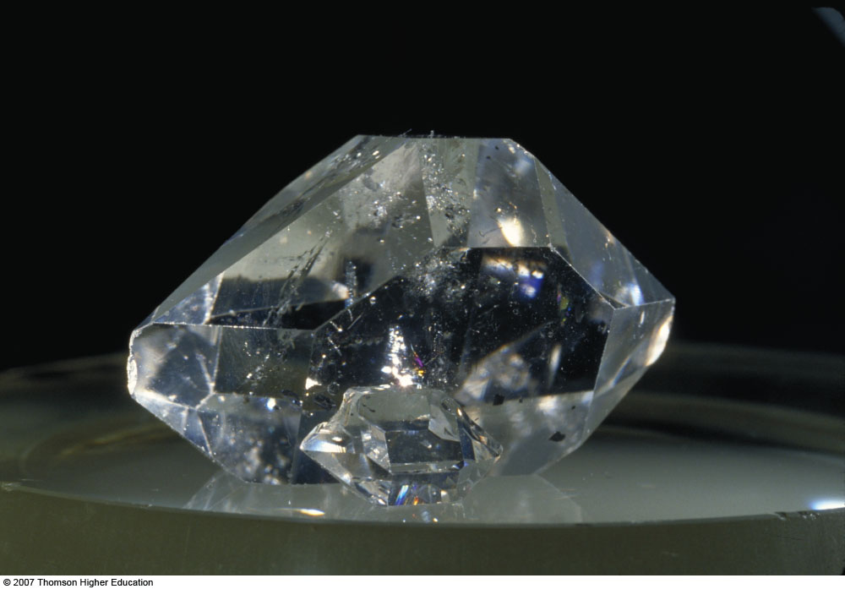
Matter
Matter: has mass & occupies space
Substance: a specific
type of matter that has
the same properties &
the same composition
throughout a sample

Slide 55
B. Introduction to Matter
Samples of matter can be classified in several different ways:
  Physical State: Gas, liquid, solid?
  Chemical Composition: Pure or mixture? Element or compound?
  Physical Properties: MP, BP, density, etc.
  Chemical Properties: Reactivity

Slide 56
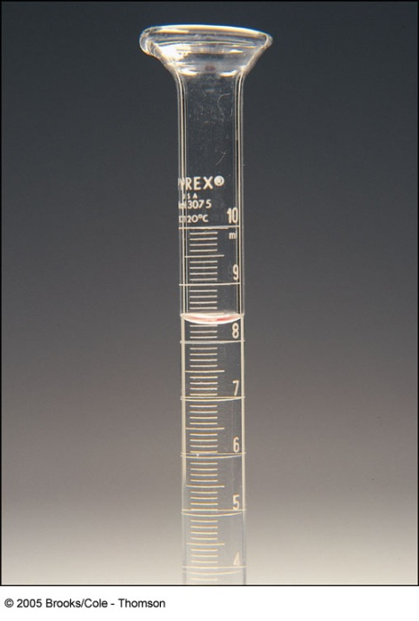
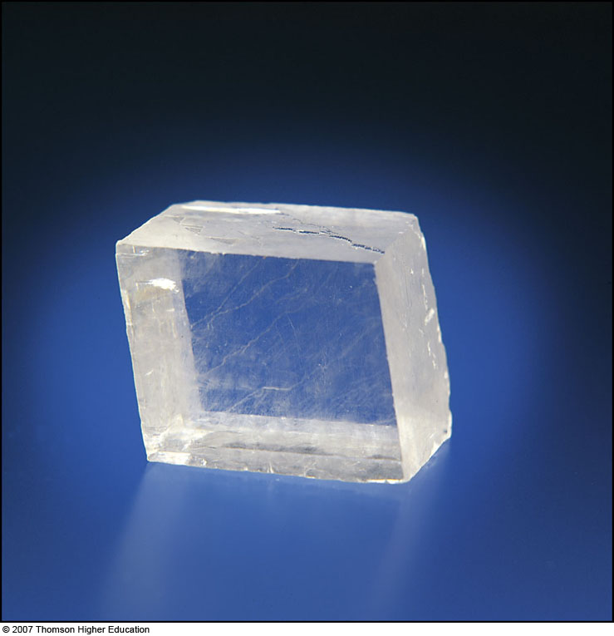
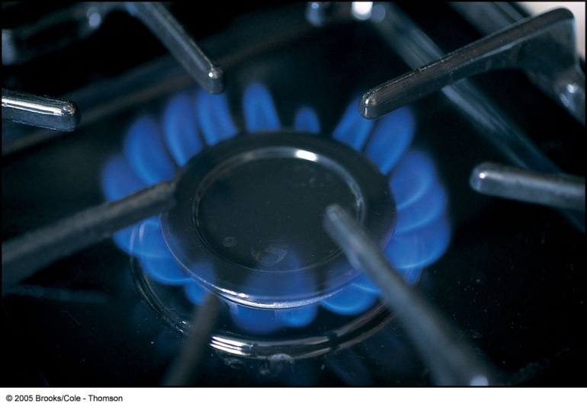
Physical States of Matter: 4
Is the substance a gas, a liquid, or a solid?
How are these physical states defined?

Slide 57
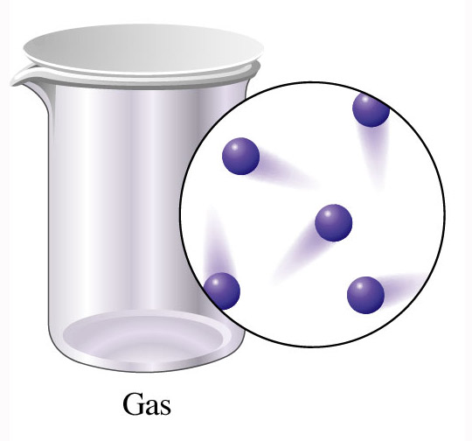
a) Gas
No definite shape nor volume
Easily compressible fluid
Expands to fill the container it occupies
Volume varies considerably with temperature and pressure

Slide 58
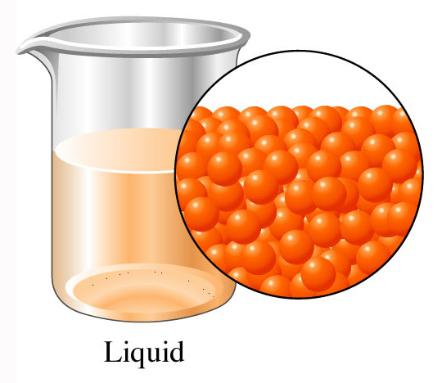
b) Liquid
Has definite volume, but takes the shape of the container it occupies
Relatively incompressible fluid
The resistance to flow of a liquid is called viscosity
Ex honey has a high viscosity

Slide 59
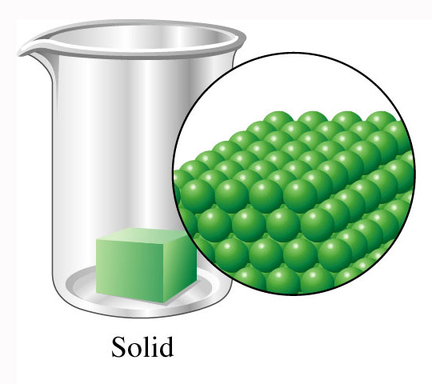
c) Solid
Has a rigid shape and a fixed volume
Changes very little as temperature and pressure change
Solids that lose their shape under certain conditions are called amorphous solids ex rubber

Slide 60
Plasma
Very rare
Found in the sun
Very dangerous to life
Matter n the plasma state is very high in energy and therefor dangerous to living things

Slide 61
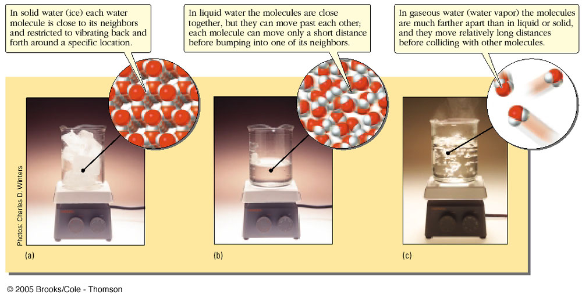
d) Nanoscale Representations of Physical States
The Kinetic-Molecular Theory

Slide 62
e) Macroscale, Microscale, Nanoscale
Macroscale: samples of matter large enough to be seen and handled – physical properties can be observed by the human senses (unaided)
Microscale: samples of matter that have to be viewed with a microscope
Nanoscale: samples that are at the atomic or molecular scale where chemical reactions occur

Slide 63
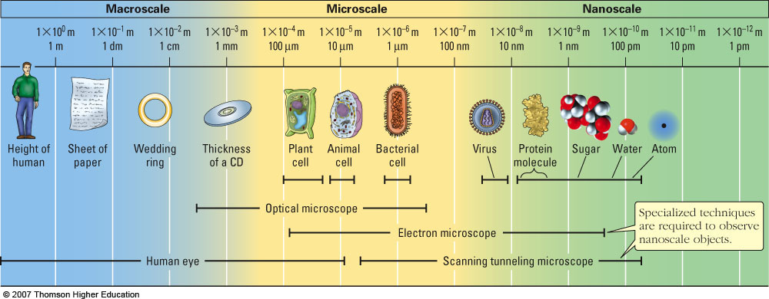
e) Macroscale, Microscale, Nanoscale

Slide 64
2. Chemical Composition
Is the substance pure (made up of one component), or is it a mixture (made up of multiple components)?
If the substance is a mixture, is it heterogeneous or homogeneous?
If the substance is pure, is it an element or a compound?

Slide 65
a) Pure or a Mixture?
Pure Substance: a substance from which all other substances have been separated
Mixture: an impure material that can be separated by physical means into two or more substances
• Unlike a pure substance, a mixture can have a variable composition – not necessarily uniform throughout the sample.
• Mixtures are classified as being either heterogeneous or homogeneous.

Slide 66
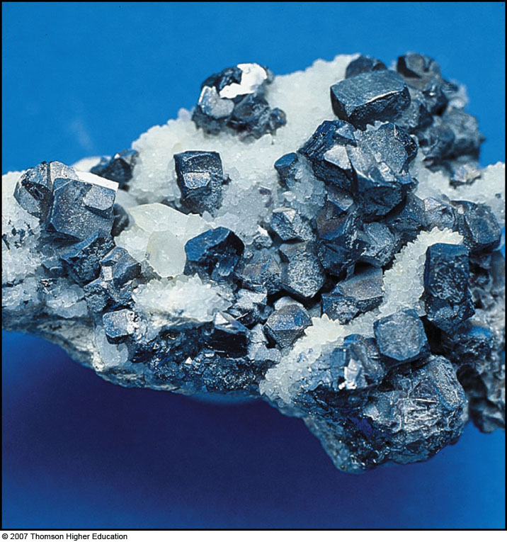
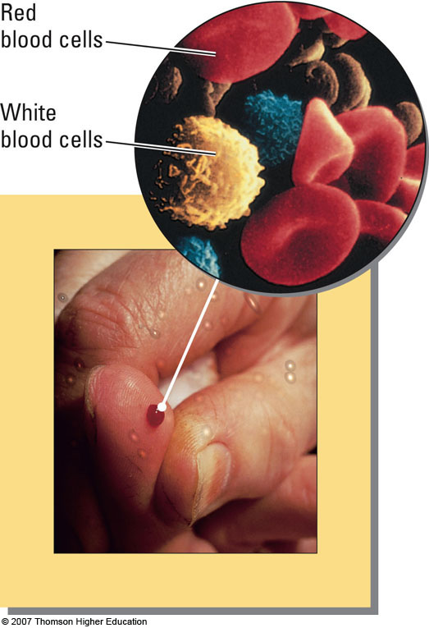
Heterogeneous Mixtures
Heterogeneous: a mixture in which the uneven texture is visible to the naked eye or with a microscope
• Properties in one region differ from another

Slide 67
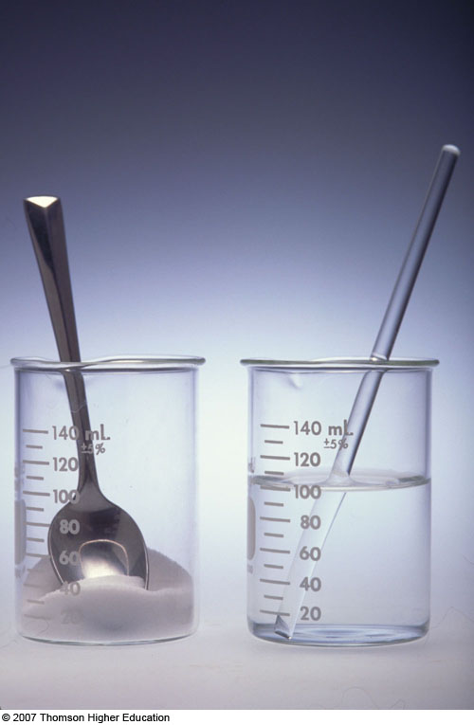
Homogeneous Mixture (Solution)
Homogeneous: completely uniform
• Two or more substances in the same phase
Same properties throughout the sample
• eg. Salt water (solution of sodium chloride dissolved in water)

Slide 68
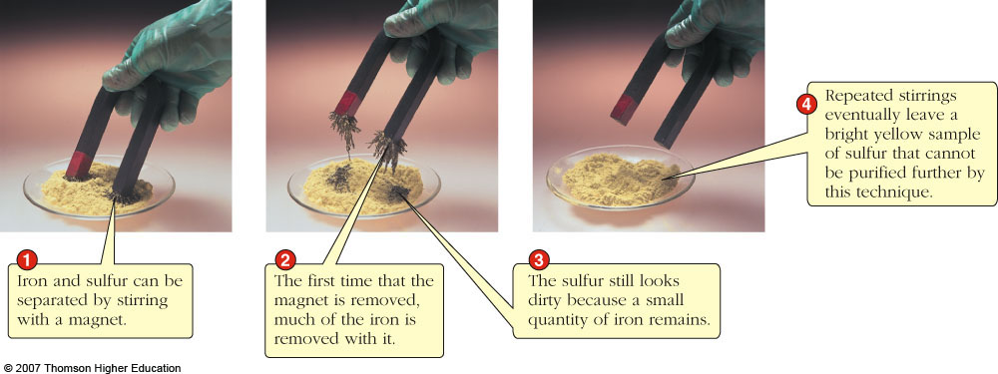
Mixtures can be separated by physical means into two or more pure substances
Each pure substance can be classified as either an element or a compound.

Slide 69


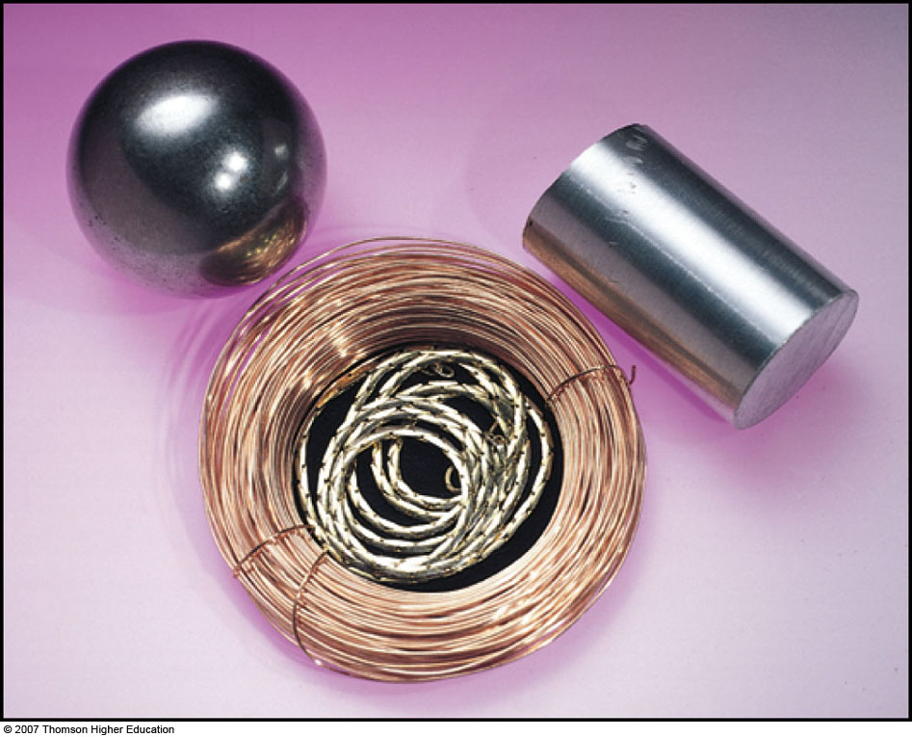
b) Elements
Element: a substance that cannot be decomposed into two or more new substances by chemical or physical means
• The smallest unit of an element is an atom.
• ex. Iron, aluminum, copper & gold
Pure elements are made up of only one type of atom!

Slide 70
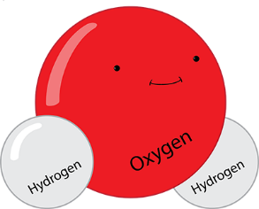
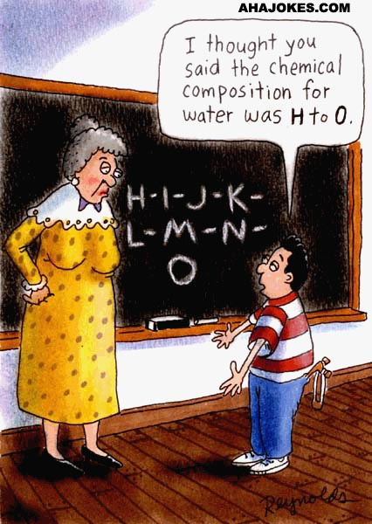
c) Compounds
Compound: a pure substance composed of two or more elements chemically combined – can be decomposed by chemical means
• The smallest unit of a compound is a molecule.
• ex. Water molecules are composed of hydrogen and oxygen atoms
Pure compounds are made up of only one type of molecule!

Slide 71
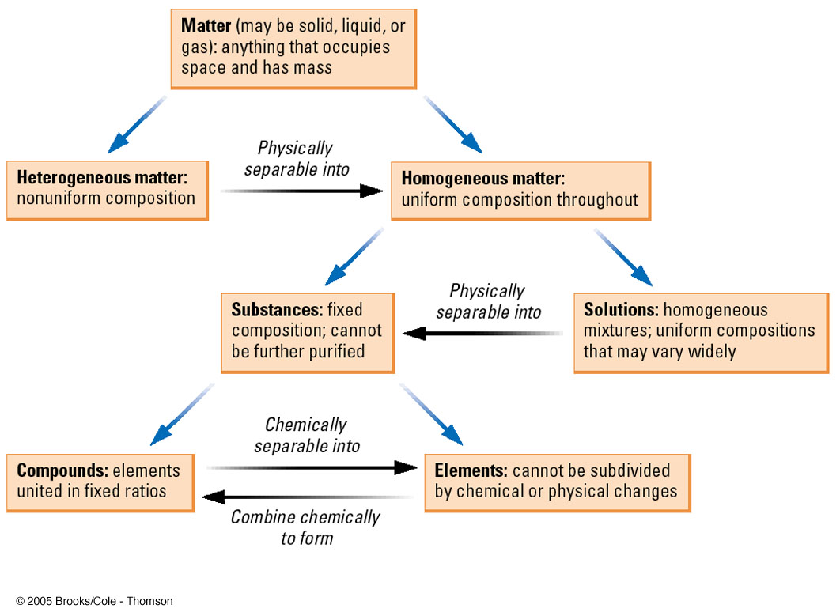
4. Classification of Matter

Slide 72
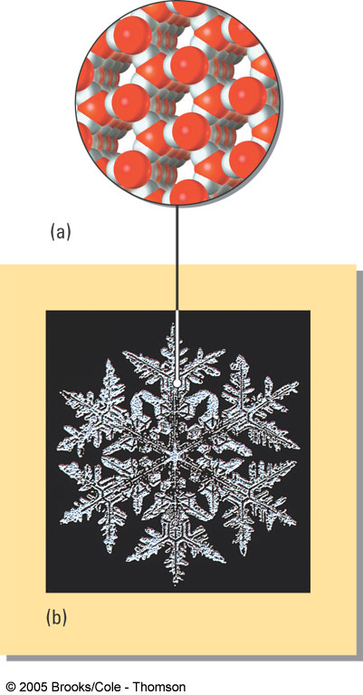
3. Properties of Matter
Every sample of matter can be classified and/or identified by its physical & chemical properties
a) Physical Properties: Properties that can be observed and measured without changing the chemical composition of a substance
    Mass
    Volume
    Color
    Physical state
    Melting/Boiling point
    Temperature
    Density

Slide 73
Mass
The most general property of matter, and can be measured in units of grams or kilograms on various types of balance scales
It is the amount of matter in an object
Mass is also the measure of inertia of an object
Inertia is the resistance of an object to change in its motion
The more mass…..the more inertia

Slide 74
Weight
An object has weight because it has mass
Weight is the measure of the earths gravitational attraction for matter ( 9.8m/sec/sec)
All objects exert gravitational attraction on other objects
The earths gravity is great because the earth has a large mass
The pull of gravity on an object determines the objects weight
The metric unit of weight is the newton (N)

Slide 75
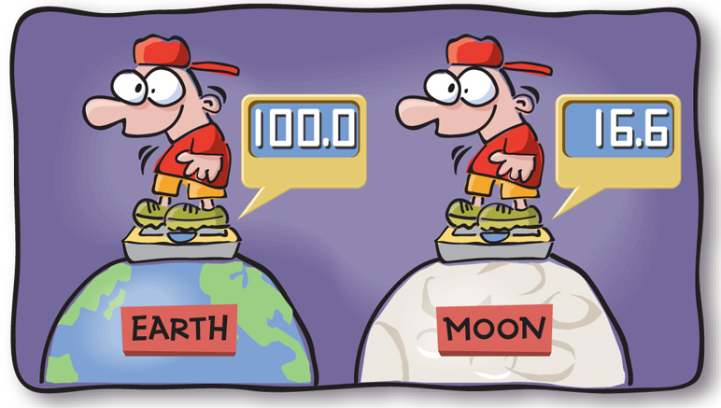
Difference between weight and mass
Weight changes as the gravitational pull changes
Example earth verses the moon
Mass is constant and does not change ( unless one diets)

Slide 76
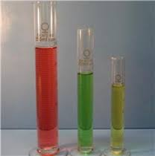
Volume
The amount of space an object takes up
It is measured in liters, milliliters and cubic centimeters

Slide 77
Temperature (K, C & F)
Temperature is the physical property of matter that determines whether on object can heat another.
It is a measure of the motion of the particles
There are three common units of temperature:
Kelvin: SI base unit; based on absolute temperature scale (K = 273 + °C)
Celsius: commonly used in scientific community
Fahrenheit: common temperature scale in the United States (not used in science)

Slide 78
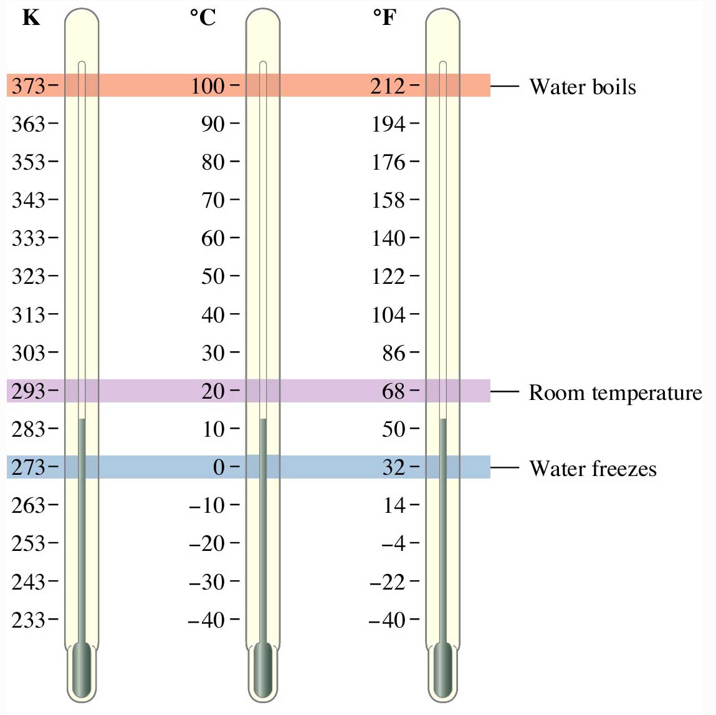
25 °C = _____ K
350 K = _____ °C

Slide 79
25 °C = _____ K
350 K = _____ °C
298
77

Slide 80
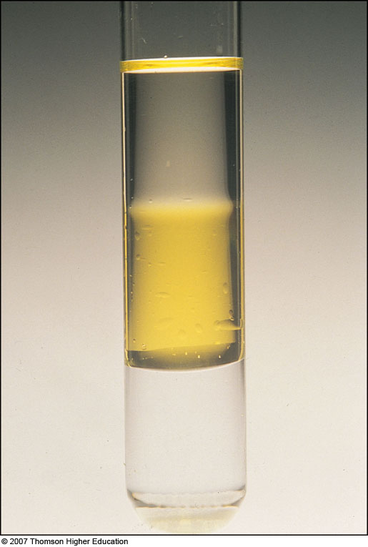
Density
The density of an object is the ratio of the mass of a sample to its volume.
d = m/v
(d = density, m = mass, v = volume)
The standard units are:
g/ml (liquid), g/cm³ (solid), g/L (gas)

Slide 81
i) Density
Calculate the volume of a 23.4 g sample of ethanol (d = 0.789 g/mL).
D = m/v
.0789 g/ml = 23.4g/x
What is x?
What unit is x measured in?
Answer: 296.58 ml

Slide 82
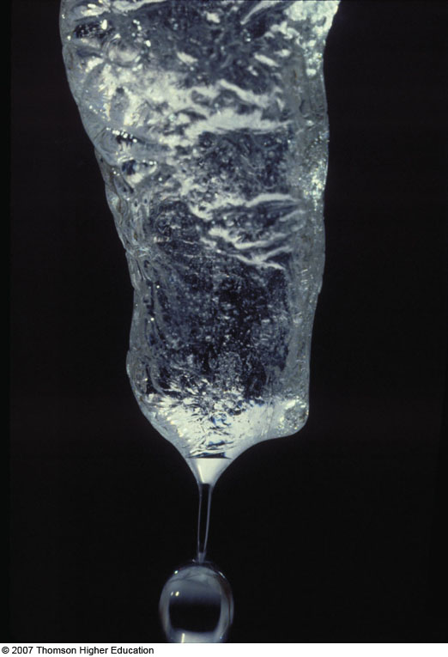
Physical Changes
Physical Change: a change in a physical property of a substance
• The same substance is present before & after the physical change.
• eg. Melting ice (change from solid to liquid)

Slide 83
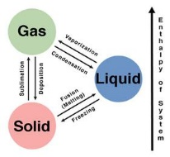
Types of physical changes:
( changes in states of matter)
Melting
Freezing
Vaporization
Evaporation ( vaporization at the surface of a liquid)
Boiling point
Sublimation: change directly from a solid to a gas ex dry ice

Slide 84
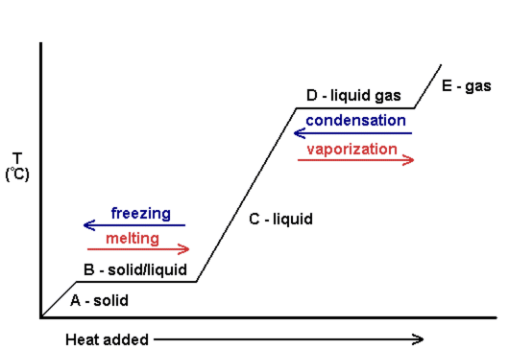
In a phase change:
Gas has the most energy
Liquid has the 2nd highest temperature
Solids have the lease amount of energy

Slide 85
b) Chemical Properties
Chemical Properties: a description of the kinds of chemical changes (reactions) a substance can undergo
i) Chemical Change (Reaction): process in which substances (reactants) change into other substances (products) with different chemical constitutions
- The same substance is NOT present before & after the change

Slide 86

The substance that undergoes the chemical change is called the reactant ( and is on the left side of the equations) and the new substance is the product ( on the right side of the equation)

Slide 87


Indication of a chemical reaction
Chemical and physical changes are accompanied by energy changes: 2 types
Exothermic: release heat
Endothermic: absorb heat
Production of heat or light
Production of gas
Formation of a precipitate

Slide 88

Some Clues That a Chemical Reaction Has Occurred

Slide 89


Exercise
What is a clue that a chemical reaction has occurred?
  a) The color changes.
  b) A solid forms.
  c) Bubbles are present.
  d) A flame is produced.
Notes:
The answer is c. The formation of bubbles (a gas) is a sign that a chemical reaction has taken place.

Slide 90

Exercise
What is a clue that a chemical reaction has occurred?
“Colorless hydrochloric acid is added to a red solution of cobalt(II) nitrate, turning the solution blue.”
  a) The color changes.
  b) A solid forms.
  c) Bubbles are present.
  d) A flame is produced.
Notes:
The answer is a. The solution turning blue is a sign that a chemical reaction has taken place.

Slide 91

Exercise
What is a clue that a chemical reaction has occurred?
“A solid forms when a solution of sodium dichromate is added to a solution of lead nitrate.”
  a) A gas forms.
  b) A solid forms.
  c) Bubbles are present.
  d) A flame is produced.
Notes:
The answer is b. The formation of a yellow solid is a sign that a chemical reaction has taken place.

Slide 92

• In a chemical reaction, the chemical composition of a substance changes

Slide 93
c) Extensive versus Intensive Properties
All physical and chemical properties are classified as being either extensive or intensive.
Extensive Property
-depends on the specific sample under investigation
-varies from sample to sample
Depends on the amount of substance present
eg. Mass, volume, temperature, etc.
Intensive Property
-identical in all samples of a given substance
-used to identify substances
Does not depend on the amount of substance present
eg. Density, melting point, boiling point, color

Slide 94
C. Atomic Theory of Matter
In the beginning of the 1800s, chemistry was a very different science than it is today. Little was known about the nature and structure of matter.
Thanks to two brilliant early experimentalists, two important chemical laws had been proposed and tested at that time.
Remember, laws summarize but do not explain experimental data.

Slide 95
1. Law of Conservation of Mass
Antoine Lavoisier carried out experiments in which he carefully weighed the chemical reactants, carried out a chemical reaction (combustion), and then carefully collected and weighed the products.
He found that there is no detectable change in mass during an ordinary chemical reaction. Mass is conserved in a chemical reaction!

Slide 96

Interesting Side Note. . .
Antoine Lavoisier is known as the Father of Modern Chemistry, but he wasn’t always popular during his lifetime. He funded his laboratory by working as an accountant for King Louis XVI. As a royal tax collector, he was a prime target for the leaders of the French Revolution. He was beheaded on a guillotine in 1794!

Slide 97
2. Law of Constant Composition (Law of Definite Proportions)
Joseph Proust performed careful quantitative studies in which he established that all samples of a given compound have the same proportions, by mass, of the elements present in the compound.
A chemical compound always contains the same elements in the same proportions.

Slide 98
Periodic Table
The periodic table organizes the elements in a particular way. A great deal of information about an element can be gathered from its position in the period table.
For example, you can predict with reasonably good accuracy the physical and chemical properties of the element.
You can also predict what other elements a particular element will react with chemically.
Understanding the organization and plan of the periodic table will help you obtain basic information about each of the 118 known elements.

Slide 99

The first Periodic Table was published in 1869 by Dimitri Mendeleev

Slide 100

Mendeleev arranged all the known chemical elements of the time by atomic weight and found that similar physical and chemical properties reoccurred in set patterns
( every 7 elements for light elements and every 17 for heavy elements)

Slide 101




The Periodic Table
Dmitri Mendeleev (1834 - 1907)

Slide 102

Glenn Seaborg
(1912-1999)
Discovered 8 new elements.
Only living person for whom an element was named.

Slide 103


Slide 104


Other early periodic tables

Slide 105


Slide 106

Key to the Periodic Table
Elements are organized on the table according to their atomic number, usually found near the top of the square.
  The atomic number refers to how many protons an atom of that element has.
  For instance, hydrogen has 1 proton, so it’s atomic number is 1.
  The atomic number is unique to that element.
  No two elements have the same atomic number.

Slide 107
What’s in a square?
Different periodic tables can include various bits of information, but usually:
  atomic number
  symbol
  atomic mass
  number of valence electrons
  state of matter at room temperature.

Slide 108


Atomic Number
This refers to how many protons an atom of that element has.
No two elements, have the same number of protons.
Bohr Model of Hydrogen Atom
Wave Model

Slide 109

Atomic Mass
Atomic Mass refers to the “weight” of the atom.
It is derived at by adding the number of protons with the number of neutrons.
This is a helium atom. Its atomic mass is 4 (protons plus neutrons).
What is its atomic number?
H

Slide 110
Symbols
C
All elements have their own unique symbol.
It can consist of a single capital letter, or a capital letter and one or two lower case letters.
Carbon
Cu
Copper

Slide 111

Common Elements and Symbols

Slide 112

Valence Electrons
The number of valence electrons an atom has may also appear in a square.
Valence electrons are the electrons in the outer energy level of an atom.
These are the electrons that are transferred or shared when atoms bond together.

Slide 113


Slide 114

Properties of Metals
Metals are good conductors of heat and electricity.
Metals are shiny.
Metals are ductile (can be stretched into thin wires).
Metals are malleable (can be pounded into thin sheets).
A chemical property of metal is its reaction with water which results in corrosion.

Slide 115

Properties of Non-Metals
Non-metals are poor conductors of heat and electricity.
Non-metals are not ductile or malleable.
Solid non-metals are brittle and break easily.
They are dull.
Many non-metals are gases.
Sulfur

Slide 116

Properties of Metalloids
Metalloids (metal-like) have properties of both metals and non-metals.
They are solids that can be shiny or dull.
They conduct heat and electricity better than non-metals but not as well as metals.
They are ductile and malleable.
Silicon

Slide 117


Slide 118


Slide 119
Families Periods
Columns of elements are called groups or families. (18)
Elements in each family have similar but not identical properties.
For example, lithium (Li), sodium (Na), potassium (K), and other members of family IA are all soft, white, shiny metals.
All elements in a family have the same number of valence electrons.
Each horizontal row of elements is called a period.(7)
The elements in a period are not alike in properties.
In fact, the properties change greatly across even given row.
The first element in a period is always an extremely active solid. The last element in a period, is always an inactive gas.

Slide 120
Families

Slide 121


Slide 122


Slide 123


Slide 124


Slide 125


Slide 126


Slide 127


Slide 128


Slide 129


Slide 130


Slide 131


Slide 132


Slide 133


