Slide 1
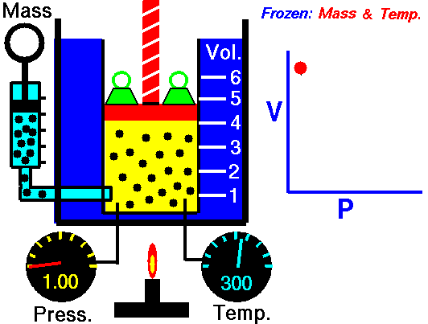
Unit 8: Gas Laws

Slide 2
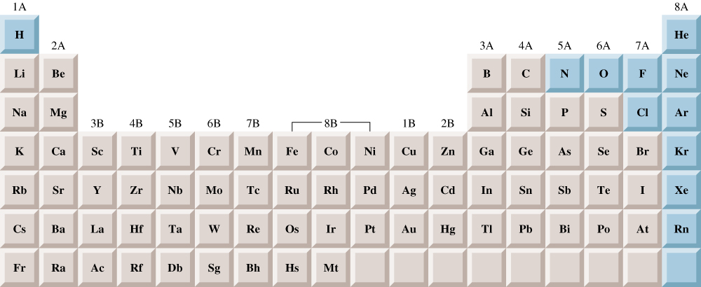
Elements that exist as gases at 25⁰C and 1 atmosphere

Slide 3
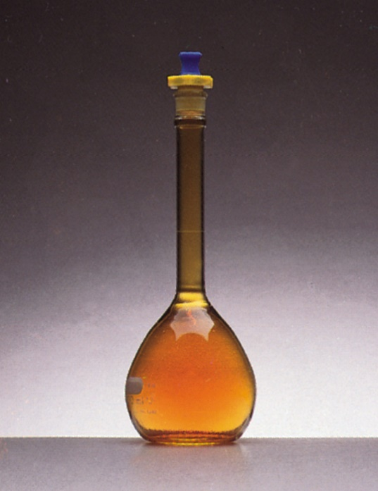
Physical Characteristics of Gases
Gases assume the volume and shape of their containers.
Gases are the most compressible state of matter.
Gases will mix evenly and completely when confined to the same container.
Gases have much lower densities than liquids and solids.

Slide 4
Physical Characteristics of Gases
Physical Characteristics | Typical Units
Volume, V | liters (L)
Pressure, P | atmosphere (1 atm = 1.015x10⁵ N/m²)
Temperature, T | Kelvin (K)
Number of atoms or molecules, n | mole (1 mol = 6.022x10²³ atoms or molecules)

Slide 5
Kinetic Theory
The idea that particles of mater are always in motion and this motion has consequences
The kinetic theory of gas provides a model of an ideal gas that helps us understand the behavior of gas molecules and physical properties of gas
Ideal Gas: an imaginary gas that conforms perfectly to all the assumptions of the kinetic theory ( does not exist)

Slide 6
Kinetic Molecular Theory of Gases
A gas is composed of molecules that are separated from each other by distances far greater than their own dimensions. The molecules can be considered to be points; that is, they possess mass but have negligible volume.
Gas molecules are in constant motion in random directions. Collisions among molecules are perfectly elastic.
Gas molecules exert neither attractive nor repulsive forces on one another.
The average kinetic energy of the molecules is proportional to the temperature of the gas in kelvins. Any two gases at the same temperature will have the same average kinetic energy

Slide 7
Kinetic Theory
The kinetic theory applies only to ideal gases
Idea gases do not actually exist
The behavior of many gases is close to ideal in the absence of very high pressure or very low pressure
According to the kinetic theory, particles of matter are in motion in solids, liquids and gases.
Particles of gas neither attract nor repel each other, but collide.

Slide 8
Remember:
The kinetic theory does not work well for:
Gases at very low temperatures
Gases at very high temperatures ( molecules close enough to attract each other)

Slide 9
Kinetic theory of gases and …
Compressibility of Gases
Boyle’s Law
    P α collision rate with wall
    Collision rate α number density
    Number density α 1/V
    P α 1/V
Charles’ Law
    P α collision rate with wall
    Collision rate α average kinetic energy of gas molecules
    Average kinetic energy α T
    P α T

Slide 10
Kinetic theory of gases and …
Avogadro’s Law
    P α collision rate with wall
    Collision rate α number density
    Number density α n
    P α n
Dalton’s Law of Partial Pressures
    Molecules do not attract or repel one another
    P exerted by one type of molecule is unaffected by the presence of another gas
    P_{total} = ΣP_{i}

Slide 11
Some Terms that will be on the test:
Diffusion: of gases occurs at high temperature and with small molecules
Ideal gas law: pressure x volume = molar amount x temperature x constant
Charles law: V1/T1 = V2/T2
Gay Lussac’s law: Temperature is constant and volume can be expressed as ratio of whole number (for reactant and product)

Slide 12
Boyles law: P1V1 = P2V2
Avogadro’s Principle: equals volume of gas at same temperature and pressure contains equal number of molecules
Grahams Law: The rate of effusion of gases at same temperature and pressure are inversely proportional to square root of their molar masses

Slide 13
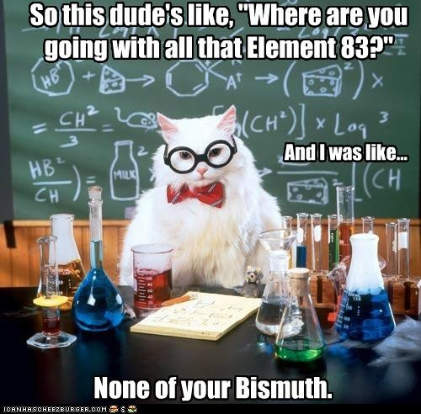

Slide 14
Deviation of real gases from ideal behavior:
Van der Waals: proposed that real gases deviate from the behavior expected of ideal gases because:
Particles of real gases occupy space
Particles of real gases exert attractive forces on each other

Slide 15
Differences Between Ideal and Real Gases
Ideal Gas
Real Gas
The more polar a molecule is, the more it will deviate from the ideal gas properties
Obey PV=nRT | Always | Only at very low P and high T
Molecular volume | Zero | Small but nonzero
Molecular attractions | Zero | Small
Molecular repulsions | Zero | Small
K.T. more likely to hold true for gases composed of
Particles with little attraction for each other
Most real gases behave like ideal gases
When their molecules are far apart and the have
Enough kinetic energy

Slide 16
Real Gases
Real molecules do take up space and do interact with each other (especially polar molecules).
Need to add correction factors to the ideal gas law to account for these.

Slide 17
Ideally, the VOLUME of the molecules was neglected:
at 1 Atmosphere Pressure
at 10 Atmospheres Pressure
at 30 Atmospheres Pressure
Ar gas, ~to scale, in a box 3nm x 3nm x3nm

Slide 18
But since real gases do have volume, we need:
Volume Correction
The actual volume free to move in is less because of particle size.
More molecules will have more effect.
Corrected volume V’ = V – nb
“b” is a constant that differs for each gas.

Slide 19
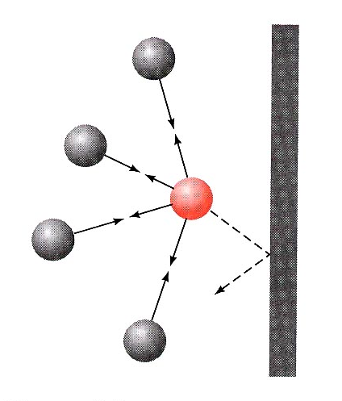
Pressure Correction
Because the molecules are attracted to each other, the pressure on the container will be less than ideal.
Pressure depends on the number of molecules per liter.
Since two molecules interact, the effect must be squared.

Slide 20
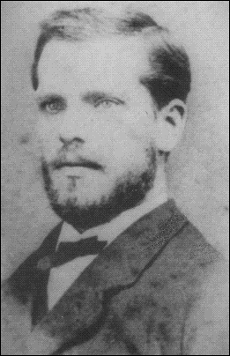
Van der Waal’s equation
Corrected Pressure
Corrected Volume
“a” and “b” are
determined by experiment
“a” and “b” are
different for each gas
bigger molecules have larger “b”
“a” depends on both
size and polarity
Johannes Diderik van der Waals
Mathematician & Physicist
Leyden, The Netherlands
November 23, 1837 – March 8, 1923

Slide 21
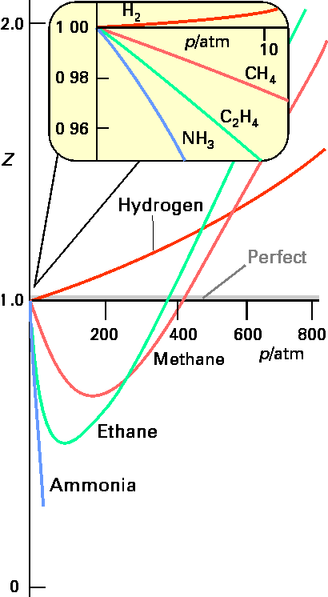
Compressibility Factor The most useful way of displaying this new law for real molecules is to plot the compressibility factor, Z :
For n = 1
Z = PV / RT
Ideal Gases have Z = 1

Slide 22
Qualitative descriptions of gases
To fully describe the state/condition of a gas, you need to use 4 measurable quantities:
Volume
Pressure
Temperature
Number of molecules

Slide 23
Some Trends to be aware of:
At a constant temperature, the pressure a gas exerts and the volume of a gas Decrease
At a constant pressure, the volume of a gas increases as the temperature of the gas increases
At a constant volume, the pressure increases as temperature increases

Slide 24
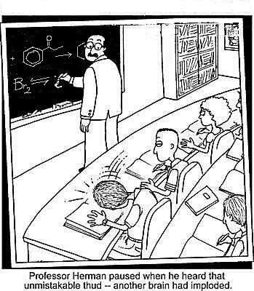
Gas Laws
The mathematical relationship between the volume, pressure, temperature and quantity of a gas

Slide 25
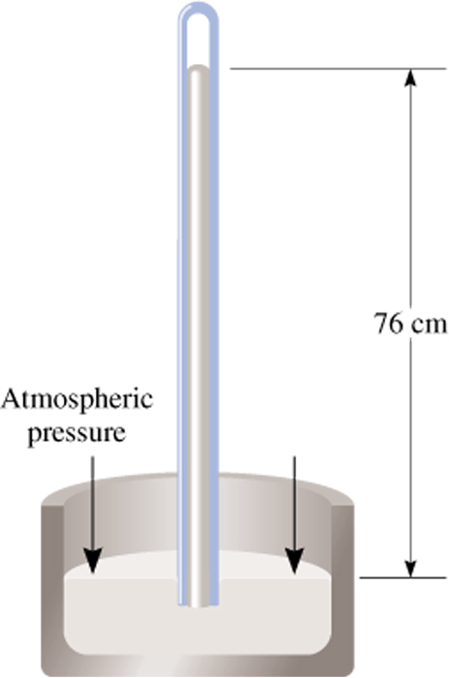
Force
Pressure =
Area
Units of Pressure
1 pascal (Pa) = 1 N/m²
1 atm = 760 mmHg = 760 torr
1 atm = 101,325 Pa
Barometer

Slide 26
Units of Pressure
1atm = 760 mmHg or 760 torr
1 atm = 101.325 Kpa
1 atm = 1.01325 x 10⁵ Pa
Pascal : The pressure exerted by a force of 1 newton action on an area of one square meter

Slide 27
Convert:
.830 atm to mmHg
Answer:
631 mmHg

Slide 28


And now, we pause for this commercial message from STP
OK, so it’s really not THIS kind of STP…
STP in chemistry stands for Standard Temperature and Pressure
Standard Pressure = 1 atm (or an equivalent)
Standard Temperature = 0 deg C (273 K)
STP allows us to compare amounts of gases between different pressures and temperatures

Slide 29
Standard Temperature and pressure (STP)
STP: equals to 1 atm pressure at 0 celsius

Slide 30
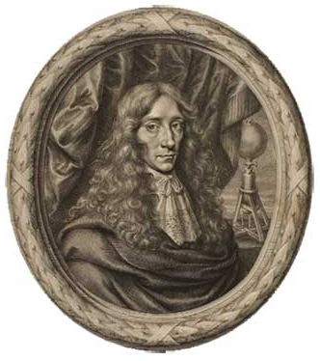
Boyle’s Law
Pressure and volume are inversely related at constant temperature.
PV = K
As one goes up, the other goes down.
P₁V₁ = P₂V₂
“Father of Modern Chemistry”
Robert Boyle
Chemist & Natural Philosopher
Listmore, Ireland
January 25, 1627 – December 30, 1690
“From a knowledge of His work, we shall know Him”
Robert Boyle

Slide 31
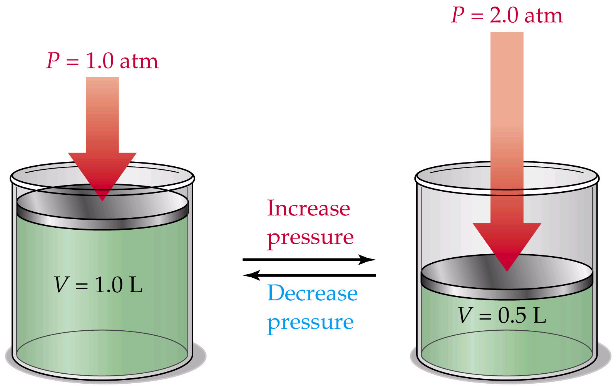
Boyle’s Law: P₁V₁ = P₂V₂

Slide 32
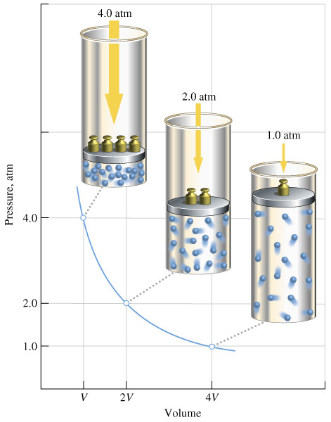
Boyle’s Law: P₁V₁ = P₂V₂

Slide 33
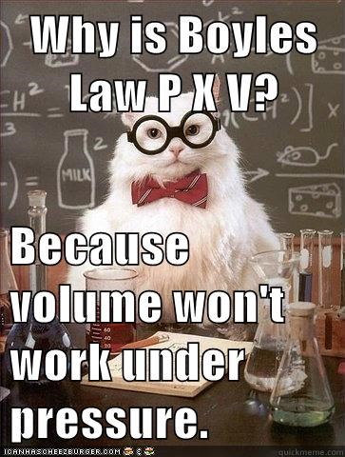

Slide 34
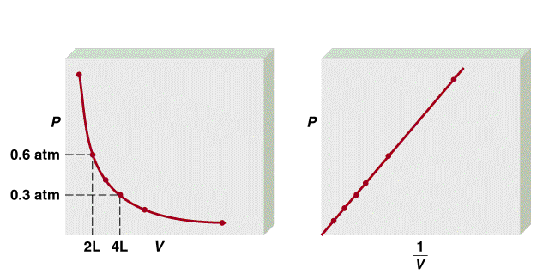
Boyle’s Law
P α 1/V
Constant temperature
Constant amount of gas
P x V = constant
P₁ x V₁ = P₂ x V₂

Slide 35
A sample of chlorine gas occupies a volume of 946 mL at a pressure of 726 mmHg. What is the pressure of the gas (in mmHg) if the volume is reduced at constant temperature to 154 mL?
P₁ x V₁ = P₂ x V₂
P₁ = 726 mmHg
P₂ = ?
V₁ = 946 mL
V₂ = 154 mL
P₁ x V₁
726 mmHg x 946 mL
P₂ =
=
= 4460 mmHg
V₂
154 mL

Slide 36
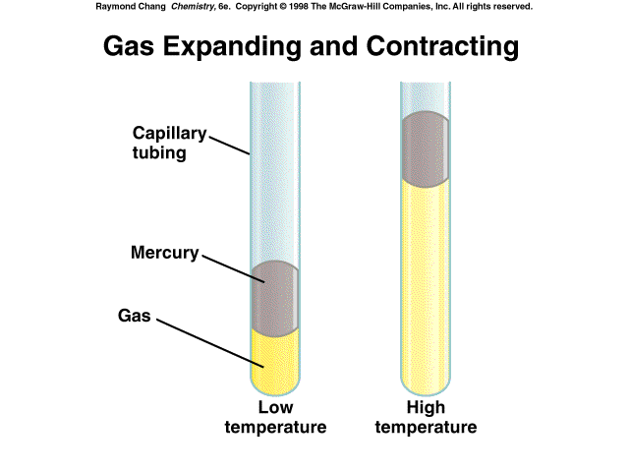
As T increases
V increases

Slide 37
A sample of oxygen gas occupies a volume of 150 ml when its pressure is 720 mmHg. What volume will the gas occupy at a pressure of 750 mm Hg if the temperature remains constant ?
Given:
V1= 150 ml V2 =?
P1 = 720 mm Hg P2 = 750 mmHg
P₁V₁ = P₂V₂
Answer: 144 ml

Slide 38
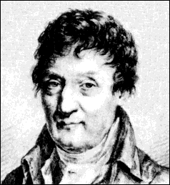
Charles’ Law
Volume of a gas varies directly with the absolute temperature at constant pressure.
V = KT
V₁ / T₁ = V₂ / T₂
Jacques-Alexandre Charles
Mathematician, Physicist, Inventor
Beaugency, France
November 12, 1746 – April 7, 1823

Slide 39
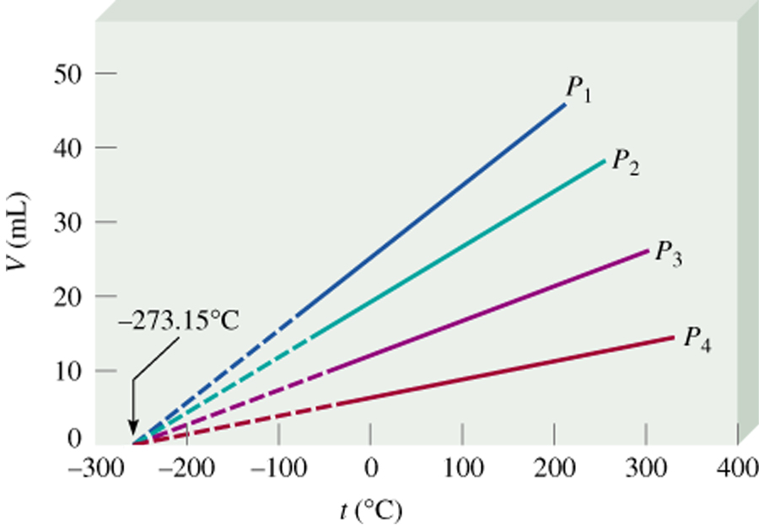
Variation of gas volume with temperature
at constant pressure.
Charles’ & Gay-Lussac’s Law
V α T
Temperature must be
in Kelvin
V = constant x T
V₁/T₁ = V₂/T₂
T (K) = t (⁰C) + 273.15

Slide 40
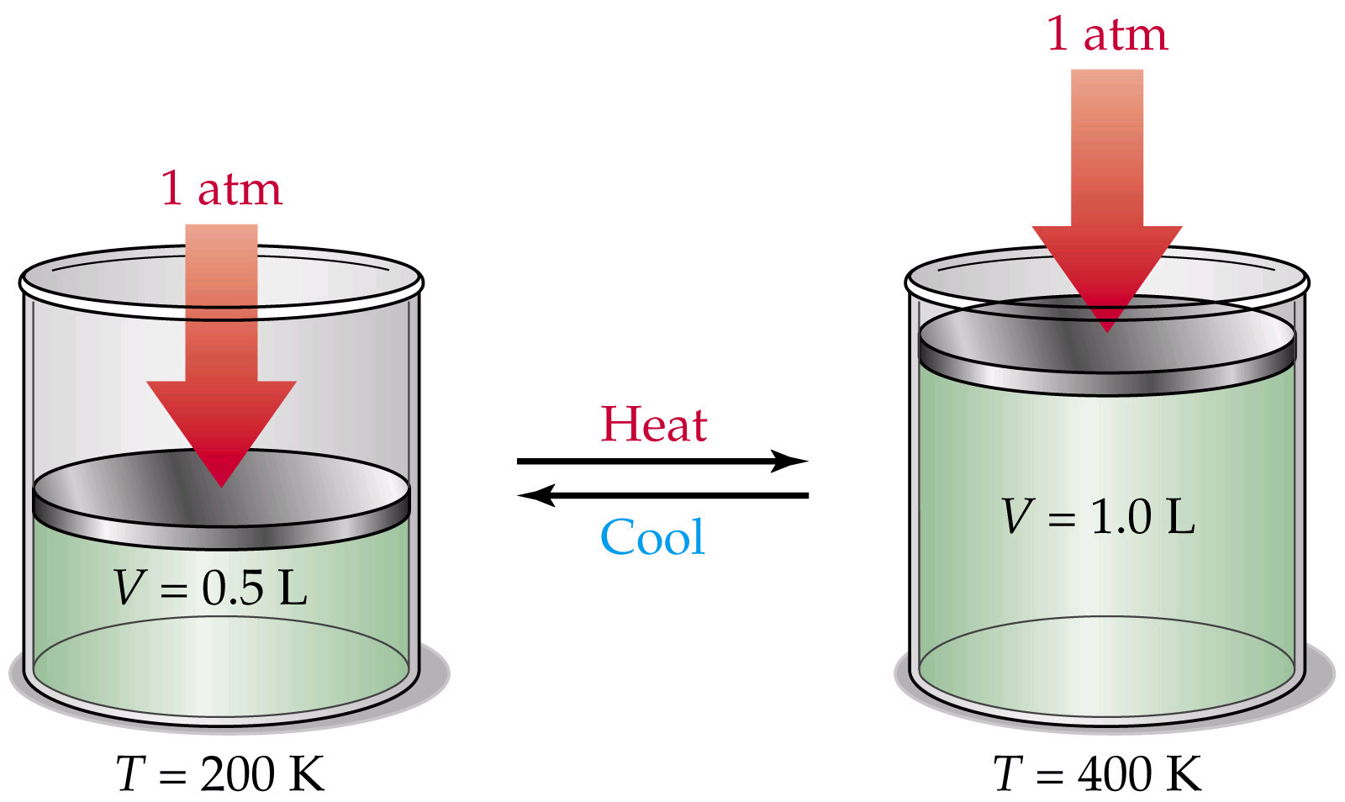
Charles’ Law: V₁/T₁ = V₂/T₂

Slide 41
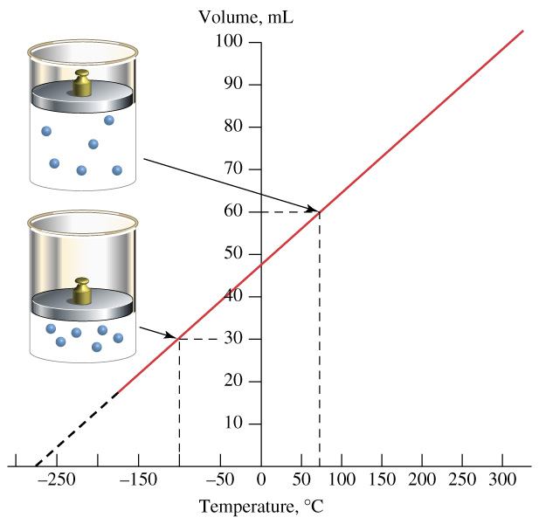
Charles’ Law: V₁/T₁ = V₂/T₂
P₁V₁ = P₂V₂

Slide 42
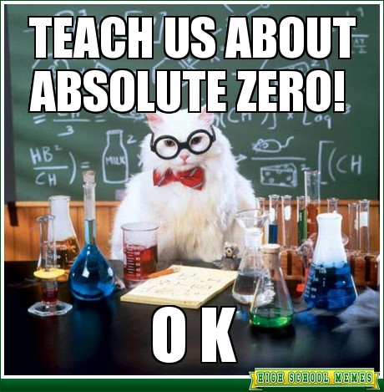
Absolute Zero:
The temperature -273.15 Celsius or 0 kelvin

Slide 43
A sample of carbon monoxide gas occupies 3.20 L at 125 ⁰C. At what temperature will the gas occupy a volume of 1.54 L if the pressure remains constant?
V₁/T₁ = V₂/T₂
V₁ = 3.20 L
V₂ = 1.54 L
T₁ = 398.15 K
T₂ = ?
V₂ x T₁
1.54 L x 398.15 K
T₂ =
=
= 192 K
V₁
3.20 L

Slide 44
A sample of neon gas occupies a volume of 752 ml at 25 Celsius. What volume will the gas occupy at 50 Celsius if the pressure remains constant
V1/T1 = V2/T2
Given:
V1 = 752 ml V2= ?
T1 = 25 Celsius T2 = 50 Celsius
Answer: V2 = 815 ml

Slide 45
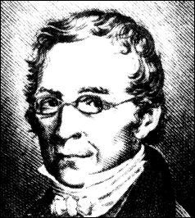
Gay-Lussac Law, Amonton’s law
At constant volume, pressure and absolute temperature are directly related.
P = k T
P₁ / T₁ = P₂ / T₂
Is named for French chemist and physicist Joseph Gay-Lussac. Gay-Lussac formulated the law in 1802, but it was a formal statement of the relationship between temperature and pressure described by French physicist Guillaume Amonton in the late 1600’s.
Joseph-Louis Gay-Lussac
Experimentalist
Limoges, France
December 6, 1778 – May 9, 1850

Slide 46
A gas content of an aerosol can under pressure of 3 atm at 25 Celsius. What would the pressure of the gas in the aerosol can be at 52 Celsius:
Given:
P1/T1 =P2/T2
P1 = 3 atm P2 = ?
T1 = 25 Celsius T2 = 52 celsius
Answer: 3.25 atm

Slide 47
Combined Gas Law: combines Boyles, Charles and Gay-Lussacs laws
P₁V₁/T₁ = P₂V₂/T₂

Slide 48
Helium filled balloon has a volume of 50 ml at 25 C and 820 mmHg. What vol will it occupy at 650 mmHg and 10C?
P₁V₁/T₁ = P₂V₂/T₂
Answer: 59.9 ml

Slide 49
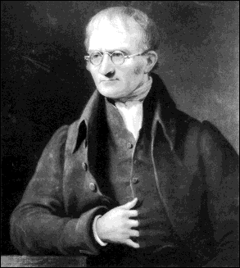
Dalton’s Law
The total pressure in a container is the sum of the pressure each gas would exert if it were alone
in the container.
The total pressure is the sum of the partial pressures.( pressure of each gas in a mixture)
P_{Total} = P₁ + P₂ + P₃ + P₄ + P₅ ...
(For each gas P = nRT/V)
John Dalton
Chemist & Physicist
Eaglesfield, Cumberland, England
September 6, 1766 – July 27, 1844

Slide 50
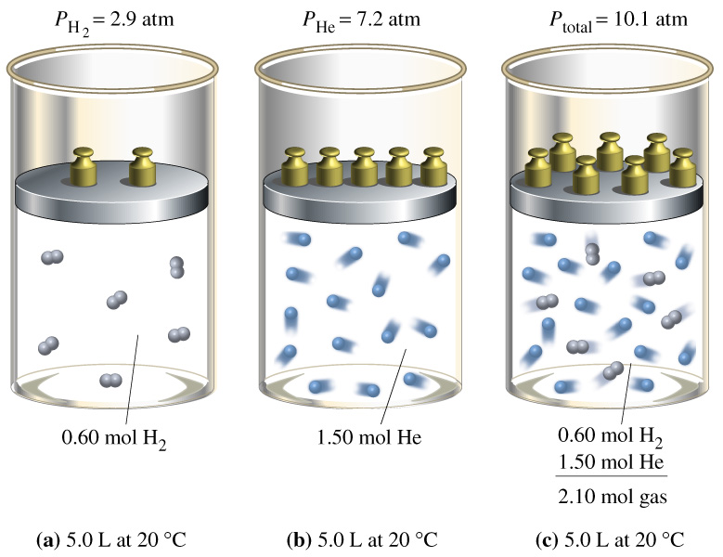
Dalton’s Law

Slide 51
Dalton’s Law of Partial Pressures
2 H₂O₂ (l) ---> 2 H₂O (g) + O₂ (g)
        0.32 atm 0.16 atm
What is the total pressure in the flask?
P_{total} in gas mixture = P_{A} + P_{B} + ...
Therefore,
P_{total} = P_{H2O} + P_{O2} = 0.48 atm
Dalton’s Law: total P is sum of PARTIAL pressures.

Slide 52
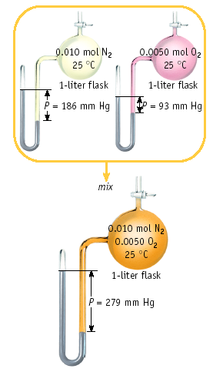
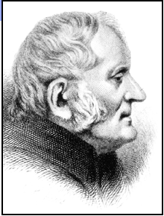
Dalton’s Law
John Dalton
1766-1844

Slide 53
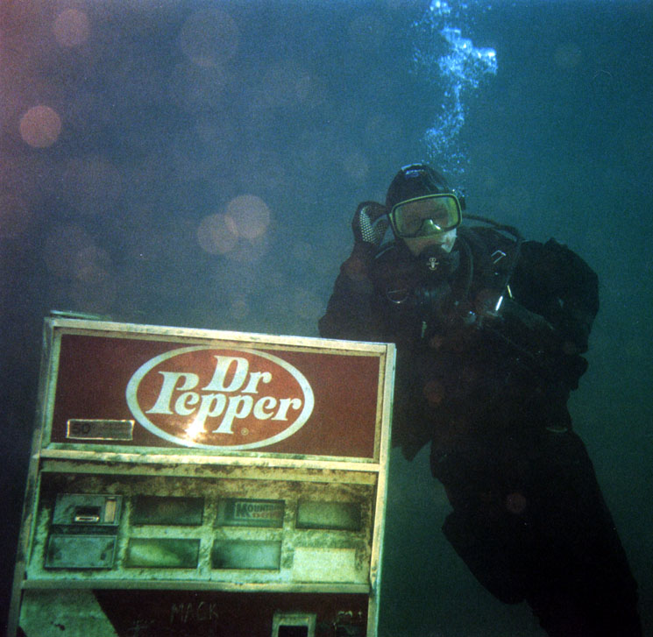
Health Note
When a scuba diver is several hundred feet under water, the high pressures cause N₂ from the tank air to dissolve in the blood. If the diver rises too fast, the dissolved N₂ will form bubbles in the blood, a dangerous and painful condition called "the bends". Helium, which is inert, less dense, and does not dissolve in the blood, is mixed with O₂ in scuba tanks used for deep descents.

Slide 54
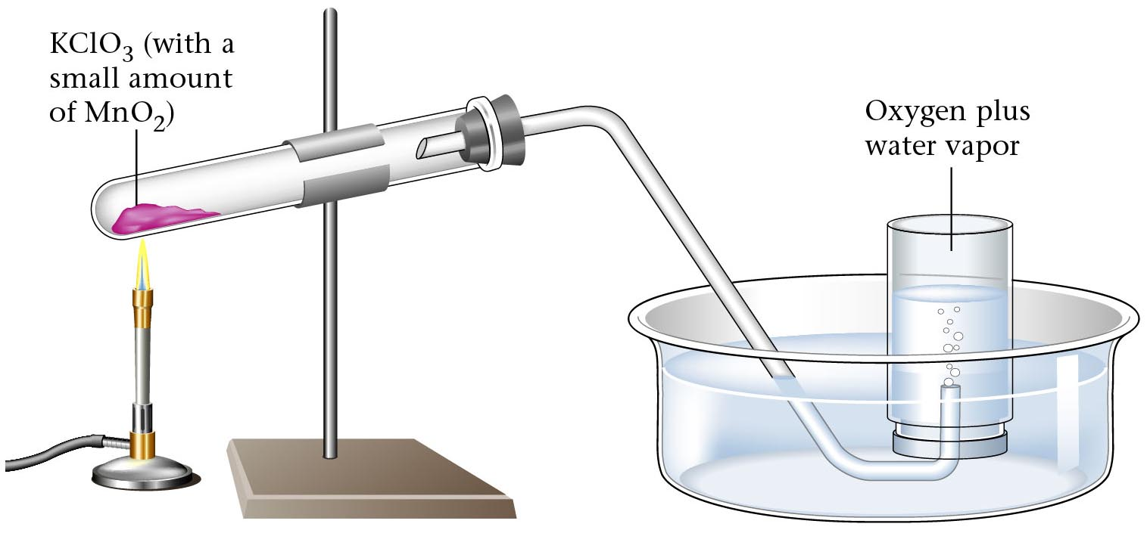
Collecting a gas “over water”
Gases, since they mix with other gases readily, must be collected in an environment where mixing can not occur. The easiest way to do this is under water because water displaces the air. So when a gas is collected “over water”, that means the container is filled with water and the gas is bubbled through the water into the container. Thus, the pressure inside the container is from the gas AND the water vapor. This is where Dalton’s Law of Partial Pressures becomes useful.

Slide 55
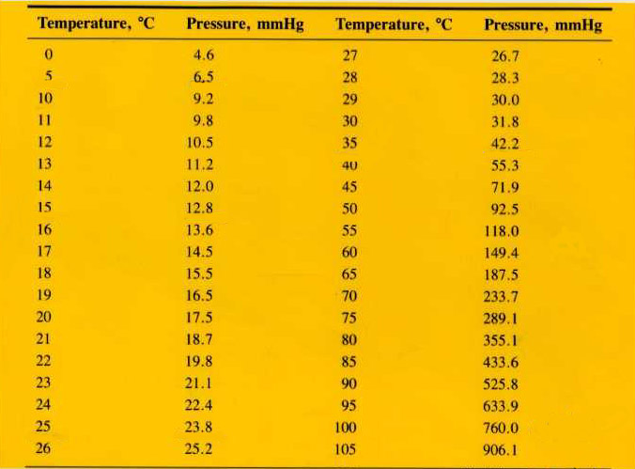
Table of Vapor Pressures for Water

Slide 56
Solve This!
A student collects some hydrogen gas over water at 20 degrees C and 768 torr. What is the pressure of the H₂ gas?
768 torr – 17.5 torr = 750.5 torr

Slide 57
Vapor Pressure
Water evaporates!
When that water evaporates, the vapor has a pressure.
Gases are often collected over water so the vapor pressure of water must be subtracted from the total pressure.

Slide 58
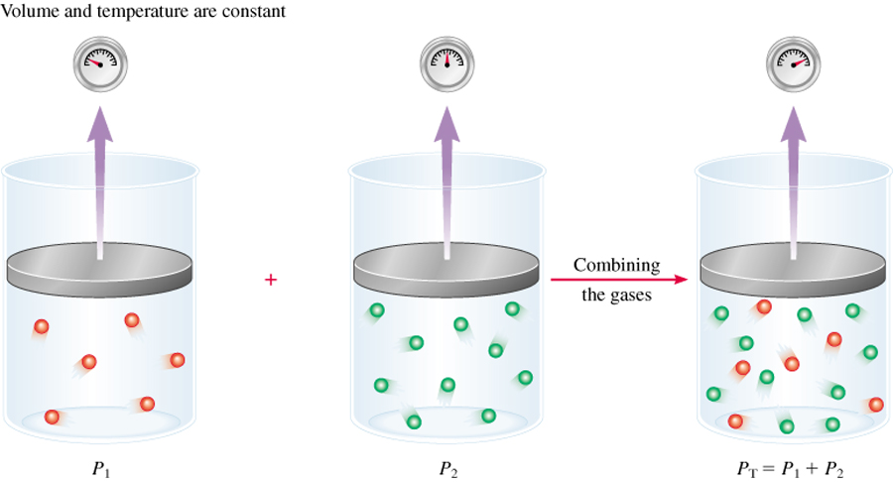
Dalton’s Law of Partial Pressures
V and T are constant
P₁
P₂
P_{total} = P₁ + P₂

Slide 59
Consider a case in which two gases, A and B, are in a container of volume V.
n_{A}RT
P_{A} =
n_{A} is the number of moles of A
V
n_{B}RT
P_{B} =
n_{B} is the number of moles of B
V
n_{A}
n_{B}
P_{T} = P_{A} + P_{B}
X_{A} =
X_{B} =
n_{A} + n_{B}
n_{A} + n_{B}
P_{A} = X_{A} P_{T}
P_{B} = X_{B} P_{T}
P_{i} = X_{i} P_{T}

Slide 60
A sample of natural gas contains 8.24 moles of CH₄, 0.421 moles of C₂H₆, and 0.116 moles of C₃H₈. If the total pressure of the gases is 1.37 atm, what is the partial pressure of propane (C₃H₈)?
P_{i} = X_{i} P_{T}
P_{T} = 1.37 atm
0.116
X_{propane} =
= 0.0132
8.24 + 0.421 + 0.116
P_{propane} = 0.0132 x 1.37 atm
= 0.0181 atm

Slide 61
Oxygen from decomposition of KClO₃ was collected by water displacement. The barometric pressure and temperature during this experiment were 731 mm Hg and 20 Celsius. What was the partial pressure of oxygen collected
Given:
PT = P_{atm} = 731 mmHg
PH₂0= 17.5 ( from table )
PT = PO₂ + PH₂0
PO₂ = Patm –PH₂O
= 731 – 17.5 =713.5 mmHg

Slide 62
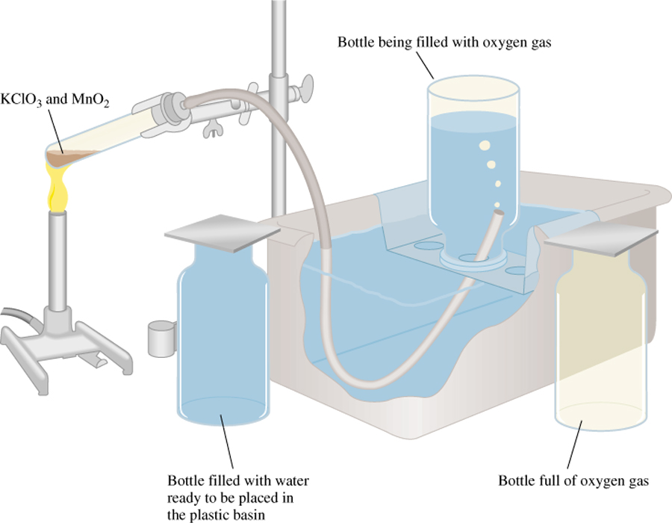
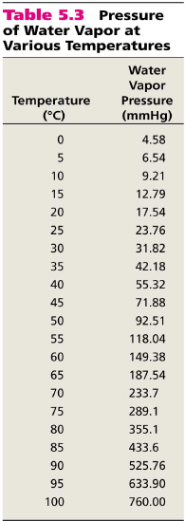
Bottle full of oxygen gas and water vapor
2KClO₃ (s) 2KCl (s) + 3O₂ (g)
P_{T} = P_{O} + P_{H O}
2
2

Slide 63
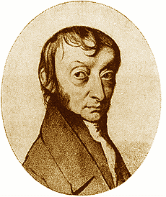
Avogadro’s Law
At constant temperature and pressure, the volume of a gas is directly related to the number of moles.
V = K n
V₁ / n₁ = V₂ / n₂
Amedeo Avogadro
Physicist
Turin, Italy
August 9, 1776 – July 9, 1856

Slide 64
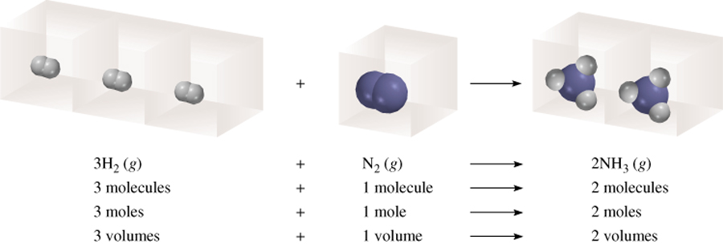
Avogadro’s Law
V α number of moles (n)
Constant temperature
Constant pressure
V = constant x n
V₁/n₁ = V₂/n₂

Slide 65
Ammonia burns in oxygen to form nitric oxide (NO) and water vapor. How many volumes of NO are obtained from one volume of ammonia at the same temperature and pressure?
4NH₃ + 5O₂ 4NO + 6H₂O
1 mole NH₃ 1 mole NO
At constant T and P
1 volume NH₃ 1 volume NO

Slide 66

Avogadro’s Law: V₁/n₁=V₂/n₂

Slide 67
Ideal Gas Equation
1
Boyle’s law: V α (at constant n and T)
P
Charles’ law: V α T (at constant n and P)
Avogadro’s law: V α n (at constant P and T)
nT
V α
P
nT
nT
V = constant x = R
R is the gas constant
P
P
PV = nRT

Slide 68
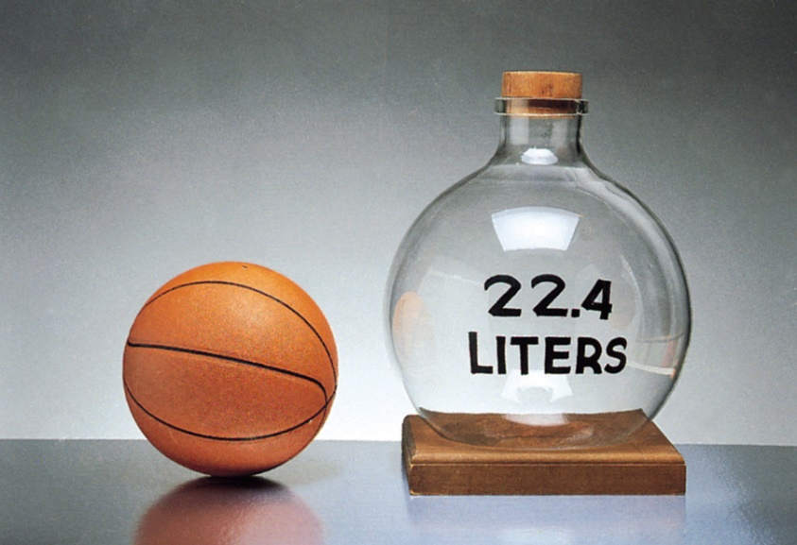
The conditions 0 ⁰C and 1 atm are called standard temperature and pressure (STP).
Experiments show that at STP, 1 mole of an ideal gas occupies 22.414 L.
PV = nRT
Must be in: kelvin, liters, moles, atmospheres
PV
(1 atm)(22.414L)
R =
=
nT
(1 mol)(273.15 K)
R = 0.082057 L • atm / (mol • K)

Slide 69
What is the volume (in liters) occupied by 49.8 g of HCl at STP?
T = 0 ⁰C = 273.15 K
P = 1 atm
PV = nRT
1 mol HCl
nRT
n = 49.8 g x
= 1.37 mol
V =
36.45 g HCl
P
L•atm
1.37 mol x 0.0821 x 273.15 K
mol•K
V =
1 atm
V = 30.6 L

Slide 70
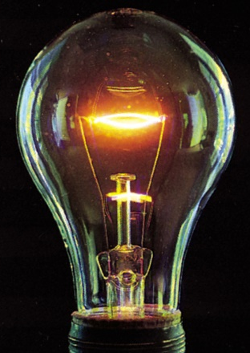
Argon is an inert gas used in lightbulbs to retard the vaporization of the filament. A certain lightbulb containing argon at 1.20 atm and 18 ⁰C is heated to 85 ⁰C at constant volume. What is the final pressure of argon in the lightbulb (in atm)?
PV = nRT
n, V and R are constant
nR
P
=
= constant
P₁ = 1.20 atm
P₂ = ?
V
T
T₁ = 291 K
T₂ = 358 K
P₁
P₂
=
T₁
T₂
T₂
358 K
P₂ = P₁ x
= 1.20 atm x
= 1.48 atm
T₁
291 K

Slide 71
Density (d) Calculations
PM
m is the mass of the gas in g
m
d =
=
V
RT
M is the molar mass of the gas
Molar Mass (M ) of a Gaseous Substance
dRT
M =
d is the density of the gas in g/L
P

Slide 72

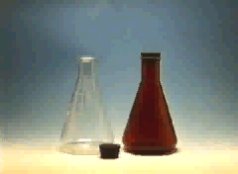
GAS DENSITY
Low
density
22.4 L of ANY gas AT STP = 1 mole
High
density

Slide 73
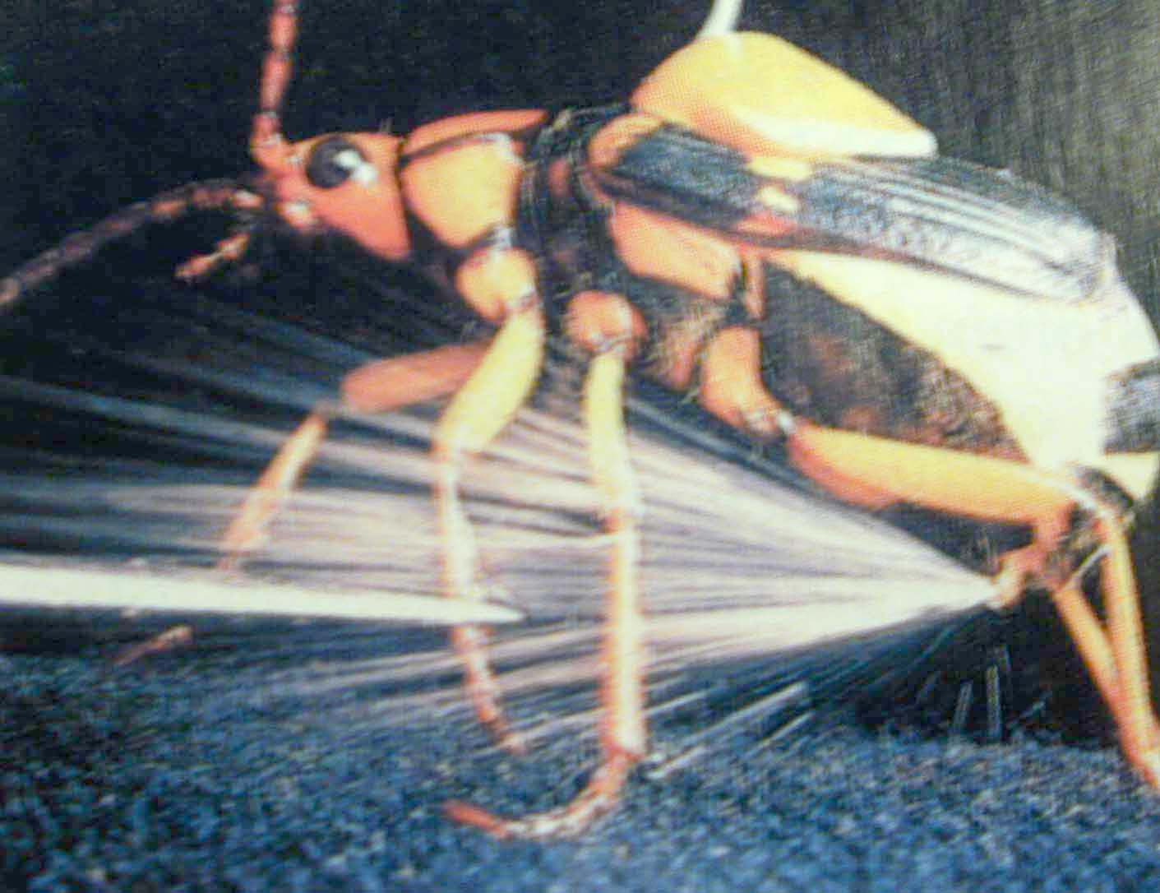
Gases and Stoichiometry
2 H₂O₂ (l) ---> 2 H₂O (g) + O₂ (g)
Decompose 1.1 g of H₂O₂ in a flask with a volume of 2.50 L. What is the volume of O₂ at STP?
Bombardier beetle uses decomposition of hydrogen peroxide to defend itself.

Slide 74
Gases and Stoichiometry
2 H₂O₂ (l) ---> 2 H₂O (g) + O₂ (g)
Decompose 1.1 g of H₂O₂ in a flask with a volume of 2.50 L. What is the volume of O₂ at STP?
Solution
1.1 g H₂O₂ 1 mol H₂O₂ 1 mol O₂ 22.4 L O₂
34 g H₂O₂ 2 mol H₂O₂ 1 mol O₂
= 0.36 L O₂ at STP

Slide 75
Gas Stoichiometry: Practice!
A. What is the volume at STP of 4.00 g of CH₄?
B. How many grams of He are present in 8.0 L of gas at STP?

Slide 76
What if it’s NOT at STP?
1. Do the problem like it was at STP. (V₁)
2. Convert from STP (V₁, P₁, T₁) to the stated conditions (P₂, T₂)

Slide 77
Try this one!
How many L of O₂ are needed to react 28.0 g NH₃ at 24°C and 0.950 atm?
4 NH₃(g) + 5 O₂(g) 4 NO(g) + 6 H₂O(g)

Slide 78
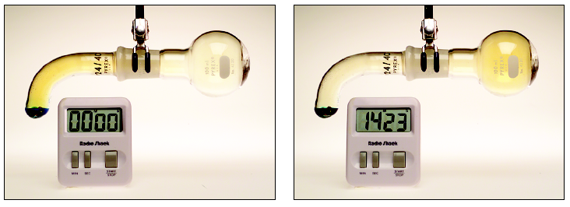
GAS DIFFUSION AND EFFUSION
HONORS only
diffusion is the gradual mixing of molecules of different gases.
effusion is the movement of molecules through a small hole into an empty container.

Slide 79
GAS DIFFUSION AND EFFUSION
HONORS only
Graham’s law governs effusion and diffusion of gas molecules.
Rate of effusion is inversely proportional to its molar mass.
Thomas Graham, 1805-1869. Professor in Glasgow and London.

Slide 80
GAS DIFFUSION AND EFFUSION
HONORS only
Molecules effuse thru holes in a rubber balloon, for example, at a rate (= moles/time) that is
proportional to T
inversely proportional to M.
Therefore, He effuses more rapidly than O₂ at same T.
He

Slide 81
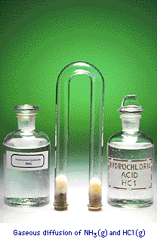
Gas Diffusion relation of mass to rate of diffusion
HONORS only
HCl and NH₃ diffuse from opposite ends of tube.
Gases meet to form NH₄Cl
HCl heavier than NH₃
Therefore, NH₄Cl forms closer to HCl end of tube.

Slide 82
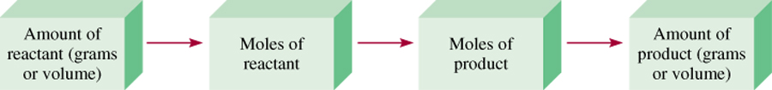
Gas Stoichiometry
g C₆H₁₂O₆ mol C₆H₁₂O₆ mol CO₂ V CO₂
What is the volume of CO₂ produced at 37⁰ C and 1.00 atm when 5.60 g of glucose are used up in the reaction:
C₆H₁₂O₆ (s) + 6O₂ (g) 6CO₂ (g) + 6H₂O (l)
1 mol C₆H₁₂O₆
6 mol CO₂
5.60 g C₆H₁₂O₆
x
x
= 0.187 mol CO₂
180 g C₆H₁₂O₆
1 mol C₆H₁₂O₆
L•atm
0.187 mol x 0.0821 x 310.15 K
nRT
mol•K
V =
=
= 4.76 L
P
1.00 atm

Slide 83
Propane ( C3H8) combustion equation
C₃H₈ + 5O₂ → 3CO₂ + 4H₂O
A. What volume in liters of O₂ is required for complete combustion of .35 L of Propane?
B. What will the volume of CO₂ produced in the reaction be?
Solution:
A. .35 L C₃H₈ x 5L O₂/ 1L C₃H₈ = 1.75 L O₂
B. .35L C₃H₈ x 3L CO₂/ 1L C₃H₈ = 1.05 L CO₂

Slide 84
Tungstun is used in light bulbs
WO₃ + 3H₂ → W + 3H₂O
How many liters of hydrogen at 35 C and 745 mmHg are needed to react completely with 875 G WO₃?
Solution
Convert grams to mole
875G x 1 mole WO₃/ 232g WO₃ (wt PT) x 3mol H₂/ 1 Mol WO₃ = 11.3 mol H₂O
PV =nRT
P = .980 atm ( converted)
T = 308 K (converted)
R = .0823
Answer: 292L

Slide 85
Remember that the standard molar vol of gas at STP is 22.4L
A chemical reaction produced 98 ml of SO2 at STP. What was the mass in grams of the gas produced?
Solution
Convert ml to L to mole to grams
98ml x 1L/1000ml x 1mol SO2/22.4L x 64.1 g SO2 /1mol SO2 = .28g

Slide 86
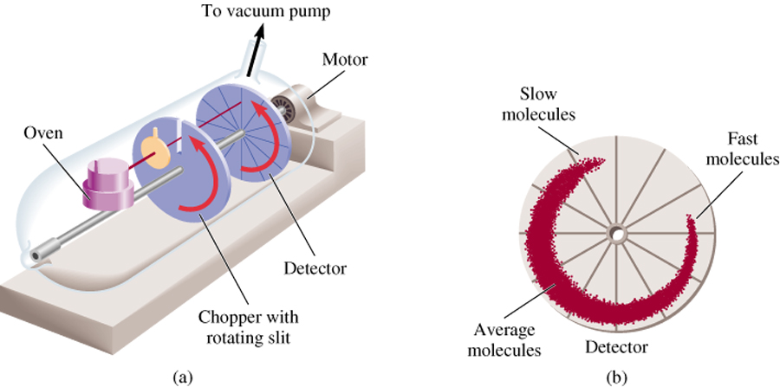
Apparatus for studying molecular speed distribution

Slide 87
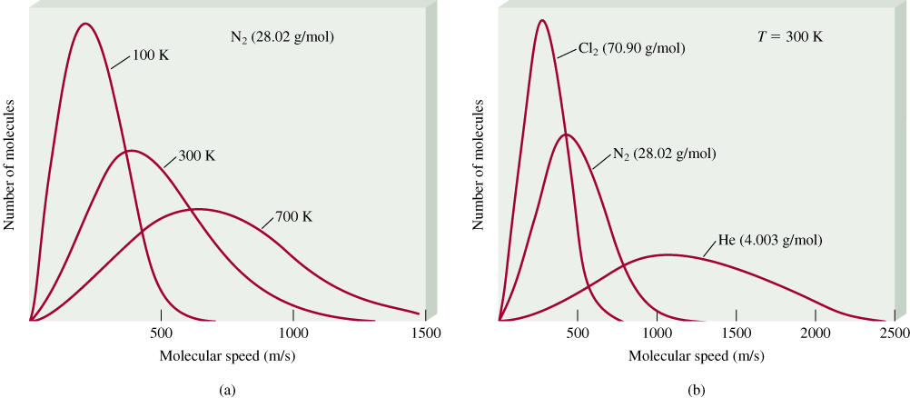
The distribution of speeds
of three different gases
at the same temperature
The distribution of speeds
for nitrogen gas molecules
at three different temperatures
√
3RT
u_{rms} =
M

Slide 88

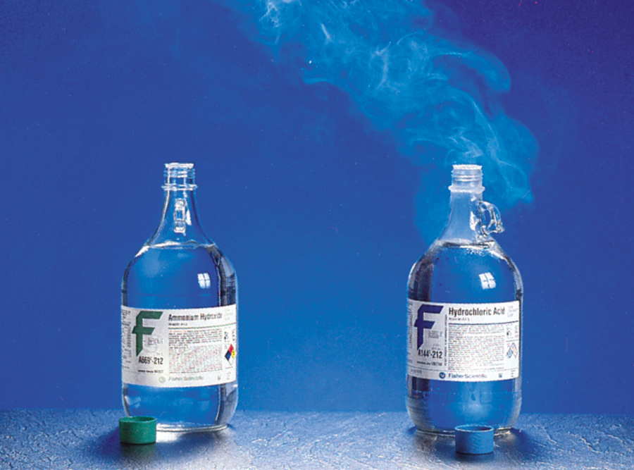
Gas diffusion is the gradual mixing of molecules of one gas with molecules of another by virtue of their kinetic properties.
NH₄Cl
NH₃
17 g/mol
HCl
36 g/mol

Slide 89
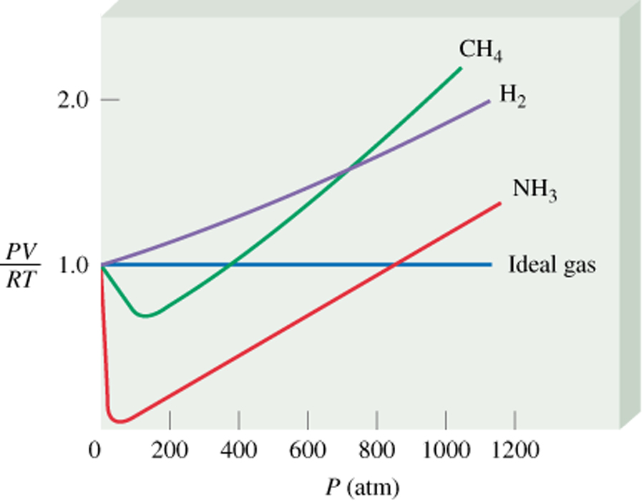
Deviations from Ideal Behavior
1 mole of ideal gas
Repulsive Forces
PV = nRT
PV
n =
= 1.0
RT
Attractive Forces

Slide 90
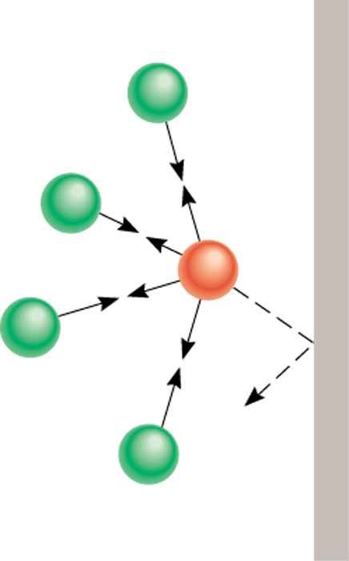
Effect of intermolecular forces on the pressure exerted by a gas.

Slide 91
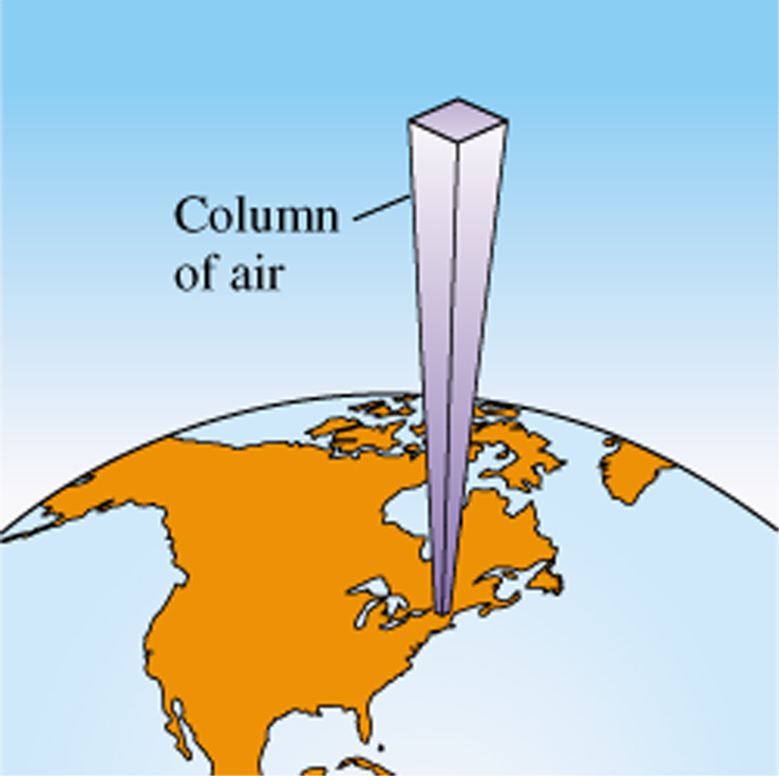
10 miles
0.2 atm
4 miles
0.5 atm
Sea level
1 atm

Slide 92
Manometer
An old simple way of measuring pressure.
A “U” shaped tube is partially filled with liquid, usually water or mercury.
Each end is connected to a pressure source, and the difference in liquid height corresponds to the difference in pressure.
The difference in height of the 2 arms of the “U” tube can be used to find the gas pressure

Slide 93
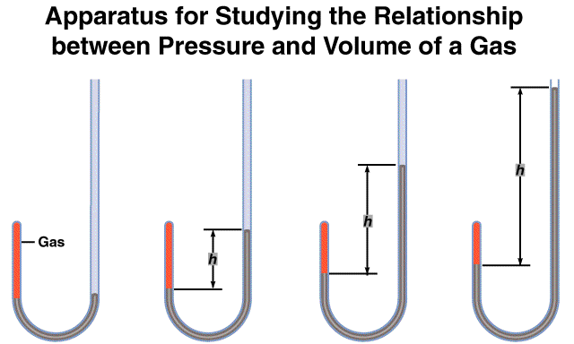
As P (h) increases
V decreases

Slide 94
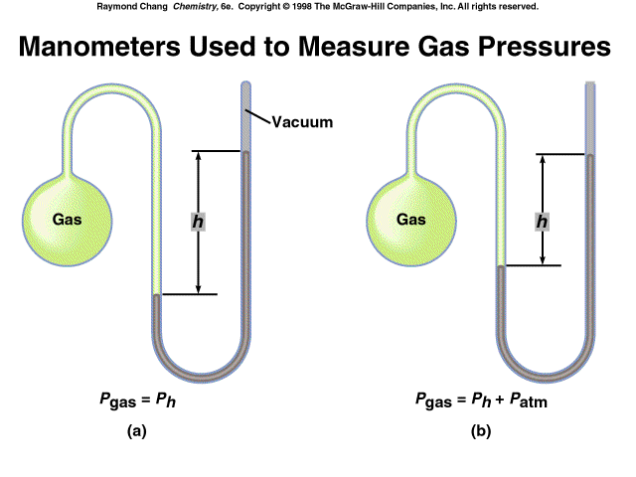
Closed
Open

Slide 95
Closed Manometers
1 Kpa = 7.5 mm
Ex A closed manometer is filled with mercury and connected to a container of argon. The difference in the height of mercury in the 2 arms is 77.0 mm. What is the pressure in kilopascals, of argon?
Solution:
77 mm x 1 Kpa/ 7.5mm = 10.2 KPa

Slide 96
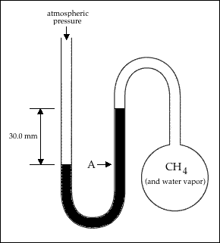
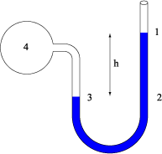
Open manometers can exist in several ways
1. The height of the tube is higher on the gas side
2. The height of the tube is higher on the atmospheric side
# 1
#2

Slide 97
When the height is greater on the side connected to the gas, then the air pressure is higher than the gas pressure.
The air pressure is exerting more force on the fluid so the fluid height compensates for this.
You must subtract the pressure that results from the change in height of the mercury fluid column.
In order to do this you must first convert mmHg to kPa. 7.5mm of Hg (mercury) exerts a pressure of 1 kPa

Slide 98
An open manometer is filled with mercury and connected to a container of nitrogen. The level of mercury is 36 mm higher in the arm attached to the nitrogen. Air pressure = 101.3 Kpa what is the pressure, in Kilopascals of nitrogen
Solution:
36 mm x 1 KPa/7.5 mm = 4.8
101.3 Kpa – 4.8 =96.5

Slide 99
When the height is greater on the side connected to Atmosphere, then the atmospheric pressure is higher than the gas pressure.
The air pressure is exerting more force on the fluid so the fluid height compensates for this.
You must add the pressure that results from the change in height of the mercury fluid column.
In order to do this you must first convert mmHg to kPa. 7.5mm of Hg (mercury) exerts a pressure of 1 kPa

Slide 100


Slide 101
An open manometer is filled with mercury and connected to a container of nitrogen. The level of mercury is 24 mm higher in the arm attached to the atmospheric side. Air pressure = 100.5 Kpa what is the pressure, in Kilopascals of nitrogen
Solution:
24 mm x 1 KPa/7.5 mm = 3.2
100.5 + 3.2 = 103.7

Slide 102


Slide 103
GRAHAM'S LAW OF EFFUSION
Graham's Law says that a gas will effuse at a rate that is inversely proportional to the square root of its molecular mass, MM.
Expressed mathematically:
Rate1/rate2 =√MM2/MM1

Slide 104
Under the same conditions of temperature and pressure, how many times faster will hydrogen effuse compared to carbon dioxide?
Rate1/rate2 =√MM2/MM1
Solution:
√44/2 = 4.69

Slide 105
If the carbon dioxide in Problem 1 takes 32 sec to effuse, how long will the hydrogen take?
32/4.69 = 6.82

Slide 106
An unknown gas diffuses 0.25 times as fast as He. What is the molecular mass of the unknown gas?
Solution
.25 = √ 4/x
.25x =4
X =8
Square 8 = 64g

Slide 107
Practice Grahams Law Problems
1. If neon gas travels at 400 m/s at a given temperature, calculate the velocity of butane, C4H10, at the same temperature.
2. Hydrogen sulfide, H2S, has a very strong rotten egg odor. Methyl salicylate, C8H8O3, has a wintergreen odor, and benzaldehyde, C7H6O, has a pleasant almond odor. If the vapors for these three substances were released at the same time from across a room, which odor would you smell first? Show your work and explain your answer.

Slide 108





Practice Grahams
Law Problems
1. If neon gas travels at 400 m/s at a given temperature, calculate the velocity of butane, C4H10, at the same temperature.
Solution: Neon: masss 20.2 g V2= 400 m/s
butane: mass: 58 g V1 = ?
2. Hydrogen sulfide, H2S, has a very strong rotten egg odor. Methyl salicylate, C8H8O3, has a wintergreen odor, and benzaldehyde, C7H6O, has a pleasant almond odor. If the vapors for these three substances were released at the same time from across a room, which odor would you smell first? Show your work and explain your answer.
H2S = 58 C8H8O3 = 152 C7H6O = 106
Temp is same so kinetic energy is same so lightest molecule moves fastest

Slide 109
3. A nitrogen molecule travels at about 505 m/s at room temperature. Find the velocity of a helium atom at the same temperature.
4. A carbon dioxide molecule travels at 45.0 m/s at a certain temperature. At the same temperature, find the velocity of an oxygen molecule.

Slide 110











3. A nitrogen molecule travels at about 505 m/s at room temperature. Find the velocity of a helium atom at the same temperature.
Nitrogen: m2 = 28g v2 = 505m/s Helium: m1 = 4 g v1 = ?
4. A carbon dioxide molecule travels at 45.0 m/s at a certain temperature. At the same temperature, find the velocity of an oxygen molecule.
CO2: m2 = 44g V2= 45 m/s O2 : m1 = 32 g v1= ?

Slide 111

Raoult’s law:
states that the partial vapor pressure of each component of an ideal mixture of liquids is equal to the vapor pressure of the pure component multiplied by its mole fraction in the mixture.
Thus the total vapor pressure of the ideal solution depends only on the vapor pressure of each chemical component (as a pure liquid) and the mole fraction of the component present in the solution
Is used to determine the vapor pressure of a solution when a solute has been added to it
Raoult's law is based on the assumption that intermolecular forces between unlike molecules are equal to those between similar molecules: the conditions of an ideal solution. This is analogous to the ideal gas law

Slide 112
25 grams of cyclohexane (Po = 80.5 torr, MM = 84.16g/mol) and 30 grams of ethanol (Po = 52.3 torr , MM = 92.14) are both volatile components present in a solution. What is the partial pressure of ethanol?
Solution:
Moles cyclohexane: 25g x 1mol/84.16 = .297 moles
Moles ethanol: 30 g x 1mol/92.14 = .326 moles
X ethanol: .326/(.326)+(.297) =.523
Px_{Po} = (.523) (52.3 torr) =27.4 torr

Slide 113
A solution contains 15 g of mannitol C₆H₁₄O₆, dissolved in 500g of water at 40C. The vapor pressure of water at 40C is 55.3 mm Hg. Calculate the vapor pressure of solution ( assume mannitol is nonvolatile)
Solution:
Molecular wt water = 18g
Convert grams of water to moles
500g x 1mol/18g =27.78 mole water
Mass mannitol = 182 g
Convert grams mannitol to moles
15g x 1mol/182g = .0824 moles
Total moles = 27.78 + .0824 =27.86
Mole fraction water = 27.78 (water)/27.86 (total moles) = .997
Solution vapor pressure = .997 x 55.3 mmHg = 55.13 mmHg

Slide 114
We will do additional Raoult problems on the board

