Slide 1
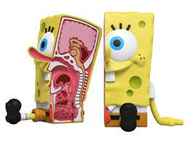
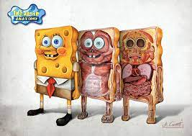
Anatomical Terms Practice and Review

Slide 3
Practice
1. The knees are ___________ to the waist
2. The arms are __________ to the midline.
3. The neck is ______________ to the arms.
4. The nose is __________ to the sternum
5. The scapula is ___________ to the sternum

Slide 4
Answers
inferior
2. lateral
3. medial
4. superior
5. posterior

Slide 5
Practice
6. The navel is _________ to the arms
7. The wrist is _______ to the elbow.
8. The toes are ____________ to the knees
9. The skin is ____________ to the muscles
10. The mouth is ___________ to the chin

Slide 6
Answers:
1. medial
2. Distal
3. distal
4. superficial
5. Superior

Slide 7
Practice
1. The eyes are ___________ to the nose
2. The biceps are __________ to the triceps
3. The forehead is __________ to the ears
4. The bones are ___________ to the muscles
5. The knees are_____________ to the ankles

Slide 8
Answers
1. lateral
2. anterior
3. medial
4. deep
5. proximal

Slide 9
Practice
1. The heart is _______ to the spine
2. The fingers are _________ to the wrist
3. The mouth is _________to the nose
4. The lungs are ____________ to the heart
5. The muscles are _____________ to the bones
6. The spine is ____________ to the abdomen

Slide 10
Answers:
1. anterior
2. distal
3. inferior
4. lateral
5. superficial
6. posterior

Slide 11
Good Luck

