Slide 1
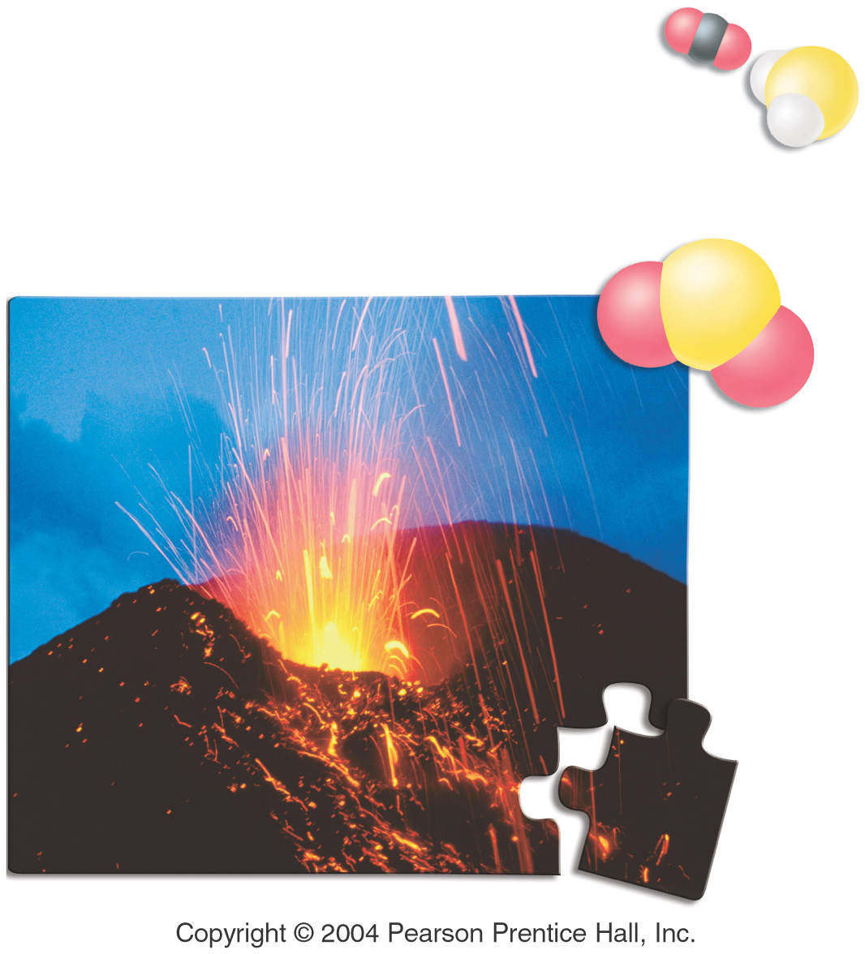
Stoichiometry

Slide 2
Cake Recipe
Ingredients for12 servings :
8 Eggs (E)
2 cups Sugar (Su)
2 cups Flour (Fl)
1 cup Butter (Bu)
Calculate the amount of ingredients needed for 40 servings

Slide 3
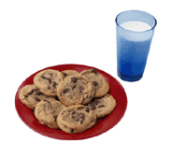

Chocolate Chip Cookies!!
1 cup butter
1/2 cup white sugar
1 cup packed brown sugar
1 teaspoon vanilla extract
2 eggs
2 1/2 cups all-purpose flour
1 teaspoon baking soda
1 teaspoon salt
2 cups semisweet chocolate chips
Makes 3 dozen
How many eggs are needed to make 3 dozen cookies?
How much butter is needed for the amount of chocolate chips used?
How many eggs would we need to make 9 dozen cookies?
How much brown sugar would I need if I had 1 ½ cups white sugar?

Slide 4
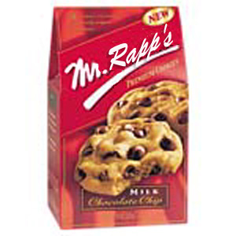
Cookies and Chemistry…Huh!?!?
Just like chocolate chip cookies have recipes, chemists have recipes as well
Instead of calling them recipes, we call them reaction equations
Furthermore, instead of using cups and teaspoons, we use moles
Lastly, instead of eggs, butter, sugar, etc. we use chemical compounds as ingredients

Slide 5
Chemistry Recipes
Looking at a reaction tells us how much of something you need to react with something else to get a product (like the cookie recipe)
Be sure you have a balanced reaction before you start!
    Example: 2 Na + Cl₂ → 2 NaCl
    This reaction tells us that by mixing 2 moles of sodium with 1 mole of chlorine we will get 2 moles of sodium chloride
    What if we wanted 4 moles of NaCl? 10 moles?
    50 moles?

Slide 6
Molar Mass of Compounds
The molar mass (MM) of a compound is determined the same way, except now you add up all the atomic masses for the molecule (or compound)
  Ex. Molar mass of CaCl₂
  Avg. Atomic mass of Calcium = 40.08g
  Avg. Atomic mass of Chlorine = 35.45g
  Molar Mass of calcium chloride =
  40.08 g/mol Ca + (2 X 35.45) g/mol Cl
  → 110.98 g/mol CaCl₂
20
Ca
40.08
17
Cl 35.45

Slide 7
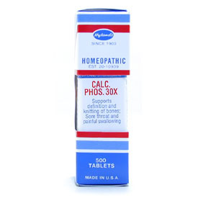
Practice
Calculate the Molar Mass of calcium phosphate
  Formula =
  Masses elements:
  Molar Mass =
Ca₃(PO₄)₂

Slide 8
Practice
Write the balanced reaction for hydrogen gas reacting with oxygen gas.
  2 H₂ + O₂ → 2 H₂O
  How many moles of reactants are needed?
  What if we wanted 4 moles of water?
  What if we had 3 moles of oxygen, how much hydrogen would we need to react, and how much water would we get?
  What if we had 50 moles of hydrogen, how much oxygen would we need, and how much water produced?

Slide 9
What is Stoichiometry?
Chemists and chemical engineers must perform calculations based on balanced chemical reactions to predict the cost of processes.
These calculations are used to avoid using large excess amounts of costly chemicals.
The calculations these scientists use are called stoichiometry calculations.

Slide 10
Stoichiometry
The branch of chemistry that deals with the mass relationships of elements in compounds and the mass relationships between reactant and product in a chemical reaction.

Slide 11
Stoichiometry
“stochio” = Greek for element
“metry” = measurement
Composition stoichiometry: involves the mass relationships of elements in chemical compounds (mass-mole)
Reaction stoichiometry: (concerned with chemical reactions) involves the mass relationships among reactants and products in chemical reactions. It is based on chemical equation and the law of conservation of mass (mass-mass)

Slide 12
All stoichiometry calculations require knowing the chemical equation for the reactant studied.
In stoichiometry, if one knows the amount of one substance in a reaction, they can determine the amount of all of the other substances.

Slide 13
Flowchart
Atoms or Molecules
Divide by 6.02 X 10²³
Multiply by 6.02 X 10²³
Moles
Multiply by atomic/molar mass from periodic table
Divide by atomic/molar mass from periodic table
Mass (grams)

Slide 14
Calculations
molar mass Avogadro’s number
Grams Moles particles
Everything must go through Moles!!!

Slide 15
Types of Stoichiometry Problems
There are several basic types of stoichiometry problems we’ll introduce in this chapter:
  Mole-Mole stoichiometry problems
  Mole-Mass stoichiometry problems
  Mass- Mole stoichiometry problems
  Mass-Mass stoichiometry problems
  Mass-Volume stoichiometry problems
  Volume-Volume stoichiometry problems

Slide 16
STOICHIOMETRY
The Stoichiometry Flow Chart
Use mole ratio from equation
Use Molar mass (A)
Use Molar mass (B)

Slide 17
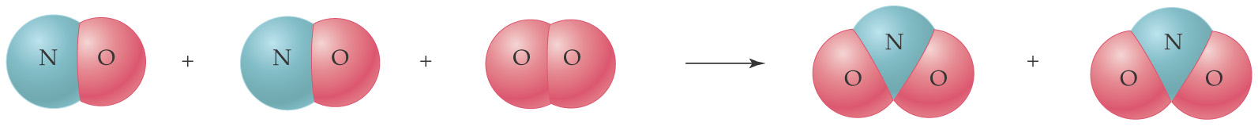
Interpreting Chemical Equations
Lets look at the reaction of nitrogen monoxide with oxygen to produce nitrogen dioxide:
  2 NO(g) + O₂(g) → 2 NO₂(g)
Two molecules of NO gas react with one molecule of O₂ gas to produce 2 molecules of NO₂ gas.

Slide 18
Moles & Equation Coefficients
2 NO(g) + O₂(g) → 2 NO₂(g)
The coefficients represent molecules, so we can multiply each of the coefficients and look at more than individual molecules.
NO (g) | O₂(g) | NO₂(g)
2 molecules | 1 molecule | 2 molecules
2000 molecules | 1000 molecules | 2000 molecules
12.04 × 10²³ molecules | 6.02 × 10²³ molecules | 12.04 × 10²³ molecules
2 moles | 1 mole | 2 moles

Slide 19
Mole Ratios
2 NO(g) + O₂(g) → 2 NO₂(g)
We can now read the balanced chemical equation as “two moles of NO gas react with one mole of O₂ gas to produce 2 moles of NO₂ gas”.
The coefficients indicate the mole ratio, or the ratio of the moles, of reactants and products in every balanced chemical equation.

Slide 20
Volume & Equation Coefficients
According to Avogadro’s theory, there are equal numbers of molecules in equal volumes of gas at the same temperature and pressure.
So, twice the number of molecules occupies twice the volume.
2 NO(g) + O₂(g) → 2 NO₂(g)
So, instead of 2 molecules NO, 1 molecule O₂, and 2 molecules NO₂, we can write: 2 liters of NO react with 1 liter of O₂ gas to produce 2 liters of NO₂ gas.

Slide 21
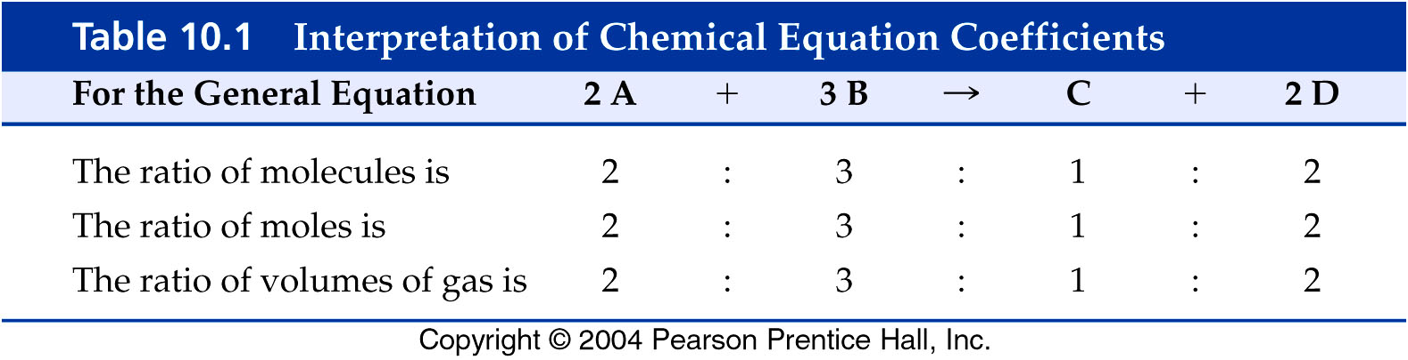
Interpretation of Coefficients
From a balanced chemical equation, we know how many molecules or moles of a substance react and how many moles of product(s) are produced.
If there are gases, we know how many liters of gas react or are produced.

Slide 22
Stoichiometry is about measuring the amounts of elements and compounds involved in a reaction.
Consider the chemical equation:
4NH₃ + 5O₂ → 6H₂O + 4NO
There are several numbers involved.
What do they all mean?
  Remember : chemical equations indicate the amount of reactants needed to produce a given amount of product, or the amount of one reactant needed to react with a given amount of another reactant

Slide 23
Stoichiometry
4NH₃ + 5O₂ → 6H₂O + 4NO
Recall that Chemical formulas represent numbers of atoms
NH₃ | 1 nitrogen and 3 hydrogen atoms
O₂ | 2 oxygen atoms
H₂O | 2 hydrogen atoms and 1 oxygen atom
NO | 1 nitrogen atom and 1 oxygen atom

Slide 24
Stoichiometry
4NH₃ + 5O₂ → 6H₂O + 4NO
Recall that Chemical formulas have molar masses:
NH₃ | 17 g/mol
O₂ | 32 g/mol
H₂O | 18 g/mol
NO | 30 g/mol
***To find the molar mass of a chemical formula – add the atomic masses of the
elements forming the compound. Use the periodic table to determine the atomic
mass of individual elements.***

Slide 25
Molar mass
Just like mole ratios, molar mass is a conversion factor that relates the mass of a substance to the number of moles of that substance
Ex 1mole NO/30g NO
30g NO/1mol NO

Slide 26
Stoichiometry
4NH₃ + 5O₂ → 6H₂O + 4NO
Recall that Chemical formulas are balanced with coefficients
4 X NH₃ | = 4 nitrogen + 12 hydrogen
5 X O₂ | = 10 oxygen
6 X H₂O | = 12 hydrogen + 6 oxygen
4 X NO | = 4 nitrogen + 4 oxygen

Slide 27
Stoichiometry
4NH₃ + 5O₂ → 6H₂O + 4NO
With Stoichiometry we find out that
4 : 5 : 6 : 4
do more than just multiply atoms.
4 : 5 : 6 : 4
Are what we call a mole ratio.

Slide 28
Mole - Mole Relationships
We can use a balanced chemical equation to write mole ratio which can be used as unit factors:
  N₂(g) + O₂(g) → 2 NO(g)
Since 1 mol of N₂ reacts with 1 mol of O₂ to produce 2 mol of NO, we can write the following mole relationships:
∆
1 mol N₂
1 mol N₂
1 mol O₂
1 mol O₂
2 mol NO
2 mol NO
1 mol O₂
2 mol NO
1 mol NO
1 mol N₂
1 mol N₂
2 mol O₂

Slide 29
Stoichiometry
4NH₃ + 5O₂ → 6H₂O + 4NO
4 : 5 : 6 : 4
Can mean either:
4 molecules of NH₃ react with 5 molecules of O₂
to produce 6 molecules of H₂O and 4 molecules of NO
OR
4 moles of NH₃ react with 5 moles of O₂
to produce 6 moles of H₂O and 4 moles of NO

Slide 30
Conservation of Mass
The law of conservation of mass states that mass is neither created nor destroyed during a chemical reaction. Lets test: 2 NO(g) + O₂(g) → 2 NO₂(g)
  2 mol NO + 1 mol O₂ → 2 mol NO
  2 (30.01 g) + 1 (32.00 g) → 2 (46.01 g)
  60.02 g + 32.00 g → 92.02 g
  92.02 g = 92.02 g
The mass of the reactants is equal to the mass of the product! Mass is conserved.

Slide 31
Ideal Stoichiometry calculations
Chemical equations help us understand and predict chemical reactions without labs
However chemical equations do have limitations

Slide 32
Limitations of chemical equations
Do not reveal the conditions under which reactions occurred
Chemical equations can be written to describe changes that do not occur.
Chemical equations don’t tell how fast reactions occur or the pathways taken
Factors not revealed by chemical equations can affect the relative amount of reactants needed or products produced

Slide 33
Theoretical stoichiometry calculations
Thus due to these limitations, the reactions are theoretical values under ideal conditions
Meaning complete conversion of all reactants to products occurs ( this is impossible to obtain)
Theoretical stoichiometry calculations: are important for determining maximum amount of product possible.

Slide 34
Mole-Mole Problems
Calculate the number of moles of one substance that will react with or be produced from another substance
Given moles A x Coeffient B = Moles B
Coeffient A

Slide 35
Mole - Mole Calculations
How many moles of oxygen react with 2.25 mol of nitrogen?
  N₂(g) + O₂(g) → 2 NO(g)
We want mol O₂, we have 2.25 mol N₂.
Use 1 mol N₂ = 1 mol O₂.
1 mol O₂
2.25 mol N₂ ×
= 2.25 mol O₂
1 mol N₂

Slide 36
Stoichiometry Question (1)
4NH₃ + 5O₂ → 6H₂O + 4NO
How many moles of H₂O are produced if 2.00 moles of O₂ are used?
6 mol H₂O
2.00 mol O₂
=
2.40 mol H₂O
5 mol O₂
Notice that a correctly balanced equation is essential to get the right answer

Slide 37
Stoichiometry Question (2)
4 NH₃ + 5 O₂ → 6 H₂O + 4 NO
How many moles of NO are produced in the reaction if 15 mol of H₂O are also produced?
4 mol NO
15 mol H₂O
=
10. mol NO
6 mol H₂O

Slide 38
Mole-Mass Problems
Calculate the mass (usually in grams) of a substance that will react with or be produced from a given number of moles of a second substance.
Given moles A x Coeffient B x wt B PT = grams B
Coeffient A 1 mole B

Slide 39
Stoichiometry Question (3)
4 NH₃ + 5 O₂ → 6 H₂O + 4 NO
How many grams of H₂O are produced if 2.2 mol of NH₃ are combined with excess oxygen?
6 mol H₂O
18.02 g H₂O
59 g H₂O
2.2 mol NH₃
=
4 mol NH₃
1 mol H₂O

Slide 40
Stoichiometry Question (4)
4 NH₃ + 5 O₂ → 6 H₂O + 4 NO
How many grams of O₂ are required to produce 0.3 mol of H₂O?
5 mol O₂
32 g O₂
0.3 mol H₂O
=
8 g O₂
6 mol H₂O
1 mol O₂

Slide 41
Mass-Mole Problems
Calculate the amount in moles of 1 substance that will react with or be produced by a given mass of another substance.
Given mass A x 1 mole A x Coefficient B = Moles B
wt A PT Coefficient A

Slide 42
2 H₂ (g) + O₂ (g) → 2 H₂O (g)
Q1. How many moles of hydrogen are necessary to react with 15.0 g of oxygen?
A. 15.0g O₂ (^{1 mole O}₂ ) ( ^{2 mole H}₂) = 0.938 moles H₂
^{32.0 g 1 mole O}₂
Q2. How many grams of hydrogen are necessary to react with 15.0 g of oxygen?
A. 15.0g O₂ (^{1 mole O}₂ ) ( ^{2 mole H}₂) ( ^{2.016 g H}₂) = 1.89 g H₂
^{32.0 g 1 mole O}₂ ^{1 mole H}₂

Slide 43
Mass-Mass Problems
Calculate the number of grams of one substance that is required to react with or be produced from a given number of grams of a second substance involved in a chemical reaction.
Given mass A x 1mole A x Coefficient B x wt B PT = mass B
wt A PT Coefficient A 1 mole B

Slide 44
Converting grams to grams
Many stoichiometry problems follow a pattern:
grams(x) ↔ moles(x) ↔ moles(y) ↔ grams(y)
We can start anywhere along this path depending on the question we want to answer
Notice that we cannot directly convert from grams of one compound to grams of another. Instead we have to go through moles.

Slide 45
Mass - Mass Problems
In a mass-mass stoichiometry problem, we will convert a given mass of a reactant or product to an unknown mass of reactant or product.
There are three steps:
  Convert the given mass to moles using the molar mass as a unit factor.
  Convert the moles of given to moles of the unknown using the coefficients in the balanced equation.
  Convert the moles of unknown to grams using the molar mass as a unit factor.

Slide 46
Mass-Mass Stoichiometry Problem
What is the mass of mercury produced from the decomposition of 1.25 g of orange mercury (II) oxide (MM = 216.59 g/mol)?
  2 HgO(s) → 2 Hg(l) + O₂(g)
Convert grams Hg to moles Hg using the molar mass of mercury (200.59 g/mol).
Convert moles Hg to moles HgO using the balanced equation.
Convert moles HgO to grams HgO using the molar mass.

Slide 47
Problem Continued
  2 HgO(s) → 2 Hg(l) + O₂(g)
  g Hg ⇒ mol Hg ⇒ mol HgO ⇒ g HgO
1 mol HgO
2 mol Hg
200.59 g Hg
1.25 g HgO ×
×
×
216.59 g HgO
2 mol HgO
1 mol Hg
= 1.16 g Hg

Slide 48
Stoichiometry Question (5)
4 NH₃ + 5 O₂ → 6 H₂O + 4 NO
How many grams of NO is produced if 12 g of O₂ is combined with excess ammonia?
1 mol O₂
4 mol NO
30.01 g NO
12 g O₂
x
x
x
32 g O₂
5 mol O₂
1 mol NO
=
9.0 g NO

Slide 49
STOICHIOMETRY
2 H₂ (g) + O₂ (g) → 2 H₂O (g)
Q3. How many grams of water are produced from 15.0 g of oxygen?
A. 15.0g O₂ (^{1 mole O}₂ ) ( ^{2 mole H}₂^{O}) ( ^{18.0 g H}₂^{O}) =16.9 g H₂O
^{32.0 g 1 mole O}₂ ^{1 mole H}₂^{O}
Q4. How much hydrogen and oxygen is needed to produce 25.0 grams of water?
A. 25.0g H₂O (^{1 mole H}₂^{O} ) ( ^{2 mole H}₂) ( ^{2.016 g H}₂) = 2.80 g H₂
^{18.0 g 2 mole H}₂^{O} ^{1 mole H}₂
A. 25.0g H₂O (^{1 mole H}₂^{O} ) ( ^{1 mole O}₂) ( ^{32.0 g O}₂) = 22.2 g O₂
^{18.0 g 2 mole H}₂^{O} ^{1 mole O}₂
Notice that the Law of Conservation of Mass still applies.

Slide 50
Mass-Volume Problems
In a mass-volume stoichiometry problem, we will convert a given mass of a reactant or product to an unknown volume of reactant or product.
There are three steps:
  Convert the given mass to moles using the molar mass as a unit factor.
  Convert the moles of the given to moles of the unknown using the coefficients in the balanced equation.
  Convert the moles of unknown to liters using the molar volume of a gas as a unit factor.

Slide 51
Mass-Volume Stoichiometry Problem
How many liters of hydrogen are produced from the reaction of 0.165 g of aluminum metal with dilute hydrochloric acid?
  2 Al(s) + 6 HCl(aq) → 2 AlCl₃(aq) + 3 H₂(g)
Convert grams Al to moles Al using the molar mass of aluminum (26.98 g/mol).
Convert moles Al to moles H₂ using the balanced equation.
Convert moles H₂ to liters using the molar volume at STP.

Slide 52
Problem Continued
  2 Al(s) + 6 HCl(aq) → 2 AlCl₃(aq) + 3 H₂(g)
  g Al ⇒ mol Al ⇒ mol H₂ ⇒ L H₂
1 mol Al
3 mol H₂
22.4 L H₂
0.165 g Al ×
×
×
26.98 g Al
2 mol Al
1 mol H₂
= 0.205 L H₂

Slide 53
Volume-Volume Stoichiometry
Gay-Lussac discovered that volumes of gases under similar conditions, combine in small whole number ratios. This is the law of combining volumes.
Consider the reaction: H₂(g) + Cl₂(g) → 2 HCl(g)
10 mL of H₂ reacts with 10 mL of Cl₂ to produce 20 mL of HCl.
The ratio of volumes is 1:1:2, small whole numbers.

Slide 54
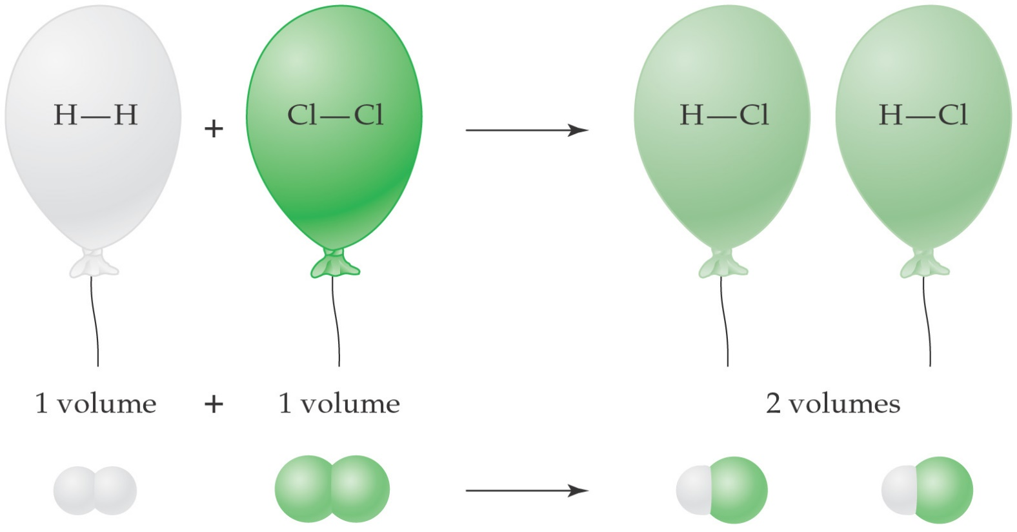
Law of Combining Volumes
The whole number ratio (1:1:2) is the same as the mole ratio in the balanced chemical equation:
H₂(g) + Cl₂(g) → 2 HCl(g)

Slide 55
Volume-Volume Problems
In a volume-volume stoichiometry problem, we will convert a given volume of a gas to an unknown volume of gaseous reactant or product.
There is one step:
  Convert the given volume to the unknown volume using the mole ratio (therefore the volume ratio) from the balanced chemical equation.

Slide 56
Volume-Volume Problem
How many liters of oxygen react with 37.5 L of sulfur dioxide in the production of sulfur trioxide gas?
  2 SO₂(g) + O₂(g) → 2 SO₃(g)
From the balanced equation, 1 mol of oxygen reacts with 2 mol sulfur dioxide.
So, 1 L of O₂ reacts with 2 L of SO₂.
Pt ∆

Slide 57
Problem Continued
Pt ∆
  2 SO₂(g) + O₂(g) → 2 SO₃(g)
  L SO₂ ⇒ L O₂
1 L O₂
37.5 L SO₂ ×
= 18.8 L O₂
2 L SO₂
How many L of SO₃ are produced?
2 L SO₃
37.5 L SO₂ ×
= 37.5 L SO₃
2 L SO₂

Slide 58
Have we learned it yet?
Try these on your own - 4 NH₃ + 5 O₂ → 6 H₂O + 4 NO
a) How many moles of H₂O can be made using 1.6 mol NH₃?
b) what mass of NH₃ is needed to make 0.75 mol NO?
c) how many grams of NO can be made from 47 g of NH₃?

Slide 59
Answers
4 NH₃ + 5 O₂ → 6 H₂O + 4 NO
a)
b)
c)
6 mol H₂O
2.4 mol H₂O
1.6 mol NH₃
x
=
4 mol NH₃
4 mol NH₃
17.04 g NH₃
13 g NH₃
0.75 mol NO
x
x
=
4 mol NO
1 mol NH₃
1 mol NH₃
4 mol NO
30.01 g NO
47 g NH₃
x
x
x
17.04 g NH₃
4 mol NH₃
1 mol NO
=
83 g NO

Slide 60
Limiting Reactant Concept
Say you’re making grilled cheese sandwiches. You need 1 slice of cheese and 2 slices of bread to make one sandwich.
  1 Cheese + 2 Bread → 1 Sandwich
If you have 5 slices of cheese and 8 slices of bread, how many sandwiches can you make?
You have enough bread for 4 sandwiches and enough cheese for 5 sandwiches.
You can only make 4 sandwiches; you will run out of bread before you use all the cheese.

Slide 61
Limiting Reactant
Since you run out of bread first, bread is the ingredient that limits how many sandwiches you can make.
In a chemical reaction, the limiting reactant is the reactant that controls the amount of products you can make.
A limiting reactant is used up before the other reactants.
The other reactants are present in excess.

Slide 62
Limiting Reactants
When all of one substance (reactant) is used up, no more product can be formed, even if more of the other reactant is available.
The substance that is used up first in the reaction is the limiting reactant.
It limits the amount of the other reactant that can combine and the amount of products formed in a chemical reaction

Slide 63
Excess Reactant: the substance that is not used up completely in a reaction.
Wen you are told that one reactant is in excess, you do not have to be concerned with its quantity.

Slide 64
Given the amount of each of 2 reactants, A & B . How can you decide which is the limiting reactant
You must discover which of the reactants requires mre of the other than is available.
This requires doing a Mole-Mole problem

Slide 65
Use the following method
chose 1 of the 2 reactants ( say A)
Calculate the amount in moles of the other reactant (B) required by (A)
Compare the calculated amount with the amount of (B) actually available
If more is required of (B) than is available, (B) is the limiting reactant.
If less is required, than (A) is the limiting reactant

Slide 66
Determining the Limiting Reactant
If you heat 2.50 mol of Fe and 3.00 mol of S, how many moles of FeS are formed?
  Fe(s) + S(s) → FeS(s)
According to the balanced equation, 1 mol of Fe reacts with 1 mol of S to give 1 mol of FeS.
So 2.50 mol of Fe will react with 2.50 mol of S to produce 2.50 mol of FeS.
Therefore, iron is the limiting reactant and sulfur is the excess reactant.
∆

Slide 67
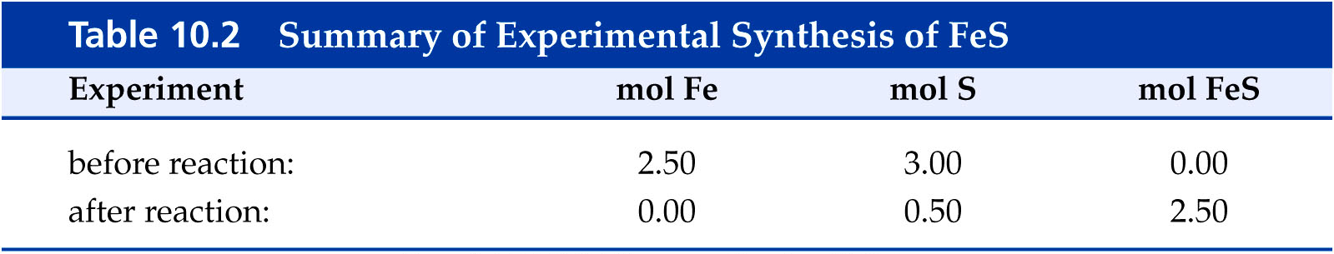
Determining the Limiting Reactant
If you start with 3.00 mol of sulfur and 2.50 mol of sulfur reacts to produce FeS, you have 0.50 mol of excess sulfur (3.00 mol – 2.50 mol).
The table below summarizes the amounts of each substance before and after the reaction.

Slide 68
Mass Limiting Reactant Problems
There are three steps to a limiting reactant problem:
Calculate the mass of product that can be produced from the first reactant.
mass reactant #1 ⇒ mol reactant #1 ⇒ mol product ⇒ mass product
Calculate the mass of product that can be produced from the second reactant.
mass reactant #2 ⇒ mol reactant #2 ⇒ mol product ⇒ mass product
The limiting reactant is the reactant that produces the least amount of product.

Slide 69
Mass Limiting Reactant Problem
How much molten iron is formed from the reaction of 25.0 g FeO and 25.0 g Al?
  3 FeO(l) + 2 Al(l) → 3 Fe(l) + Al₂O₃(s)
First, lets convert g FeO to g Fe:
We can produce 19.4 g Fe if FeO is limiting.
1 mol FeO
3 mol Fe
55.85 g Fe
25.0 g FeO ×
×
×
71.85 g FeO
3 mol FeO
1 mol Fe
= 19.4 g Fe

Slide 70
Mass Problem Continued
  3 FeO(l) + 2 Al(l) → 3 Fe(l) + Al₂O₃(s)
Second, lets convert g Al to g Fe:
We can produce 77.6 g Fe if Al is limiting.
1 mol Al
3 mol Fe
55.85 g Fe
25.0 g Al ×
×
×
26.98 g Al
2 mol Al
1 mol Fe
= 77.6 g Fe

Slide 71
Mass Problem Continued
Lets compare the two reactants:
  25.0 g FeO can produce 19.4 g Fe
  25.0 g Al can produce 77.6 g Fe
FeO is the limiting reactant.
Al is the excess reactant.

Slide 72
Volume Limiting Reactant Problems
Limiting reactant problems involving volumes follow the same procedure as those involving masses, except we use volumes.
volume reactant ⇒ volume product
We can convert between the volume of the reactant and the product using the balanced equation

Slide 73
Volume Limiting Reactant Problem
How many liters of NO₂ gas can be produced from 5.00 L NO gas and 5.00 L O₂ gas?
  2 NO(g) + O₂(g) → 2 NO₂ (g)
Convert L NO to L NO₂ and L O₂ to L NO₂:
∆
2 L NO₂
5.00 L NO ×
= 5.00 L NO₂
2 L NO
2 L NO₂
5.00 L O₂ ×
= 10.0 L NO₂
1 L O₂

Slide 74
Volume Problem Continued
Lets compare the two reactants:
  5.00 L NO can produce 5.00 L NO₂
  5.00 L O₂ can produce 10.0 L NO₂
NO is the limiting reactant.
O₂ is the excess reactant.

Slide 75
Percent Yield
When you perform a laboratory experiment, the amount of product collected is the actual yield.
The amount of product calculated from a limiting reactant problem is the theoretical yield ( maximum amount of product that can be produced).
The percent yield is the amount of the actual yield compared to the theoretical yield.
actual yield
× 100 % = percent yield
theoretical yield

Slide 76
Reasons Actual yield is less than theoretical yield
Some reactant might take part in competing side reactions
During purification process, some of the product is lost

Slide 77
Calculating Percent Yield
Suppose a student performs a reaction and obtains 0.875 g of CuCO₃ and the theoretical yield is 0.988 g. What is the percent yield?
Cu(NO₃)₂(aq) + Na₂CO₃(aq) → CuCO₃(s) + 2 NaNO₃(aq)
The percent yield obtained is 88.6%.
0.875 g CuCO₃
× 100 % = 88.6 %
0.988 g CuCO₃

Slide 78
EX C₆H₆ + Cl₂ → C₆H₅Cl + HCl
When 36.8 g of C₆H₆ reacts with an excess of Cl₂ the actual yield is 38.8g. What is the percent yield of C₆H₅Cl
Solution:
Must do a Mass-Mass problem to get Theoretical yield of C₆H₅Cl
Given mass A x 1 mole A x Coefficient B x wt B PT = mass B
wt A PT Coefficient A 1 mole B

Slide 79
EX C₆H₆ + Cl₂ → C₆H₅Cl + HCl
When 36.8 g of C₆H₆ reacts with an excess of Cl₂ the actual yield is 38.8g. What is the percent yield of C₆H₅Cl
Given mass A x moleA x Coefficient B x wt B PT = mass B
wt A PT Coefficient A 1 mole B
C₆H₆ = A C₆H₅Cl = B actual yield is 38.8g.
36.8g C₆H₆ x 1mol C₆H₆ x 1 mol C₆H₅Cl x 113g C₆H₅Cl = 53.2 g
78g C₆H₆ 1 mol C₆H₆ 1 mol C₆H₅Cl

Slide 80
Percent Yield = Actual yield x 100
theoretical yield
% yield = 38.8 x 100 =72.9%
53.2

Slide 81
Conclusions
The coefficients in a balanced chemical reaction are the mole ratio of the reactants and products.
The coefficients in a balanced chemical reaction are the volume ratio of gaseous reactants and products.
We can convert moles, liters, or grams of a given substance to moles, liters, or grams of an unknown substance in a chemical reaction using the balanced equation.

Slide 82
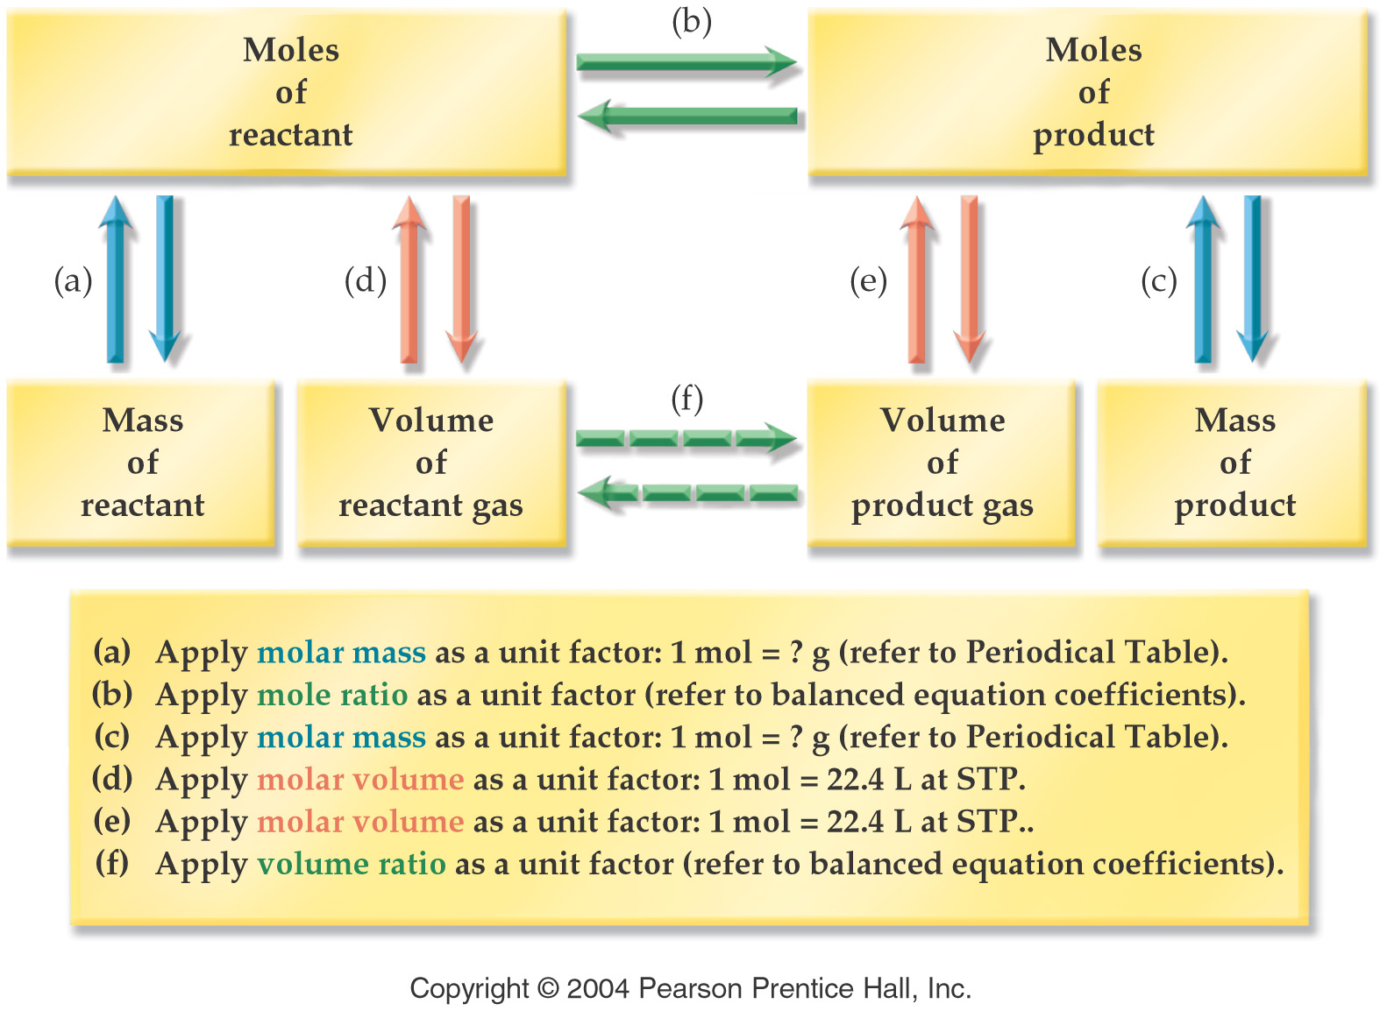
Stoichiometry

Slide 83
Stoichiometry
The limiting reactant is the reactant that is used up first in a chemical reaction.
The theoretical yield of a reaction is the amount calculated based on the limiting reactant.
The actual yield is the amount of product isolated in an actual experiment.
The percent yield is the ratio of the actual yield to the theoretical yield.

