Slide 1
Acids, Bases, & Salts

Slide 2
Traditional definition of acid
A chemical compound that contains hydrogen and ionizes in aqueous solution to form hydrogen ions. Begins with (H)
Ex HCl HNO₃
Their water solutions are known as aqueous acids

Slide 3
Traditional definition of a base
A substance that contains hydroxide ions (OH) and dissociate to give hydroxide ions in aqueous solution. Has (OH) ex NaOH
KOH
A solution that contains OH) from a soluble base is called alkaline

Slide 4
History of Acids and Bases
In the early days of chemistry chemists were organizing physical and chemical properties of substances. They discovered that many substances could be placed in two different property categories:
Substance A
Sour taste
Reacts with carbonates to make CO₂
Reacts with metals to produce H₂
Turns blue litmus pink
Reacts with B substances to make salt water
Substance B
Bitter taste
Reacts with fats to make soaps
Do not react with metals
Turns red litmus blue
Reacts with A substances make salt and water
Arrhenius was the first person to suggest a reason why substances are in A or B due to their ionization in water.

Slide 5
Arrhenius Theory
The Swedish chemist Svante Arrhenius proposed the first definition of acids and bases.
(Substances A and B became
known as acids and bases)
According to the Arrhenius model:
“acids are substances that dissociate in water to produce H⁺ ions and bases are substances that dissociate in water to produce OH⁻ ions”
NaOH (aq)  Na⁺ (aq) + OH⁻ (aq) Base
HCl (aq)  H⁺ (aq) + Cl⁻ (aq) Acid

Slide 6
Bronsted Lowry Theory
Johannes Brønsted and Thomas Lowry revised Arrhenius’s acid-base theory to include this behavior. They defined acids and bases as follows:
“An acid is a hydrogen containing species that donates a proton. A base is any substance that accepts a proton”
HCl (aq) + H₂O (l)  Cl⁻ (aq) + H₃O⁺ (aq)
In the above example what is the Brønsted acid? What is the Brønsted base?
Bronsted
Lowry

Slide 7
Types of Acids and Bases
In the 1800’s chemical concepts were based on the reactions of aqueous solutions.
Svante Arrhenius developed a concept of acids and bases relevant to reactions in H₂O.
Arrhenius acid – produces hydrogen ions in water.
Arrhenius base – produce hydroxide ions in water.

Slide 8
A broader ,more modern concept of acids and bases was developed later.
Bronsted-Lowry acid- donates a hydrogen ion in a reaction. . (proton donors)
Bronsted – Lowry base – accepts a hydrogen in a reaction. . (proton acceptors)

Slide 9
What is H⁺?
e⁻
+
+
Hydrogen (H)
Proton (H⁺)

Slide 10
Conjugate acid- compound formed when an base gains a hydrogen ion
Conjugate base – compound formed when an acid loses a hydrogen ion

Slide 11
BrØnsted-Lowry Acids and Bases
According to the BrØnsted-Lowry theory,
acids donate a proton (H⁺).
bases accept a proton (H⁺).

Slide 12
NH₃, a BrØnsted-Lowry Base
In the reaction of ammonia and water,
NH₃ is the base that accept H⁺.
H₂O is the acid that donates H⁺.

Slide 13
Conjugate Acid-Base Pairs
In any acid-base reaction, there are two conjugate acid-base pairs.
Each pair is related by the loss and gain of H⁺ .
One pair occurs in the forward direction.
One pair occurs in the reverse direction.
conjugate acid-base pair 1
HA + B A⁻ + BH⁺
conjugate acid-base pair 2

Slide 14
Conjugate Acid-Base Pairs

Slide 15
Conjugate Acids and Bases
In this acid-base reaction,
an acid, HF, donates H⁺ to form its conjugate base, F⁻.
a base, H₂O, accepts H⁺ to form its conjugate acid, H₃O+.
there are two conjugate acid-base pairs.

Slide 16
Conjugate Acid-Base Pairs
In the reaction of HF and H₂O,
one conjugate acid-base pair is HF/F⁻.
the other conjugate acid-base pair is H₂O/H₃O⁺.
each pair is related by a loss and gain of H⁺.

Slide 17
Conjugate Acid-Base Pairs
In the reaction of NH₃ and H₂O,
one conjugate acid-base pair is NH₃/NH₄⁺
the other conjugate acid-base is H₂O/H₃O⁺.

Slide 18
Learning Check
A. Write the conjugate base of the following.
1. HBr
2. H₂S
3. H₂CO₃
B. Write the conjugate acid of the following.
1. NO₂⁻
2. NH₃
3. OH⁻

Slide 19
Solution
A. Remove H⁺ to write the conjugate base.
1. HBr Br⁻
2. H₂S HS⁻
3. H₂CO₃ HCO₃⁻
B. Add H⁺ to write the conjugate acid.
1. NO₂⁻ HNO₂
2. NH₃ NH₄⁺
3. OH⁻ H₂O

Slide 20
Learning Check
Identify the sets that contain acid-base conjugate pairs.
1. HNO₂, NO₂⁻
2. H₂CO₃, CO₃²⁻
3. HCl, ClO₄⁻
4. HS⁻, H₂S
5. NH₃, NH₄⁺

Slide 21
Solution
Identify the sets that contain acid-base conjugate pairs.
1. HNO₂, NO₂⁻
4. HS⁻, H₂S
5. NH₃, NH₄⁺

Slide 22
Learning Check
A. The conjugate base of HCO₃⁻ is
1. CO₃²⁻ 2. HCO₃⁻ 3. H₂CO₃
B. The conjugate acid of HCO₃⁻ is
1. CO₃²⁻ 2. HCO₃⁻ 3. H₂CO₃
C. The conjugate base of H₂O is
1. OH⁻ 2. H₂O 3. H₃O⁺
D. The conjugate acid of H₂O is
1. OH⁻ 2. H₂O 3. H₃O⁺

Slide 23
What? | Why?
An anion that is the conjugate base of a strong acid does not affect pH. | = very weak base
An anion that is the conjugate base of a weak acid increases pH. | = strong base
A cation that is the conjugate acid of a weak base decreases pH. | = strong acid
Cations of the strong Arrhenius bases (Na⁺, Ca²⁺) do not affect pH. | = very weak acid (not really acidic at all)

Slide 24
Lewis Acids
Lewis acids are defined as electron-pair acceptors.
Atoms with an empty valence orbital can be Lewis acids.

Slide 25
Lewis Bases
Lewis bases are defined as electron-pair donors.
Anything that could be a Brønsted–Lowry base is a Lewis base.
Lewis bases can interact with things other than protons.

Slide 26
Three definitions of acid
Who | Theory: Acid= | When
Arrhenius | increases H⁺ | 1880’s
Brønsted | proton donor | 1923
Lowry | ditto | 1923
Lewis | Electron-pair acceptor | 1923

Slide 27
What is an ACID?
pH less than 7
Neutralizes bases
Forms H ⁺ ions in solution
Corrosive-reacts with most metals to form hydrogen gas
Good conductors of electricity

Slide 28
Properties of an Acid
Tastes Sour
Conduct Electricity
Corrosive, which means they break down certain substances. Many acids can corrode fabric, skin,and paper
Some acids react strongly with metals
Turns blue litmus paper red
Picture from BBC Revision Bites http://www.bbc.co.uk/schools/ks3bitesize/science/chemistry/acids_bases_1.shtml

Slide 29
Uses of Acids
Acetic Acid = Vinegar
Citric Acid = lemons, limes, & oranges. It is in many sour candies such as lemonhead & sour patch.
Ascorbic acid = Vitamin C which your body needs to function.
Sulfuric acid is used in the production of fertilizers, steel, paints, and plastics.
Car batteries

Slide 30
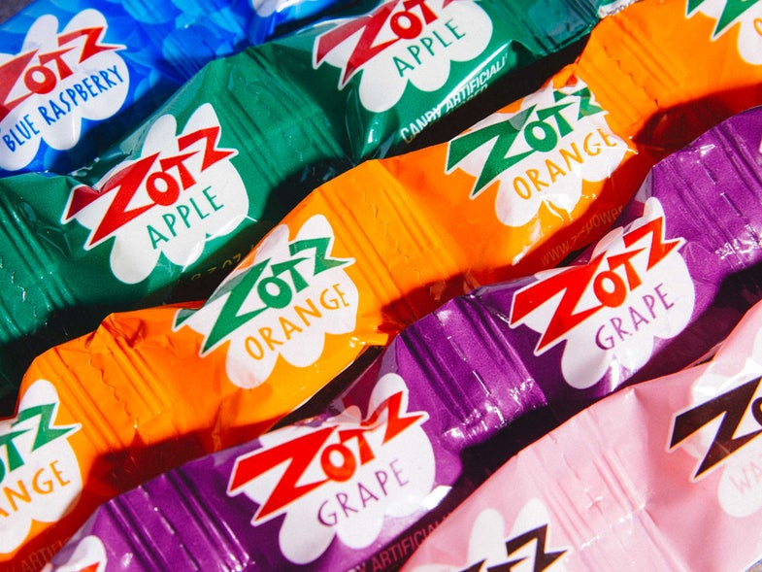
How the Fizz is Made
Zotz Candy
The fizzy center of these candies is made with a mix of malic acid and tartaric acids.
Baking soda is added to this and when these substances combine with your saliva, you get a fizzy and enjoyable explosion
So when the acid and base become liquid from being mixed with your saliva, an acid base reaction happens

Slide 31
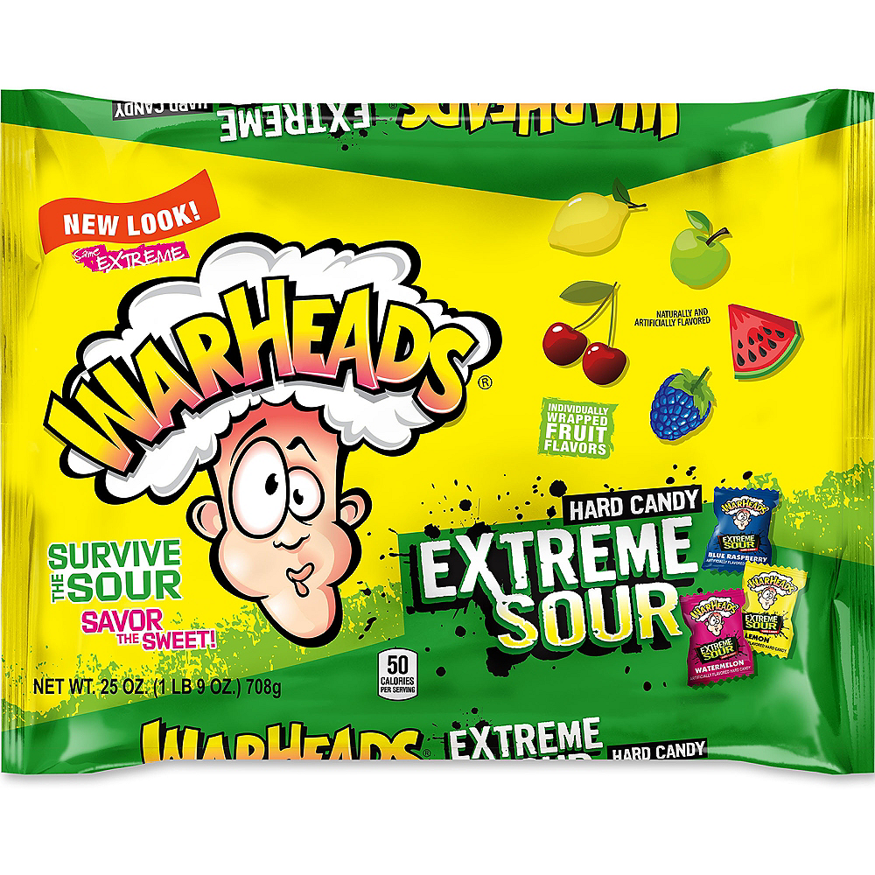
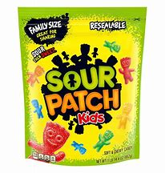
Candy Experiment
To test for acid yourself, try this: What you need:
Fruit-flavored or sour candy, such as LemonHeads, Nerds, WARHEADS, or sour gummy candy
Baking soda
What to do:
Dissolve the candy in a small amount of warm water (about a half-cup or less). For hard candy like Smarties, you may want to crush it first to make it dissolve faster.
Sprinkle a spoonful of baking soda into water.
Watch for bubbles. If it bubbles, the candy is acidic.
What's happening: When you dissolve acidic candy in water and add baking soda, the reaction produces carbon dioxide gas. This is what makes the bubbles.

Slide 32
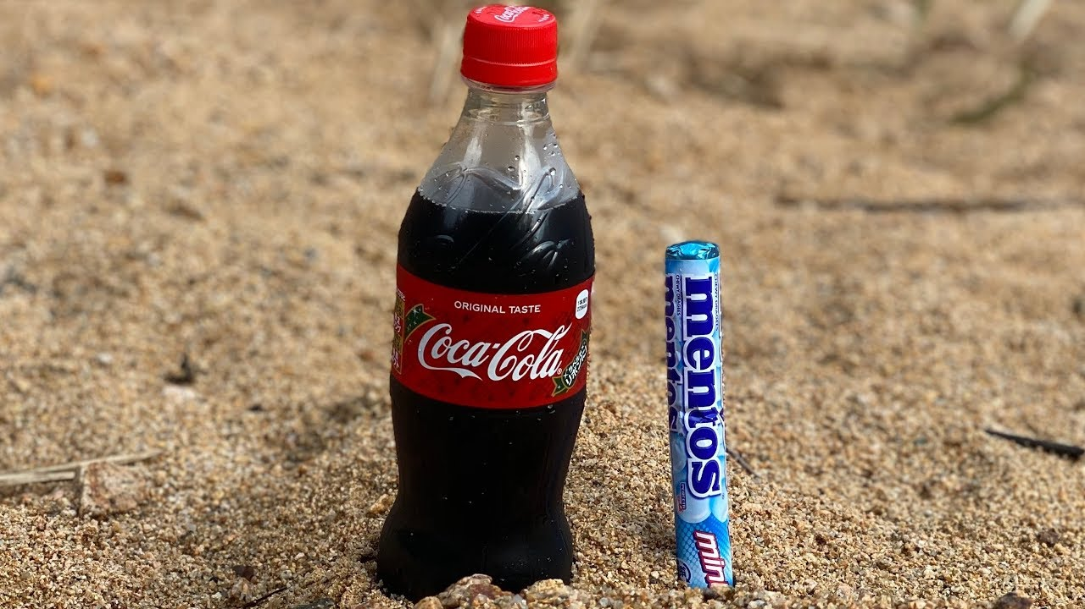
What about
Mentos and Coke

Slide 33
Many people assume that the geyser forms when a Mentos candy is dropped into a bottle of soda because of an acid/base reaction, just like when you mix baking soda (sodium bicarbonate) and a vinegar solution (acetic acid in water) to create the ever-popular “volcano” science project.
While the volcano project is most certainly acid-base chemistry, the Mentos-soda geyser is not.
But they do have one thing in common: carbon dioxide.
In the case of the baking soda volcano, carbon dioxide is formed when sodium bicarbonate reacts with an acid.
On the other hand, when you drop a Mentos candy into a bottle of cola, the carbon dioxide gas was already present in the soda to begin with, yet it seems to suddenly erupt.

Slide 34
There’s an Equilibrium of Gas Inside Every Bottle of Soda
In a bottle of soda, there is gas dissolved in the soda, and there’s gas floating above the surface of the soda when the bottle is closed.
The pressure (courtesy of the cap) keeps the gas in place (whether the gas is in solution or in the air trapped above), and the amount of dissolved carbon dioxide is proportional to the amount of carbon dioxide gas above, as they are in equilibrium.
When you unscrew the bottle cap, the carbon dioxide gas escapes, which means more carbon dioxide is dissolved than in gas form.
The dissolved gas rises out of solution in an attempt to regain that balance. That’s one of the reasons why when you open a bottle of soda, the gas bubbles suddenly rise.

Slide 35
Dropping “Something” into a Bottle of Soda Will Cause More Gas Bubbles to Suddenly Form
While Mentos seems to work best, even pieces of rock salt can cause a small eruption of gas from soda.
Mentos work particularly well because they are denser, so they sink faster.
When a piece of Mentos candy is dropped into a soda bottle, just after the bottle is opened, the candy sinks right down to the bottom quickly, and the amount of gas and the speed at which it’s released causes an impressive geyser effect.

Slide 36
What makes Pop Rocks pop?
The secret behind that famous Pop Rocks candy “popping” sensation is pressurized carbon dioxide gas (CO2).
Each of those tiny little candy pebbles contains a small amount of gas.
When they burst free from their candy shells, these tiny gas bubbles make that irresistible popping sound.

Slide 37
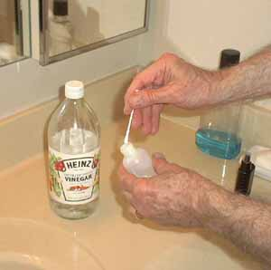
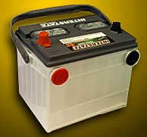
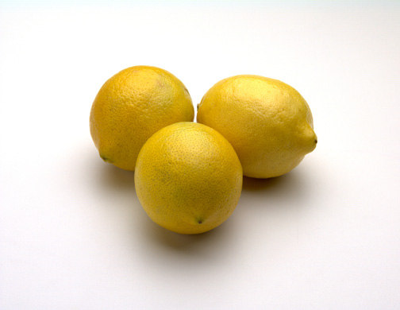
Common Acids
HCl- hydrochloric- stomach acid
also known as muriatic acid
H₂SO₄- sulfuric acid - car batteries
HNO₃ – nitric acid - explosives
HC₂H₃O₂- acetic acid - vinegar
H₂CO₃-carbonic acid – sodas
H₃PO₄- phosphoric acid –flavorings
HCOOH - formic acid- ant stings

Slide 38
Remember
When concentrated sulfuric acid is diluted with water, a large amount of heat is released during the formation of hydrates.
This causes the release of a great deal of heat.
For this reason NEVER add water to acid, always acid to water.

Slide 39
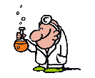
When you spill chemicals on your skin, you should rinse the affected area with water immediately and thoughly
In case of an acid, if tingling sensation remains, this is your signal to continue rinsing affected area.

Slide 40
Weak vs. Strong Acids
Weak Acids do not ionize completely, and are weak electrolytes
Ex: Acetic, Boric, Nitrous, Phosphoric, Sulfurous
Strong Acids ionize completely, and are strong electrolytes
Ex: Hydrochloric, Nitric; Sulfuric, Hydriodic

Slide 41
How can we identify strong and weak acids Easy, memorize them!
Strong and Weak Acids
Strong Acids
HClO₄
H₂SO₄
HI
HBr
HCl
HNO₃
Weak Acids
HC₂H₃O₂ (acetic acid) HCO₃
HCOOH (formic acid) H₂CO₃
HF (hydrofluoric acid)
HCN (hydrocyanic acid)
HNO₂ (nitrous acid)
HSO₄-
H₃PO₄
H₂S

Slide 42
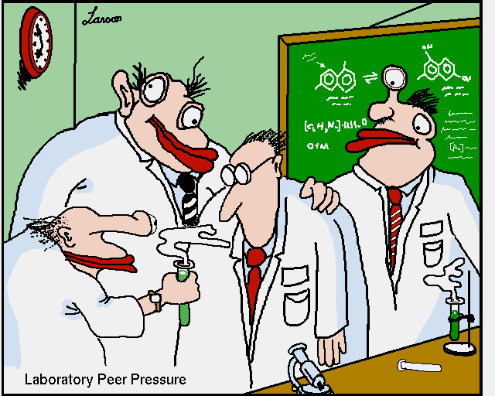

Slide 44
Types of Aqueous Acids
Monoprotic acid: an acid that can donate 1 proton (H⁺ ion) per molecule ex HCl HNO3
diprotic acid: an acid that can donate 2proton (H⁺ ion) per molecule ex H₂SO₄
triprotic acid: an acid that can donate 3 proton (H⁺ ion) per molecule ex H₃PO₄
polyprotic acid: an acid that can donate more than 1 proton (H⁺ ion) per molecule

Slide 45
How to name an Acid
An acid is a compound that contains one or more hydrogen atoms and produces hydrogen ions (H⁺) when dissolved in water.
An Acid always starts with a Hydrogen.
That is to say that the cation is an hydrogen with a positive charge and that is followed by an anion or polyatomic anion.

Slide 46
Binary Acids and ternary acids
Acids that contain hydrogen and one other element are called binary acids
Acids that contain 3 elements are ternary acids

Slide 47
First Rule for naming an Acid
When the name of the anion ends in –ide, the acid name begins with hydro-.
The stem of the anion has the suffix –ic and is followed by the word acid.
Example
HF
HBr

Slide 48
Second Rule for naming an Acid
When the anion name ends in –ite, the acid name is the stem of the anion with the suffix -ous, followed by the word acid.
Example
H₂SO₃
HNO₂

Slide 49
Third Rule for naming an Acid
When the anion name ends in –ate, the acid name is the stem of the anion with the suffix -ic followed by the word acid.
Example
HNO₃
H₃PO₄

Slide 50
Naming Acids
Binary acids
hydro (element) ic acid
HF
Ternary acids
replace the anion suffix -ate with -ic
H₂SO₄
replace the anion suffix -ite with -ous
H₂SO₃

Slide 51
Oxyacids
An acid that is composed of hydrogen, oxygen and a 3rd element
Are named by adding prefix and suffix to the root name of the 3rd element
One acid is defined as the “ic” acid
The other acids in the series are based on how many oxygen they have compared to the “ic” acid

Slide 52
one more oxygen than the ic acid prefix per-, then the root of the name for the element other than hydrogen and oxygen, then -ic, and then acid.
one less oxygen atom than the ic acid is named by writing the root of the name for the element other than hydrogen and oxygen, then -ous, and then acid.
two less oxygen atoms than the ic acid is named by writing hypo-, then the root of the name for the element other than hydrogen and oxygen, then -ous, and then acid.

Slide 54
Bromic acid HBrO₃

Slide 55
PRACTICE PROBLEMS #9D
Give the formula for the name or the name for the formula.
H₂S H₂SO₃ (aq) HF (aq)
HClO₂ HIO (aq) HNO₂
H₂SO₄ (aq) HI (aq) H₂C₂O₄ (aq)
Acetic acid nitrous acid iodic acid
Hydrogen sulfide
Sulfurous acid
Hydrofluoric acid
Hydrogen chlorite
Hydrogen nitrite
Hypoiodous acid
Hydroiodic acid
Oxalic acid
Sulfuric acid
HC₂H₃O_{2 (aq)}
HNO₂ (aq)
HIO₃ (aq)

Slide 56
Writing the Formulas for the Acids
Examples
Hydrochloric Acid
Sulfuric Acid
Nitric Acid
Acetic Acid
Phosphoric Acid
Carbonic Acid
Sulfurous Acid
Nitrous Acid

Slide 58
Acid? Yes or No
An Acid must ionize
with H⁺ as the only
positive ion in soln
H₃PO₄
KH
CH₃COOH
CH₃OH
KI

Slide 59
What is a BASE?
pH greater than 7
Feels slippery
Dissolves fats and oils
Usually forms OH⁻ ions in solution
Neutralizes acids

Slide 60
Properties of a Base
Feel Slippery
Taste Bitter
Corrosive
Can conduct electricity. (Think alkaline batteries.)
Do not react with metals.
Turns red litmus paper blue.

Slide 61
Uses of Bases
Bases give soaps, ammonia, and many other cleaning products some of their useful properties.
The OH- ions interact strongly with certain substances, such as dirt and grease.
Chalk and oven cleaner are examples of familiar products that contain bases.
Your blood is a basic solution.

Slide 62
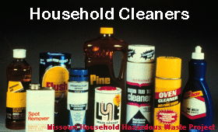
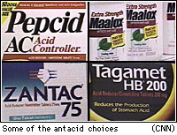
Common Bases
NaOH- sodium hydroxide (LYE) soaps, drain cleaner
Mg (OH)₂ - magnesium hydroxide-antacids
Al(OH)₃-aluminum hydroxide-antacids, deodorants
NH₄OH-ammonium hydroxide- “ammonia”

Slide 63
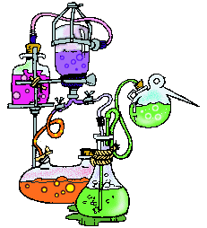
How to name a Base
Bases are named in the same way as other ionic compounds – the name of the cation is followed by the name of the anion.
A base is any ionic compound that, when dissolved in water has excessive (OH⁻) anions.
Examples
LiOH
Al(OH)₃

Slide 64
Naming Bases
Name the cation (+)
all bases end in hydroxide
KOH
Mg(OH)₂
NH₄OH
Exception?

Slide 65
Weak vs. Strong Bases
Memorized Strong Bases
Hydroxides of group 1 and 2 metals are strong ( all others are weak)
Weak Bases: ammonia; potassium carbonate, sodium carbonate
Strong Bases: sodium hydroxide; sodium phosphate; barium hydroxide; calcium hydroxide

Slide 66
Base? Yes or No
A base must ionize
with the
hydroxide ion
as the only negative ion
NaOH
CH₃OH
C₂H₅OH
KOH
Mg(OH)₂
NH₄OH

Slide 67
Neutralization Reaction
The reaction of hydronium ion and hydroxide ion to form water
H₃O + OH → 2H₂O
This is the net ionic equation for any reaction between a traditional acid and base

Slide 68
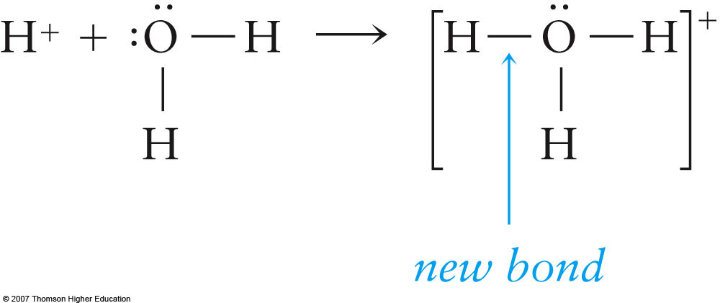
Hydronium Ion
Unknown to Arrhenius free H⁺ ions do not exist in water. They covalently react with water to produce hydronium ions, H₃O⁺.
or:
H⁺ (aq) + H₂O (l)  H₃O⁺ (aq)
This new bond is called a coordinate covalent bond since both new bonding electrons come from the same atom

Slide 69
Hydronium Ion
Hydronium ion is the name for H₃O⁺
is often times abbreviated as H⁺ (aq)
they both mean the same thing.

Slide 70
Neutralization Reaction
A neutralization reaction is the reaction of an acid with a base to produce salt and water.
Example
H₂SO4 + NaOH → NaHSO₄ + H₂O

Slide 71
Salt Hydrolysis Reaction of a salt with water
Salts are ionic compounds derived from acids and bases
So when dissolved in water some salts produce either:
A neutral solution
A basic solution
An acidic solution

Slide 72
Salts
Salts are the ionic product of an acid base neutralization reaction.
Acidic Salts are formed from a strong acid and a weak base.
Neutral salts are formed from a strong acid and strong base.
Basic salts are formed from a strong base and a weak acid.
Give the acid and base the following salts were formed from and label the salts as acidic, basic, or neutral.
NaCl
NaC₂H₃O₂
NH₄Cl

Slide 73
Salts
Salts are the ionic product of an acid base neutralization reaction.
Acidic Salts are formed from a strong acid and a weak base.
Neutral salts are formed from a strong acid and strong base.
Basic salts are formed from a strong base and a weak acid.
Give the acid and base the following salts were formed from and label the salts as acidic, basic, or neutral.
NaCl
NaC₂H₃O₂
NH₄Cl
Reactants are?
NaCl + HOH

Slide 74
Salts
Salts are the ionic product of an acid base neutralization reaction.
Acidic Salts are formed from a strong acid and a weak base.
Neutral salts are formed from a strong acid and strong base.
Basic salts are formed from a strong base and a weak acid.
Give the acid and base the following salts were formed from and label the salts as acidic, basic, or neutral.
NaCl
NaC₂H₃O₂
NH₄Cl
HCl + NaOH
NaCl + HOH
S.A.
s.b.
NaC₂H₃O₂ + HOH

Slide 75
Salts
Salts are the ionic product of an acid base neutralization reaction.
Acidic Salts are formed from a strong acid and a weak base.
Neutral salts are formed from a strong acid and strong base.
Basic salts are formed from a strong base and a weak acid.
Give the acid and base the following salts were formed from and label the salts as acidic, basic, or neutral.
NaCl
NaC₂H₃O₂
NH₄Cl
HCl + NaOH
NaCl + HOH
Neutral salt
S.A.
s.b.
NaC₂H₃O₂ + HOH

Slide 76
Salts
Salts are the ionic product of an acid base neutralization reaction.
Acidic Salts are formed from a strong acid and a weak base.
Neutral salts are formed from a strong acid and strong base.
Basic salts are formed from a strong base and a weak acid.
Give the acid and base the following salts were formed from and label the salts as acidic, basic, or neutral.
NaCl
NaC₂H₃O₂
NH₄Cl
HCl + NaOH
NaCl + HOH
Neutral salt
s.a.
s.b.
HC₂H₃O₂ + NaOH
NaC₂H₃O₂ + HOH

Slide 77
Salts
Salts are the ionic product of an acid base neutralization reaction.
Acidic Salts are formed from a strong acid and a weak base.
Neutral salts are formed from a strong acid and strong base.
Basic salts are formed from a strong base and a weak acid.
Give the acid and base the following salts were formed from and label the salts as acidic, basic, or neutral.
NaCl
NaC₂H₃O₂
NH₄Cl
HCl + NaOH
NaCl + HOH
Neutral salt
s.a.
s.b.
HC₂H₃O₂ + NaOH
NaC₂H₃O₂ + HOH
w.a.
s.b.

Slide 78
Salts
Salts are the ionic product of an acid base neutralization reaction.
Acidic Salts are formed from a strong acid and a weak base.
Neutral salts are formed from a strong acid and strong base.
Basic salts are formed from a strong base and a weak acid.
Give the acid and base the following salts were formed from and label the salts as acidic, basic, or neutral.
NaCl
NaC₂H₃O₂
NH₄Cl
HCl + NaOH
NaCl + HOH
Neutral salt
s.a.
s.b.
HC₂H₃O₂ + NaOH
NaC₂H₃O₂ + HOH
basic salt
w.a.
s.b.

Slide 79
Salts
Salts are the ionic product of an acid base neutralization reaction.
Acidic Salts are formed from a strong acid and a weak base.
Neutral salts are formed from a strong acid and strong base.
Basic salts are formed from a strong base and a weak acid.
Give the acid and base the following salts were formed from and label the salts as acidic, basic, or neutral.
NaCl
NaC₂H₃O₂
NH₄Cl
HCl + NaOH
NaCl + HOH
Neutral salt
s.a.
s.b.
HC₂H₃O₂ + NaOH
NaC₂H₃O₂ + HOH
basic salt
w.a.
s.b.
NH₄Cl
+ HOH

Slide 80
Salts
Salts are the ionic product of an acid base neutralization reaction.
Acidic Salts are formed from a strong acid and a weak base.
Neutral salts are formed from a strong acid and strong base.
Basic salts are formed from a strong base and a weak acid.
Give the acid and base the following salts were formed from and label the salts as acidic, basic, or neutral.
NaCl
NaC₂H₃O₂
NH₄Cl
HCl + NaOH
NaCl + HOH
Neutral salt
s.a.
s.b.
HC₂H₃O₂ + NaOH
NaC₂H₃O₂ + HOH
basic salt
w.a.
s.b.
HCl +
NH₄OH
NH₄Cl
+ HOH

Slide 81
Salts
Salts are the ionic product of an acid base neutralization reaction.
Acidic Salts are formed from a strong acid and a weak base.
Neutral salts are formed from a strong acid and strong base.
Basic salts are formed from a strong base and a weak acid.
Give the acid and base the following salts were formed from and label the salts as acidic, basic, or neutral.
NaCl
NaC₂H₃O₂
NH₄Cl
HCl + NaOH
NaCl + HOH
Neutral salt
s.a.
s.b.
HC₂H₃O₂ + NaOH
NaC₂H₃O₂ + HOH
basic salt
w.a.
s.b.
HCl +
NH₄OH
NH₄Cl
+ HOH
s.a.
w.b.

Slide 82
Salts
Salts are the ionic product of an acid base neutralization reaction.
Acidic Salts are formed from a strong acid and a weak base.
Neutral salts are formed from a strong acid and strong base.
Basic salts are formed from a strong base and a weak acid.
Give the acid and base the following salts were formed from and label the salts as acidic, basic, or neutral.
NaCl
NaC₂H₃O₂
NH₄Cl
HCl + NaOH
NaCl + HOH
neutral salt
s.a.
s.b.
HC₂H₃O₂ + NaOH
NaC₂H₃O₂ + HOH
basic salt
w.a.
s.b.
HCl +
NH₄OH
NH₄Cl
+ HOH
acidic salt
s.a.
w.b.

Slide 83
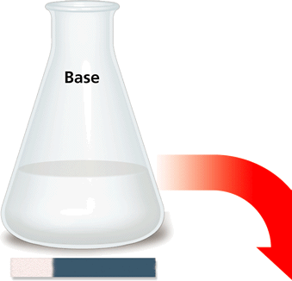
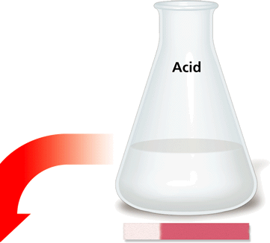
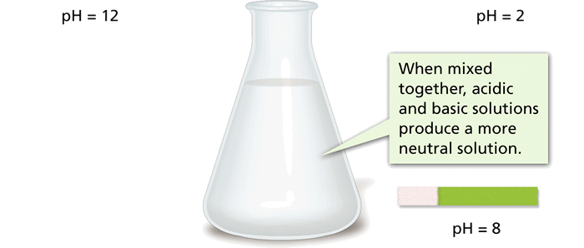
Acid – Base Reactions
A reaction between an acid and a base is called neutralization. An acid-base mixture is not as acidic or basic as the individual starting solutions.

Slide 84
Acid – Base reactions
Each salt listed in this table can be formed by the reaction between an acid and a base.

Slide 85
What kind of reaction?
Double Replacement Reaction

Slide 86
Acids & Bases
For the following identify the acid and the base as strong or weak .
a. Al(OH)₃ + HCl →
b. Ba(OH)₂ + HC₂H₃O₂ →
c. KOH + H₂SO₄ →
d. NH₃ + H₂O →
Weak base
Strong acid
Strong base
Weak acid
Strong base
Strong acid
Weak acid
Weak base

Slide 87
Acids & Bases
For the following predict the product. To check your answer left click on the mouse. Draw a mechanism detailing the proton movement.
a. Al(OH)₃ + HCl →
b. Ba(OH)₂ + HC₂H₃O₂ →
c. KOH + H₂SO₄ →
d. NH₃ + H₂O →
3
AlCl₃ + 3 H₂O
2
Ba(C₂H₃O₂)₂ + 2 H₂O
2
K₂SO₄ + 2 H₂O
NH₄⁺ + OH⁻

Slide 88
pH Scale
pH is a measure of how acidic or basic a solution is.
The pH scale ranges from 0 to 14.
French for hydrogen power (pouvoir hydrogene)
Is used to indicate the hydronium ion concentration of a solution

Slide 89
pH Scale
A change of 1 pH unit represents a tenfold change in the acidity of the solution.
For example, if one solution has a pH of 1 and a second solution has a pH of 2, the first solution is not twice as acidic as the second—it is ten times more acidic.

Slide 90
pH scale
The pH scale is used to measure the [H⁺] and [OH⁻] in solution.
[H⁺]
[OH⁻]
0 1 2 3 4 5 6 7 8 9 10 11 12 13 14

Slide 91
pH values greater than 7 have low [H+] and are basic (8, 9, 10 . . .)
pH values less than 7 have high [H+] and are acidic (6, 5, 4 . . .)
[H⁺]
[OH⁻]
0 1 2 3 4 5 6 7 8 9 10 11 12 13 14

Slide 92
AND….
Because pH numbers represent log values based on the power of 10
pH 5 is 10 times more acidic than pH 6
pH 4 is 100 times more acidic than pH 6

Slide 93
[H⁺]
[OH⁻]
0 1 2 3 4 5 6 7 8 9 10 11 12 13 14

Slide 94
Water is neutral
Water ionizes (only slightly) into equal concentrations of H+ and OH- ions.
In 1.0L of water there are
[H+] = 1.0x10⁻⁷ M and [H+] = 1.0x10⁻⁷ M
When multiplied together they give you the ion product constant for water!

Slide 95
Ways to Check for PH

Slide 96
pH paper
pH paper changes color to indicate a specific pH value.

Slide 97
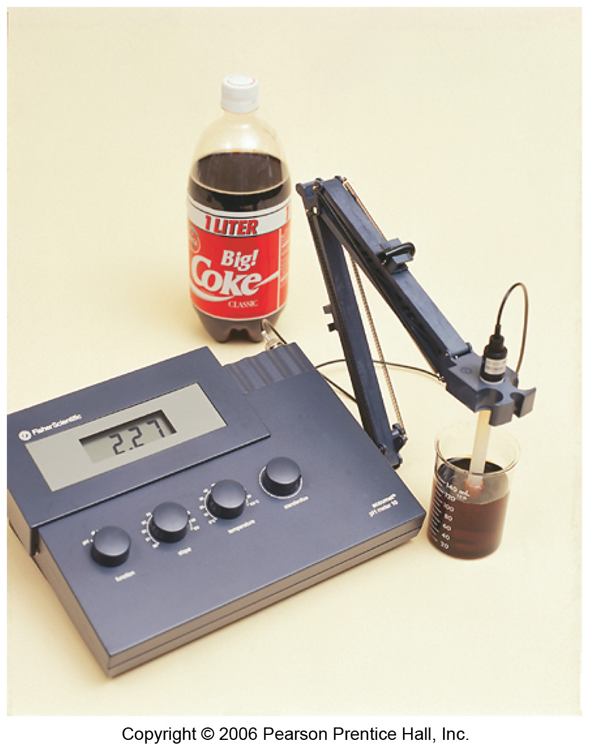
Fig 16.6
Figure 16.6 A digital pH meter. The device is a millivoltmeter, and the electrodes immersed in the solution being tested produce a voltage that depends on the pH of the solution.
BACK

Slide 98
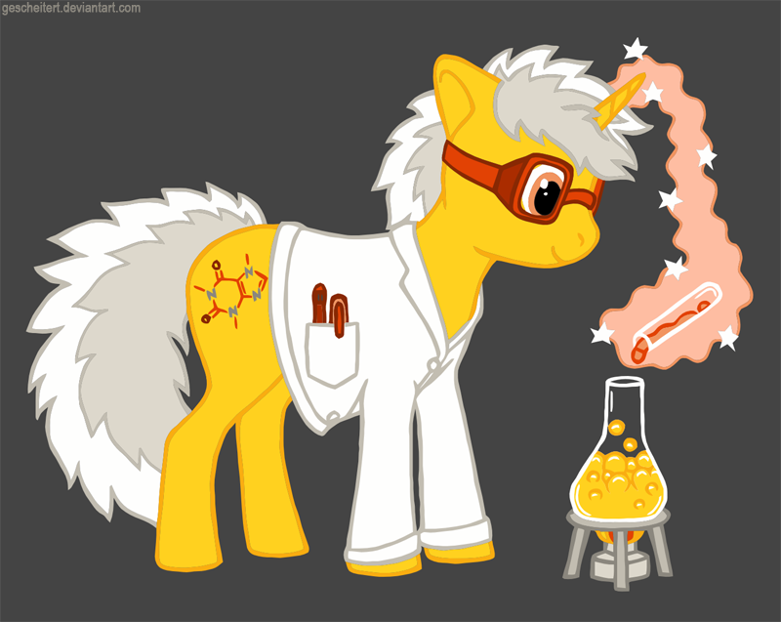
Situations in which pH is controlled
“Heartburn”
Planting vegetables and flowers
Fish Tanks and Ponds
Blood
Swimming pools

Slide 99
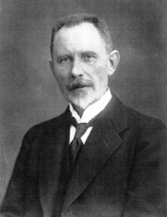
pH numbers?
The concept of pH was first introduced by Danish chemist SØren SØrenson in 1909
SØren SØrenson decide that expressing [H⁺] in scientific notation is tooooooo looooooooooooong
It’s more convenient to express [H⁺] in terms of pH (0-14)
pH = -log [H⁺]

Slide 100
[OH⁻]
1.0 x 10⁻¹⁴
[OH⁻]
10^{-pOH}
1.0 x 10⁻¹⁴
[H⁺]
-Log[OH⁻]
[H⁺]
pOH
10^{-pH}
14 - pOH
-Log[H⁺]
14 - pH
pH

Slide 101
pH = -log [H⁺]

Slide 102
FORMULAS
Ka (Kb) = Kw
pH = - log [H₃O⁺]
pOH = -log [OH⁻]
pH + pOH = 14

Slide 103
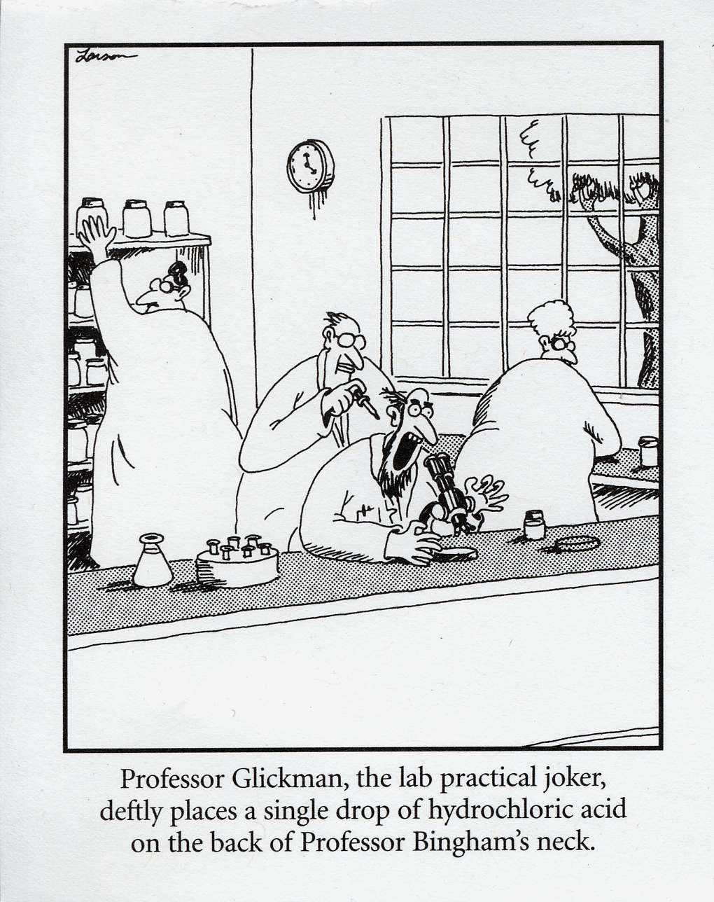
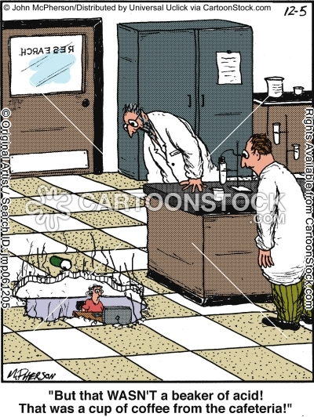

Slide 104
LOGS
If [H+] is given, find the absolute value of the log
That’s your pH
If pH is given, find the antilog (10^{x)} of the negative number
That’s your [H+]
What if [OH⁻] is given?

Slide 105
If you know one, you know them all:
[H⁺]
[OH⁻]
pH
pOH

Slide 106
pH practice
Find the pH for solutions having the following [H+]
1 x 10⁻⁴ M
1 x 10⁻¹¹ M
Find [H+] given these pH
2
8
pH are not always whole numbers
The pH of an unknown solution is 6.35, what is the [H⁺] & [OH⁻]?

Slide 107
Now for some examples
Find the pH and pOH, when [H⁺] = 10⁻⁴

Slide 108
Now for an example
Find the pH and pOH, when [H⁺] = 10⁻⁴
pH = 4 and pOH = 10, since they must add to 14
using the calculator pH = -log [H⁺], type in 10⁻⁴, push the log button and pH = -(-4) = 4. Same for pOH

Slide 109
Given the following [H3O] concentration determine the pH
A. 1 x 10⁻³
answer: 3
B 1 x 10⁻⁵
Answer: 5

Slide 110
Determine the pH of each of the following solutions
Answer: 4
A. 0.01 M HCl
Answer : 2
B. .0001 M HCl
Answer: 4
C. .00001 M NaOH
Answer: 9

Slide 111
Given the following [OH] concentration determine the pH
A. 1 x 10⁻³
answer: 11
B 1 x 10⁻⁵
Answer: 9

Slide 112
Determine the pH of each solution when given the following
A. 2 x 10⁻⁵
Answer 4.69
B. 3.8 x 10⁻³
Answer: 2.42
You will need to use your calculator for these
pH = -log [H⁺]

Slide 113
Given the following pH values, determine the [H3O]
A. 3
Answer: 1 x 10⁻³
B 8
Answer: 1 x 10⁻⁸

Slide 114
Given the following pOH values, determine the [H3O]
A. 3
Answer: 1 x 10⁻¹¹
B 8
Answer: 1 x 10⁻⁶

Slide 115
Determine the [H3O] for each of the solutions with the following pH solution
A. 4.23
Answer: shift log -4.24
5.8 x 10⁻⁵
B. 9.48
Answer: shift log -9.48
3.31 x 10⁻¹⁰
You will need to use your calculator for these
You will be using antilog
[ ] means concentration

Slide 116
pH & indicators Table M
Approximate range of pH color change
methyl orange
3.2 - 4.4
Red to Yellow
bromthymol blue
6.0 - 7.6
Yellow to Blue
phenolphthalein
8.2 - 10
Colorless to pink
litmus
5.5 - 8.2
Red to blue
bromcresol green
3.8 - 5.4
Yellow to blue
thymol blue
8.0 - 9.6
Yellow to blue

Slide 117
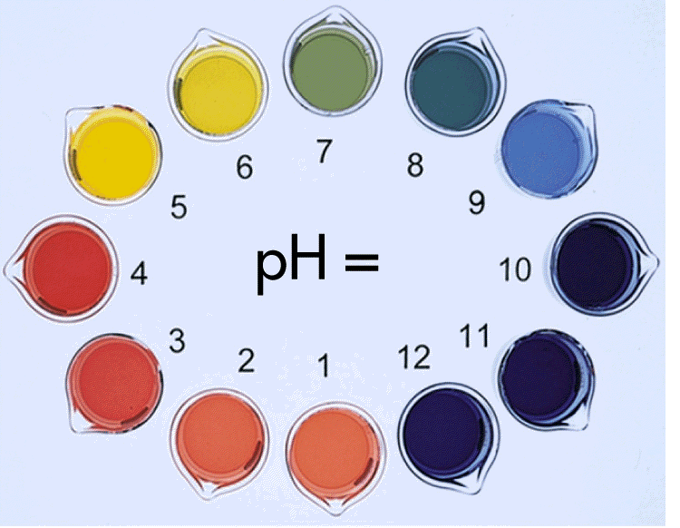
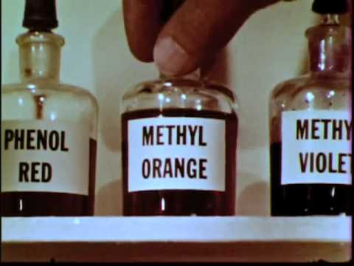
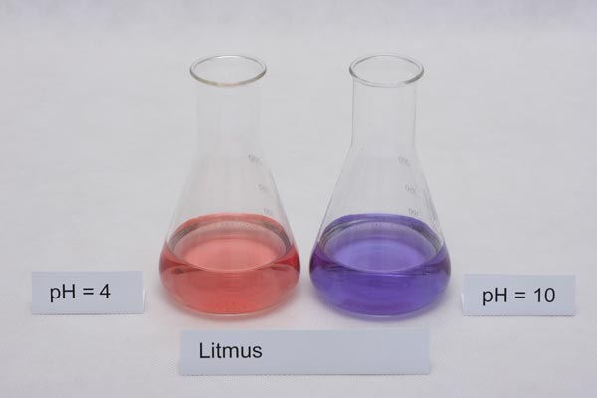
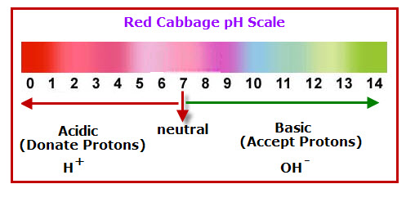
Indicators
Indicators are weak organic (carbon containing) acids of various colors depending on the formula of the acid.
HA  H⁺ + A⁻
colorless
pink

Slide 118
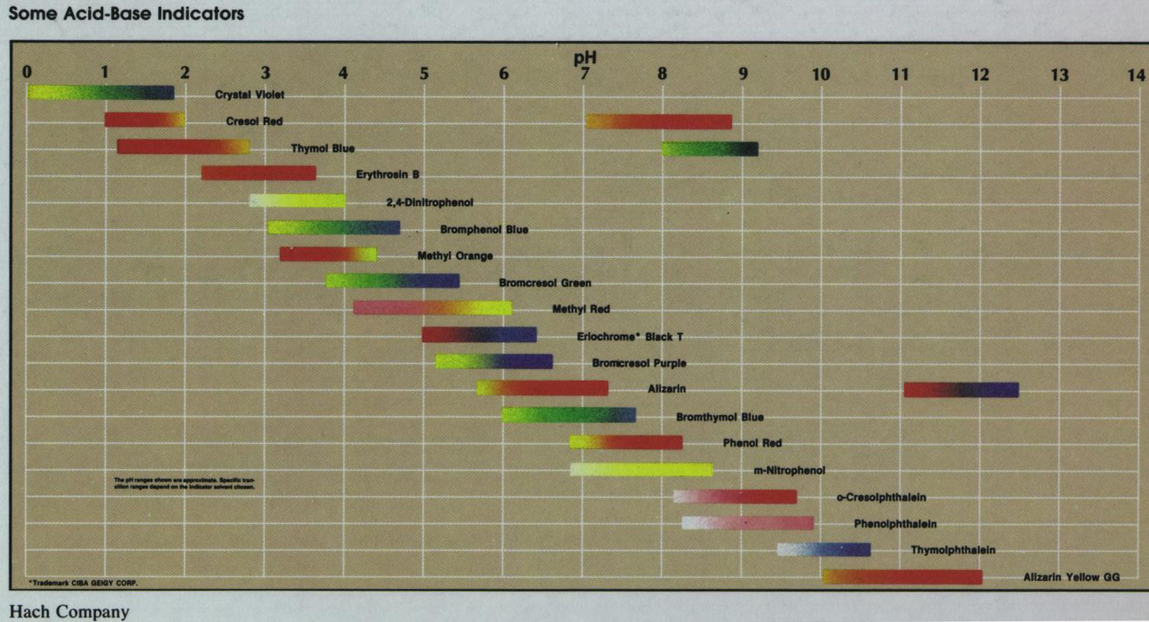
Color versus pH of Many Different indicators

Slide 119
Indicators are general divide into 3 types
This is according to the pH at which they change color
Those that change color at pH of 7 ex bromethynol blue (good for strong acid and base)
Those that change color at pH lower than 7 ex methyl red ( good for strong acid and weak base)
Those that change color at pH higher than 7 ex phenolphthalein (good for weak acid and strong base

Slide 120
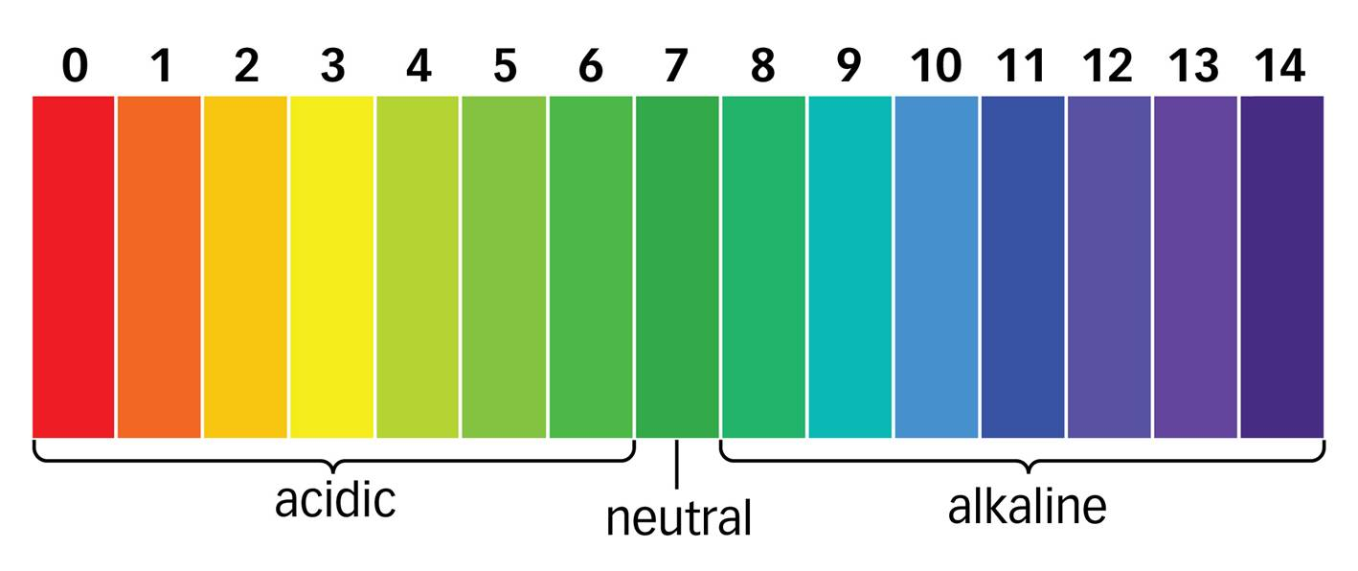
Universal Indicator
Can be made by mixing several different indicators solutions together
The strips of paper can be soaked in universal indicator solution to produce pH paper

Slide 121
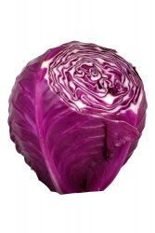
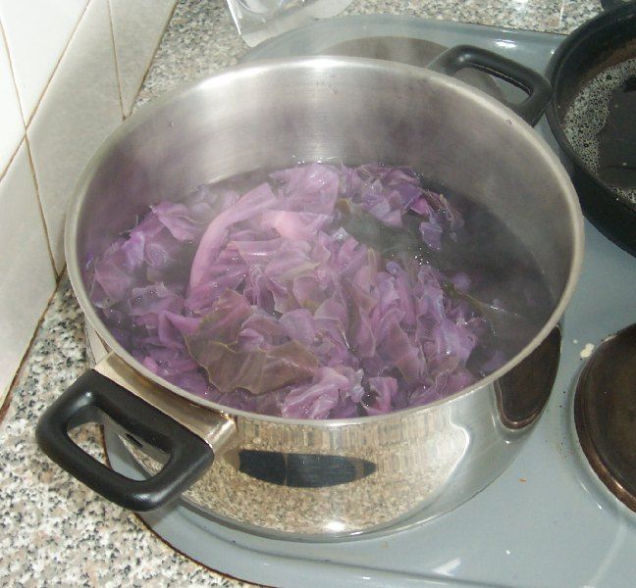
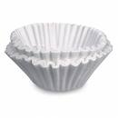
How can we make an indicator?
Step One
Step Two
Step Three
Red Cabbage
Cook the Cabbage
Filter the Juice

Slide 122
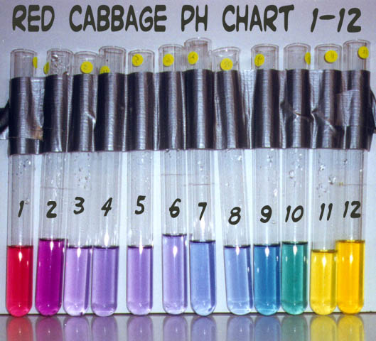
What color is the juice after filtering?

Slide 123
What color is the juice after filtering? The color of pH 6, 7, or 8
Colors of cabbage juice at various pH values

Slide 124
Methyl orange
Bromthymol blue
phenolphthalein
litmus
Bromcresol green
Thymol blue
0 1 2 3 4 5 6 7 8 9 10 11 12 13 14

Slide 125
Amphoteric / Amphiprotic substance
Acts either as an acid or a base
Water, NH₃ & others……
Sometimes accepts an H⁺
Sometimes donates an H⁺

Slide 126
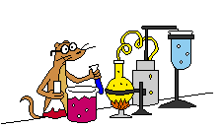
Buffers
A buffer is a mixture of chemicals that make a solution resist a change of pH
pH remains relatively constant when adding an acid or base
A buffer is either a solution of a weak acid and one of its salts or a weak base and one of its salts
The salt cation is only a spectator ion and is not involved in the reaction

Slide 127
Buffer Capacity
Buffers can’t stop the change in pH they can only resist it
There comes a point when the buffer is “used up”
It can no longer take H⁺ ions out of solution and the pH begins to change

Slide 128
This is important when the system is fragile
Bloodstream pH 7.3 > 7.5
If < 6.9 or > 7.7 the person dies
Buffer aids in maintaining homeostasis of the individual
The buffer species in the blood is
carbonic acid / hydrogen carbonate ion
H₂CO₃ / HCO₃⁻

Slide 129
If the blood is too alkaline, the reaction decreases the amount of OH⁻ in the bloodstream
H₂CO₃ + OH⁻ → HOH + HCO₃⁻
If excess H⁺ is in the blood, the reaction
decreases it
H⁺ + HCO₃⁻ → H₂CO₃

Slide 130
EQUIVALENTS NORMALITY
Chemists often find it convenient to use “equivalents” instead of “moles” to quantify the amount of a substance.
The purpose for using equivalents instead of moles is that equivalents are defined so that one equivalent of any acid will react with one equivalent of any base

Slide 131
EQUIVALENTS OF ACIDS AND BASES
Acids
An equivalent of a protonic acid is defined as the amount of the acid that will donate one mole of hydrogen ions in reactions with bases.
The number of equivalents of an acid equal to one mole of the acid can be determined from its chemical formula.

Slide 132
HCl has only one acidic hydrogen. Thus one mole of HCl is equal to one equivalent (abbreviated “eq”) of HCl, since one mole of HCl donates one mole of H⁺ ions. 1 mol HCl = 1 eq HCl.
H₂SO₄ has two acidic hydrogens. Thus one mole of H₂SO₄ donates two moles of H⁺ ions and contains two equivalents of H₂SO₄. 1 mol H₂SO₄ = 2 eq H₂SO_{4.}

Slide 133
Bases
An equivalent of an hydroxide base is defined as the amount of the base that will react with one mole of hydrogen ions.
Since one mole of hydroxide ions reacts with one mole of hydrogen ions (H⁺ + OH⁻ =H₂O), the number of equivalents of an hydroxide base in one mole of the hydroxide base equals the number of hydroxide ions in the chemical formula of the base.

Slide 134
Therefore for:
Base Mol Eq
NaOH 1 1
Ca (OH)₂ 1 2
Al (OH)₃ 1 3

Slide 135
Equivalent Weight
One mole of a substance is defined as the weight (mass) in grams equal to its molecular weight (MW). Similarly, one equivalent of a substance is the weight in grams equal to its “equivalent weight” (EW).

Slide 136
For HCl, 1 mol HCl = 1 eq HCl. MW of HCl = 36.46; EW of HCl = 36.46.
For H₂SO₄, 1mol H₂SO₄ = 2 eq H₂SO₄. MW of H₂SO₄ = 98.08; EW of H₂SO₄ = 49.04.

Slide 137
Problems Involving Equivalents
Problems involving equivalents, weights, and equivalent weights are similar to those for moles.
Just as the MW was needed for mole problems, the EW is needed for problems with equivalents.
There is a mathematical formula for solving these problems,
#eq = wt (g)/EW

Slide 138
Example problem and solutions
Calculate the #eq of Ca(OH)₂ in 6.32 g of Ca(OH)₂.
EW_{Ca(OH)2} = MW_{Ca(OH)2} = 74.09 = 37.05
2 2

Slide 139
Using the formula: #eq Ca(OH)₂ = wt (g) Ca(OH)₂
EW_{Ca(OH)2}
Ca(OH)₂ = 6.32 g Ca(OH)₂ = 0.171 eq Ca(OH)₂
37.05 g Ca(OH)₂/eq Ca(OH)₂

Slide 140
OR Using dimensional analysis:
6.32 g Ca(OH)₂ x 1 eq Ca(OH)₂ = 0.171 eq Ca(OH)₂
37.05 g Ca(OH)₂

Slide 141
Ex Determine the mass of 1 equivalent of 1 eq of H₂S
Solution:
1mole H₂S x 34.1gH₂S/ 1molH₂S x 1mol/2eq =17.0g
Base problems work the same

Slide 142
NORMALITY
The “normality” (N) of a substance in solution is equal to the number of equivalents of the substance in one liter of solution.
In general, N_{A} = #eq A
#L_{soln}

Slide 143
Example Problem
Calculate the normality of a Ca(OH)₂ solution containing 6.32 g of Ca(OH)₂ in 5.85 L of solution.
N_{Ca(OH)2} = #eq Ca(OH)₂
#L_{soln}

Slide 144
Solution
In the example above, we calculated that 6.32 g Ca(OH)₂ = 0.171 eq Ca(OH)₂.
Thus, N_{Ca(OH)2} = 0.171 eq Ca(OH)₂ = 0.0292 N
5.85 L_{soln}
The solution is said to be a 0.0292 “normal” solution of Ca(OH)₂.
N can stand for the noun, “normality” or the adjective, “normal”

Slide 145
Determine the number of equivalents need to make :
1.5L of 3N solution of HCl
Solution
1.5L HCl x 3N (eq/L) = 4.5 eq HCl

Slide 146
Determine the normality of solution of 1 mole of H₂SO₄ dissolved in 1 liter of solution
Solution
1mole H₂SO₄ x 2 equ/1mole x 1L = 2N

Slide 147
How many milliliters of 1.5 N H₂SO₄ solution would be required to prepare 500 ml of 1.2 N solution of H₂SO₄
Solution:
Step 1 convert ml to liters
Step 2 convert liters to equivalents
Step 3 convert equivalents to liters

Slide 148
Solution:
500 ml = .5L
.5 L x 1.2 N (eq/L) = .6 eq H₂SO₄
.6 eq H₂SO₄ x 1L/1.5 Eq H₂SO₄ ₌ .4L or 400ml

Slide 149
EX What volume of .75 N H₃PO₄ would be required to prepare 2.5 L of .2 M H₃PO₄ solution
Solution
2.5L H₃PO₄ x .2M H₃PO₄(mol/L) x 3 eq/1 L = 1.5 eq
1.5 eq H₃PO₄ x 1L/.75eq = 2 liters

Slide 150
Molarity
Chemists describe solutions in terms of concentration. We define the concentration of a solution as the amount of solute in a given volume of solution.
The most commonly used expression of concentration is molarity (M).
Molarity is defined as the number of moles of solute dissolved in a liter of solution.
A 1.0 M solution contains 1.0 mol of solute per liter of solution

Slide 151
Molarity
Molarity is calculated using the following equation:
What does this mean for you?
Set-up these problems using dimensional analysis
If you’re given grams, you have to convert grams to moles
If you’re given mL, you have to convert mL to L
M= molarity = moles of solute = mol
liters of solution = L

Slide 152
Molarity Example 1
5.7 g KNO₃ dissolves in a 233 mL solution. What is molarity?
Convert grams to moles
Convert mL to L
Divide mol/L
5.7 g KNO₃ 1 mol KNO₃ = 0.056 mol KNO₃
101.10 g KNO₃
233 mL 1 L = 0.233 L
1000 mL
0.056 mol KNO₃
0.233 L = 0.24 M KNO₃

Slide 153
Molarity Example 2
Calculate the molarity of a solution that has 11.5 g of NaOH dissolved in 1500 mL of solution
Convert grams to moles
Convert mL to L
Divide mol/L
11.5 g NaOH 1 mol NaOH = 0.288 mol NaOH
40.0 g NaOH
1500 mL 1 L = 1.5 L
1000 mL
0.288 mol NaOH
1.5 L = 0.19 M NaOH

Slide 154
Working Backwards
If you know the molarity of a solution, you can work backward to find the volume or the mass of solute dissolved.
Liters of solution x molarity = moles of solute (convert moles to grams, if necessary
Moles of solute/molarity = liters of solution

Slide 155
Example 3
How many moles of AgNO₃ are present in 25 mL of a 0.75 M solution?
Convert mL into L
Liters of solution x molarity = moles of solute
0.025 L x 0.75 M = 0.0019 mol AgNO₃
25 mL 1 L = 0.025 L
1000 mL

Slide 156
Example 4
Formalin, HCHO, is used in preserving specimens. How many grams of HCHO must be used to prepare 2.5 L of 12.3 M formalin?
Get moles of solute
2.5 L x 12. 3 M = 31 mole HCHO
Convert moles to grams
Therefore, 2.5 L of 12.3 M formalin contains 930 g of HCHO
31 mol HCHO 30.026 g HCHO = 930 g HCHO
1 mol HCHO

Slide 157
Conversion of Normality to Molarity and Molarity to Normality
A problem that comes up frequently is to calculate the normality of a molar solution and vice versa.
To keep from getting confused, remember that #eq > #mol, and therefore N > M.
For acids, N = nM, where n is the number of acidic hydrogens in the chemical formula of the acid.

Slide 158
For hydroxide bases, N = nM, where n is the number of hydroxide ions in the chemical formula of the base.
Examples
6.0 M HCl = 6.0 N HCl;
3.0M H₂SO₄ = 6.0 N H₂SO₄;
0.050 N Ca(OH)₂ = 0.025 M Ca(OH)₂

Slide 159
Ex What is the molarity of .06 N Sr(OH)₂ solution
Solution
For hydroxide bases, N = nM, where n is the number of hydroxide ions in the chemical formula of the base.
.06N = 2M
M = .03

Slide 160
M1V1 =M2V2
Example
How much concentrated 18M sulfuric acid is needed to make 300 ml of 6 M solution

Slide 161
Solution
M1V1 =M2V2
M1 = 18M M2 = 6M
V1 = ? V2 = 300 ml
Solve for x
X = 100 ml sulfuric acid
So that 200 ml would be water

Slide 162
2. 5.00 g KOH is dissolved in 250. mL of water, calculate the molarity.
Molarity =

Slide 163
2. 5.00 g KOH is dissolved in 250. mL of water, calculate the molarity.
Molarity = 5.00 g

Slide 164
2. 5.00 g KOH is dissolved in 250. mL of water, calculate the molarity.
Molarity = 5.00 g x 1 mole
56.11 g

Slide 165
2. 5.00 g KOH is dissolved in 250. mL of water, calculate the molarity.
Molarity = 5.00 g x 1 mole
56.11 g
0.250 L

Slide 166
2. 5.00 g KOH is dissolved in 250. mL of water, calculate the molarity.
Molarity = 5.00 g x 1 mole
56.11 g
---------------------------
0.250 L
= 0.356 M

Slide 167
3. How many moles are there in 205. mL of a 0.172 M solution?

Slide 168
3. How many moles are there in 205. mL of a 0.172 M solution?
0.205 L

Slide 169
3. How many moles are there in 205. mL of a 0.172 M solution?
0.205 L x 0.172 moles
1 L

Slide 170
3. How many moles are there in 205. mL of a 0.172 M solution?
0.205 L x 0.172 moles = 0.0353 moles
1 L

Slide 171
4. How many grams NaCl are there in 250.0 mL of 0.500 M solution?

Slide 172
4. How many grams NaCl are there in 250.0 mL of 0.500 M solution?
0.250 L

Slide 173
4. How many grams NaCl are there in 250.0 mL of 0.500 M solution?
0.250 L x 0.500 moles
1 L

Slide 174
4. How many grams NaCl are there in 250.0 mL of 0.500 M solution?
0.250 L x 0.500 moles x 58.5 g
1 L 1 mole

Slide 175
4. How many grams NaCl are there in 250.0 mL of 0.500 M solution?
0.250 L x 0.500 moles x 58.5 g = 7.31 g
1 L 1 mole

Slide 176
5. How many grams of NaCl must be used to prepare a 100.0 mL of 0.250 M solution.

Slide 177
5. How many grams of NaCl must be used to prepare a 100.0 mL of 0.250 M solution.
0.1000 L

Slide 178
5. How many grams of NaCl must be used to prepare a 100.0 mL of 0.250 M solution.
0.1000 L x 0.250 moles
1 L

Slide 179
5. How many grams of NaCl must be used to prepare a 100.0 mL of 0.250 M solution.
0.1000 L x 0.250 moles x 58.5 g
1 L 1 mole

Slide 180
5. How many grams of NaCl must be used to prepare a 100.0 mL of 0.250 M solution.
0.1000 L x 0.250 moles x 58.5 g = 1.46 g
1 L 1 mole

Slide 181
6. How many millilitres of a 0.200 M solution of CoCl₂ will contain 25.0 g?

Slide 182
6. How many millilitres of a 0.200 M solution of CoCl₂ will contain 25.0 g?
25.0 g

Slide 183
6. How many millilitres of a 0.200 M solution of CoCl₂ will contain 25.0 g?
25.0 g x 1 mole
129.9 g

Slide 184
6. How many millilitres of a 0.200 M solution of CoCl₂ will contain 25.0 g?
25.0 g x 1 mole x 1 L
129.9 g 0.200 mol

Slide 185
6. How many millilitres of a 0.200 M solution of CoCl₂ will contain 25.0 g?
25.0 g x 1 mole x 1 L x 1000 mL
129.9 g 0.200 mol 1 L

Slide 186
6. How many millilitres of a 0.200 M solution of CoCl₂ will contain 25.0 g?
25.0 g x 1 mole x 1 L x 1000 mL = 962 mL
129.9 g 0.200 mol 1 L

Slide 187
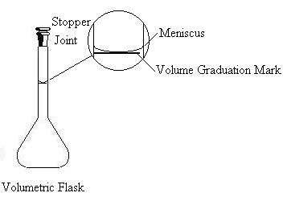
7. Describe how you would prepare 100.0 mL of a 0.200 M solution of CoCl₂.
0.1000 L x 0.200 moles x 129.9 g = 2.60 g
1 L 1 mole
Weigh 2.60 g of CoCl₂
Dissolve in water
Transfer to a 100 mL
volumetric flask and fill to the line

Slide 188
Titrations
Lab procedure used to determine a concentration (M) of a solution.
Titrations use an indicator to signal when the “endpoint” is reached
Endpoint is when the solution is neutralized
Indicator changes color

Slide 189
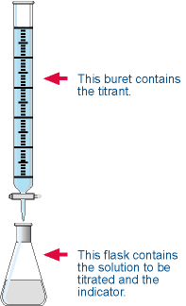
Titration
Titration is an experimental procedure to determine the concentration of an unknown acid or base.
The figure on the left shows the glassware for a titration experiment. A buret clamp holds the buret to a ring stand and below the buret is a flask containing the solution to be titrated, which includes an indicator. The purpose of the indicator is to indicate the point of neutralization by a color change.

Slide 190
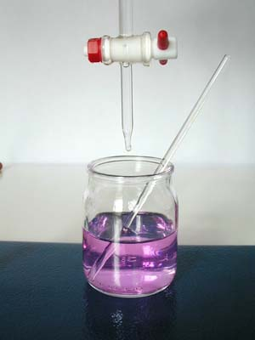
The picture on the left shows the tip of a buret, with air bubble, which is not good, and also shows the stop-cock.
Note the position of the stop-cock is in the “off” position.
This picture shows the color of the phenolphthalein indicator at the end-point.
NaOH + HCl  NaCl + HOH

Slide 191
Titrations are reactions in which we measure the volume of a standardized solution (e.g. NaOH) that reacts stoichiometrically with an acid.
In an acid-base reaction, using the concept of equivalents, we know that at the endpoint of a titration:
#eq base = #eq acid.

Slide 192
EX Titration Problem
For the acid/base titration combination of HNO₃ with KOH determine the number of moles of HNO₃ that would be required to react with .75 mol of KOH

Slide 193
Solution
Step 1 write a balance equation
Step 2 convert moles of chemical “A” to moles of chemical “B”
HNO₃ + KOH → HOH + KNO₃
.75 mol KOH x 1mol HNO₃ /1mol KOH = .75 mol HNO₃

Slide 194
EX If 15 ml of .025M aq sulfuric aid is required to neutralize 10 ml of aq solution of potassium hydroxide, what is the molarity of KOH solution
Step1 write a balance equation
Step 2 convert liters “A” to moles “A”
Step 3 convert moles “A” to moles “B”
Step 4 molarity = moles/Liter
so that
molarity of B = MolesB/Liters B

Slide 195
Step1 write a balance equation
H₂SO₄ + 2KOH → 2HOH + K₂SO₄
Step 2 convert liters “A” to moles “A”
.015L H₂SO₄ x .25 M H₂SO₄ (mol/L) = .000375 mol H₂SO₄

Slide 196
Step 3 convert moles “A” to moles “B”
.000375 H₂SO₄ x 2 mol KOH/1mol H₂SO₄ = .00075 mol KOH
Step 4 molarity = moles/Liter
.00075M/ .010L = .0750 M KOH

Slide 197
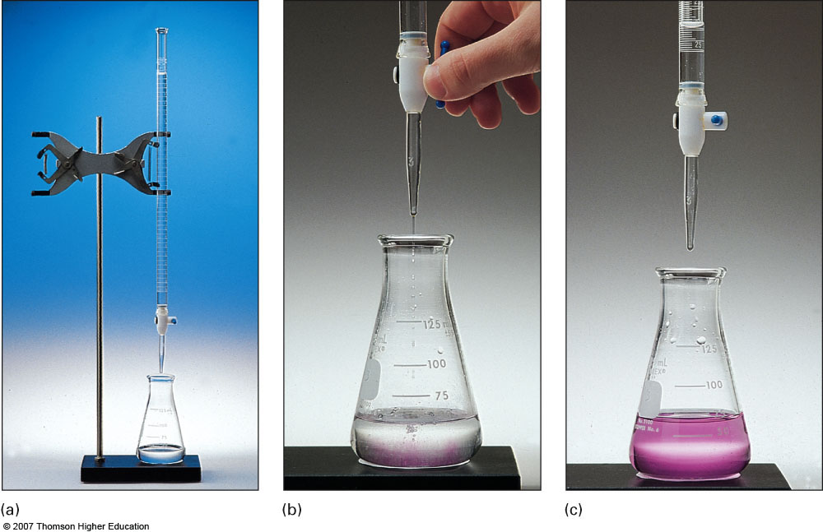
Molarity and Titration

Slide 198
Chemical Reactions of Acids, Bases and oxides
Compounds with acidic properties and compounds with basic properties often react with each other.
One major similarity is that in each type of reaction listed, one of the products is a salt

Slide 199
Types of Reactions
1. Acids react with many metals
It isa single replacement reaction with salts and hydrogen gas being given off

Slide 200
What type of Reaction?
Single Replacement Reactions

Slide 201
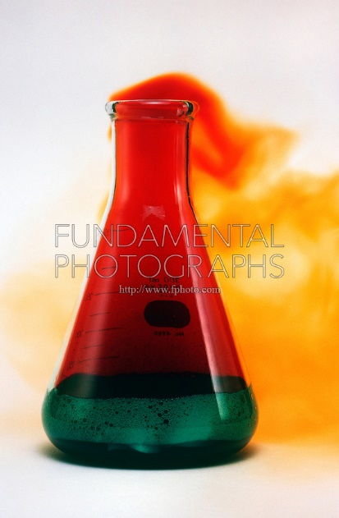
Write the balanced equation for the reaction that occurs between
Mg + HCl
Mg + 2HCl H₂ + MgCl₂
Zn + 2HNO₃ H₂ + Zn(NO₃)₂
Zn + HNO₃
Al + HBr
2Al + 6HBr 3H₂ + 2AlBr₃

Slide 202
2. Acids react with metal oxides
The products are a salt and water
Ex CuO + H₂SO₄ → CuSO₄ + H₂O

Slide 203
Acids react with carbonates
The products of are salt, water, and carbon dioxide
Ex
CaCO₃ + HCl → CaCl₂ + CO + H₂O

Slide 204
Hydroxides react with nonmetal oxides
The product is a salt or a salt and water depending on the quantities of reactants and their identity
EX
CO₂ + 2NaOH → Na₂CO₃ + H₂O
1mole 2 mole
CO₂ + NaOH → NaHCO₃
1 mole 1 mole

Slide 205
Oxidizing reactions
Reaction in which atoms/ions of an element lose 1 or more electrons and attain a more positive oxidation state
The most common oxidizing acids are hot concentrated sulfuric acid, nitric acid, and chlorine-containing oxyacids

Slide 206
Hot concentrated sulfuric acid reacts to form hydrogen sulfide and water
Ex
Zn + 5H₂SO₄ → 4ZnSO₄ + H₂S + 4H₂O

Slide 207
Nitric acid produces several different products depending upon the acid concentration and the reactant
Dilute produces the nitrogen containing product and nitrogen monoxide and water
Ex 3Cu + 8HNO₃ (aq) → 3 Cu(NO₃)₂ + 2NO + 4H₂O

Slide 208
Concentrated nitric acid produces the nitrogen contaning product, nitrogen dioxide and water
Ex Cu + 4HNO₃ (conc) → Cu(NO₃)₂ + 2NO₂ + 2H₂O

