Slide 1
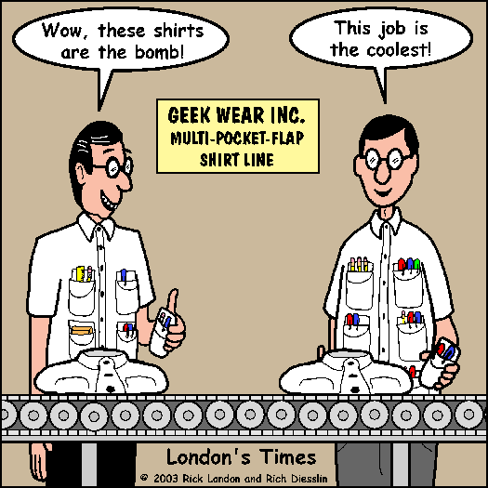
Unit 2: Alkanes, alkenes and alkynes

Slide 2
Hydrocarbons
Are compounds that contain only carbon and hydrogen.
There are three main classes of hydrocarbons based on the types of carbon-carbon bonds present:
1. Saturated hydrocarbons: contain single bonds only ( alkanes)
2. Unsaturated hydrocarbons: contain multiple bonds ..double or triple (alkenes, alkynes
3. Aromatic hydrocarbons: contain cyclic compounds

Slide 3
Alkanes
Alkanes are the simplest organic molecules, they only contain C and hydrogen, and only contain single bonds.
Compounds that have the maximum number of bonded hydrogens, are said to be saturated.
Alkanes are saturated hydrocarbons.
General Formula: C^{n}H^{2n+2}
The simplest members of this group are the n-alkanes.
The n-alkanes are straight chain molecules, but there are also branched alkanes (isomers).

Slide 4
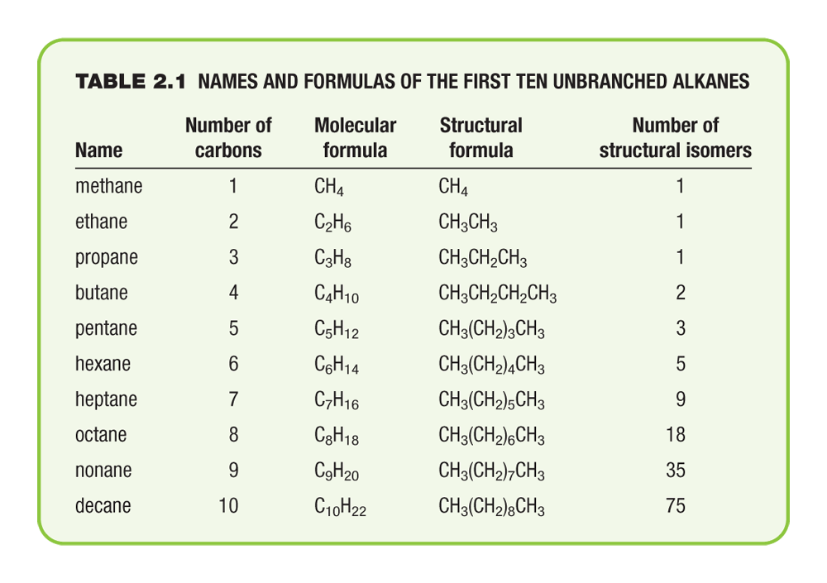
Names and Formulas of the First Ten Unbranched Alkanes

Slide 5
Any series that differs only by an increasing number of –CH²- groups is known as a Homologous series. The individual members are said to be homologs of each other.
The –CH₂- group is called a methylene group

Slide 6
Nomenclature of Organic Compounds
In the early days of organic chemistry, new compounds were given names based on their origin or molecular shapes ex limonene ( lemons) cubane ( shape)
Today, because of the shear number of organic compounds, a systematic naming system is used.
This naming system was devised by the International union of Pure and Applied Chemistry (IUPAC)

Slide 7
Nomenclature of Alkanes
There are two general types of nomenclature:
trivial names (acetone, acetic acid)
IUPAC System (propanone, ethanoic acid)

Slide 8
IUPAC Rules: The systematic way to name all organic compounds.
For alkanes:
(1) Find the longest continuous chain of carbon atoms. This is the base name of the compound.
(2) Number the longest chain beginning with the end nearest a substituent.
(3) Name the substituent groups attached to the longest chain as alkyl groups. Also state the location of each alkyl group according to its numbered carbon on the main chain.
(4) When two or more substituents are present, list them in alphabetical order. If two or more of the same alkyl groups are present, use the prefixes di-, tri- etc to avoid repetition.

Slide 9
Prefixes are used when there are more than one type of alkyl substituent
Di = 2
Tri = 3
Tetra = 4
Penta = 5
The prefixes do not count when alphabetizing.
Example the compound 3-ethyl-2,4,5-trimethylheptane

Slide 10
Little chains coming off the parent chain are called alkyl groups and have a yl ending using the prefixes for the number of carbons
They also can be abbreviated further
Example:
ethyl Et-
Propyl Pr-
Isopropyl iPr-

Slide 11
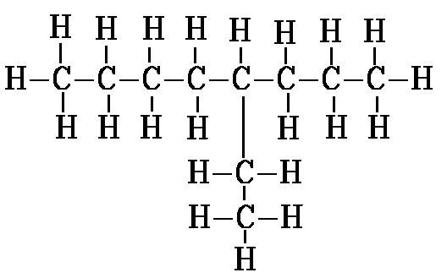
Example: 3-methylhexane

Slide 12

If there are two chains of equal length, choose the chain that has the highest number of substituents.
The numbering system in the second drawing is the correct one.
The correct name is:3-ethyl-2-methylhexane.
The incorrect numbering system would have lead to the incorrect name 3-isopropylhexane

Slide 13
IMPORTANT NOTE
: WHEN THERE IS MORE THAN ONE SUBSTITUENT, THE SUBSTITUENTS ARE LISTED IN ALPHABETICAL ORDER, not arranged according to the numbers of their respective positions (see above: 3-ethyl-2-methyl not 2-methyl-3-ethyl).

Slide 14
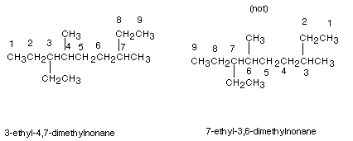
There is also a tie-breaker for numbering the parent chain. If a first substituent occurs equally close to either terminus of the parent chain, the nearness of the second substituent to the termini of the chain is determinative (and so on, to the third or fourth substituent, if necessary).
Example:

Slide 15
Note that in the first numbering system, the first substituent when numbering from left to right is an ethyl group at the 3 position; also when numbering from right to left (second structure) the first substituent is encountered at the 3 position also (methyl).
A tie-breaker is therefore needed.
In the left to right numbering, the second substituent is encountered at the 4 position (methyl) , while in the right to left numbering, the second substituent (also methyl) is at the 6 position.
So the left to right system is chosen.

Slide 16
Complex Substituent Nomenclature
Substituents other than methyl, ethyl, propyl, butyl etc. are also named preferably using IUPAC systematic nomenclature.
The rules are essentially the same as for naming alkanes except for the following:
(1) Numbering in the parent chain of the substituent begins at the carbon atom having the unspecified valence
(2) the family suffix for a substituent , as noted earlier, is -yl.

Slide 17
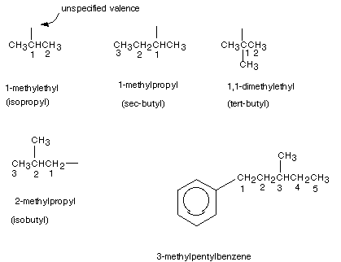
Examples of the IUPAC naming of a number of substituents are given below. Also given are the "common" or "trivial" names of the more common substituents.

Slide 18
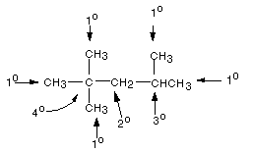
PRIMARY, SECONDARY, TERTIARY, AND QUATERNARY CARBON ATOMS
Primary carbons:are carbons which are attached to only one other carbon atom. In an alkane, these are methyl groups.
Secondary carbons: are carbons which are attached to two other carbon atoms.
Tertiary carbons: are carbons bonded to three other carbons.
. Quaternary carbons are carbon atoms which are directly bonded to four other carbon atoms.

Slide 19
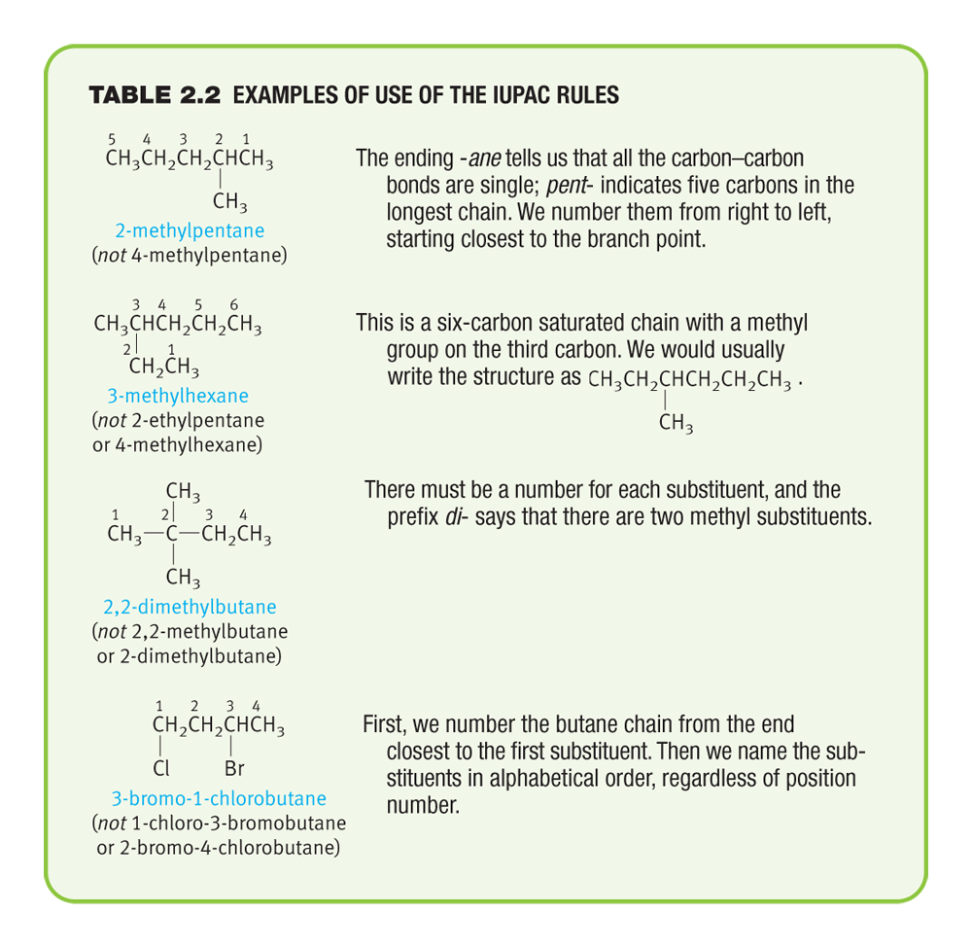
Examples of Use of the IUPAC Rules

Slide 20
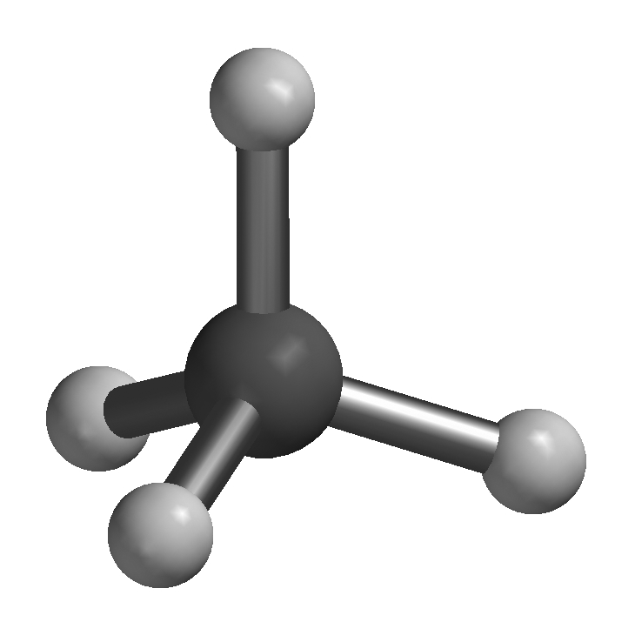
Methane -- ball-and-stick

Slide 21
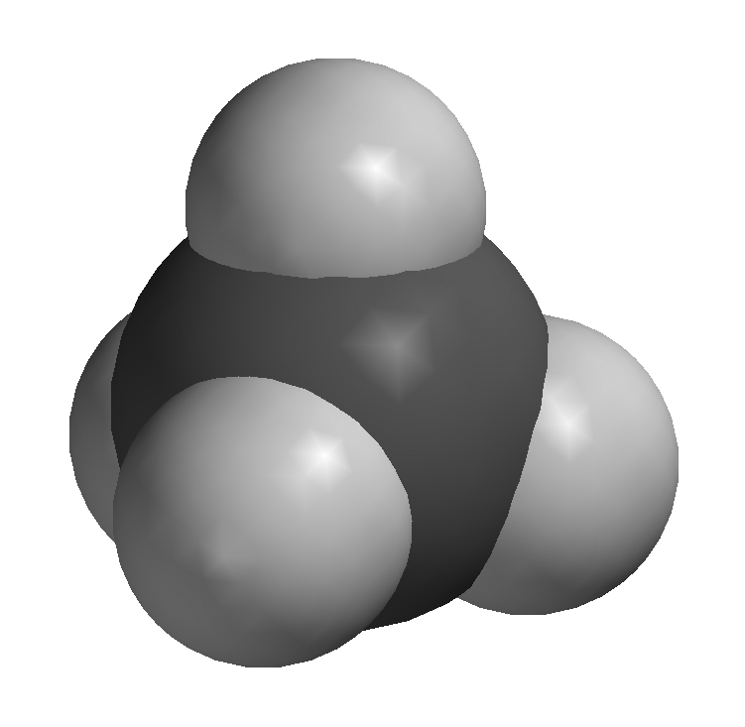
Methane -- space-filling model

Slide 22
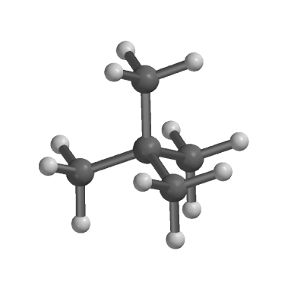
2,2-Dimethylpropane ball-and-stick model

Slide 23
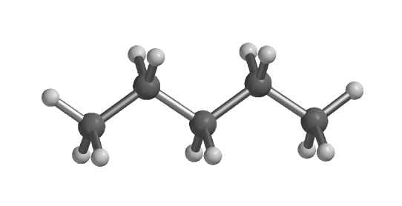
Pentane: ball-and-stick model

Slide 24
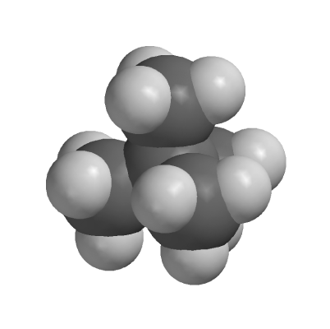
2,2-Dimethylpropane space filling model

Slide 25
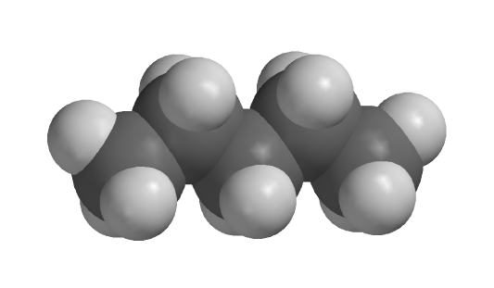
Pentane: space filling model

Slide 26
Cycloalkanes
Cycloalkanes are alkanes in which the carbon skeleton is cyclic.
Basically any ring size, even including very large sizes, is possible.
The general formula is C_{n}H_{2n}, since there are two less hydrogen atoms in these compounds than in acylic alkanes .
Note that they consist solely of methylene groups, having no terminal methyl groups as do alkanes.
They are named simply as the acyclic alkane of the same number of carbon atoms, with the prefix "cyclo" attached to that name, using no separator.

Slide 27
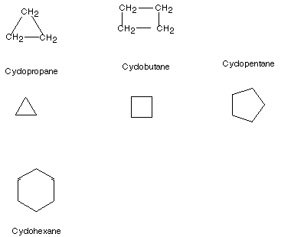
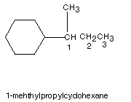
cycloalkanes
Substituent Nomenclature is also useful in naming cycloalkanes.

Slide 28
Parent Chain
Use the cycloalkane as the parent chain if it has a greater number of carbons than any alkylsubstituent.
If an alkyl chain off the cycloalkane has a greater number of carbons, then use the alkyl chain as the parent and the cycloalkane as a cycloalkyl-substituent

Slide 29
Nomenclature of Substituted Cycloalkanes:
In naming substituted cycloalkanes, some additional rules are needed:
If there is only one substituent, no locant is needed. By definition, that ring position attached to the substituent would be number 1.
If there are two substituents, the number 1 carbon is one of the two substituted carbons, but which? The one which would be listed first in the alphabetized list of substituent .
Number toward the second substituent in the direction which yields the lower number for the carbon bearing that second substituent.

Slide 30
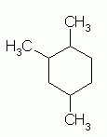
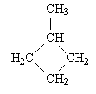
1,2,4 trimethyl cyclohexane
Methyl cyclobutane

Slide 31
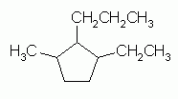
Numbering the Cycloalkane
When numbering the carbons of a cycloalkane, start with a substituted carbon so that the substituted carbons have the lowest numbers (sum).
When two or more different substituents are present, number according to alphabetical order.
example: 1 ethyl,2 propyl, 3 methyl cyclopentane

Slide 32
Halogen Substituents
Halogen substituents are treated exactly like alkyl groups
The halogen substituents are named by changing the ine ending of the element to –o
F- flouro
Cl- cholor
Br- bromo
I- iodo

Slide 33
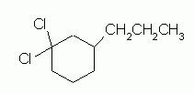
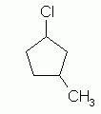


Practice Naming

Slide 34
1,2 dichoro, 4 propyl cyclohexane
1 choro, 3 methyl cyclpentane
1 bromo, 2 choro cyclobutane
1 bromo, 2 chloro, 3 methyl cyclobutane

Slide 35
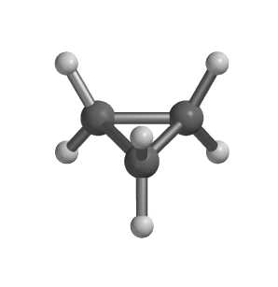
Ball-and-stick model of cyclopropane

Slide 36
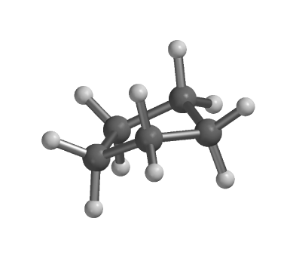
Ball-and-stick model of cyclopentane

Slide 37
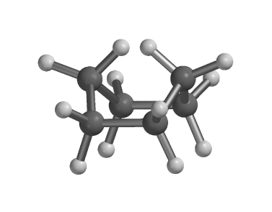
Ball-and-stick model of boat cyclohexane

Slide 38
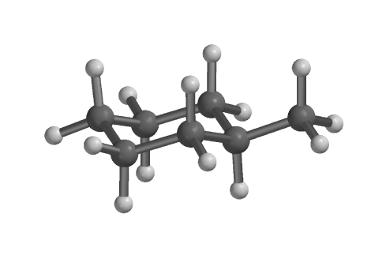
Ball-and-stick model of methylcyclohexane

Slide 39
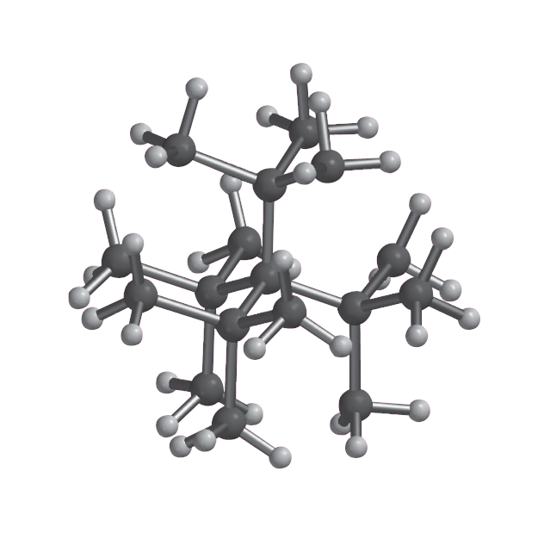
tetra-t-butylmethane -- ball-and-stick

Slide 40
Sources and properties of Alkanes
The 2 most important natural sources of Alkanes are petroleum and natural gases ( 80% methane and 5 to 10% ethane with remainder some higher alkanes
Natural gas, gasoline, oils and paraffin wax are all alkanes, and so alkanes are often used as fuels, lubricants and solvents.
Alkanes are non-polar, and are said to be Hydrophobic (‘water hating’) since they do not dissolve in water.

Slide 41
Typically the density of alkanes is around 0.7g/ml, and so when an alkane and water are mixed, they will form two separate phases, with the alkane on top. (Oil floats on water)
So alkanes are insoluble in water
They have lower boiling points for a given molecular weight than most other organic compounds since they are nonpolar.

Slide 42
They are constantly moving and the electrons in a nonpolar molecule can become unevenly distributed causing the molecule to have partially positive and partially negative ends..thus weekly attracted to each other ( Van der Waals attraction)
The boiling points of alkanes rise as the chan length increases and falls as the chains become branched and more nearly spherical in shape

Slide 43
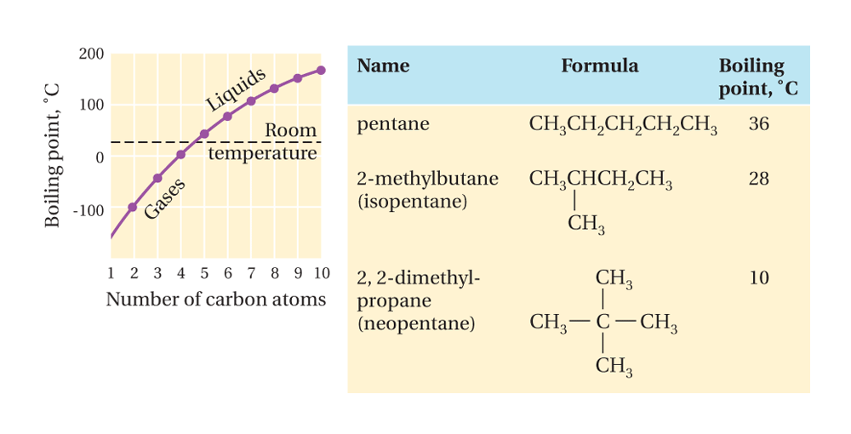
Boiling points of the normal alkanes

Slide 44
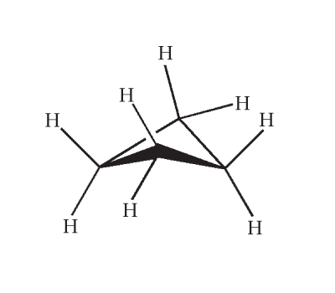
Cyclobutane structure

Slide 45
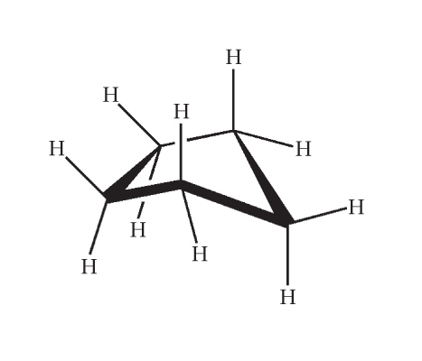
Cyclopentane structure

Slide 46
Conformations of alkanes
The shapes of molecules often affects their properties
One can have an infinite number of shapes as a consequence of rotating one carbon atom with respect to the other carbon atoms.. This is called conformations or conformers.
Conformers are stereoisomers ( isomers in which the atoms are connected in the same order but differ in arranged space)
Examples include staggered conformation and eclipse conformation

Slide 47
Definition: CONFORMATIONS--Different spatial arrangements (structures) of a molecule which are generated by the relatively easy rotation around a single bond (usually a C-C single bond).
The staggered conformation is the most stable and eclipse least stable
The most important thing to remember about conformers is that they are just different forms of a single molecule that can be converted into one another by rotation

Slide 48
Torsional Strain:An energy increase caused by the eclipsing of bonds.
Strain :Any increase in energy of a molecule, particularly an increase relative to that which would normally be expected.
Eclipsing :The relationship between two bonds when the dihedral angle is zero.

Slide 49
Drawing Conformations
There are three common ways of drawing conformations:
Wedges (discussed earlier)
Newman Projections:
Sawhorse Structures

Slide 50
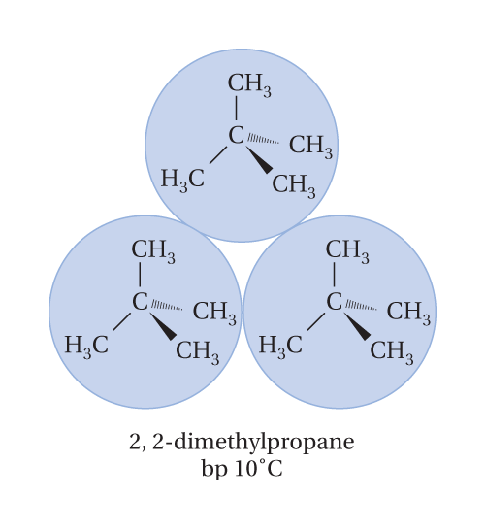
2,2-Dimethylpropane dash-wedge model

Slide 51
Newman Projections:
The molecule is drawn as if it is viewed straight down the C-C bond
The front carbon is drawn with 3 bonds in a Y shape
The back carbon is drawn as a circle with 3 bonds pointing out from it.

Slide 52
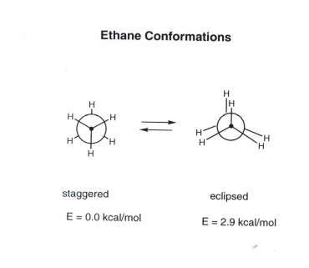

Slide 53
Sawhorse Structures
These picture the molecule as viewed looking down on the C-C bond at an angle from above.

Slide 54
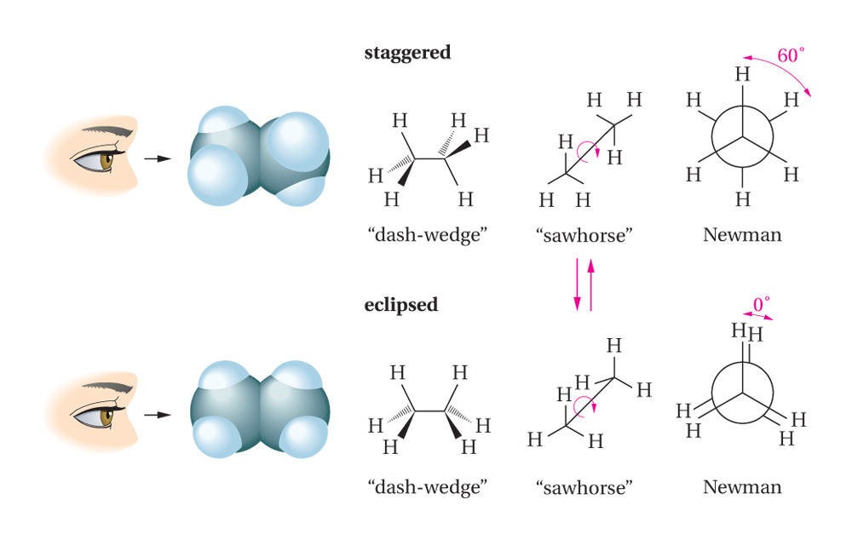
Two of the possible conformations for ethane: staggered and eclipsed.

Slide 55
Boat and Chair Conformations
Cyclohexane adopts a puckered structure. The most stable conformation for cyclohexane is called the chair conformation.
In the chair conformation, all the bond angles are 109.5° and all the C-H bonds are staggered

Slide 57
Boat Conformation
Cyclohexane can also exist in another conformation called the boat

Slide 58
The boat is just a chair with the footrest flipped up.
This also has bond angles of 109.5° and thus avoids any angle strain, but there is torsional strain.
The two hydrogens at the ends of the boat are in close contact, causing torsional strain

Slide 59
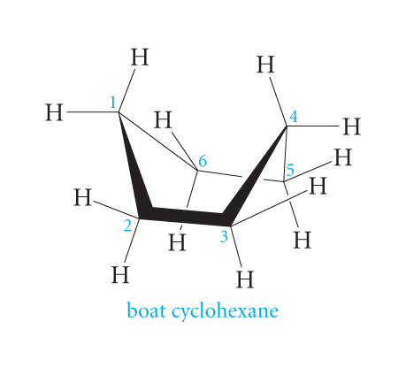
Boat cyclohexane

Slide 60
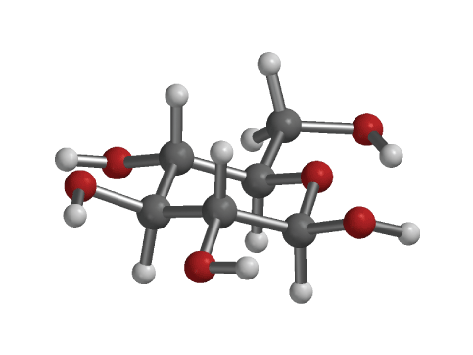
Ball-and-stick model of glucose

Slide 61
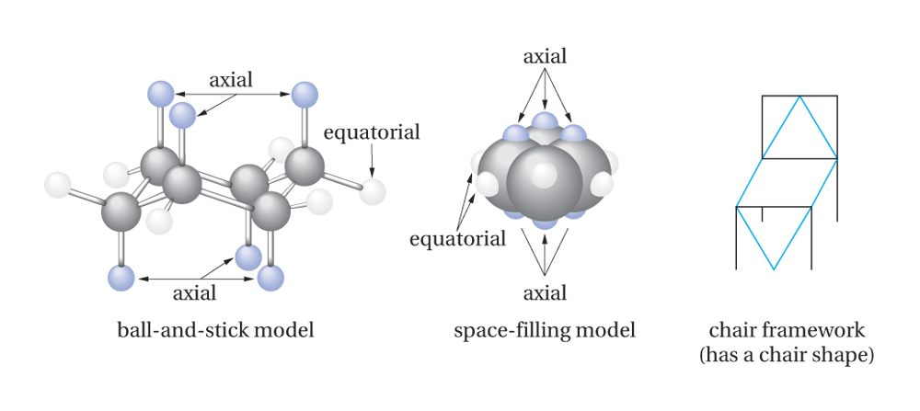
The chair conformation of cyclohexane, shown in ball-and-stick and space-filling models.

Slide 62
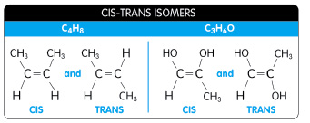
Cis-trans isomers
These are stereoisomers meaning they have the same order of attachment of atoms, but different arrangements.
This differing in the way the atoms or groups are positioned in space gives them different physical and chemical properties

Slide 63
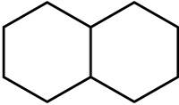
polycyclic
When two or more rings are joined, the molecule is said to be polycyclic. (A molecule with two joined rings is bicyclic, etc.)
Decalin is probably the most common bicyclic alkane.
It can exist in two geometric isomers (cis and trans decalin).

Slide 64
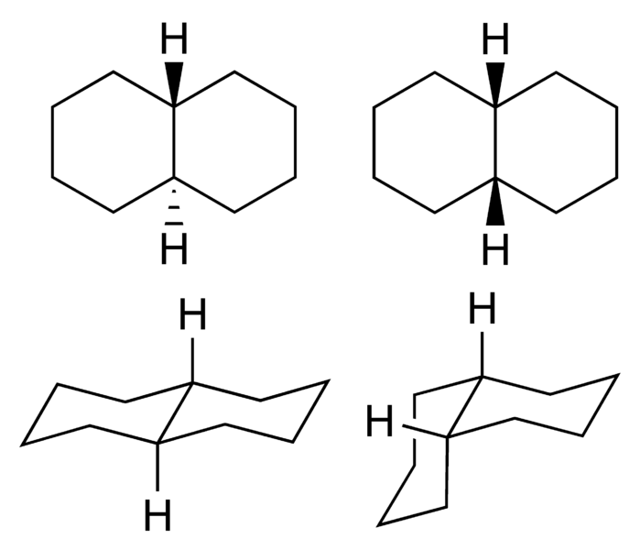
Trans on left, cis on right

Slide 65
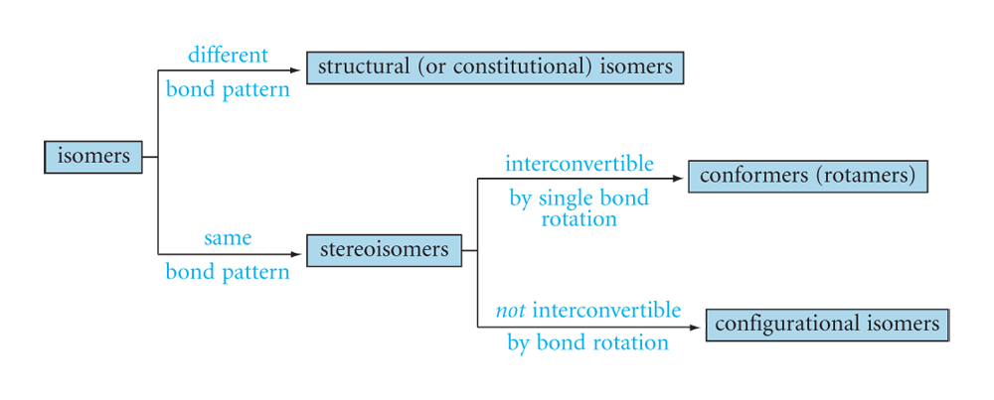
The relationships of the various types of isomers.

Slide 66
Reactions of Alkanes
Alkanes are relatively inert and do not react with most acids, bases, oxidizing and reducing agents
However, they do react with some reagents such as oxygen t and halogens
Most of the reactions are exothermic in nature
Short chain alkanes are obtained by the ‘catalytic cracking’ of larger chain alkanes such as crude oil or petroleum refining.
The process of using hydrogen gas to ensure all the products are alkanes is called Hydrocracking.

Slide 67
Combustion reaction of alkane
CH₃-CH₂-CH₃ + 5 O₂ ——> 3 CO₂ + 4 H₂O + heat
Alkane plus oxygen gives carbon dioxide, water and heat

Slide 68
Halogenation of alkane
Reaction of an alkane with flourine is explosive even in the cold and dark, and you tend to get carbon and hydrogen fluoride produced.
The violence of the reaction drops considerably as you go from fluorine to chlorine to bromine.

Slide 69
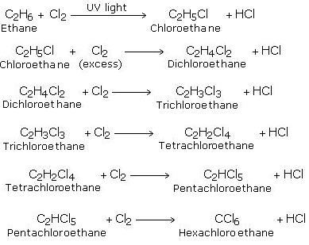

Slide 70
Alkenes
Alkenes ( also called olefins) are hydrocarbons which have carbon–carbon double bonds.
A double bond is a σ bond and a π bond
Alkenes have physical properties similar to those of alkanes…they are less dense than water and since they are nonpolar, they are not very soluble in it.

Slide 71
Elements of Unsaturation
Alkanes are said to be saturated since they have they maximum number of bonds to hydrogen.
An alkene is unsaturated.
An element of unsaturation relates to 2 missing hydrogens from the saturated formula (C^{n}H^{2n+2}).

Slide 72
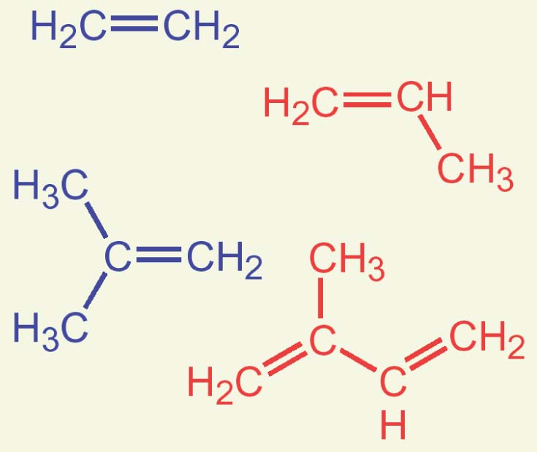
Many Alkenes Are Known by Common Names
Ethylene = ethene
Propylene = propene
Isobutylene = 2-methylpropene
Isoprene = 2-methyl-1,3-butadiene
Acetylene = ethyne

Slide 73
Note that some common named alkyl groups need to be memorized
Isopropyl
CH₃CHCH₃
Tertbutyl
CH₃
CH₃-C-
CH₃
Vinyl CH₂=CH-
Example vinyl chloride
CH₂=CHCl
isopropenyl
CH₂=C-
CH₃
Example isopropenyl chloride
CH₂=CCl
CH₃
Allyl= CH₂=CHCH₂
Example allyl chloride
CH₂=CHCH₂Cl

Slide 74
Nomenclature
Simple alkenes are named like alkanes (root from the longest carbon chain), but the –ane suffix is replaced by-ene
Find longest continuous carbon chain containing the double bond for root name
When the chain is longer than 3 carbons, number the atoms such that the double bond is given the lowest number (i.e. start at the end nearest the double bond).
Rings have “cyclo” prefix

Slide 75
Types of Alkadienes
When more than one multiple bonds are present in a molecule, it is useful to classify the structure
Cumulated: when the double bonds are next to one another ex c=c=c
Conjugated are when the multiple bonds alternate with a single bond ex c=c-c=c
Isolated or nonconjugated are when more than one single bond separates the multiple bonds ex c=c-c-c-c-=c-c

Slide 76
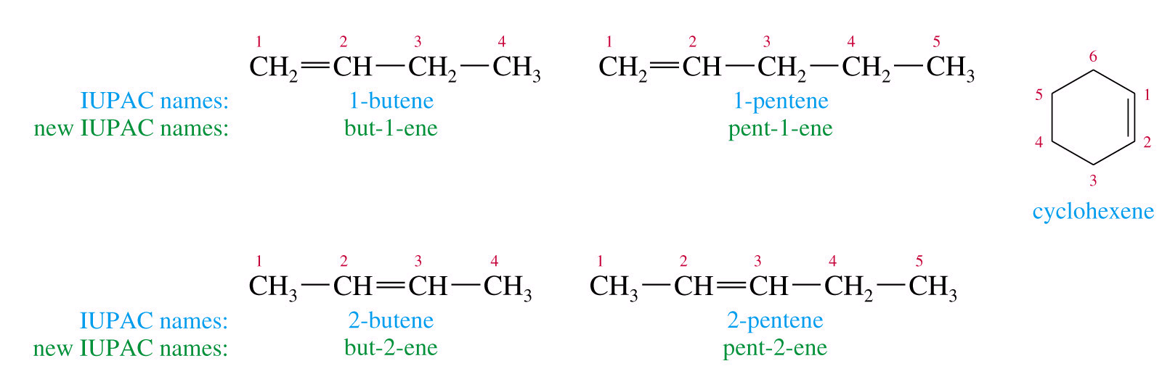
Alkene Nomenclature

Slide 77
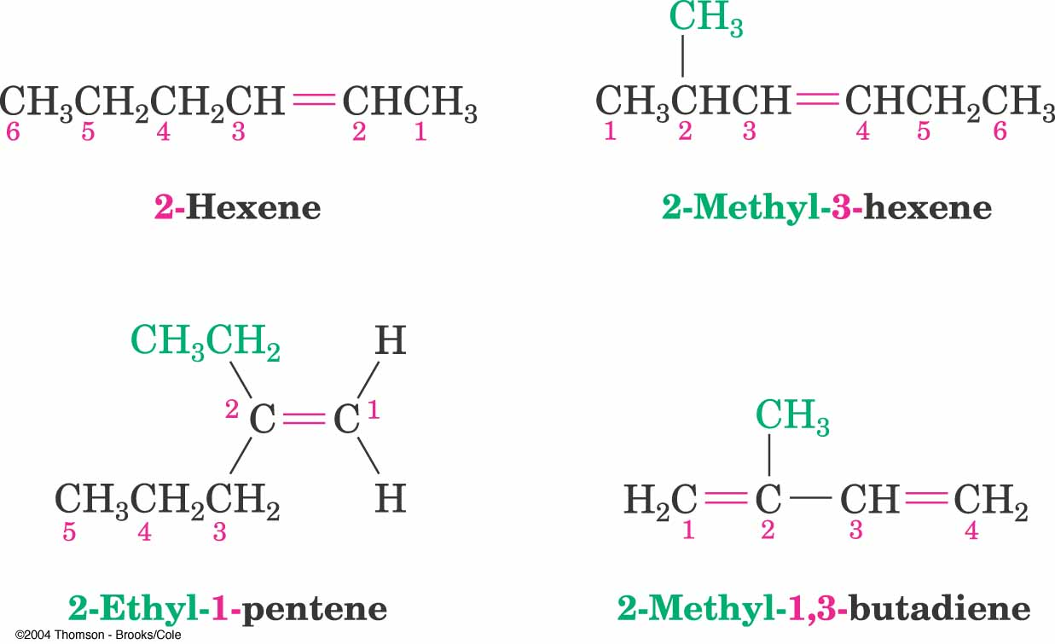

Slide 78
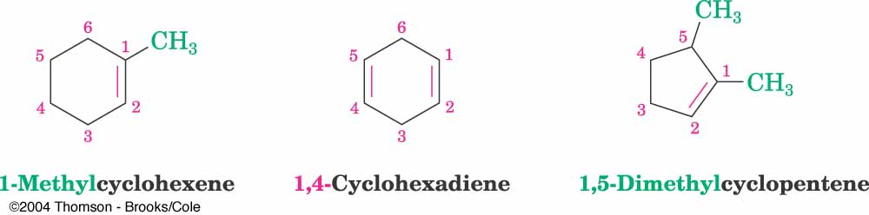
Cyclic alkenes

Slide 79
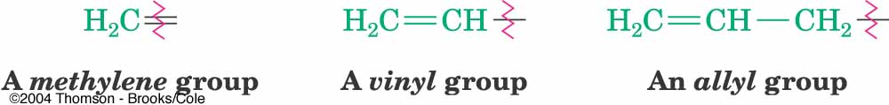
Alkyl Groups with π-Bonds

Slide 80
Alkylidene Groups
Double Bonds Fused to Rings

Slide 81
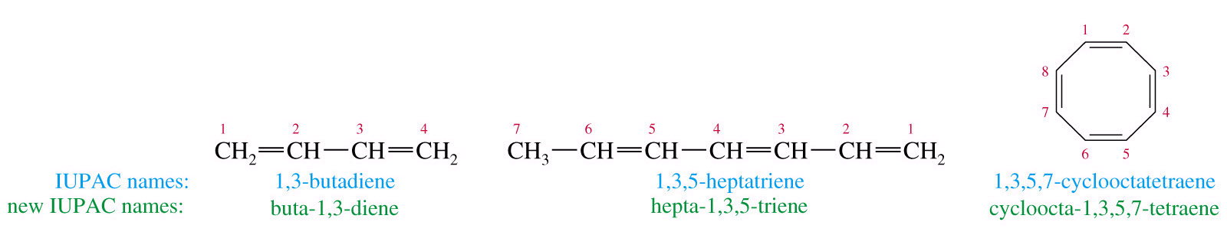
Polyenes

Slide 82
Name the following Alkenes

Slide 83
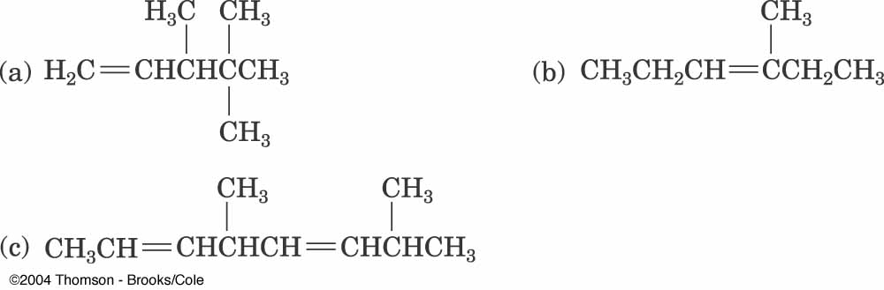
Name these Alkenes

Slide 84
Name These

Slide 86
Comparison of alkanes and alkenes
Alkanes
have 4 atoms attached to a carbon (tetrahedral)
Relatively free rotation
Many conformations are possible, staggered is preferred
Bond angle is 109.5
Bond length is 1.54A
Alkenes
Have 3 ( trigonal)
Restricted rotation
Planar
Bond angle is 120
Bond length is 1.34A

Slide 87
6.4 Electronic Structure of Alkenes
Carbon atoms in a double bond are sp²-hybridized
  Three equivalent orbitals at 120º separation in plane
  Fourth orbital is atomic p orbital
Combination of electrons in two sp² orbitals of two atoms forms σ bond between them
Additive interaction of p orbitals creates a π (pi) bonding orbital
  Subtractive interaction creates a π anti-bonding orbital
Occupied π (pi) orbital prevents rotation about σ-bond

Slide 88
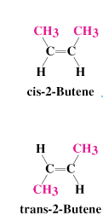
Cis-Trans Isomerism in Alkenes
The presence of a carbon-carbon double can create two possible structures
  cis isomer - two similar groups on same side of the double bond
  trans isomer similar groups on opposite sides
Each carbon must have two different groups for these isomers to occur
Can be separated from one another by their difference in boiling points (distillation)

Slide 89
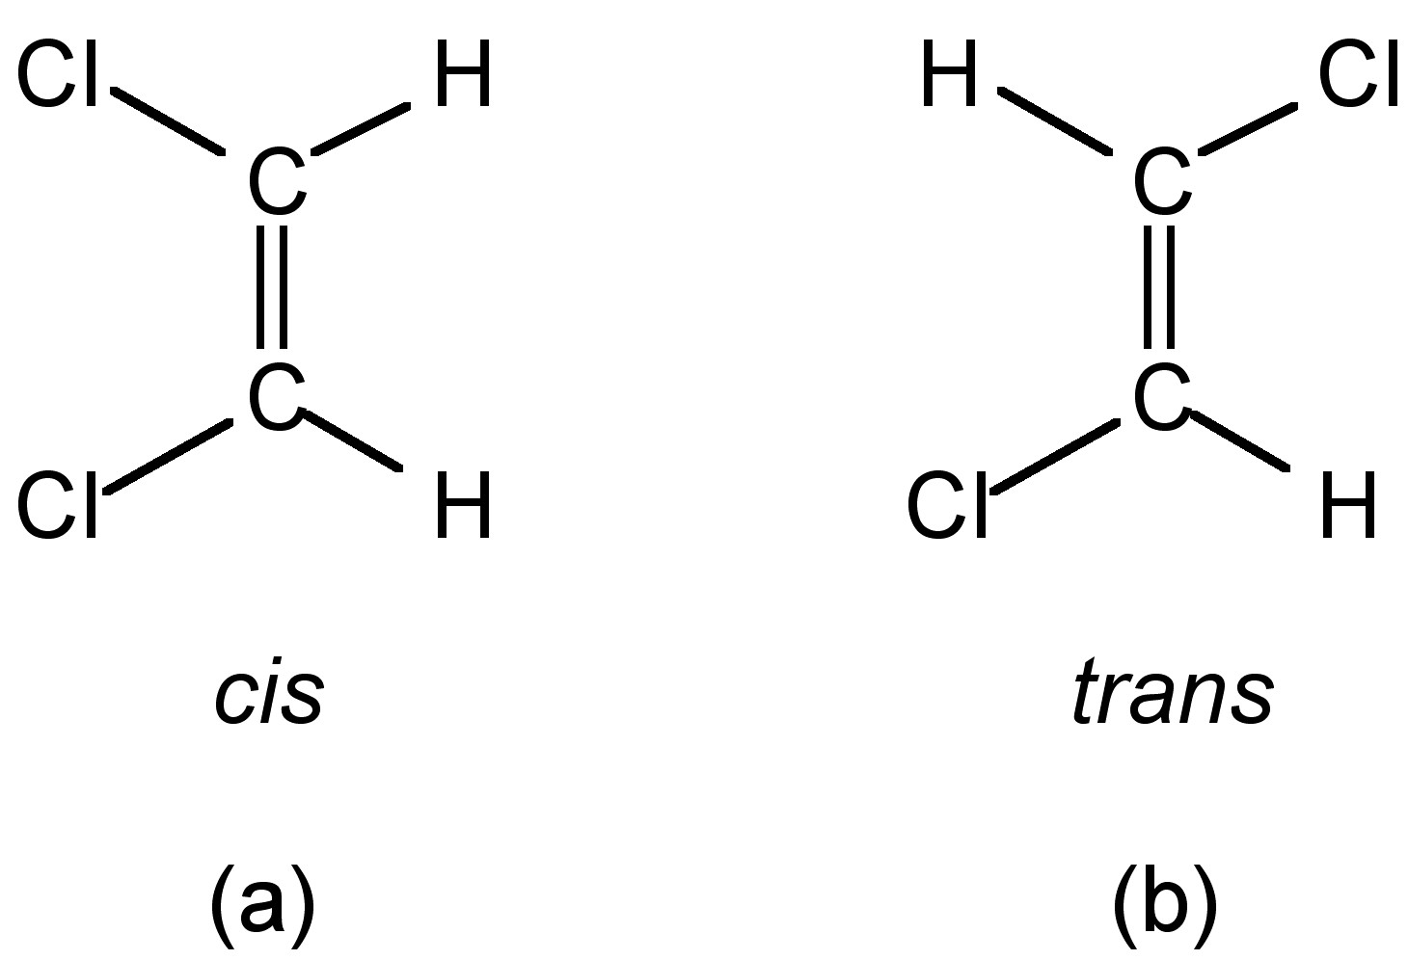
cis-trans Isomers
When similar groups (not H’s) are bound to the same side of the double bond the alkene is said to be cis.
When similar groups are bound to opposite side of the double bond it is said to be trans.

Slide 90
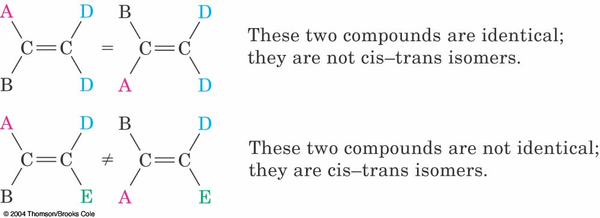
cis-trans Isomers

Slide 91
Cis or Trans?

Slide 92
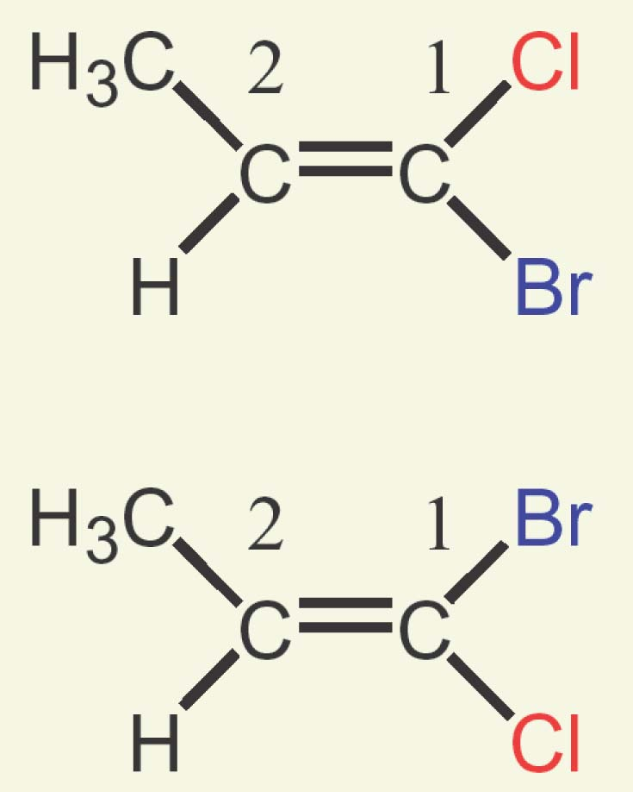
Sequence Rules: The E,Z Designation
Neither compound is clearly “cis” or “trans”
  Substituents on C1 are different than those on C2
  We need to define “similarity” in a precise way to distinguish the two stereoisomers
Cis, trans nomenclature only works for disubstituted double bonds

Slide 94

Develop a System for Comparison of Priority of Substituents
Assume a valuation system
  If Br has a higher “value” than Cl
  If CH₃ is higher than H
Then, in A, the higher value groups are on opposite sides
In B, they are on the same side
  Requires a universally accepted “valuation”

Slide 95


E,Z Stereochemical Nomenclature
Compare where higher priority group is with respect to bond and designate as prefix
E -entgegen, opposite sides
Z - zusammen, together on the same side

Slide 96

Ranking Priorities: Cahn-Ingold-Prelog Rules
Must rank atoms that are connected at comparison point
Higher atomic number gets higher priority
  Br > Cl > O > N > C > H
In this case,The higher priority groups are opposite:
(E )-2-bromo-2-chloro-propene

Slide 97

Extended Comparison
If atomic numbers are the same, compare at next connection point at same distance
Compare until something has higher atomic number
Do not combine – always compare

Slide 98

Dealing With Multiple Bonds
Substituent is drawn with connections shown and no double or triple bonds
Added atoms are valued with 0 ligands themselves

Slide 99
Alkene stability
Cis alkenes are less stable than trans alkenes
Compare heat given off on hydrogenation: ΔHº
Less stable isomer is higher in energy
  And gives off more heat
  tetrasubstituted > trisubstituted > disubstituted > monosusbtituted
  hyperconjugation stabilizes alkyl

Slide 100
Prepartion of Alkenes
The most common reaction of alkanes is substitution reactions
The most common reaction of alkenes is addition reactions
In addition reactions, a reagent is added to the carbons of the double bond to give a product with a C-C SINGLE BOND

Slide 101

Addition Reactions

Slide 102

Addition of Halogens

Slide 103
Examples

Slide 104

Mechanism

Slide 105
Hydrogenation
Addition of Hydrogen

Slide 106
Hydrogenation of Alkenes also called–Reduction of Alkenes
Addition of H-H across C=C
Reduction in general is addition of H₂ or its equivalent
Requires Pt, Pd, or Ni as powders on carbon and H₂
Hydrogen is first adsorbed on catalyst
Reaction is heterogeneous

Slide 107
Hydrogenation of alkene
The double bond of an alkene will react with hydrogen gas, H2, in the presence of certain metal catalysts (usually platinum or palladium) in such a way that one hydrogen is added to each of the carbons that had been joined by the double bond.

Slide 109

Mechanism

Slide 110
Addition of Water to Alkenes
Acid-Catalyzed Hydration
Oxymercuration-Demercuration
Hydroboration-Oxydation

Slide 111
Acid-Catalyzed Hydration

Slide 113
Mechanism

Slide 114

Mechanism

Slide 115
Dehydration of an Alcohol
Alcohols can be dehydrated ( removing the water ) by heating them with a strong acid to form alkenes

Slide 116
Dehydration of an Alcohol

Slide 119

Elimination Reactions

Slide 120
Halohydrin Formation

Slide 121
Mechanism

Slide 123

  Orientation of the OH toward the more stable cabocation (follows Markovnikov addition)

Slide 124
Markovnikov Addition

Slide 125


Slide 126
Oxymercuration-Demercuration
Use mercuric acetate in THF followed by sodium borohydride
Markovnikov orientation
  via mercurinium ion
  This is another alternative for converting alkenes to alcohols with Markovnikov orientation

Slide 127

Tetrahydrofuran (THF)

Slide 128
Mechanism

Slide 129
Hydroboration-Oxidation
Herbert Brown invented hydroboration (received the 1979 Nobel Chemistry Prize.)
Involves the addition of hydrogen-boron bond to an alkene
Borane (BH3) is electron deficient is a Lewis acid
Borane adds to an alkene to give an organoborane

Slide 130

Hydroboration-Oxidation

Slide 131

Hydroboration-Oxidation Forms an Alcohol from an Alkene
Addition of H-BH₂ (from BH₃-THF complex) to three alkenes gives a trialkylborane
Oxidation with alkaline hydrogen peroxide in water produces the alcohol derived from the alkene

Slide 132
Orientation in Hydration via Hydroboration
Regiochemistry is opposite to Markovnikov orientation (Anti-Markovnikov)
  OH is added to carbon with most H’s
H and OH add with syn stereochemistry, to the same face of the alkene (opposite of anti addition)

Slide 133
Diels alder reaction
This is an example of a cycloaddition reaction.
It is used to make cyclic compounds.
The two reactants arte a diene ( alkene with 2 double bonds ) and a dienophile

Slide 134

Diels alder reaction

Slide 135
Anti-Markovnikov Addition

Slide 136

Syn Addition

Slide 137

Mechanism of Hydroboration
Borane is a Lewis acid
Alkene is Lewis base
Transition state involves anionic development on B
The components of BH₃ are across C=C

Slide 138


Slide 139


Slide 140

Hydrogenation Data Helps to Determine Stability
ΔHhydrogenation of Alkenes

Slide 141

Enthalpy Change Shows Relative Energy of Alkene

Slide 142

Both cis and trans 2-Butene are Hydrogenated to Butane

Slide 143

“E” is More Stable than “Z” by 2.3 KJ/mol

Slide 144

Relative Stabilities of Alkenes

Slide 145


Slide 146


Slide 147

HBr Addition

Slide 148
Markovnikov’s Rule
The addition of H-X across a double bond results in the more highly substituted alkyl halide as the major product.

Slide 149

Depicting a Reaction

Slide 150
Addition of HBr or HCl
Markovnikov Addition

Slide 151



Slide 152


Slide 153


Slide 154


Slide 155

What Alkenes are Needed to form Theses Alkyl Halides?

Slide 156
Definitions
Regioisomers – two constitutional isomers that could result from an addition reaction.
Regiospecific – only one regiosisomer forms at the expense of the other.
Regioselective – both regioisomers are formed, but one is formed in preference.

Slide 157
Determine the major product:

Slide 159
Rearrangements

Slide 160


Slide 161

Propose a Mechanism

Slide 162

Alkynes or acetylenes
Alkynes or acetylenes are compounds that contain a carbon–carbon triple bond.
The triple bond results in a molecular formula of C^{n}H^{2n-2}
The triple bond contributes two elements of unsaturation.

Slide 163
Nomenclature of Alkynes
A common name that you should know is...
acetylene
IUPAC nomenclature is similar to that for alkenes, except the –ane ending is replaced with –yne.
The chain is numbered from the end closest to the triple bond.
When additional functional groups are present, the suffixes are combined

Slide 164
When additional functional groups are present, the suffixes are combined
Ex 2-methy-1penten-3yne
H₂C=C-C=C-CH₃
CH₃
Ex 3-butyn-2-ol

Slide 165
Addition reaction of alkyne

Slide 166

Addition reaction of alkyne

