Slide 1
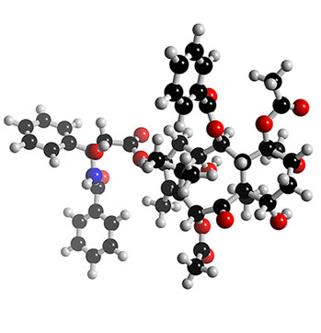
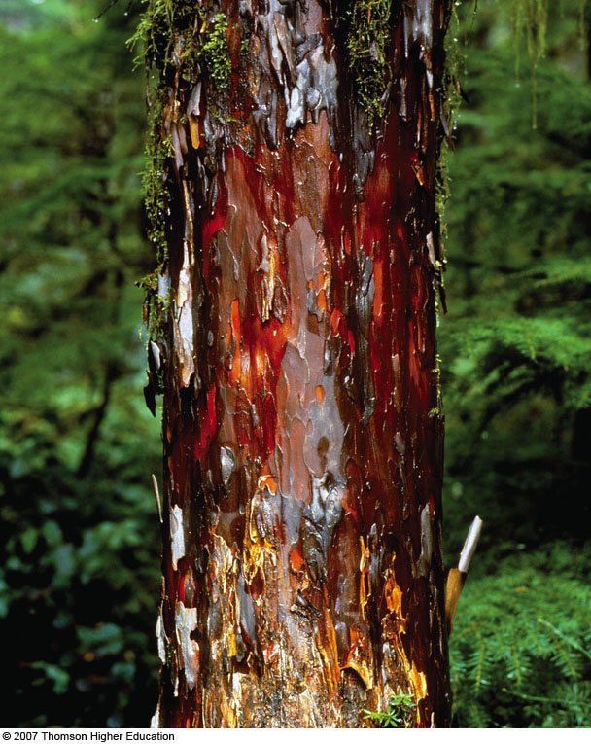
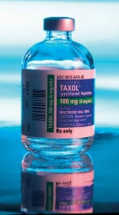
Unit 1: Matter and The Nature of Chemistry

Slide 2
Chemistry
Chemistry is the study of the structure, composition & properties of matter and its transformations from one form to another.
Matter is anything that has mass and occupies space.
Chemistry is everywhere!

Slide 3
Natural Science falls into 2 general categories:
Biological sciences: concerned primarily with living things
Physical science: concerned primarily with nonliving things
Which category would chemistry be listed as?

Slide 4
Applications of Chemistry
Chemical reactions are involved in:
Biological Processes: medical, pharmaceutical & biotechnology industries
Atmospheric Phenomena: ozone depletion, acid rain, climate change (global warming)
Energy Production & Consumption: petroleum & alternative energy industries
Making New Materials: polymer, computer & clothing industries, etc.

Slide 5
Branches of Chemistry
Organic chemistry: study all substances containing carbon and hydrogen
Inorganic chemistry: study substances not classified as organic ( elements other than carbon)
Physical chemistry: study properties transformations and interrelationships of energy and matter

Slide 6
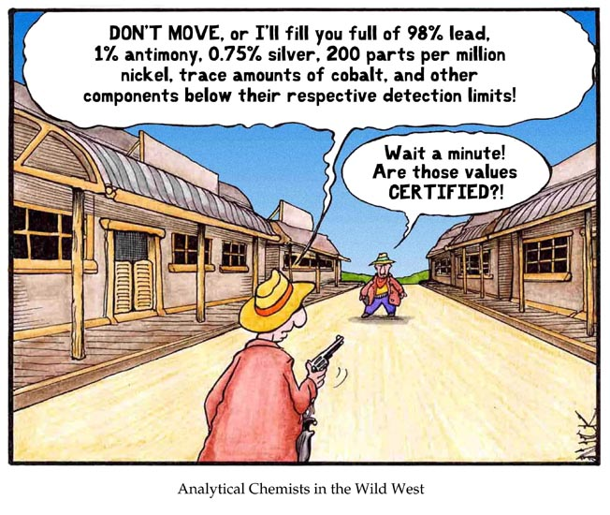

Slide 7
Biochemistry: study of all substances and processes that occur in living things
Analytical chemistry: identification of substances and determination of their composition
Other branches of chemistry include nuclear and polymer chemistry

Slide 8
The Scientific Method
A logical approach to the solution of a problem, that lends itself to investigations by observation, generalization, theorizing and testing

Slide 9
Steps in the Scientific method
observe and state a problem
Form a hypothesis
Test the hypothesis
Record and analyze data
Form a conclusion
Replicate the work

Slide 10
Steps 1,&,2 Observing and stating the problem and forming a hypothesis
Chemical Research (ALL research) is carried out through careful experimentation & explanation.
In the first step, a chemist develops a hypothesis in response to an observation.
Hypothesis: a tentative explanation for an observation that provides a basis for experimentation

Slide 11
For an experiment to be valid, it should contain a control setup, a variable, and an experimental setup
Control setup: The part of the experiment that does not contain the variable
Experimental setup: the part of the experiment that does contain the variable
Variable: the single factor that is isolated and tested
A valid experiment contains only one variable ,

Slide 13
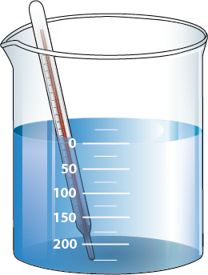
both beakers are same size, same amount of water, identical thermometers, beaker a has antifreeze added to it
What is the variable in the experiment?
What is the control setup?
What is the experimental setup?
Beaker A Beaker B

Slide 14
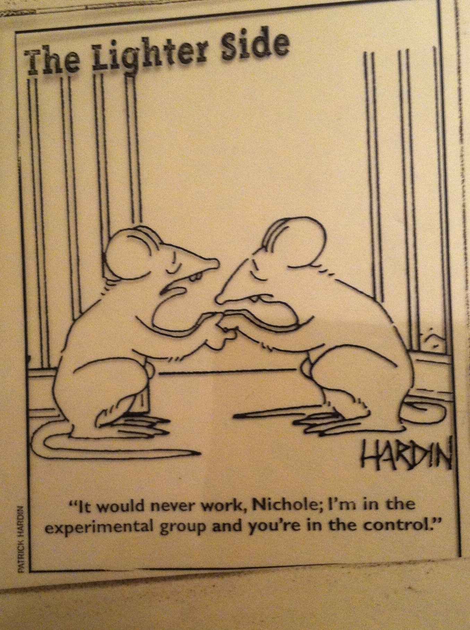

Slide 16
b) Experiment
Next, the chemist performs an experiment designed to test the validity of the hypothesis.
Experiment: the observation of natural phenomena carried out in a controlled manner so that the results can be duplicated and rational conclusions obtained
If the results of the experiment contradict the hypothesis, a new hypothesis must be developed.

Slide 17
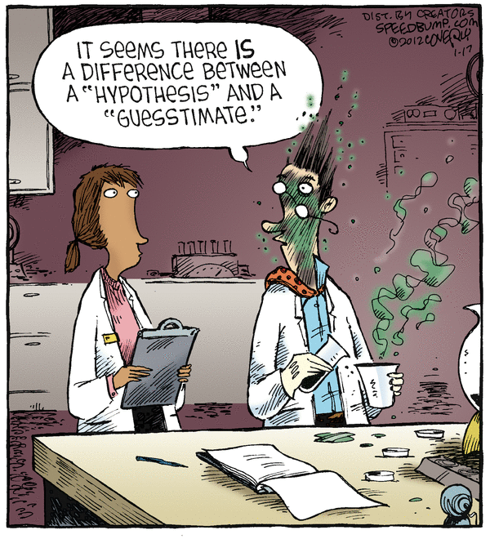
Hypothesis
No hypothesis, theory or law is ever free from being tested
Hypothesis should be written in an “If…..then” form
“If fertilizer is used, then the crops will produce more.”
This allows for the hypothesis to be either accepted or rejected, no gray areas

Slide 18
c) Law
After a series of experiments, a researcher may see a relationship or a regularity in the results. If this relationship can be stated clearly, we call it a law.
Law: concise statement that summarizes a wide range of experimental results & has not been contradicted by experiments
A law summarizes a set of experimental results, but does not provide an explanation.

Slide 19
d) Theory
If a hypothesis is supported by a great deal of experimental data, it becomes a theory.
Theory: The most logical explanation of events that occur in nature
Ex: atomic theory, kinetic theory
Theory: a tested explanation of basic natural phenomena; a unifying principle that explains a body of facts and the laws based on them

Slide 20
Data
Recorded observations and measurements
Varies with each type of lab performed: qualitative, quantitative

Slide 21
2. The Scientific Method

Slide 22
Matter
Before we can understand the changes we see going on around us, we must find out how matter is organized
Some kinds of matter are easily recognized while other is not
Matter: material of the universe
Specific properties: of matter make it easy to tell one kind of mater from another ex: color, odor, shape, texture, hardness
General properties: describe how all matter is the same

Slide 23
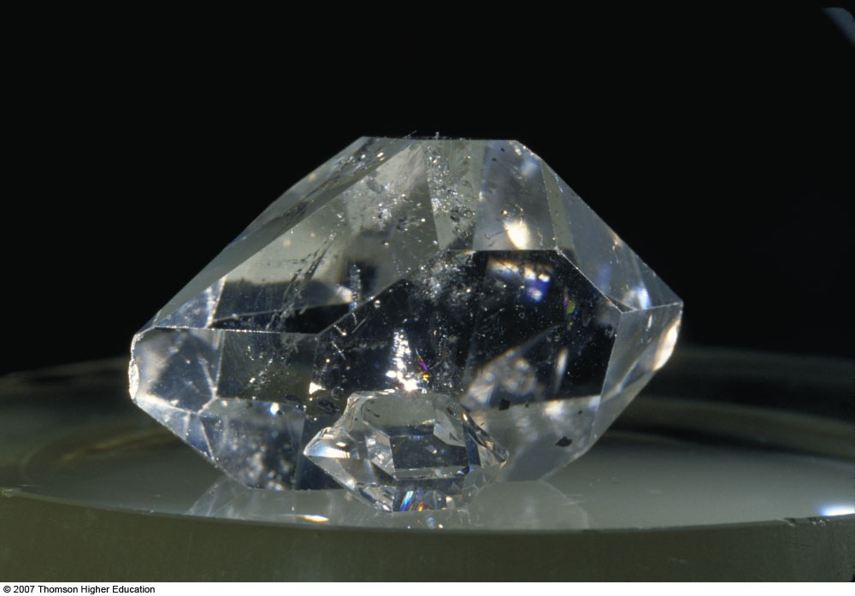
Matter
Matter: has mass & occupies space
Substance: a specific
type of matter that has
the same properties &
the same composition
throughout a sample

Slide 24
B. Introduction to Matter
Samples of matter can be classified in several different ways:
Physical State: Gas, liquid, solid?
Chemical Composition: Pure or mixture? Element or compound?
Physical Properties: MP, BP, density, etc.
Chemical Properties: Reactivity

Slide 25
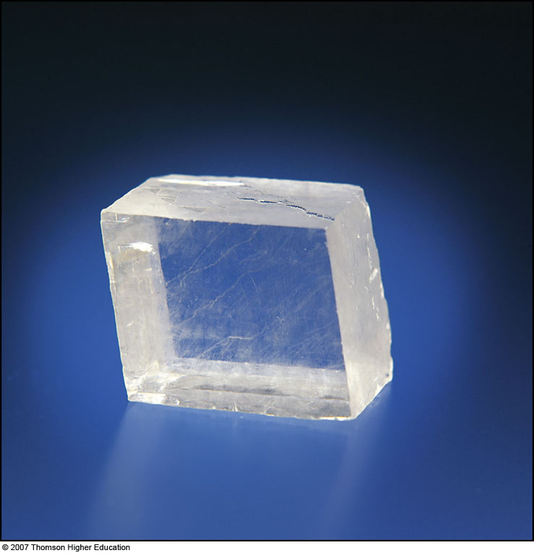
Physical States of Matter: 4
Is the substance a gas, a liquid, or a solid?
How are these physical states defined?

Slide 26
a) Gas
No definite shape nor volume
Easily compressible fluid
Expands to fill the container it occupies
Volume varies considerably with temperature and pressure

Slide 27
b) Liquid
Has definite volume, but takes the shape of the container it occupies
Relatively incompressible fluid
The resistance to flow of a liquid is called viscosity
Ex honey has a high viscosity

Slide 28
c) Solid
Has a rigid shape and a fixed volume
Changes very little as temperature and pressure change
Solids that lose their shape under certain conditions are called amorphous solids ex rubber

Slide 29
Plasma
Very rare
Found in the sun
Very dangerous to life
Matter n the plasma state is very high in energy and therefor dangerous to living things

Slide 30
d) Nanoscale Representations of Physical States The Kinetic-Molecular Theory

Slide 31
e) Macroscale, Microscale, Nanoscale
Macroscale: samples of matter large enough to be seen and handled – physical properties can be observed by the human senses (unaided)
Microscale: samples of matter that have to be viewed with a microscope
Nanoscale: samples that are at the atomic or molecular scale where chemical reactions occur

Slide 32
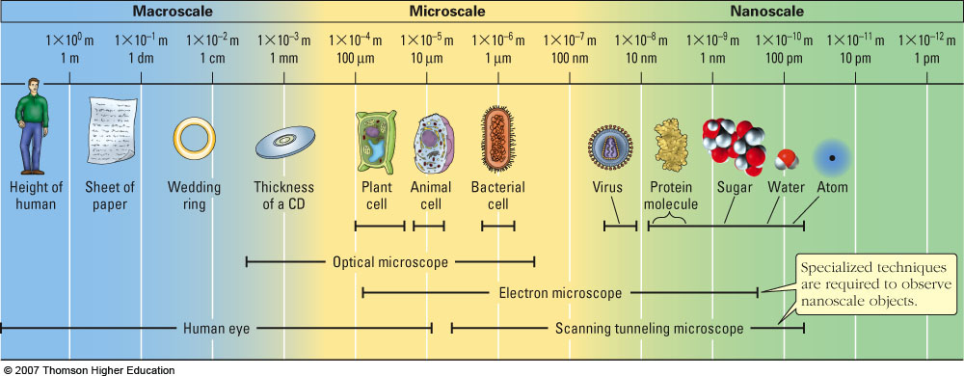
e) Macroscale, Microscale, Nanoscale

Slide 33
2. Chemical Composition
Is the substance pure (made up of one component), or is it a mixture (made up of multiple components)?
If the substance is a mixture, is it heterogeneous or homogeneous?
If the substance is pure, is it an element or a compound?

Slide 34
a) Pure or a Mixture?
Pure Substance: a substance from which all other substances have been separated
Mixture: an impure material that can be separated by physical means into two or more substances
• Unlike a pure substance, a mixture can have a variable composition – not necessarily uniform throughout the sample.
• Mixtures are classified as being either heterogeneous or homogeneous.

Slide 35
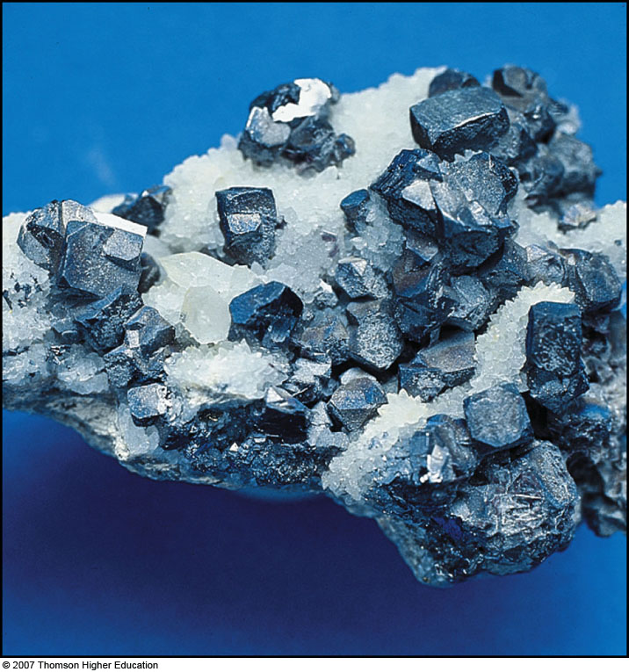
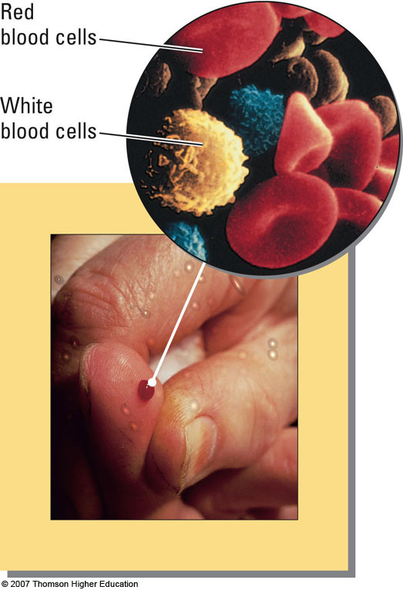
Heterogeneous Mixtures
Heterogeneous: a mixture in which the uneven texture is visible to the naked eye or with a microscope
• Properties in one region differ from another

Slide 36
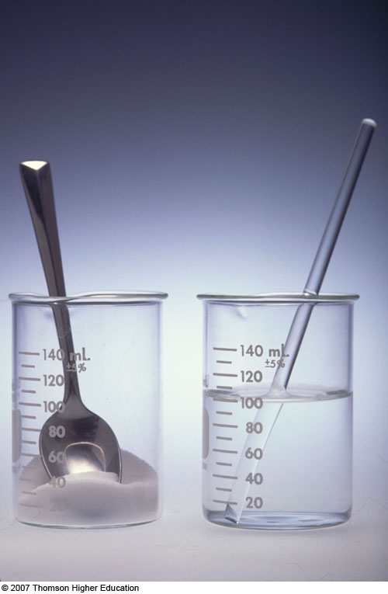
Homogeneous Mixture (Solution)
Homogeneous: completely uniform
• Two or more substances in the same phase
Same properties throughout the sample
• eg. Salt water (solution of sodium chloride dissolved in water)

Slide 37
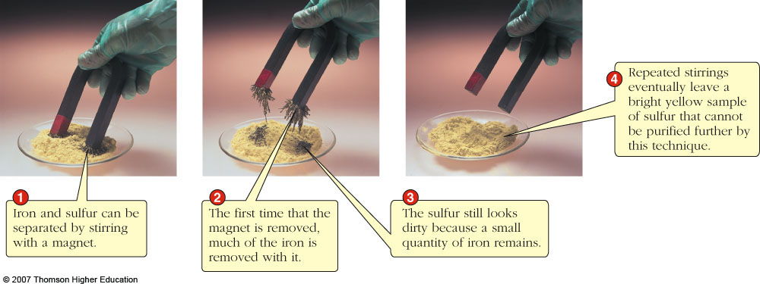
Mixtures can be separated by physical means into two or more pure substances
Each pure substance can be classified as either an element or a compound.

Slide 38
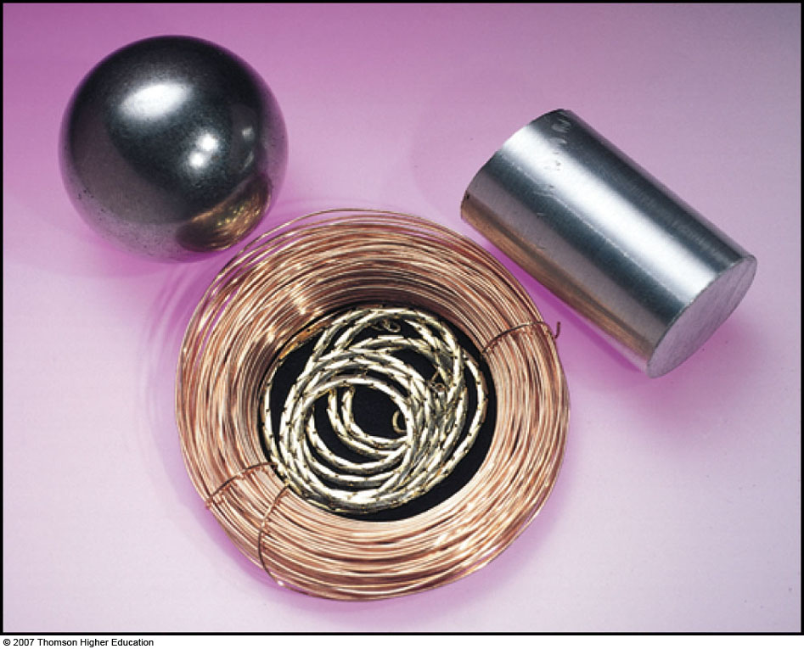
b) Elements
Element: a substance that cannot be decomposed into two or more new substances by chemical or physical means
• The smallest unit of an element is an atom.
• ex. Iron, aluminum, copper & gold
Pure elements are made up of only one type of atom!

Slide 39
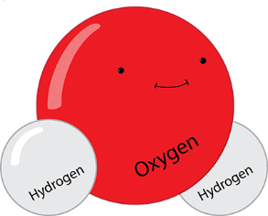
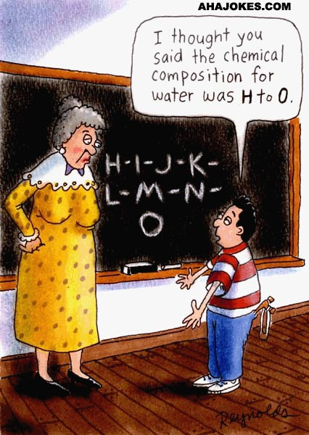
c) Compounds
Compound: a pure substance composed of two or more elements chemically combined – can be decomposed by chemical means
• The smallest unit of a compound is a molecule.
• ex. Water molecules are composed of hydrogen and oxygen atoms
Pure compounds are made up of only one type of molecule!

Slide 40
3. Properties of Matter
Every sample of matter can be classified and/or identified by its physical & chemical properties
a) Physical Properties: Properties that can be observed and measured without changing the chemical composition of a substance
Mass
Volume
Color
Physical state
Melting/Boiling point
Temperature
Density

Slide 41
Mass
The most general property of matter, and can be measured in units of grams or kilograms on various types of balance scales
It is the amount of matter in an object
Mass is also the measure of inertia of an object
Inertia is the resistance of an object to change in its motion
The more mass…..the more inertia

Slide 42
Weight
An object has weight because it has mass
Weight is the measure of the earths gravitational attraction for matter ( 9.8m/sec/sec)
All objects exert gravitational attraction on other objects
The earths gravity is great because the earth has a large mass
The pull of gravity on an object determines the objects weight
The metric unit of weight is the newton (N)

Slide 43
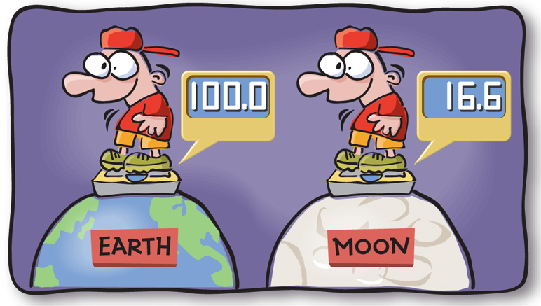
Difference between weight and mass
Weight changes as the gravitational pull changes
Example earth verses the moon
Mass is constant and does not change ( unless one diets)

Slide 44
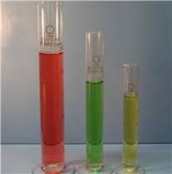
Volume
The amount of space an object takes up
It is measured in liters, milliliters and cubic centimeters

Slide 45
Temperature (K, C & F)
Temperature is the physical property of matter that determines whether on object can heat another.
It is a measure of the motion of the particles
There are three common units of temperature:
Kelvin: SI base unit; based on absolute temperature scale (K = 273 + °C)
Celsius: commonly used in scientific community
Fahrenheit: common temperature scale in the United States (not used in science)

Slide 46
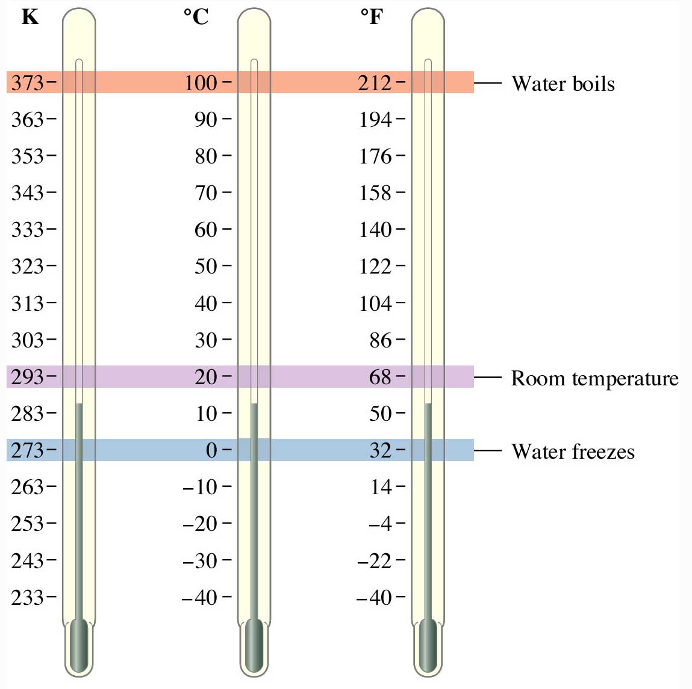
25 °C = _____ K
350 K = _____ °C

Slide 47
25 °C = _____ K
350 K = _____ °C
298
77

Slide 48
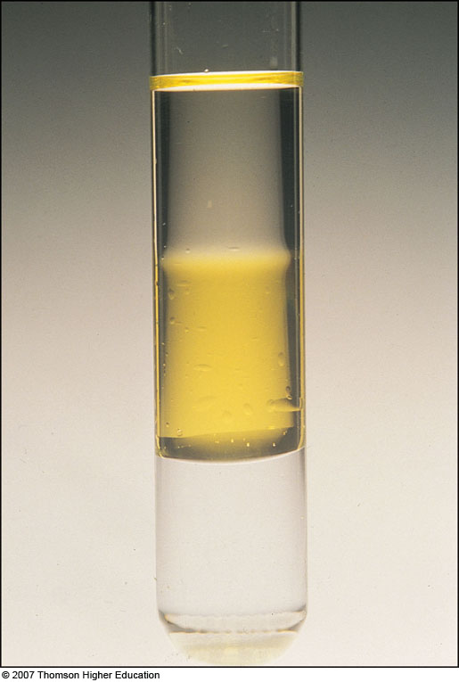
Density
The density of an object is the ratio of the mass of a sample to its volume.
d = m/v
(d = density, m = mass, v = volume)
The standard units are:
g/ml (liquid), g/cm³ (solid), g/L (gas)

Slide 49
i) Density
Calculate the volume of a 23.4 g sample of ethanol (d = 0.789 g/mL).
D = m/v
.0789 g/ml = 23.4g/x
What is x?
What unit is x measured in?
Answer: 296.58 ml

Slide 50
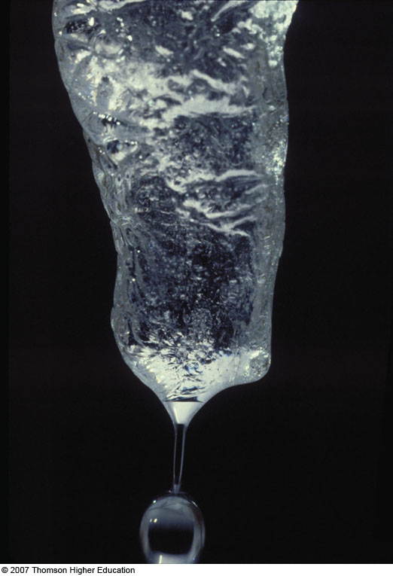
Physical Changes
Physical Change: a change in a physical property of a substance
• The same substance is present before & after the physical change.
• eg. Melting ice (change from solid to liquid)

Slide 51
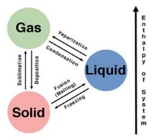
Types of physical changes: ( changes in states of matter)
Melting
Freezing
Vaporization
Evaporation ( vaporization at the surface of a liquid)
Boiling point
Sublimation: change directly from a solid to a gas ex dry ice

Slide 52
In a phase change:
Gas has the most energy
Liquid has the 2nd highest temperature
Solids have the lease amount of energy

Slide 53
b) Chemical Properties
Chemical Properties: a description of the kinds of chemical changes (reactions) a substance can undergo
i) Chemical Change (Reaction): process in which substances (reactants) change into other substances (products) with different chemical constitutions
- The same substance is NOT present before & after the change

Slide 54
The substance that undergoes the chemical change is called the reactant ( and is on the left side of the equations) and the new substance is the product ( on the right side of the equation)

Slide 55
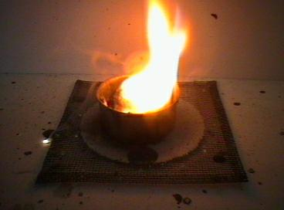
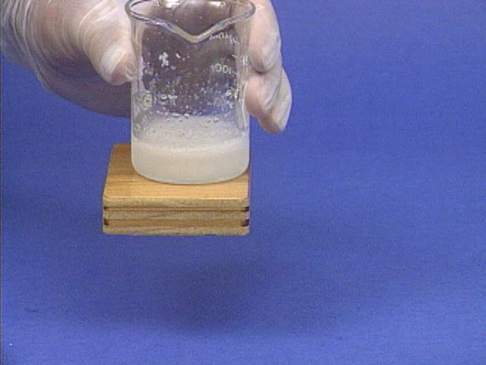
Indication of a chemical reaction
Chemical and physical changes are accompanied by energy changes: 2 types
Exothermic: release heat
Endothermic: absorb heat
Production of heat or light
Production of gas
Formation of a precipitate

Slide 56
Some Clues That a Chemical Reaction Has Occurred

Slide 57
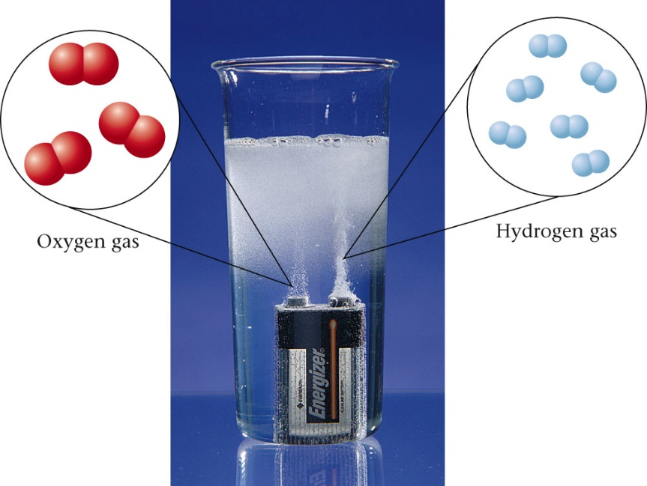
Exercise
What is a clue that a chemical reaction has occurred?
a) The color changes.
b) A solid forms.
c) Bubbles are present.
d) A flame is produced.
Notes:
The answer is c. The formation of bubbles (a gas) is a sign that a chemical reaction has taken place.

Slide 58
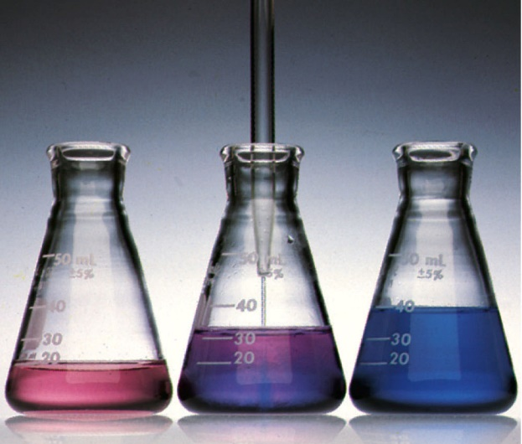
Exercise
What is a clue that a chemical reaction has occurred?
“Colorless hydrochloric acid is added to a red solution of cobalt(II) nitrate, turning the solution blue.”
a) The color changes.
b) A solid forms.
c) Bubbles are present.
d) A flame is produced.
Notes:
The answer is a. The solution turning blue is a sign that a chemical reaction has taken place.

Slide 59
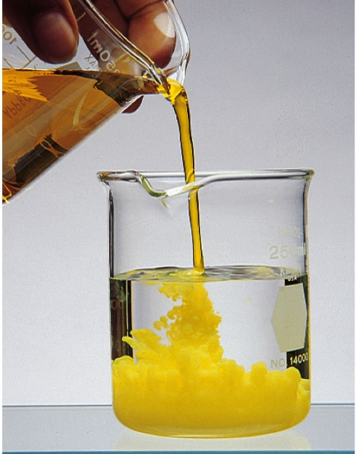
Exercise
What is a clue that a chemical reaction has occurred?
“A solid forms when a solution of sodium dichromate is added to a solution of lead nitrate.”
a) A gas forms.
b) A solid forms.
c) Bubbles are present.
d) A flame is produced.
Notes:
The answer is b. The formation of a yellow solid is a sign that a chemical reaction has taken place.

Slide 60
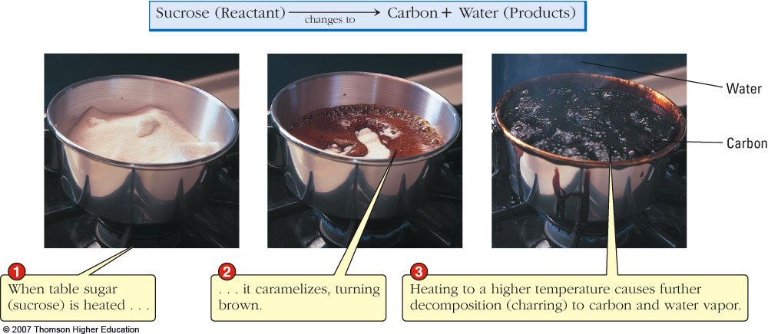
• In a chemical reaction, the chemical composition of a substance changes

Slide 61
c) Extensive versus Intensive Properties
All physical and chemical properties are classified as being either extensive or intensive.
Extensive Property
-depends on the specific sample under investigation
-varies from sample to sample
eg. Mass, volume, temperature, etc.
Intensive Property
-identical in all samples of a given substance
-used to identify substances
eg. Density, melting point, boiling point, color

Slide 62
4. Classification of Matter

Slide 63
C. Atomic Theory of Matter
In the beginning of the 1800s, chemistry was a very different science than it is today. Little was known about the nature and structure of matter.
Thanks to two brilliant early experimentalists, two important chemical laws had been proposed and tested at that time.
Remember, laws summarize but do not explain experimental data.

Slide 64
1. Law of Conservation of Mass
Antoine Lavoisier carried out experiments in which he carefully weighed the chemical reactants, carried out a chemical reaction (combustion), and then carefully collected and weighed the products.
He found that there is no detectable change in mass during an ordinary chemical reaction. Mass is conserved in a chemical reaction!

Slide 65
Interesting Side Note. . .
Antoine Lavoisier is known as the Father of Modern Chemistry, but he wasn’t always popular during his lifetime. He funded his laboratory by working as an accountant for King Louis XVI. As a royal tax collector, he was a prime target for the leaders of the French Revolution. He was beheaded on a guillotine in 1794!

Slide 66
2. Law of Constant Composition (Law of Definite Proportions)
Joseph Proust performed careful quantitative studies in which he established that all samples of a given compound have the same proportions, by mass, of the elements present in the compound.
A chemical compound always contains the same elements in the same proportions.

Slide 67
Periodic Table
The periodic table organizes the elements in a particular way. A great deal of information about an element can be gathered from its position in the period table.
For example, you can predict with reasonably good accuracy the physical and chemical properties of the element.
You can also predict what other elements a particular element will react with chemically.
Understanding the organization and plan of the periodic table will help you obtain basic information about each of the 118 known elements.

Slide 68
The first Periodic Table was published in 1869 by Dimitri Mendeleev

Slide 69
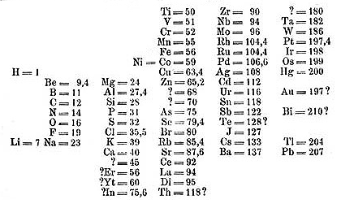
Mendeleev arranged all the known chemical elements of the time by atomic weight and found that similar physical and chemical properties reoccurred in set patterns
( every 7 elements for light elements and every 17 for heavy elements)

Slide 70
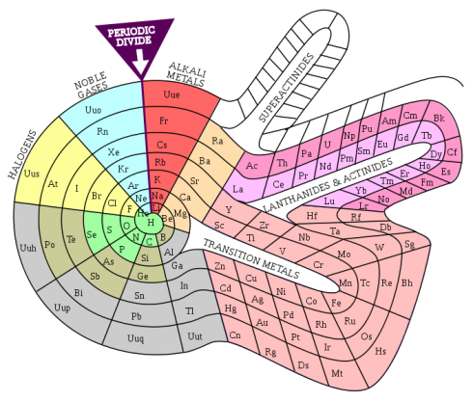

Slide 71
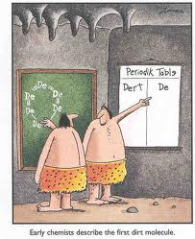
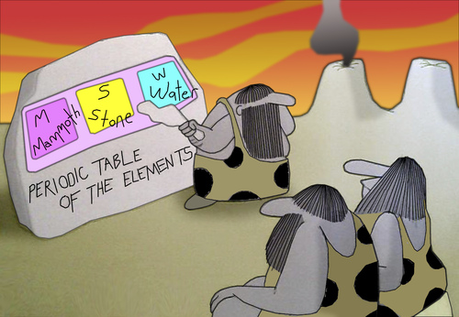
Other early periodic tables

Slide 73
Key to the Periodic Table
Elements are organized on the table according to their atomic number, usually found near the top of the square.
The atomic number refers to how many protons an atom of that element has.
For instance, hydrogen has 1 proton, so it’s atomic number is 1.
The atomic number is unique to that element.
No two elements have the same atomic number.

Slide 74
What’s in a square?
Different periodic tables can include various bits of information, but usually:
atomic number
symbol
atomic mass
number of valence electrons
state of matter at room temperature.

Slide 75
Atomic Number
This refers to how many protons an atom of that element has.
No two elements, have the same number of protons.
Bohr Model of Hydrogen Atom
Wave Model

Slide 76
Atomic Mass
Atomic Mass refers to the “weight” of the atom.
It is derived at by adding the number of protons with the number of neutrons.
This is a helium atom. Its atomic mass is 4 (protons plus neutrons).
What is its atomic number?
H

Slide 77
Symbols
C
All elements have their own unique symbol.
It can consist of a single capital letter, or a capital letter and one or two lower case letters.
Carbon
Cu
Copper

Slide 78
Common Elements and Symbols

Slide 79
Valence Electrons
The number of valence electrons an atom has may also appear in a square.
Valence electrons are the electrons in the outer energy level of an atom.
These are the electrons that are transferred or shared when atoms bond together.

Slide 81
Properties of Metals
Metals are good conductors of heat and electricity.
Metals are shiny.
Metals are ductile (can be stretched into thin wires).
Metals are malleable (can be pounded into thin sheets).
A chemical property of metal is its reaction with water which results in corrosion.

Slide 82
Properties of Non-Metals
Non-metals are poor conductors of heat and electricity.
Non-metals are not ductile or malleable.
Solid non-metals are brittle and break easily.
They are dull.
Many non-metals are gases.
Sulfur

Slide 83
Properties of Metalloids
Metalloids (metal-like) have properties of both metals and non-metals.
They are solids that can be shiny or dull.
They conduct heat and electricity better than non-metals but not as well as metals.
They are ductile and malleable.
Silicon

Slide 86
Families Periods
Columns of elements are called groups or families. (18)
Elements in each family have similar but not identical properties.
For example, lithium (Li), sodium (Na), potassium (K), and other members of family IA are all soft, white, shiny metals.
All elements in a family have the same number of valence electrons.
Each horizontal row of elements is called a period.(7)
The elements in a period are not alike in properties.
In fact, the properties change greatly across even given row.
The first element in a period is always an extremely active solid. The last element in a period, is always an inactive gas.

Slide 87
Families

Slide 99
