Slide 1
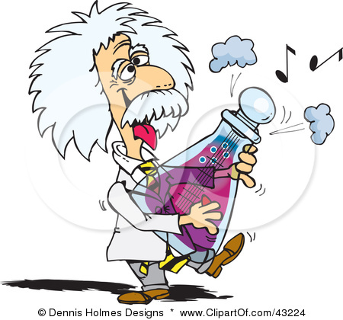
Unit 1: Introduction to Organic Chemistry

Slide 2
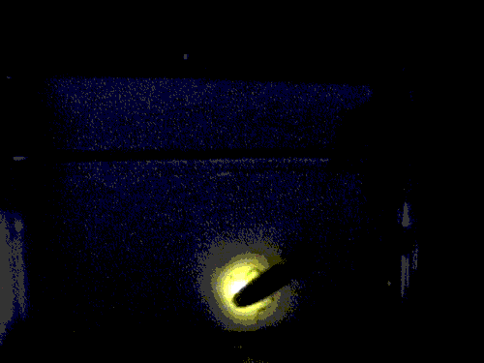

How does the firefly produce light?
What happens when the green leaves of summer are replaced by the orange, red and gold of fall?

Slide 3
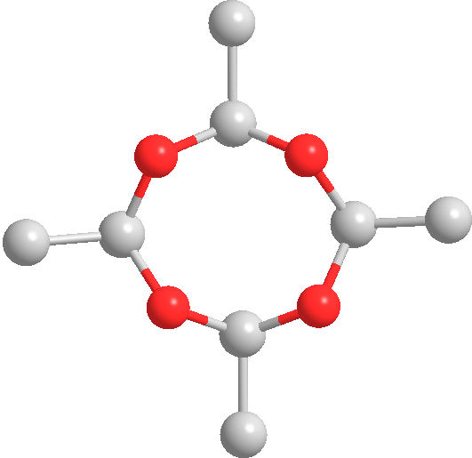
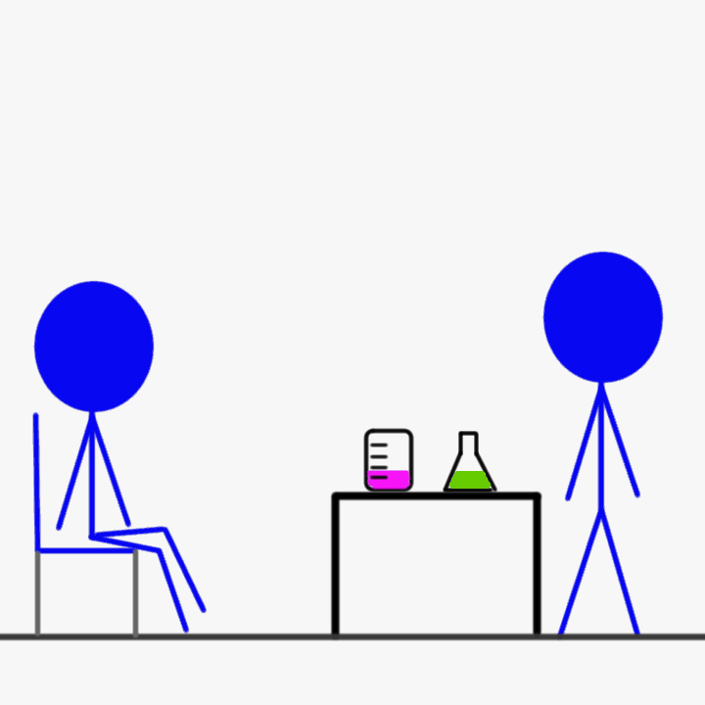
These are some of the questions that we marvel and wonder about that can be answered with Organic Chemistry

Slide 4
Organic Chemistry !"""
Organic chemistry is the chemistry of the compounds of carbon.
(Allotropic forms of carbon: diamond, graphite, fullerenes.)
Inorganic Chemistry:The chemistry of the other ~100 elements.

Slide 5
Allotropes
Allotropes are different forms of the same element.
Different bonding arrangements between atoms result in different structures with different chemical and physical properties

Slide 6
Historical reason for division:
The sources of chemicals for early chemical investigations (last quarter of 18th and first quarter of 19th centuries) were: animal, vegetable, mineral.
Organic chemicals, those from living organisms (animal,vegetable) were complex and contained C, H, and often N and/or O.
Inorganic chemicals (mineral) were simpler, could contain a variety of elements, but only rarely carbon, except for carbonates.

Slide 7
It seemed that inorganic sources of carbon (carbonate,cyanide, carbon dioxide, etc.) could not be converted into organic compounds.
This lead to the vital force theory.
Vital Force Theory: only living organisms can convert carbon containing inorganic compounds to organic compounds.

Slide 8
VITALISM – A BELIEF IN A LIFE FORCE THAT IS OUTSIDE THE JURISDICTION OF CHEMICAL AND PHYSICAL LAWS.
SCIENTISTS FEEL THAT THEY HAVE DISPROVED VITALISM BY SYTHESIZING VARIOUS ORGANIC COMPOUNDS IN A LAB

Slide 9
Friedrich Wöhler, 1828 ---
Ammonium Cyanate ___heat_____> Urea
( an inorganic compound) ( organic compound)
Jon Jacob Berzelius 1807---- Coined the term organic chemistry
Berzelius was interested in cases where two different materials had the same elemental composition and developed the term isomerism to define it

Slide 10
1928 – FREDERICK WOHLER WAS ABLE TO SYNTHESIZE UREA
HERMAN KOLBE – WAS ABLE TO SYNTHESIZE ACETIC ACID
1953 – STANLEY MILLER HETEROTROPH HYPOTHESIS: HYDROGEN, WATER, AMMONIA, AND METHANE (RECREATE PRIMITIVE EARTH)

Slide 11
Organic chemicals make up
Foods and foodstuff
Flavours and fragrances
Medicines
Materials, polymers, plastics
Plant, animal and microbial matter; natural products
A vast range of manufactured goods
[pharmaceuticals, foods, dyestuffs, adhesives, coatings, packaging, lubricants, cosmetics, films & fibres, etc. etc.]

Slide 12
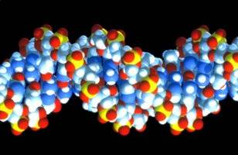
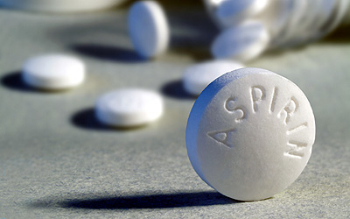
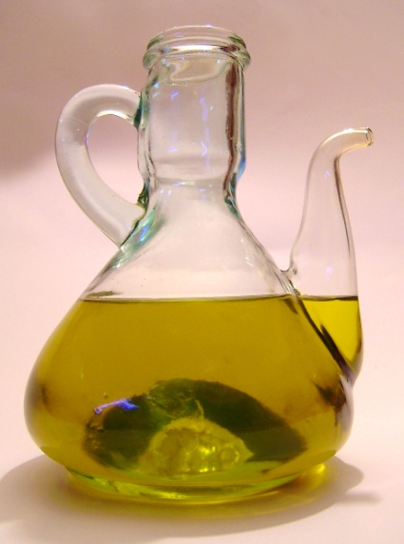
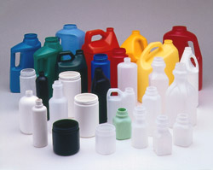
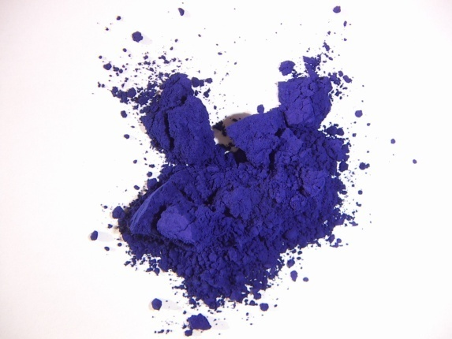
Some organic chemicals

Slide 13
3 Main Concepts of organic Chemistry
1. Stereochemistry
2. Functional groups
3. Curved arrow notation ( shows flow of electrons and where bonds form)
Reactivity in organic chemistry is based on flow of electrons, if you understand where the electrons are and where they are going then you can figure out how a chemical reaction occurs.

Slide 14
Aspects of organic molecules
Structure & bonding
Atom to atom connectivity
3D shape (Stereochemistry)
Naming (Nomenclature)
Physical properties
Interaction with physical world
Chemical properties
Transformation of molecular structure (Reactions)
How reactions occur (Mechanism)

Slide 15
THE STRUCTURAL AND FUNCTIONAL DIVERSTITY OF ORGANIC MOLECULES IS THE ABILITY OF CARBON TO FORM LARGE COMPLEX COMPOUNDS BY BONDING TO ITSELF AND OTHER ELEMENTS

Slide 16
VERSITILITY OF THE CARBON ATOM
ATOMIC NUMBER IS 6
4 VALENCE ELECTRONS
TETRAVALENT: In a tetrahedral molecular geometry the carbon atom is located at the center with four elements that are located at the corners. The bond angles are 109.5°
COMPLETES THE OUTER SHELL BY FORMING 4 COVALENT BONDS
MAKES LARGE COMPLEX MOLECULES POSSIBLE by forming chains, branches or cyclic compounds

Slide 17
3 Dimensional shape of the molecule has tetrahedral carbons
Angle formed by any two bonds to any atom = ~ 109.5º

Slide 18
109.5°
109.5°
109.5°
109.5°
Need to be able to represent 3D molecular structure in 2D

Slide 19
Angle between any two bonds at a Carbon atom = 109.5º

Slide 20
e.g.
=
Or
₌

Slide 21
VARIATIONS OF ORGANIC MOLECULES
LENGTH
SHAPE
NUMBER AND LOCATION OF DOUBLE BONDS
OTHER ELEMENTS COVALENTLY BONDED TO AVAILABLE SITES

Slide 22
HYDROCARBONS
HYDROGEN AND CARBON ONLY
STORE LARGE AMOUNTS OF ENERGY
MAJOR COMPONENT OF FOSSIL FUELS
MANY ORGANIC COMPOUNDS CONTAIN REGIONS OF HYDROCARBON CHAINS
HYDROPHOBIC – C-C AND C-H, BONDS ARE NON-POLAR
VERY DIVERSE IN STRUCTURE

Slide 23
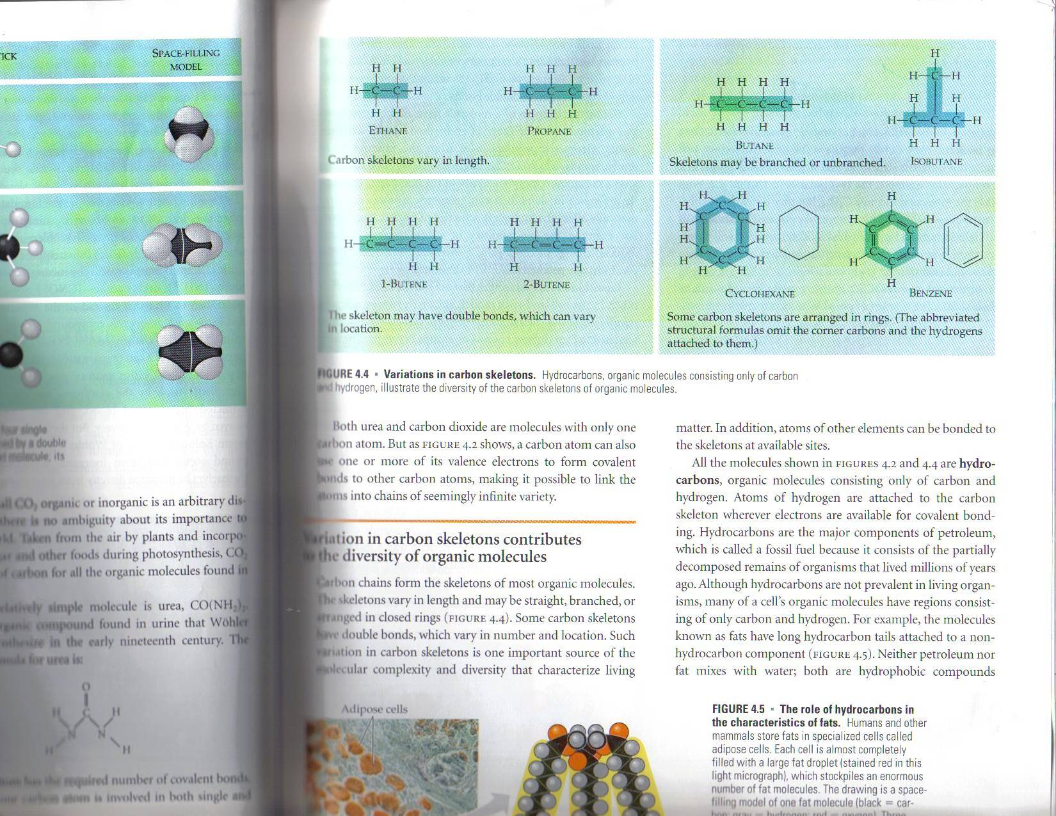

Slide 24
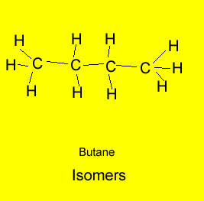
Isomers
Isomers are organic molecules having the same chemical formula but a different structural formula.
The animation above shows that atoms are rearranged in the molecule to create different isomers. Butane has two isomers.
Both butane and 2-methylpropane have the same chemical formula but a different structural formula.
.

Slide 25
ISOMERS
COMPOUNDS WITH THE SAME MOLECULAR FORMULA BUT DIFFERENT STRUCTURAL FORMULA
CONSEQUENTLY – DIFFERENT PROPERTIES

Slide 26
THREE TYPES OF ISOMERS
STRUCTURAL ISOMER – VARIATION IN COVALENT ARRANGEMENT OR MAY ALSO DIFFER IN THE LOCATION OF DOUBLE BONDS

Slide 27
GEOMETRIC ISOMER
THE SAME COVALENT PARTNER BUT DIFFER IN THE SPATIAL ARRANGEMENT AROUND THE DOUBLE BOND. SUBTLE DIFFERENCE WILL AFFECT BIOLOGICAL ACTIVITY

Slide 28
ENANTIOMERS
ISOMER THAT IS A MIRROR IMAGE OF ITSELF.
USSUALLY ONE WILL BE ACTIVE AND ONE INACTIVE
CAN OCCUR WHEN 4 DIFFERENT ATOMS ARE ATTACHED TO THE SAME (ASYMMETRIC) CARBON

Slide 29
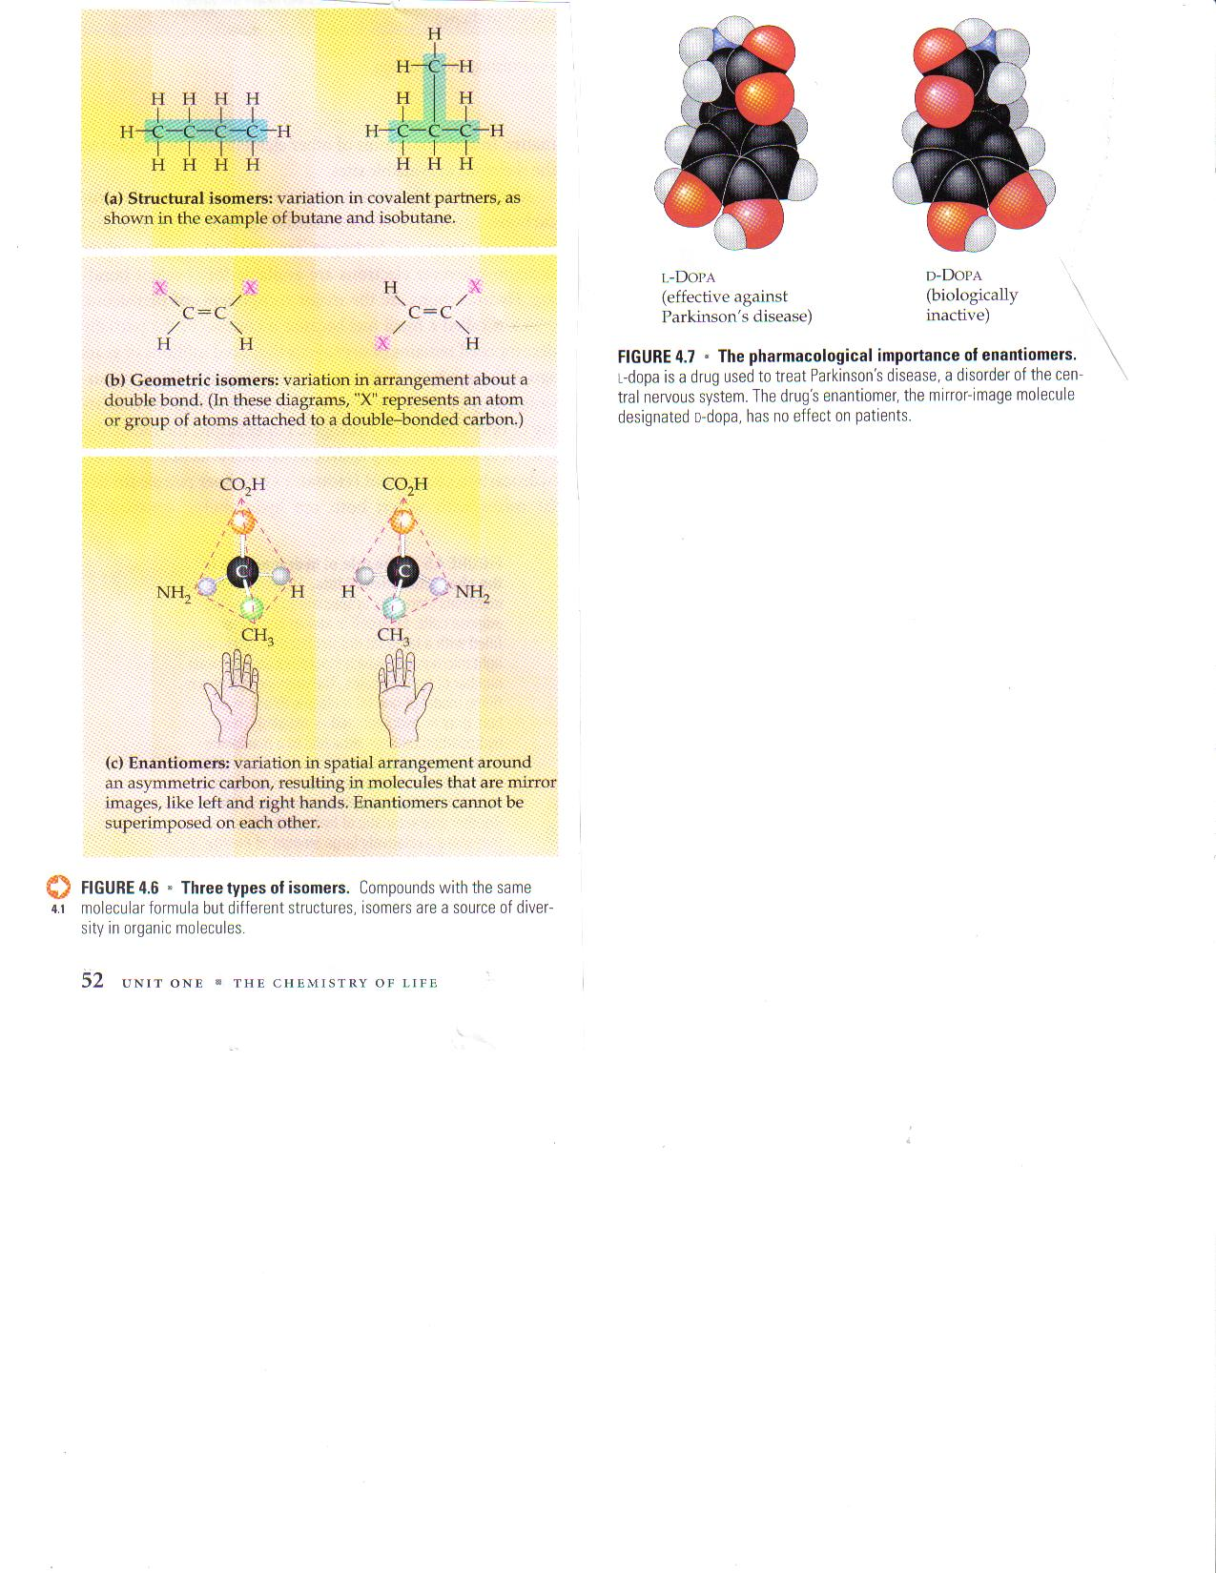

Slide 30
FUNCTIONAL GROUPS
CONTRIBUTE TO MOLECULAR DIVERSTIY
SPECIFIC CHEMICAL AND PHYSICAL PROPERTIES
USSUALLY CHEMICALLY ACTIVE
CONSISTENT BEHAVIOR FROM ONE ORGANIC MOLECULE TO ANOTHER
DETERMINES THE UNIQUE PROPERTIES OF AN ORGANIC MOLECULE

Slide 31
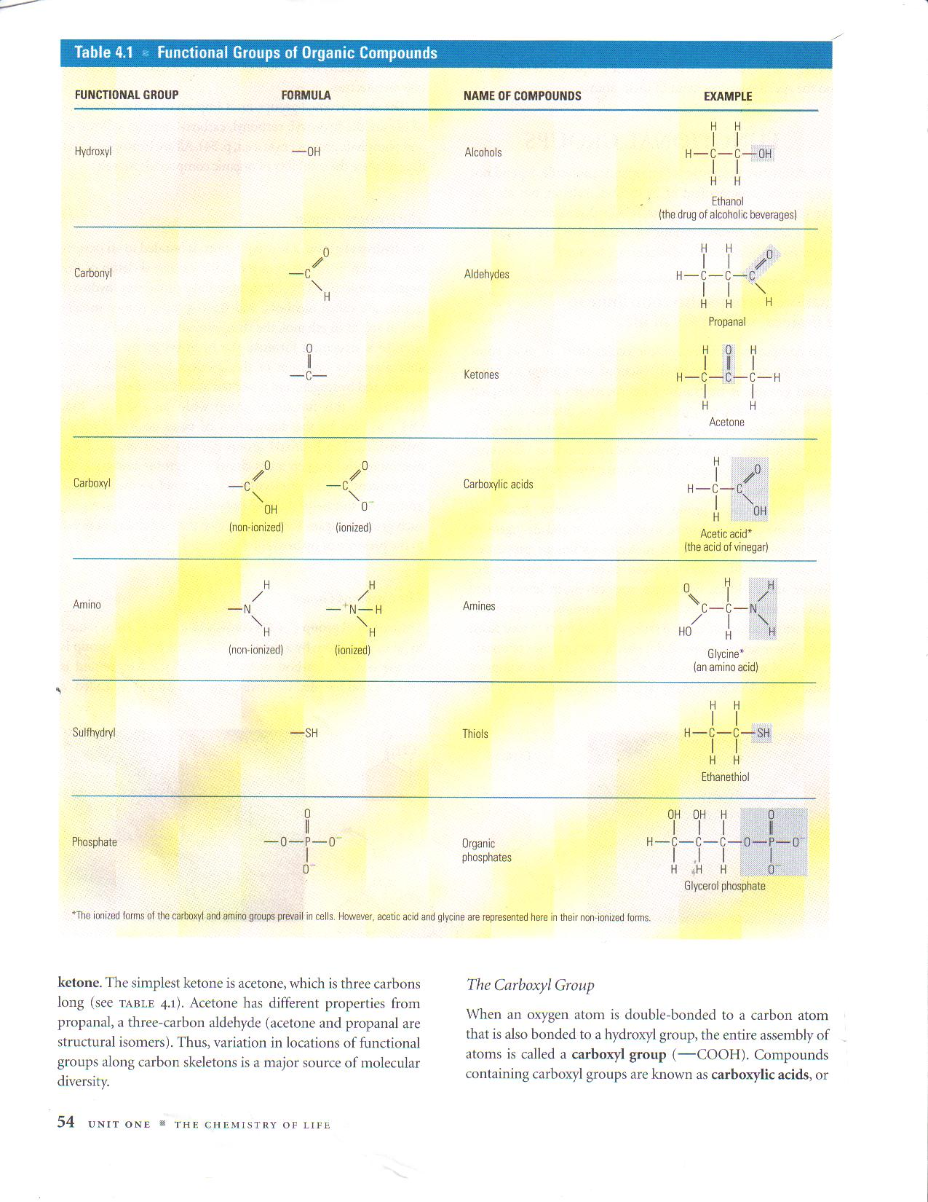

Slide 32
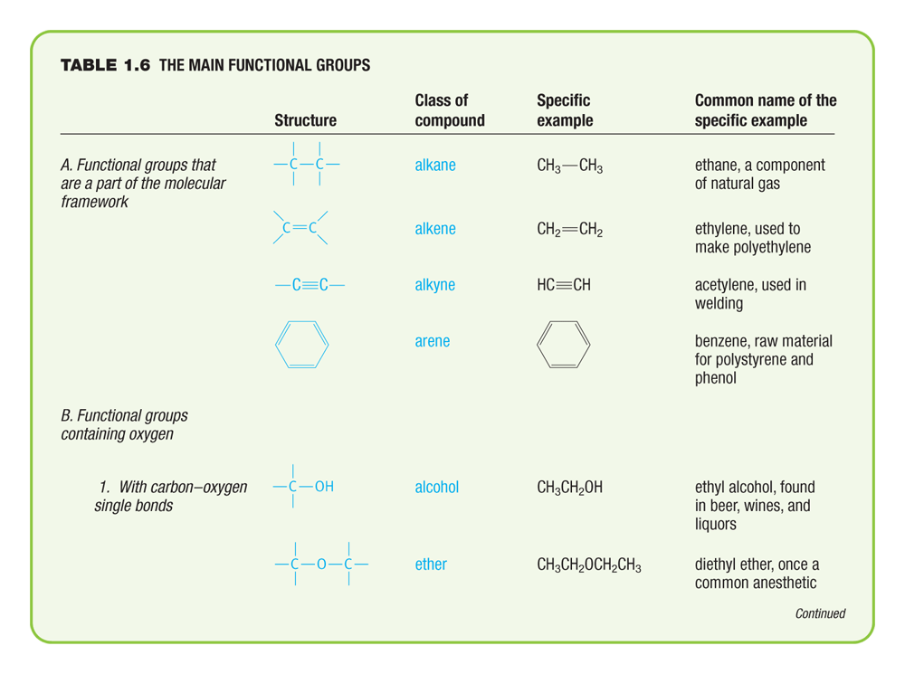
The Main Functional Groups

Slide 33
Structure of the Atom
Atoms consist of: Protons (+) ( atomic number)
Neutrons (neutral)
Electrons (-)
Protons and neutrons are in the nucleus and have similar masses (p + n = atomic weight)
Atoms with the same number of protons but different neutrons are called ISOTOPES. E.g. ¹²C (major isotope)
¹³C (~1%, used in carbon NMR) ( nuclear magnetic resonance)
¹⁴C (radioactive, used in Carbon dating)
Almost all the mass of an atom is in the nucleus, but it is the electrons that are involved in the chemical bonding and reactions of an atom.

Slide 34
Electronic Structure of the Atom
Electrons are located in orbitals around a nucleus, but the Heisenberg Uncertainty Principle tells us that we cannot pinpoint exactly where the electron is.
So we use the term ELECTRON DENSITY, which is the probability of finding the electron in a particular part of the orbital.
ORBITAL: is an allowed energy state for an electron, with an associated probability function that defines the distribution of electron density in space.

Slide 35
Electronic Configuration of Atoms
The Aufbau Principle tells us how to ‘build up’ a ground state (most stable) configuration, which is to fill the orbitals in order, until the correct number of electrons have been added.
Hund’s rule states that when there are two or more degenerate orbitals available, electrons would rather go into different orbitals rather than the same one.

Slide 36
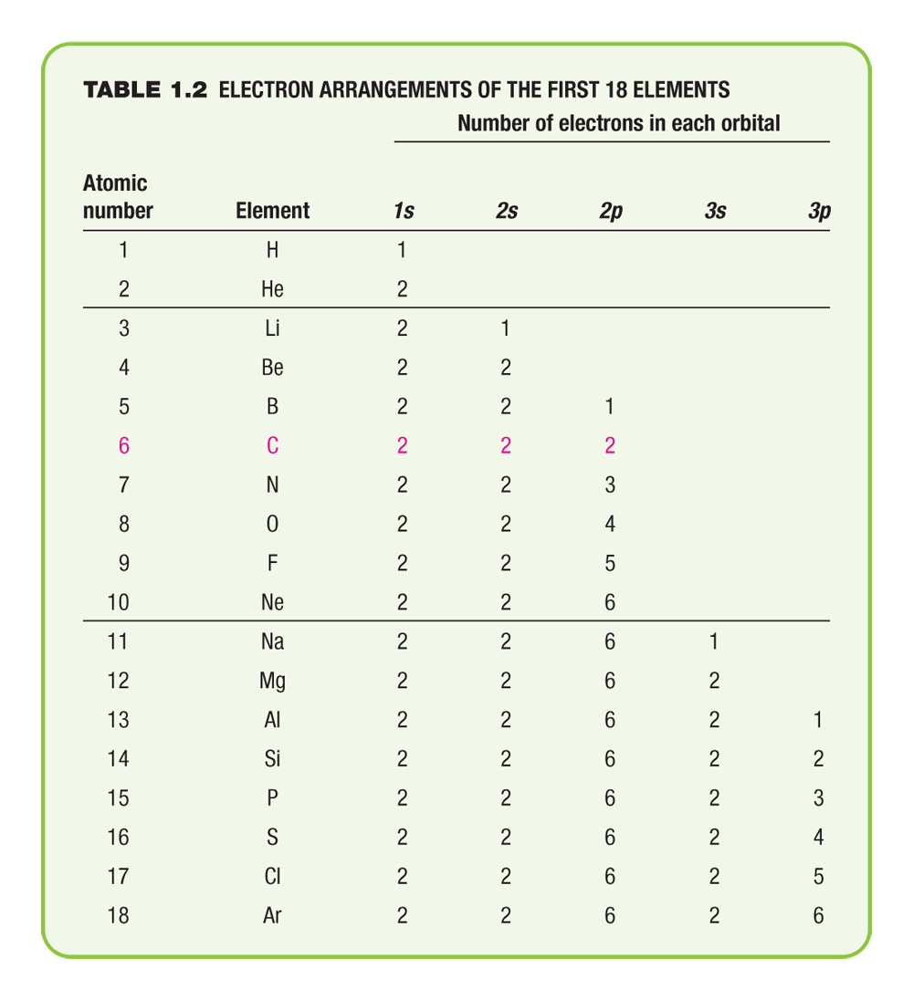
Electron Arrangements of the First 18 elements

Slide 37
valence electrons
The valence electrons are those in the outermost shell. (Periodic group number is the number of valence electrons).

Slide 38
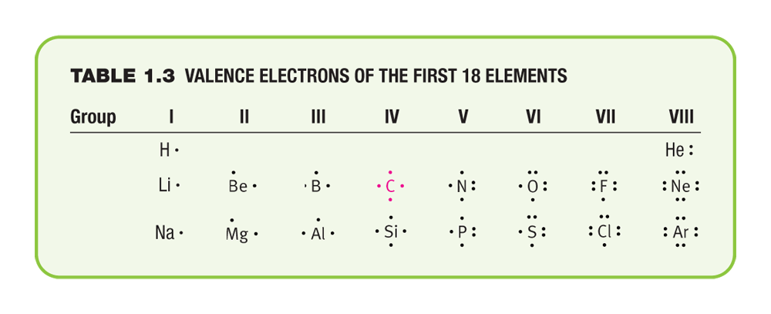
Valence Electrons of the First 18 Elements

Slide 39
Bonding
Atoms transfer or share electrons in such a way as to attain a filled shell of electrons – The OCTET rule.
A filled shell is also known as a noble gas configuration.

Slide 40
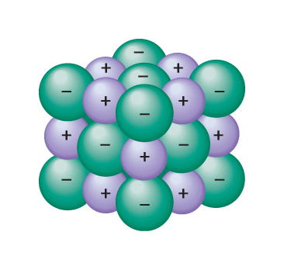
Ionic Bonding
The transfer of one or more electrons from one atom to another. (loss or gain of electrons) ( between metal and nonmetal) ( when the substance dissolves, the ions separate and are able to move about in solution relatively freely)
Electropositive (cation) gives up an electron
Electronegative (anion) accepts the electron
Na^{+ ……} Cl⁻

Slide 41
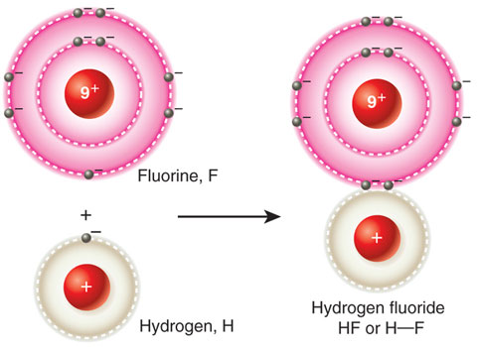
Covalent Bonding
The electrons are shared, not transferred. ( between nonmetals)
H• + H• → H:H
Covalent is the most important bonding in Organic Chemistry.

Slide 42
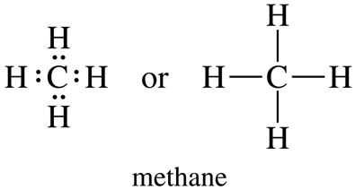
Lewis Structures
Each electron is represented by a dot.
A pair of electrons by two dots, or a dash.(showing a bond has occurred)

Slide 43
Non bonding pairs of electrons
Also known as lone pairs
Lone pairs often dictate a molecule’s reactivity.

Slide 44
Multiple Bonds
The sharing of one pair of electrons is a single bond.
The sharing of two pairs gives a double bond.
The sharing of three pairs gives a triple bond
In neutral organic compounds:
Carbon forms four bonds
Nitrogen forms three bonds (and a lone pair)
Oxygen forms two bonds

Slide 45
A covalent bond, where the electrons are shared equally is called a non-polar bond. (E.g. H-H)
Bonds between different atoms usually result in the electrons being attracted to one atom more strongly than the other. Such an unequal sharing of the pair of bonding electrons results in a POLAR bond.
This competition for electron density is scaled by ELECTRONEGATIVITY values.
Elements with higher electronegativity values have greater attraction for bonding electrons
Electronegativity group trends: elements become less electronegative as move down a group on the periodic table

Slide 46
Polar Covalent bonds
Most reactivity relates here.
They still have octet ( 8 valence electrons) but not sharing the electrons equally.
This gives rise to lots of reactivity in organic chemistry.
Ex H-F unequal sharing of electrons.. so polar covalent
Reason: F is more electronegative than H ( F= 4.0 and H = 2.2)
So electrons spend more time with F so F is partially negative and H is partially positive

Slide 47
Delta = partial
H-F H= delta + and F = delta –
The electronegativity of carbon is 2.5 and Hydrogen is 2.2 so together they are non polar
Ionic, covalent ( polar and nonpolar) depends on electronegativity

Slide 48
Electronegativity
A good measure of polar covalent bond or ionic bond.
Polar covalent bonds have an electronegativity difference less than 2 (1.5)
Ionic bonds have an electronegativity difference greater than 2 (1.5)
Nonpolar bonds: have an electronegativity difference less than 0.5

Slide 49
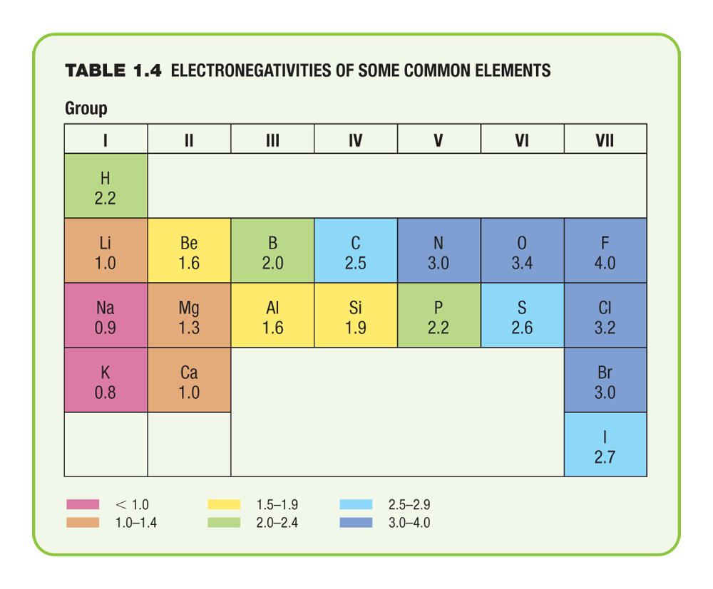
Electronegativities of Some Common Elements

Slide 50
Electronegativity
Pauling Scale
Trends are for electronegativity to decrease down the periodic table and increase across the table.
Ex NaCl Na=.9 Cl = 3.4 greater than 2 so ionic
Ex HF H=2.2 F =4.0 less than 2 so polar

Slide 51
So what if we have a bond between carbon and oxygen
Carbon is less electronegative than oxygen so carbon has a partial positive charge (delta +) and O has a partial negative charge (delta-)

Slide 52
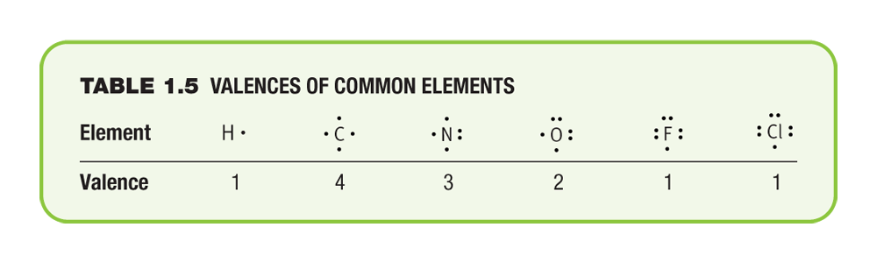
Valences of Common Electrons
The valence of an element is the number of bonds that atom of the element can form. The valence applies to whether the bonds are single double or triple

Slide 53
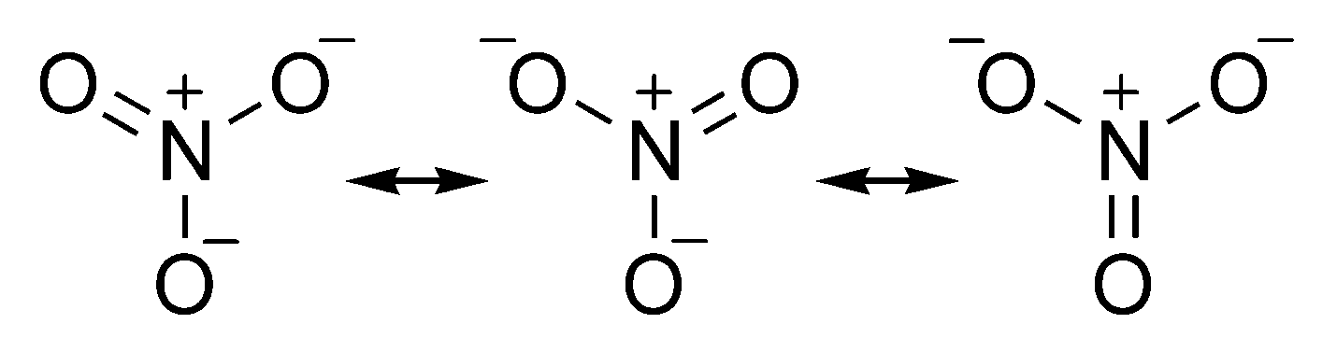
Resonance structures
Are 2 or more structures with identical arrangements of the atoms but different arrangements of the electrons.
The true structure of the molecule is a hybrid of the resonance structures
We use double headed arrows between contributing structures to distinguish resonance from an equilibrium reaction which uses reversable arrows

Slide 54
Abbreviated Structural Formulas:
1. Full structural formula: example for octane…Can also do shortcuts:
CH₃-(CH₂)₆-CH₃
2. Condensed structural formula.
3. Line segment structural formula

Slide 55
Line segment structural formula for octane
Each line represents a covalent bond between atoms
Unless indicated otherwise, assume bonds are between Carbons
C-H bonds not shown, assume they are present
[so as make up valency of Carbon to 4]

Slide 56
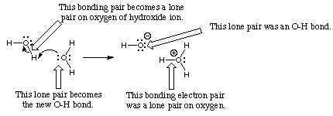
Arrow Formalism
Arrows in chemical drawings have specific meanings.
1. Curved arrows: used to show how electrons are moved in resonance structures and in reactions

Slide 57
Curved arrow Notation
A curved arrow with half a head is called a fishhook. And indicates the movement of single electrons, two fishhooks are used to show the movement of two electrons
Straight arrows point from reactant to product in the chemical reaction equation
Double headed straight arrows indicate resonance structures

Slide 58
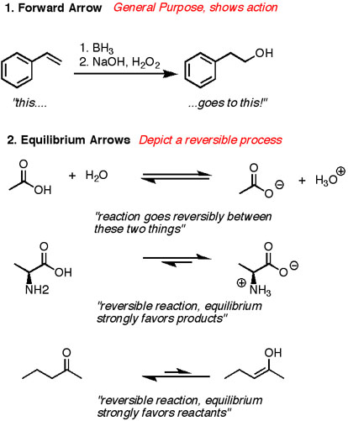

Slide 59
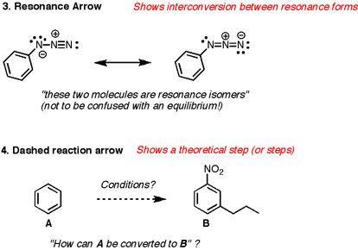

Slide 60
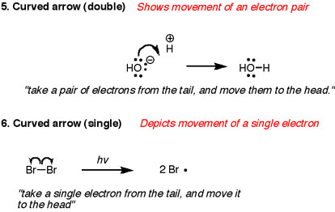

Slide 61
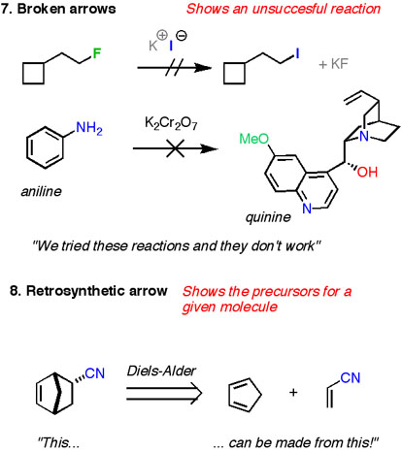

Slide 62
Atomic Orbitals
These are different shells at differing distances away from the nucleus. Each has a principal quantum number (n).
As n increases, Shells are further from the nucleus
Higher energy
Can hold more electrons
n=1 can hold 2 electrons, n=2 can hold 8 electrons

Slide 63
Each orbital contains a maximum of 2 electrons. The orbitals with different shapes are designed by letters s, p, and d
In addition the orbitals are grouped in shells designated by the numbers 1,2,3 ect..
Each shell contains differnet types and numbers of orbitals, corresponding to the shell number.
Ex shell 1 has 1s, shell 2 has 2s, 2d, shell 3 has 3s, 3p 3d ect

Slide 64
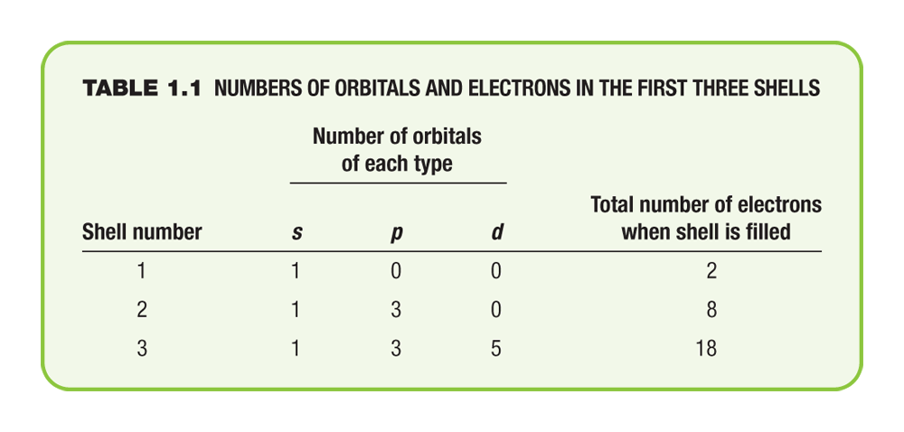
Numbers of Orbitals and electrons in the First Three Shells

Slide 65
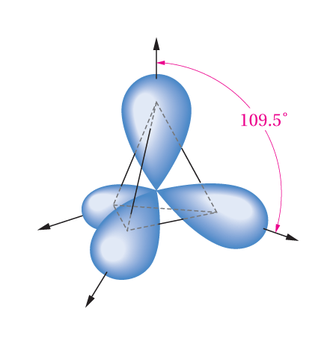
An sp³ orbital extends mainly in one direction from the nucleus and forms bonds with other atoms in that direction.
It is a p shaped orbital that is one part s and three parts p in character

Slide 66
Carbon sp³ orbitals can overlap with Hydrogen 1s orbitals to form Carbon-Hydrogen σ bonds
Each sp³ orbital contributes one electron; each s orbital contributes one electron to form C-H [C..H]
[Anti-bonding orbitals also formed; not occupied by electrons]
σ bonds: symmetrical about the bond axis

Slide 67
Geometry of Carbon in ethane is tetrahedral and is based upon sp³ hybridisation
sp³ hybridised Carbon = tetrahedral Carbon
Tetrahedral angle ≈ 109.5º

Slide 68
This represents a particular orientation of the C-H bonds on adjacent Carbons
View along C-C bond:
Newman projection
φ
Can select one C-H bond on either carbon and define a dihedral angle or torsional angle (φ)

Slide 69
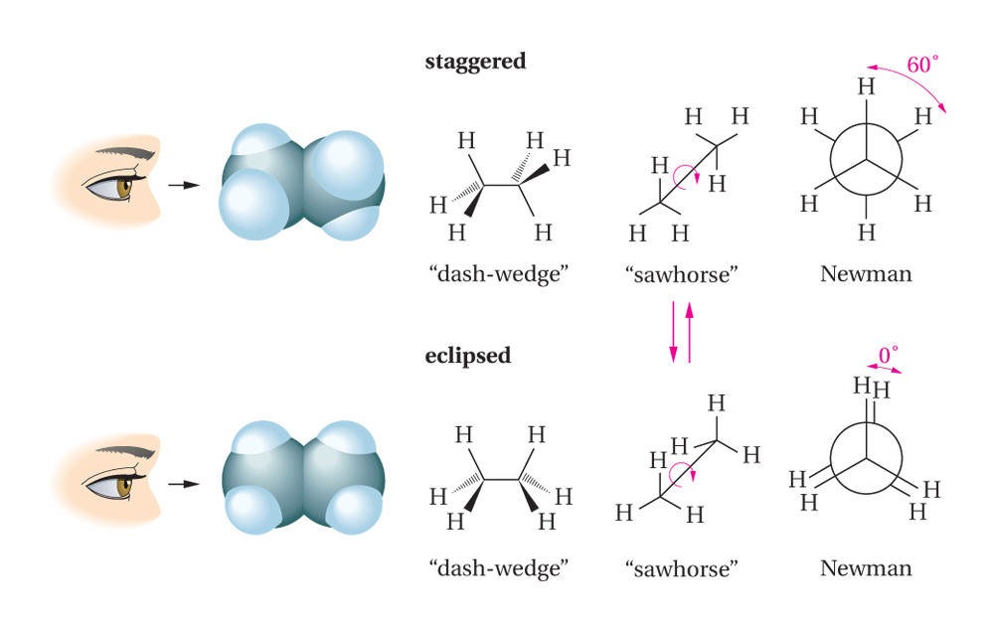

Slide 70
Staggered conformation
Minimum energy conformation
(least crowded possible conformation)
φ = 60º
C-C σ bonds: symmetrical about the bond axes.
In principle, no barrier to rotation about C-C bond
Could have φ = 0º
=
Eclipsed conformation
Maximum energy conformation
(most crowded possible conformation)

Slide 71
Eclipsed conformation experiences steric hindrance
Unfavourable interaction between groups which are close together in space
Steric hindrance exists between the eclipsing C-H bonds in this conformation
These unfavourable interactions absent in the staggered conformation
Hence, the staggered conformation is lower in energy
Energy difference between eclipsed and staggered conformations of ethane = 12 kJ mol⁻¹

Slide 72
Each C-H eclipsing interaction contributes 4 kJ mol⁻¹ of torsional strain energy
Total: 12 kJ mol⁻¹ torsional strain
Conformations: different orientations of molecules arising from rotations about C-C σ bonds
Consider one full rotation about the C-C bond in ethane
Start at φ = 0° (eclipsed conformation)

Slide 73
Eclipsed conformation
strain energy 12 kJ mol⁻¹
φ = 0°
Rotate 60°
φ = 60°
Staggered conformation
strain energy 0 kJ mol⁻¹
Rotate 60°
Eclipsed conformation
strain energy 12 kJ mol⁻¹
φ = 120°

Slide 74
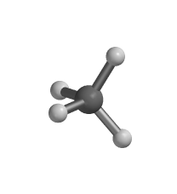
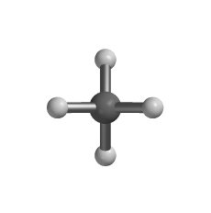
Various Structural diagrams:
1. Ball and Stick Representations: emphasizes the bonds that connect atoms

Slide 75
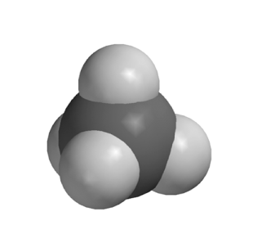
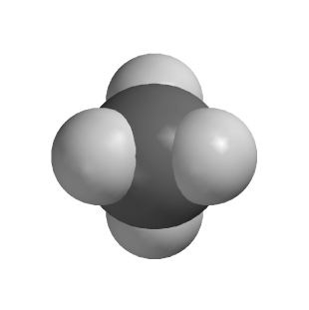
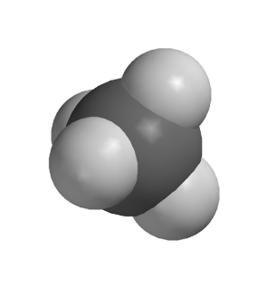
2. space-filling models: showing the approximate volume of the entire molecule

Slide 76
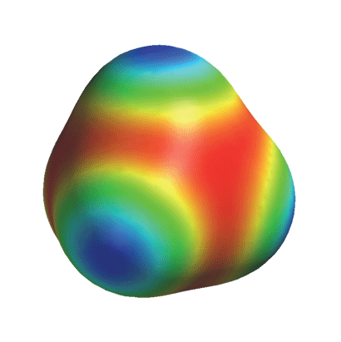
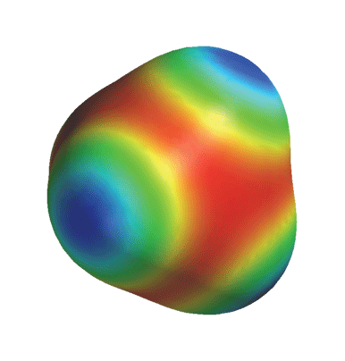
3. Electrostatic potential (ESP) view: shows distribution of electrons in a molecule, red= neg charge, blue = positive charge

Slide 77
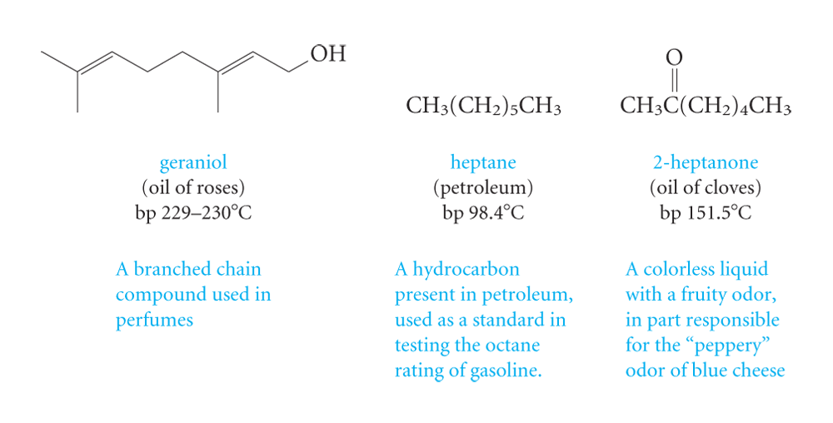
Classification According to molecular framework:
.1. Acyclic: not cyclic, chains of carbon but no rings

Slide 78
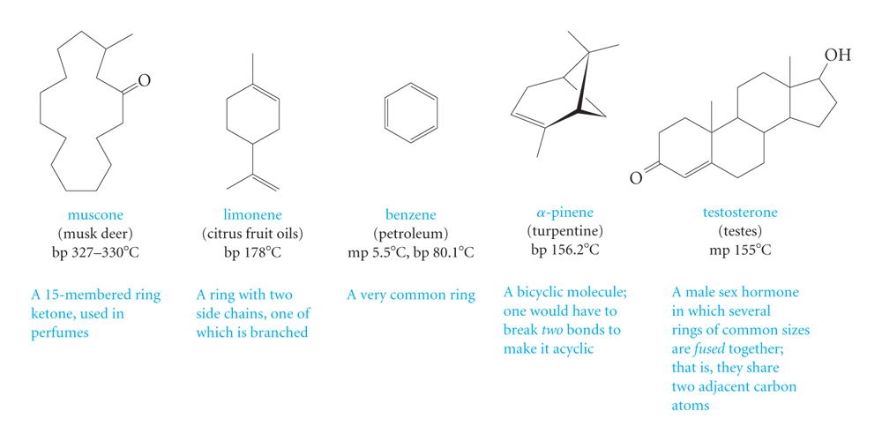
2. carbocyclic compounds with rings of various sizes and shapes.

Slide 79
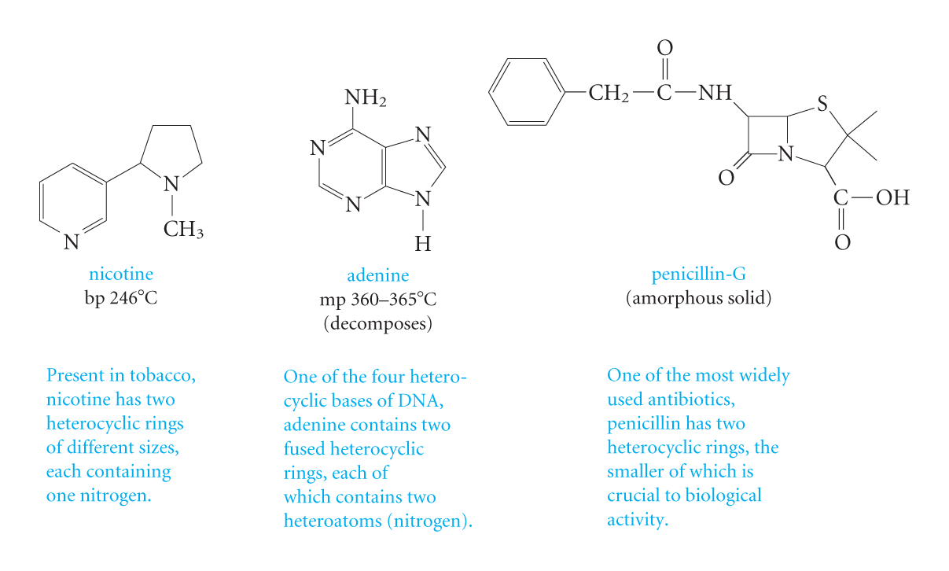
3. heterocyclic compounds having a variety of heteroatoms and ring sizes.

