Slide 1
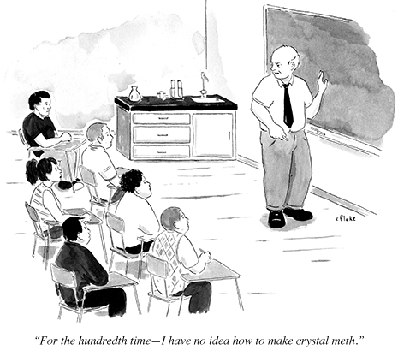
Unit : Introduction to Organic Chemistry

Slide 2
All types of life are based on carbon compounds, and so the chemistry of carbon is called Organic chemistry
The chemistry of carbon is caused by the ability of each carbon atom to form up to 4 bonds with other atoms as well as to link together to form chains or rings.

Slide 3
Organic Chemistry !"""
Organic chemistry is the chemistry of the compounds of carbon.
(Allotropic forms of carbon: diamond, graphite, fullerenes.)
Inorganic Chemistry:The chemistry of the other ~100 elements.

Slide 4
Allotropes
Allotropes are different forms of the same element.
Different bonding arrangements between atoms result in different structures with different chemical and physical properties

Slide 5
Historical reason for division:
The sources of chemicals for early chemical investigations (last quarter of 18th and first quarter of 19th centuries) were: animal, vegetable, mineral.
Organic chemicals, those from living organisms (animal,vegetable) were complex and contained C, H, and often N and/or O.
Inorganic chemicals (mineral) were simpler, could contain a variety of elements, but only rarely carbon, except for carbonates.

Slide 6
Jon Jacob Berzelius 1807---- Coined the term organic chemistry
Berzelius was interested in cases where two different materials had the same elemental composition and developed the term isomerism to define it

Slide 7
Organic compounds
The number of carbon compounds is virtually unlimited
About one hundred thousand new compounds are isolated or synthesized each year.
Over 4 million naturally /synthetic compounds already exist

Slide 8
Organic chemicals make up
Foods and foodstuff
Flavours and fragrances
Medicines
Materials, polymers, plastics
Plant, animal and microbial matter; natural products
A vast range of manufactured goods
[pharmaceuticals, foods, dyestuffs, adhesives, coatings, packaging, lubricants, cosmetics, films & fibres, etc. etc.]

Slide 9
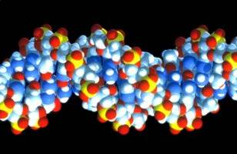
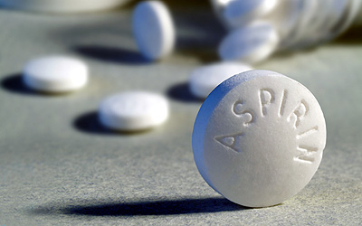
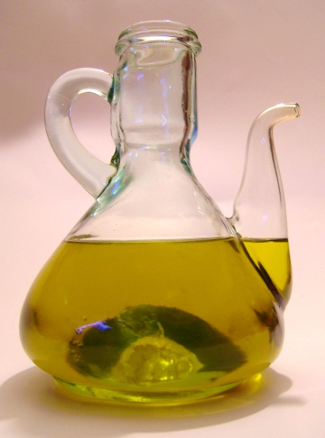
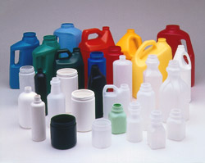
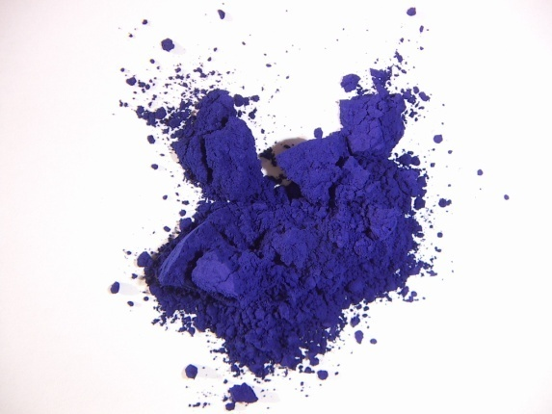
Some organic chemicals

Slide 10
2 reasons for the occurrence of so any organic compounds
carbon atoms can link up with each other to form a limitless number of chain, branched chained and ring shaped structures
Carbon atoms may be arranged in several different ways which create compounds with different properties and structures

Slide 11
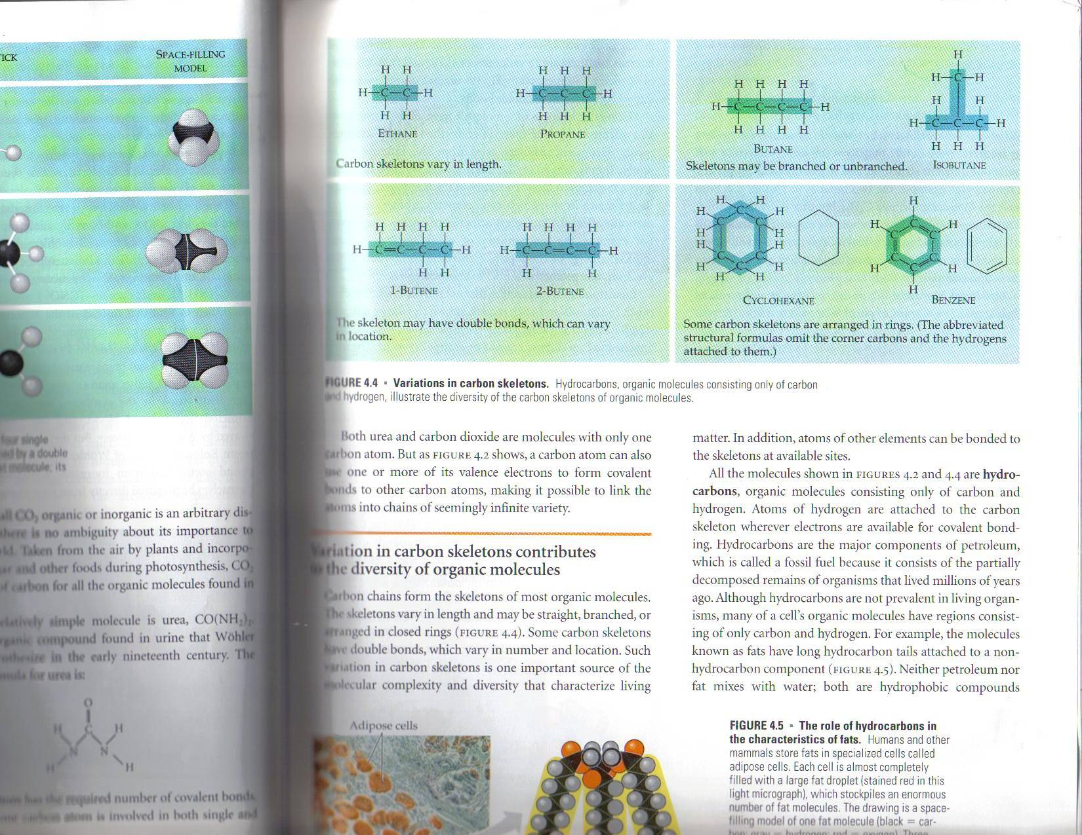

Slide 12
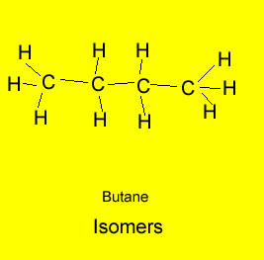
Isomers
Isomers are organic molecules having the same chemical formula but a different structural formula.
The animation above shows that atoms are rearranged in the molecule to create different isomers. Butane has two isomers.
Both butane and 2-methylpropane have the same chemical formula but a different structural formula.
.

Slide 13
ISOMERS
COMPOUNDS WITH THE SAME MOLECULAR FORMULA BUT DIFFERENT STRUCTURAL FORMULA
CONSEQUENTLY – DIFFERENT PROPERTIES

Slide 14
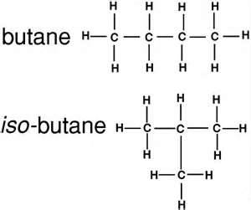
Structural formula indicates the exact numbers and types of atoms present in a molecule and show how atoms are bonded to each other.

Slide 15
THREE TYPES OF ISOMERS
STRUCTURAL ISOMER – VARIATION IN COVALENT ARRANGEMENT OR MAY ALSO DIFFER IN THE LOCATION OF DOUBLE BONDS

Slide 16
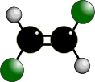
Geometric isomers

Slide 17

In alkenes
CIS
Groups/atoms are on the
SAME SIDE of the double bond
TRANS
Groups/atoms are on OPPOSITE SIDES across the double bond

Slide 18
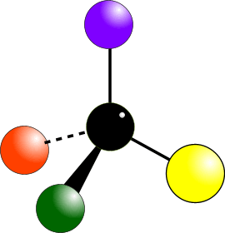
Optical isomers

Slide 19
All molecules have a mirror image – but for many molecules it is the same molecule.

Slide 20
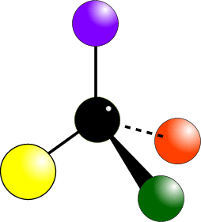

Slide 21
FUNCTIONAL GROUPS
CONTRIBUTE TO MOLECULAR DIVERSTIY
SPECIFIC CHEMICAL AND PHYSICAL PROPERTIES
USSUALLY CHEMICALLY ACTIVE
CONSISTENT BEHAVIOR FROM ONE ORGANIC MOLECULE TO ANOTHER
DETERMINES THE UNIQUE PROPERTIES OF AN ORGANIC MOLECULE

Slide 22
Difference between organic and inorganic compounds
The basic laws of chemistry are the same for both organic and inorganic compounds.

Slide 23
However the behavior of organic compounds is different from inorganic compounds
Most organic compounds do not dissolve in water
Organic compounds decompose by heat easier than inorganic compounds
Organic reactions proceed at a slower rate than inorganic reactions
Organic reactions are greatly affected by reaction conditions. Inorganic reactions follow well known patterns

Slide 24
Organic compounds consist of covalent bonds (sharing a pair of electrons) while inorganic compounds have ionic bonds ( gain or lose electrons)
Organic compounds exist s isomers and inorganic compounds rarely do.

Slide 25
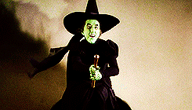
So here’s the question
Was the wicked witch organic or inorganic ?

Slide 26
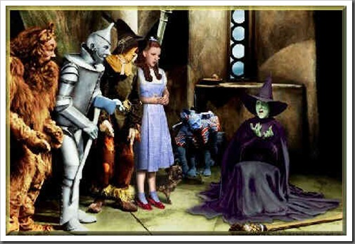

Inorganic Of Course

Slide 27
Hydrocarbons
Are compounds that contain only carbon and hydrogen.
There are three main classes of hydrocarbons based on the types of carbon-carbon bonds present:
1. Saturated hydrocarbons: contain single bonds only ( alkanes)
2. Unsaturated hydrocarbons: contain multiple bonds ..double or triple (alkenes, alkynes
3. Aromatic hydrocarbons: contain cyclic compounds

Slide 28
Alkanes
Alkanes are the simplest organic molecules, they only contain Carbon and hydrogen, and only contain single bonds.
Compounds that have the maximum number of bonded hydrogens, are said to be saturated.
Alkanes are saturated hydrocarbons.
General Formula: C^{n}H^{2n+2}
The simplest members of this group are the n-alkanes.
The n-alkanes are straight chain molecules, but there are also branched alkanes (isomers).

Slide 29
Alkenes
Alkenes ( also called olefins) are hydrocarbons which have carbon–carbon double bonds.
Compounds that do not have the maximum number of bonded hydrogens, are said to be unsaturated.
Alkenes are unsaturated hydrocarbons.
General Formula: C^{n}H^{2n}
Alkenes have physical properties similar to those of alkanes…they are less dense than water and since they are nonpolar, they are not very soluble in it.

Slide 30

Alkynes or acetylenes
Alkynes or acetylenes are compounds that contain a carbon–carbon triple bond.
The triple bond results in a molecular formula of C^{n}H^{2n-2}
The triple bond contributes two elements of unsaturation.

Slide 31
Aromatic Compounds
Many aromatic substances have rather simple structures and contain a six-carbon unit (C₆H₅)
Arenes = aromatic hydrocarbon
Aromatic: refers to the level of stability for an arene
Benzene: is the parent hydrocarbon of the class or aromatic compounds

Slide 32
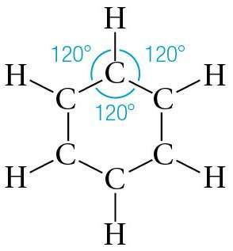
Benzene C₆H₆.
32

Slide 33
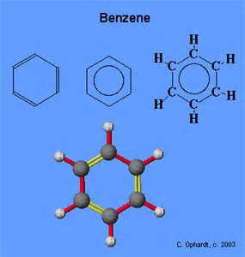
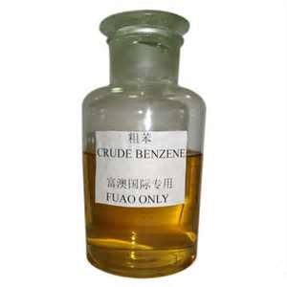
Benzene
Benzene is one of the most important commercial organic chemicals with approximately 17 billion pounds produced annually the United States alone.

Slide 34
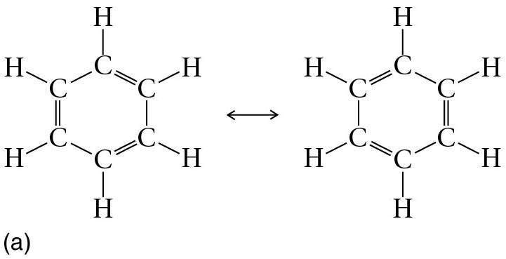
Two Lewis structures for the benzene ring.
Friedrich Kekule (1865) proposed the tetracovalence of carbon in the structure of benzene (alternating double single bonds)
34

Slide 35
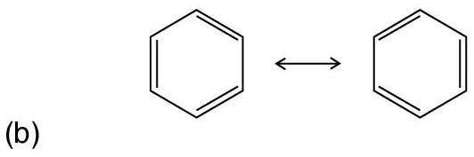
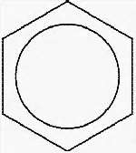
Shorthand notation for benzene rings.
35

Slide 36
Resonance structures
Are 2 or more structures with identical arrangements of the atoms but different arrangements of the electrons.
The true structure of the molecule is a hybrid of the resonance structures

Slide 37
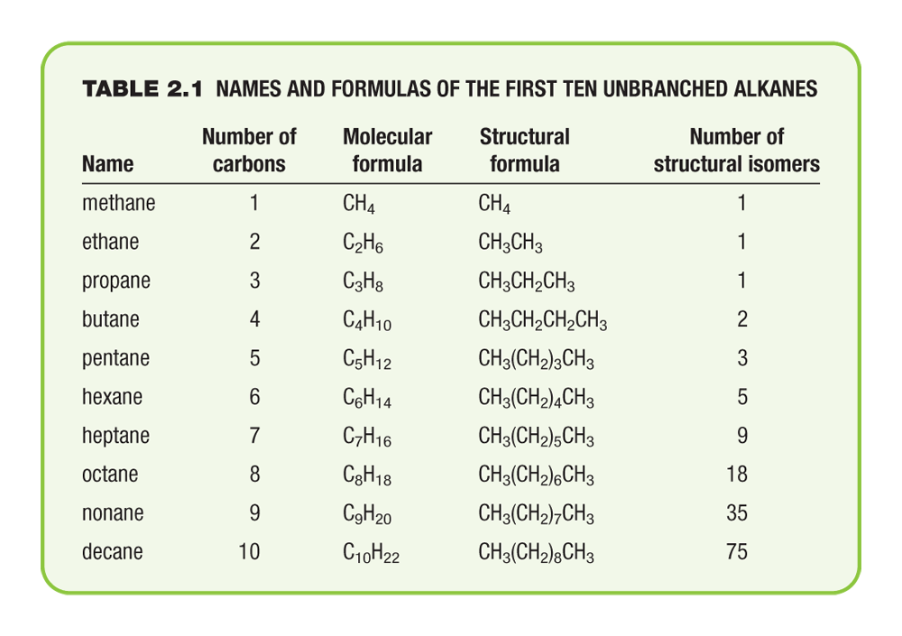
Names and Formulas of the First Ten Unbranched Alkanes

Slide 38
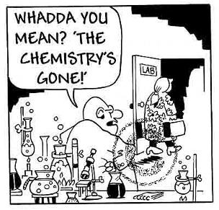
Nomenclature of hydrocarbons

Slide 39
Nomenclature of Organic Compounds
In the early days of organic chemistry, new compounds were given names based on their origin or molecular shapes ex limonene ( lemons) cubane ( shape)
Today, because of the shear number of organic compounds, a systematic naming system is used.
This naming system was devised by the International union of Pure and Applied Chemistry (IUPAC)

Slide 40
Nomenclature of Alkanes
There are two general types of nomenclature:
trivial names (acetone, acetic acid)
IUPAC System (propanone, ethanoic acid)

Slide 41
IUPAC Rules: The systematic way to name all organic compounds.
For alkanes:
(1) Find the longest continuous chain of carbon atoms. This is the base name of the compound.
(2) Number the longest chain beginning with the end nearest a substituent.
(3) Name the substituent groups attached to the longest chain as alkyl groups. Also state the location of each alkyl group according to its numbered carbon on the main chain.
(4) When two or more substituents are present, list them in alphabetical order. If two or more of the same alkyl groups are present, use the prefixes di-, tri- etc to avoid repetition.

Slide 42
Prefixes are used when there are more than one type of alkyl substituent
Di = 2
Tri = 3
Tetra = 4
Penta = 5
The prefixes do not count when alphabetizing.
Example the compound 3-ethyl-2,4,5-trimethylheptane

Slide 43
Any series that differs only by an increasing number of –CH²- groups is known as a Homologous series. The individual members are said to be homologs of each other.
The –CH₂- group is called a methylene group

Slide 44
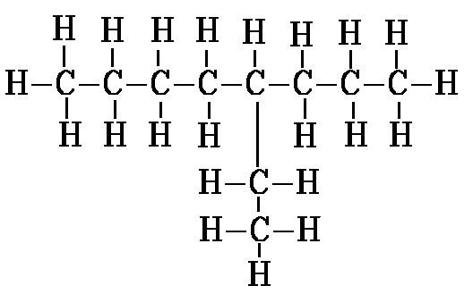
Example: 4 -ethyloctane

Slide 45

If there are two chains of equal length, choose the chain that has the highest number of substituents.
The numbering system in the second drawing is the correct one.
The correct name is:3-ethyl-2-methylhexane.
The incorrect numbering system would have lead to the incorrect name 3-isopropylhexane

Slide 46
IMPORTANT NOTE
: WHEN THERE IS MORE THAN ONE SUBSTITUENT, THE SUBSTITUENTS ARE LISTED IN ALPHABETICAL ORDER, not arranged according to the numbers of their respective positions (see above: 3-ethyl-2-methyl not 2-methyl-3-ethyl).

Slide 47
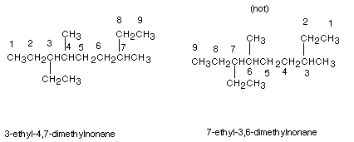
There is also a tie-breaker for numbering the parent chain. If a first substituent occurs equally close to either terminus of the parent chain, the nearness of the second substituent to the termini of the chain is determinative (and so on, to the third or fourth substituent, if necessary).
Example:

Slide 48
Note that in the first numbering system, the first substituent when numbering from left to right is an ethyl group at the 3 position; also when numbering from right to left (second structure) the first substituent is encountered at the 3 position also (methyl).
A tie-breaker is therefore needed.
In the left to right numbering, the second substituent is encountered at the 4 position (methyl) , while in the right to left numbering, the second substituent (also methyl) is at the 6 position.
So the left to right system is chosen.

Slide 49
Complex Substituent Nomenclature
Substituents other than methyl, ethyl, propyl, butyl etc. are also named preferably using IUPAC systematic nomenclature.
The rules are essentially the same as for naming alkanes except for the following:
(1) Numbering in the parent chain of the substituent begins at the carbon atom having the unspecified valence
(2) the family suffix for a substituent , as noted earlier, is -yl.

Slide 50
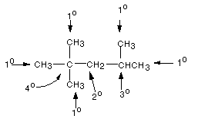
PRIMARY, SECONDARY, TERTIARY, AND QUATERNARY CARBON ATOMS
Primary carbons: are carbons which are attached to only one other carbon atom. In an alkane, these are methyl groups.
Secondary carbons: are carbons which are attached to two other carbon atoms.
Tertiary carbons: are carbons bonded to three other carbons.
. Quaternary carbons are carbon atoms which are directly bonded to four other carbon atoms.

Slide 51
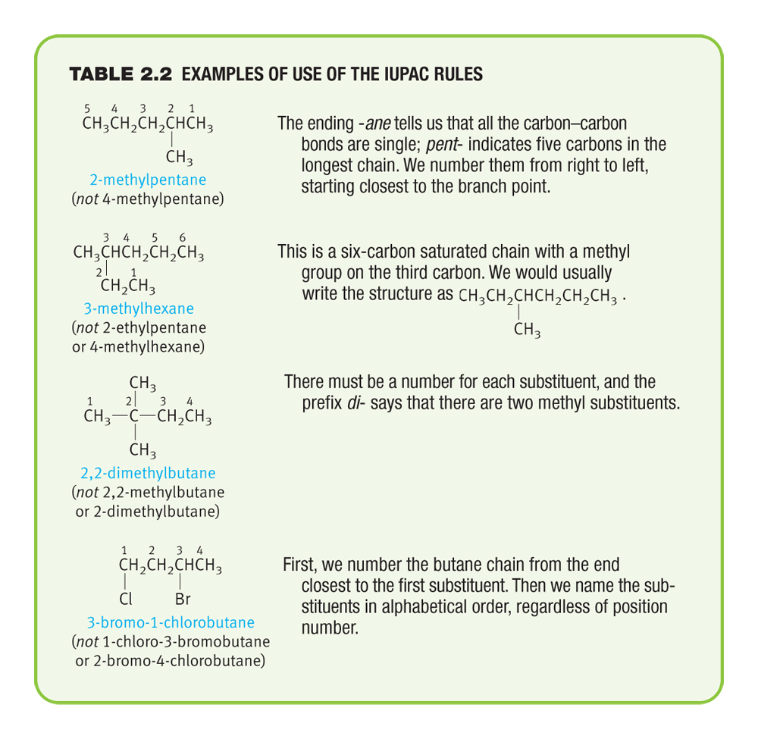
Examples of Use of the IUPAC Rules

Slide 52
Cycloalkanes
Cycloalkanes are alkanes in which the carbon skeleton is cyclic.
Basically any ring size, even including very large sizes, is possible.
The general formula is C_{n}H_{2n}, since there are two less hydrogen atoms in these compounds than in acylic alkanes .
They are named simply as the acyclic alkane of the same number of carbon atoms, with the prefix "cyclo" attached to that name, using no separator.

Slide 53
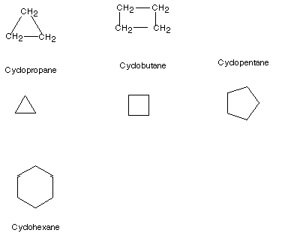
cycloalkanes

Slide 54
Nomenclature of Substituted Cycloalkanes:
In naming substituted cycloalkanes, some additional rules are needed:
If there is only one substituent, no locant is needed. By definition, that ring position attached to the substituent would be number 1.
If there are two substituents, the number 1 carbon is one of the two substituted carbons, but which? The one which would be listed first in the alphabetized list of substituent .
Number toward the second substituent in the direction which yields the lower number for the carbon bearing that second substituent.

Slide 55
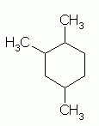
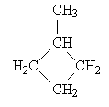
1,2,4 trimethyl cyclohexane
Methyl cyclobutane

Slide 56
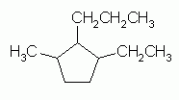
Numbering the Cycloalkane
When numbering the carbons of a cycloalkane, start with a substituted carbon so that the substituted carbons have the lowest numbers (sum).
When two or more different substituents are present, number according to alphabetical order.
example: 1 ethyl,2 propyl, 3 methyl cyclopentane

Slide 57
Halogen Substituents
Halogen substituents are treated exactly like alkyl groups
The halogen substituents are named by changing the ine ending of the element to –o
F- flouro
Cl- cholor
Br- bromo
I- iodo

Slide 58
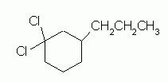
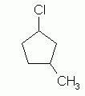


Practice Naming

Slide 59
1,2 dichoro, 4 propyl cyclohexane
1 choro, 3 methyl cyclpentane
1 bromo, 2 choro cyclobutane
1 bromo, 2 chloro, 3 methyl cyclobutane

Slide 60
ALKENE Nomenclature
Simple alkenes are named like alkanes (root from the longest carbon chain), but the –ane suffix is replaced by-ene
Find longest continuous carbon chain containing the double bond for root name
When the chain is longer than 3 carbons, number the atoms such that the double bond is given the lowest number (i.e. start at the end nearest the double bond).
Rings have “cyclo” prefix

Slide 61
Alkadienes
When more than one multiple bonds are present in a molecule, it is called an alkadiene
Chains are the first consideration in naming alkenes and if multiple bonds are present it is an alkadiene]
Ex
C=c-c-c=c-c-c-c-c
Would be 1,4 nonadiene or nona 1,4-diene

Slide 62
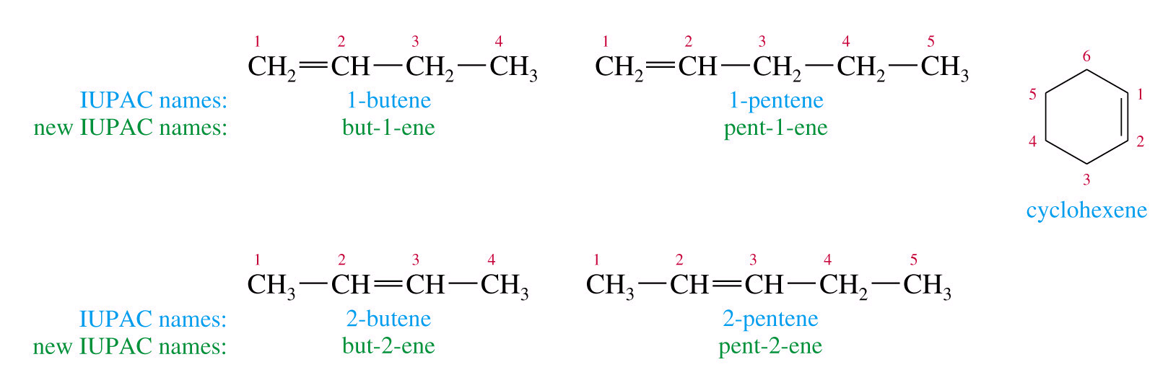
Alkene Nomenclature

Slide 63
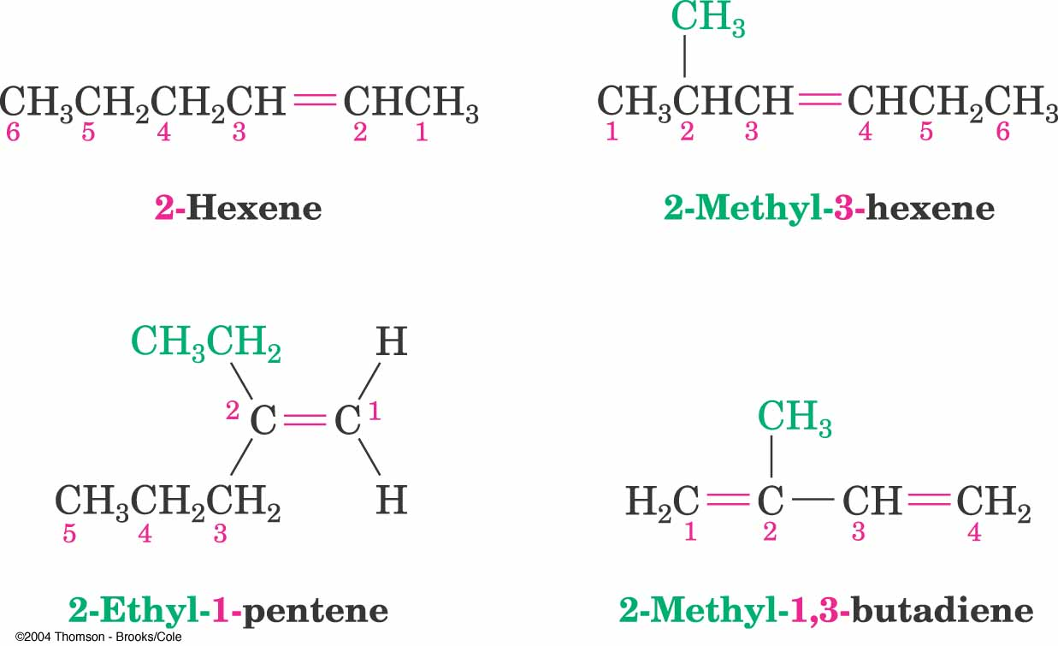

Slide 64
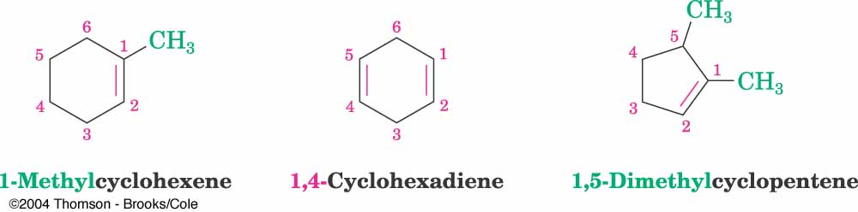
Cyclic alkenes

Slide 65
Name the following Alkenes

Slide 66
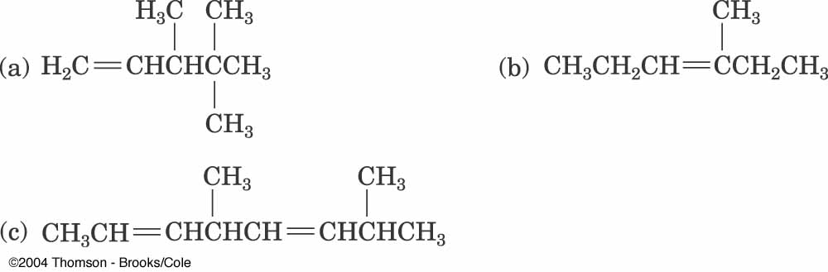
Name these Alkenes

Slide 67
Nomenclature of Alkynes
A common name that you should know is...
acetylene
IUPAC nomenclature is similar to that for alkenes, except the –ane ending is replaced with –yne.
The chain is numbered from the end closest to the triple bond.
When additional functional groups are present, the suffixes are combined

Slide 68
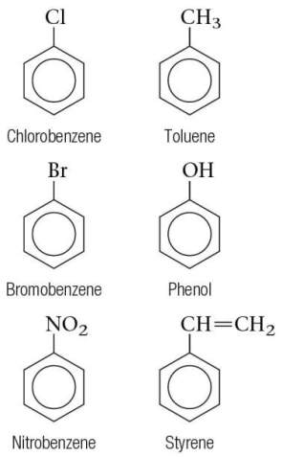
Some common mono-substituted benzene molecules
Toluene, sometimes you see this on marker pens ”contains no toluene”
Has the condensed structural formula C₆H₅CH₃
68

Slide 69
Common Names of
Benzene Derivatives
=>

Slide 70
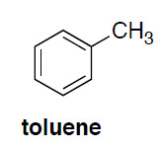
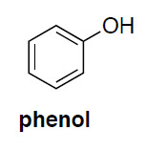
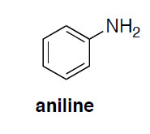
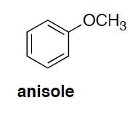
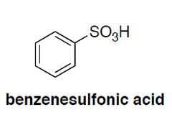
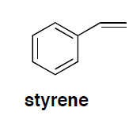
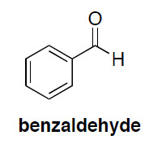
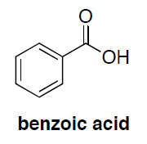
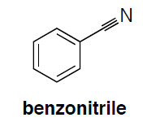

Slide 71
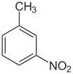
Disubstituted Benzenes
The prefixes ortho-, meta-, and para- are
commonly used for the 1,2-, 1,3-, and 1,4-
positions, respectively.
m nitrotoulene
=>

Slide 72
3 or More Substituents
Use the smallest possible numbers, but
the carbon with a functional group is #1.
=>

Slide 73
Common Names for
Disubstituted Benzenes
=>

Slide 74
Some common mono-substituted benzene molecules
Toluene, sometimes you see this on marker pens ”contains no toluene”
Has the condensed structural formula C₆H₅CH₃
74

Slide 75
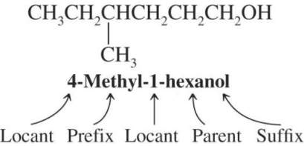
  IUPAC Substitutive Nomenclature
    An IUPAC name may have up to 4 features: locants, prefixes, parent compound and suffixes
    Numbering generally starts from the end of the chain which is closest to the group named in the suffix
75

Slide 76
Some common mono-substituted benzene molecules
Toluene, sometimes you see this on marker pens ”contains no toluene”
Has the condensed structural formula C₆H₅CH₃
76

Slide 77
  IUPAC Substitutive Nomenclature
    An IUPAC name may have up to 4 features: locants, prefixes, parent compound and suffixes
    Numbering generally starts from the end of the chain which is closest to the group named in the suffix
77

Slide 78
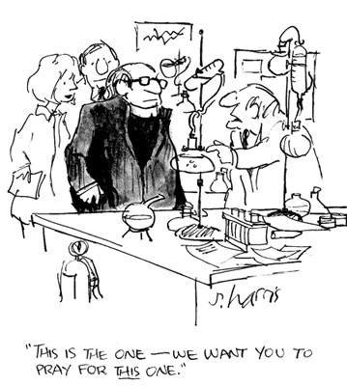
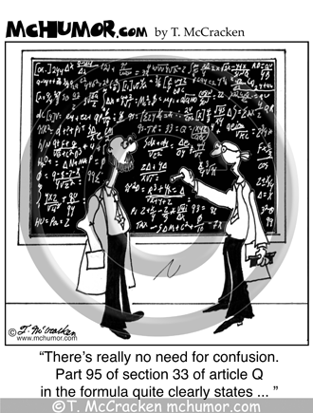

Slide 79

Reactions of Hydrocarbons

Slide 80
Reactions of Alkanes
Alkanes are relatively inert and do not react with most acids, bases, oxidizing and reducing agents
However, they do react with some reagents such as oxygen and halogens
Most of the reactions are exothermic in nature

Slide 81
1. Combustion reaction of alkane
CH₃-CH₂-CH₃ + 5 O₂ ——> 3 CO₂ + 4 H₂O + heat
Alkane plus oxygen gives carbon dioxide, water and heat

Slide 82

2. Substitution reaction
1alkane reacts with halogens when one or ore atoms of a halogen are substituted for one or more hydrogen atoms

Slide 83


Slide 84
Prepartion of Alkenes
The most common reaction of alkanes is substitution reactions
The most common reaction of alkenes is addition reactions
In addition reactions, a reagent is added to the carbons of the double bond to give a product with a C-C SINGLE BOND

Slide 85

1. Addition of Halogens

Slide 86
Examples

Slide 87
2. Cracking:
Process where complex organic molecules are broken down into simper molecules
Ex C3H8 → C₃H6 + H2
3. Combustion Reactions: same as alkanes

Slide 88

4. Alkylation Reaction
Adding an alkane and an alkyne

Slide 89
5. Hydrogenation
Addition of Hydrogen

Slide 90
Hydrogenation of Alkenes also called–Reduction of Alkenes
Addition of H-H across C=C
Reduction in general is addition of H₂ or its equivalent
Requires Pt, Pd, or Ni as powders on carbon and H₂
Hydrogen is first adsorbed on catalyst
Reaction is heterogeneous

Slide 91
Hydrogenation of alkene
The double bond of an alkene will react with hydrogen gas, H2, in the presence of certain metal catalysts (usually platinum or palladium) in such a way that one hydrogen is added to each of the carbons that had been joined by the double bond.

Slide 93
6. Addition of Water to Alkenes
Acid-Catalyzed Hydration
Oxymercuration-Demercuration
Hydroboration-Oxydation

Slide 94
Acid-Catalyzed Hydration

Slide 95


Slide 96
Mechanism

Slide 97
7. Dehydration of an Alcohol
Alcohols can be dehydrated ( removing the water ) by heating them with a strong acid to form alkenes

Slide 98
Dehydration of an Alcohol
+ H₂O

Slide 99

1. Addition reaction of alkyne

Slide 100

1. Substitution Reaction Benzene
Benzene reacts mainly by substitution reaction

Slide 101



Aromatic substitution
bromination
nitration
sulfonation

Slide 102

Friedel-Crafts reaction
Refers to Alkylation of aromatics
The Friedel-Craft alkylation reaction has some limitations…it cannot be applied to an aromatic ring that already has one it a nitro or sulfonic acid group

Slide 103

Organic Functional Groups

Slide 104

The Main Functional Groups

Slide 105


Slide 107


Slide 108
Alcohols, Phenols and Thiols
“Alcohols have a general formula R-OH
Phenols have a hdroxyl group attached directly to an aromatic ring
Thiols and thiophenols are similar to alcohols and phenols, except the oxygen is replaced by sulfur

Slide 109
Naming Alcohols
Parent name ends in -ol
Find longest chain containing the C to which the OH group is attached
Number C’s starting at end nearest OH group
Locate and number substituents and give full name
- use a number to indicate position of OH group
- cyclic alcohols have cyclo- before the parent name; numbering begins at the OH group, going in direction that gives substituents lowest possible numbers
- use a prefix (di-, tri-) to indicate multiple OH groups in a compound

Slide 110
Structures of Alcohols, Phenols, Thiols and Ethers
Alcohols, phenols, thiols and ethers consist of a hydrocarbon singly bonded to an oxygen or a sulfur
Alcohols have an -OH group attached to an alkane, phenols have an -OH group attached to a benzene, thiols have an -SH group attached to an alkane and ethers have an O bonded to two C’s

Slide 111
Nomenclature

Slide 112


Nomenclature Unsaturated alcohols
CH₂=CHCH₂OH Cyclohexanol
2-propen-1-ol
phyenylmethanol

Slide 113
Classification of Alcohols
Alcohols can be classified as methyl, primary, secondary or tertiary
Classification is based on the number of alkyl groups attached to the carbon to which the OH group is attached
If OH is attached to a 1° C, it’s a 1° alcohol, etc.

Slide 114



Nomenclature of Phenols
Phenol p-chlorophenol
2,4,6-tribromophenol

Slide 115

Naming Thiols
CH3–SH
methanethiol
4,4-dimethyl-2-pentanethiol

Slide 116
Thiols - Nomenclature
Common names for simple thiols are derived by naming the alkyl group bonded to -SH and adding the word "mercaptan"

Slide 117
Naming Examples

Slide 118


Ethers and Epoxides; and Sulfides

Slide 119

Ethers and Their Relatives
An ether has two organic groups (alkyl, aryl, or vinyl) bonded to the same oxygen atom, R–O–R′
Diethyl ether is used industrially as a solvent
Tetrahydrofuran (THF) is a solvent that is a cyclic ether
Thiols (R–S–H) and sulfides (R–S–R′) are sulfur (for oxygen) analogs of alcohols and ethers
119

Slide 120
Naming Ethers
Simple ethers are named by their common names
For common names: name each alkyl group attached to the oxygen followed by ether
For complex ethers IUPAC names are used
For IUPAC names:
1. Name as an alkane, with larger alkyl group being the parent chain
2. The smaller alkyl group and the O are named together as an alkoxy group (replace -yl with -oxy)
3. Number chain starting at end nearest alkoxy group
4. Use a number to give location of alkoxy group

Slide 121

Epoxides (Oxiranes)
Cyclic ethers with a three-membered ring containing one oxygen atom also called oxiranes
Also called epoxides
121

Slide 122

Sulfides
Sulfides (RSR′), are sulfur analogs of ethers
  Named by rules used for ethers, with sulfide in place of ether for simple compounds and alkylthio in place of alkoxy
122

Slide 123

Aldehydes and Ketones

Slide 124

Carbonyl Group
Carbon atom joined to oxygen by a double bond.
Characteristic of:
Ketones
Aldehydes

Slide 125

Aldehydes
Comes from alcohol dehydrogenation
Obtained by removing of a hydrogen from an alcohol
The –CH=O group is called a formyl group

Slide 126


Aldehydes
Both common and IUPAC names frequently used
Common names from acids from which aldehydes can be converted

Slide 127
Aldehydes
IUPAC
Longest chain with aldehyde
Drop “e” and add “-al”
Aldehyde takes precedence over all other groups so far
Examples

Slide 128




Common Aldehyde names
Formaldehyde Ethanal (acetaldehyde)
Propanal (propionaldehyde) Butanal (n-butyraldehyde)

Slide 129



Aldehyde group has priority over double bonds or hydroxyl group
Cyclopentanecarbaldehyde Benzaldehyde
salicylaldehyde

Slide 130

Ketones
Naming:
  Drop “e”, add “-one”
  Many common names
  Simplest is 3 carbons
    C. name: acetone
    IUPAC: propanone

Slide 131



Ketones
Carbonyl carbon gets lowest number
See examples…
Acetone 2-butanone 3-pentanone
(ethyl methyl ketone) (diethyl ketone)

Slide 132



O
CH₂=CH-C-CH₃
3-buten-2-one 2-methylcyclopentanone
Cyclohexanone acetophenone
(methyl phenyl ketone)

Slide 133



Alizarin
Alizarin: orange red quinone used to dye red coats of British army during American revolution

Slide 134
Carboxylic acids:

Slide 135
Structure of carboxylic acids and their derivatives
Carboxylic acids have the following general formula:
Some simple carboxylic acids:
Since carbon can have only four bonds, there are no cyclic carboxylic acids (i.e. the carboxyl group cannot form part of a carbon ring)

Slide 136
Carboxyl Group
Carboxylic acids contain the carboxyl group on carbon 1.
O
||
CH₃ — C—OH = CH₃—COOH
carboxyl group

Slide 137
IUPAC nomenclature for carboxylic acids
  Select the longest, continuous carbon chain that involves the carboxyl group. This is the parent chain and the –COOH carbon is designated as C-1.
  Name the parent chain by dropping the “e” from the corresponding alkane name and changing to “oic acid”
  Indicate the identity and location of substituents on the parent chain at the front of the carboxylic acid’s name
Benzoic acid

Slide 138

Common names for carboxylic acids

Slide 139
Naming Carboxylic Acids
Formula IUPAC Common
alkan -oic acid prefix – ic acid
HCOOH methanoic acid formic acid
CH₃COOH ethanoic acid acetic acid
CH₃CH₂COOH propanoic acid propionic acid
CH₃CH₂CH₂COOH butanoic acid butyric acid

Slide 140
Naming Rules
Identify longest chain
(IUPAC) Number carboxyl carbon as 1
(Common) Assign α, β, χ to carbon atoms adjacent to carboxyl carbon
CH₃
|
CH₃ — CH—CH₂ —COOH
IUPAC 3-methylbutanoic acid
Common β-methylbutryic acid

Slide 141


Esters

Slide 142
Esters
In and ester, the H in the carboxyl group is replaced with an alkyl group
O
||
CH₃ — C—O —CH₃ = CH₃—COO —CH₃
ester group

Slide 143
Esters in Plants
Esters give flowers and fruits their pleasant fragances and flavors.

Slide 144
Naming esters
144
The alcohol part of the name comes first and the carboxylic part second
For example CH₃COOCH₃ is made from CH₃COOH and CH₃OH. i.e Ethanoic acid and methanol
It’s name is Methyl ethanoate

Slide 145
Naming Esters
Name the alkyl from the alcohol –O-
Name the acid with the C=O with –ate
acid alcohol
O
|| methyl
CH₃ — C—O —CH₃
Ethanoate methyl ethanoate (IUPAC)
(acetate) methyl acetate (common)

Slide 146
Some Esters and Their Names
Flavor/Odor
Raspberries
HCOOCH₂CH₃ ethyl methanoate (IUPAC)
ethyl formate (common)
Pineapples
CH₃CH₂CH₂ COOCH₂CH₃
ethyl butanoate (IUPAC)
ethyl butyrate (common)

Slide 147
esters
Give the IUPAC and common names of the following compound, which is responsible for the flavor and odor of pears.
O
||
CH₃ — C—O —CH₂CH₂CH₃

Slide 148
Solution
O
|| propyl
CH₃ — C—O —CH₂CH₂CH₃
propyl ethanoate (IUPAC)
propyl acetate (common)

Slide 149
Draw the structure of the following compounds:
3-bromobutanoic acid
Ethyl propionoate

Slide 150
Solution
A. 3-bromobutanoic acid
Br
|
CH₃CHCH₂COOH
B. Ethyl propionoate
O
||
CH₃ CH₂ COCH₂CH₃ CH₃CH₂COOCH₂CH₃

Slide 151
Chemical reactions of esters
Ester hydrolysis: the hydrolysis of an ester is accomplished by reacting water with the ester in the presence of an acid catalyst (this is the reverse reaction of esterification).
An example:

Slide 152
Chemical reactions of esters
Ester saponification: another hydrolysis reaction, but this time, under basic conditions. Rather than a carboxylic acid, the acid salt is produced here.
Example:

Slide 153
Esterification
Reaction of a carboxylic acid and alcohol
Acid catalyst
O
|| H⁺
CH₃ — C—OH + HO—CH₂CH₃
O
||
CH₃ — C—O—CH₂CH₃ + H₂O

Slide 154
Hydrolysis
Esters react with water and acid catalyst
Split into carboxylic acid and alcohol
O
|| H⁺
H — C—O—CH₂CH₃ + H₂O
O
||
H — C—OH + HO—CH₂CH₃

Slide 155
Saponification
Esters react with a bases
Produce the salt of the carboxylic acid and alcohol
O
||
CH₃C—OCH₂CH₃ + NaOH
O
  ||
  CH₃C—O– Na⁺ + HOCH₂CH₃
salt of carboxylic acid

Slide 156
Amines
Organic bases derived from ammonia

Slide 157
Primary, secondary or tertiary depending on whether 1, 2, or 3 organic groups are attached to the nitrogen.
H-N-H R-N-H R-N-R R-N-R
H H H R
ammonia primary secondary tertiary

Slide 158
Amines
(organic ammonia) :NH₃
:NH₂R or RNH₂ 1º amine (R may be Ar)
:NHR₂ or R₂NH 2º amine
:NR₃ or R₃N 3º amine
NR₄⁺ 4º ammonium salt

Slide 159
amines are classified by the class of the nitrogen, primary amines have one carbon bonded to N, secondary amines have two carbons attached directly to the N, etc.
Nomenclature.
Common aliphatic amines are named as “alkylamines”

Slide 160

Polymer Chemistry

Slide 161
Ancient Polymers
161
Originally natural polymers were used
  Wood – Rubber
  Cotton – Wool
  Leather – Silk
  Oldest known uses
  Rubber balls used by Incas
  Noah used pitch (a natural polymer)
  for the ark
Notes:
161

Slide 162
Polymers: Introduction
Polymer: High molecular weight molecule made up of a small repeat unit (monomer).
  A-A-A-A-A-A-A-A-A-A-A-A-A-A-A-A-A-A-A-A-A-A-A-A
Monomer: Low molecular weight compound that can be connected together to give a polymer

Slide 163
Oligomer: Short polymer chain
Copolymer: polymer made up of 2 or more monomers
  Random copolymer: A-B-B-A-A-B-A-B-A-B-B-B-A-A-B
  Alternating copolymer: A-B-A-B-A-B-A-B-A-B-A-B-A-B
  Block copolymer: A-A-A-A-A-A-A-A-B-B-B-B-B-B-B-B

Slide 164

Copolymers
Adapted from Fig. 14.9, Callister & Rethwisch 8e.
two or more monomers polymerized together
random – A and B randomly positioned along chain
alternating – A and B alternate in polymer chain
block – large blocks of A units alternate with large blocks of B units
graft – chains of B units grafted onto A backbone
  A – B –
random
alternating
block
graft
164

Slide 165
Polymers
Are large molecules (macromolecules) that are built by repetitive linking of many smaller units called monomers.
. The repeating structure is usually a carbon backbone and results in a long chainlike molecule.
In each polymer molecule the atoms are
Are bound together by covalent bonds

Slide 166


Kevlar
Strong Network of Covalent Bonds
And Polar Hydrogen Bonds

Slide 167
Polymers have lots and lots of repeats
We like to think that the atoms that make up the backbone of a polymer chain comes in a regular order, and this order repeats itself all along the length of the polymer chain
This little recurring structure is called the repeat structure or the repeat unit

Slide 168
Repeat Units
Poly mer
        many repeat unit
repeat
unit
repeat
unit
repeat
unit
H
H
H
H
H
H
H
H
H
H
H
H
H
H
H
H
H
H
C
C
C
C
C
C
C
C
C
C
C
C
C
C
C
C
C
C
H
H
H
H
H
H
H
Cl
H
Cl
H
Cl
H
CH₃
H
CH₃
H
CH₃
Polyethylene (PE)
Poly(vinyl chloride) (PVC)
Polypropylene (PP)
Adapted from Fig. 14.2, Callister & Rethwisch 8e.
168
Notes:
168

Slide 169
Repeat Units
CH2-CH-CH2-CH-CH2-CH-CH2-CH-CH2
CH3 CH3 CH3 CH3
To make things simple, we usually only draw one unit of the repeat structure, like this
[-CH2-CH-]_{n}
CH3
The repeat unit is put inside brackets, and the subscript n just stands for the number of repeat units in the polymer chain

Slide 170
Bulk or Commodity Polymers
170
Notes:
170
Relatively few polymers responsible for virtually all polymers sold – these are the bulk or commodity polymers

Slide 171
Physical Properties of polymers
1. composed of very large molecules
2. Low modulus of elasticity (low stiffness)
3. Low tensile and compressive strength
4. Can be crystalline or semi-crystalline structure
5. Deformation: very sensitive to temperature

Slide 172
Physical Properties of polymers
6.Low thermal and electrical conductivity ( good insulators)
7. Low temperatures makes plastics brittle

Slide 173
Polymer History
It has been estimated that about 50% of industrial chemist in the U.S. Work in some area of polymer chemistry
Many discoveries of polymers arose from accidents

Slide 174



1920s Wallace H. Carothers produced the polymer Nylon, not seeing any use in his product, he discarded it until his assistant Julian Hill noticed its silky appearance and thread strengths.

Slide 175
1930s saw the development of PVC and Teflon
These two polymers gave rise to the term plastics.
Next researchers started producing artificial rubber.

Slide 176




PVC – (polyvinyl chloride)
Chain Length: 4,000 – 5,000
More Polar → Stronger Bonding

Slide 177


Teflon was discovered in 1938 by Roy Puckett
He was studying tetrafluoroethylene and stored it in a steel canister, upon checking it one of the canisters failed to produce perflouroethylene gas and upon opening it found a white powder that was stick resistant

Slide 178
Synthetic and Biological Polymers
Polymers: Macromolecules formed by the covalent attachment of a set of small molecules termed monomers.
Polymers are classified as:
(1) Man-made or synthetic polymers that are synthesized in the laboratory;
(2) Biological polymer that are found in nature. (biopolymers)
Synthetic polymers: nylon, poly-ethylene, poly-styrene
Biological polymers: DNA, proteins, carbohydrates

Slide 179
synthetic polymers
In the United States alone, annual synthetic polymer productions excedes 87 billion pounds and includes clothing , appliances, vehicles, homes , toys paints, tires ect

Slide 180
Industrial important Polymers
About 85% of the worlds plastic consumption consist of 4 polymers.
These polymers are produced at high volume and low costs
They are all Thermoplastics.

Slide 181
Industrial important Polymers
Polyethylene (PE) electrical wire insulation, flexible tubing, squeeze bottles
Polypropylene (PP) carpet fibers, ropes, liquid containers (cups, buckets, tanks), pipes
Polystyrene (PS) packaging foams, egg cartons, lighting panels, electrical appliance components
Polyvinyl chloride (PVC) bottles, hoses, pipes, valves, electrical wire insulation, toys, raincoats

Slide 182
Elastomers: rubber like substances
Elastomers are long polymer chains above their glass transition temperature.
Elastomers are usually lightly crosslinked and are easily deformed.
Common elastomers include:
polybutadiene (used in shoe soles)
polyisobutylene (used in automobile tires )
polyisoprene (natural rubber).

Slide 183
Elastomers
Elastomeric polymer chains can be crosslinked, or connected by covalent bonds.
This process is sometimes called vulcanization.
Crosslinking is initiated by heat, light, or the addition of chemicals.
Crosslinking makes elastomers reversibly stretchable for small deformations.
When stretched, the polymer chains become elongated and ordered along the deformation direction.

Slide 184
Elastomers
When no longer stretched, the chains randomize again.
The crosslinks guide the elastomer back to its original shape.
Crosslinking makes elastomers reversibly stretchable for small deformations. Stretched Returned to randomization

Slide 185

Rubber Tree
Natural rubber is an unsaturated hydrocarbon polymer.
Sap:
  Sticky
  Viscous
  Gooey

Slide 186
Natural Rubber
Most rubber has a molecular weight in excess of one million.
Natural rubber has many undesirable properties: it is sticky and smelly and softens in warm weather and hardens in cold
Charles Goodyear invented vulcanization

Slide 187

Vulcanization
Charles Goodyear invented vulcanization
Vulcanization: a process of cross-linking polymer chains by heating rubber with sulfur. This adds strength to the rubber.

Slide 188




Vulcanization

Slide 189
Types of Polymers
Polymer Classifications
  Thermoset: cross-linked polymer that cannot be melted (tires, rubber bands)
  Thermoplastic: Meltable plastic
  Elastomers: Polymers that stretch and then return to their original form: often thermoset polymers
  Thermoplastic elastomers: Elastic polymers that can be melted (soles of tennis shoes)

Slide 190




Cotton
Long Strands of Cellulose
+ Hydrogen Bonds
Cellulose is the most common organic material on earth!
It is also a primary constituent of wood and paper.

Slide 191



Polymer formation and reaction types

Slide 192

Addition polymerization also called chain growth polymers

Slide 193

Methods for making polymers
condensation polymerization
Addition polymerization: monomers react to form a polymer without net loss of atoms. Monomers simply add together to produce the polymer.
Most common form: free radical chain reaction of ethylenes
n monomers
one polymer molecule

Slide 194
Addition polymerisation
Monomers contain C=C bonds
Double bond opens to (link) bond to next monomer molecule
Chain forms when same basic unit is repeated over and over.
Modern polymers also developed based on alkynes R-C C - R’

Slide 195
Free-Radical Polymerization of Propene
H₂C
CHCH₃
CH
CH
CH
CH
CH
CH
CH
CH₃
CH₃
CH₃
CH₃
CH₃
CH₃
CH₃
polypropylene
Notes:
6

Slide 196
Free Radical: a compound with an unpaired electron

Slide 197

Condensation polymerization also called step growth polymers
Usually formed by the reaction between two different functional groups with the loss of some small molecule such as water

Slide 198

Condensation polymerization
Condensation polymerization: the polymer grows from monomers by splitting off a small molecule such as water or carbon dioxide.
Example: formation of amide links and loss of water
Monomers
First unit of polymer + H₂O

Slide 199
Types of Covalent Chain Configurations and Strength
Weakest------------------------------strongest
secondary
bonding
Linear
B
ranched
Cross-Linked
Network
199

Slide 200

Molecular Structure of Polymers
Linear
  High Density Polyethylene (HDPE), PVC, Nylon, Cotton
Branched
  Low Density
  Polyethylene (LDPE)
Cross-linked
  Rubber
Network
  Kevlar, Epoxy

Slide 201
Types of Covalent Chain Configurations and Strength
Linear Polymers: Polyethylene, polyvinyl chloride (PVC), polystyrene, polymethyl methacrylate (plexiglass), nylon, fluorocarbons (teflon)
Branched Polymers: Many elastomers or polymeric rubbers
Cross-linked Polymers: Many elastomers or polymeric rubbers are cross-linked (vulcanization process); most thermosetting polymers
Network Polymers: Epoxies, phenol-formaldehydes.

Slide 202





Low-Density Polyethylene (LDPE)
Chain Length: 1000 - 2000

Slide 203






High-Density Polyethylene (HDPE)
Chain Length: 10,000 – 100,000

Slide 204



Ultra-high-molecular-weight polyethylene (UHMWPE)
Chain Length: 2-6 million
Joint Replacement
Helmet
Gears

Slide 205
Conclusions:
Polymers make up all sorts of materials that are all around us!
They can have a huge range or material properties based on their:
  Functional Groups
  Structure
  Backbone
Keep thinking about how chemical interactions on the nano-scale correspond to material properties on the macro-scale

