Slide 1
Nuclear Chemistry

Slide 2
The composition And structure of the nucleus
Nucleus: Latin meaning nut or seed
The protons and neutrons found within the nucleus of an atom are called nucleons.
  Remember the nucleus is very small therefore the nucleons are packed very tightly together.

Slide 3
The protons within the nucleus repulse each other because of the positive charge of the protons, therefore attractive forces are required to hold the protons in the nucleus.
The force that keeps the nucleons together is called the strong nuclear forces

Slide 4
Review of Atomic Structure
Nucleus | Electrons
99.9% of the mass 1/10,000 the size of the atom | 0.01% of the mass

Slide 5
Review of Atomic Structure
Nucleus | Electrons
99.9% of the mass 1/10,000 the size of the atom | 0.01% of the mass
Composed of protons (p⁺) and neutrons (n⁰) | Composed of electrons (e⁻)

Slide 6
Review of Atomic Structure
Nucleus | Electrons
99.9% of the mass 1/10,000 the size of the atom | 0.01% of the mass
Composed of protons (p⁺) and neutrons (n⁰) | Composed of electrons (e⁻)
Positively charged | Negatively charged

Slide 7
Review of Atomic Structure
Nucleus | Electrons
99.9% of the mass 1/10,000 the size of the atom | 0.01% of the mass
Composed of protons (p⁺) and neutrons (n⁰) | Composed of electrons (e⁻)
Positively charged | Negatively charged
Strong nuclear force (holds the nucleus together) | Weak electrostatic force (because they are charged negatively

Slide 8
Chemical Symbols
A chemical symbol looks like…
To find the number of , subtract the
from the
mass #
14
C
atomic #
6
neutrons
atomic #
mass #

Slide 9
All atoms of the same element have the same atomic number (# of protons)
Isotopes: atoms of the same element with the same number of protons but different numbers of neutrons
chemical reactions occur when atoms are rearranged by breaking/making chemical bonds
Atoms are neither created nor destroyed

Slide 10
Only the outer electrons (valence electrons) of atoms are affected in chemical reactions
Chemical reactions involves the release/absorption of certain amounts of energy
Reaction rates are affected by: pressure, temperature, concentration and catalysts

Slide 11
Introduction to Nuclear Chemistry
Nuclear chemistry is the study of the structure of the atomic nuclei and the changes they undergo.

Slide 12
Chemical vs. Nuclear Reactions
Chemical Reactions | Nuclear Reactions
Occur when bonds are broken | Occur when nuclei emit particles and/or rays

Slide 13
Chemical vs. Nuclear Reactions
Chemical Reactions | Nuclear Reactions
Occur when bonds are broken | Occur when nuclei emit particles and/or rays
Atoms remain unchanged, although they may be rearranged | Atoms often converted into atoms of another element

Slide 14
Chemical vs. Nuclear Reactions
Chemical Reactions | Nuclear Reactions
Occur when bonds are broken | Occur when nuclei emit particles and/or rays
Atoms remain unchanged, although they may be rearranged | Atoms often converted into atoms of another element
Involve only valence electrons | May involve protons, neutrons, and electrons

Slide 15
Chemical vs. Nuclear Reactions
Chemical Reactions | Nuclear Reactions
Occur when bonds are broken | Occur when nuclei emit particles and/or rays
Atoms remain unchanged, although they may be rearranged | Atoms often converted into atoms of another element
Involve only valence electrons | May involve protons, neutrons, and electrons
Associated with small energy changes | Associated with large energy changes

Slide 16
Chemical vs. Nuclear Reactions
Chemical Reactions | Nuclear Reactions
Occur when bonds are broken | Occur when nuclei emit particles and/or rays
Atoms remain unchanged, although they may be rearranged | Atoms often converted into atoms of another element
Involve only valence electrons | May involve protons, neutrons, and electrons
Associated with small energy changes | Associated with large energy changes
Reaction rate influenced by temperature, particle size, concentration, etc. | Reaction rate is not influenced by temperature, particle size, concentration, etc.

Slide 17
Radioactivity
Emission of subatomic particles or high-energy electromagnetic radiation by nuclei
Such atoms/isotopes said to be radioactive
All nuclides of elements beyond Bismuth (#83) in the periodic table are radioactive with only Polonium (84), Radon (86), Actinium ((89), Thorium (90), Uranium (92) and Protactinium (91) have naturally radioactive nuclides, the remainder have been artificially produced

Slide 18
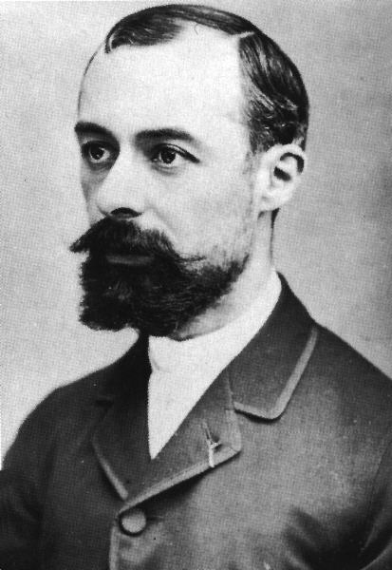
Its discovery
Discovered in 1896 by Antoine Henri Becquerel
Called strange, new emission uranic rays
Uranic rays became radioactivity
Becquerel accidently discovered that phosphorescent salts produced spontaneous emissions that darkened photographic plates

Slide 19
Radioactivity
  His work with uranium salts lead to the conclusion that the minerals gave off some sort of radiation.
  This radiation was later shown to be separable by electric (and magnetic) fields into three types; alpha (α), beta (β), and gamma (γ) rays.
Notes:
2

Slide 20
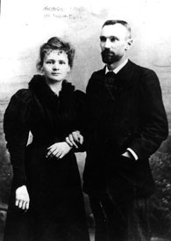
Marie And Pierre Currie
Marie Curie & hubby discovered two new elements, both of which emitted uranic rays
  Polonium & Radium

Slide 21
These findings of the Curies and Becquerel contradicted Dalton’s theory of indivisible atoms.

Slide 22
Types of radioactivity
Rutherford and Curie found that emissions produced by nuclei
Different types:
  Alpha decay
  Beta decay
  Gamma ray emission

Slide 23
Review
Type of Radioactive Decay | Particle Emitted | Change in Mass # | Change in Atomic #
Alpha | α He | -4 | -2
Beta | β e | 0 | +1
Gamma | γ | 0 | 0
4
2
0
-1

Slide 24
Isotopic symbolism
Let’s briefly go over it
Proton = ¹₁p or ¹₁H
Neutron = ¹₀n
Electron = ⁰₋₁e
Positon = ⁰₊₁e

Slide 25
Alpha radiation
Composition – Alpha particles, same as helium nuclei
Symbol – Helium nuclei, He, α
Charge – 2+
Mass (amu) – 4
Penetrating power – low (0.05 mm body tissue)
Shielding – paper, clothing
4
2

Slide 26
Beta radiation
Composition – Beta particles, same as an electron
Symbol – e⁻, β
Charge – 1-
Mass (amu) – 1/1837 (practically 0)
Penetrating power – moderate (4 mm body tissue)
Shielding – metal foil

Slide 27
Gamma radiation
Composition – High-energy electromagnetic radiation
Symbol – γ
Charge – 0
Mass (amu) – 0
Penetrating power – high (penetrates body easily)
Shielding – lead, concrete

Slide 28
Nuclear bombardment reactions:
  are those in which a nucleus is bombarded, or struck, by another nucleus or by a nuclear particle.

Slide 29
Nuclear Bombardment Reactions
In 1919, Ernest Rutherford discovered that it is possible to change the nucleus of one element into the nucleus of another element.
  Rutherford used a radioactive alpha source to bombard nitrogen nuclei.
  He discovered that protons are ejected in the process.
Notes:
2

Slide 30
Nuclear Bombardment Reactions
The British physicist James Chadwick suggested in 1932 that the radiation from beryllium consists of neutral particles, each with a mass of that of a proton.
  Chadwick’s suggestion led to the discovery of the neutron.
Notes:
2

Slide 31
Transmutation
Transforming one element into another
In 1919, Rutherford bombarded N-17 to make O-17
He provided the first artificial nuclear disintegration
The Joliot-Curie’s bombarded Al-27 to form P-30

Slide 32
Transuranium Elements
The transuranium elements are elements with atomic number greater than that of uranium (Z=92), the naturally occurring element of greatest Z.
  The first transuranium element was produced at the University of California at Berkley in 1940 by E. M. McMillan and P. H. Abelson.
  They produced an isotope of element 93, which they named neptunium.
Notes:
2

Slide 33
Transuranium Elements
The transuranium elements are elements with atomic number greater than that of uranium (Z=92), the naturally occurring element of greatest Z.
  Recent work (described in the essay at the end of Section 1.5) has yielded other elements including the heaviest to date, 118.
Notes:
2

Slide 34
J.D. Cockcroft and E.T.S. Walton provided experimental verification for Einstein's equation E= MC²
In 1928, he began to work on the acceleration of protons with Ernest Walton.
In 1932, they bombarded lithium with high energy neutrons, electrons and protons and succeeded in transmuting it into helium and other chemical elements.
This was one of the earliest experiments to change the atomic nucleus of one element to a different nucleus by artificial means.
This feat was popularly – if somewhat inaccurately – known as splitting the atom

Slide 35
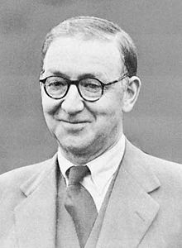
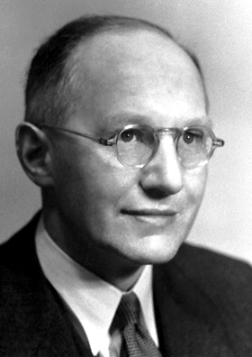
J.D. Cockcroft and E.T.S. Walton

Slide 36
Nuclear Equations
A nuclear equation is a symbolic representation of a nuclear reaction using nuclide symbols.
  For example, the nuclide symbol for uranium-238 is
Notes:
2

Slide 37
Nuclear Equations
A nuclear equation is a symbolic representation of a nuclear reaction using nuclide symbols.
  The radioactive decay of by alpha-particle emission (loss of a nucleus) is written
Notes:
2

Slide 38
Nuclear Equations
A nuclear equation is a symbolic representation of a nuclear reaction using nuclide symbols.
  Reactant and product nuclei are represented in nuclear equations by their nuclide symbol.
Notes:
2

Slide 39
Nuclear Equations
A nuclear equation is a symbolic representation of a nuclear reaction using nuclide symbols.
  Other particles are given the following symbols.
Proton
or
Neutron
Electron
or
Positron
or
Gamma photon
Notes:
2

Slide 40
Nuclear Equations
A nuclear equation is a symbolic representation of a nuclear reaction using nuclide symbols.
  The total charge is conserved during a nuclear reaction.
  This means that the sum of the subscripts for the products must equal the sum of the subscripts for the reactants.
Notes:
2

Slide 41
Nuclear Equations
A nuclear equation is a symbolic representation of a nuclear reaction using nuclide symbols.
  The total number of nucleons is also conserved during a nuclear reaction.
  This means that the sum of the superscripts for the products must equal the sum of the superscripts for the reactants.
Notes:
2

Slide 42
Nuclear Equations
A nuclear equation is a symbolic representation of a nuclear reaction using nuclide symbols.
  Note that if all reactants and products but one are known in a nuclear equation, the identity of the missing nucleus (or particle) is easily obtained.
  This is illustrated in the next example.
Notes:
2

Slide 43
A Problem To Consider
Technetium-99 is a long-lived radioactive isotope of technetium. Each nucleus decays by emitting one beta particle. What is the product nucleus?
  The nuclear equation is
  From the superscripts, you can write
Notes:
2

Slide 44
A Problem To Consider
Technetium-99 is a long-lived radioactive isotope of technetium. Each nucleus decays by emitting one beta particle. What is the product nucleus?
  The nuclear equation is
  Similarly, from the subscripts, you get
Notes:
2

Slide 45
A Problem To Consider
Technetium-99 is a long-lived radioactive isotope of technetium. Each nucleus decays by emitting one beta particle. What is the product nucleus?
  The nuclear equation is
  Hence A = 99 and Z = 44, so the product is
Notes:
2

Slide 46
Nuclear Chemistry
  Radioactive decay is the process in which a nucleus spontaneously disintegrates, giving off radiation.
Notes:
2

Slide 47
Types of Radioactive Decay
There are six common types of radioactive decay.
  Alpha emission (abbreviated a): emission of a nucleus, or alpha particle, from an unstable nucleus.
  An example is the radioactive decay of radium-226.
Notes:
2

Slide 48
Types of Radioactive Decay
There are six common types of radioactive decay.
  Beta emission (abbreviated β or β⁻): emission of a high speed electron from a stable nucleus.
  An example is the radioactive decay of carbon-14.
Notes:
2

Slide 49
Types of Radioactive Decay
There are six common types of radioactive decay.
  Positron emission (abbreviated β⁺): emission of a positron from an unstable nucleus.
  The radioactive decay of techencium-95 is an example of positron emission.
Notes:
2

Slide 50
Types of Radioactive Decay
There are six common types of radioactive decay.
  Electron capture (abbreviated EC): the decay of an unstable nucleus by capturing, or picking up, an electron from an inner orbital of an atom.
  An example is the radioactive decay of potassium-40.
Notes:
2

Slide 51
Types of Radioactive Decay
There are six common types of radioactive decay.
  Gamma emission (abbreviated γ): emission from an excited nucleus of a gamma photon, corresponding to radiation with a wavelength of about 10⁻¹² m.
  An example is metastable technetium-99.
Notes:
2

Slide 52
Types of Radioactive Decay
There are six common types of radioactive decay.
  Spontaneous fission: the spontaneous decay of an unstable nucleus in which a heavy nucleus of mass number greater than 89 splits into lighter nuclei and energy is realeased.
  For example, uranium-236 undergoes spontaneous fission.
Notes:
2

Slide 53
Alpha Decay
Example 1: Write the nuclear equation for the radioactive decay of polonium – 210 by alpha emission.
Step 1: Write the element that you are starting with.
Mass #
Step 3: Write the alpha particle.
210
Po
206
Pb
4
He
84
82
2
Atomic #

Slide 54
Alpha Decay
Example 2: Write the nuclear equation for the radioactive decay of radium – 226 by alpha emission.
Step 1: Write the element that you are starting with.
Step 2: Draw the arrow.
Mass #
226
Ra
222
Rn
4
He
88
86
2
Atomic #

Slide 55
Beta Decay
Example 1: Write the nuclear equation for the radioactive decay of carbon – 14 by beta emission.
Step 1: Write the element that you are starting with.
Step 4: Determine the other product (ensuring everything is balanced).
Step 2: Draw the arrow.
Step 3: Write the beta particle.
Mass #
14
C
14
N
0
e
6
7
-1
Atomic #

Slide 56
Beta Decay
Example 2: Write the nuclear equation for the radioactive decay of zirconium – 97 by beta decay.
Step 1: Write the element that you are starting with.
Step 4: Determine the other product (ensuring everything is balanced).
Step 2: Draw the arrow.
Step 3: Write the beta particle.
Mass #
97
Zr
97
Nb
0
e
40
41
-1
Atomic #

Slide 57
Problems
Write a nuclear equation for each of the following:
1. beta decay in Bk-249
2. alpha decay of Ra-224

Slide 58
Nuclear Stability
The existence of stable nuclei with more than one proton is due to the nuclear force.
  The nuclear force is a strong force of attraction between nucleons that acts only at very short distances (about 10⁻¹⁵ m).
  This force can more than compensate for the repulsion of electrical charges and thereby give a stable nucleus.
Notes:
2

Slide 59
Nuclear Stability
Several factors appear to contribute the stability of a nucleus.
  The shell model of the nucleus is a nuclear model in which protons and neutrons exist in levels, or shells, analogous to the shell structure exhibited in electron configurations.
  Experimentally, note that nuclei with certain numbers of protons and neutrons appear to be very stable.
Notes:
2

Slide 60
Nuclear Stability
Several factors appear to contribute the stability of a nucleus.
  These numbers, called magic numbers, are the numbers of nuclear particles in a completed shell of protons or neutrons.
  Because nuclear forces differ from electrical forces, these numbers are not the same as those for electrons is atoms.
Notes:
2

Slide 61
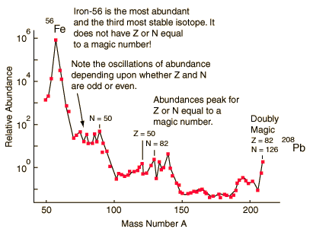
Nuclear Stability
Several factors appear to contribute the stability of a nucleus.
  For protons, the magic numbers are
      2, 8, 20, 28, 50, and 82
  For neutrons, the magic numbers are
      2, 8, 20, 28, 50, 82, and 126
Notes:
2

Slide 62
Nuclear Stability
Several factors appear to contribute the stability of a nucleus.
  Evidence also points to the special stability of pairs of protons and pairs of neutrons
  .Nuclei with a greater number of neutrons than protons have lower binding energies and are less stable
Notes:
2

Slide 63
As the atomic number increases, stable nuclei have neutron-proton ratios greater than a 1 to 1 and become less stable
Ex ²⁰⁶ ₈₂ Pb has a ratio of 124/82 (1.51N to 1 P)
The stability of a nucleus also depends on the even-odd relationship of protons and neutrons

Slide 64
Nuclear Stability
Several factors appear to contribute the stability of a nucleus.
  The table below liststs the number of stable isotopes that have an even number of protons and an even number of neutrons.
 | Number of Stable Isotopes
 | 157 | 52 | 50 | 5
Number of protons | Even | Even | Odd | Odd
Number of neutrons | Even | Odd | Even | Odd
Notes:
2

Slide 65
Nuclear Stability
Several factors appear to contribute the stability of a nucleus.
  Finally, when you plot each stable nuclide on a graph of protons vs. neutrons, these stable nuclei fall in a certain region, or band.
  The band of stability is the region in which stable nuclides lie in a plot of number of protons against number of neutrons. (see chart
Notes:
2

Slide 66
Nuclear Stability
Several factors appear to contribute the stability of a nucleus.
  No stable nuclides are known with atomic numbers greater than 83.
  On the other hand, all elements with Z equal to 83 or less have one or more stable nuclides.
Notes:
2

Slide 67
Predicting the Type of Radioactive Decay
Nuclides outside the band of stability are generally radioactive.
  Nuclides to the left of the band have more neutrons than that needed for a stable nucleus.
  These nuclides tend to decay by beta emission because it reduces the neutron-to-proton ratio.
Notes:
2

Slide 68
Predicting the Type of Radioactive Decay
Nuclides outside the band of stability (chart) are generally radioactive.
  In contrast, nuclides to the right of the band of stability have a neutron-to-proton ratio smaller than that needed for a stable nucleus.
  These nuclides tend to decay by positron emission or electron capture because it increases the neutron to proton ratio.
Notes:
2

Slide 69
Predicting the Type of Radioactive Decay
Nuclides outside the band of stability are generally radioactive.
  In the very heavy elements, especially those with Z greater than 83, radioactive decay is often by alpha emission.
Notes:
2

Slide 70
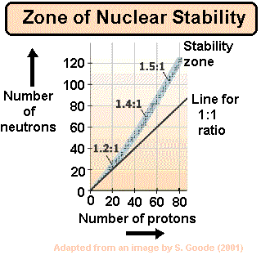

Slide 71
A Problem To Consider
Predict the expected type of radioactive decay for each of the following radioactive nuclides.
  The atomic weight of calcium is 40.1 amu, so you expect calcium-40 to be a stable isotope.
  Calcium-47 has a mass number greater than that of the stable isotope, so you would expect it to decay by beta emission.
Notes:
2

Slide 72
A Problem To Consider
Predict the expected type of radioactive decay for each of the following radioactive nuclides.
  The atomic weight of aluminum is 27.0 amu, so you expect aluminum-27 to be a stable isotope.
  Aluminum-25 has a mass number less than that of the stable isotope, so you would expect it to decay by positron emission or electron capture.
Notes:
2

Slide 73
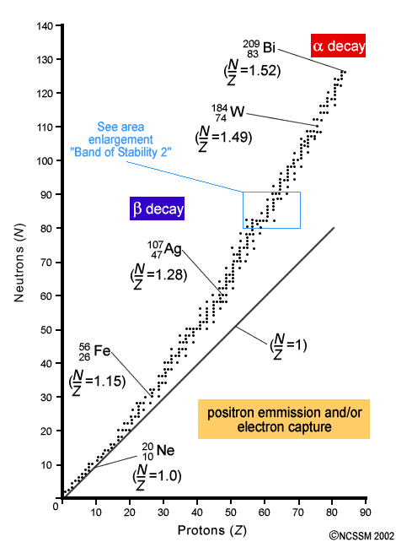
Cont.
In determining nuclear stability, ratio of neutrons to protons (N/Z) important
Notice lower part of valley (N/Z = 1)
Bi last stable (non-radioactive) isotopes
N/Z too high: above valley, too many n, convert n to p, beta-decay
N/Z too low: below valley, too many p, convert p to n

Slide 74
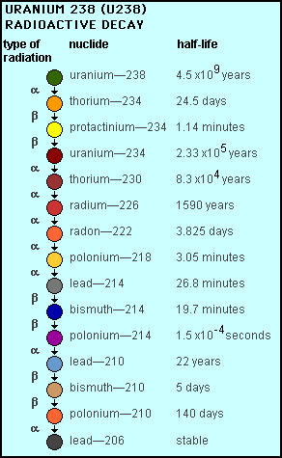
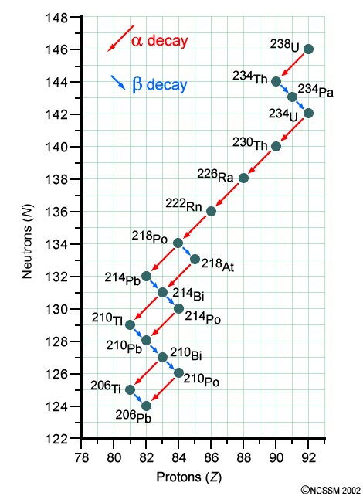
Radioactive decay series

Slide 75

Detecting radioactivity
Particles detected through interactions w/atoms or molecules
Simplest ⇒ film-badge dosimeter
Photographic film in small case, pinned to clothing
Monitors exposure
Greater exposure of film ⇒ greater exposure to radioactivity

Slide 76
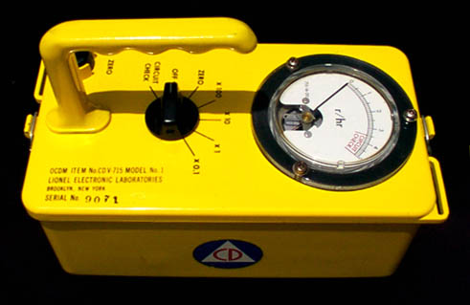
Geiger counter
Emitted particles pass through Ar-filled chamber
Create trail of ionized Ar atoms
Induced electric signal detected on meter and then clicks
Each click = particle passing through gas chamber

Slide 77
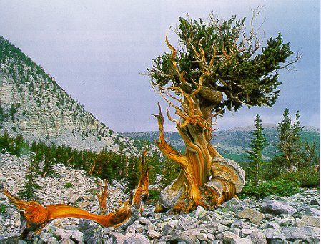
Radiometric dating: radiocarbon dating
Devised in 1949 by Libby at U of Chicago
Age of artifacts, etc., revealed by presence of C-14
C-14 formed in upper atmosphere via:
¹⁴₇N + ¹₀n ⇒ ¹⁴₆C + ¹₁H
C-14 then decays back to N by β-emission:
¹⁴₆C ⇒ ¹⁴₇N + ⁰₋₁e; t_{1/2} = 5730 years
Approximately constant supply of C-14
Taken up by plants via ¹⁴CO₂ & later incorporated in animals
Living organisms have same ratio of C-14:C-12
Once dead, no longer incorporating C-14 ⇒ ratio decreases
5% deviation due to variance of atmospheric C-14
Bristlecone pine used to calibrate data
Carbon-dating good for 50,000 years

Slide 78
Radiometric dating: uranium/lead dating
Relies on ratio of U-238:Pb-206 w/in igneous rocks (rocks of volcanic origin)
Measures time that has passed since rock solidified
t_{1/2} = 4.5 x 10⁹ years
For ex, if rock contains equal amts of isotopes above, it would be 4.5 billion years old

Slide 79
Radioactive decay kinetics
Half-life = time taken for ½ of parent nuclides to decay to daughter nuclides

Slide 80
Half-Life
is the time required for half of a radioisotope’s nuclei to decay into its products.
For any radioisotope,
# of ½ lives | % Remaining
0 | 100%
1 | 50%
2 | 25%
3 | 12.5%
4 | 6.25%
5 | 3.125%
6 | 1.5625%

Slide 81
Half-Life

Slide 82
Half-Life
For example, suppose you have 10.0 grams of strontium – 90, which has a half life of 29 years. How much will be remaining after x number of years?
You can use a table:
# of ½ lives | Time (Years) | Amount Remaining (g)
0 | 0 | 10
1 | 29 | 5
2 | 58 | 2.5
3 | 87 | 1.25
4 | 116 | 0.625

Slide 83
Half-Life
Or an equation!
initial mass
m_{t} = m₀ x (0.5)^{n}
mass remaining
# of half-lives

Slide 84
Half-Life
Example 1: If gallium – 68 has a half-life of 68.3 minutes, how much of a 160.0 mg sample is left after 1 half life? ________
2 half lives? __________ 3 half lives? __________

Slide 85
Half-Life
Example 2: Cobalt – 60, with a half-life of 5 years, is used in cancer radiation treatments. If a hospital purchases a supply of 30.0 g, how much would be left after 15 years? ______________
15 divided by 5 = 3 half lifes
30 x .5 xy3 =
Answer: 3.75 g

Slide 86
Half-Life
Example 3: Iron-59 is used in medicine to diagnose blood circulation disorders. The half-life of iron-59 is 44.5 days. How much of a 2.000 mg sample will remain after 133.5 days? ______________
Answer: .25 mg

Slide 87
Half-Life
Example 4: The half-life of polonium-218 is 3.0 minutes. If you start with 20.0 g, how long will it take before only 1.25 g remains? ______________
Answer:
1.25/20 = .0625
Log .0625/log .5 = 4
4 x 30 min = 120 min

Slide 88
Half-Life
Example 5: A sample initially contains 150.0 mg of radon-222. After 11.4 days, the sample contains 18.75 mg of radon-222. Calculate the half-life.
Answer:
18.75/150 = .125
Log .125/log.5 = 3
11.4 divided by 3 = 3.8 days half life

Slide 89
How much ⁹⁹Tc was in the original sample if the sample decays to 62.5 g in 639,000 years. The ½ life of ⁹⁹Tc is 2 x 10⁵ years
Answer
First find # divisions = 639,000/ 2 x 10⁵ = 3.19
62.5 = (x) x .5^{3.19}
x = 570 g

Slide 90
Rate of Radioactive Decay
The rate of radioactive decay, that is the number of disintegrations per unit time, is proportional to the number of radioactive nuclei in the sample.
  You can express this rate mathematically as
  where N_{t} is the number of radioactive nuclei at time t, and k is the radioactive decay constant.
Notes:
2

Slide 91
Rate of Radioactive Decay
The rate of radioactive decay, that is the number of disintegrations per unit time, is proportional to the number of radioactive nuclei in the sample.
The problems will follow first order kinetic energy
  Therefore, the half-life of a radioactive sample is related only to the radioactive decay constant.
Notes:
2

Slide 92
Rate of Radioactive Decay
The half-life, t½ ,of a radioactive nucleus is the time required for one-half of the nuclei in a sample to decay. (see Figure 21.11)
  The first-order relationship between t_{½} and the decay constant k is
Notes:
2

Slide 93
A Problem To Consider
The decay constant for the beta decay of technetium-99 is 1.0 x 10-13 s-1. What is the half-life of this isotope in years?
  Substitute the value of k into our half-life equation.
Notes:
2

Slide 94
A Problem To Consider
The decay constant for the beta decay of technetium-99 is 1.0 x 10-13 s-1. What is the half-life of this isotope in years?
  Then convert from seconds to years.
Notes:
2

Slide 95
Rate of Radioactive Decay
Once you know the decay constant, you can calculate the fraction of radioactive nuclei remaining after a given period of time.
  The first-order time-concentration equation is
Notes:
2

Slide 96
A Problem To Consider
Phosphorus-32 has a half-life of 14.3 days. What fraction of a sample of phosphorus-32 would remain after 5.5 days?
  If we substitute k = 0.693/t_{½} we get
Notes:
2

Slide 97
A Problem To Consider
Phosphorus-32 has a half-life of 14.3 days. What fraction of a sample of phosphorus-32 would remain after 5.5 days?
  Substituting t = 5.5 d and t_{½} = 14.3 d, you obtain
Notes:
2

Slide 98
A Problem To Consider
Phosphorus-32 has a half-life of 14.3 days. What fraction of a sample of phosphorus-32 would remain after 5.5 days?
5.5/14.3 = .3846 so 0.3846^{-0.267} = .774
  Hence,
Notes:
2

Slide 99
Mass Defect and Nuclear Binding Energy
The isotopes of carbon have 6 protons and 6 neutrons in its nucleus and is defind as having an AMU of exactly 12
On this scale a helium has a mass of 4.0015 ( 2 protons at 1.0073 and 2 neutrons at 1.0087 each)
When added these 4 units equal 4.0320 not 4.0015
The difference (.0305) between the measured masses and the calculated mass is called nuclear mass defect

Slide 100
Mass-Energy Calculations
When nuclei decay, they form products of lower energy.
  The change of energy is related to the change in mass, according to the mass-energy equivalence relation derived by Albert Einstein in 1905.
  Energy and mass are equivalent and related by the equation
  Here c is the speed of light, 3.00 x 10⁸ m/s.
Notes:
2

Slide 101
Mass-Energy Calculations
When nuclei decay, they form products of lower energy.
  If a system loses energy, it must also lose mass.
  Though mass loss in chemical reactions is small (10⁻¹² kg), the mass changes in nuclear reactions are approximately a million times larger.
Notes:
2

Slide 102
Mass-Energy Calculations
The equivalence of mass and energy explains the fact that the mass of an atom is always less than the sum of the masses of its constituent particles.
  When nucleons come together to form a stable nucleus, energy is released.
  According to Einstein’s equation, there must be a corresponding decrease in mass.
Notes:
2

Slide 103
Mass-Energy Calculations
The binding energy of a nucleus is the energy needed to break a nucleus into its individual protons and neutrons.
  Thus the binding energy of the helium-4 nucleus is the energy change for the reaction
4.00260
2(1.00728)
2(1.008665)
  Both binding energy and the corresponding mass defect are reflections of the stability of the nucleus.
Notes:
2

Slide 104
Mass-Energy Calculations
The binding energy of a nucleus is the energy needed to break a nucleus into its individual protons and neutrons.
  Figure 21.16 shows the values of binding energy per nucleon plotted against the mass number for various nuclides.
  Note that nuclides near mass number 50 have the largest binding energies per nucleon.
Notes:
2

Slide 105
Mass-Energy Calculations
The binding energy of a nucleus is the energy needed to break a nucleus into its individual protons and neutrons.
  For this reason, heavy nuclei might be expected to split to give lighter nuclei, while light nuclei might be expected to combine to form heavier nuclei.
Notes:
2

Slide 106
Figure 21.16 Plot of binding energy per nucleon versus mass number
Notes:
2

Slide 107
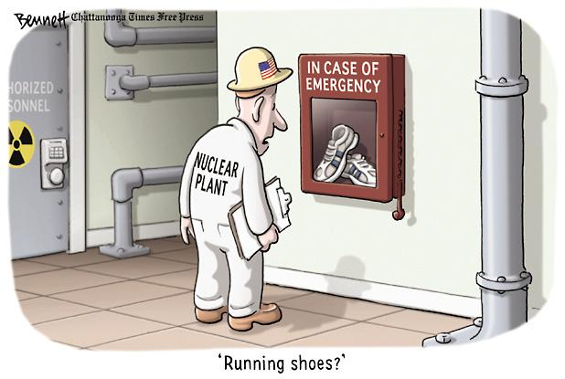

Types of Nuclear Reactions

Slide 108
Radioactive decay: release an alpha, beta or gamma particle and forms a slightly lighter more stable nucleus
Fission: ( Latin meaning splitting) a very heavy nucleus splits to form medium mass nuclei
Nuclear Disintegration: a nucleus is bombarded with alpha particles, proton, deuterons, neutrons or other particles. The unstable nucleus emits a proton or neutron and becomes more stable.
Fusion: (Latin meaning pouring out) light mass nuclei combine to form heavier more stable nuclei)

Slide 109
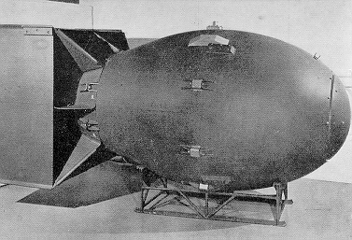
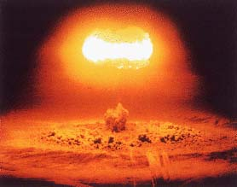
Fission
Meitner, Strassmann, and Otto Hahn discovered fission: splitting of uranium-235
Instead of making heavier elements, created a Ba and Kr isotope plus 3 neutrons and a lot of energy
Sample rich in U-235 could create a chain rxn
To make a bomb, however, need critical mass = enough mass of U-235 to produce a self-sustaining rxn

Slide 110
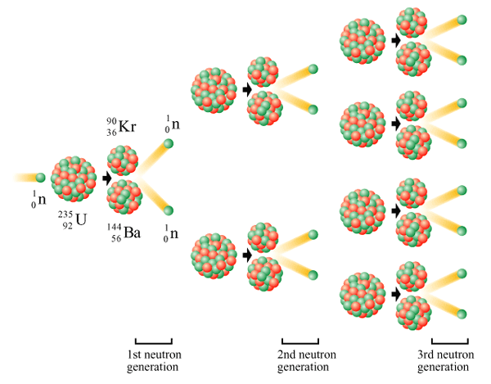
Chain Reaction

Slide 111
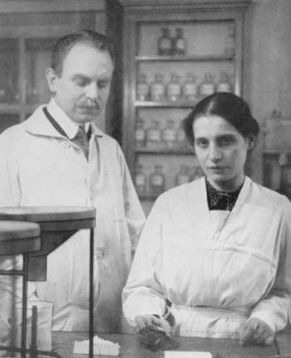

Chain Reaction Lisa Meitner
A chain reaction is one which the material that starts the reaction is also one of the products
Lisa Meitner

Slide 112
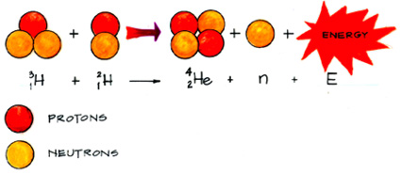
Nuclear Fusion

Slide 113
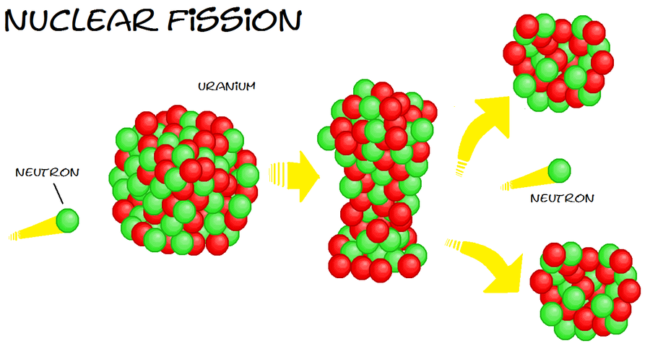

Slide 114
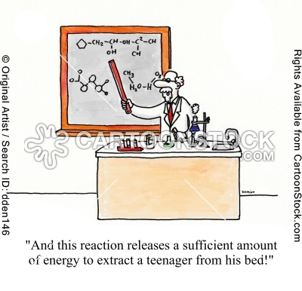

Slide 115


Slide 116
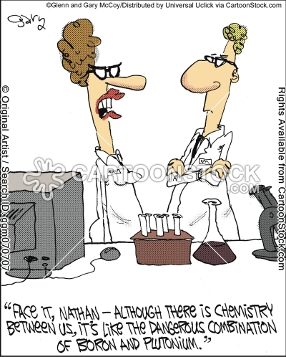

Slide 117
Nuclear power
In America, about 20% electricity generated by nuclear fission

Slide 118
Radiation on life
3 divisions
1. acute radiation
2. Increased cancer risk
3. genetic effects

Slide 119

The first
Quickly dividing cell at greatest risk:
Intestinal lining
Immune response cells
Likelihood of death
Depends on dose/
duration

Slide 120
2nd
Cancer = uncontrolled cell growth leading to tumors
Dose? Unknown
Cancer is a murky illness

Slide 121
3rd
Causes genetic defects ⇒ teratogenic

Slide 122
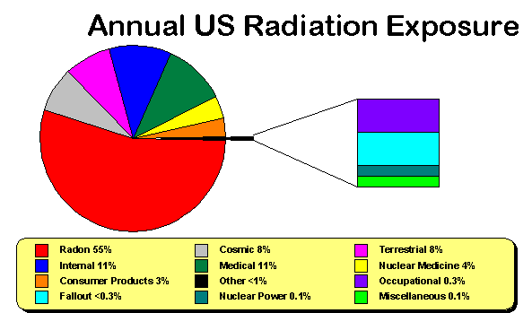
Average American 360 mrem/yr

Slide 123
Radon is a cancer-causing radioactive gas.
You cannot see, smell or taste radon, but it may be a problem in your home.
The Surgeon general has warned that radon is the second leading cause of lung cancer in the United States today.
If you smoke and your home has high radon levels, you're at high risk for developing lung cancer.
Some scientific studies of radon exposure indicate that children may be more sensitive to radon.
This may be due to their higher respiration rate and their rapidly dividing cells, which may be more vulnerable to radiation damage.

Slide 124
Most indoor radon comes into the building from the soil or rock beneath it.
Radon and other gases rise through the soil and get trapped under the building.
The trapped gases build up pressure.
Air pressure inside homes is usually lower than the pressure in the soil.
Therefore, the higher pressure under the building forces gases though floors and walls and into the building.
Most of the gas moves through cracks and other openings. Once inside, the radon can become trapped and concentrated.

Slide 125
Radon may also be dissolved in water, particularly well water.
After coming from a faucet, about one ten thousandth of the radon in water is typically released into the air.
The more radon there is in the water, the more it can contribute to the indoor radon level.

Slide 126
Biological Effects and Radiation Dosage
To monitor the effect of nuclear radiations on biological tissue, it is necessary to have a measure of radiation dosage.
  The rad (from radiation absorbed dose) is the dosage of radiation that deposits 1 x 10⁻² J of energy per kilogram of tissue.
  However, the biological effect of radiation not only on the energy deposited but also on the type of radiation.
Notes:
2

Slide 127
Biological Effects and Radiation Dosage
To monitor the effect of nuclear radiations on biological tissue, it is necessary to have a measure of radiation dosage.
  The rem is a unit of radiation dosage used to relate various kinds of radiation in terms of biological destruction.
  It equals the rad times a factor for the type of radiation, called the relative biological effectiveness (RBE).
Notes:
2

Slide 128
Biological Effects and Radiation Dosage
To monitor the effect of nuclear radiations on biological tissue, it is necessary to have a measure of radiation dosage.
  Beta and gamma radiations have an RBE of about 1, where neutron radiation has an RBE about 5 and alpha radiation an RBE of about 10.
  A single dose of about 500 rems is fatal to most people.
Notes:
2

Slide 129
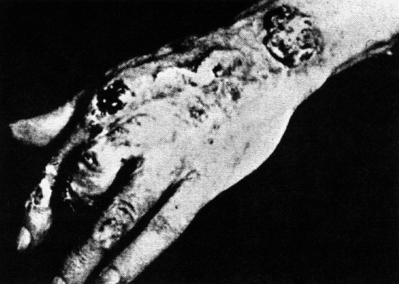
More facts
20 rem ⇒ decreased white blood cell count after instantaneous exposure
100-400 rem ⇒ vomiting, diarrhea, lesions, cancer-risk increase
500-1000 ⇒ death w/in 2 months
1000-2000 ⇒ death w/in 2 weeks
Above 2000 ⇒ death w/in hours

Slide 130
Diagnostic and therapeutic radiation
Radiotracer = radioactive nuclide in brew to track movement of brew in body
Tc-99 ⇒ bones
I-131 ⇒ thyroid
Tl-201 ⇒ heart
F-18 ⇒ heart, brain
P-31 ⇒ tumors

Slide 131
Radiotherapy
Using radiation to treat cancer
Develop symptoms of radiation sickness: vomiting, diarrhea, skin burns, hair loss

Slide 132
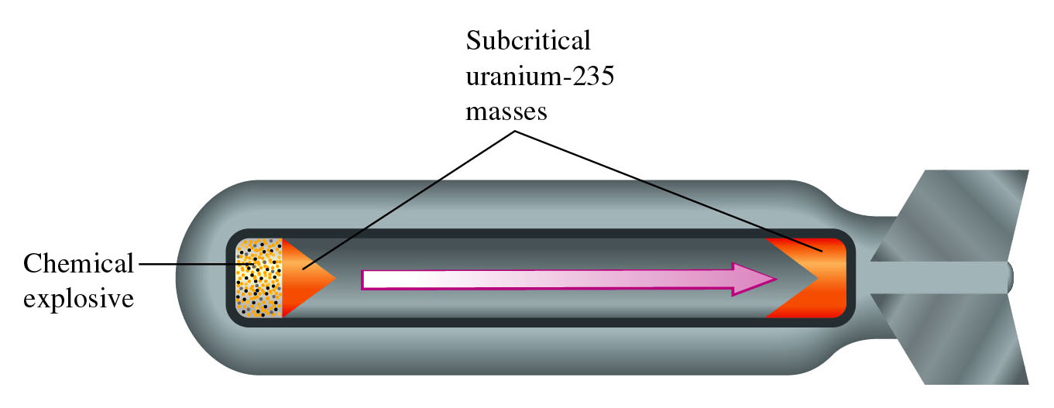
Figure 21.18: An atomic bomb.
Return to slide 81

