Slide 1
Balance chemical equations by following these steps:
Trial and error will work but can be very inefficient.
USE A TABLE (write atoms underneath reactants and products)
If they look the same on both sides of the equation, treat polyatomic ions (such as SO₄^{2–}) as a group & balance them as such.
If ‘OH’ and H₂O are in the equation, write water as HOH.
Balance one compound at a time & rewrite the # of atoms in the chart as things change.
Only add coefficients; NEVER change subscripts!!!

Slide 2
If H and O appear in more than one place, attempt to balance them LAST.
Balance everything that isn’t ‘H’ or ‘O’ 1st.
Balance the ‘H’s 2nd to last.
Balance the ‘O’s last.
Always double-check after you think you are finished.
CHECK YOUR ANSWERS!!!
:
See pages 209 - 211

Slide 3
Balance the following:
Fe + Br₂ → FeBr₃
Sn(NO₂)₄ + K₃PO₄ → KNO₂ + Sn₃ (PO₄)₄
C₂H6 + O₂ → CO₂ + H₂O

Slide 4
____Ba + ____H₂O → ____Ba(OH)₂ + ____H₂
____CO₂ + ____H₂O → ____H₂CO₃
____Fe₂O₃ + ____C → ____Fe + ____CO
____Fe + ____H₂O → ____H₂ + ____Fe₂O₃

Slide 5
Exercise
Balance the following equation in standard form (lowest multiple integers) and determine the sum of the coefficients?
FeO(s) + O₂(g) → Fe₂O₃(s)
a) 3
b) 4
c) 7
d) 14
Notes:
The answer is c. The balanced equation is:
4FeO(s) + O₂(g) → 2Fe₂O₃(s). The sum of the coefficients is therefore 4 + 1 + 2 = 7.

Slide 6
Exercise
Which of the following correctly balances the chemical equation given below? There may be more than one correct balanced equation. If a balanced equation is incorrect, explain what is incorrect about it.
CaO + C → CaC₂ + CO₂
I. CaO₂ + 3C → CaC₂ + CO₂
II. 2CaO + 5C → 2CaC₂ + CO₂
III. CaO + (2.5)C → CaC₂ + (0.5)CO₂
IV. 4CaO + 10C → 4CaC₂ + 2CO₂
Notes:
II, III, and IV are correct. I is not correct because you cannot use subscripts to balance a chemical equation.

Slide 7
Exercise
Of the three that are correct, which one is preferred most (the most accepted convention)? Why?
CaO + C → CaC₂ + CO₂
I. CaO₂ + 3C → CaC₂ + CO₂
II. 2CaO + 5C → 2CaC₂ + CO₂
III. CaO + (2.5)C → CaC₂ + (0.5)CO₂
IV. 4CaO + 10C → 4CaC₂ + 2CO₂
Notes:
II is preferred most (most accepted convention) because it is the balanced equation with the smallest integers (whole numbers).

Slide 8
Concept Check
When balancing a chemical equation, which of the following statements is false?
a) Subscripts in the reactants must be conserved in the products.
b) Coefficients are used to balance the atoms on both sides.
c) When one coefficient is doubled, the rest of the coefficients in the balanced equation must also be doubled.
d) Phases are often shown for each compound but are not critical to balancing an equation.
Notes:
The answer is a. Subscripts in the reactants do not have to be conserved in the products in order to make the equation balance. Coefficients are used to balance the atoms on both sides. For example:
2H₂(g) + O₂(g) → 2H₂O(g).
Balancing using subscripts will change the compounds.

Slide 9
Notice the red are the most common mistakes when balancing equations
The number of atoms of each type of element must be the same on both sides of a balanced equation.
Subscripts must not be changed to balance an equation.
A balanced equation tells us the ratio of the number of molecules which react and are produced in a chemical reaction.
Make sure the formulas are written correctly in the equation.

Slide 10
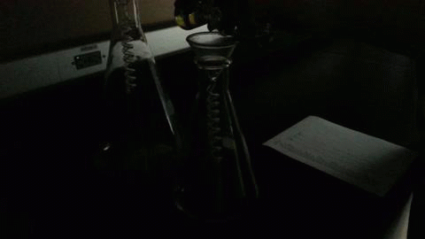
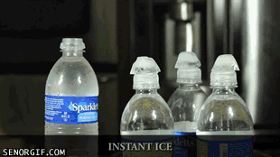
Chemical Reactions

Slide 11
Types of Reactions
There are five types of chemical reactions we will talk about:
Synthesis reactions
Decomposition reactions
Single replacement reactions
Double replacement reactions
Combustion reactions
You need to be able to identify the type of reaction and predict the product(s)

Slide 12
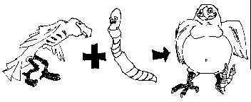
1. Synthesis reactions
Synthesis reactions occur when two substances (generally elements) combine and form a compound. (Sometimes these are called combination or addition reactions.)
reactant + reactant → 1 product
Basically: A + B → AB
Example: 2H₂ + O₂ → 2H₂O
Example: C + O₂ → CO₂

Slide 13
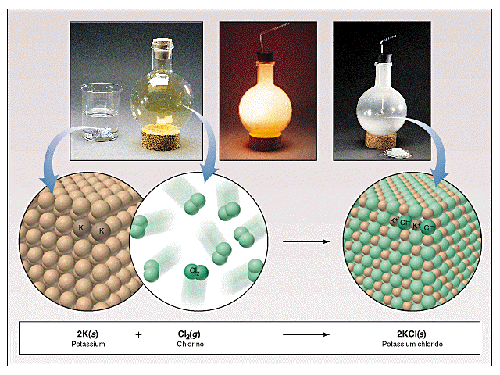
Synthesis Reactions
Here is another example of a synthesis reaction

Slide 14
Practice
Predict the products. Write and balance the following synthesis reaction equations.
Sodium metal reacts with chlorine gas
Na_{(s)} + Cl_{2(g)} →
Solid Magnesium reacts with fluorine gas
Mg_{(s)} + F_{2(g)} →
Aluminum metal reacts with fluorine gas
Al_{(s)} + F_{2(g)} →

Slide 15
Synthesis reaction of oxides
Oxides of active metals react with water to produce metal hydroxides
Ex CaO + H₂O → Ca(OH)₂
Many nonmetal oxides undergo synthesis reactions with water to produce a solution of an oxyacid
Ex SO₃ +H₂O → H₂SO₄

Slide 16
2. Decomposition Reactions
Decomposition reactions occur when a compound breaks up into the elements or in a few to simpler compounds
1 Reactant → Product + Product
In general: AB → A + B
Example: 2 H₂O → 2H₂ + O₂
Example: 2 HgO → 2Hg + O₂

Slide 17
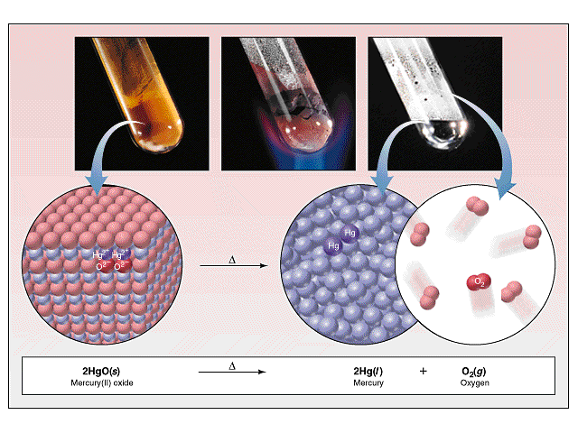
Decomposition Reactions
Another view of a decomposition reaction:

Slide 18
Decomposition Exceptions
Carbonates and chlorates are special case decomposition reactions that do not go to the elements.
Carbonates (CO₃²⁻) decompose to carbon dioxide and a metal oxide
Example: CaCO₃ → CO₂ + CaO
Chlorates (ClO₃⁻) decompose to oxygen gas and a metal chloride
Example: 2 Al(ClO₃)₃ → 2 AlCl₃ + 9 O₂

Slide 19
Metal Hydroxides decompose when heated to give metal oxide and water
E Ca(OH)₂ heat_____> CaO + H₂O
The 2 exceptions are sodium and potassium hydroxide

Slide 20
Certain acids decompose to nonmetallic and water
H₂SO₄ → SO₃ + H₂O
H₂CO₃ --→ CO₂ + H₂O

Slide 21
Practice
Predict the products. Then, write and balance the following decomposition reaction equations:
Solid Lead (IV) oxide decomposes PbO_{2(s)} →
Aluminum nitride decomposes
AlN_{(s)} →

Slide 22
Practice
Identify the type of reaction for each of the following synthesis or decomposition reactions, and write the balanced equation:
N_{2(g)} + O_{2(g)} →
BaCO_{3(s)} →
NH_{3(g)} + H₂CO_{3(aq)} →
NI_{3(s)} →
Nitrogen monoxide
(

Slide 23
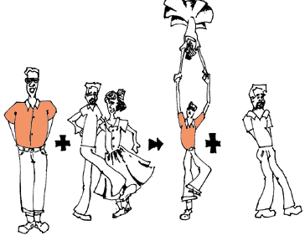
3. Single Replacement Reactions
Single Replacement Reactions occur when one element replaces another in a compound.
A metal can replace a metal (+) OR a nonmetal can replace a nonmetal (-).
element + compound→ element + compound
A + BC → AC + B (if A is a metal) OR
A + BC → BA + C (if A is a nonmetal)
(remember the cation always goes first!)
When H₂O splits into ions, it splits into
H⁺ and OH⁻ (not H+ and O⁻² !!)

Slide 24
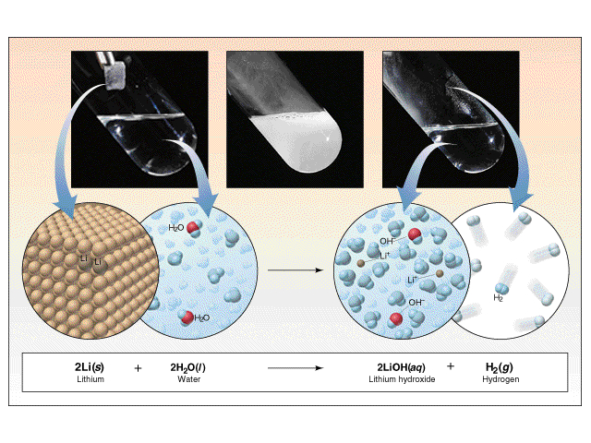
Single Replacement Reactions
Another view:

Slide 25
Single Replacement Reactions
Write and balance the following single replacement reaction equation:
Zinc metal reacts with aqueous hydrochloric acid
Zn_{(s)} + HCl_{(aq)} → ZnCl₂ + H_{2(g)}
Note: Zinc replaces the hydrogen ion in the reaction
2

Slide 26
Single Replacement Reactions
Sodium chloride solid reacts with fluorine gas
NaCl_{(s)} + F_{2(g)} → NaF_{(s)} + Cl_{2(g)}
Note that fluorine replaces chlorine in the compound
Aluminum metal reacts with aqueous copper (II) nitrate
Al_{(s)}+ Cu(NO₃)_{2(aq)}→
2
2

Slide 27
Replacement of hydrogen in water by a metal
Most active metals ( except group 1) react with water to produce metal hydroxides and hydrogen gas
Ex 2Na + 2H₂O → 2NaOH + H₂
Less active metals such as iron react with steam to form a metal oxide and hydrogen
3Fe + 4H₂O -→ Fe₃O₄ + 4H₂

Slide 28
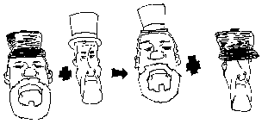
4. Double Replacement Reactions
Double Replacement Reactions occur when a metal replaces a metal in a compound and a nonmetal replaces a nonmetal in a compound
Compound + compound → compound+ compound
AB + CD → AD + CB

Slide 29
Double Replacement Reactions
Think about it like “foil”ing in algebra, first and last ions go together + inside ions go together
Example:
AgNO_{3(aq)} + NaCl_{(s)} → AgCl_{(s)} + NaNO_{3(aq)}
Another example:
K₂SO_{4(aq)} + Ba(NO₃)_{2(aq)} → KNO_{3(aq)} + BaSO_{4(s)}
2

Slide 30
Practice
Predict the products. Balance the equation
HCl_{(aq)} + AgNO_{3(aq)} →
CaCl_{2(aq)} + Na₃PO_{4(aq)} →
Pb(NO₃)_{2(aq)} + BaCl_{2(aq)} →
FeCl_{3(aq)} + NaOH_{(aq)} →
H₂SO_{4(aq)} + NaOH_{(aq)} →
KOH_{(aq)} + CuSO_{4(aq)} →

Slide 31
5. Combustion Reactions
Combustion reactions occur when a hydrocarbon reacts with oxygen gas.
This is also called burning!!! In order to burn something you need the 3 things in the “fire triangle”: 1) A Fuel (hydrocarbon) 2) Oxygen to burn it with 3) Something to ignite the reaction (spark)

Slide 32
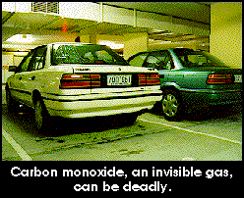
Combustion Reactions
In general: C_{x}H_{y} + O₂ → CO₂ + H₂O
Products in combustion are ALWAYS carbon dioxide and water. (although incomplete burning does cause some by-products like carbon monoxide)
Combustion is used to heat homes and run automobiles (octane, as in gasoline, is C₈H₁₈)

Slide 33
Combustion Reactions
Edgar Allen Poe’s drooping eyes and mouth are potential signs of CO poisoning.

Slide 34
Combustion
Example
C₅H₁₂ + O₂ → CO₂ + H₂O
Write the products and balance the following combustion reaction:
C₁₀H₂₂ + O₂ →
8
5
6

Slide 35
Mixed Practice
State the type, predict the products, and balance the following reactions:
BaCl₂ + H₂SO₄ →
C₆H₁₂ + O₂ →
Zn + CuSO₄ →
Cs + Br₂ →
FeCO₃ →

Slide 36
Reaction : Go or No Go
There are several ways to determine if a reaction occurs:
1. If water is a product of the reaction,
2. If a precipitate is a product of the reaction,
then the reaction will occur
Refer to solubility Handout

Slide 37
Total Ionic Equations
Once you write the molecular equation (synthesis, decomposition, etc.), you should check for reactants and products that are soluble or insoluble.
We usually assume the reaction is in water
We can use a solubility table to tell us what compounds dissolve in water.
If the compound is soluble (does dissolve in water), then splits the compound into its component ions
If the compound is insoluble (does NOT dissolve in water), then it remains as a compound

Slide 38
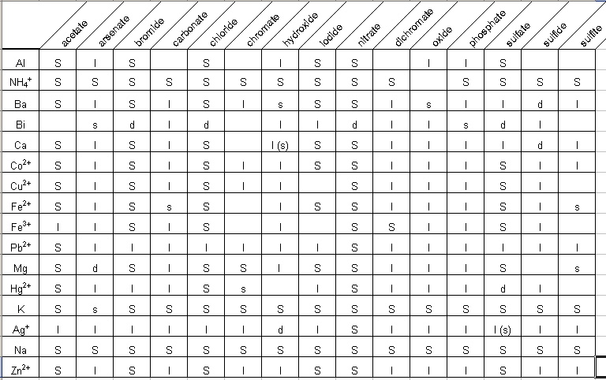
Solubility Table

Slide 39
Solubilities Not on the Table!
Gases only slightly dissolve in water
Strong acids and bases dissolve in water
Hydrochloric, Hydrobromic, Hydroiodic, Nitric, Sulfuric, Perchloric Acids
Group I hydroxides (should be on your chart anyway)
Water slightly dissolves in water! (H+ and OH-)
For the homework… SrSO₄ is insoluble; BeI₂ and the products are soluble
There are other tables and rules that cover more compounds than your table!

Slide 40
Total Ionic Equations
Molecular Equation:
K₂CrO₄ + Pb(NO₃)₂ → PbCrO₄ + 2 KNO₃
Soluble Soluble Insoluble Soluble

Slide 41
Use your table and underline those compounds that are insoluble (precipitate out)
Ag AgCl NaCl CaCO₃ NaCO₃ Mg(OH)₂
Answer:
AgCl CaCO₃ Mg(OH)₂

Slide 42
Does the following reaction occur?
AgNO₃ + KI → AgI + KNO₃
Yes AgI precipitates
Ba(OH)₂ + MgSO₄ → BaSO₄ + Mg(OH)₂
yes both precipitate out

Slide 43
Activity series of elements
Activity: ability of an element to react
The more readily an element react with other substances, the greater its activity.
Activity Series: A list of elements organized according to the case with which they undergo certain chemical reactions
Activity series are useful aids in predicting whether or not certain chemical reaction will occur
Refer to Handout

