Slide 2
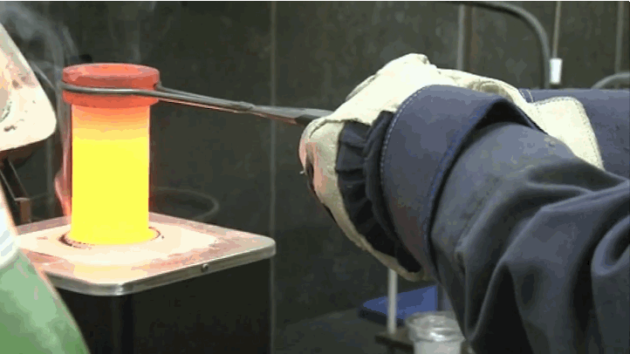
Unit 6 Chemical Reactions:

Slide 3
Chemical Equations
Chemical reactions are described by chemical equations
Chemical equations are symbols and formulas what is taking place within a reaction.

Slide 4
Reading and Writing Chemical Equations: 3 requirements
Equation must represent the known facts (the reactants and products must be identified)
Equation must contain the correct formulas (oxidation numbers play a role here)
Law of conservation of mass must be satisfied (atoms are neither created nor destroyed in ordinary chemical reactions)
To equalize numbers atoms, coefficients are added when necessary

Slide 5
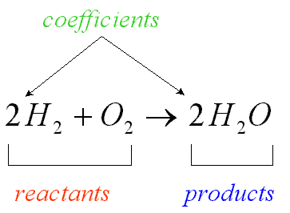
Coefficients: are small whole numbers that appear in front of a formula in a chemical reaction

Slide 6
Significance of a chemical equation
Chemical equations can be interpreted quantitatively in 3 ways:
Ratios of reactants and products
Reverse Reactions

Slide 7
Amount of reactants and Products
Chemical equations generally show the smallest numbers of atoms/molecules/ions that will satisfy the law of conservation of mass
Chemical equations provide information about moles and masses of reactant and products

Slide 8
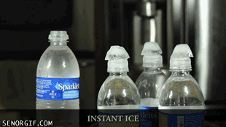
Example
Shows:
2 molecule of H reacts with 1 molecule of O to yield 2 molecules of H₂O
2 moles of H reacts with 1 moles of O to yield 2 moles of H₂O
2 grams of H reacts with 1 gram of O to yield 2 grams of H₂O

Slide 9
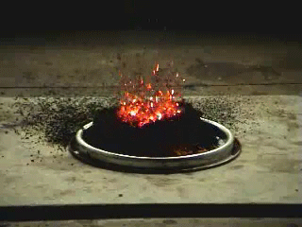
Important information not provided by chemical equations
No indication of whether or not a reaction will occur.
No information about speed with which reactions occur or the pathway the atoms take from reactant to product

Slide 10
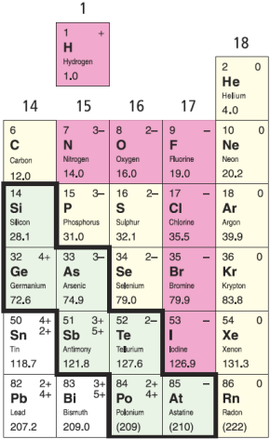
Turn Word Equations into
Balanced Equations
If you don’t transform your word into a skeleton equation properly, you won’t be able to balance the equation correctly.
Be careful of diatomic elements -- remember the special seven!!
H₂, N₂, O₂, F₂, Cl₂, Br₂, I₂
See page 208

Slide 11
Word equation: any equation in which the reactants and products in a chemical reaction are represented by words.
Ex methane + oxygen → carbon dioxide + water
Word equations do not give the quantities of reactants used or produced formed

Slide 12
the arrow (--->) means reacts to yield or yields
Formula equation: represents the reactants and products of the chemical reaction by their symbols or formulas

Slide 13
Change chemical names into chemical formulas. 4 types:
Simple ionic compounds
Multivalent ionic compounds
Ionic compounds with polyatomic ions
Covalent compound

Slide 14
Turn Word Equations into
Balanced Equations
Several common covalent molecules containing hydrogen have common names that you should know and MEMORIZE!!
methane = CH₄
glucose = C₆H₁₂O₆
ethane = C₂H₆
ammonia = NH₃
See page 208

Slide 15
Turn Word Equations into
Balanced Equations
Example #1:
Word Equation: Solutions of lead nitrate react with potassium iodide to produce solid lead iodide and a solution of potassium nitrate.
Skeleton Equation: Pb(NO₃)_{2(aq)} + KI_{(aq)} ⇒ PbI_{2(s)} + KNO_{3(aq)}
Balanced Equation: Pb(NO₃)_{2(aq)} + 2KI_{(aq)} ⇒ PbI_{2(s)} + 2KNO_{3(aq)}
See page 208

Slide 16
Example #2:
Word Equation: Copper reacts with hydrogen nitrate to produce copper (II) nitrate plus hydrogen.
Skeleton Equation: Cu + H(NO₃) ⇒ Cu(NO₃)₂ + H₂
Balanced Equation: Cu + 2H(NO₃) ⇒ Cu(NO₃)₂ + H₂

Slide 17
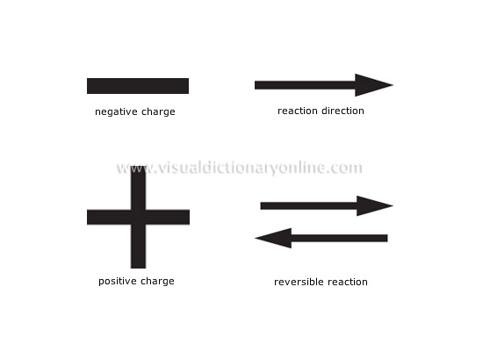

Slide 18
Catalyst: a substance that speeds up a chemical reaction but is not permanently consumed in the reaction.
Reversible reaction: is a chemical reaction in which the products reform the original reactants

Slide 19
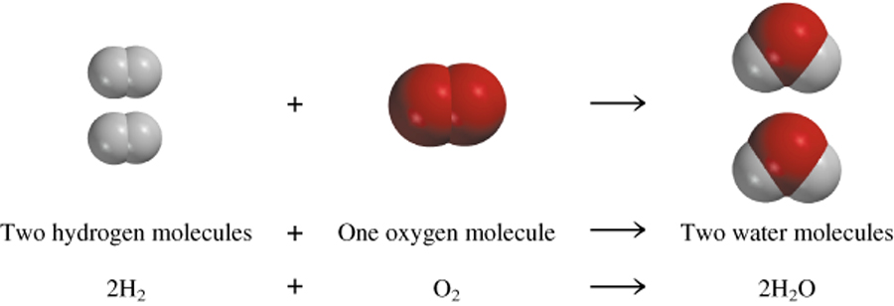
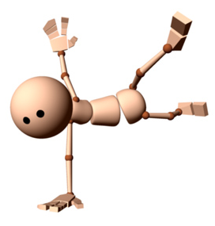
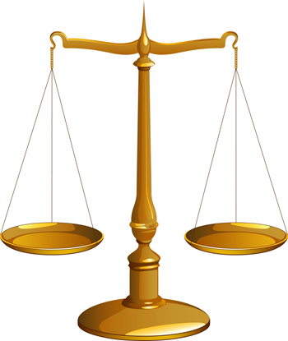
BALANCING EQUATIONS

Slide 20
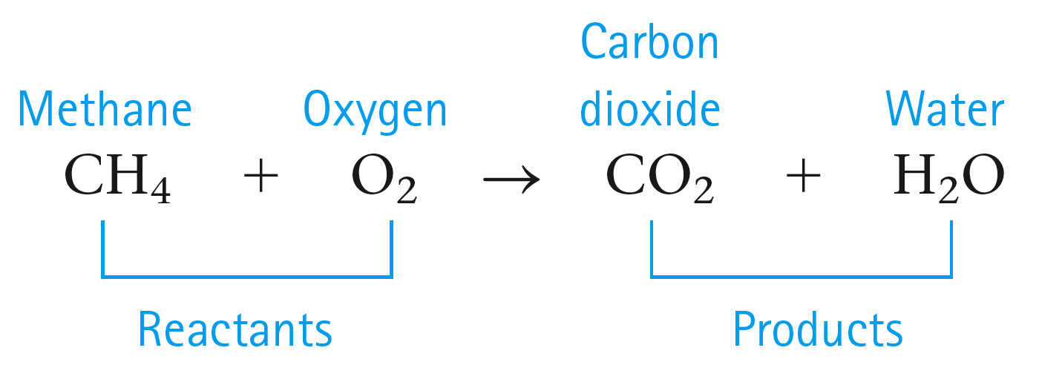
Chemical reactions involve a rearrangement of the ways atoms are grouped together.
A chemical equation represents a chemical reaction.
Reactants are shown to the left of the arrow.
Products are shown to the right of the arrow.

Slide 21
In a chemical reaction atoms are not created or destroyed.
All atoms present in the reactants must be accounted for in the products.
Same number of each type of atom on both sides of the arrow.
Thus Equations must be balanced

Slide 22
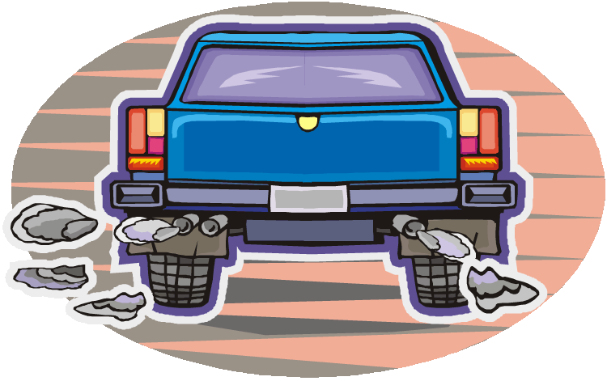
Law of Conservation of Mass
When a chemical reaction occurs, new compounds are created, BUT…
No new matter is created or destroyed; atoms are just rearranged as the atoms change partners to form new compounds.
If there are 3 atoms of oxygen in the reactants, there MUST be 3 atoms of oxygen in the products.
Number of each atom in reactants = number of each atom in products.
The law of conservation of mass:
Mass of reactants = mass of products
If you could collect and measure all of the exhaust from this car, you would find that mass of reactants (gas + O₂) = mass of products (exhaust).

Slide 23
How to Write and Balance Equations
Read the description of the chemical reaction. What are the reactants, the products, and their states? Write the appropriate formulas.
Hydrogen gas (H₂) and oxygen gas (O₂) combine to form liquid water (H₂O).
Write the unbalanced equation that summarizes the information from step 1.
H₂(g) + O₂(g) → H₂O(l)

Slide 24
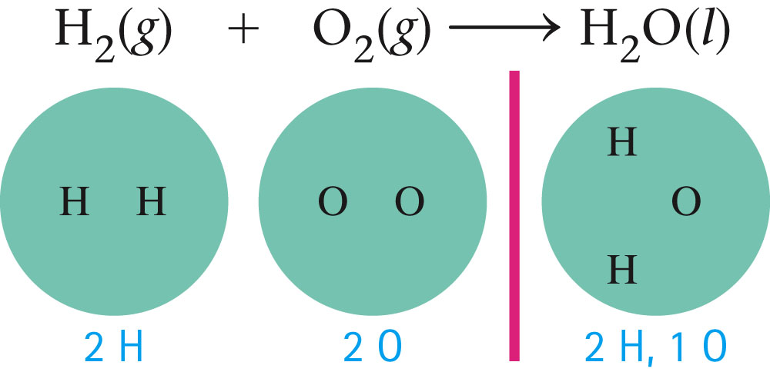
How to Write and Balance Equations
Balance the equation by inspection, starting with the most complicated molecule.
Equation is unbalanced by counting the atoms on both sides of the arrow.

Slide 25
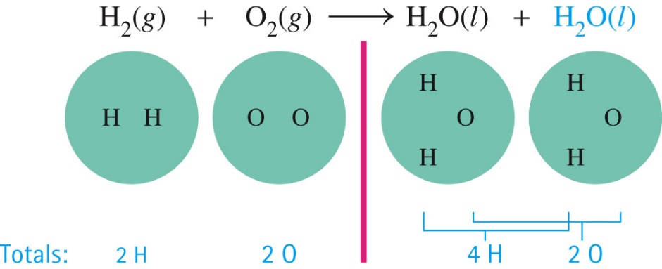
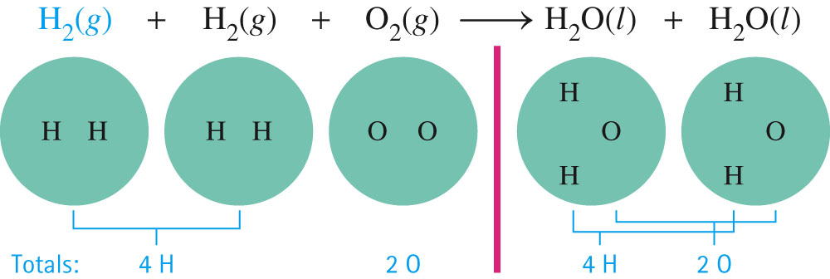
How to Write and Balance Equations
Balance the equation by inspection, starting with the most complicated molecule.
We must balance the equation by adding more molecules of reactants and/or products.

Slide 26
How to Write and Balance Equations
4. Check to see that the coefficients used give the same number of each type of atom on both sides of the arrow. Also check to see that the coefficients used are the smallest integers that give the balanced equation.
The balanced equation is:
2H₂(g) + O₂(g) → 2H₂O(l)
or could be:
4H₂(g) + 2O₂(g) → 4H₂O(l)
preferred

Slide 27
Another Balancing Example:

Slide 28
Balancing using the underline method.
Na₂O(s) + H₂O(l) → NaOH(aq)
2
CH₄(g) + O₂(g) → CO₂(g) + H₂O(g)
2
2
Fe(s) + O₂(g) → Fe₂O₃(s)
4
2
3
2
LiOH(s) + CO₂(g) → LiHCO₃(s)
Δ
KClO₃(s) → KCl(s) + O₂(g)
2
2
3
MnO₂

Slide 29
Balancing Example:

Slide 30
Writing & Balancing Equations
The simplest form of chemical equation is a word equation.
Potassium metal + oxygen gas → potassium oxide
A skeleton equation shows the formulas of the elements/compounds.
A skeleton equation shows which atoms are involved, but not how many molecules are involved.
K + O₂ → K₂O

Slide 31
Writing & Balancing Equations
A balanced chemical equation shows all atoms and the coefficients tells us how many molecules (and atoms) there are.
Balancing ensures that the number of each atom is the same on both sides of the reaction arrow.
4K + O₂ → 2K₂O
K
K
O
O
K
O
K
K
K
K
O
K

Slide 32
Counting Atoms to Balance Equations
Using the law of conservation of mass, we can count atoms to balance the number of atoms in chemical equations.
Word equation: methane + oxygen → water + carbon dioxide
Skeleton equation: CH₄ + O₂ → H₂O + CO₂
To balance the compounds, take note of how many
atoms of each element occur on each side of the
reaction arrow.
See Page 207

Slide 33
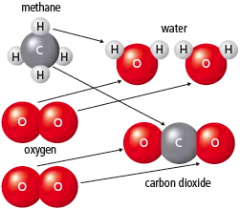
Counting Atoms to Balance Equations
Skeleton equation: CH₄ + O₂ → H₂O + CO₂
Carbon = 1 Carbon = 1
Hydrogen = 4 Hydrogen = 2
Oxygen = 2 Oxygen = 3
Balanced equation: CH₄ + 2O₂ → 2H₂O + CO₂ Carbon = 1 Carbon = 1
Hydrogen = 4 Hydrogen = 4
Oxygen = 4 Oxygen = 4
The same number of atoms must be on each side.
See Page 207

Slide 34
Balancing Equations
hydrogen + oxygen → water
H₂ +
O₂ →
H₂O
 | Reactants | Products
H | 2 | 2
O | 2 | 1

Slide 35
Balancing Equations
X
hydrogen + oxygen → hydrogen peroxide
H₂ + O₂ → H₂O₂
YOU CANNOT CHANGE THE SUBSCRIPTS
 | Reactants | Products
H | 2 | 2
O | 2 | 2

Slide 36
Balancing Equations
hydrogen + oxygen → water
H₂ + O₂ → H₂O
2
 | Reactants | Products
H | 2 | 2
O | 2 | 1

Slide 37
Balancing Equations
hydrogen + oxygen → water
H₂ + O₂ → H₂O
2
 | Reactants | Products
H | 2 | 4
O | 2 | 2

Slide 38
Balancing Equations
hydrogen + oxygen → water
2 H₂ + O₂ → H₂O
2
(g)
(g)
(l)
 | Reactants | Products
H | 4 | 4
O | 2 | 2

