Slide 1
Maximizing Genetic Information
The human genome contains about 20,325 genes
- However, these encode about 100,000 mRNAs, which in turn specify more than a million proteins
Several events account for the fact that proteins outnumber genes
Notes:
1

Slide 2
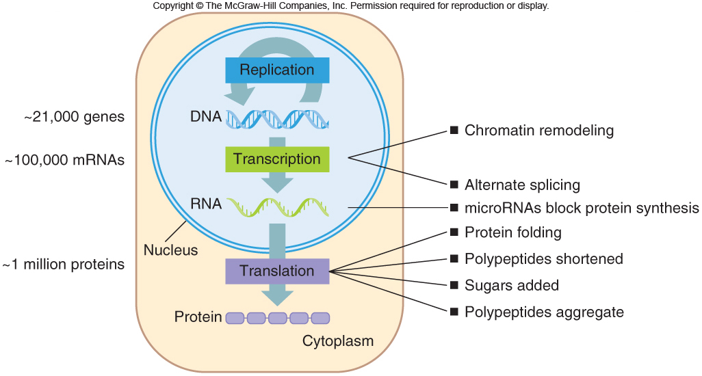
Maximizing Genetic Information
Figure 11.8
Figure 11.11

Slide 3
Maximizing Genetic Information
The “genes in pieces” pattern of exons and introns and alternate splicing help to greatly expand the gene number
Figure 11.9
Notes:
3

Slide 4
Most of the Human Genome Does Not Encode Protein
Only 1.5% of human DNA encodes protein
Rest of genome includes:
- Viral DNA
- Noncoding RNAs
- Introns
- Promoters and other control sequences
- Repeated sequences
Notes:
4

Slide 5
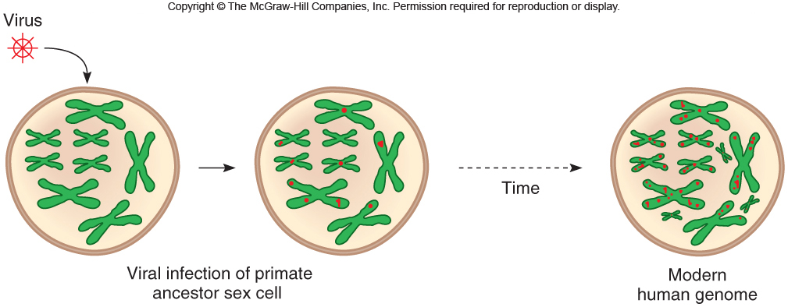
Viral DNA
About 8% of our genome is derived from RNA viruses called retroviruses
- This is evidence of past infection
- Sequences tend to increase over time
Figure 11.11
Notes:
5

Slide 6
RNA
sncRNA: stands for small noncoding RNA also called microRNA ( miRNA, miRs).. typically composed of only 22 nucleotides, and acts as a negative regulator of genes ( meaning they turn the genes off)
sncRNA controls 20-30% of human coding DNA genes ( whole mechanism is called RNAi or RNA interference)

Slide 7
Noncoding RNAs
Nearly all of the human genome can be transcribed, and much of it is in the form of noncoding RNAs (ncRNAs)
This includes rRNAs and tRNAs
However, there are hundreds of thousands of other ncRNAs
- These are transcribed from pseudogenes
- But are not translated into protein
Notes:
7

Slide 8
Repeats
Transposons are the most abundant type of repeat
- Sequences that jump about the genome
- Alu repeats can copy themselves
- Comprise about 2-3% of the genome
Rarer classes of repeats include those that comprise telomeres, centromeres, and rRNA gene clusters
Notes:
8

Slide 9
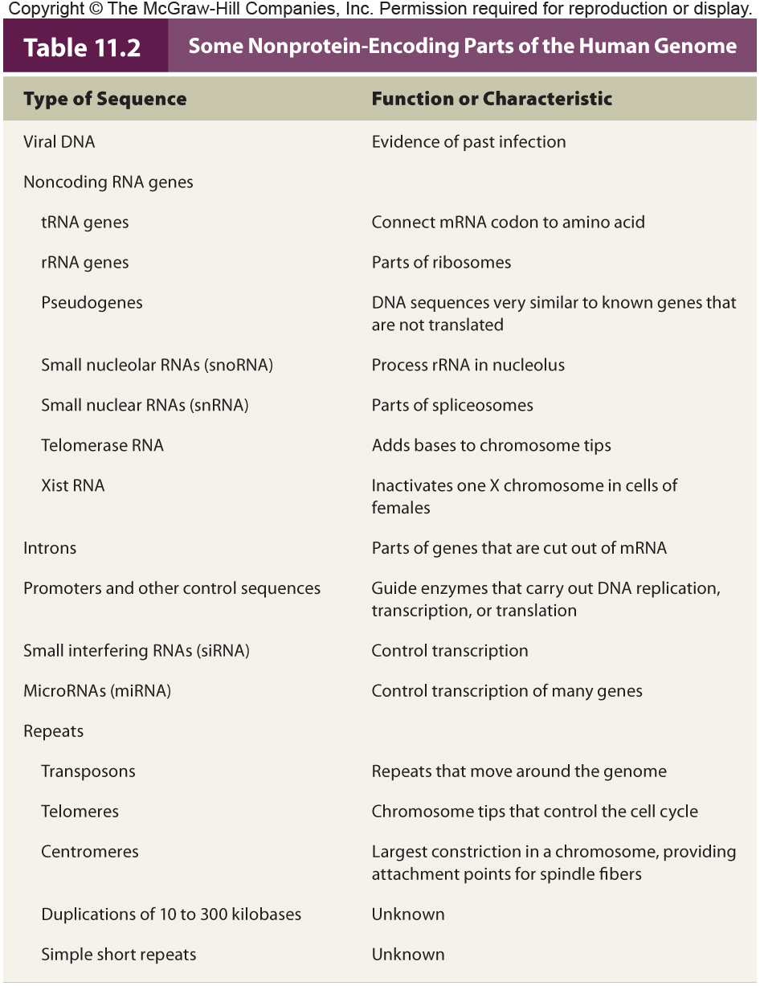
Table 11.4

Slide 10
The Nature of Mutations
A mutation is change in a DNA sequence that is present in < 1% of a population
May occur at the DNA or chromosome level
A polymorphism is a genetic change that is present in > 1% of a population
The effect of mutations vary
“Loss-of-function” mutations – Recessive
“Gain-of-function” mutations – Dominant
Notes:
10

Slide 11
The Nature of Mutations
The term mutant refers to phenotype
- Usually connotes an abnormal or unusual, or even uncommon variant that is nevertheless “normal”
Notes:
11

Slide 12
The Nature of Mutations
Germline mutations
- Originate in meiosis
- Affect all cells of an individual
Somatic mutations
- Originate in mitosis
- Affect only cells that descend from changed cell
Notes:
12

Slide 13
Mutations Alter Proteins
Identifying how a mutation causes symptoms has clinical applications
Examples of mutations that cause disease:
- Beta globin gene
- Collagen genes
Notes:
13

Slide 14
Sickle Cell Anemia
Results from a single DNA base change in the β-globin gene, which replaces glutamic acid (6th position) with valine
Phenotype associated with homozygotes
Altered surface of hemoglobin allows molecules to link in low oxygen conditions
Creates sickle shape of RBC
Sickling causes anemia, joint pain, and organ damage when RBC become lodged in small blood vessels
Notes:
14

Slide 15
Figure 12.2
Notes:
15

Slide 16
Thalassemia
Caused by another beta hemoglobin mutation
Too few beta globin chains
Excess of alpha globin prevents formation of hemoglobin molecules
So RBCs die
Liberated iron slowly damages heart, liver, and endocrine glands
Thalassemia minor (heterozygous)
Thalassemia major (homozygous for mutation and more severe)
Notes:
16

Slide 17
Collagen
A major component of connective tissue
- Bone, cartilage, skin, ligament, tendon, and tooth dentin
More than 35 collagen genes encode more than 20 types of collagen molecules
Mutations in these genes lead to a variety of medical problems
Notes:
17

Slide 18
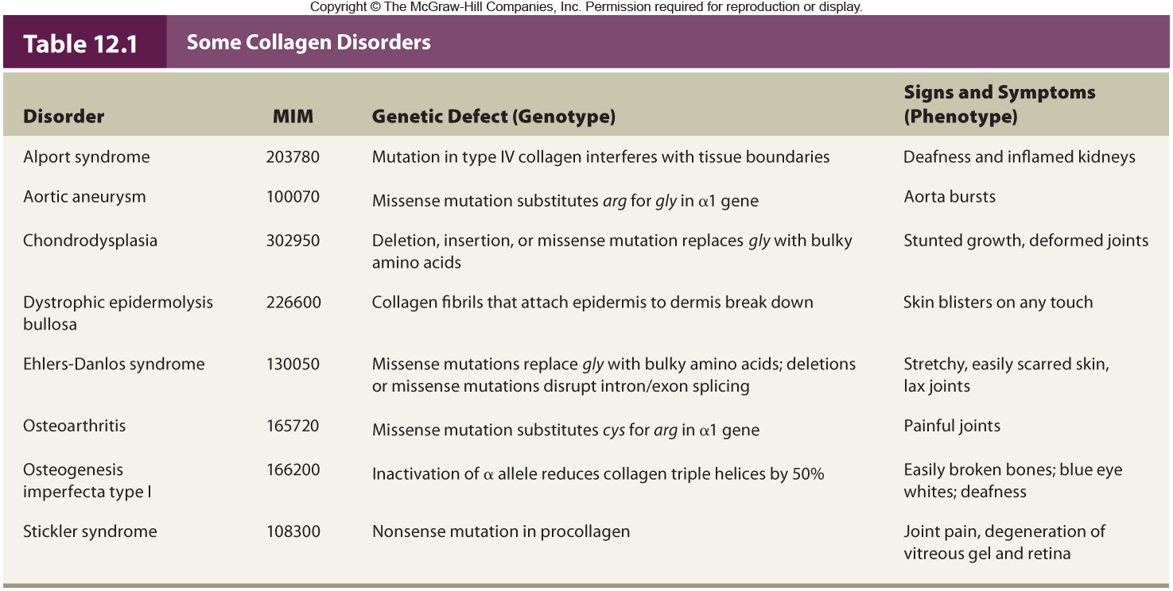
Collagen Disorders
Notes:
18

Slide 19
Collagen has a precise structure
- Triple helix of two α1 and one α2 polypeptides
- Longer precursor, procollagen is trimmed to form collagen
Figure 12.3
Notes:
19

Slide 20
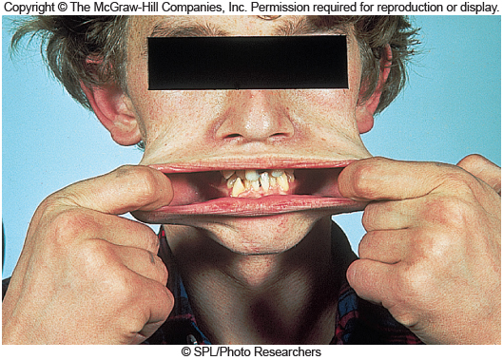
Ehler-Danos Syndrome
A mutation prevents procollagen chains from being cut
Collagen molecules cannot assemble, and so skin becomes stretchy
Figure 12.4
Figure 12.4

Slide 21
How Mutations Cause Disease
Mutations in a gene may cause either different versions of the same disease or distinct illnesses
Table 12.2 lists several examples of mutations and the diseases they produce
Figure 12.4

Slide 22
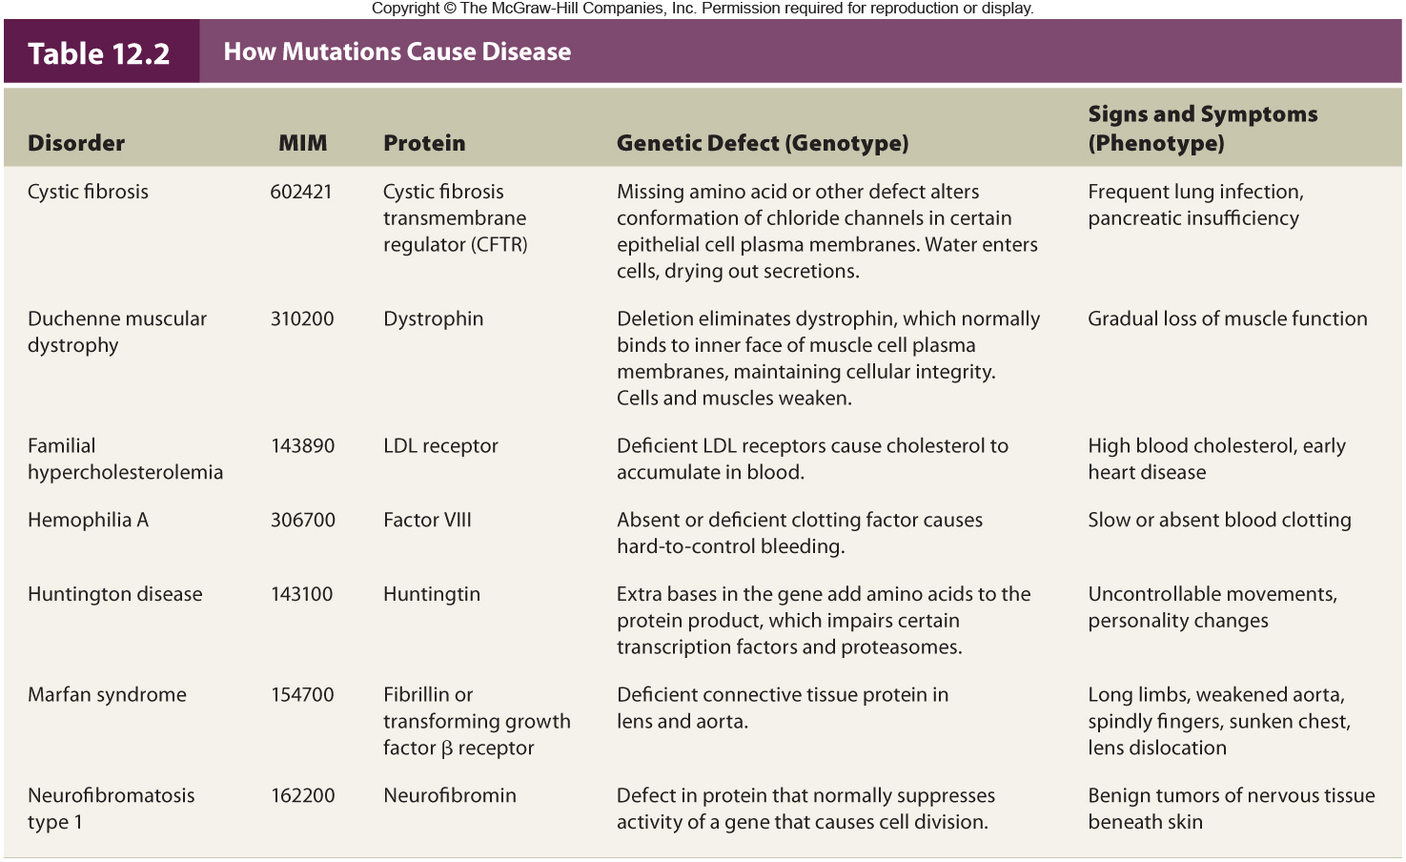
How Mutations Cause Disease
Notes:
22

Slide 23
Causes of Mutations
Mutations may occur spontaneously or by exposure to a chemical or radiation
An agent that causes a mutation is called a mutagen
Figure 12.4

Slide 24
Spontaneous Mutation
De novo or new mutations
Not caused by exposure to known mutagen
Result from errors in DNA replication
DNA bases have slight chemical instability
Exist in alternating forms called tautomers
As replication fork encounters unstable tautomers, mispairing can occur
Figure 12.4

Slide 25
Spontaneous Mutation Rate
Rate differs between genes
- Larger genes usually have higher mutation rates
Each human gene has about 1/100,000 chance of mutating
Each individual has multiple new mutations
Mitochondrial genes mutate at a higher rate than nuclear genes because they cannot repair their DNA
Figure 12.4

Slide 26
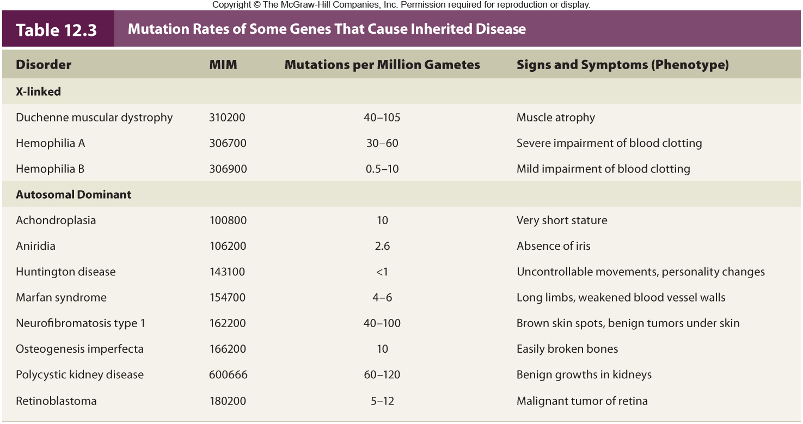
Mutation Rates
Notes:
26

Slide 27
Determining Mutation Rate
Estimates of spontaneous mutation rate can be derived from observation of new, dominant traits
For autosomal genes,
mutation rate = # of new cases/2X where X = # of individuals examined
Figure 12.4

Slide 28
Induced Mutations
Caused by mutagens, many are also carcinogens and cause cancer
Examples:
- Alkylating agents: remove a base
- Acridine dyes: add or remove base
- X rays: break chromosomes
- UV radiation: creates thymine dimers
Site-directed mutagenesis: Changes a gene in a desired way
Figure 12.4

Slide 29
Exposure to Mutagens
Some mutagen exposure is unintentional
- Workplace
- Industrial accidents
- Chernobyl
- Medical treatments
- Weapons
- Natural sources
- Cosmic rays, sunlight, earth’s crust
Figure 12.4

Slide 30
Types of Mutations
Mutations can be classified in several ways
- By whether they remove, alter, or add a function
- By exactly how they structurally alter DNA
Figure 12.4

Slide 31
Point Mutations
A change of a single nucleotide (most common genetic mistake) ex sickle cell anemia and tay-sachs
Transition = Purine replaces purine or pyrimidine replaces pyrimidine
A to G or G to A or
C to T or T to C
Transversion = Purine replaces pyrimidine or pyrimidine replaces purine
A or G to T or C
T or C to A or G
Figure 12.4

Slide 32
Consequences of Point Mutations
Missense mutation = Replaces one amino acid with another
Nonsense mutation = Changes a codon for an amino acid into a stop codon
- Creates truncated proteins that are often non-functional
A stop codon that is changed to a coding codon lengthens the protein
Figure 12.4

Slide 33
Splice Site Mutations
Alters a site where an intron is normally removed from mRNA
Can affect the phenotype if:
1) Intron is translated or exon skipped
- Example: CF mutation
2) Exon is skipped
- Example: Familial dysautonomia (FD)
Figure 12.4

Slide 34
Deletions and Insertions
The genetic code is read in triplets
Nucleotides changes not in multiples of 3 lead to disruptions of the reading frame
Cause a frameshift mutation and alter amino acids after mutation
Nucleotide changes in multiples of 3 will NOT cause a frame-shift
- But they can still alter the phenotype
Figure 12.4

Slide 35
Deletions and Insertions
A deletion removes genetic material
- Male infertility: Tiny deletions in the Y
An insertion adds genetic material
- Gaucher disease: Insertion of one base
A tandem duplication is an insertion of identical sequences side by side
- Charcot-Marie-Tooth disease: Tandem duplication of 1.5 million bases
Figure 12.4

Slide 36
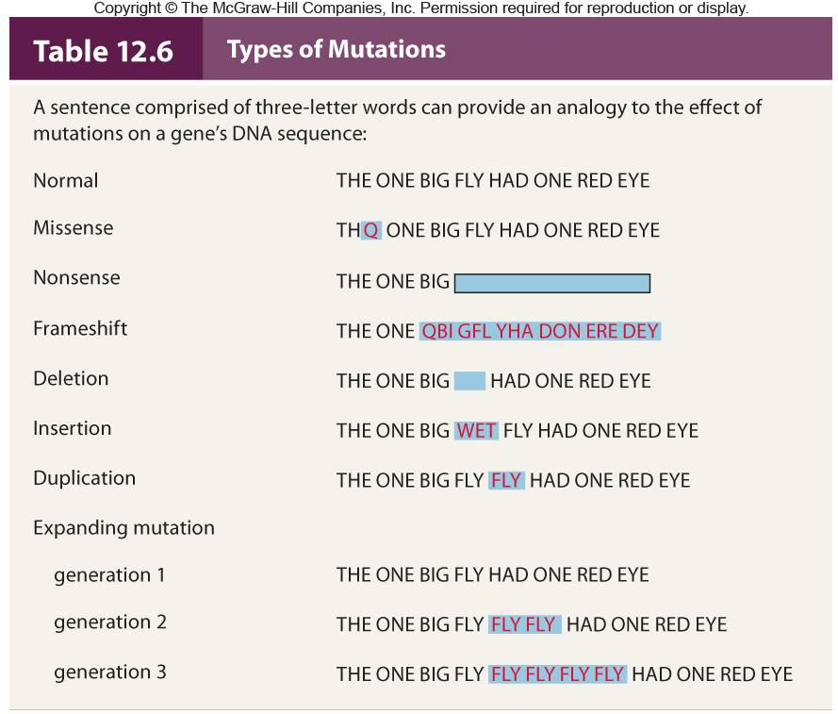
Table 12.6

Slide 37
Expanding Repeats
Insertion of triplet repeats leads to extra amino acids
- The longer proteins shut down the cells
Some genes are particularly prone to expansion of repeats
Number of repeats correlates with earlier onset and more severe phenotype
Anticipation is the expansion of the triplet repeat with an increase in severity of phenotype with subsequent generations
Figure 12.4

Slide 38
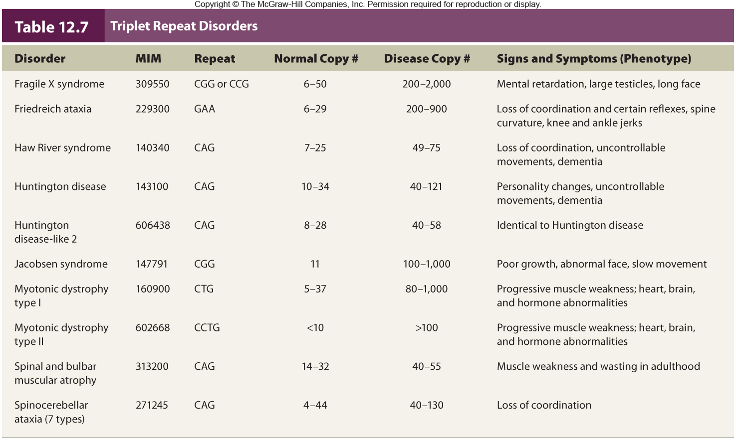
Triplet Repeat Disorders
Table 12.7

Slide 39
DNA Repair
Errors in DNA replication or damage to DNA create mutations
- May result in cancer
Fortunately, most errors and damage are repaired
Type of repair depends upon the type of damage or error
Organisms vary in their ability to repair DNA
Figure 12.4

Slide 40
Types of DNA Repair
In many modern species, three types of DNA repair peruse the genetic material
1) Photoreactivation repair
2) Excision repair
3) Mismatch repair
Figure 12.4

Slide 41
Photoreactivation Repair
Enzymes called photolyases use light energy to break the extra bonds in a pyrimidine dimer
Enables UV-damaged fungi to recover from exposure to sunlight
Humans do not have this type of repair
Figure 12.4

Slide 42
Excision Repair
Pyrimidine dimers and surrounding bases are removed and replaced
Humans have two types of excision repair
Nucleotide excision repair
- Replaces up to 30 bases
- Corrects mutations caused by different insults
Base excision repair
- Replaces 1-5 bases
- Specific to oxidative damage
Figure 12.4

Slide 43
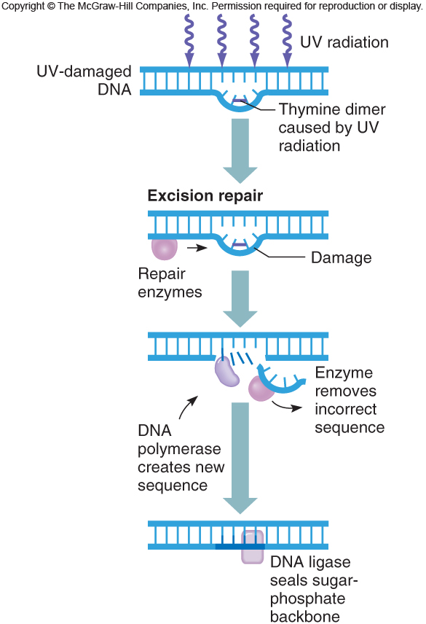
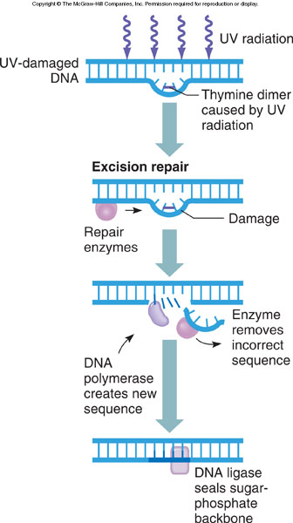
Excision Repair
Figure 12.13
Figure 12.13

Slide 44
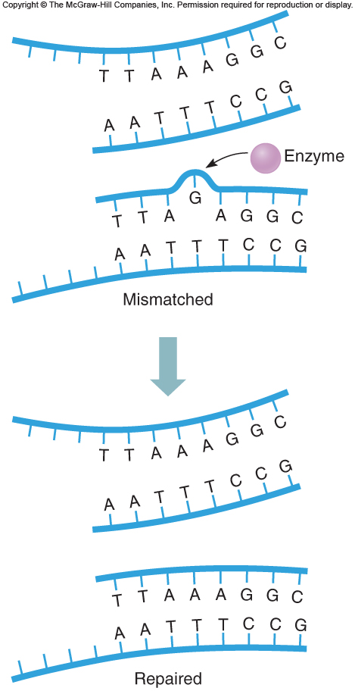
Mismatch Repair
Enzymes detect nucleotides that do not base pair in newly replicated DNA
The incorrect base is excised and replaced
Proofreading is the detection of mismatches
Figure 12.14
Figure 12.4

Slide 45
Repair Disorders: Trichothiodystrophy
At least five genes are involved
Symptoms reflect accumulating oxidative damage
Faulty nucleotide excision repair or base excision repair or both
Symptoms: premature aging, hearing and vision problems high risk of cancer
Figure 12.4

Slide 46
Repair Disorders: Inherited Colon Cancer
Hereditary nonpolyposis colon cancer
Affects 1/200 individuals (accounts for 3% of all colorectal cancer) ( relatives of newly diagnosed colon cancer patients advised to test for this mutation and carrier of HPNCC are at high risk of colon cancer)
Defect in mismatch repair
HNPCC gene is on chromosome 2
Figure 12.4

Slide 47
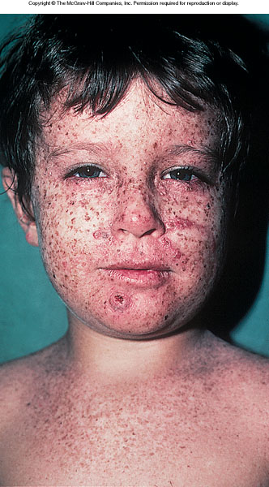
Repair Disorders: Xeroderma Pigmentosum
More than ½ of all xp children will develop cancer before teenage yrs
Autosomal recessive; Seven genes involved
Malfunction of excision repair
Thymine dimers remain and block replication
Must avoid sunlight
Only 250 cases worldwide
Figure 12.16
Figure 12.4
1000x increase risk of developing skin cancer

Slide 48
Repair Disorders: Ataxia Telangiectasis
Autosomal recessive disorder
Defect in cell cycle checkpoint kinase
Cells continue through cell cycle without pausing to inspect DNA
Individuals with AT have 50X the risk of developing over general population
Heterozygotes have a two- to sixfold increase in cancer risk
Figure 12.4

Slide 49
Failure of DNA Repair
If both copies of a repair gene are mutant, a disorder can result
The protein p53 monitors repair of DNA
If damage is too severe, the p53 protein promotes programmed cell death or apoptosis
Mutations may occur in genes encoding DNA repair proteins
Lead to overall increase in mutations
Figure 12.4

Slide 50
Cytogenetics
Cytogenetics is a subdiscipline within genetics
Deals with chromosome variations
In general, excess genetic material has milder effects on health than a deficit
Still, most large-scale chromosomal abnormalities present in all cells disrupt or halt prenatal development
Notes:
50

Slide 51
Portrait of a Chromosome
A chromosome consists primarily of DNA and protein
Distinguished by size and shape
Essential parts are:
- Telomeres
- Origins of replication sites
- Centromere
Notes:
51

Slide 52
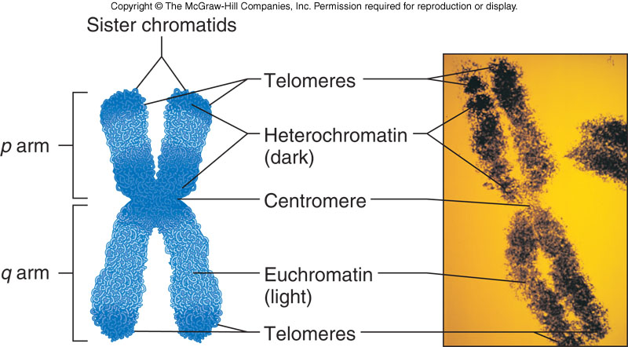
Portrait of a Chromosome
Figure 13.1

Slide 53
Portrait of a Chromosome
Heterochromatin is darkly staining
- Consists mostly of repetitive DNA
Euchromatin is lighter-staining
- Contains most protein-encoding genes
Telomeres are chromosome tips composed of many repeats of TTAGGG
- Shorten with each cell division
Notes:
53

Slide 54
Centromeres
The largest constriction of the chromosome and where spindle fibers attach
The bases that form the centromere are repeats of a 171-base DNA sequence
Replicated at the end of S-phase
Notes:
54

Slide 55
On a Chromosome
The short arm of the chromosome is called “p”
The long arm of the chromosome is called “q”
Each genetic trait or disease is given an address using this method
Ex: Alzheimer’s is 10q24.1 meaning it is found on chromosome 10 long arm band 24 section 1
Ex sickle cell anemia: 11p15.5
Ex fragile x syndrome: Xp27.3
Top 3 autosomal recessive cells: sickle cell, cystic fibrosis and Tat-sachs
Top Autonomic dominant diseases: Huntington’s and neurofibromastoma

Slide 56
Karyotype
A chromosome chart
Displays chromosomes arranged by size and structure
Humans have 24 chromosome types
- Autosomes are numbered 1-22 by size
- Sex chromosomes are X and Y
Notes:
56

Slide 57
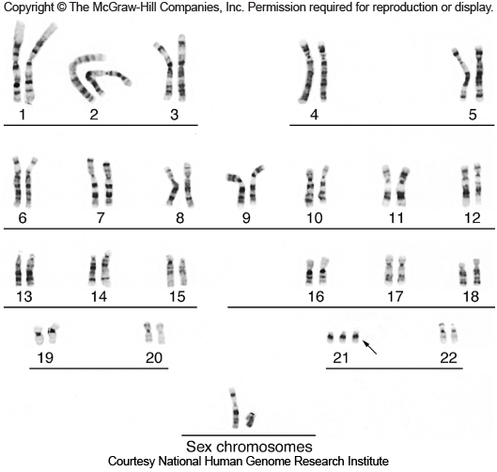
Karyotype
Figure 13.3
Notes:
57

Slide 58
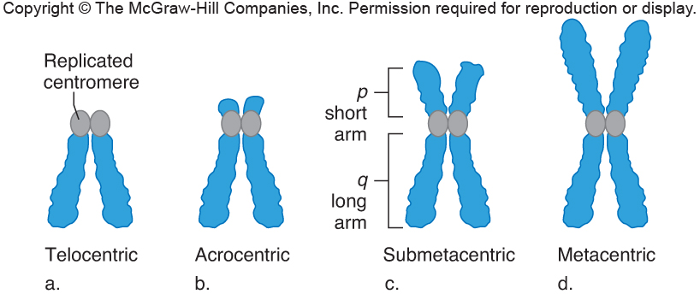
Centromere Positions
At tip – Telocentric
Close to end – Acrocentric
Off-center – Submetacentric
At midpoint – Metacentric
Figure 13.4
Notes:
58

Slide 59
Karyotype
Karyotypes are useful at several levels
1) Can confirm a clinical diagnosis
2) Can reveal effects of environmental toxins
Notes:
59

Slide 60
Visualizing Chromosomes
Tissue is obtained from person
- Fetal tissue: Amniocentesis
Chorionic villi sampling
Fetal cell sorting
Chromosome microarray analysis
- Adult tissue: White blood cells
Skinlike cells from cheek swab
Chromosomes are extracted
Then stained with a combination of dyes and DNA probes
Notes:
60

Slide 61
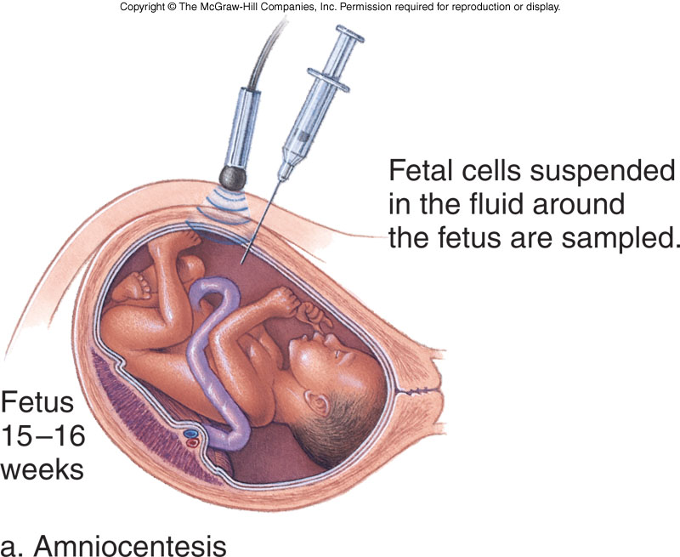
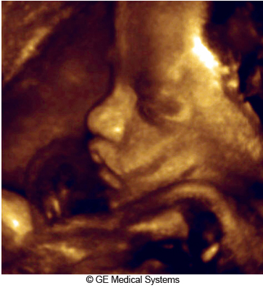
Amniocentesis
Detects about 1,000 of the more than 5,000 known chromosomal and biochemical problems
Ultrasound is used to follow needle’s movement
Figure 13.6
Figure 13.5a
Notes:
61

Slide 62
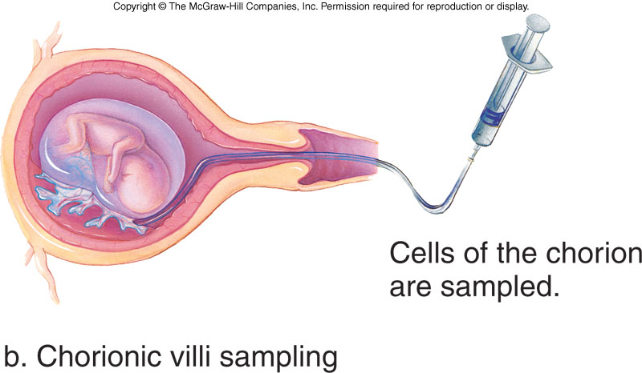
Chorionic Villi Sampling
Performed during 10-12th week of pregnancy
Provides earlier results than amniocentesis
However, it does not detect metabolic problems
- And has greater risk of spontaneous abortion
Figure 13.5b
Notes:
62

Slide 63
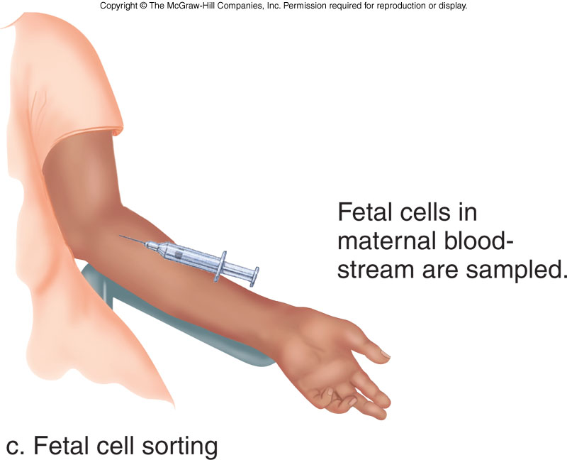
Fetal Cell Sorting
Fetal cells are distinguished from maternal cells by a fluorescence-activated cell sorter - Identifies cell-surface markers
Figure 13.5c
A new technique detects fetal mRNA in the bloodstream of the mother
Notes:
63

Slide 64
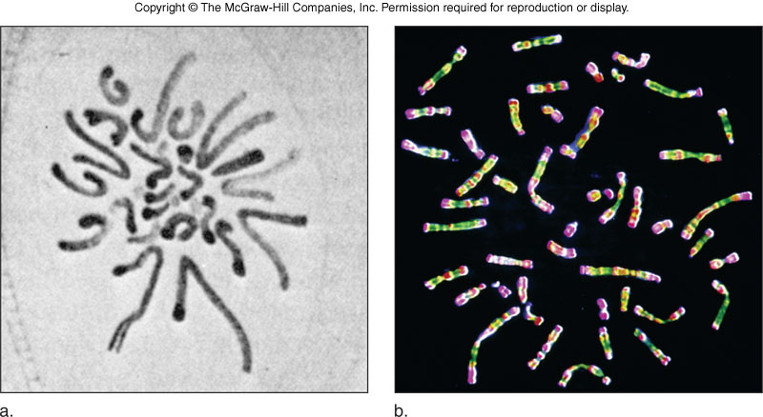
Viewing Chromosomes
1882
Figure 13.8
Now
Drawing by German biologist Walther Flemming
Micrograph of actual stained human chromosomes
Notes:
64

Slide 65
Staining Chromosomes
In the earliest karyotypes, dyes were used to stain chromosomes a uniform color
Chromosomes were grouped into decreasing size classes, designated A though G
In the 1970s, improved staining techniques gave banding patterns unique to each chromosome
Then researchers found that synchronizing the cell cycle of cultured cells revealed even more bands per chromosome
Notes:
65

Slide 66
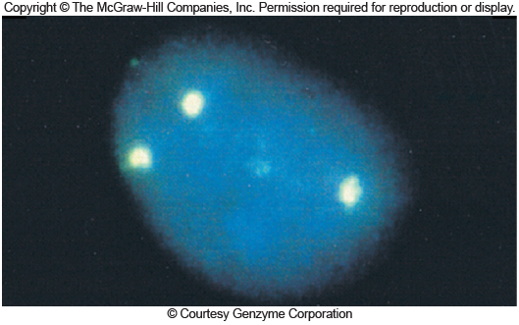
FISH
Fluorescence in situ hybridization
DNA probes labeled with fluorescing dye bind complementary DNA
Fluorescent dots correspond to three copies of chromosome 21
Figure 13.9
Notes:
66

Slide 67
Chromosomal Shorthand
Notes:
67

Slide 68
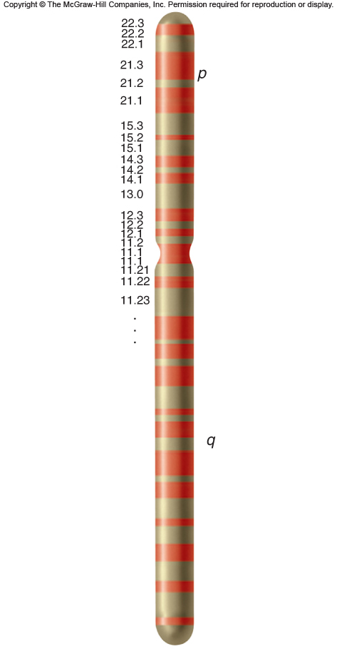
Ideogram
A schematic chromosome map
Indicates chromosome arms (p or q) and delineates major regions and subregions by numbers
Figure 13.10
Notes:
68

Slide 69
Chromosome Abnormalities
A karyotype may be abnormal in two ways:
1) In chromosome number
2) In chromosome structure
Abnormal chromosomes account for at least 50% of spontaneous abortions
Due to improved technology, more people are being diagnosed with chromosomal abnormalities
Notes:
69

Slide 70
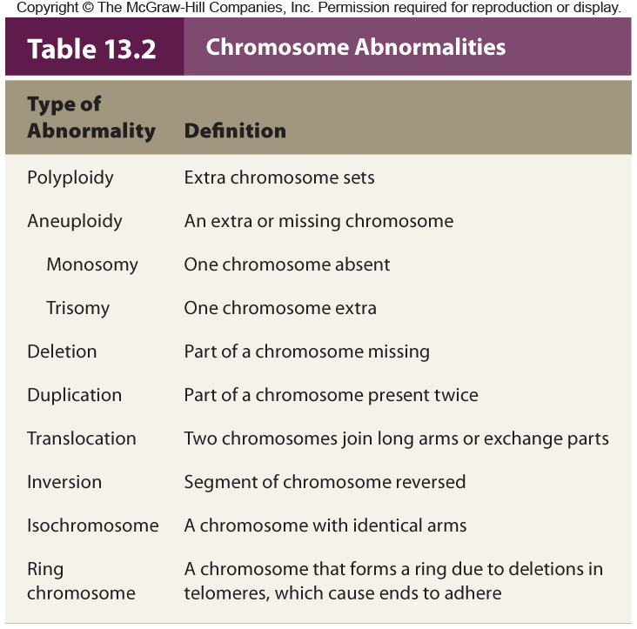
Notes:
70

Slide 71
Polyploidy
Cell with extra chromosome sets is polyploid
Triploid (3N) cells have three sets of chromosomes
- Produced in one of two main ways:
- Fertilization of one egg by two sperm
- Fusion of haploid and diploid gametes
Triploids account for 17% of all spontaneous abortions and 3% of stillbirths and newborn deaths
Notes:
71

Slide 72
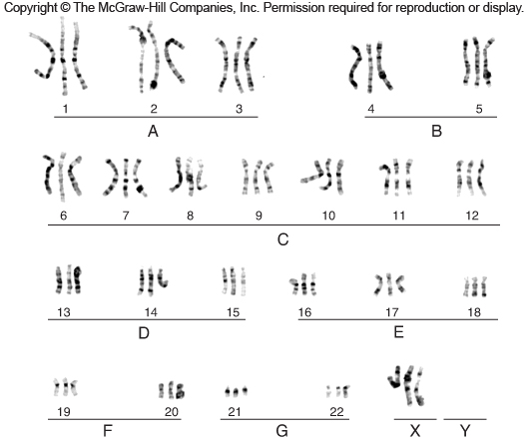
Triploidy
Figure 13.11
Notes:
72

Slide 73
Aneuploidy
A normal chromosomal number is euploid
Cells with extra or missing chromosomes are aneuploid
Most autosomal aneuploids are spontaneously aborted
Those that are born are more likely to have an extra chromosome (trisomy) rather than a missing one (monosomy)
Notes:
73

Slide 74
Nondisjunction
The failure of chromosomes to separate normally during meiosis
Produces gamete with an extra chromosome and another with one missing chromosome
Notes:
74

Slide 75
Aneuploidy
Aneuploidy can also arise during mitosis, producing groups of somatic cells with the extra or missing chromosomes
An individual with two chromosomally-distinct cell populations is called a mosaic
A mitotic nondisjunction event that occurs early in development can have serious effects on the health of the individual
Notes:
75

Slide 76
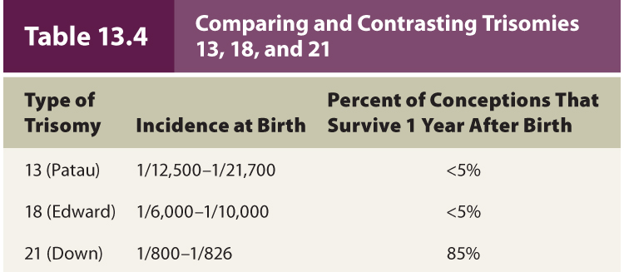
Trisomies
Most autosomal aneuploids cease developing as embryos or fetuses
Most frequently seen trisomies in newborns are those of chromosomes 21, 18, and 13
- Carry fewer genes than other autosomes
Notes:
76

Slide 77
Trisomy 21
Down syndrome
Most common trisomy among newborns
Distinctive facial and physical problems
Figure 13.13
Varying degrees of developmental disabilities
Individuals more likely to develop leukemia
Link with one form of Alzheimer disease
Notes:
77

Slide 78
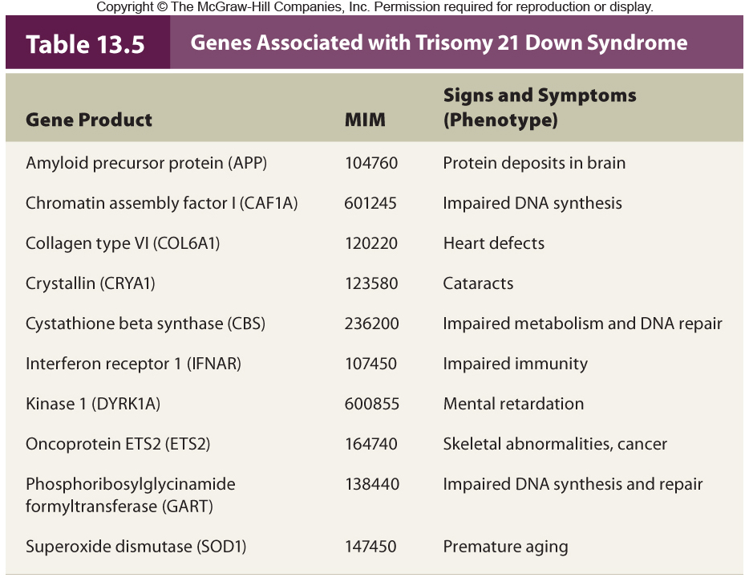
Table 13.6

Slide 79
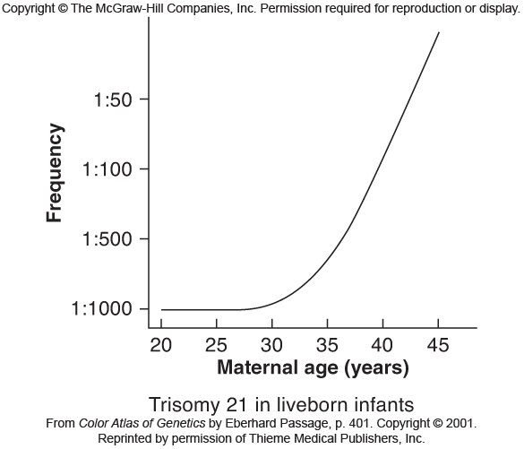
The risk of conceiving an offspring with Down syndrome rises dramatically with maternal age
Figure 13.7
Notes:
79

Slide 80
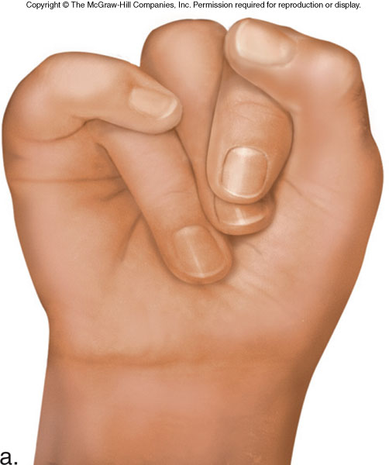
Trisomy 18
Figure 13.14a
Edwards syndrome
Most due to nondisjunction in meiosis II in oocyte and do not survive
Serious mental and physical disabilities
A distinctive feature: Oddly-clenched fists
Notes:
80

Slide 81
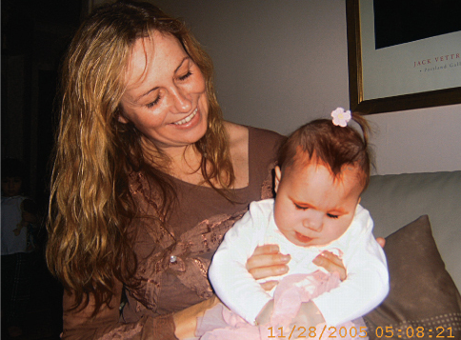
Trisomy 13
Patau syndrome
Very rare and generally do not survive 6 months
Figure 13.14b
Serious mental and physical disabilities
A distinctive feature: Eye fusion
Notes:
81

Slide 82
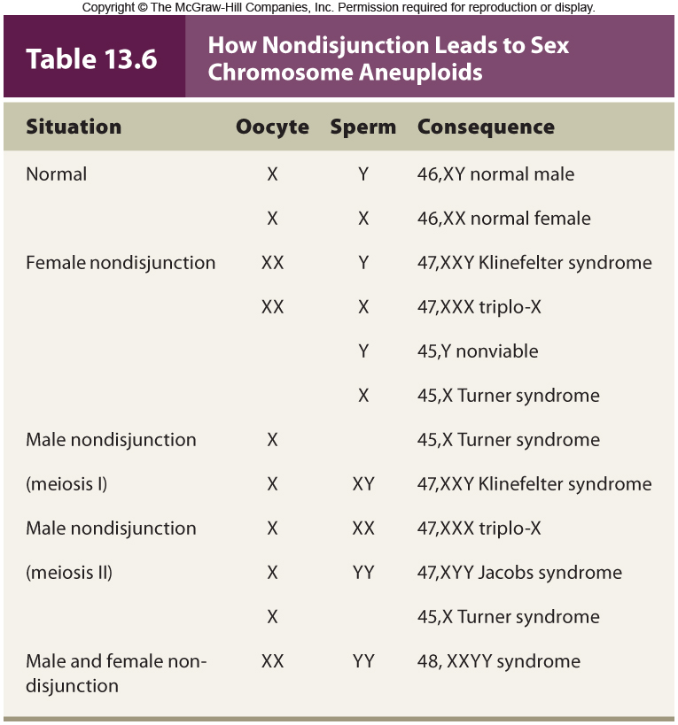
Table 13.7

Slide 83
Turner Syndrome
Called the XO syndrome
1 in 2,500 female births
99% of affected fetuses die in utero
Features include short stature, webbing at back of neck, incomplete sexual development (infertile), impaired hearing
Individuals who are mosaics may have children
No bar bodies in cells
Notes:
83

Slide 84
Triplo-X
Called the XXX syndrome
1 in 1,000 female births
Few modest effects on phenotype include tallness, menstrual irregularities, and slight impact on intelligence
X-inactivation of two X chromosomes occurs and cells have two Barr bodies
May compensate for presence of extra X
Notes:
84

Slide 85
Klinefelter Syndrome
Called the XXY syndrome
1 in 500 male births
Phenotypes include:
- Incomplete sexual development
- Rudimentary testes and prostate
- Long limbs, large hands and feet
- Some breast tissue development
Most common cause of male infertility
Notes:
85

Slide 86
XXYY Syndrome
Likely arises due to unusual oocyte and sperm
Associated with more severe behavioral problems than Klinefelter syndrome
- AAD, obsessive compulsive disorder, learning disabilities
Individuals are infertile
Treated with testosterone
Notes:
86

Slide 87
XYY Syndrome
Also known as Jacobs syndrome
1 in 1,000 male births
96% are phenotypically normal
Modest phenotypes may include great height, acne, speech and reading disabilities
Studies suggesting increase in aggressive behaviors are not supported
Notes:
87

Slide 88
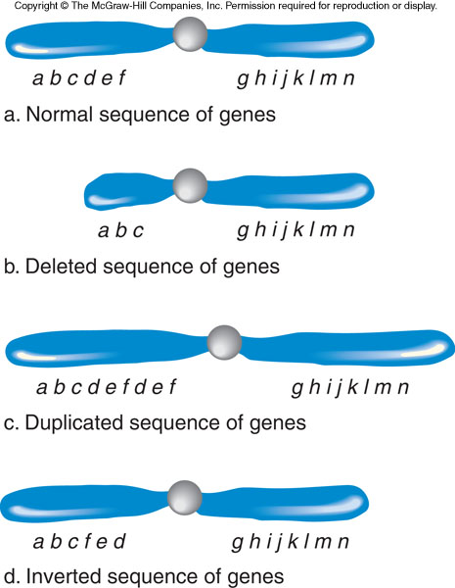
Chromosome Structural Abnormalities
Figure 13.15
Notes:
88

Slide 89
Deletions
A deletion refers to a missing genetic segment from a chromosome
Deletions are often not inherited
- Rather they arise de novo
Larger deletions increase the likelihood that there will be an associated phenotype
Cri-du-chat (cat cry) syndrome
- Deletion 5p–
Notes:
89

Slide 90
Duplications
A duplication refers to the presence of an extra genetic segment on a chromosome
Duplications are often not inherited
- Rather they arise de novo
The effect of duplications on the phenotype is generally dependent on their size
- Larger duplications tend to have an effect, while smaller one do not
Notes:
90

Slide 91
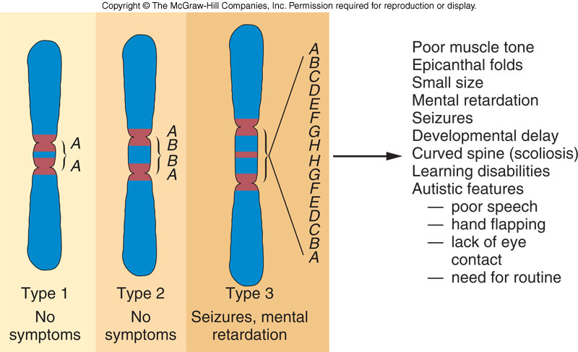
Duplications in Chromosome 15
Figure 13.17
Notes:
91

Slide 92
Translocations
In a translocation, two nonhomologous chromosomes exchange segments
There are two major types:
1) Robertsonian translocation
2) Reciprocal translocation
Notes:
92

Slide 93
Robertsonian Translocations
Two nonhomologous acrocentric chromosomes break at the centromere and their long arms fuse
- The short arms are often lost
Affect 1 in 1,000 people
Translocation carriers have 45 chromosomes
- Produce unbalanced gametes
Notes:
93

Slide 94
Translocation Down Syndrome
About 5% of Down syndrome results from a Robertsonian translocation between chromosomes 21 and 14
Tends to recur in families, which also have more risk of spontaneous abortions
One of the parents is a translocation carrier
- They may have no symptoms
- However, the distribution of the unusual chromosome leads to various imbalances
Notes:
94

Slide 95
Reciprocal Translocations
Two nonhomologous chromosomes exchange parts
About 1 in 500 people are carriers
- Are usually healthy because they have the normal amount of genetic material (but it is rearranged)
However, if the translocation breakpoint interrupts a gene, there may be an associated phenotype
Notes:
95

Slide 96
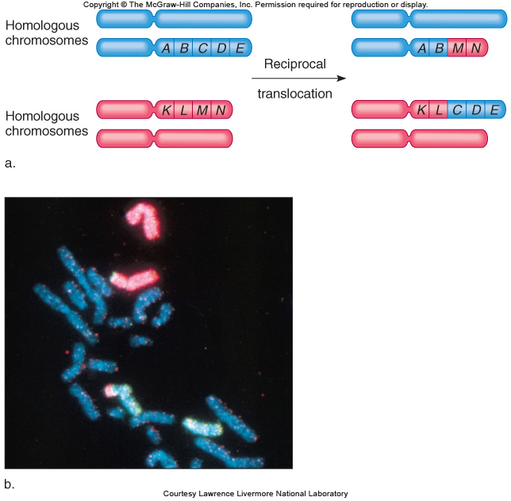
Figure 13.19
Figure 13.19

Slide 97
Inversions
An inversion is a chromosome segment that is flipped in orientation
5-10% cause health problems probably due to disruption of genes at the breakpoints
Paracentric inversion = Inverted region does NOT include centromere
Pericentric inversion = Inverted region includes centromere
Inversions may impact meiotic segregation
Notes:
97

Slide 98
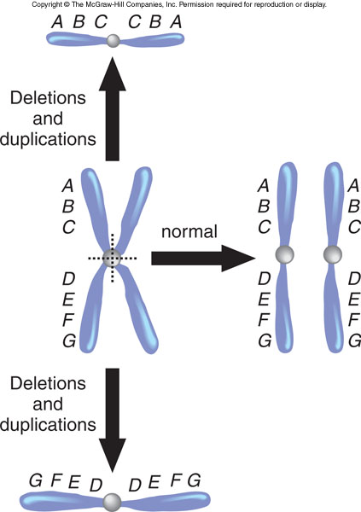
Isochromosomes
Chromosomes with identical arms
Form when centromeres divide along the incorrect plane during meiosis
Figure 13.22
Notes:
98

Slide 99
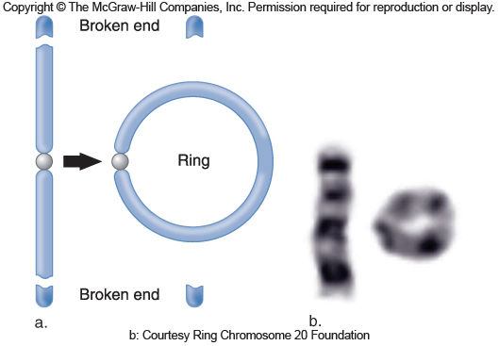
Ring Chromosomes
Occur in 1 in 25,000 conceptions
May arise when telomeres are lost and sticky chromosome ends fuse
Genes can be lost or disrupted causing symptoms
Figure 13.23
Notes:
99

Slide 100
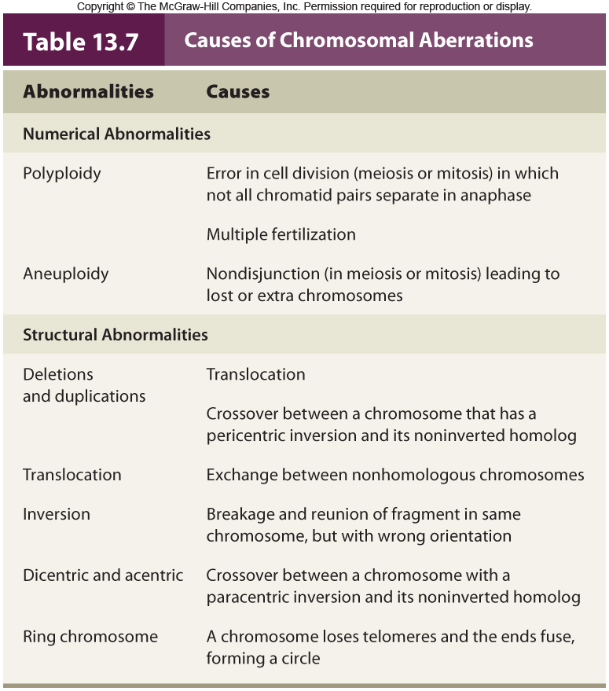
Table 13.8

Slide 101
Uniparental Disomy
Inheritance of two chromosomes or chromosome parts from the same parent
UPD requires the simultaneous occurrence of two rare events
1) Nondisjunction of the same chromosome in both sperm and egg
2) Trisomy followed by chromosome loss
Notes:
101

Slide 102
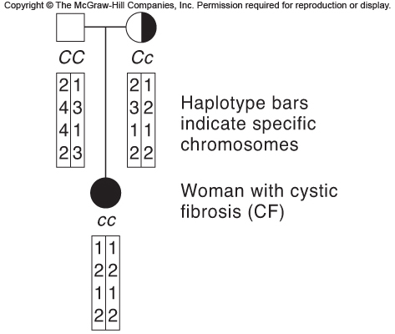
Uniparental Disomy
Figure 13.24
Figure 13.24

