Slide 2
Humans are 0.1% different
:
80% of this is from small scale structural variants in our DNA : the SNPs ( pronounces snips) ( 1 nucleotide change)
20% is from large scale structural variants in our DNA called CNVs ( copy number variants) which includes insertions, deletions, and rearrangements ex HIV, Heart, autism, schizophrenia

Slide 3
How do you locate a SNP?
Search for groups of SNPs = haplotypes
Searching for groups of SNPs has led to GWAS ( GeeWaas): Genome wide association studies ( the future of genetics)
Ex in a study with type 2 diabetes take 1000 with T2D and 1000 w/o T2 d… do the T2D persons have a unique SNP in common?
Recent findings are:
T2D: 18 QTLs ( meaning 18 similar trait genes)
T1D: 32 QLTs ( these genes found to affect the hypothalamus)
Crohns disease: 32 QTL ( one gene associated with autophaging where the cell digest itself)
Ulcerative colitis: 10 QTL
BMI and Obesity: 15 QTLs
Prostate cancer: 16 QTL
Breast cancer: 5 QTLs

Slide 4
Multifactorial environmental factors:
Disease: Genetic factor Environmental
Cystic fibrosis 90% 10%
Type 2 Diabetes 55% 45%
HIV (Aids) 5% 95%
Fetal alcohol syndrome 5% 95%

Slide 5
SNPs and CNVs related genetic diseases
:
intracranial aneurisms
asthma
Alzheimer’s
scleroderma
essential tremor
epilepsy
fatty liver disease
alcohol dependency
tobacco dependency
baldness
osteoporosis/mylitis
restless leg syndrome
rheumatoid arthritis
migraines
TCGA: the cancer genome atlas

Slide 6
The human microbiome project: analysis of 90,000,000,000,000 microbes in and on the human body. Of the 100 trillion cells in the human body: 10 trillion are human cells and 90 trillion are microbes living in the body ( bacteria, viral, fungal, and protozoan)
GINA: Genetic Information Nondiscrimination Act: signed into law on May 21,2008
In the near future, genetic chips will be used to find SNPs

Slide 7
Genetic chip questions to ask yourself: ( this chip will be about size of a credit card and contain all your genetic information
Do you want to know?
who else should know
Who pays? Insurance( can you be dropped or your rates raised)
Who else should have access t your info ( spouse, kids, ex spouse, new job)
where will you keep this info ?Is internet safe?
What about prenatal genome: SNP test
Who is going to explain to average person what the chip information means?

Slide 8
DNA is the Genetic Material
“A genetic material must carry out two jobs: duplicate itself and control the development of the rest of the cell in a specific way.”
- Francis Crick, 1953

Slide 9
DNA:
1.5% of all DNA makes proteins and is called Coding DNA
Remaining 98,.5% is Noncoding DNA ( termed junk DNA) still learning what it does.
Coding DNA genes: codes for proteins ( over 20,000 genes)
Noncoding DNA genes: don’t code for protein, does carry the code to code for RNA only ( so transcribed about not translated (500 genes id as of yet)

Slide 10
History of DNA
Friedrich Miescher, 1871
- Swiss physician and biochemist
- Isolated white blood cell nuclei from pus
- Found an acid substance with nitrogen and phosphorus
- He called it nuclein
- Later, it was called nucleic acid
Notes:
10

Slide 11
History of DNA
Archibald Garrod, 1902
- English physician
- Linked inheritance of “inborn errors of metabolism” with the lack of particular enzymes
- First described the disease alkaptonuria
Notes:
11

Slide 12
History of DNA
Frederick Griffiths, 1928
- English microbiologist
- Worked with Diplococcus pneumonia, which exists in two types
- Type S (Smooth) = Produces capsule
- Type R (Rough) = No capsule
- Capsule associated with virulence
Notes:
12

Slide 13
Frederick Griffiths, 1928
Performed experiments which provided evidence that genetic material is a particular chemical

Slide 14
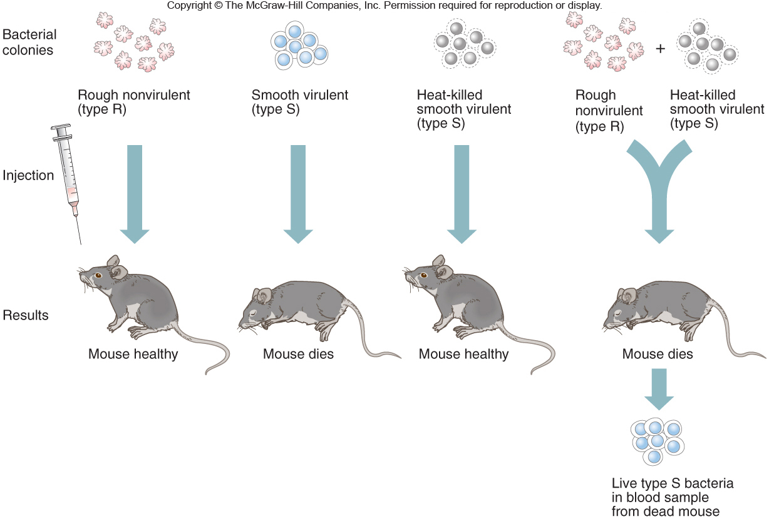
Discovery of Bacterial Transformation
Figure 9.1
Figure 9.1

Slide 15
History of DNA
Avery, MacLeod, and McCarty, 1944
- American physicians
- Treated lysed S bacteria with protease and DNase
- Only DNase prevented transformation
- Thus, DNA is the transforming principle
- Can convert Type R bacteria into S
Notes:
15

Slide 16
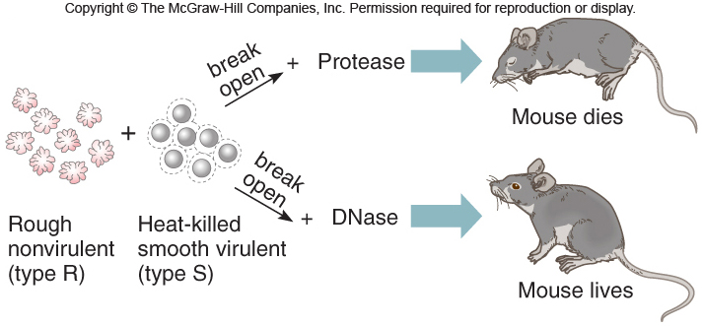
The Transforming Principle
Figure 9.1
Figure 9.2

Slide 17
History of DNA
Alfred Hershey and Martha Chase, 1953
- American microbiologists
- Viruses can infect E. coli bacteria
- A virus has protein “head” and DNA core
- Used radioactive ³⁵S and ³²P to label protein and DNA, respectively
- The “blender experiments” showed that the virus transfers DNA, not protein, into a bacterial cell
- Thus, DNA is the genetic material
Notes:
17

Slide 18
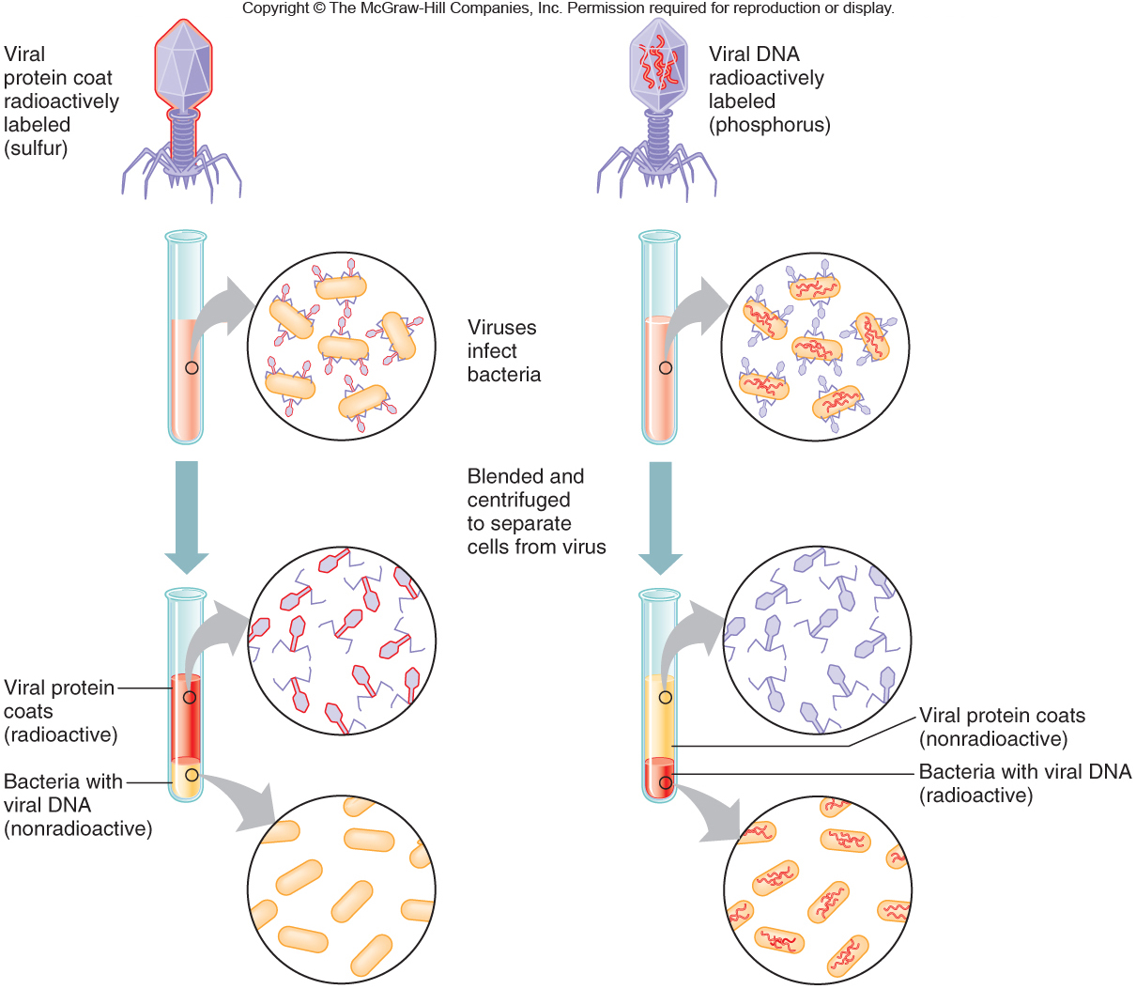
Hershey-Chase Experiment
Figure 9.3
Notes:
18

Slide 19
Discovering the Structure of DNA
Phoebus Levine
- Russian-American biochemist
- Identified the 5-carbon sugars ribose in 1909 and deoxyribose in 1929
- Discovered that the three parts of a nucleotide are found in equal proportions
- Sugar
- Phosphate
- Base
Notes:
19

Slide 20
Discovering the Structure of DNA
Erwin Chargaff, 1951
- Austrian-American biochemist
- Analyzed base composition of DNA from various species and observed regular relationships:
- Adenine + Guanine = Thymine + Cytosine
- A = T and C = G
Notes:
20

Slide 21
Discovering the Structure of DNA
Rosalind Franklin and Maurice Wilkins, 1952
- English scientists
- Distinguished two forms of DNA
- “A” form, which is dry and crystalline
- “B” form, which is wet and cellular
- Used a technique called X-ray diffraction
- It took Franklin 100 hours to obtain “photo 51” of the B-form of DNA
Notes:
21

Slide 22
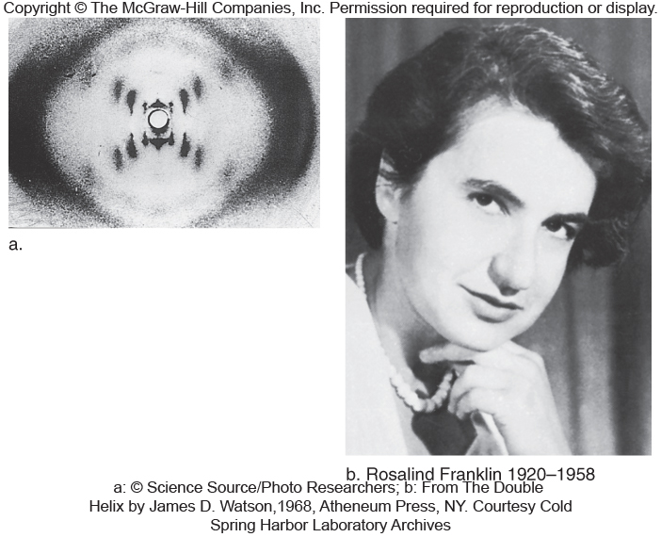
Discovering the Structure of DNA
Franklin reasoned that the DNA is a helix with symmetrically organized subunits
Figure 9.4
Notes:
22

Slide 23
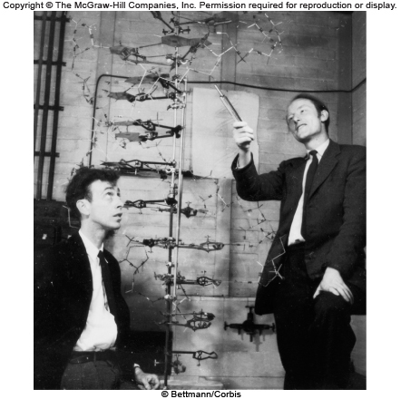
Discovering the Structure of DNA
James Watson and Francis Crick
- Did not perform any experiments
- Rather, they used the earlier research and inferences from model building with cardboard cutouts to solve the structure of DNA
Figure 9.5
Notes:
23

Slide 24
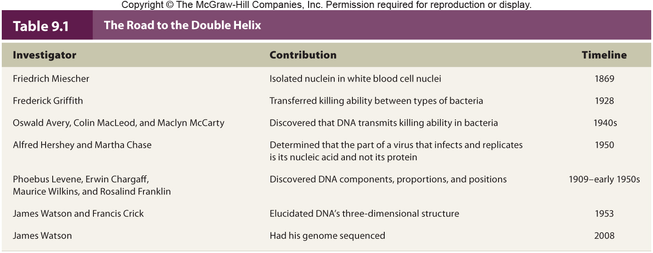
The Road to the Double Helix
Notes:
24

Slide 25
DNA Structure
A single building block is a nucleotide
Each nucleotide is composed of:
- A deoxyribose sugar
- A phosphate group
- A nitrogenous base; one of four types
- Adenine (A), Guanine (G) = Purines
- Cytosine (C), Thymine (T) = Pyrimidines
Notes:
25

Slide 26
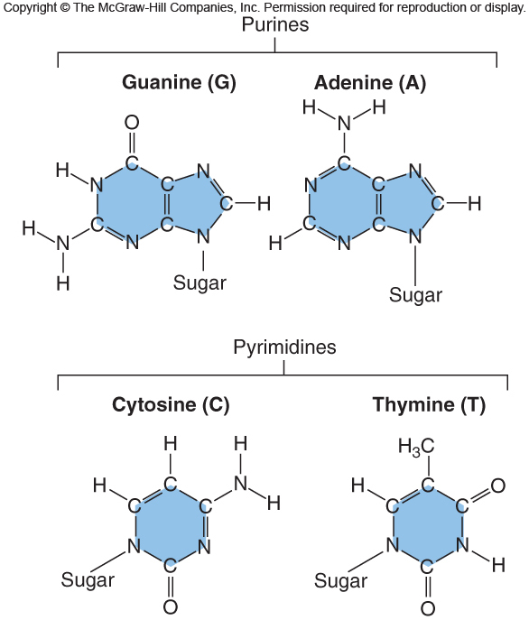
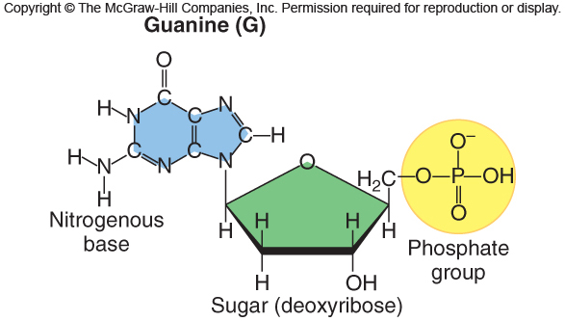
DNA Structure
Figure 9.7
Figure 9.6
Notes:
26

Slide 27
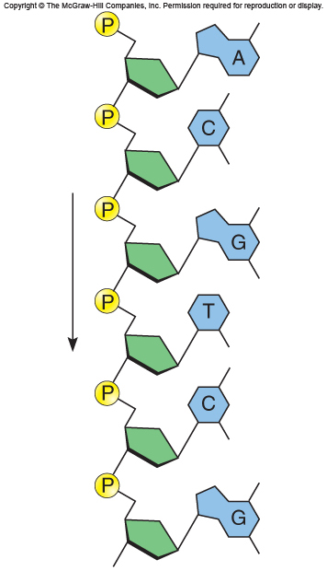
DNA Structure
Nucleotides join via a bond between the 5’-phosphate of one and the 3’ hydroxyl of another
- This creates a continuous sugar-phosphate backbone
Figure 9.8
Notes:
27

Slide 28
Two polynucleotide chains align forming a double helix
- The opposing orientation (head-to-toe) is called antiparallelism
Figure 9.9
Notes:
28

Slide 29
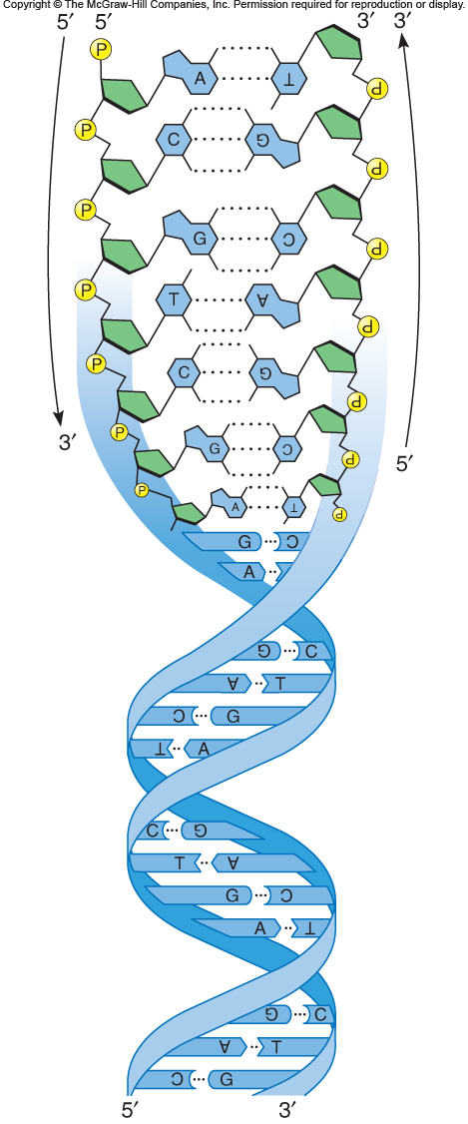
Note that one strand of the double-helix runs in a 5’ to 3’ direction, and the other strand runs in a 3’ to 5’ direction
Figure 9.11
Notes:
29

Slide 30
DNA Structure
The key to the constant width of the double helix is the specific pairing of purines and pyrimidines via hydrogen bonds
The complementary base pairs are:
- Adenine and guanine
- Cytosine and thymine
Notes:
30

Slide 31
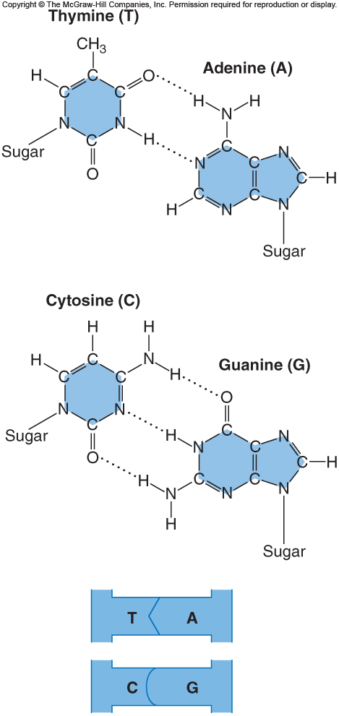
DNA Structure
Figure 9.12
Notes:
31

Slide 32
DNA is Highly Condensed
The DNA coils around proteins called histones, forming a bead-on-a-string-like structure
The bead part is called the nucleosome
The nucleosome in turn winds tighter forming chromatin
Chromatin fibers attach in loops to scaffold proteins
Notes:
32

Slide 33
Molecular Definition of a Gene
A gene is a segment of DNA
- It directs the formation of RNA to produce protein
The protein (or functional RNA) creates the phenotype
Information is conveyed by the sequence of the nucleotides
Notes:
33

Slide 34
DNA Replication
At first, researchers suggested that DNA might replicate in any of 3 possible ways
Model of DNA Replication | Organization of DNA Strand
1. Conservative | old/old + new/new
2. Semiconservative | old/new + new/old
3. Dispersive | mixed old & new
Notes:
34

Slide 35
DNA Replication
Matthew Meselson and Franklin Stahl, 1957
- Grew E. coli on media containing ¹⁵N for several generations
- Thus, making all the DNA heavy
- Shifted bacteria to media containing ¹⁴N
- Then traced replicating DNA
- Determined that DNA replication is semiconservative
Notes:
35

Slide 36
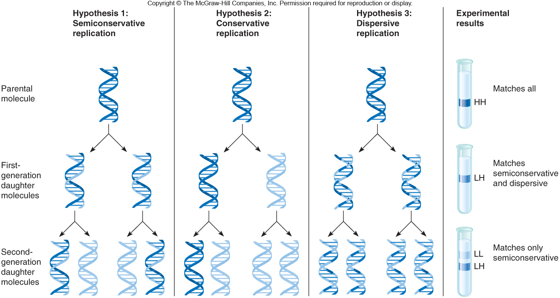
Meselson-Stahl Experiment
Figure 9.14
Figure 9.14

Slide 37
Overview of DNA Replication
DNA replication occurs during the S phase of the cell cycle, prior to cell division
Human DNA replicates about 50 bases/sec
A human chromosome replicates simultaneously at hundred points along its length
A site where DNA is locally opened is called a replication fork
Notes:
37

Slide 38
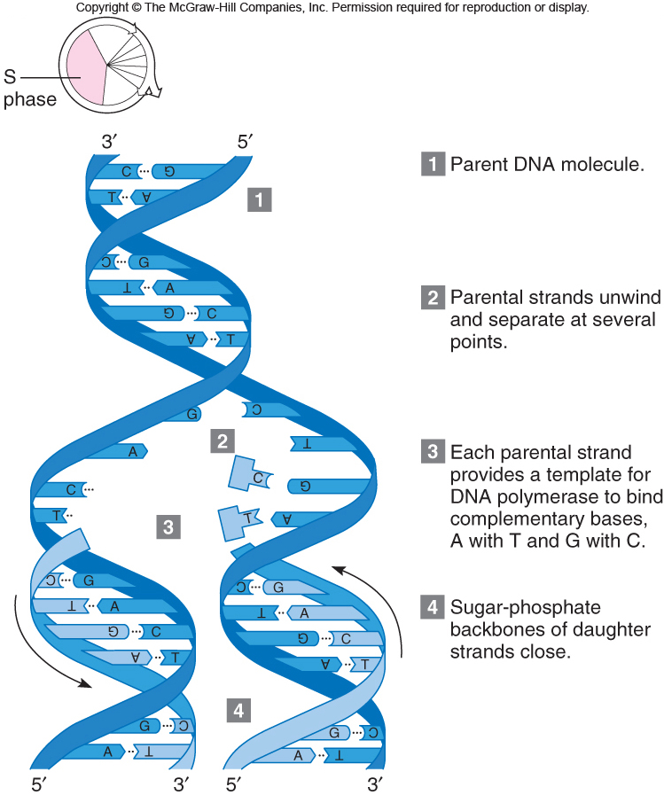
Overview of DNA Replication
Figure 9.15
Notes:
38

Slide 39
Enzymes in DNA Replication
Figure 9.16
Notes:
39

Slide 40
Activities at the Replication Fork
Notes:
40

Slide 41
Activities at the Replication Fork
Notes:
41

Slide 42
Activities at the Replication Fork
Notes:
42

Slide 43
Activities at the Replication Fork
Notes:
43

Slide 44
Gene Expression
The human genome contains about 20,325 protein-encoding genes
- However, this represents only a small part of the genome
Much of the human genome controls protein synthesis
- Including the time, speed, and location
Notes:
44

Slide 45
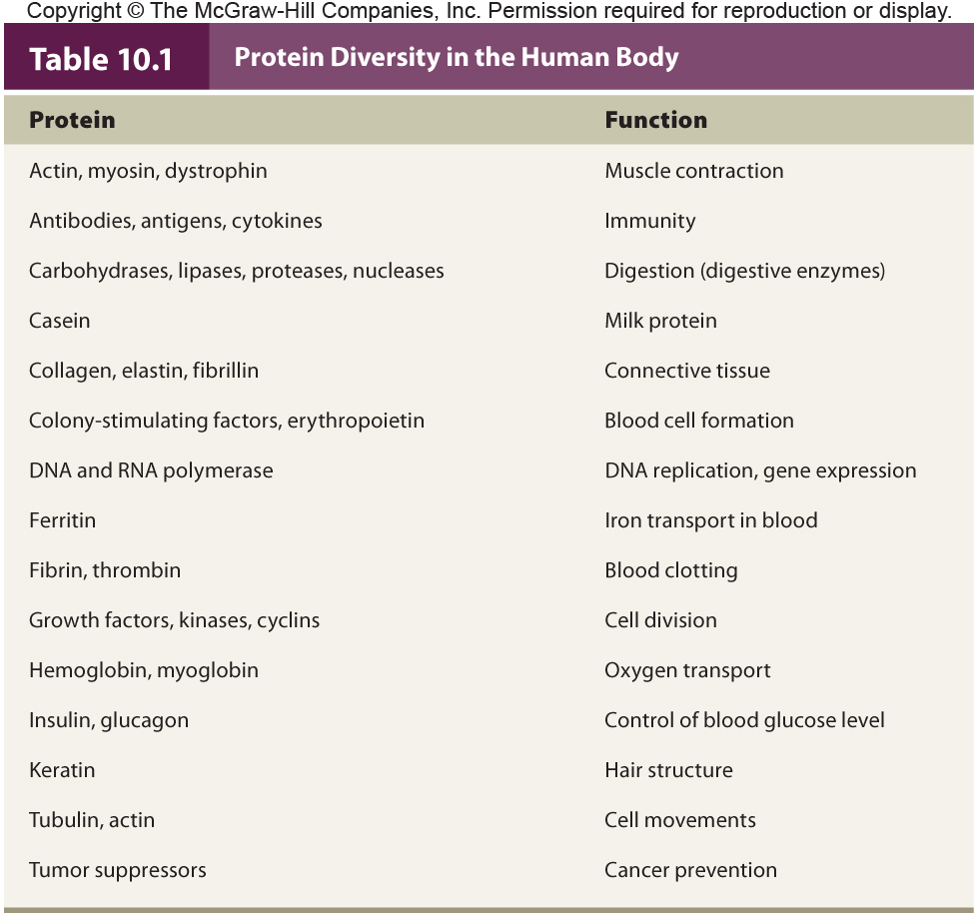
Proteins have diverse functions in the body
Notes:
45

Slide 46
Gene Expression
Production of protein from instructions on the DNA
Gene expression requires several steps
- Transcription = Production of mRNA
- Translation = Production of protein using mRNA, tRNA, and rRNA
- Folding of the protein into the active 3-D form
Notes:
46

Slide 47
Transcription
RNA is the bridge between DNA and protein
RNA is synthesized from one strand of the DNA double helix, which is called the template strand
The complementary strand is called the coding strand of DNA
Requires the enzyme RNA polymerase
Notes:
47

Slide 48
Nucleic Acids
There are two types of nucleic acids
- RNA
- DNA
Both consist of sequences of N-containing bases joined by sugar-phosphate backbones
- However, they differ in several aspects
Notes:
48

Slide 49
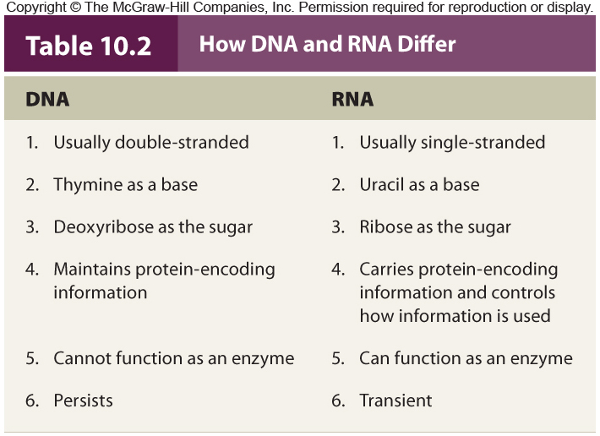
Nucleic Acids
Table 10.2

Slide 50
Types of RNA
There are three major types of RNA
- messenger RNA or mRNA
- ribosomal RNA or rRNA
- transfer RNA or tRNA
Other classes of RNA control gene expression
- Will be discussed later
Notes:
50

Slide 51
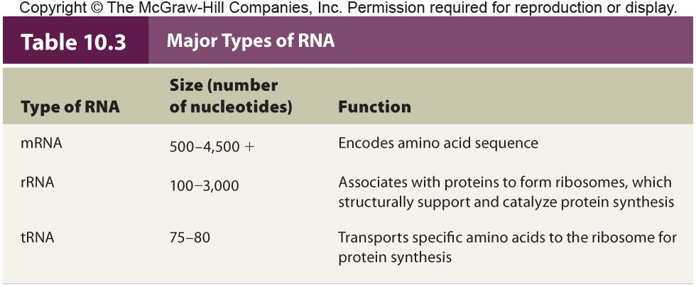
Major Types of RNA
Notes:
51

Slide 52
mRNA
Carries information that specifies a particular protein
Produced in the nucleus
Transported to the ribosome
A three nucleotide codon specifies a particular amino acid
Most mRNAs are 500-4,500 bases long
Notes:
52

Slide 53
rRNA
Associate with proteins to make up ribosomes
Ribosomes consist of two subunits that join during protein synthesis
rRNAs provide structural support
- Some are a catalyst (ribozymes)
Most rRNAs are from 100-3,000 bases long
Notes:
53

Slide 54
tRNA
Only 75-80 bases long
The 2-D shape is a cloverleaf shape
The 3-D shape is an inverted L
Has two business ends:
- The anticodon forms hydrogen bonds with the mRNA codon
- The 3’ end binds the amino acid specified by the mRNA codon
Notes:
54

Slide 55
Transcription Factors
In bacteria, operons control gene expression
In more complex organisms transcription factors control gene expression and link genome to environment
- These contain DNA-binding domains
About 2,000 in humans
Mutations in transcription factors may cause a wide range of effects
Notes:
55

Slide 56
Steps of Transcription
Transcription is described in three steps:
- Initiation
- Elongation
- Termination
Notes:
56

Slide 57
Steps of Transcription
In transcription initiation, a cascade of transcription factors bind to the promoter region of a gene
These open a pocket allowing the RNA polymerase to bind just in front of the start of the gene sequence
Notes:
57

Slide 58
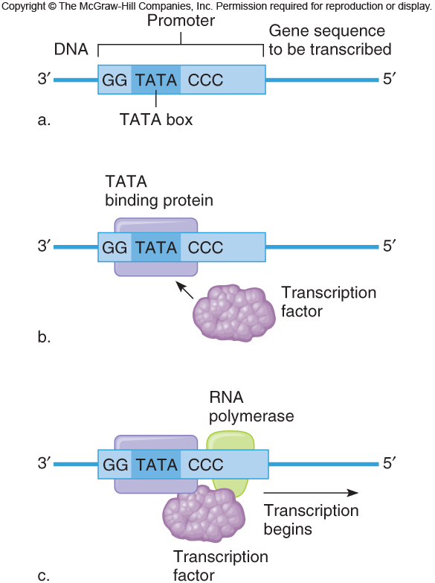
Figure 10.7
Notes:
58

Slide 59
Steps of Transcription
During elongation, RNA polymerase reads the nucleotides on the template strand from 3’ to 5’ and creates an RNA molecule that looks like the coding strand
Then termination occurs when sequences in the DNA prompt the RNA polymerase to fall off ending the transcript
Notes:
59

Slide 60
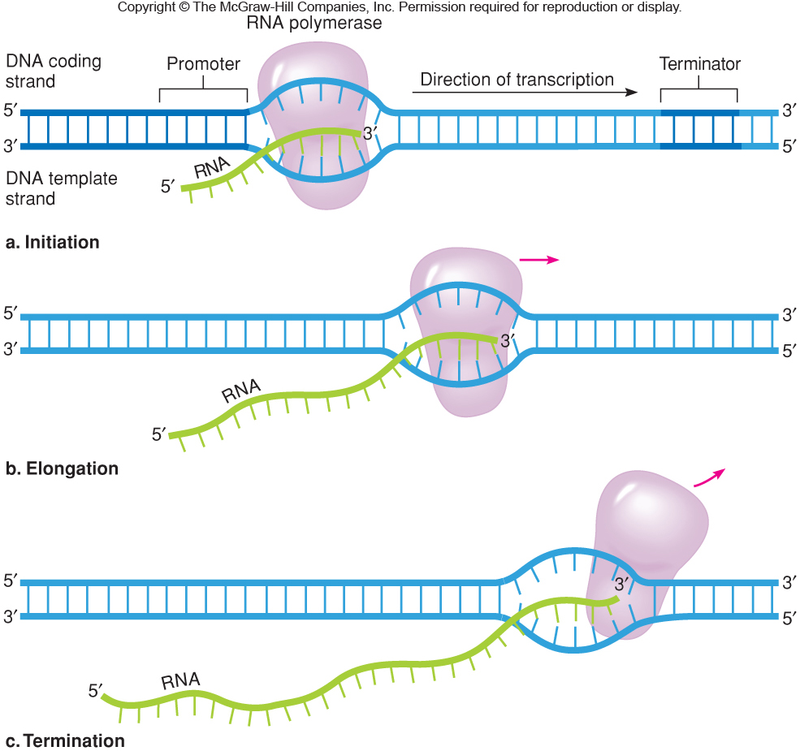
Figure 10.8
Notes:
60

Slide 61
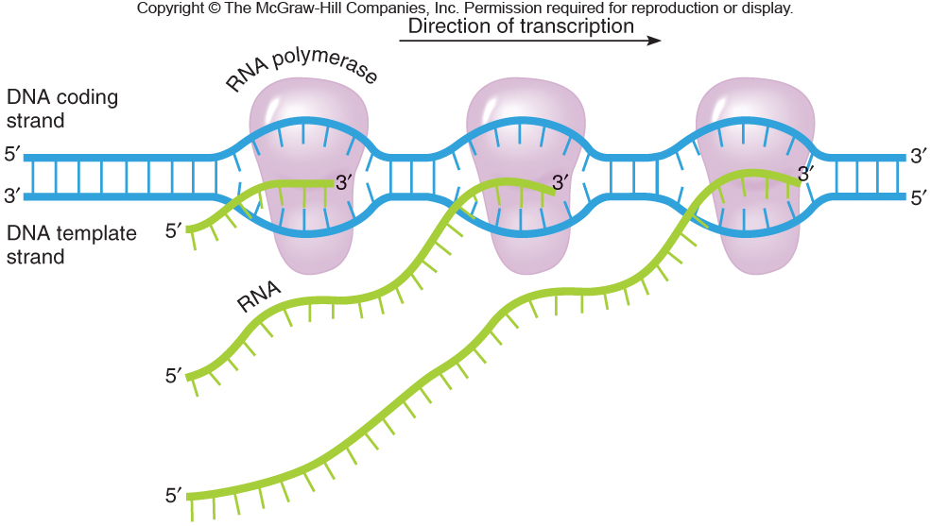
Simultaneous Transcription of mRNAs
Several mRNAs may be transcribed from the same template DNA strand at a time
Figure 10.9
Notes:
61

Slide 62
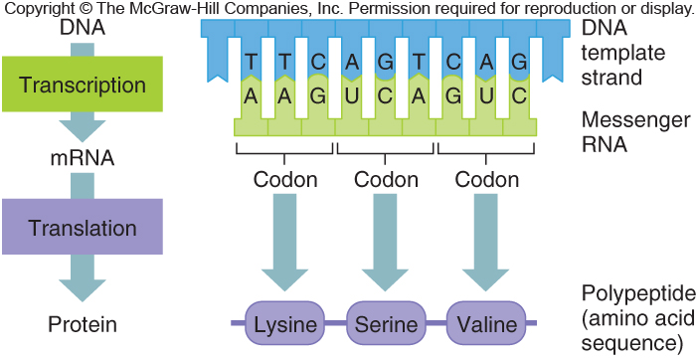
Translation
The process of reading the mRNA base sequence and creating the amino acid sequence of a protein
Occurs on the ribosome
Figure 10.11
Notes:
62

Slide 63
The Genetic Code
The correspondence between the chemical languages of mRNA and proteins
In the1960s, researchers used logic and clever experiments with synthetic RNAs to decipher the genetic code
More recently, annotations of the human genome has confirmed and extended the earlier work
Notes:
63

Slide 64
The Genetic Code
It is a triplet code
- Three successive mRNA bases form a codon
There are 64 codons, including:
- One start signal (AUG)
- Three stop signals (UAA, UAG, and UGA)
Notes:
64

Slide 65
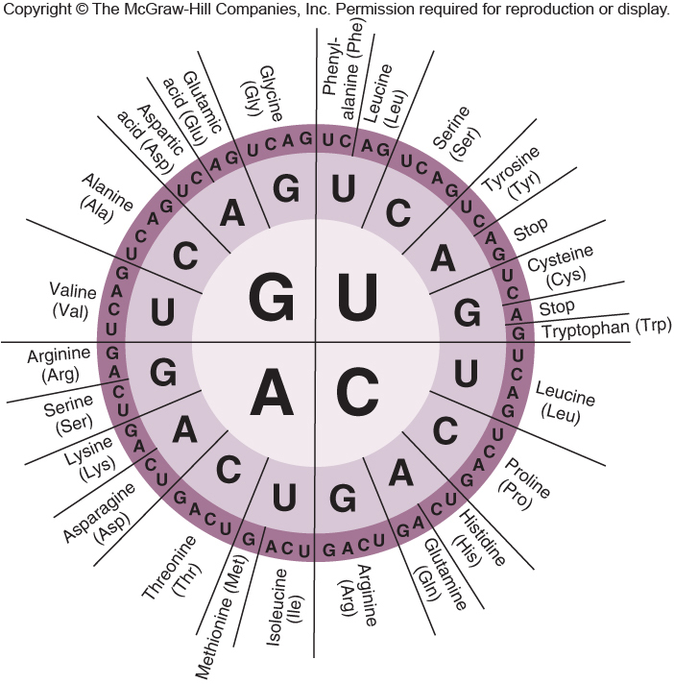
Figure 10.12
Notes:
65

Slide 66
The Genetic Code
It is non-overlapping
It is degenerate
- Two or more codons may specify the same amino acid (synonymous codons)
It is universal
- Evidence that all life evolved from a common ancestor
Notes:
66

Slide 67
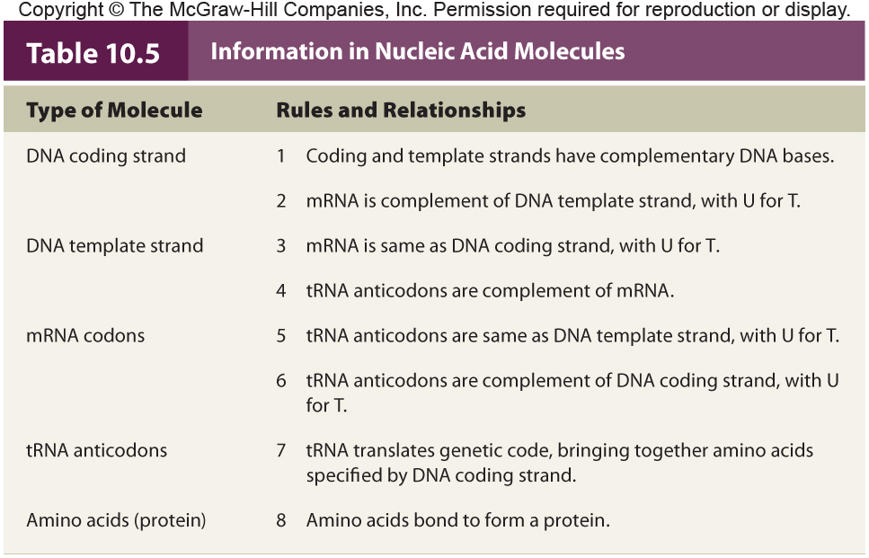
Notes:
67

Slide 68
Protein Structure
Proteins fold into one or more 3-D shapes or conformations
There are four levels for protein structure
- Primary (1^{O}) structure
- Secondary (2^{O}) structure
- Tertiary (3^{O}) structure
- Quaternary (4^{O}) structure
Notes:
68

Slide 69
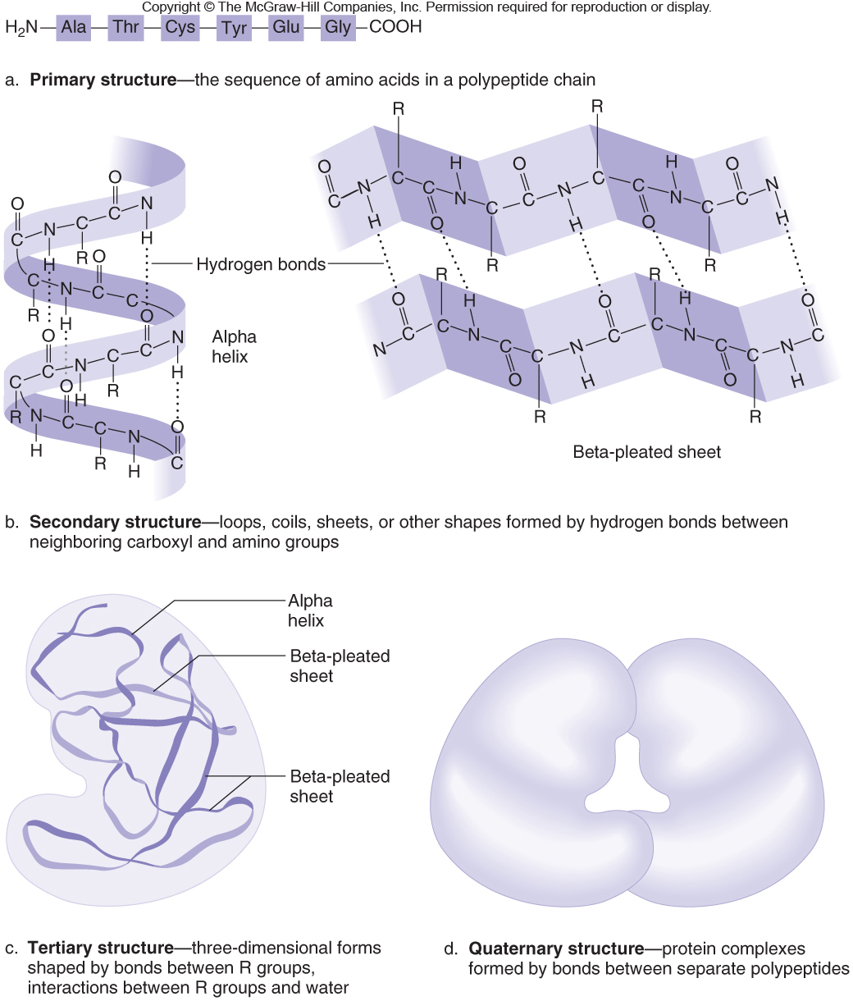
Figure 10.19
Notes:
69

Slide 70
Protein Folding
Protein folding begins as translation proceeds
Enzymes and chaperone proteins assist
Should a protein misfold, an “unfolded protein response” occurs
- Protein synthesis slows or even stops
Notes:
70

Slide 71
Protein Misfolding
Misfolded proteins are tagged with ubiquitin
Then, they are escorted to a proteasome, a tunnel-like multiprotein structure
As the protein moves through the tunnel, it is straightened and dismantled
Proteasomes also destroy properly-folded proteins that are in excess or no longer needed
Notes:
71

Slide 72
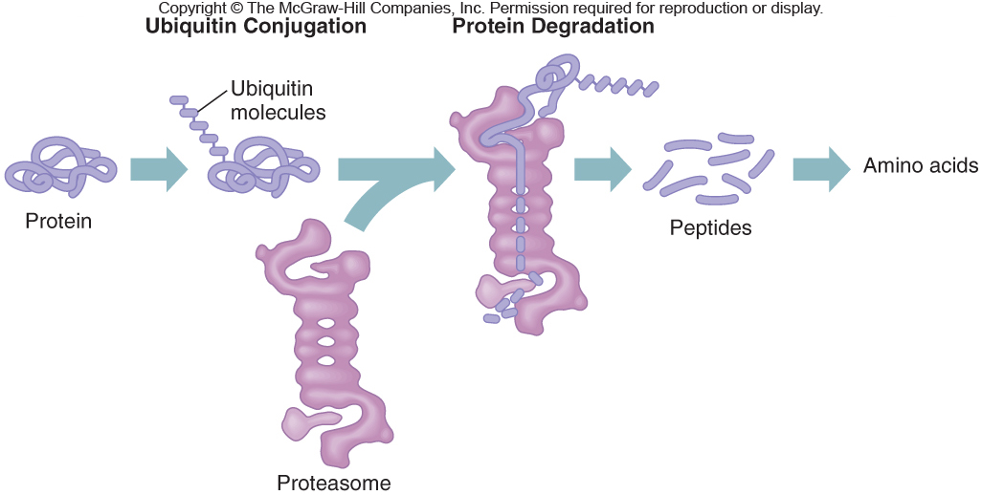
Protein Misfolding
Figure 10.20
Notes:
72

Slide 73
Protein Misfolding
Most misfolded proteins are the result of errors in one of the steps of protein synthesis and processing
In several disorders that affect the brain, the misfolded proteins aggregate
- The protein masses that form clog the proteasomes and inhibit their function
Different proteins are affected in different disorders
Notes:
73

Slide 74
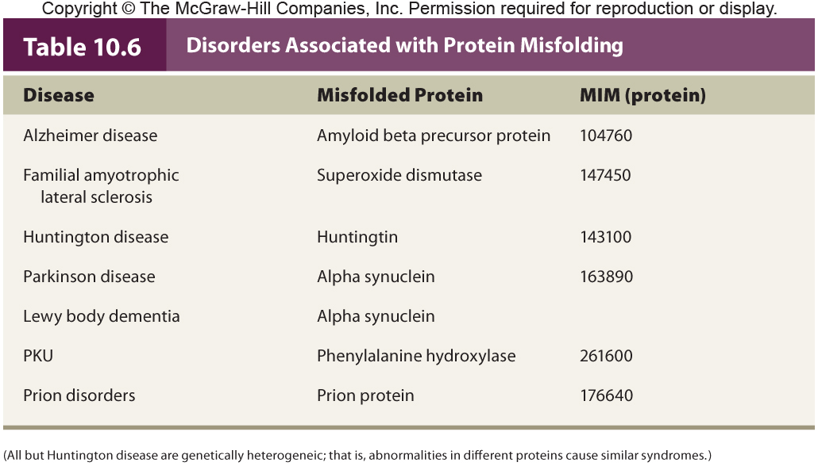
Protein Misfolding
Notes:
74

Slide 75
Phenylketonuria (PKU)
Defect is in the enzyme phenylalanine hydroxylase which normally breaks down phenylalanine
The mutation is inherited from carrier parents
A localized misfolding occurs
- Misfolding spreads until the entire four-subunit enzyme can no longer function
The buildup of phenylalanine causes mental retardation
Notes:
75

Slide 76
Prions
Prion protein (PrP) can fold into any of several conformations
One conformation is aberrant
- Moreover, it can be passed on to other prions upon contact, propagating like an “infectious” agent
In addition, the aberrant conformation can form even in the wild-type protein
Notes:
76

Slide 77
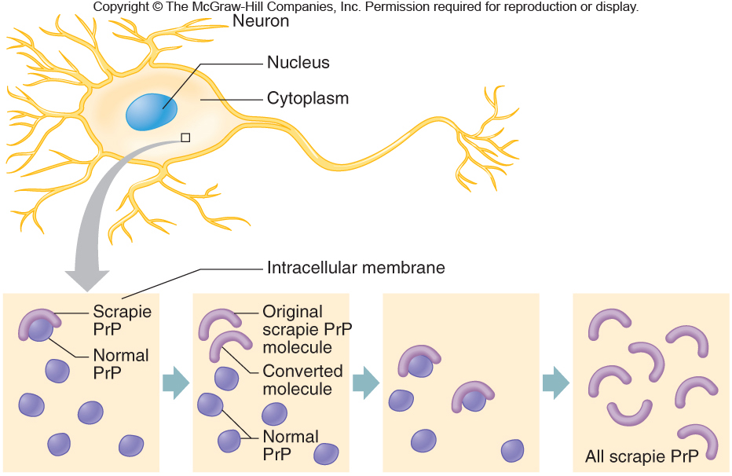
Prions
Figure 10.22
Notes:
77

Slide 78
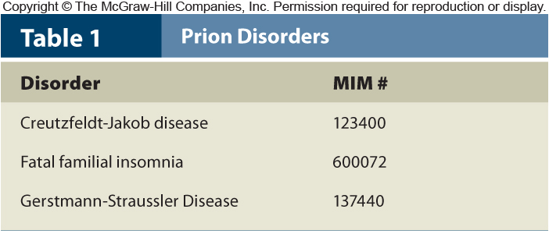
Prion Diseases
Prion diseases are called transmissible spongiform encephalopathies (TSEs)
- They have been found in 85 species
Examples: Scrapie (sheep); Kuru (humans); Bovine spongiform encephalopathy (cows)
Notes:
78

Slide 79
Gene Expression Through Time and Tissue
Changes in gene expression may occur over time and in different cell types
This may occur at the molecular, tissue, or organ/gland level
Epigenetic changes
- Changes to the chemical groups that associate with DNA that are transmitted to daughter cells after cell division
Notes:
79

Slide 80
Proteomics
Proteomics tracks all proteins made in a cell, tissue, gland, organ or entire body
Proteins can be charted based on the relative abundance of each class at different stages of development
There are fourteen categories of proteins
- Including the immunoglobulins, which are activated after birth
Notes:
80

Slide 81
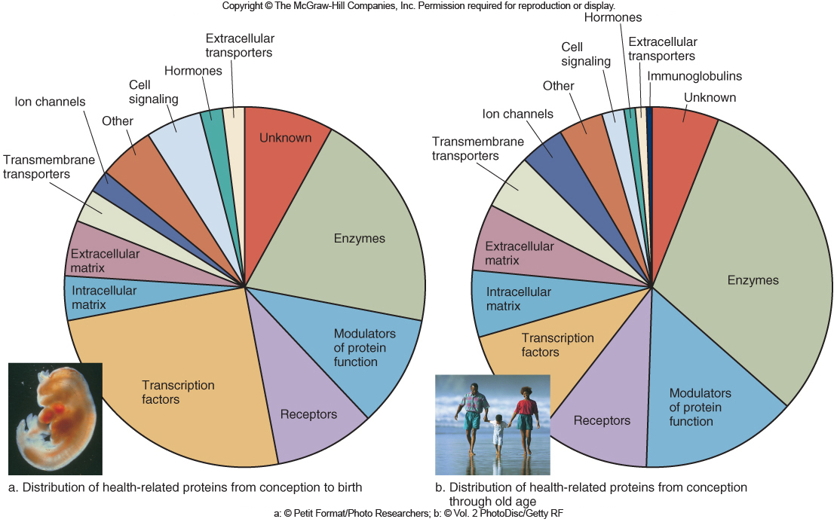
Figure 11.4
Figure 11.5

Slide 82
Control of Gene Expression
A protein-encoding gene contains some controls over its own expression level
- Promoter sequence (mutations)
- Extra copies of gene
Much of the control of gene expression occurs in two general processes
1) Chromatin remodeling = “On/off” switch
2) microRNAs = “Dimmer” switch
Notes:
82

Slide 83
Chromatin Remodeling
Histones play major role in gene expression
- Expose DNA when and where it is to be transcribed and shield it when it is to be silenced
The three major types of small molecules that bind to histones are:
- Acetyl group
- Methyl groups
- Phosphate groups
Notes:
83

Slide 84
Chromatin Remodeling
Figure 11.5
Notes:
84

Slide 85
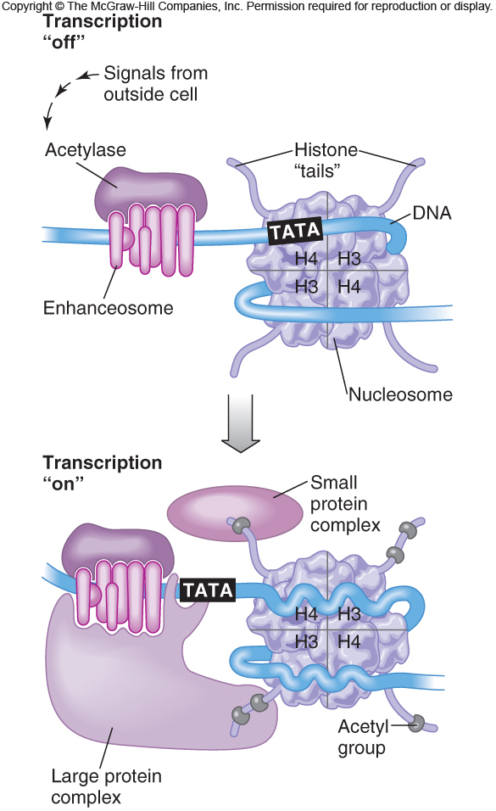
Acetyl binding can subtly shift histone interactions in a way that eases transcription
Figure 11.6
Notes:
85

Slide 86
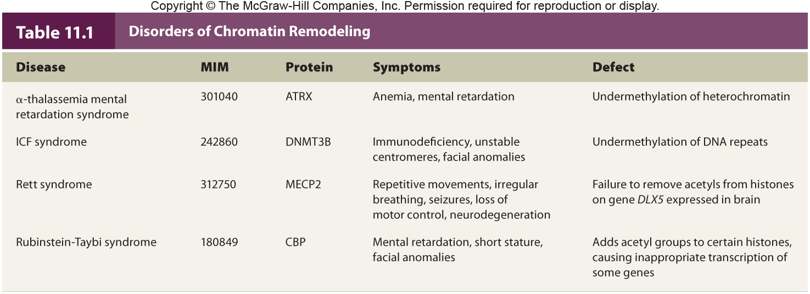
Chromatin Remodeling
Notes:
86

Slide 87
MicroRNAs
MicroRNAs belong to a class of molecules called noncoding RNAs
They are 21-22 bases long
The human genome has about 1,000 distinct microRNAs that regulate at least 1/3rd of the protein-encoding genes
When a microRNA binds to a “target” mRNA, it prevents translation
Notes:
87

Slide 88
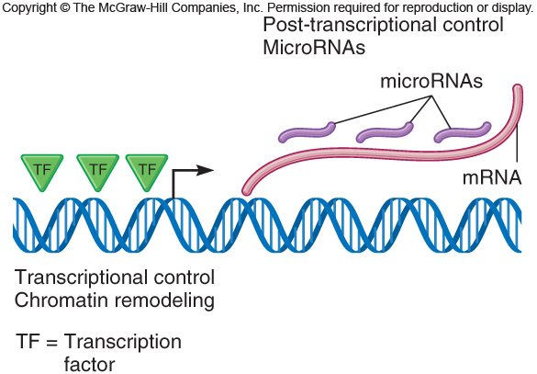
Figure 11.7
Notes:
88

Slide 89
MicroRNAs
Cancer provides a practical application of microRNAs because certain microRNAs are more or less abundant in cancer cells than in healthy ones
A related technology is called RNA interference (RNAi)
- Small synthetic, double-stranded RNA molecules are introduced into selected cells to block gene expression
Notes:
89

