Slide 2
Trends found on the Periodic Table

Slide 3
Periodic Groups
Elements in the same column have similar chemical and physical properties
These similarities are observed because elements in a column have similar e⁻ configurations (same amount of electrons in outermost shell)

Slide 4
Periodic Trends
Periodic Trends –can be seen with our current arrangement of the elements (Moseley)
Trends we’ll be looking at:
Electron affinity
Atomic Radius
Ionization Energy
Electronegativity

Slide 5
. Trend in Electron Affinity
:
The energy release when an electron is added to an atom. Most favorable toward NE corner of PT since these atoms have a great affinity for e-.
Period Trends: The halogens gain e- most easily, while elements of groups 2 & 18 are lest likely to gain e-
Group Trends: more difficult to explain

Slide 7
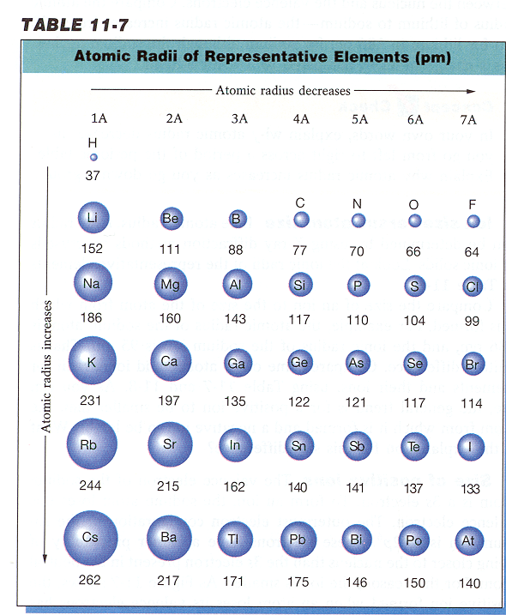
Atomic Radius
Atomic Radius – size of an atom
(distance from nucleus to outermost e⁻)

Slide 8
Atomic Radius Trend
Group Trend – As you go down a column, atomic radius increases
As you go down, e⁻ are filled into orbitals that are farther away from the nucleus (attraction not as strong)
Periodic Trend – As you go across a period (L to R), atomic radius decreases
As you go L to R, e⁻ are put into the same orbital, but more p⁺ and e⁻ total (more attraction = smaller size)

Slide 9
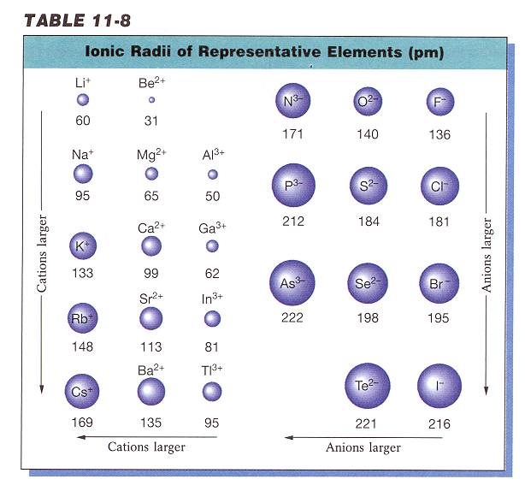
Ionic Radius
Ionic Radius –
size of an atom when it is an ion

Slide 10
Ionic Radius Trend
Metals – lose e⁻, which means more p⁺ than e⁻ (more attraction) SO…
Cation Radius < Neutral Atomic Radius
Nonmetals – gain e⁻, which means more e⁻ than p⁺ (not as much attraction) SO…
Anion Radius > Neutral Atomic Radius

Slide 11
Periodic Table: electron behavior
The periodic table can be classified by the behavior of their electrons

Slide 12
Ionic Radius Trend
Group Trend – As you go down a column, ionic radius increases
Periodic Trend – As you go across a period (L to R), cation radius decreases,
    anion radius decreases, too.
As you go L to R, cations have more attraction (smaller size because more p⁺ than e⁻). The anions have a larger size than the cations, but also decrease L to R because of less attraction (more e⁻ than p⁺)

Slide 13
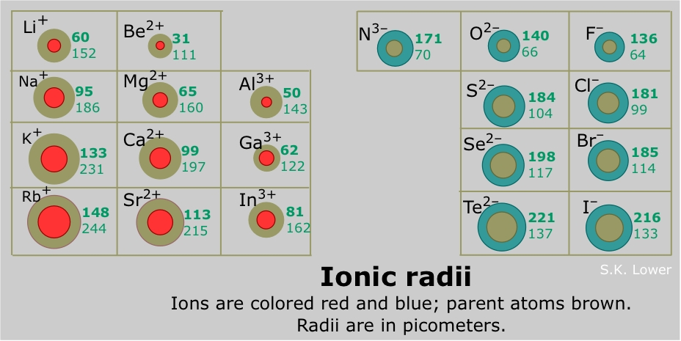
Ionic Radius

Slide 14
Ionic Radius
How do I remember this?????
The more electrons that are lost, the greater the reduction in size.
Li⁺¹ Be⁺²
protons 3 protons 4
electrons 2 electrons 2
Which ion is smaller?

Slide 15
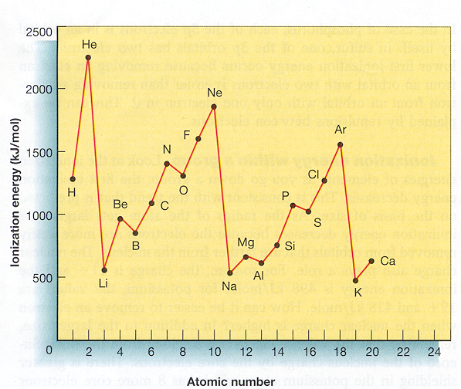
Ionization Energy
Ionization Energy – energy needed to remove outermost e⁻

Slide 16
Ionization Energy
Group Trend – As you go down a column, ionization energy decreases
As you go down, atomic size is increasing (less attraction), so easier to remove an e⁻
Periodic Trend – As you go across a period (L to R), ionization energy increases
As you go L to R, atomic size is decreasing (more attraction), so more difficult to remove an e⁻
(also, metals want to lose e⁻, but nonmetals do not)

Slide 17
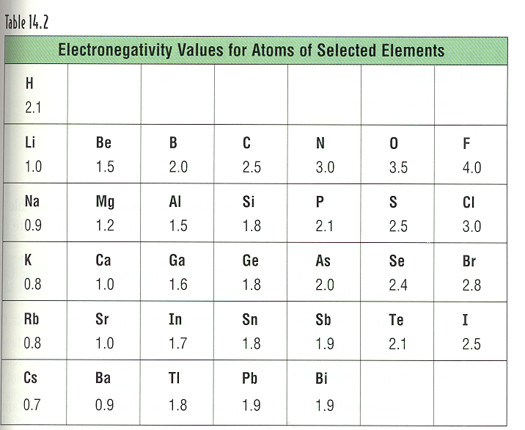
Electronegativity
Electronegativity- tendency of an atom to attract e⁻

Slide 18
Electronegativity Trend
Group Trend – As you go down a column, electronegativity decreases
As you go down, atomic size is increasing, so less attraction to its own e⁻ and other atom’s e⁻
Periodic Trend – As you go across a period (L to R), electronegativity increases
As you go L to R, atomic size is decreasing, so there is more attraction to its own e⁻ and other atom’s e⁻

Slide 19
Reactivity
Reactivity – tendency of an atom to react
Metals – lose e⁻ when they react, so metals’ reactivity is based on lowest Ionization Energy (bottom/left corner) Low I.E = High Reactivity
Nonmetals – gain e⁻ when they react, so nonmetals’ reactivity is based on high electronegativity (upper/right corner)
High electronegativity = High reactivity

Slide 20
Metallic Character
Properties of a Metal – 1. Easy to shape
Conduct electricity 3. Shiny
Group Trend – As you go down a column, metallic character increases
Periodic Trend – As you go across a period (L to R), metallic character decreases (L to R, you are going from metals to non-metals

Slide 21
Summary of Trend
Periodic Table and Periodic Trends
1. Electron Configuration
3. Ionization Energy: Largest toward NE of PT
4. Electron Affinity: Most favorable NE of PT
2. Atomic Radius: Largest toward SW corner of PT

Slide 22
Electron configuration
THe arrangement of electrons in atoms
There are distinct electron configurations for each element on the periodic table

Slide 23
Rules governing electron configuration
Aufbau principle ( means building up in german) States that as protons are individually added to the nucleus to build up the element, electrons are added to the atomic orbitals. ( large elements don’t always follow this rule)
Hund’s rule: orbitals of equal energy are each added to the nucleus to build up the elements

Slide 24
Paulie exclusion principle: no 2 electrons in the same atom can have the same set of 4 quantum numbers
Heisenberg uncertainty principle It is not possible to accurately measure both the velocity and position of an electron at the same time

Slide 25
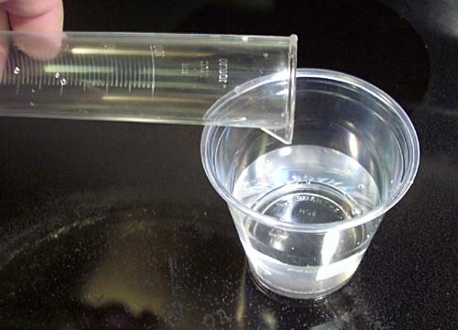
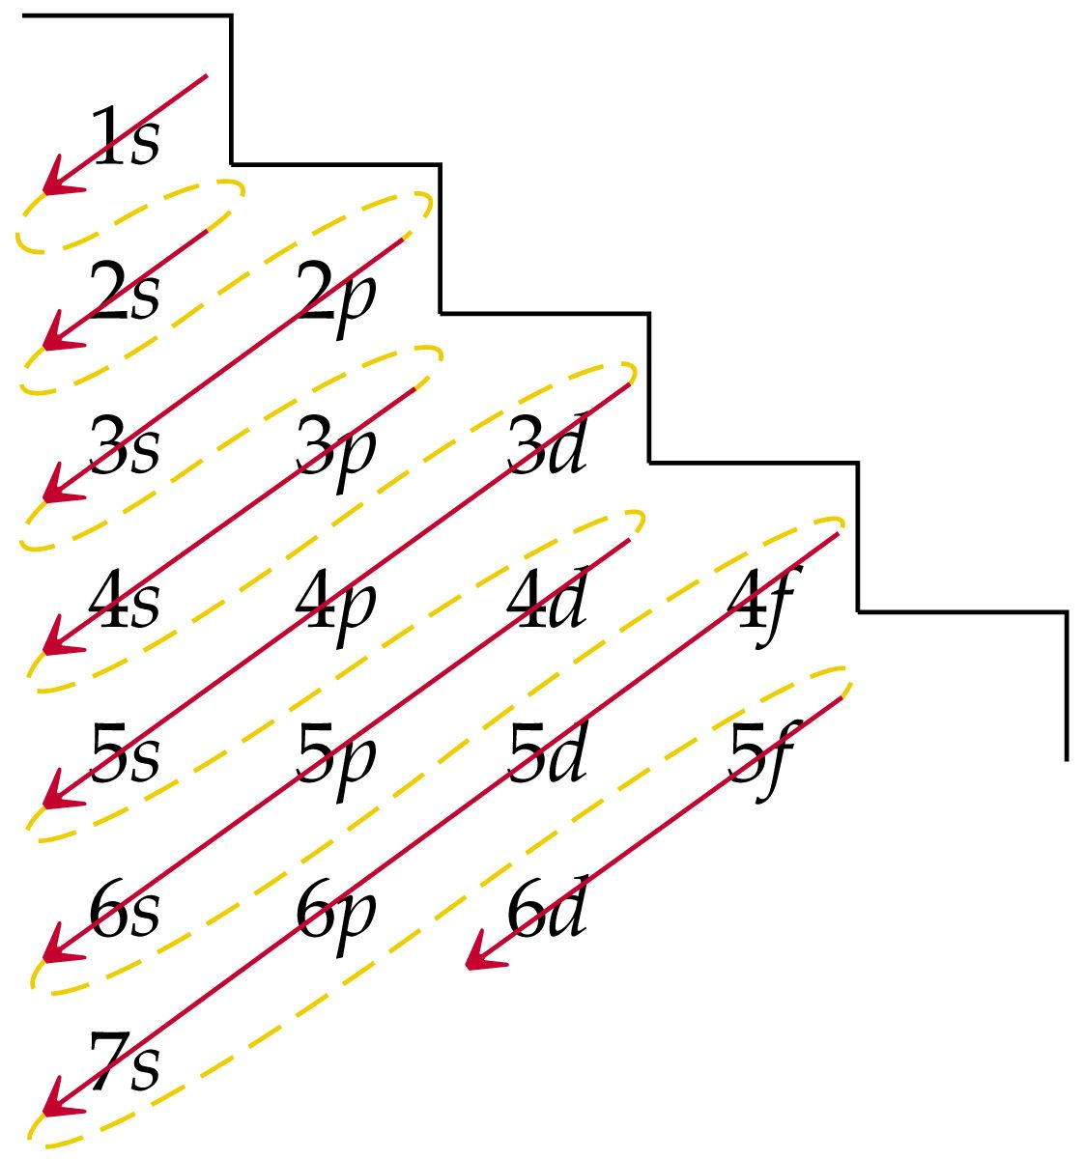
Aufbau Principle -- “Bottom Up Rule”
Notes:
25

Slide 26
Pauli exclusion principle
An orbital can contain a maximum of 2 electrons,
and they must have the opposite “spin.”
Example:
Determine the electron configuration and orbital notation for the ground state neon atom.
Notes:
26

Slide 27
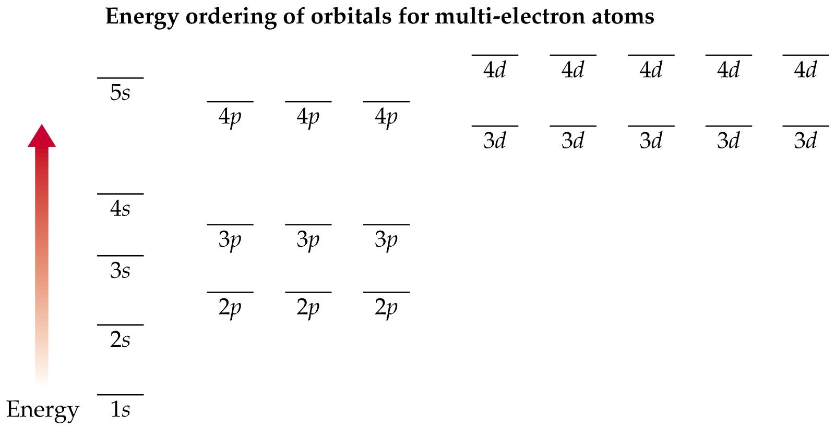
Basic Principle:
electrons occupy lowest energy levels available
Rules for Filling Orbitals
Bottom-up
(Aufbau’s principle)
Fill orbitals singly before doubling up
(Hund’s Rule)
Paired electrons have opposite spin
(Pauli exclusion principle)
Notes:
27

Slide 28
Identify examples of the following principles:
1) Aufbau 2) Hund’s rule 3) Pauli exclusion

Slide 29
Representing electron configuration
There are 3 different types of notation
Orbital notation
Electron dot notation
Electron configuration notation

Slide 30
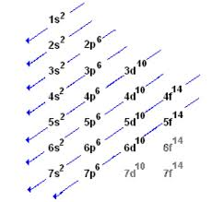

Slide 31
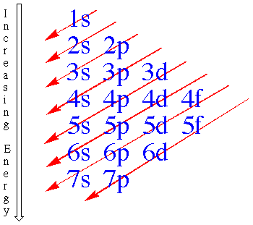
Ar
Kr
Xe
Ra

Slide 32
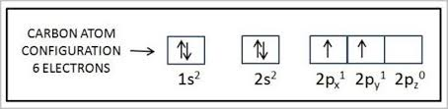
Orbital notation
An unoccupied orbital is represented by a line________
An orbital containing:
1 electron is represented as an arrow going up
2 electrons is represented as one arrow up and one arrow down ( showing opposite spins of electrons)

Slide 33
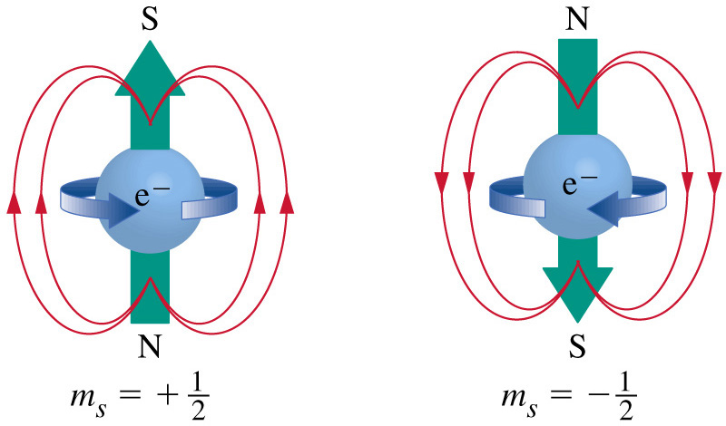
Stern-Gerlach
Experiment
Electron spin
How could an orbital hold two electrons
without electrostatic repulsion?
↑
↓
Notes:
33

Slide 34
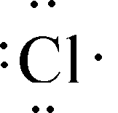
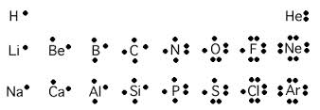

Electron dot notation
shows only electrons in the highest or outermost main energy level ( with the highest principle quantum numbers)

Slide 35
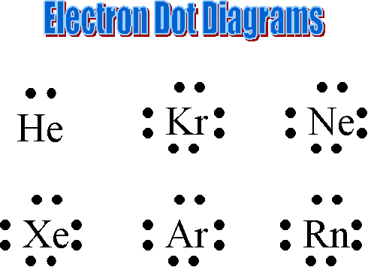

Slide 36
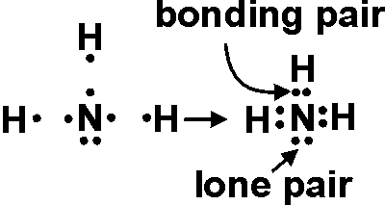
Electron dot notation with elements leads to the use of lewis structure with compounds

Slide 37

Electron configuration notation
eliminates the lines and arrows of orbital notation
Instead the number of electrons in a sublevel is shown

Slide 38
spdf Notation
2 ways to write electron configurations
spdf NOTATION
for H, atomic number = 1
1
no. of
electrons
1
s
sublevel
value of energy level
Orbital Box Notation
ORBITAL BOX NOTATION
for He, atomic number = 2
2
Arrows show electron spin
(+½ or -½)
1s
↑↓
1s
Notes:
38

Slide 39
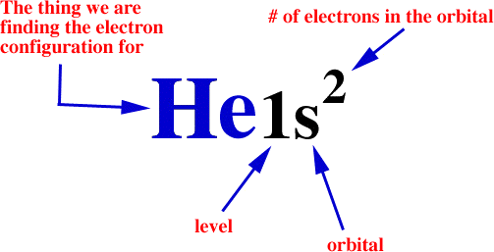
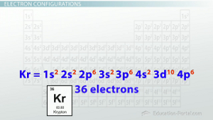

Slide 40
Periodic Table e⁻ configuration from the periodic periodic table
(To be covered in future chapters)
H
1s¹
He
1s²
Be
2s²
B
2p¹
B
2p¹
F
2p⁵
Li
2s¹
C
2p²
N
2p³
O
2p⁴
Ne
2p⁶
Na
3s¹
Mg
3s²
Al
3p¹
Si
3p²
P
3p³
S
3p⁴
Cl
3p⁵
Ar
3p⁶
K
4s¹
Ca
4s²
Sc
3d¹
Ti
3d²
V
3d³
Cr
4s¹3d⁵
Mn
3d⁵
Fe
3d⁶
Co
3d⁷
Ni
3d⁸
Cu
4s¹3d¹⁰
Zn
3d¹⁰
Ga
4p¹
Ge
4p²
As
4p³
Se
4p⁴
Be
4p⁵
Kr
4p⁶
Rb
5s¹
Sr
5s²
Y
4d¹
Zr
4d²
Nb
4d³
Mo
5s¹4d⁵
Tc
4d⁵
Ru
4d⁶
Rh
4d⁷
Ni
4d⁸
Ag
5s¹4d¹⁰
Cd
4d¹⁰
In
5p¹
Sn
5p²
Sb
5p³
Te
5p⁴
I
5p⁵
Xe
5p⁶
Cs
6s¹
Ba
6s²
La
5d¹
Hf
5d²
Ta
5d³
W
6s¹5d⁵
Re
5d⁵
Os
5d⁶
Ir
5d⁷
Ni
5d⁸
Au
6s¹5d¹⁰
Hg
5d¹⁰
Tl
6p¹
Pb
6p²
Bi
6p³
Po
6p⁴
At
6p⁵
Rn
6p⁶
Fr
7s¹
Ra
7s²
Ac
6d¹
Rf
6d²
Db
6d³
Sg
7s¹6d⁵
Bh
6d⁵
Hs
6d⁶
Mt
6d⁷

Slide 41
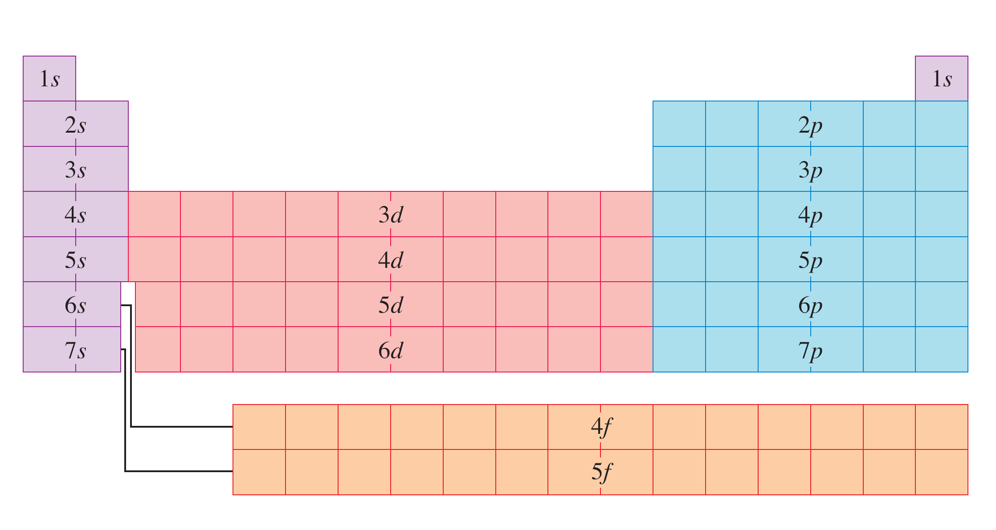

Slide 42
Shorthand notation practice
[Noble Gas Core] + higher energy electrons
Examples
● Aluminum: 1s²2s²2p⁶3s²3p¹ [Ne]3s²3p¹
● Calcium: 1s²2s²2p⁶3s²3p⁶4s²
[Ar]4s²
● Nickel: 1s²2s²2p⁶3s²3p⁶4s²3d⁸
[Ar]4s²3d⁸ {or [Ar]3d⁸4s²}
● Iodine: [Kr]5s²4d¹⁰5p⁵ {or [Kr]4d¹⁰5s²5p⁵}
● Astatine (At): [Xe]6s²4f¹⁴5d¹⁰6p⁵
{or [Xe]4f¹⁴5d¹⁰6s²6p⁵}

Slide 43
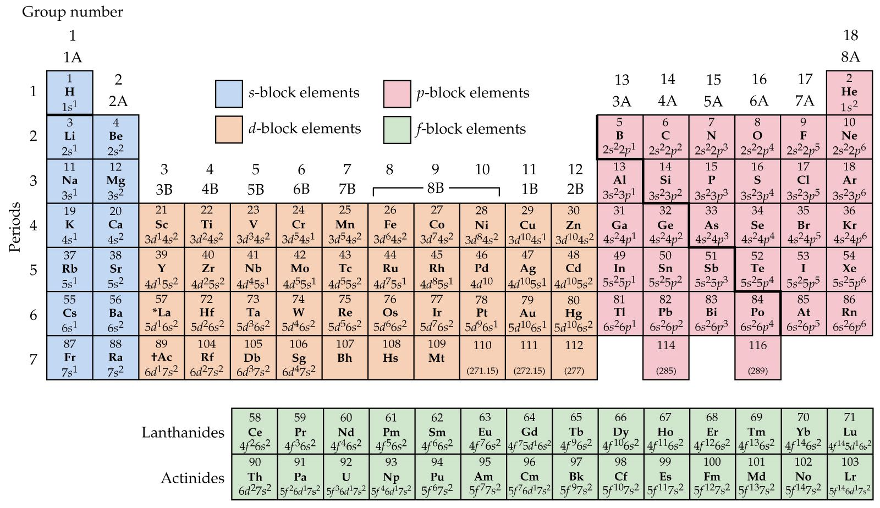
Outer electron configuration for the elements
Notes:
43

Slide 44
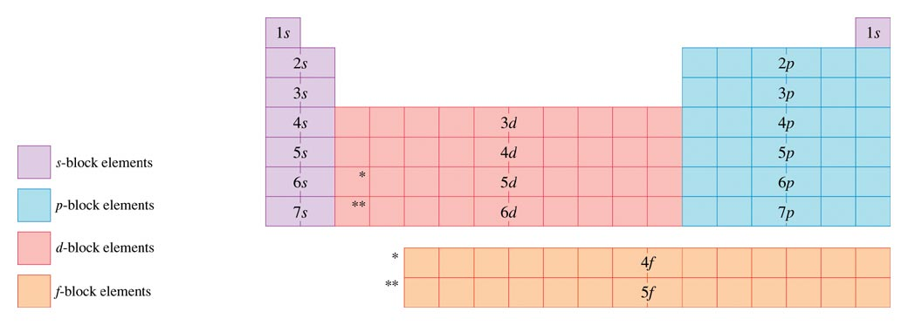
Using the periodic table to know configurations
Period
1
2
3
4
5
6
7
Ne
Ar
Kr
Xe

Slide 45
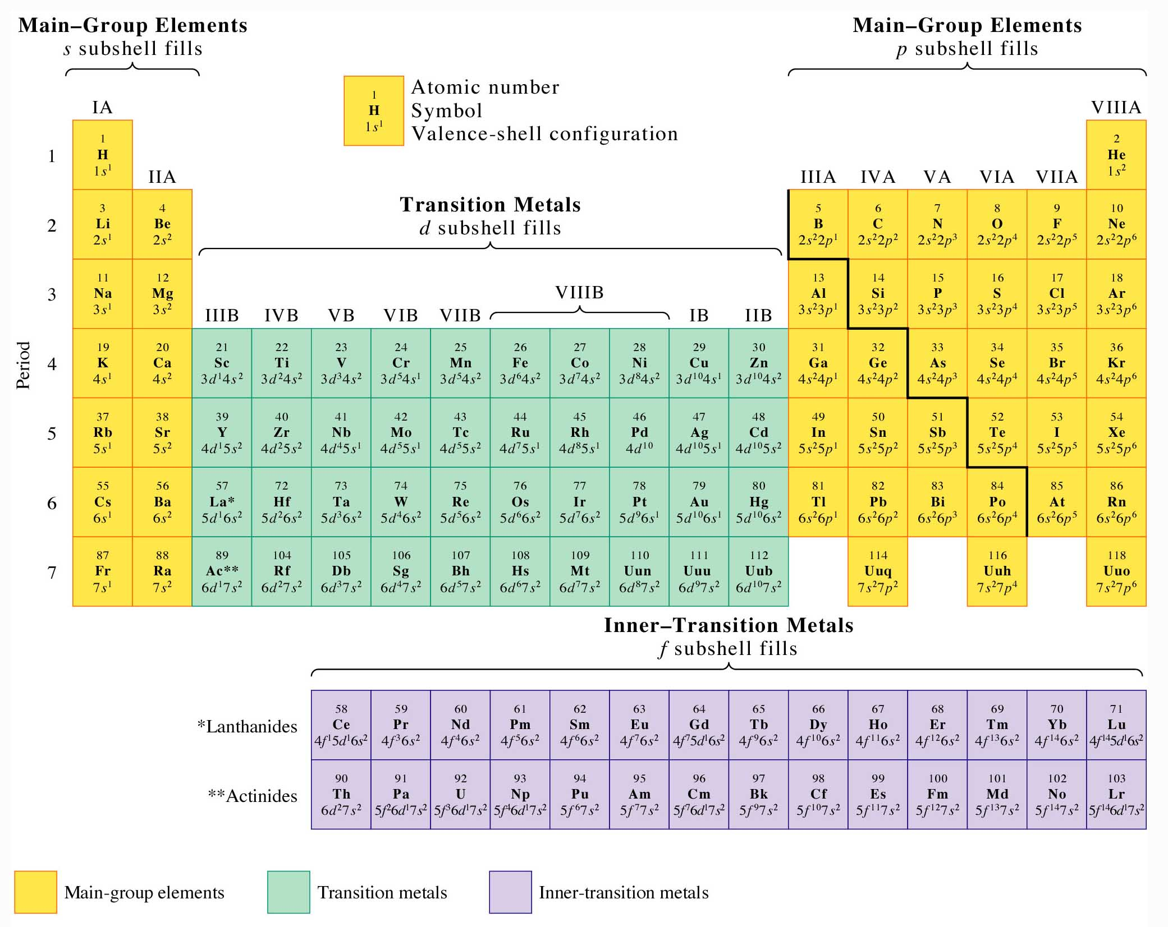
Valence e’s for “main group” elements

Slide 46
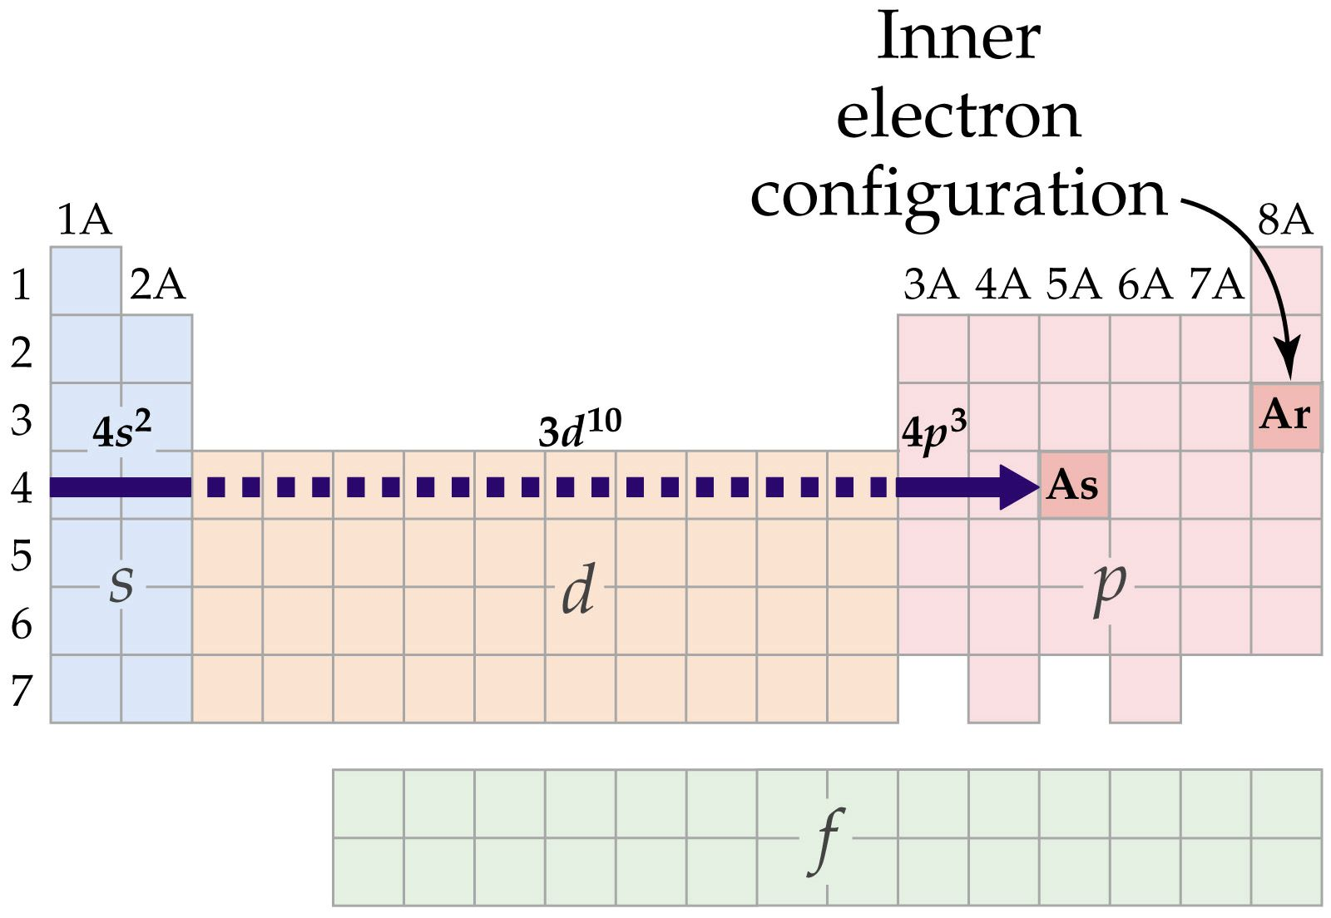
Electron configuration for As
Notes:
46

Slide 47
Phosphorus
Symbol: P
Atomic Number: 15
Full Configuration: 1s²2s²2p⁶3s²3p³
Valence Configuration: 3s²3p³
Shorthand Configuration: [Ne]3s²3p³
↑
↑
↑
↑↓
↑↓
↑↓
↑↓
↑↓
↑↓
Box Notation
↑↓
↑↓
↑↓
↑↓
↑↓
↑↓
↑
↑
↑
1s
2s
2p
3s
3p
Notes:
47

Slide 48
Quantum numbers and orbital energies
Each electron in an atom has a unique set of quantum numbers to define it
{ n, l, m_{l}, m_{s} }
n = principal quantum number
  electron’s energy depends principally on this
l = azimuthal quantum number
  for orbitals of same n, l distinguishes different shapes (angular momentum)
m_{l} = magnetic quantum number
  for orbitals of same n & l, m_{l} distinguishes different orientations in space
m_{s} = spin quantum number
  for orbitals of same n, l & m_{l}, m_{s} identifies the two possible spin orientations
Notes:
Unit 6- Atomic Electon Configurations and Periodicity
48

Slide 49
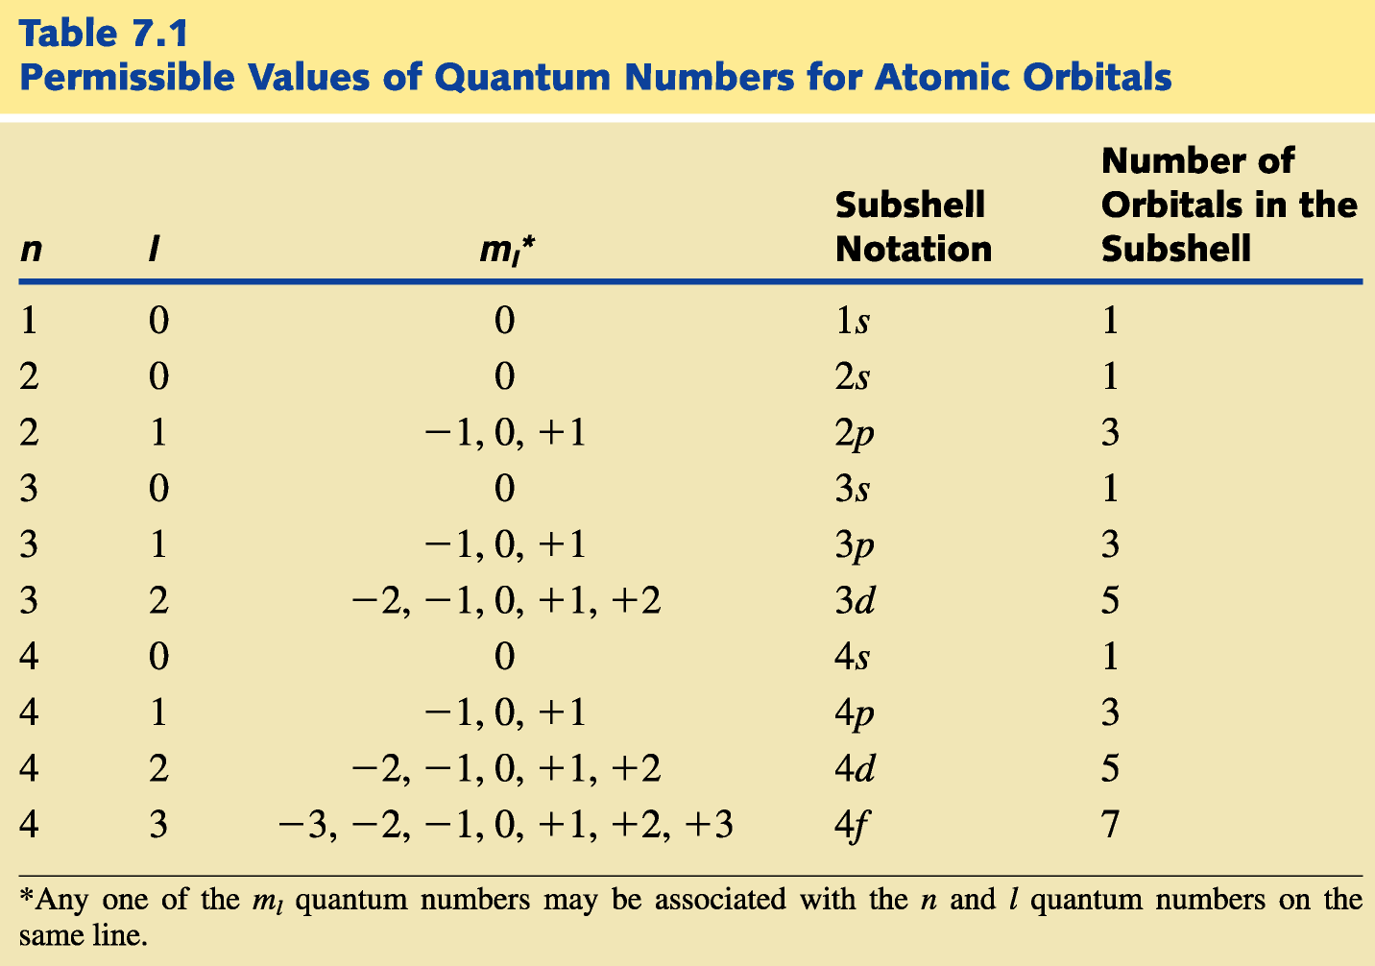
Concept: Each electron in an atom has a unique set of quantum numbers to define it
{ n, l, m_{l}, m_{s} }
49

Slide 50
Electronic configuration of Br
1s² 2s²2p⁶ 3s²3p⁶3d¹⁰ 4s²4p⁵
[Ar] 3d¹⁰4s²4p⁵
[Ar] = “noble gas core”
[Ar]3d¹⁰ = “pseudo noble gas core”
(electrons that tend not to react)
Atom’s reactivity is determined by valence electrons
valence e’s in Br: 4s²4p⁵
highest n electrons
Notes:
50

Slide 51
Valence e⁻ shells for
transition metals v. main group elements
d orbitals sometimes
included in valence shell
d orbitals not included
in valence shell
(pseudo noble gas cores)

Slide 52
Rule-of-thumb for valence electrons
Identify all electrons at the highest principal quantum number (n)
Examples
● Sulfur: 1s²2s²2p⁶3s²3p⁴ or [Ne]3s²3p⁴
valence electrons: 3s²3p⁴
● Strontium: [Kr]5s²
valence electrons: 5s²
● Gallium: [Ar]4s²3d¹⁰4p¹
valence electrons: 4s²4p¹
● Vanadium: [Ar]4s²3d³
valence electrons: 4s² or 3d³4s²
Use on exams,
but recognize
limitations
Use Table 8.9
for online HW

Slide 53
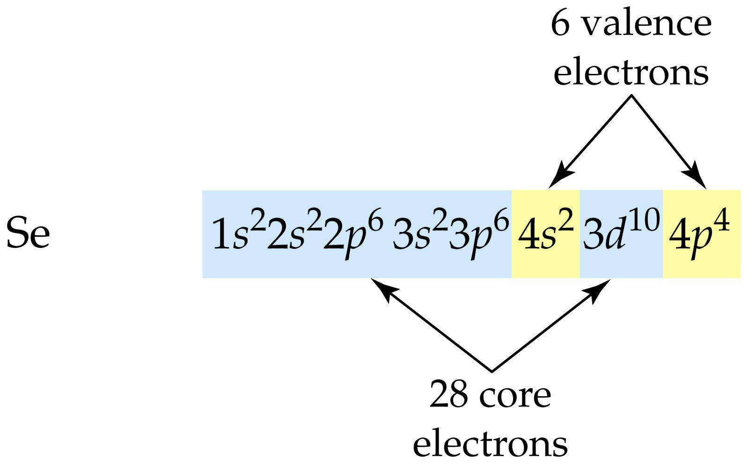
Selenium’s valence electrons
Written for increasing energy:
Pseudo noble gas core includes:
• noble gas electron core
• d electrons (not very reactive)
Notes:
53

Slide 54
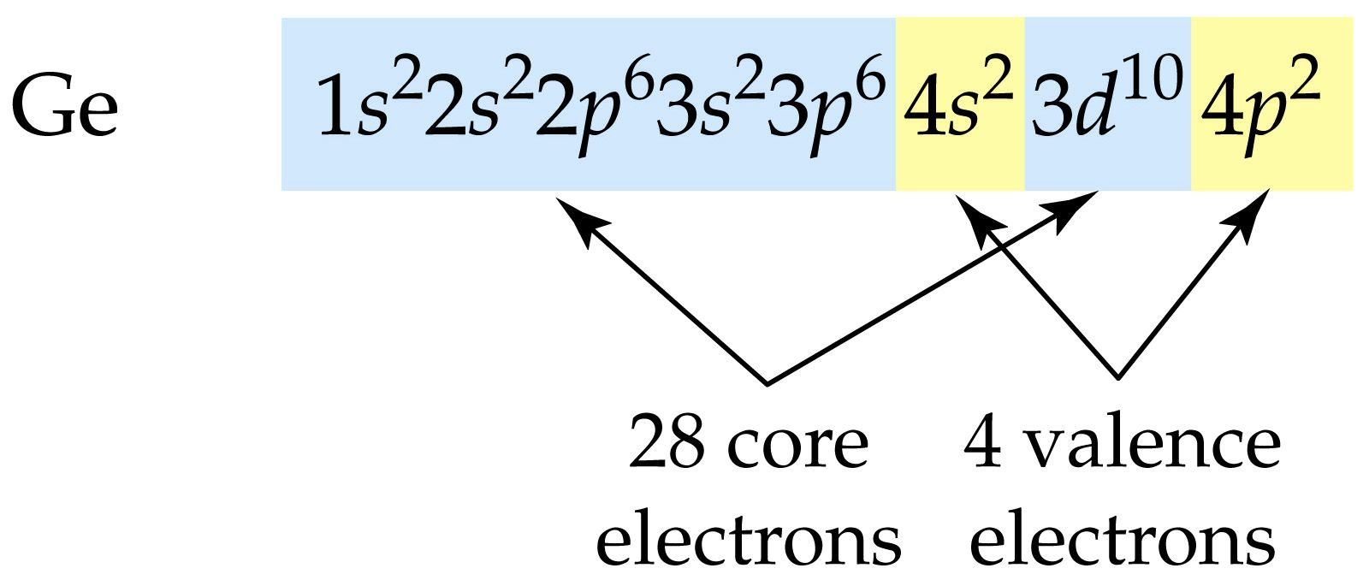
Core and valence electrons in Germanium
Written for increasing energy:
Pseudo noble gas core includes:
• noble gas core
• d electrons
Notes:
54

