Slide 1
Unit 4: The Periodic Table of elements

Slide 2
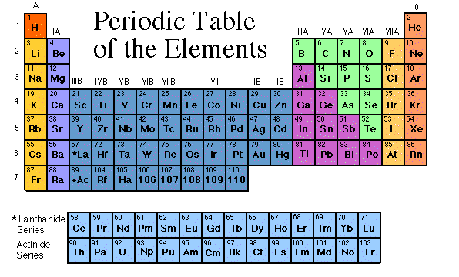
Unit 4: Periodic Table of Elements

Slide 3
Periodic Table
The periodic table organizes the elements in a particular way.
A great deal of information about an element can be gathered from its position in the period table.
For example, you can predict with reasonably good accuracy the physical and chemical properties of the element.

Slide 4
You can also predict what other elements a particular element will react with chemically.
Understanding the organization and plan of the periodic table will help you obtain basic information about each of the 118 known elements.

Slide 5
chlorine
nitrogen
silver
gold
mercury
oxygen
hydrogen
helium
sodium
niobium
neodymium
carbon

Slide 6
The History of the Modern Periodic Table

Slide 7
During the nineteenth century, chemists began to categorize the elements according to similarities in their physical and chemical properties.
The end result of these studies was our modern periodic table.

Slide 8
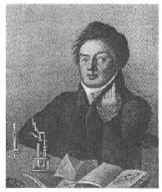
Johann Dobereiner
In 1829, he classified some elements into groups of three, which he called triads.
The elements in a triad had similar chemical properties and orderly physical properties.
(ex. Cl, Br, I and
Ca, Sr, Ba)
Model of triads
1780 - 1849

Slide 9
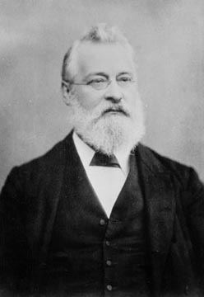
John Newlands
In 1863, he suggested that elements be arranged in “octaves” because he noticed (after arranging the elements in order of increasing atomic mass) that certain properties repeated every 8th element.
Law of Octaves
1838 - 1898

Slide 10
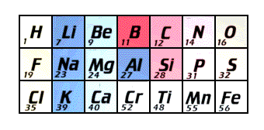
John Newlands
Newlands' claim to see a repeating pattern was met with savage ridicule on its announcement.
His classification of the elements, he was told, was as arbitrary as putting them in alphabetical order and his paper was rejected for publication by the Chemical Society.
1838 - 1898
Law of Octaves

Slide 11
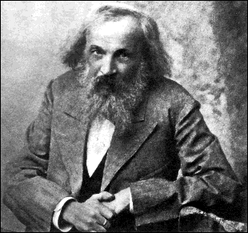
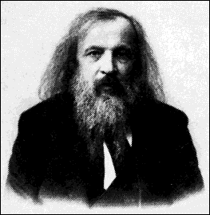
Dmitri Mendeleev
In 1869 he published a table of the elements organized by increasing atomic mass.
1834 - 1907

Slide 12
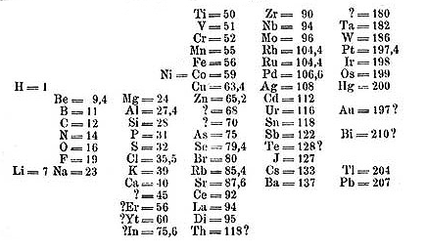
Mendeleev’s Periodic table
Mendeleev arranged all the known chemical elements of the time by atomic weight
He found that similar physical and chemical properties reoccurred in set patterns
( every 7 elements for light elements and every 17 for heavy elements)

Slide 13
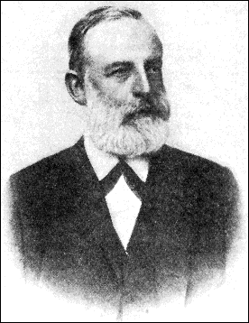
Lothar Meyer
At the same time, he published his own table of the elements organized by increasing atomic mass.
1830 - 1895

Slide 14
Both Mendeleev and Meyer arranged the elements in order of increasing atomic mass.
Both left vacant spaces where unknown elements should fit.
So why is Mendeleev called the “father of the modern periodic table” and not Meyer, or both?

Slide 15
Mendeleev...
stated that if the atomic weight of an element caused it to be placed in the wrong group, then the weight must be wrong.
(He corrected the atomic masses of Be, In, and U)
was so confident in his table that he used it to predict the physical properties of three elements that were yet unknown.

Slide 16
After the discovery of these unknown elements between 1874 and 1885, and the fact that Mendeleev’s predictions for Sc, Ga, and Ge were amazingly close to the actual values, his table was generally accepted.

Slide 17
However, in spite of Mendeleev’s great achievement, problems arose when new elements were discovered and more accurate atomic weights determined.
By looking at our modern periodic table, can you identify what problems might have caused chemists a headache?
Ar and K
Co and Ni
Te and I
Th and Pa

Slide 18
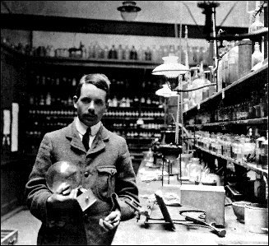
Henry Moseley
In 1913, through his work with X-rays, he determined the actual nuclear charge (atomic number) of the elements*.
He rearranged the elements in order of increasing atomic number.
*“There is in the atom a fundamental quantity which increases by regular steps as we pass from each element to the next. This quantity can only be the charge on the central positive nucleus.”
1887 - 1915

Slide 19
Henry Moseley
His research was halted when the British government sent him to serve as a foot soldier in WWI.
He was killed in the fighting in Gallipoli by a sniper’s bullet, at the age of 28.
Because of this loss, the British government later restricted its scientists to noncombatant duties during WWII.

Slide 20
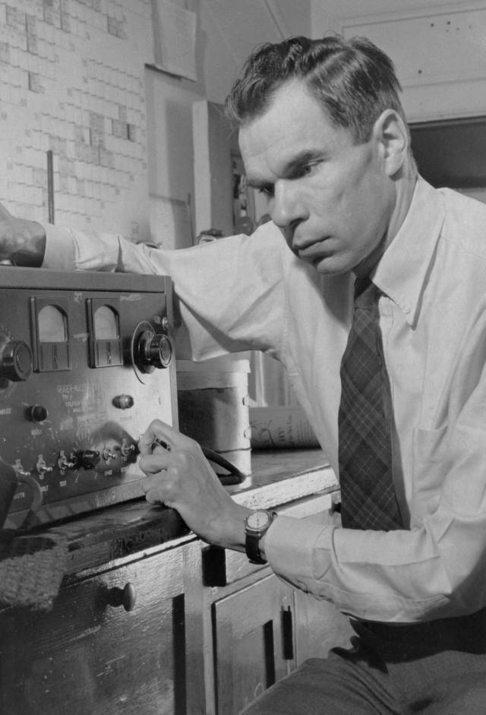
Glenn T. Seaborg
After co-discovering 10 new elements, in 1944 he moved 14 elements out of the main body of the periodic table to their current location below the Lanthanide series.
These became known
as the Actinide series.
1912 - 1999

Slide 21
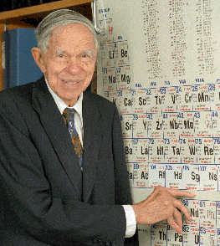
Glenn T. Seaborg
He is the only person to have an element named after him while still alive.
"This is the greatest honor ever bestowed upon me - even better, I think, than
winning the Nobel Prize."
1912 - 1999

Slide 22
Periodic Law
Periodic: means repeating according to some pattern
Today Mendeleev’s principle is known as the periodic law
When elements are arranged in order of increasing atomic number, there is a periodic pattern in their physical and chemical properties.

Slide 23
Periodicity
The difference in atomic number between any element in a group follows the exact same pattern

Slide 24
Periodicity
He | 2 10 |  | Fr
Ne |  | 8 | Li
Ar | 18 8 |  | Na
Kr | 36 | 18 | K
Xe | 54 | 18 | Rb
Ra | 86 | 32 | Cs
 | Atomic number | Difference in atomic number

Slide 25
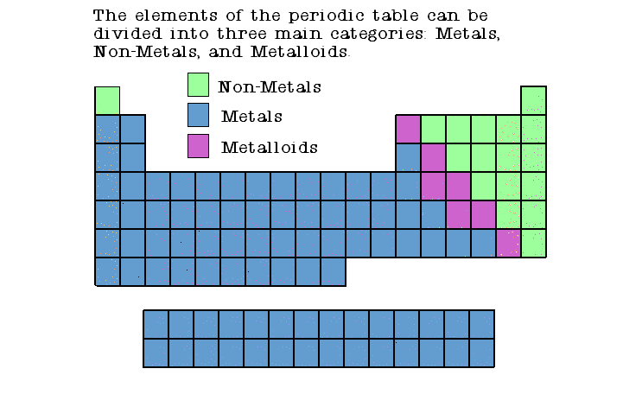

Slide 26
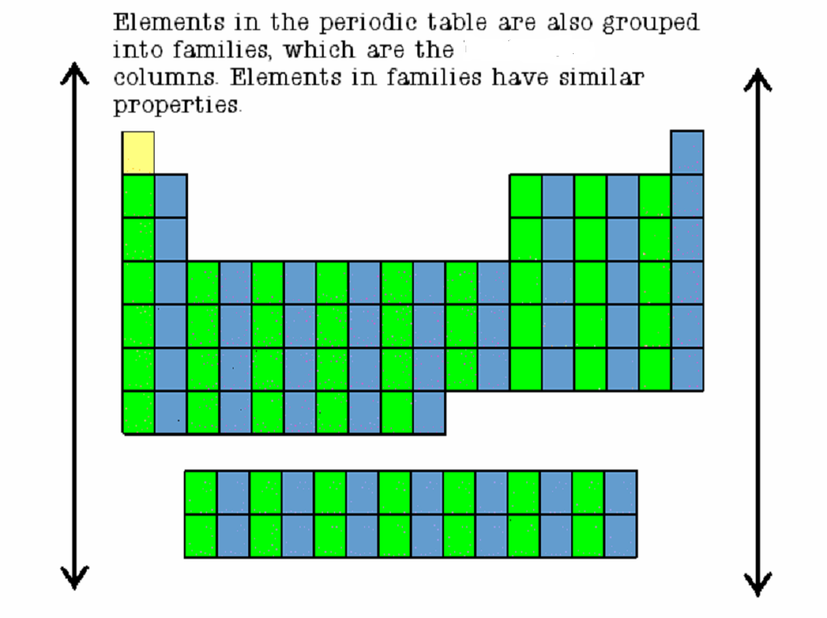

Slide 27
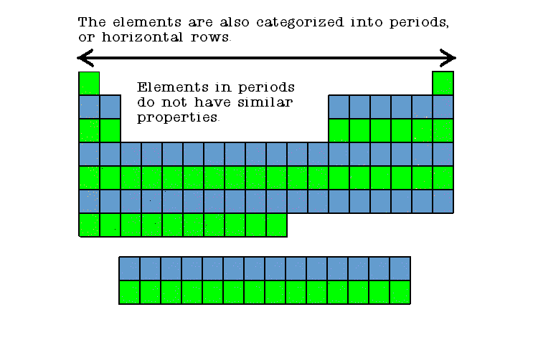

Slide 28
Families Periods
Columns of elements are called groups or families.
Elements in each family have similar but not identical properties.
For example, lithium (Li), sodium (Na), potassium (K), and other members of family IA are all soft, white, shiny metals.
All elements in a family have the same number of valence electrons.
Each horizontal row of elements is called a period.
The elements in a period are not alike in properties.
In fact, the properties change greatly across even given row.
The first element in a period is always an extremely active solid. The last element in a period, is always an inactive gas.

Slide 29
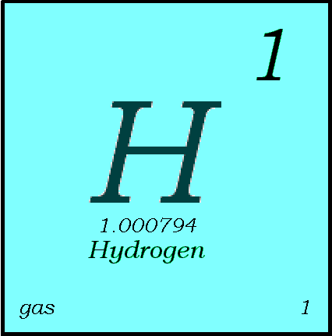
Key to the Periodic Table
Elements are organized on the table according to their atomic number, usually found near the top of the square.
  The atomic number refers to how many protons an atom of that element has.
  For instance, hydrogen has 1 proton, so it’s atomic number is 1.
  The atomic number is unique to that element. No two elements have the same atomic number.

Slide 30
What’s in a square?
Different periodic tables can include various bits of information, but usually:
  atomic number
  symbol
  atomic mass
  number of valence electrons
  state of matter at room temperature.

Slide 31


Atomic Number
This refers to how many protons an atom of that element has.
No two elements, have the same number of protons.
Bohr Model of Hydrogen Atom
Wave Model

Slide 32
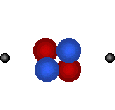
Atomic Mass
Atomic Mass refers to the “weight” of the atom.
It is derived at by adding the number of protons with the number of neutrons.
This is a helium atom. Its atomic mass is 4 (protons plus neutrons).
What is its atomic number?
H

Slide 33
Symbols
C
All elements have their own unique symbol.
It can consist of a single capital letter, or a capital letter and one or two lower case letters.
Carbon
Cu
Copper

Slide 34
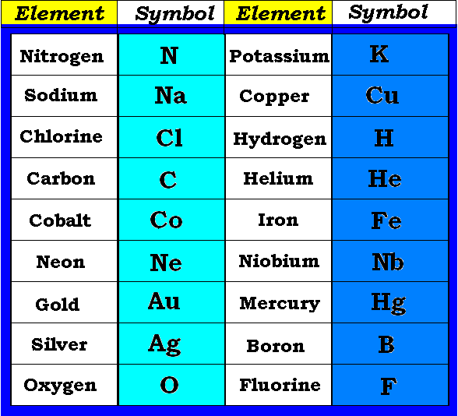
Common Elements and Symbols

Slide 35
Families

Slide 36
Hydrogen
Helium
The hydrogen square sits atop the group AIkali, and Helium on top of the Noble gases but neither are members of those groups.
Hydrogen is in a class of its own, as is Helium.
They are gases at room temperature.
Hydogen has one proton and one electron in its one and only energy level.
Hydrogen only needs 2 electrons to fill up its valence shell.
Neither are metals

Slide 37
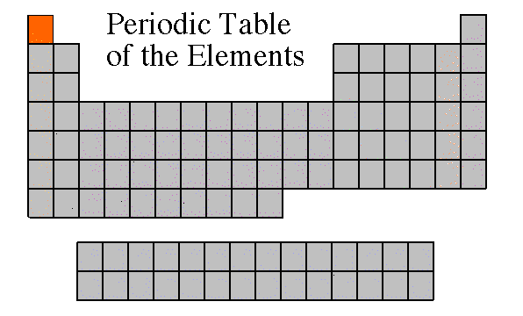

Slide 38
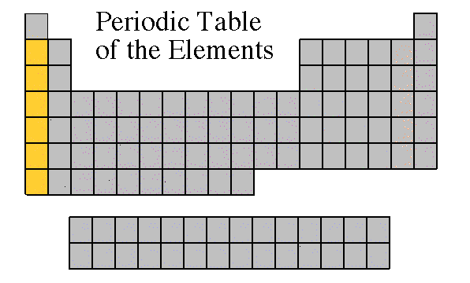
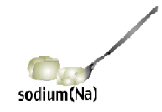
Alkali Metals
The alkali family is found in the first column of the periodic table.
Atoms of the alkali metals have a single electron in their outermost level, in other words, 1 valence electron.
They are shiny, have the consistency of clay, and are easily cut with a knife.

Slide 39
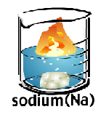
Alkali Metals
They are the most reactive metals.
They react violently with water.
Alkali metals are never found as free elements in nature. They are always bonded with another element.

Slide 40
Alkali Metals
Are soft with a silvery metallic luster and high conductivity

Slide 41
What does it mean to be reactive?
We will be describing elements according to their reactivity.
Elements that are reactive bond easily with other elements to make compounds.
Some elements are only found in nature bonded with other elements.
  .

Slide 42
What makes an element reactive?
  An incomplete valence electron level.
  All atoms (except hydrogen and Helium) want to have 8 electrons in their very outermost energy level
  (This is called the rule of octet.)
  Atoms bond until this level is complete.
  Atoms with few valence electrons lose them during bonding.
  Atoms with 6, 7, or 8 valence electrons gain electrons during bonding

Slide 43
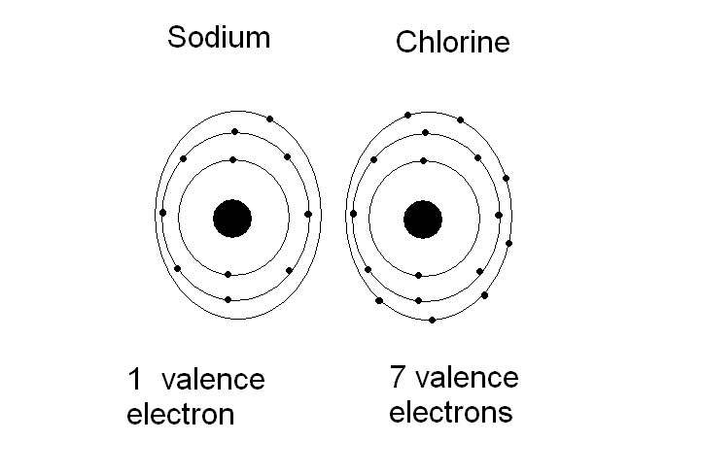
5

Slide 44
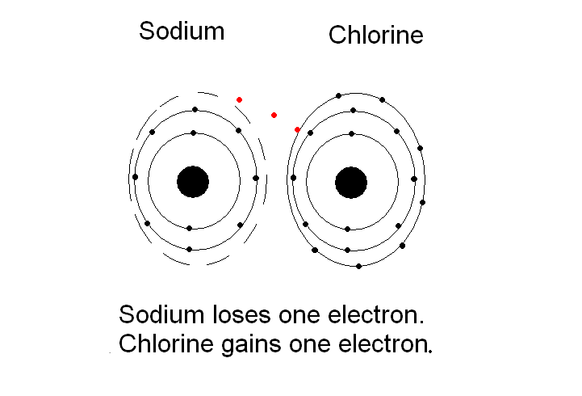

Slide 45
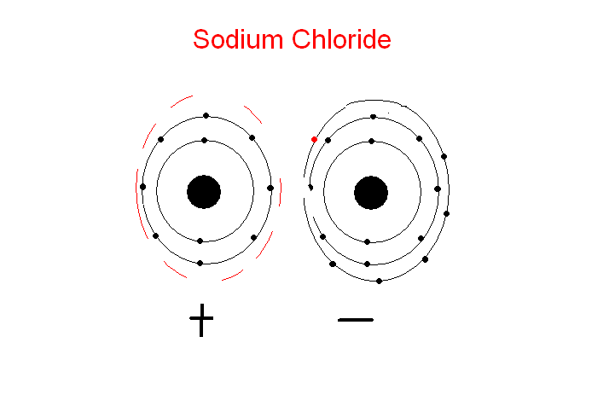

Slide 47
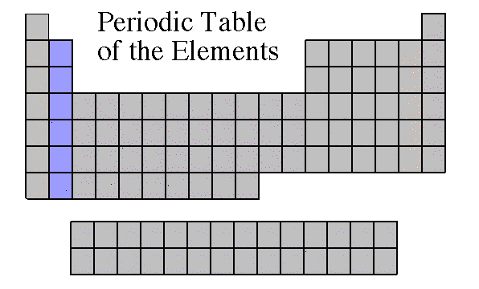
Alkaline Earth Metals
They are never found uncombined in nature.
They have two valence electrons.
Alkaline earth metals include magnesium and calcium, among others.
ThEy are less reactive than the alkali metals

Slide 49
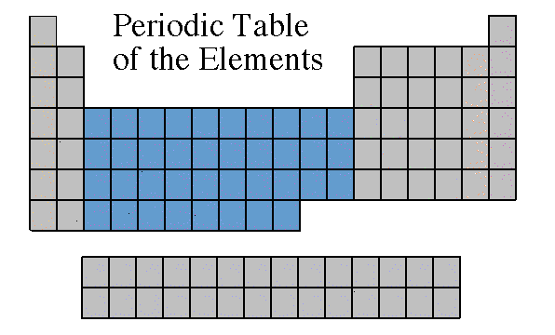
Transition Metals: combine with oxygen to form oxides
Transition Elements include those elements in the B families.
These are the metals you are probably most familiar: copper, tin, zinc, iron, nickel, gold, and silver.
They are good conductors of heat and electricity.( malleable and ductile

Slide 50

Transition Metals
The compounds of transition metals are usually brightly colored and are often used to color paints.
Transition elements have 1 or 2 valence electrons, which they lose when they form bonds with other atoms. Some transition elements can lose electrons in their next-to-outermost level.

Slide 51
Transition Elements
Transition elements have properties similar to one another and to other metals, but their properties do not fit in with those of any other family.
Many transition metals combine chemically with oxygen to form compounds called oxides.

Slide 53
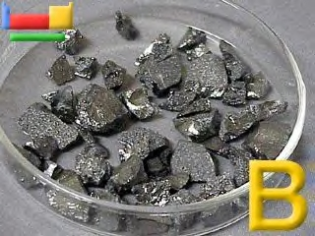
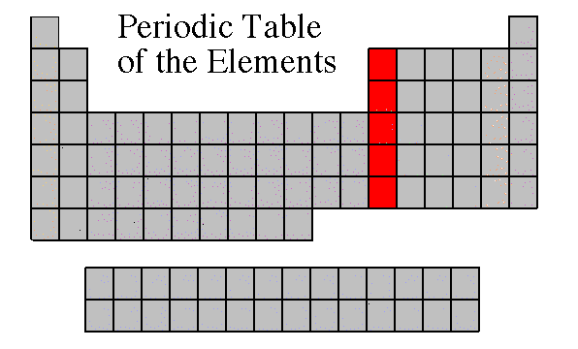
Boron Family
The Boron Family is named after the first element in the family.
Atoms in this family have 3 valence electrons.
This family includes a metalloid (boron), and the rest are metals.
This family includes the most abundant metal in the earth’s crust (aluminum).

Slide 55
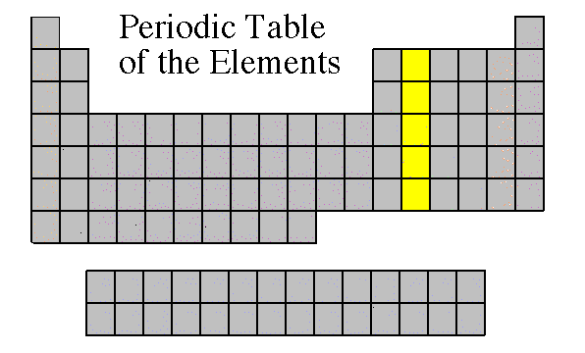
Carbon Family
Atoms of this family have 4 valence electrons.
This family includes a non-metal (carbon), metalloids, and metals.
The element carbon is called the “basis of life.”
There is an entire branch of chemistry devoted to carbon compounds called organic chemistry.

Slide 57

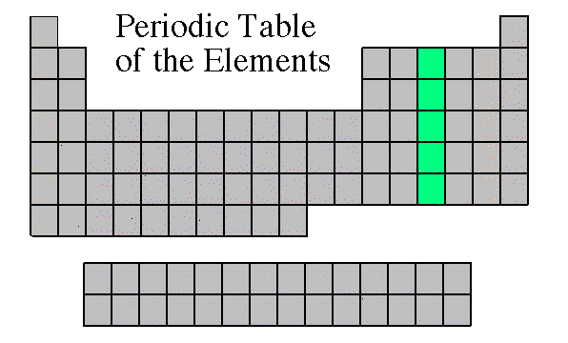
Nitrogen Family : Pnicogens
The nitrogen family is named after the element that makes up 78% of our atmosphere.
This family includes non-metals, metalloids, and metals.
Atoms in the nitrogen family have 5 valence electrons. They tend to share electrons when they bond.
Other elements in this family are phosphorus, arsenic, antimony, and bismuth.

Slide 58
Pnicogens
Also known as the choking gas formers
Combines with oxygen to make you choke

Slide 60
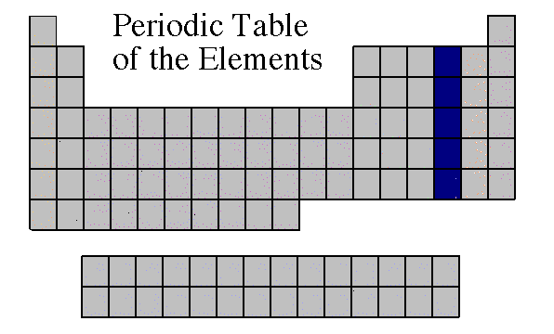
Oxygen Family: Chalcogens
Atoms of this family have 6 valence electrons.
Most elements in this family share electrons when forming compounds.
Oxygen is the most abundant element in the earth’s crust. It is extremely active and combines with almost all elements.
Contains elements that support combustion

Slide 62
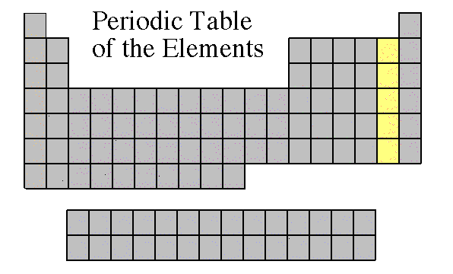
Halogen Family: salt formers
Most reactive nonmetals
The elements in this family are fluorine, chlorine, bromine, iodine, and astatine.
Halogens have 7 valence electrons, which explains why they are the most active non-metals. They are never found free in nature.
Halogen atoms only need to gain 1 electron to fill their outermost energy level.
They react with alkali metals to form salts.

Slide 63
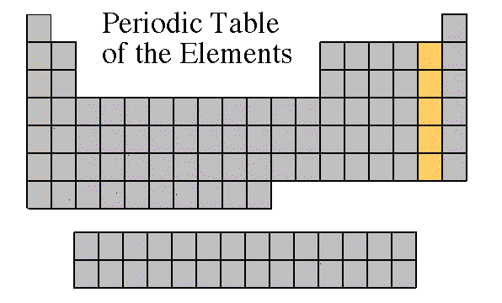

Slide 64

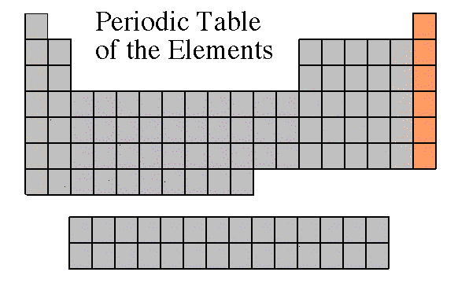
Noble Gases
Noble Gases are colorless gases that are extremely un-reactive.
One important property of the noble gases is their inactivity. They are inactive because their outermost energy level is full.
.

Slide 65


Because they do not readily combine with other elements to form compounds, the noble gases are called inert.
The family of noble gases includes helium, neon, argon, krypton, xenon, and radon.
All the noble gases are found in small amounts in the earth's atmosphere

Slide 67
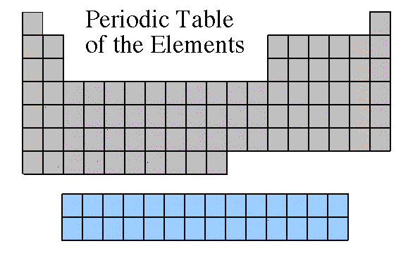
Rare Earth Elements
The thirty rare earth elements are composed of the lanthanide and actinide series.
One element of the lanthanide series and most of the elements in the actinide series are called trans-uranium, which means synthetic or man-made.

Slide 69
Across the Periodic Table
Periods: Are arranged horizontally across the periodic table (rows 1-7)
These elements have the same number of valence shells.
2nd Period
6th Period

Slide 70
Down the Periodic Table
Family: Are arranged vertically down the periodic table (columns or group, 1- 18 or 1-8 A,B)
These elements have the same number electrons in the outer most shells, the valence shell.
Alkali Family:
1 e- in the valence shell
Halogen Family:
7 e- in the valence shell

Slide 71
Infamous Families of the Periodic Table
Notable families of the Periodic Table and some important members:
Alkali
Halogen
Noble Gas
Alkaline (earth)
Chalcogens
Transition Metals

Slide 72
Blocks of The Periodic Table
The Periodic Table is generally divided into 4 blocks
S block: groups 1 &2 (active metals)
P block: groups 13-18
D block: groups 3-12
F block: actinides and lanthanides

Slide 73
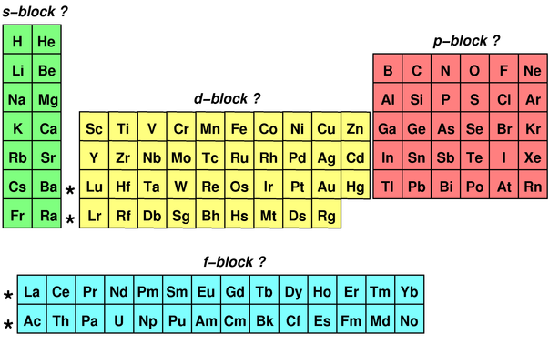

Slide 74
The S and P block together make up the main group elements
The D bock is composed of the transitional elements
The most important D block metal is iron
Iron + carbon = steel (alloy)
Zinc + copper =brass (alloy)
The F block is composed of the lanthanides and actinides
The 1st 4 actinides ( thorium thru neptunium) have been found in nature, the remaining are only known as lab elements

