Slide 1
Exceptions to Mendel’s Law
Mendel’s traits showed two distinct forms
Most genes do not exhibit simple inheritance
Genotypic ratios persist but phenotypic ratios may vary due to “outside-the-gene” influences including
- Multiple alleles
- Other nuclear genes
- Non-nuclear genes
- Gene linkage
- Environment
Notes:
1

Slide 2
Lethal Alleles
A lethal genotype causes death before the individual can reproduce
- This removes an expected progeny class following a specific cross
A double dose of a dominant allele may be lethal
- Examples:
- Achondroplastic dwarfism
- Mexican hairless dogs
Notes:
2

Slide 3
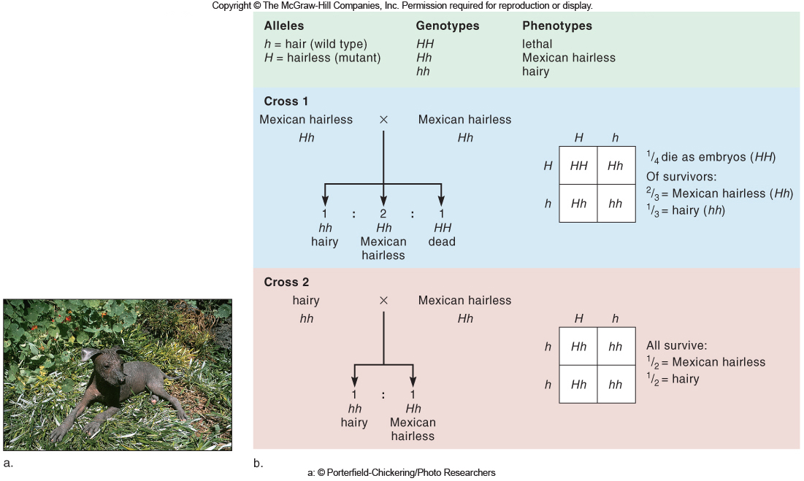
Lethal Alleles
Figure 5.1
Figure 5.1b

Slide 4
Multiple Alleles
An individual carries two alleles for each autosomal gene
However, a gene can have multiple alleles because its sequence can deviate in many ways
Different allele combinations can produce variations in the phenotype
- PKU gene has hundreds of alleles resulting in four basic phenotypes
- CF gene has over 1500 alleles
Notes:
4

Slide 5
Incomplete Dominance
The heterozygous phenotype is between those of the two homozygotes
Example: Familial hypercholesterolemia (FH)
- A heterozygote has approximately half the normal number of receptors in the liver for LDL cholesterol
- A homozygous for the mutant allele totally lacks the receptor, and so their serum cholesterol level is very high
Notes:
5

Slide 6
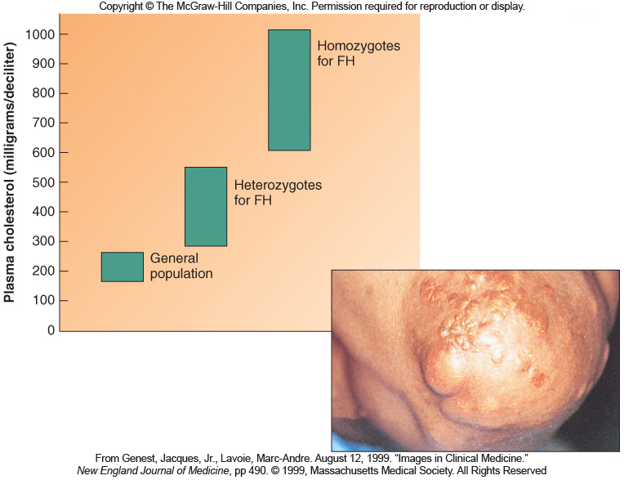
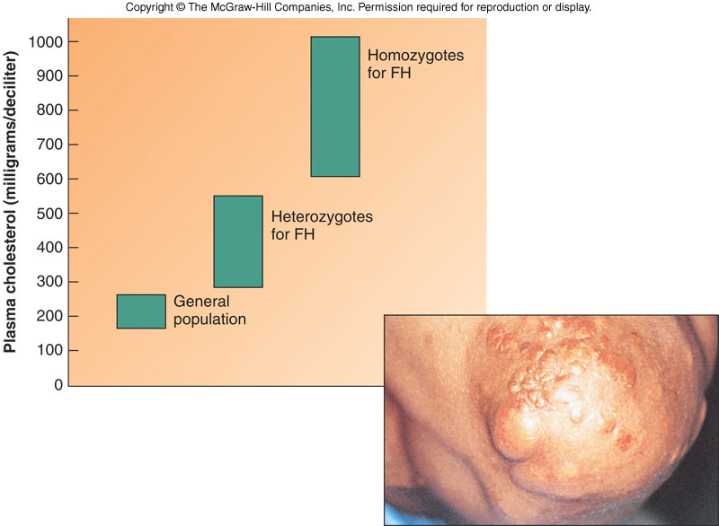
Incomplete Dominance
Figure 5.2
Notes:
6

Slide 7
Codominance
The heterozygous phenotype results from the expression of both alleles
The ABO gene encodes a cell surface protein
- I^{A} allele produces A antigen
- I^{B} allele produces B antigen
- i (I^{O}) allele does not produce antigens
Alleles I^{A} and I^{B} are codominant, and both are completely dominant to i
Notes:
7

Slide 8
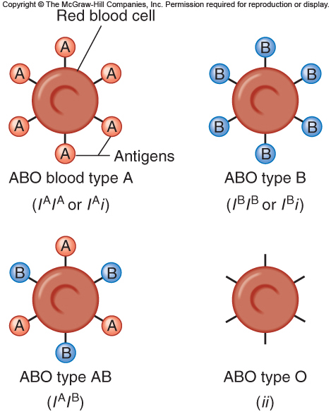
Figure 5.3

Slide 9
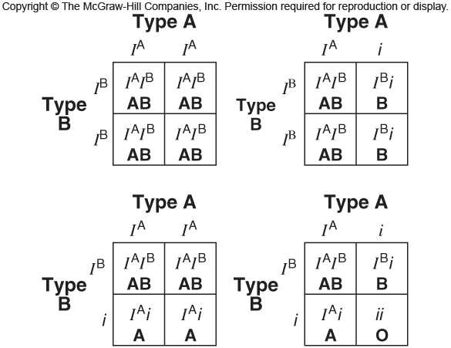
Offspring from Parents with Blood Type A and Blood Type B
Figure 5.4
Figure 5.4

Slide 10
Epistasis
The phenomenon where one gene affects the expression of a second gene
Example: Bombay phenotype
- The H gene is epistatic to the I gene
- H protein places a molecule at the cell surface to which the A or B antigens are attached
- hh genotype = no H protein
- Without H protein the A or B antigens can not be attached to the surface of the RBC
- All hh genotypes have the phenotype of type O, although the ABO blood group can be anything (A, B, AB, or O)
Notes:
10

Slide 11
Penetrance and Expressivity
Penetrance refers to the all-or-none expression of a single gene
Expressivity refers to the severity or extent
A genotype is incompletely penetrant if some individuals do not express the phenotype
A phenotype is variably expressive is symptoms vary in intensity among different people
Notes:
11

Slide 12
Pleiotropy
The phenomenon where one gene controls several functions or has more than one effect
Example: Porphyria variegata
- Affected several members of European Royal families, including King George III
- The varied illnesses & quirks appeared to be different unrelated disorders
Notes:
12

Slide 13
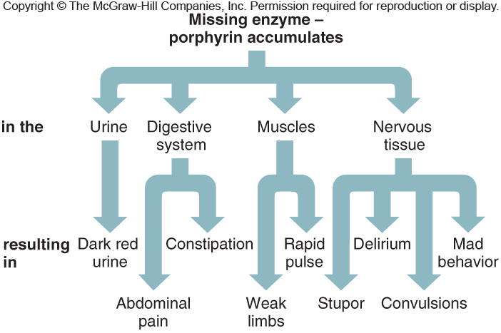
Pleiotropy
Figure 5.5
Figure 5.5a
Figure 5.5b
Photo © North Wind Picture Archives

Slide 14
The Porphyrias
Diseases that result from deficiencies of any of several enzymes required to make heme
In each disease, an intermediate biochemical builds up
- It may be excreted in urine, or accumulate in tissues causing symptoms
- These symptoms, including reddish teeth and photosensitivity, may have inspired the vampire and werewolf legends
Notes:
14

Slide 15
Genetic Heterogeneity
Different genes can produce identical phenotypes
- Hearing loss – 132 autosomal recessive forms
- Osteogenesis imperfecta – At least two different genes involved
- Alzheimer disease – At least four different genes involved
Genes may encode enzymes that catalyze the same biochemical pathway, or different proteins that are part of the pathway
Notes:
15

Slide 16
Phenocopy
A trait that appears inherited but is caused by the environment
May have symptoms that resemble an inherited trait or occur within families
Examples:
- Exposure to teratogens
- Thalidomide causes limb defects similar to inherited phocomelia
- Infection
- AIDS virus can be passed from mother to child, looking like it is inherited
Notes:
16

Slide 17
The Human Genome Sequence Adds Perspective
The Human Genome Project has revealed that complications to Mendelian inheritance are more common than originally thought
Thus terms like epistasis and genetic heterogeneity are beginning to overlap and blur
- Example: Marfan syndrome
Interactions between genes also underlie penetrance and expressivity
- Example: Huntington disease
Notes:
17

Slide 18
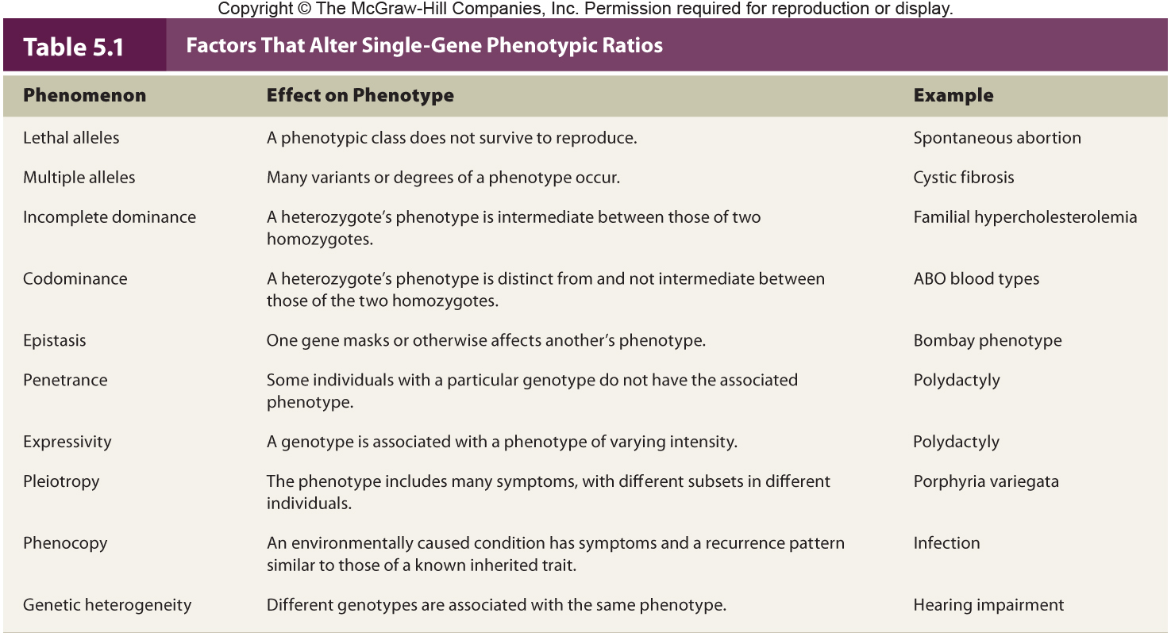
Summary
Table 5.3

Slide 19
Mitochondrion
Organelle providing cellular energy
Contains small circular DNA called mtDNA
- 37 genes without noncoding sequences
No crossing over and little DNA repair
High exposure to free radicals
Mutation rate is greater than nuclear DNA
Notes:
19

Slide 20
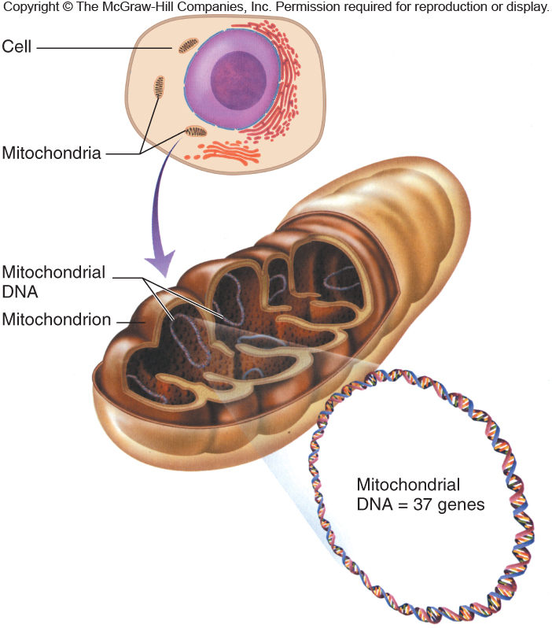
A cell typically has thousands of mitochondria, and each has numerous copies of its “mini-chromosome”
Figure 5.8
Notes:
20

Slide 21
Mitochondrion
Mitochondrial genes are transmitted from mother to all of her offspring
Figure 5.7
Notes:
21

Slide 22
Mitochondrial DNA
Table 5.4

Slide 23
Mitochondrial Disorders
Mitochondrial genes encode proteins that participate in protein synthesis and energy production
Several diseases result from mutations in mtDNA
Examples:
- Mitochondrial myopathies – Weak and flaccid muscles
- Leber optical atrophy – Impaired vision
Ooplasmic transfer technique can enable woman to avoid transmitting a mitochondrial disorder
Notes:
23

Slide 24
Heteroplasmy
The condition where the mtDNA sequence is not the same in all copies of the genome
- Thus, a mitochondrion will have different alleles for the same gene
At each cell division, the mitochondria are distributed at random into daughter cells
If an oocyte is heteroplasmic, differing number of copies of a mutant mtDNA may be transmitted
- The phenotype reflects the proportion of mitochondria bearing the mutation
Notes:
24

Slide 25
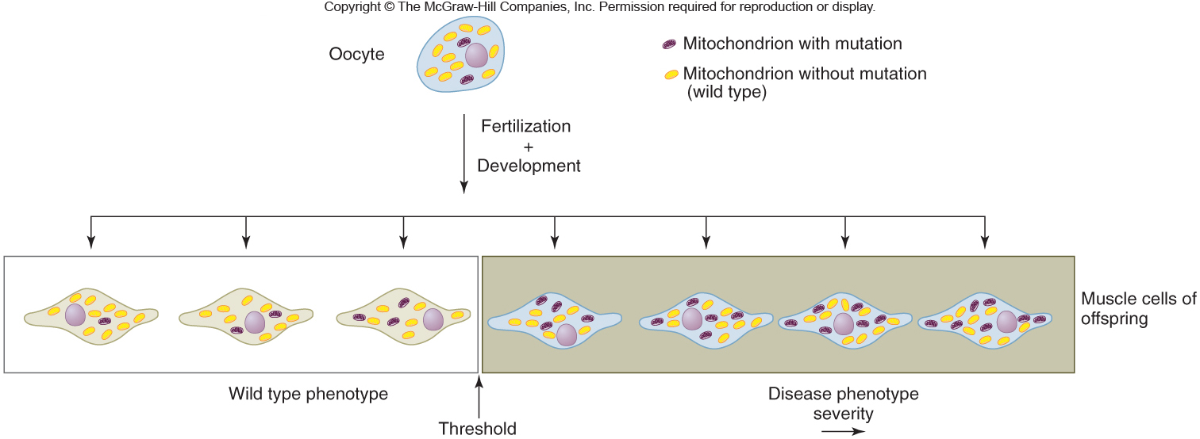
Heteroplasmy
Figure 5.9
Notes:
25

Slide 26
Mitochondrial DNA Reveals Past
mtDNA provides a powerful forensic tool used to:
- Link suspects to crimes
- Identify war dead
- Support or challenge historical records
- Example: Identification of the son of Marie Antoinette and Louis XVI
mtDNA is more likely to survive extensive damage and cells have many copies of it
Notes:
26

Slide 27
Linkage
Genes that are close on the same chromosome are said to be linked
Linked genes do not assort independently in meiosis
- Rather, they are usually inherited together when the chromosome is packaged into a gamete
- Therefore, they do not produce typical Mendelian ratios
Notes:
27

Slide 28
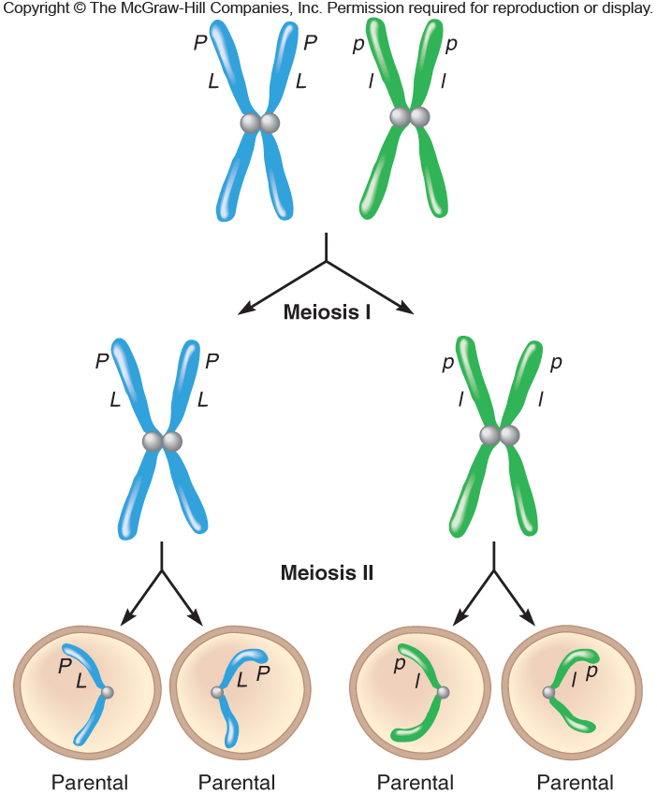
Linkage
Figure 5.10
Notes:
28

Slide 29
Linkage
Figure 5.11
Notes:
29

Slide 30
Recombination
Chromosomes recombine during crossing-over in prophase I of meiosis
New combinations of alleles are created
Parental chromosomes have the original configuration
Recombinant chromosomes have new combinations of alleles
Notes:
30

Slide 31
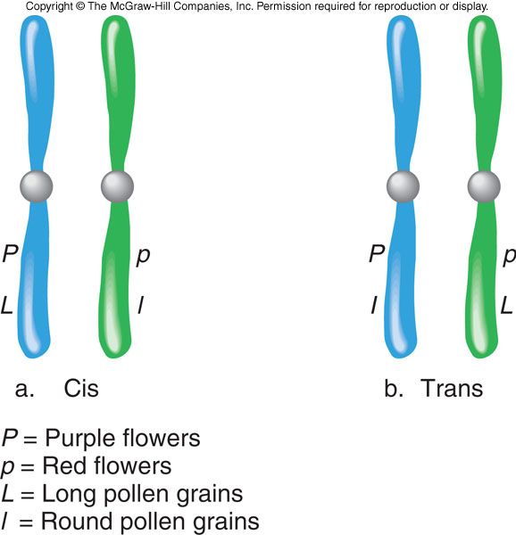
Allele Configuration in a Dihybrid
1) cis = Two dominant or two recessive alleles are on each chromosome
2) Trans = One dominant and one recessive allele are on each chromosome
Figure 5.13
Notes:
31

Slide 32
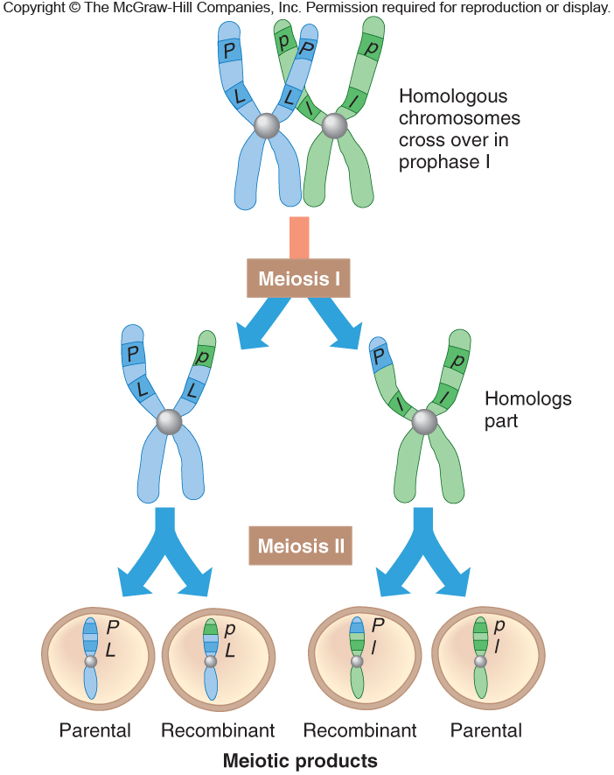
Crossing Over Disrupts Linkage
Figure 5.12
Notes:
32

Slide 33
Crossing Over Animation
Please note that due to differing operating systems, some animations will not appear until the presentation is viewed in Presentation Mode (Slide Show view). You may see blank slides in the “Normal” or “Slide Sorter” views. All animations will appear after viewing in Presentation Mode and playing each animation. Most animations will require the latest version of the Flash Player, which is available at http://get.adobe.com/flashplayer.
Figure 2.3

Slide 34
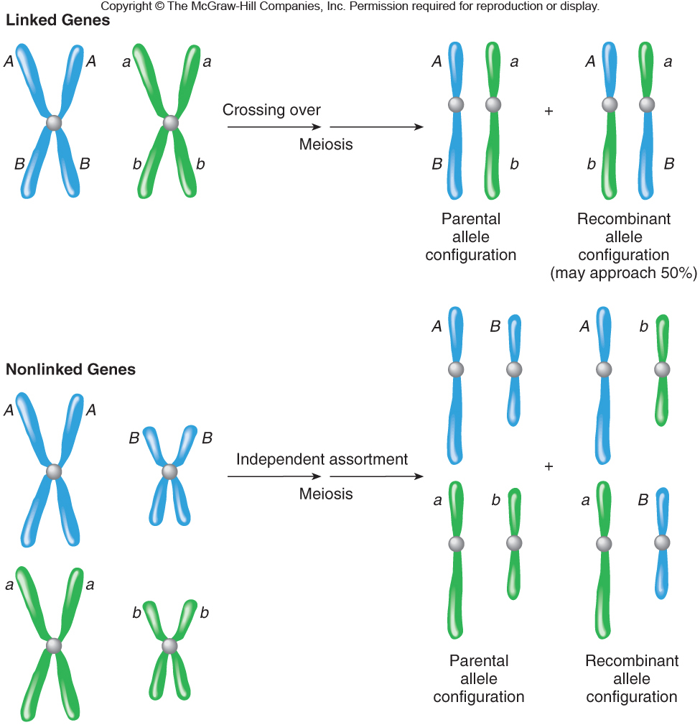
Linkage versus Non-linkage
Figure 5.15
Notes:
34

Slide 35
Frequency of Recombination
Frequency of recombination is based on percentage of meiotic divisions that result in breakage of linkage between parental alleles
The frequency of recombination between two genes is proportional to the distance between them
Notes:
35

Slide 36
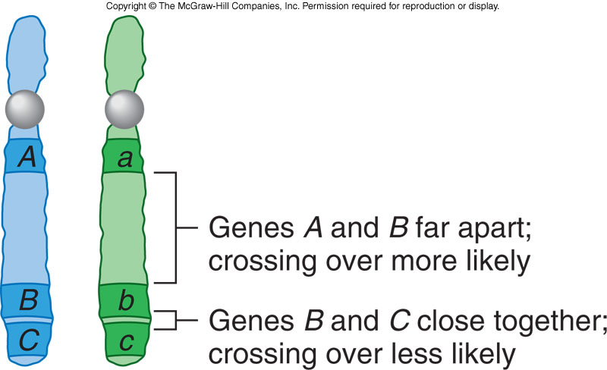
Frequency of Recombination
The correlation between crossover frequency and gene distance is used to construct linkage maps
Figure 5.14
Notes:
36

Slide 37
Linkage Maps
A linkage map is a diagram indicating the relative distance between genes
1% recombination = 1 map unit = 1 centiMorgan (cM)
Map distances are additive
Figure 5.17
Notes:
37

Slide 38
Linkage Disequilibrium (LD)
Is the non-random association between DNA sequences
- Inherited together more often than would be predicted from their frequency
The human genome consists of many “LD” blocks where alleles stick together
- These are interspersed with areas where crossing over is prevalent
Notes:
38

Slide 39
Solving Linkage Problems
The genes for Nail-patella syndrome (N) and the ABO blood type (I) are 10 map units apart on chromosome 9
Greg and Susan each have Nail-patella syndrome.
Greg has type A and Susan type B blood
What is the probability that their child has normal nail and knees and type O blood?
Notes:
39

Slide 40
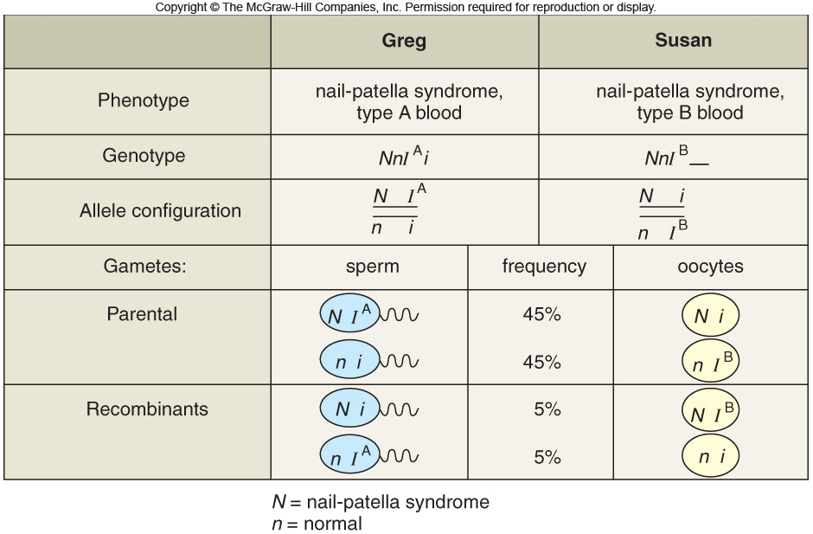
The ni sperm would have to fertilize the ni oocyte
Using the product rule, the probability of a child with nnii genotype is 0.45 x 0.05 = 0.0025 or 2.25%
Notes:
40

Slide 41
Genetic Markers
Are DNA sequences that serve as landmarks near genes of interest
These were used starting in 1980 in linkage mapping
Currently, they are used in genome-wide association studies
Notes:
41

Slide 42
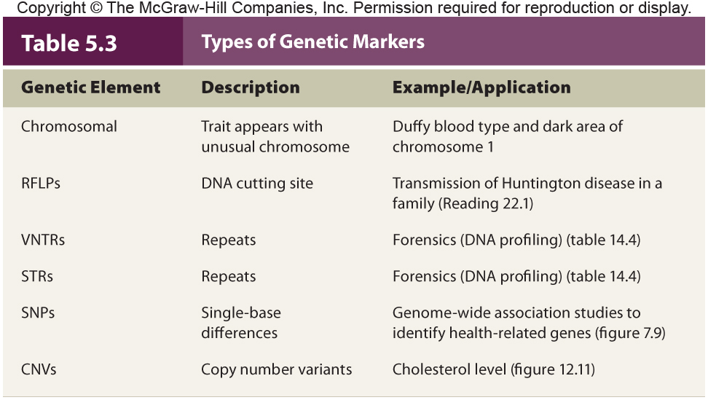
Genetic Markers
Notes:
42

Slide 43
LOD Score
Indicates the “tightness” of linkage between a marker and a gene of interest
It is the likelihood that particular crossover frequency data suggests linkage rather than inheritance by chance
LOD scores of 3 or higher signifies linkage
- Observed data are 1,000 times more likely to be due to linkage than chance
Notes:
43

Slide 44
Haplotype
Is the set of DNA sequences inherited on one chromosome due to linkage disequilibrium
Make it possible to track specific chromosome segments in pedigrees
- Disruptions of a marker sequence indicate crossover sites
Notes:
44

Slide 45
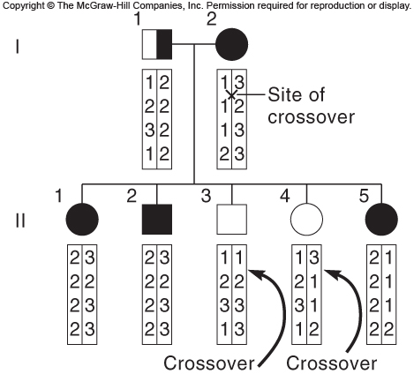
Haplotype
Notes:
45

