Slide 2
A Tale of Two Families
Modes of inheritance are the patterns in which single-gene traits and disorders occur in families
Huntington disease is autosomal dominant
- Affects both sexes and typically appears every generation
Cystic fibrosis is autosomal recessive
- Affects both sexes and can skip generations through carriers

Slide 3
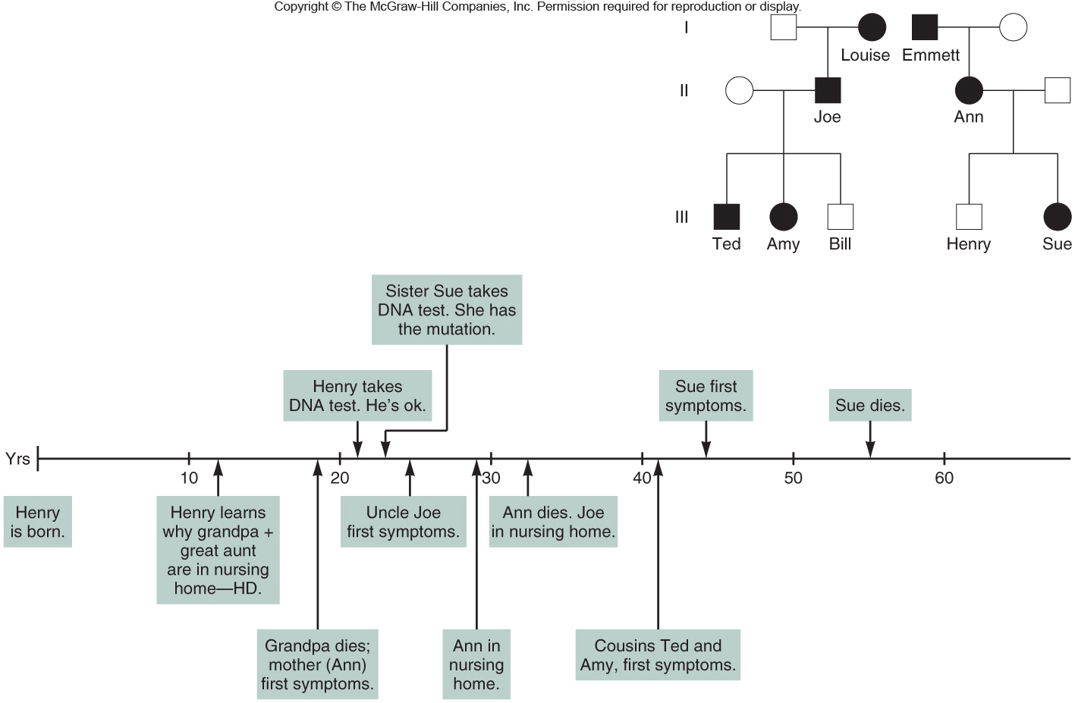
Family with Huntington Disease
Figure 4.1
Figure 3.2
Notes:
3

Slide 4
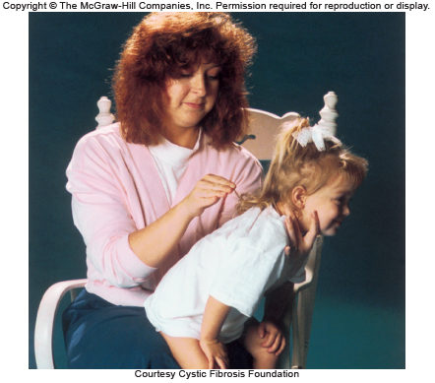
Treating Cystic Fibrosis
Figure 4.2
Figure 3.2
Notes:
4

Slide 5
Gregor Mendel
A priest who performed research in plant breeding
Without knowledge of DNA, cells, or chromosomes
Described the units of inheritance and how they pass from generation to generation
Not recognized during his lifetime
Notes:
5

Slide 6
Gregor Mendel
Experimented from 1857-1863 on traits in 24,034 plants
Developed the laws of inheritance
Used:
- Controlled plant breeding
- Careful recordkeeping
- Large numbers
- Statistics
Notes:
6

Slide 7
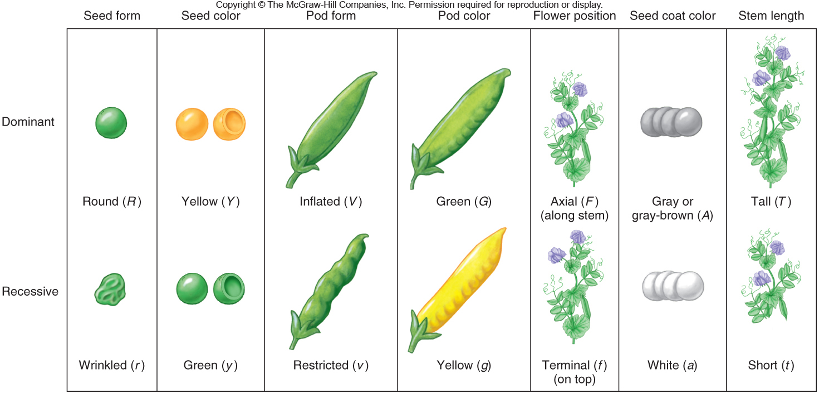
Mendel Studied Transmission of Seven Traits in the Pea Plant
Figure 4.2
Figure 4.3

Slide 8
True-Breeding Plants
Offspring have the same trait as parent
Examples:
- Round-seeded parents produce all round-seeded offspring
- Yellow-seeded parents produce all yellow-seeded offspring
- Short parents produce all short offspring
Notes:
8

Slide 9
Monohybrid Cross
True-breeding plants with two forms of a single trait are crossed
Progeny show only one form of the trait
The observed trait is dominant
The masked trait is recessive
Notes:
9

Slide 10
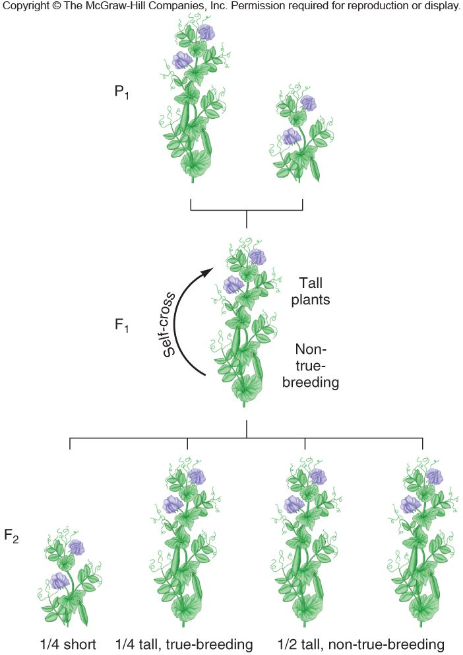
Monohybrid Cross
Parental generation (P₁)
Tall X Short
F₁
All Tall
F₂
1/4 Short : 3/4 Tall
Figure 4.4
Figure 4.3

Slide 11
Monohybrid Cross
In these experiments, Mendel confirmed that hybrids hide one expression of a trait, which reappears when hybrids are crossed
Mendel speculated that gametes contained particulate units or “elementen”
These are now called alleles
- Versions of the same gene
- Differ in DNA sequence at one or more sites
Notes:
11

Slide 12
Mendel's First Law – Segregation
Each plant possesses two units (alleles) for each trait
Alleles separate in the formation of gametes
Gametes contain ONE allele for each trait
At fertilization, gametes combine at random
Note: Mendel was really observing the events of meiosis and fertilization
Notes:
12

Slide 13
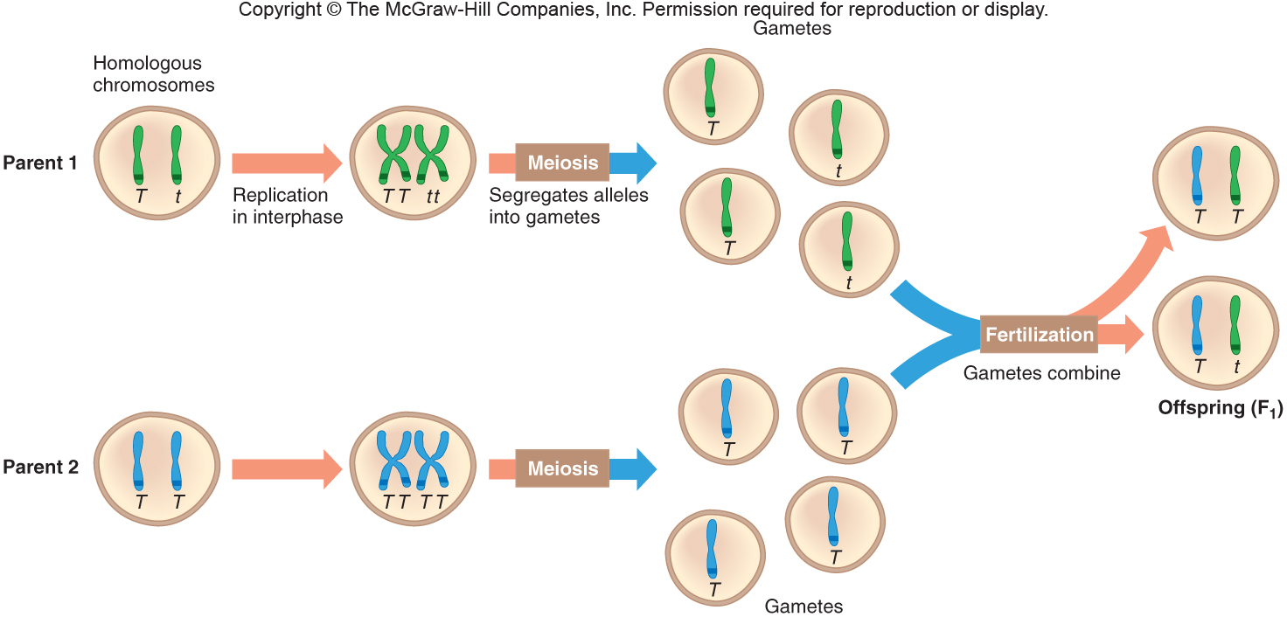
Mendel's First Law – Segregation
Figure 4.5
Notes:
13

Slide 14
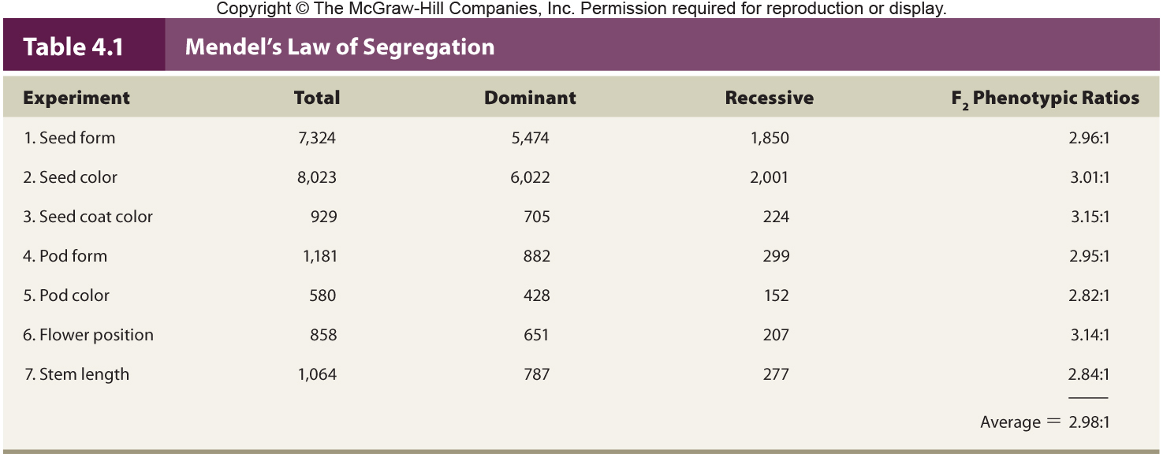
Mendel's Data

Slide 15
Terms
Genotype = The alleles present in an individual
- Homozygous carry same alleles TT or tt
- Heterozygous carry different alleles Tt
Phenotype = The trait observed
- Tall or Short
Wild Type = Most common phenotype
Mutant phenotype = A product of a change in the DNA
Notes:
15

Slide 16
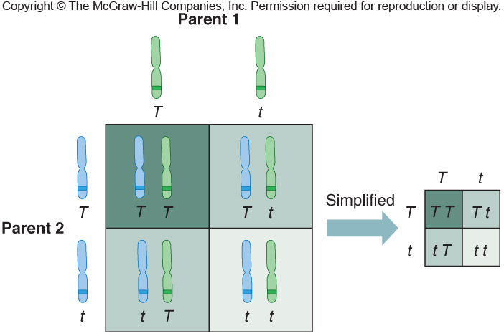
Punnett Square
Represents particular genes in gametes and how they may combine in offspring
Figure 4.6
Notes:
16

Slide 17
Test Cross
A monohybrid cross yields:
a 1 TT : 2 Tt : 1 tt genotypic ratio, and
a 3 tall : 1 short phenotypic ratio
Mendel distinguished the TT from Tt tall plants with a test-cross
- Cross an individual of unknown genotype with a homozygous recessive individual
Notes:
17

Slide 18
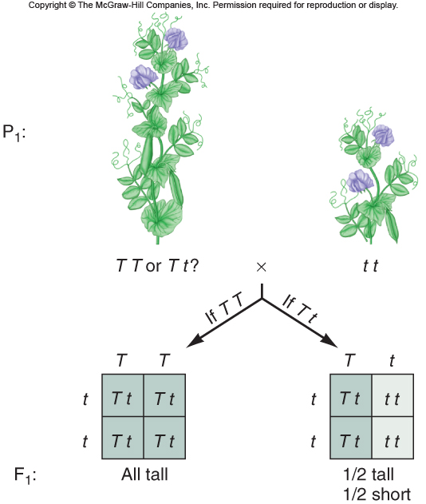
Test Cross
Figure 4.7

Slide 19
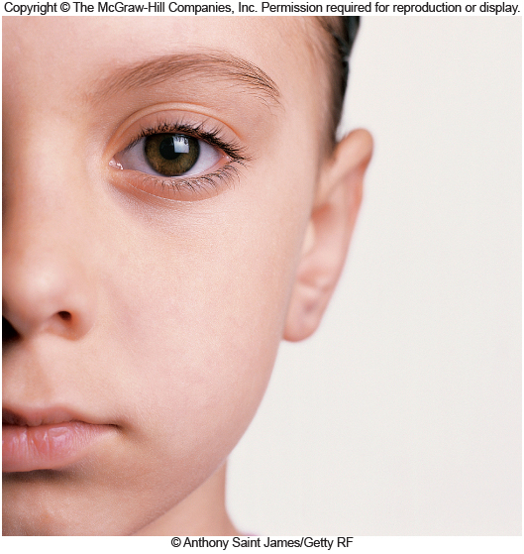
Eye Color
Wild-type human eye color is brown
- Blue and green eyes stemmed from mutations or SNPs that persisted
The surface of the back of the iris contributes to the intensity of eye color
Figure 4.8
Notes:
19

Slide 20
Autosomal Inheritance
Human autosomal traits are located on the non-sex chromosomes (#s 1-22)
They may be inherited as:
- Autosomal dominant or
- Autosomal recessive
Notes:
20

Slide 21
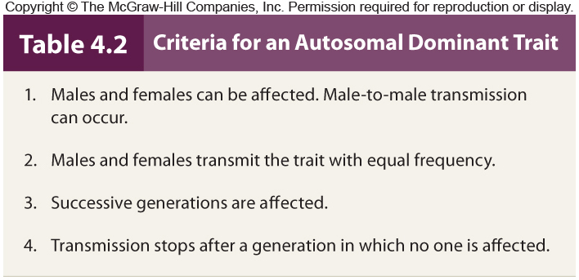
Autosomal Dominant Traits
Notes:
21

Slide 22
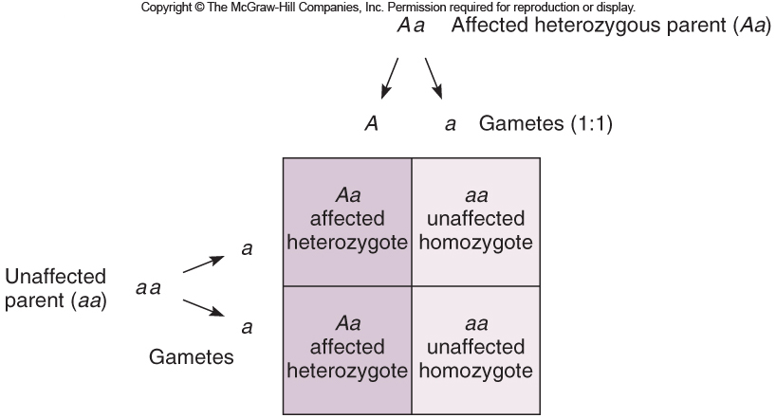
For many autosomal dominant traits, affected individuals are heterozygous (Aa)
- The homozygous dominant phenotype (AA) is either lethal or very rare
Figure 4.9
Notes:
22

Slide 23
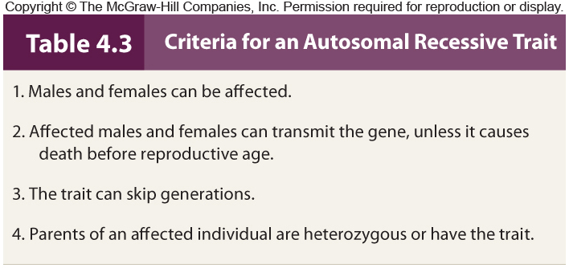
Autosomal Recessive Traits
5. More likely to occur in families with consanguinity
Notes:
23

Slide 24
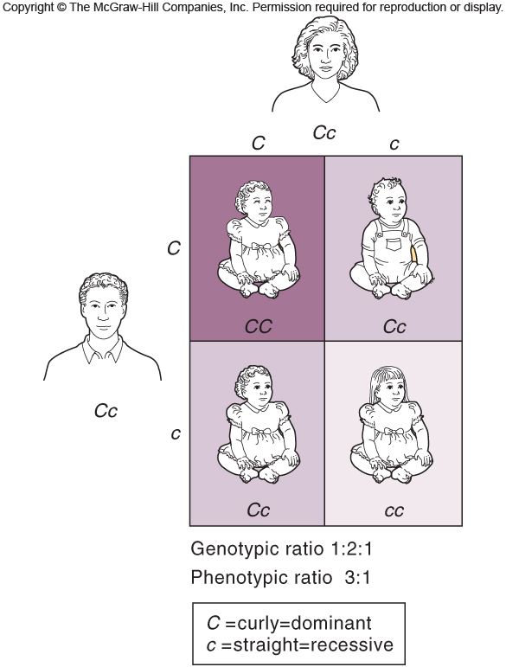
Autosomal Recessive Traits
Figure 4.10
Notes:
24

Slide 25
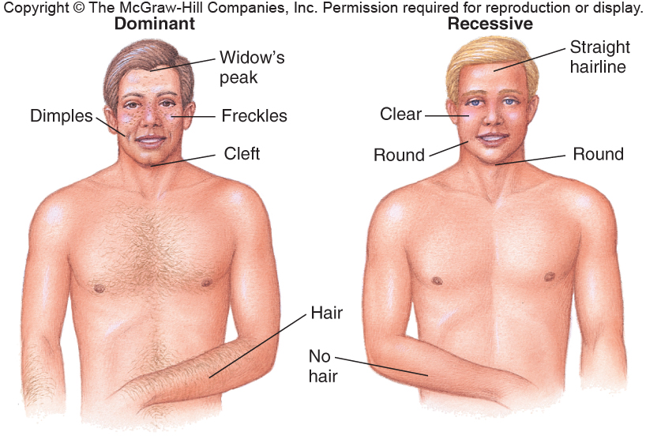
Inheritance of Some Common Traits
Box, Figure 1
Reading 4.1, Figure 1

Slide 26
Solving Genetic Problems
Follow these five general steps:
1) List all genotypes and phenotypes for the trait
2) Determine the genotypes of the parents
3) Derive possible gametes
4) Unite gametes in all combinations to reveal all possible genotypes
5) Repeat for successive generations
Notes:
26

Slide 27
On the Meaning of Dominance and Recessiveness
Whether an allele is dominant or recessive is important in determining risk and critical in medical genetics
Reflect the characteristics or abundance of a protein
Recessive traits have “loss of function”
Dominant traits have “gain of function”
Recessive disorders tend to be more severe
Notes:
27

Slide 28
Mendel's Second Law – Independent Assortment
Considers two genes on different chromosomes
The inheritance of one does not influence the chance of inheriting the other
Independent assortment results from the random alignment of chromosome pairs during metaphase I of meiosis
Notes:
28

Slide 29
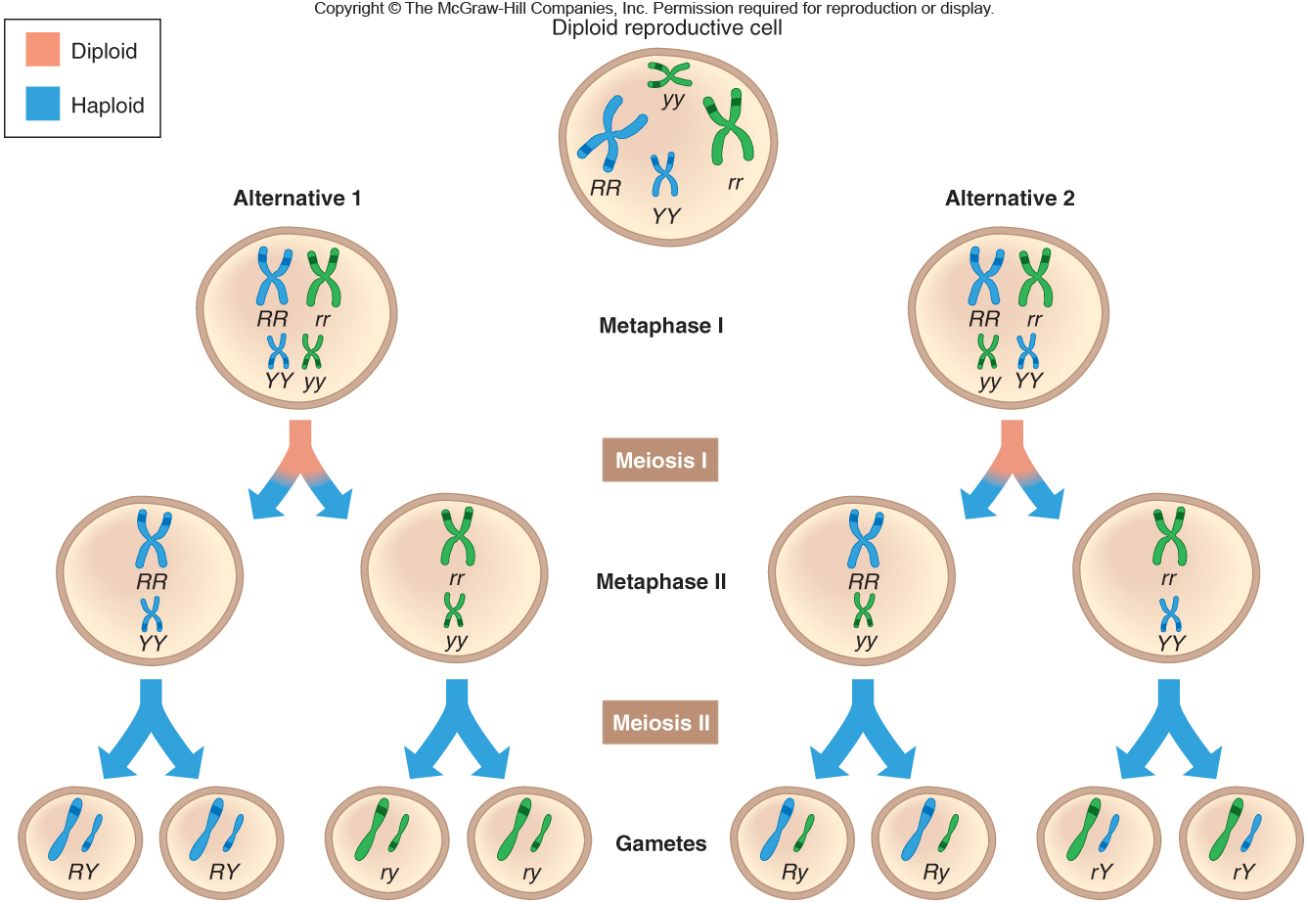
Mendel's Second Law – Independent Assortment
Figure 4.11
Figure 4.9

Slide 30
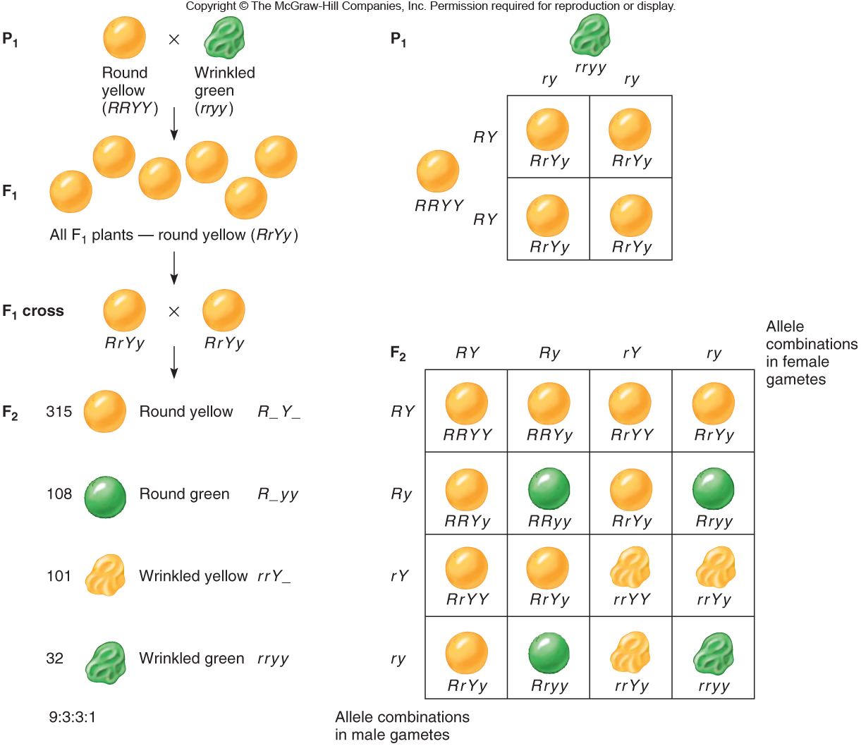
Mendel's Second Law – Independent Assortment
Figure 4.12
Figure 4.9

Slide 31
Trihybrid Cross and forked line method
It is much less difficult to consider each contrasting pair of traits separately than to combine these results. Thus the forked line method can be used to determine gametes
Do Forked line method on the following Problems: AaBbCc AaBBCc

Slide 32
Gametes and zygotes combinations
# of prs of heterozygous genes | # of gamete genotypes | # progeny phenotypes | # progeny phenotypes | # possible combinatons of gametes
1 | 2 | 2 | 3 | 4
2 | 4 | 4 | 9 | 16
3 | 8 | 8 | 27 | 64
4 | 16 | 16 | 81 | 256
n | 2^{n} | 2^{n} | 3^{n} | 4^{n}

Slide 33
Probability
The likelihood that an event will occur
Two applications of probability theory are useful in solving genetics problems
1) Product rule
2) Sum rule
Notes:
33

Slide 34
Product Rule
The probability of simultaneous independent events equals the product of their individual probabilities
Example:
- If both parents are dihybrid (RrYy), what is the probability of having an offspring that is homozygous recessive for both traits?
Notes:
34

Slide 35
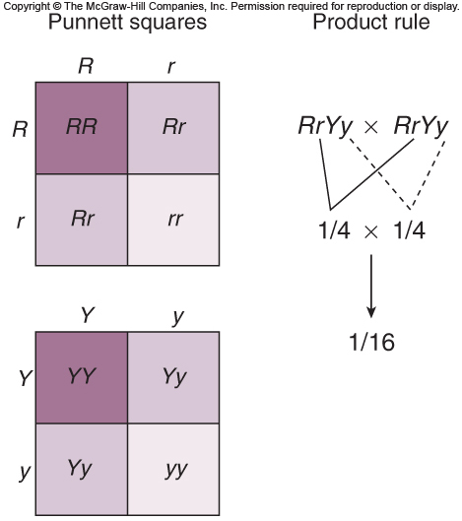
Product Rule
Do the reasoning for one gene at a time, then multiply the results
Figure 4.13
Notes:
35

Slide 36
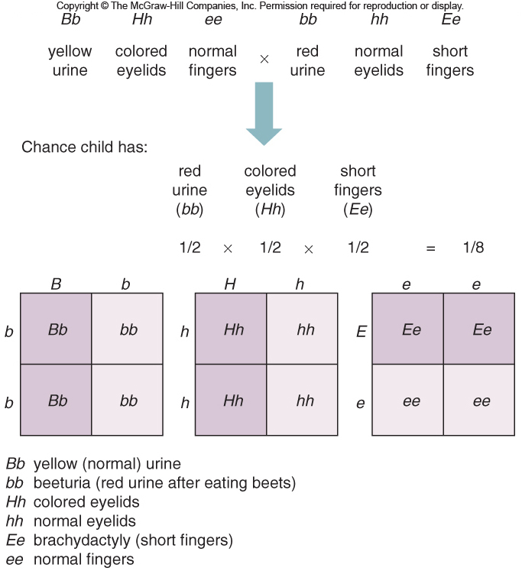
Using Probability to Track Three Traits
Figure 4.14
Notes:
36

Slide 37
Sum Rule
The probability of mutually exclusive events equals the sum of the individual probabilities
Example:
- Parents are heterozygous for a trait, R.
- What is the chance that their child carries at least one dominant R allele?
- Probability of child being RR = 1/4
- Probability of child being Rr = 1/2
- Probability of child being R_ = 1/4 + 1/2 = 3/4
Notes:
37

Slide 38
Pedigree Analysis
For researchers, families are tools; the bigger the family, the easier it is to discern modes of inheritance
Pedigrees are symbolic representations of family relationships and the transmission of inherited traits
Notes:
38

Slide 39
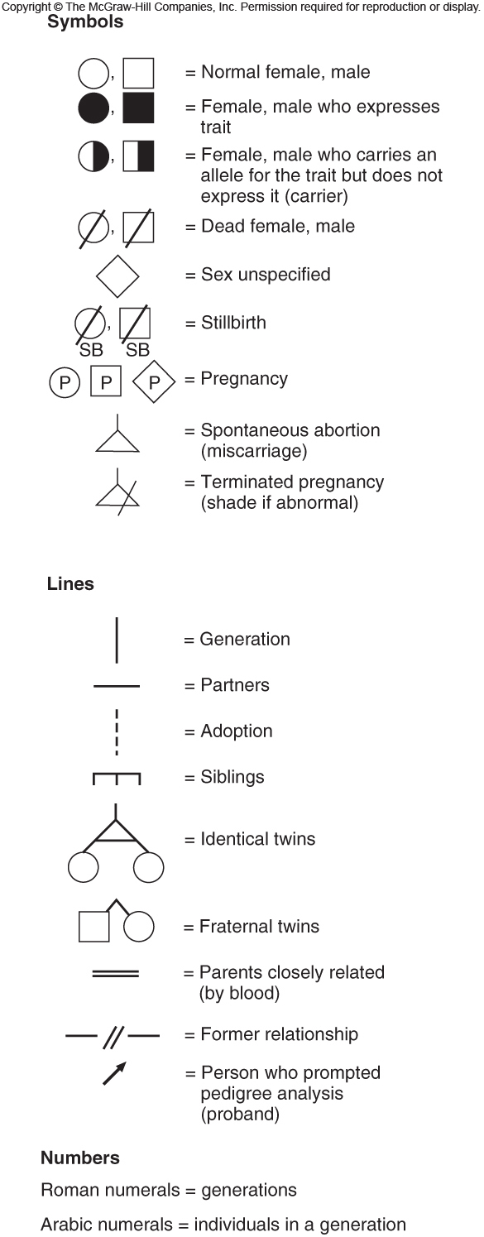
Pedigree Analysis
Figure 4.15
Notes:
39

Slide 40
An Unusual Pedigree
A partial pedigree of Egypt’s Ptolemy Dynasty showing:
- Genealogy not traits
- Extensive inbreeding
Figure 4.16a
Notes:
40

Slide 41
Autosomal Dominant Trait
Polydactyly = Extra fingers and/or toes
Figure 4.16b
Notes:
41

Slide 42
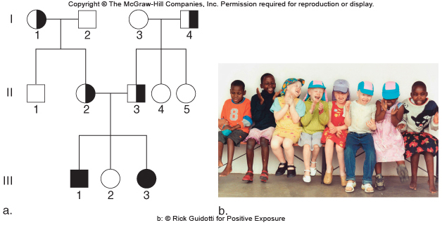
Autosomal Recessive Trait
Albinism = Deficiency in melanin production
Figure 4.17
Notes:
42

Slide 43
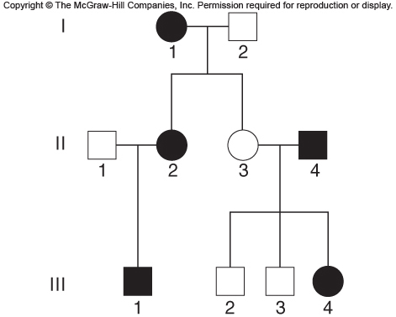
An Inconclusive Pedigree
This pedigree can account for either an autosomal dominant or an autosomal recessive trait
Figure 4.18
Notes:
43

Slide 44
Conditional Probability
Pedigrees and Punnett squares apply Mendel’s laws to predict the recurrence risks of inherited conditions
Example:
- Taneesha’s brother Deshawn has sickle cell anemia, an autosomal recessive disease.
- What is the probability that Taneesha’s child inherits the sickle cell anemia allele from her?
Notes:
44

Slide 45
X
Taneesha and Deshawn’s parents must be heterozygous
Taneesha is not affected and cannot be ss
Probability Taneesha is a carrier = 2/3
Probability child inherits sickle cell allele = 1/2
Probability child carries sickle cell allele from her
= 2/3 x 1/2 = 1/3

Slide 46
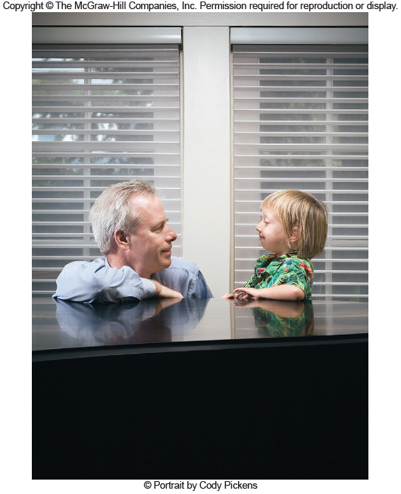
Co 4

