Slide 1
Ethical Issues…
Is human cloning ethical? “Playing with nature?”
Does a clone have parents?
Autonomy?
Might cloned children be able to choose their own destiny?
What about cloning children who have died at a young age?
Would it matter if the death were accidental?
Does cloning to create stem cells (therapeutic cloning) justify destroying a human embryo?

Slide 2
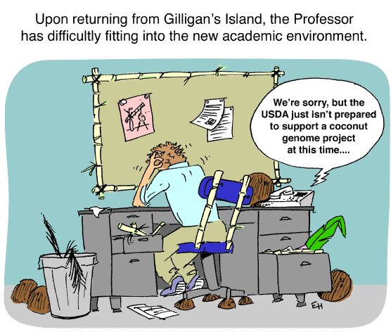

Slide 3
Stages of the Human Life Cycle
Genes orchestrate our physiology after conception through adulthood
Development is the process of forming an adult from a single-celled embryo
In humans, new individuals form from the union of sex cells or gametes
- Sperm from the male and oocyte from the female form a zygote
Notes:
3

Slide 4
Meiosis
The cell division that produces gametes with half the number of chromosomes
Occurs in special cells called germline cells
Maintains the chromosome number of a species over generations
Ensures genetic variability via the processes of independent assortment and crossing over of chromosomes
Notes:
4

Slide 5
Meiosis consists of two divisions
- Meiosis I = The reduction division
- Reduces the number of chromosomes from 46 to 23
- Meiosis II = The equational division
- Produces four cells from the two produced in Meiosis I
Note = Each division contains a prophase, a metaphase, an anaphase and a telophase
Notes:
5

Slide 6
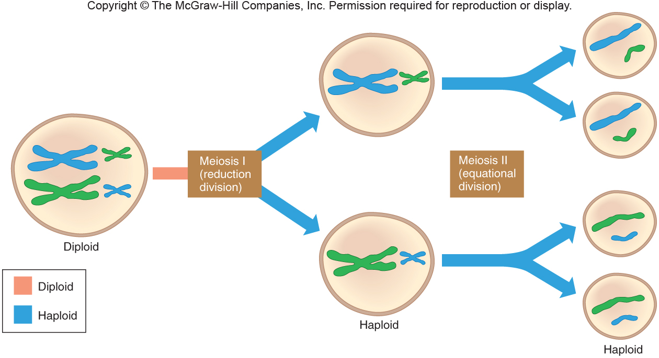
Meiosis
Figure 3.3
Notes:
6

Slide 7
Meiosis Animation
Please note that due to differing operating systems, some animations will not appear until the presentation is viewed in Presentation Mode (Slide Show view). You may see blank slides in the “Normal” or “Slide Sorter” views. All animations will appear after viewing in Presentation Mode and playing each animation. Most animations will require the latest version of the Flash Player, which is available at http://get.adobe.com/flashplayer.
Figure 2.3

Slide 8
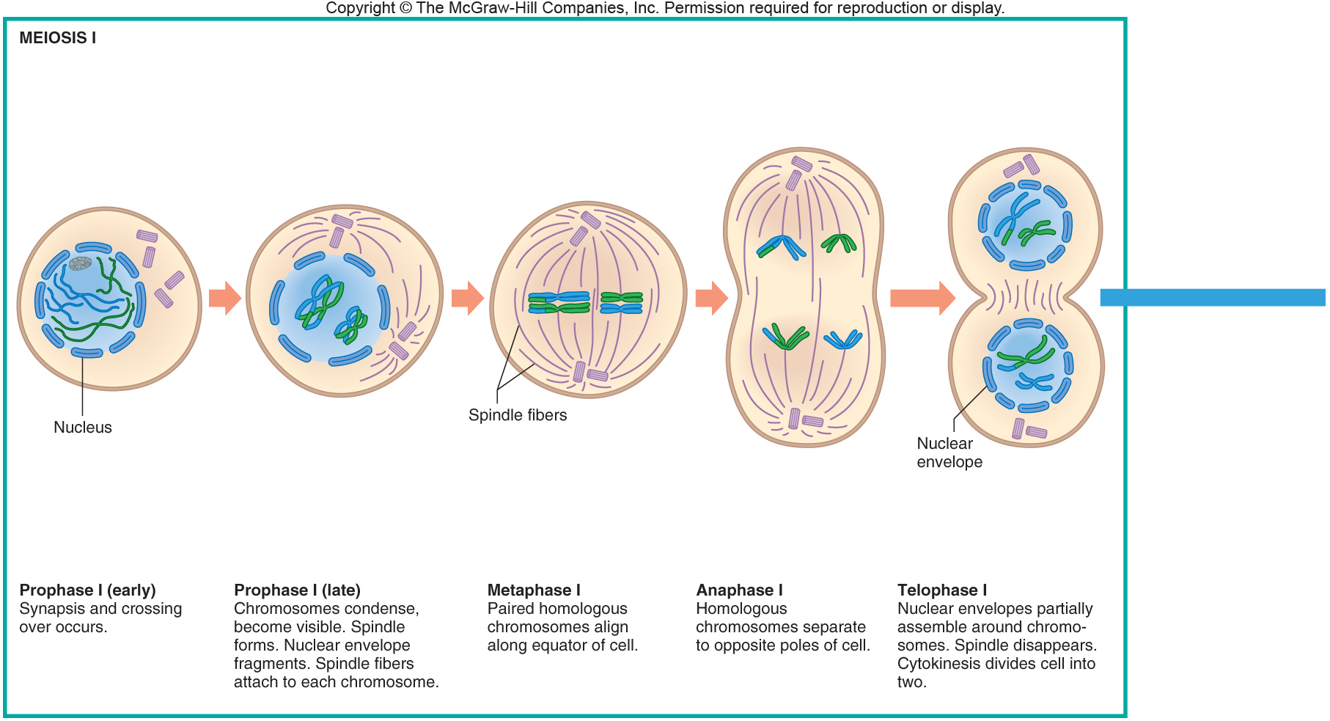
Meiosis I
Figure 3.4
Notes:
8

Slide 9
Prophase I
Homologs pair-up and undergo crossing over
Chromosomes condense
Spindle forms
Nuclear envelope breaks down
Figure 2.3

Slide 10
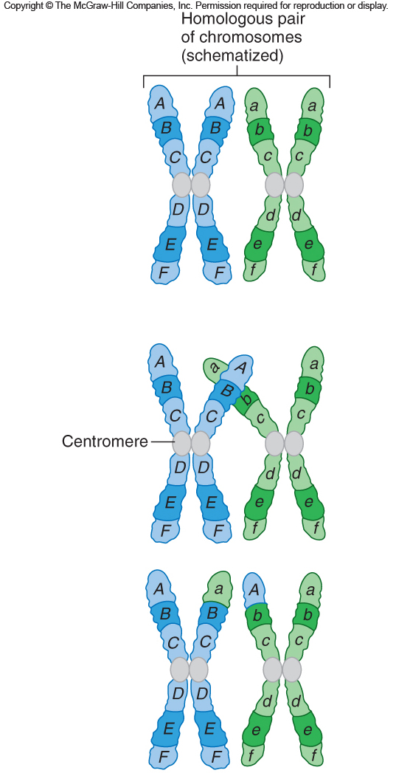
Crossing-over
Figure 3.5
Figure 2.3

Slide 11
Metaphase I
Homologous pairs align along the equator of the cell
The random alignment pattern determines the combination of maternal and paternal chromosomes in the gametes
Figure 2.3

Slide 12
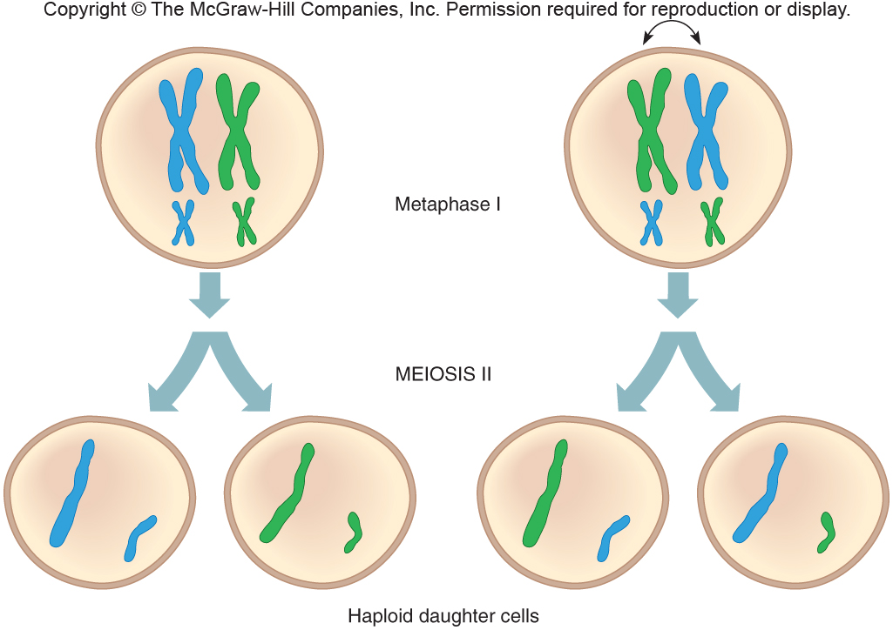
Independent Assortment
Figure 3.6
Figure 2.3

Slide 13
Anaphase I
Homologs separate and move to opposite poles of the cell
Sister chromatids remain attached at their centromeres
Figure 2.3

Slide 14
Telophase I
Nuclear envelope reforms
Spindle disappears
Cytokinesis divides cell into two
Figure 2.3

Slide 15
Interkinesis
A short interphase between the two meiotic divisions
Chromosomes unfold into very thin threads
Proteins are manufactured
However, DNA is NOT replicated a second time
Figure 2.3

Slide 16
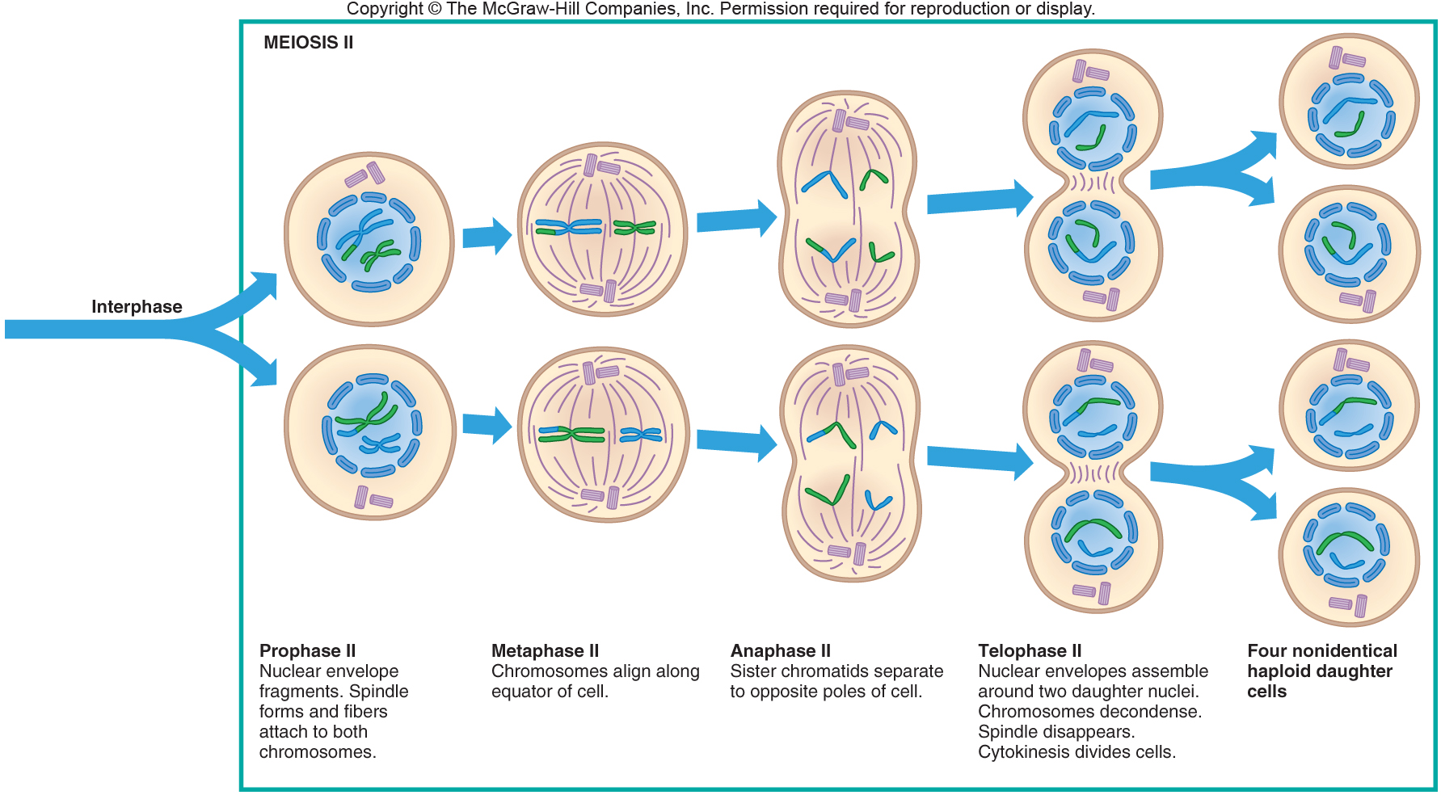
Meiosis II
Figure 3.4
Notes:
16

Slide 17
Prophase II
Metaphase II
Chromosomes are again condensed and visible
Spindle forms
Nuclear envelope fragments
Chromosomes align along the equator of the cell
Figure 2.3

Slide 18
Anaphase II
Telophase II
Centromeres divide
Sister chromatids separate to opposite cell poles
Nuclear envelope reforms
Chromosomes uncoil
Spindle disappears
Figure 2.3

Slide 19
Results of Meiosis
Four haploid cells containing a single copy of the genome
Each cell is unique – carries a new assortment of genes and chromosomes
Figure 2.3

Slide 20
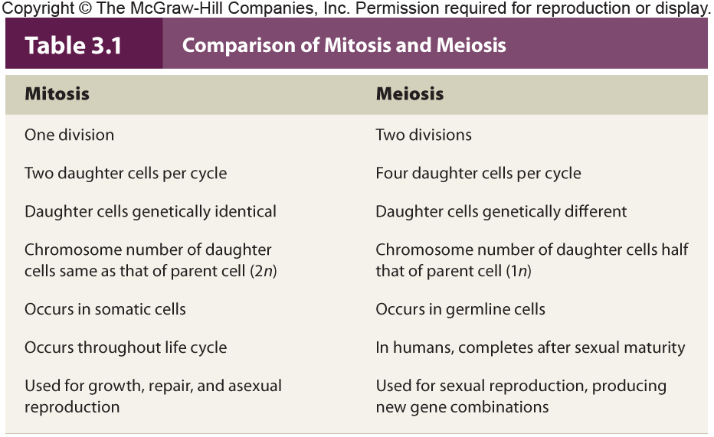
Comparison of Mitosis and Meiosis
Table 3.1
Notes:
20

Slide 21
Meiosis vs. Mitosis Animation
Please note that due to differing operating systems, some animations will not appear until the presentation is viewed in Presentation Mode (Slide Show view). You may see blank slides in the “Normal” or “Slide Sorter” views. All animations will appear after viewing in Presentation Mode and playing each animation. Most animations will require the latest version of the Flash Player, which is available at http://get.adobe.com/flashplayer.
Figure 2.3

Slide 22
Multiple Births
Dizygotic twins (Fraternal)
- Arise from two fertilized ova
- Same genetic relationship as any two siblings
Monozygotic twins (Identical)
- Arise from a single fertilized ovum
- Embryo splits early during development
- Twins may share supportive structures
Figure 2.3

Slide 23
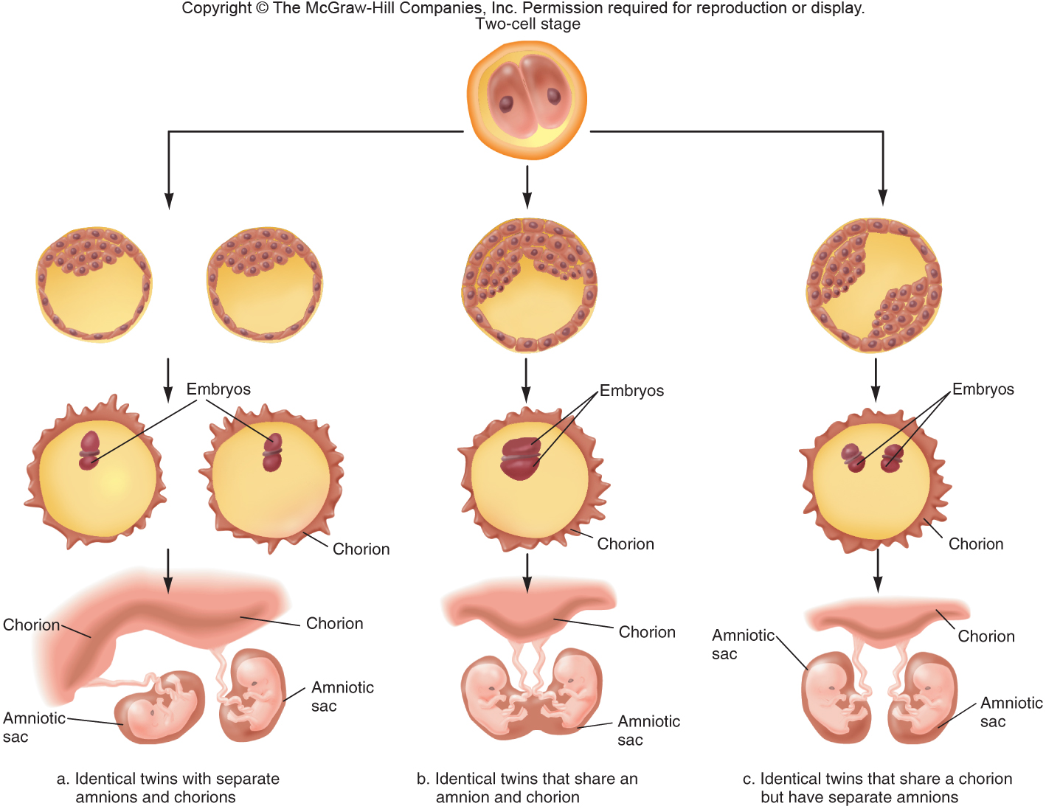
Figure 3.16
Figure 3.16
Notes:
23

Slide 24
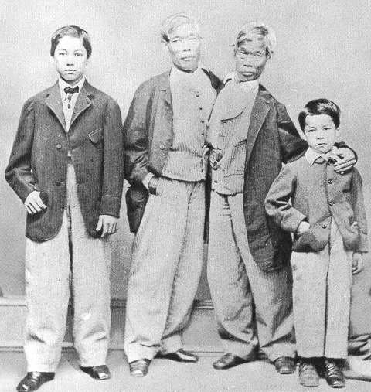
Siamese twins
1 in 50,000 to 100,000 pregnancies results in conjoined or Siamese twins (names for the Siam region of Thailand where Chang and Eng Bunker were born in 1811.
They lived to age 63yrs and had fathered a total of 22 children

Slide 25
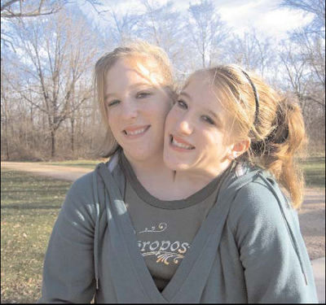
Brittany and Abby Hensel
The Hensel girls are rare incomplete twins known ass dicephalic meaning they have 2 heads.
Each girl has her own head, neck heart, stomach, gall bladder and lungs,
They share a large liver, single blood stream and all organs below the navel
They have 3 kidneys
They each have one arm and one leg.
They enjoy volleyball, basketball and cycling

Slide 26
The Embryo Develops
Organogenesis is the transformation of the simple three germ layers into distinct organs
During week 3, a band called the primitive streak appears along the back of the embryo
This is followed rapidly by the notochord, neural tube, heart, central nervous system, limbs, digits, and other organ rudiments
By week 8, all the organs that will be present in the newborn have begun to develop
- The prenatal human is now called a fetus
Figure 2.3

Slide 27
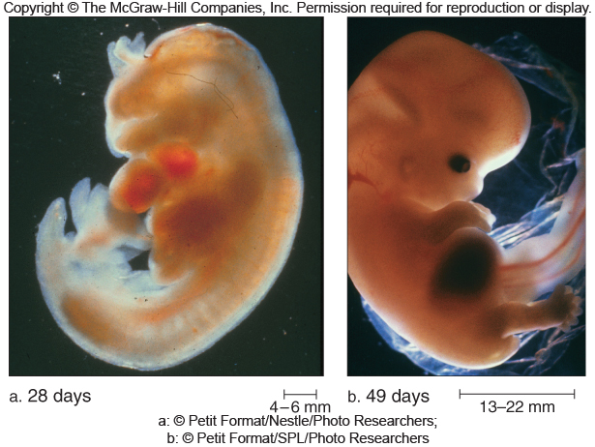
The Embryo Develops
Figure 3.18
Figure 3.18
Notes:
27

Slide 28
The Fetus Grows
During the fetal period, structures grow, specialize and begin to interact
Bone replaces cartilage in the skeleton
Body growth catches up with the head
Sex organs become more distinct
In the final trimester, the fetus moves and grows rapidly, and fat fills out the skin
The digestive and respiratory systems mature last
Figure 2.3

Slide 29
Birth Defects
The time when a particular structure is sensitive to damage is called its critical period
Birth defects can result from a faulty gene or environmental insult
Most birth defects develop during the embryonic period
- These are more severe than those that arise during the fetal period
Figure 2.3

Slide 30
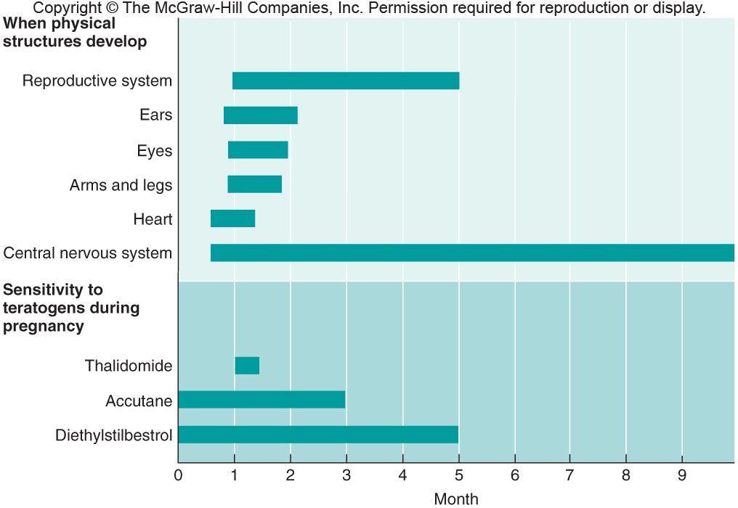
Critical Periods of Development
Figure 3.19
Figure 3.20
Figure 3.19
Notes:
30

Slide 31
Teratogens
Chemical or other agents that cause birth defects
Examples
- Thalidomide
- Cocaine
- Cigarettes
- Alcohol
- Some nutrients
- Some viruses
Figure 2.3

Slide 32
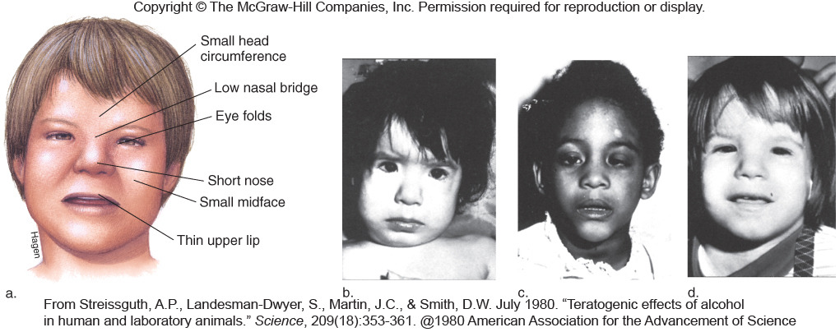
Fetal Alcohol Syndrome
Figure 3.20
Figure 3.21
Notes:
32

Slide 33
Aging
Genes may impact health throughout life
Single-gene disorders that strike in childhood tend to be recessive
Adult-onset single-gene traits are often dominant
Interaction between genes and environmental factors
- Example: Malnutrition before birth
Figure 2.3

Slide 34
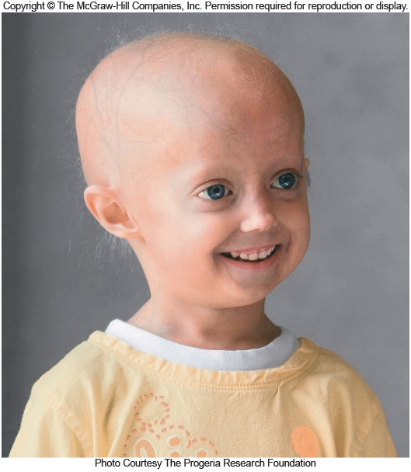
Aging
Genes control aging both passively and actively
A few single-gene disorders can speed the signs of aging
Segmented progeroid syndromes
- Hutchinson-Guilford syndrome
Figure 2.3
Figure 3.22

Slide 35
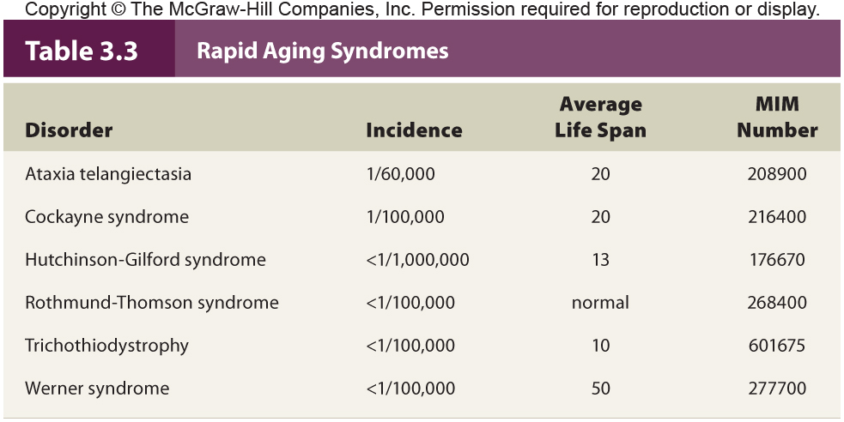
Aging
Figure 2.3

Slide 36
Is Longevity Inherited?
Aging reflects genetic activity plus a lifetime of environmental influences
Human chromosome 4 houses longevity genes
-Genome-wide screens of 100-year olds are identifying others
Adoption studies compare the effects of genes vs. the environment on aging
Figure 2.3

Slide 37
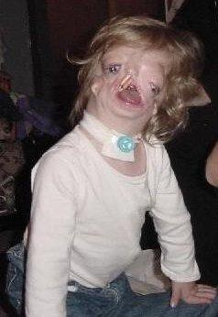
Treacher Collins syndrome is found in 1 in
Treacher Collins syndrome is found in 1 in 10,000 births. The typical physical features include downward slanting eyes, micrognathia (a small lower jaw), conductive hearing loss, underdeveloped zygoma, drooping part of the lateral lower eyelids, and malformed or absent ears.

Slide 38
One known cause of this syndrome is a mutation in the TCOF1 gene, at chromosome 5q32-q33.1. The protein coded by this gene is called treacle and has been hypothesized to assist in protein sorting during particular stages in embryonic development, particularly that of the structures of the head and face. The disorder is inherited in an autosomal-dominant pattern

Slide 39
People with the syndrome can undergo operations on the face to improve appearance, get hearing aids, and can also undergo surgery on a cleft palate

