Slide 1
Little Girl with giant axons
Hannah Sames loves to sing, dance and play outdoors. When she was 2yr old, her arches rolled inward. By age 3 her gait was unusual.
She was diagnosed with giant axonal neurophathy a disorder that affcts intermediate filaments in the nerve cells.
There is no cure, no treatment and little ongoing research for this disorder
Parents started foundation to fund research
http://hannahshopefund.org

Slide 2
Cell Division and Death
Normal growth and development require an intricate interplay between the rates of two processes
Mitosis – Cell division
- Produces two somatic cells from one
Apoptosis – Cell death
- Precise genetically-programmed sequence that carves toes and fingers during embryonic development
Figure 2.3

Slide 3
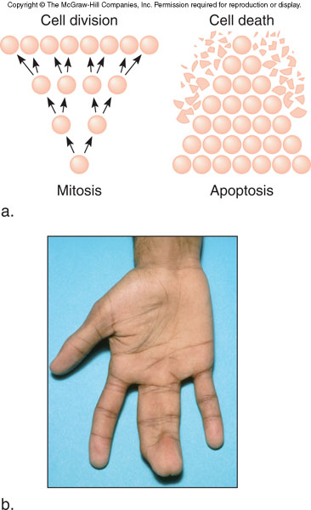
Figure 2.13
Figure 2.12

Slide 4
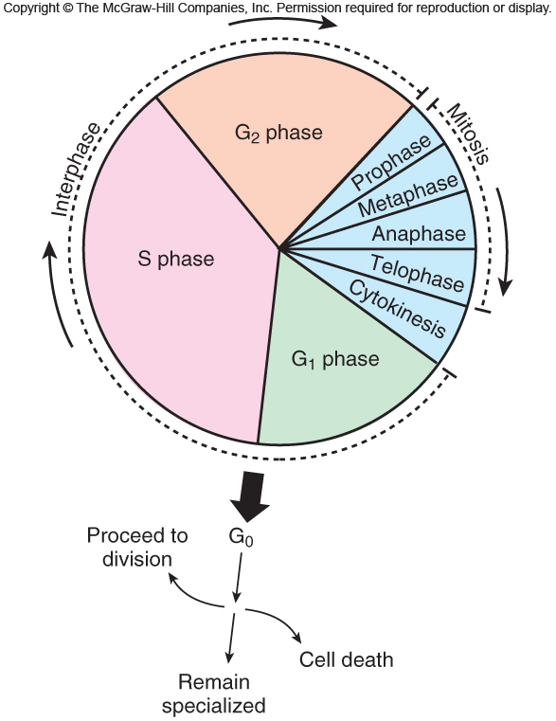
The Cell Cycle
The sequence of events associated with cell division
G phase: Gap for growth
S phase: DNA synthesis
M phase: Mitosis (nuclear division)
Cytokinesis: Cell division
Figure 2.14
Figure 2.3

Slide 5
Stages of the Cell Cycle
Interphase
- Prepares for cell division
- Replicates DNA and subcellular structures
- Composed of G₁, S, and G₂
- Cells may exit the cell cycle at G₁ or enter G₀, a quiescent phase
Mitosis – Division of the nucleus
Cytokinesis – Division of the cytoplasm
Figure 2.3

Slide 6
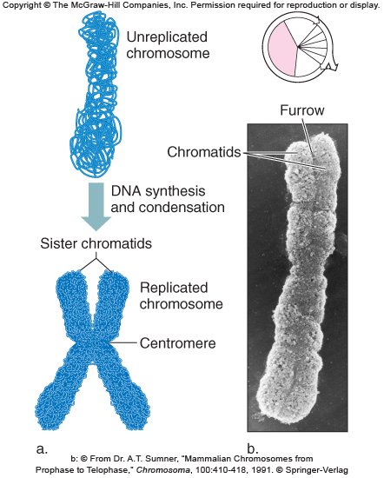
Replication of Chromosomes
Chromosomes are replicated during S phase prior to mitosis
The result is two sister chromatids held together at the centromere
Figure 2.15
Figure 2.3

Slide 7
Mitosis
Used for growth, repair, and replacement
Consists of a single division that produces two identical daughter cells
A continuous process divided into 4 phases
- Prophase
- Metaphase
- Anaphase
- Telophase
Figure 2.3

Slide 8
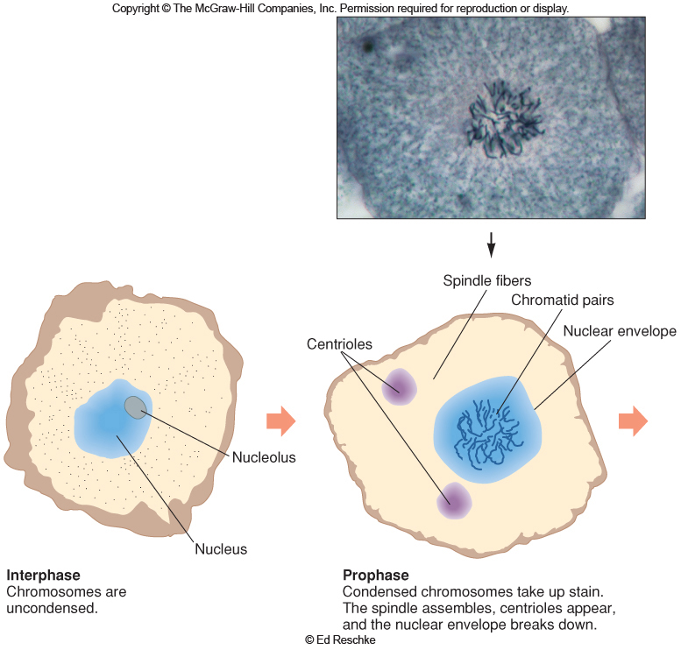
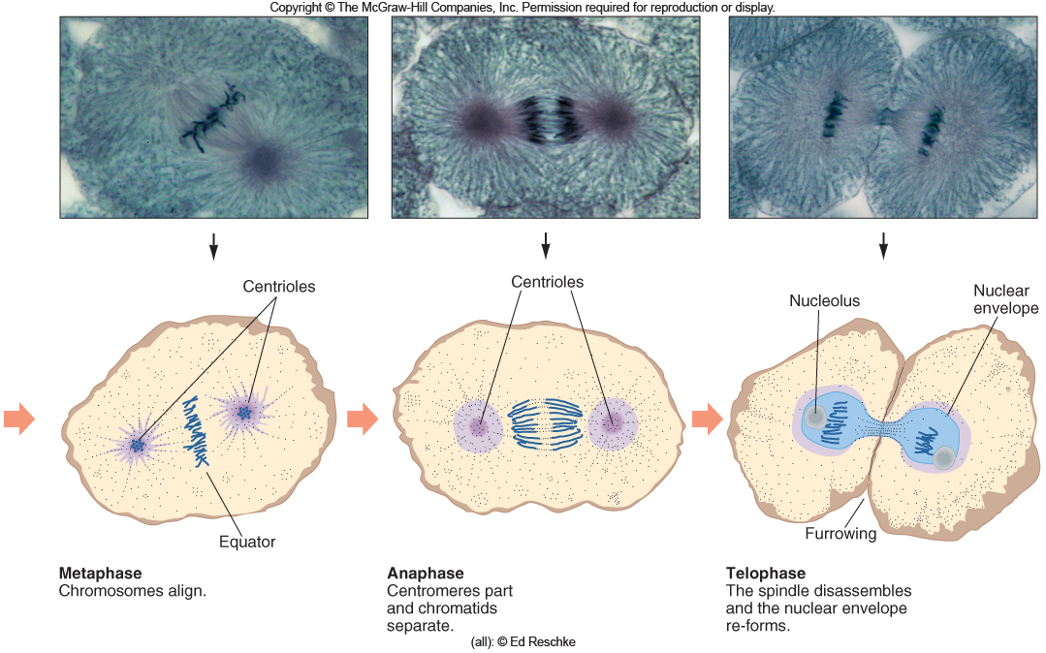
Mitosis in a Human Cell
Figure 2.15
Figure 2.16

Slide 9
Prophase
Replicated chromosomes condense
Microtubules organize into a spindle
Nuclear envelope and nucleolus break down
Figure 2.3
Figure 2.16

Slide 10
Metaphase
Chromosomes line up on the cell’s equator
Spindle microtubules are attached to centromeres of chromosomes
Figure 2.3
Figure 2.16

Slide 11
Anaphase
Centromeres divide
Chromatids separate and become independent chromosomes
- They move to opposite ends of the cell
Figure 2.3
Figure 2.16

Slide 12
Telophase
Chromosomes uncoil
Spindle disassembles
Nuclear envelope reforms
Figure 2.3
Figure 2.16

Slide 13
Cytokinesis
Cytoplasmic division occurs after nuclear division is complete
Organelles and macromolecules are distributed between the two daughter cells
Microfilament band contracts, separating the two cells
Figure 2.3

Slide 14
Mitosis Animation
Please note that due to differing operating systems, some animations will not appear until the presentation is viewed in Presentation Mode (Slide Show view). You may see blank slides in the “Normal” or “Slide Sorter” views. All animations will appear after viewing in Presentation Mode and playing each animation. Most animations will require the latest version of the Flash Player, which is available at http://get.adobe.com/flashplayer.
Figure 2.3

Slide 15
Cell Cycle Control
Checkpoints ensure that mitotic events occur in the correct sequence
Internal and external factors are involved
Many types of cancer result from faulty checkpoints
Figure 2.3

Slide 16
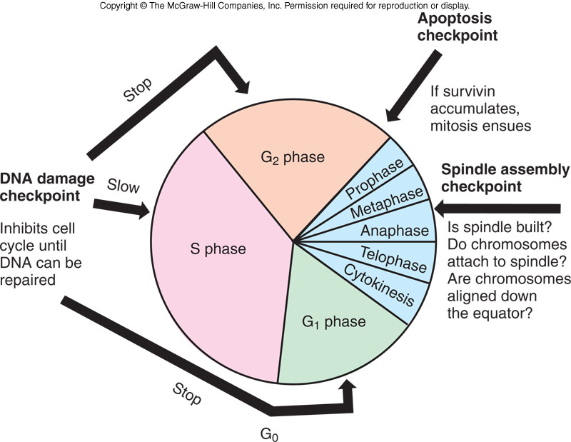
Cell Cycle Control
Figure 2.17
Figure 2.16

Slide 17
Telomeres
Located at the ends of the chromosomes
Contain hundreds to thousands of repeats of a 6-base DNA sequence
Most cells lose 50-200 endmost bases after each cell division
After about 50 divisions, shortened telomeres signal the cell to stop dividing
Sperm, eggs, bone marrow, and cancer cells produce telomerase that prevent shortening of telomeres
Figure 2.3

Slide 18
Apoptosis
Begins when a cell receives a “death signal”
Killer enzymes called caspases are activated
-Destroy cellular components
Phagocytes digest the remains
Dying cell forms bulges called blebs
Figure 2.3

Slide 19
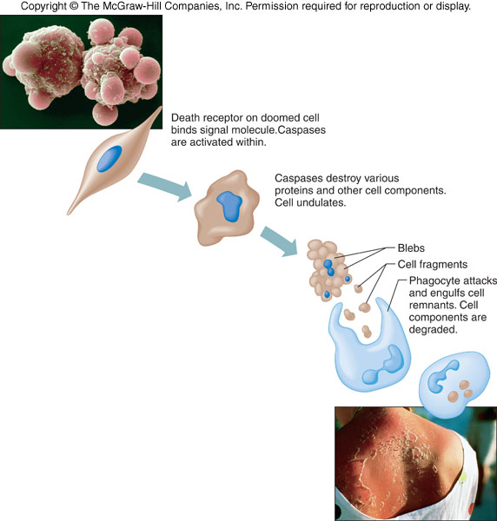
Programmed cell death is part of normal development
Figure 2.19
Mitosis and apotosis work together to form functional body
Cancer can result from too much mitosis, too little apotosis
Figure 2.18

Slide 20
Cell-to-Cell Interactions
Make multicellular life possible
Two broad types
1) Signal transduction
2) Cellular adhesion
Defects cause certain inherited disorders
Figure 2.3

Slide 21
Signal Transduction
The process of transmitting a signal from the environment to a cell
- Receptor binds to “first messenger”
- Interacts with regulator
- Causes enzyme to produce “second messenger”
- Elicits cellular response, which is typically enzyme activation
- Amplification due to cascade
Figure 2.3

Slide 22
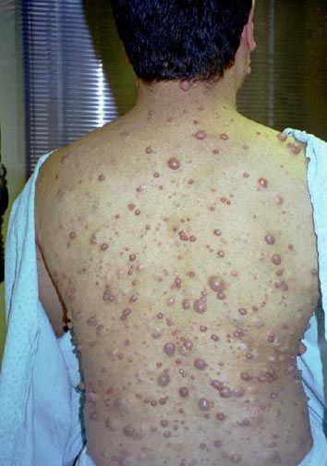
Signal Transduction
Defects in signal transduction underlie many inherited disorders. For example neurofibromatosis type 1 in which benign tumors grow in the nervous tissue especially under the skin

Slide 23
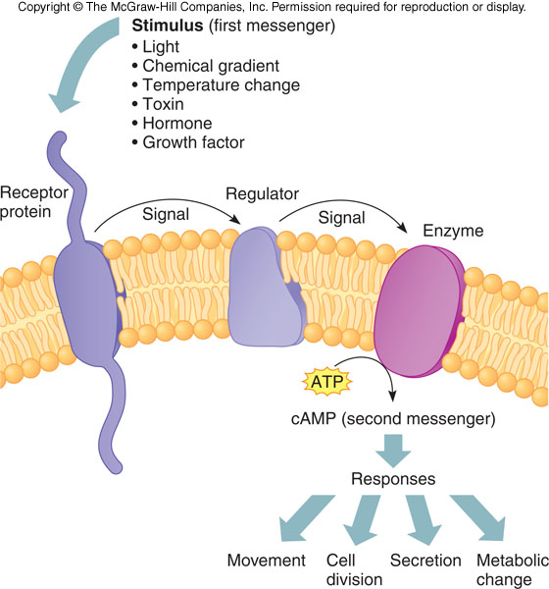
Signal Transduction
Figure 2.20
Figure 2.19

Slide 24
Second Messenger Animation
Please note that due to differing operating systems, some animations will not appear until the presentation is viewed in Presentation Mode (Slide Show view). You may see blank slides in the “Normal” or “Slide Sorter” views. All animations will appear after viewing in Presentation Mode and playing each animation. Most animations will require the latest version of the Flash Player, which is available at http://get.adobe.com/flashplayer.
Figure 2.3

Slide 25
Cellular Adhesion
A precise sequence of interactions among proteins that connect cells
Example = Inflammation
- Three types of cellular adhesion molecules (CAMs) help guide WBCs to the injured area
- Secretins, integrins, and adhesion receptor proteins
Figure 2.3

Slide 26
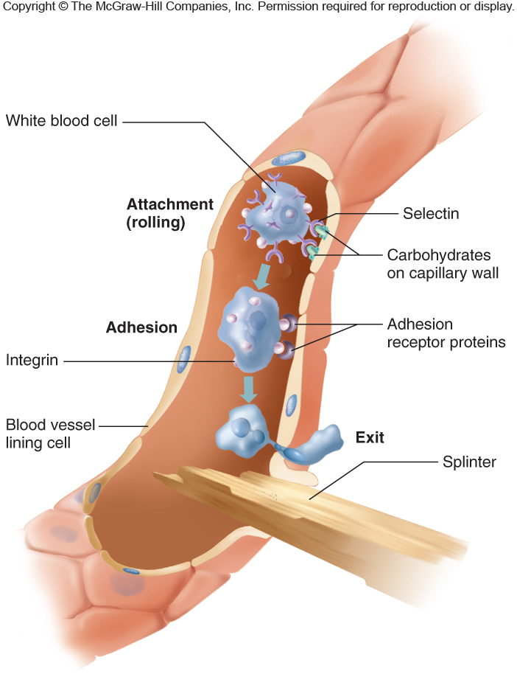
Cellular Adhesion
Figure 2.21
Figure 2.20

Slide 27
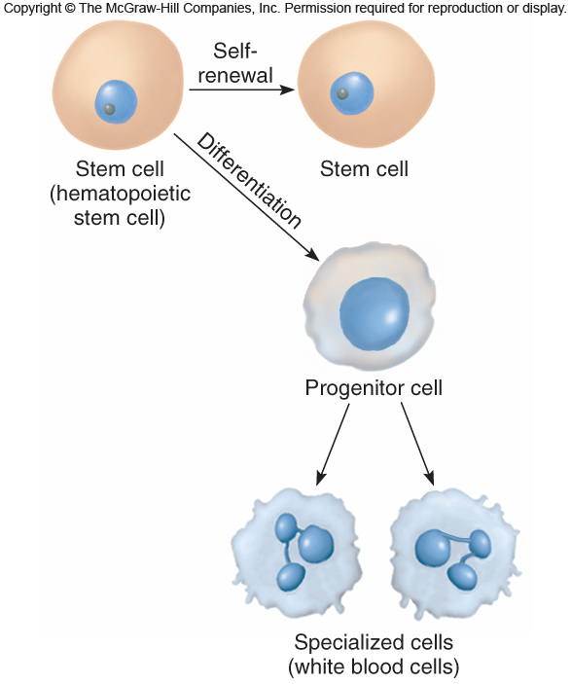
Stem Cells
A stem cell divides by mitosis
- Produces daughter cells that retain the ability to divide and some that specialize
Progenitor cells do not have the capacity of self-renewal
Figure 2.3
Figure 2.22

Slide 28
Stem Cells
All cells in the human body descend from stem cells via mitosis and differentiation
Cells differentiate down cell lineages by differential gene expression
Stem cells are present throughout life and provide growth and repair
Figure 2.3

Slide 29
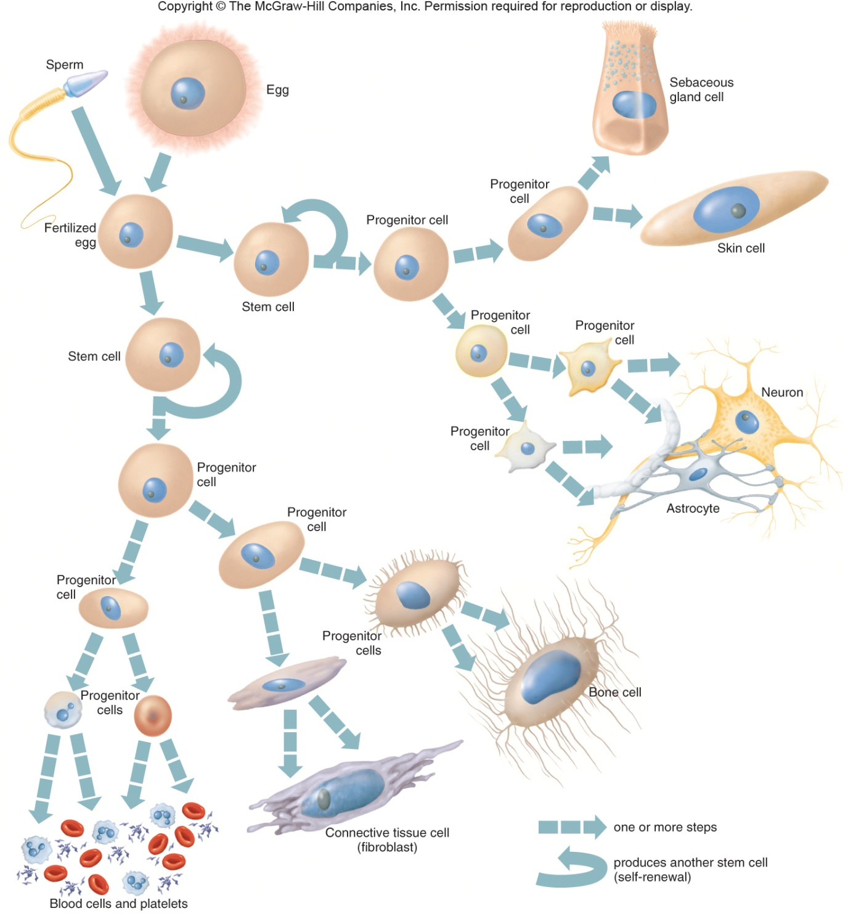
Figure 2.23
Figure 2.3

Slide 30
Stem Cells
Stem cells and progenitor cells are described in terms of their developmental potential
Totipotent – Can give rise to every cell type
Pluripotent – Have fewer possible fates
Multipotent – Have only a few fates
Figure 2.3

Slide 31
Stem Cells in Health Care
There are 3 general sources of human stem cells
1) Embryonic stem cells – Created in a lab dish using the inner cell mass (ICM) of an embryo
2) Induced pluripotent stem (iPS) cells – Somatic cells reprogrammed to differentiate into any of several cell types
3) Adult stem cells – Tissue-specific or somatic stem cells
Figure 2.3

Slide 32
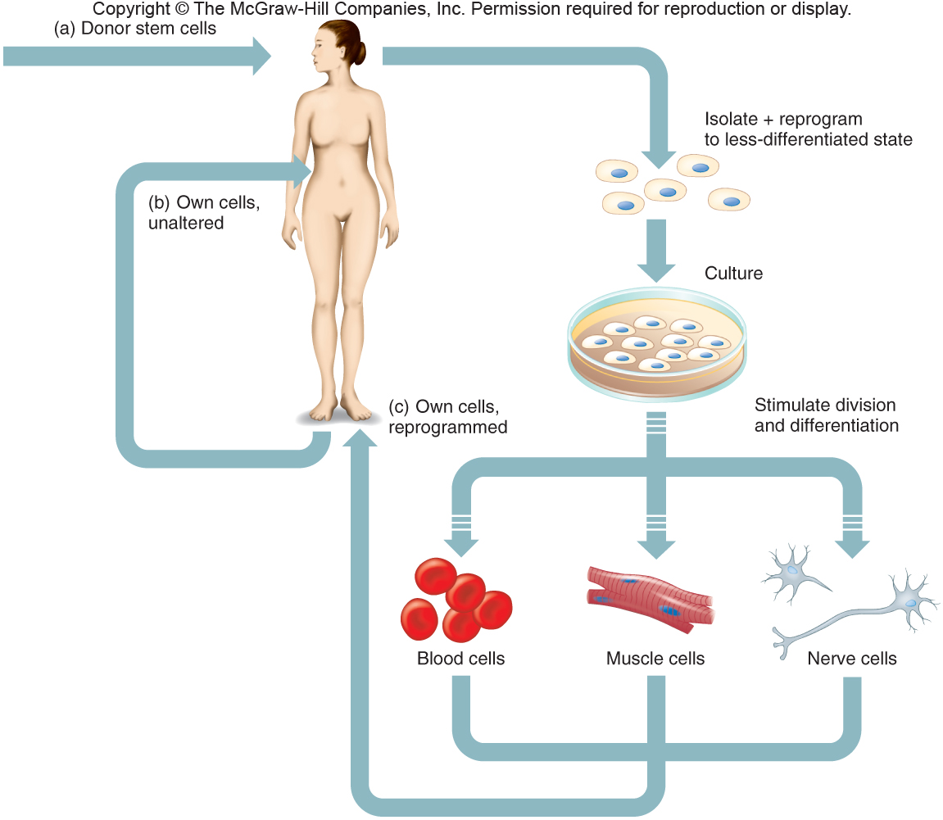
Stem Cells in Health Care
Figure 2.24
Figure 2.24

Slide 33
Stem Cell Applications
Stem cells are being used in four basic ways
1) Discovery and development of drugs
2) Observing the earliest sign of disease
3) Treatment of disease via implants and transplants
4) Stimulating stem cells in the body via the introduction of reprogramming proteins
Figure 2.3

Slide 34
Reproductive cloning: also called somatic cell nuclear transfer
oocyte is retrieved
Enucleation: the removal of nucleus from the cell
somatic cell nuclear transfer from donor to cell ( in Dolly this was a mammillary gland cell from a 6 yr old sheep
activation of embryo to develop
embryo transfer to surrogate mom

Slide 35
Therapeutic cloning:
#1-4 same
Then the clone of the donors embryo grows in a Petri dish for 6 days ( cells in the blastocyst stage) ( window for use is 10 days…on day 6 this means cells are viable for 4 more days) ( on day 11 they change and are no longer in blastocyst stage)
The embryonic stem cells are then removed from the embryo and used to produce cells for therapy, the embryo is destroyed in this process.
These cells can be used because they are pluripotent stem cells meaning they can be programmed to become any of the 220 different types of cells found in the human body

Slide 36
Alternative to embryo destruction
The formation of ethical pluripotent stem cells: (those that arise without the destruction of an embryo)such as IPs …this can be done by:
biopsy of 8 cell embryo ( remove one cell)
ANT: altered nuclear transfer
living cells from dead embryo
parthenogenesis
reprogramming cells with a new signal ( cells such as skin cells are used and go through reproductive steps #2- 5 with 5 being the donors needed organs)
Ips: means induced pluripotent stem cells

Slide 37
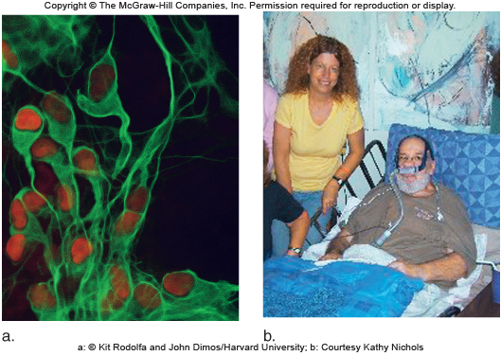
Stem Cell Applications
Figure 2.25
Figure 2.3

Slide 38
Cloning from differentiated somatic cells.
Ian Wilmut and his team of researchers at Roslin Institute in Scotland cloned Dolly, the first mammal to be cloned from a somatic cell.

Slide 39
Nuclear transfer method of producing clones
Animal Cloning

Slide 40
Four reasons why genetically identical animals are not phenotypically identical.
Mitochondria
Immune response
Epigenetics
Embryo development

Slide 41
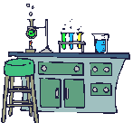
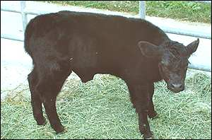
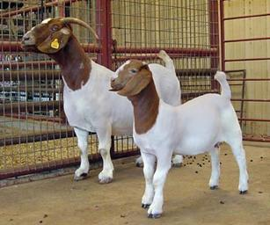
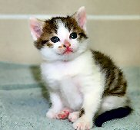
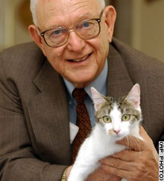
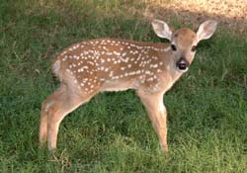
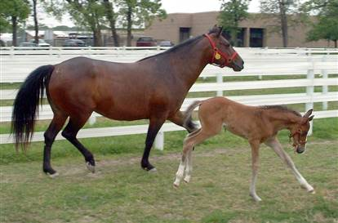
Cloning at Texas A&M
World leader in producing the most number of clones from different species
Cattle
Second Chance (1999)
86² (2000)
Goat – Second Addition (2001)
Pig litter (2001)
Cat - Cc (2001)
Deer – Dewey (2003)
Horse – Paris Texas (2005)
Notes:
Second Chance: first cloned calf from adult steer; oldest animal ever cloned (21 year old Brahman)
Bull 86²: name due to his exponential genetic potential; first animal cloned for disease resistance; cloned using ear cells that were frozen for 15 years (1985), representing the longest time ever that genetic material has been maintained by cryopreservation, thawed and then successfully used in cloning; born 3 years after the death of Bull 86 (Angus), who was resistant to brucellosis, salmonellosis, and tuberculosis
Donor for cloned Boer goat: 8-year-old Boer Champion doe and a top producer in Ewing and Donna Downen's breeding program in Early, Texas
Cc (Carbon Copy) the Cat – first cloned pet
Dewey – first cloned deer
Paris Texas, Horse – first cloned horse in North America. Others produced in Italy. Cloned by team of French and American researchers. A&M researchers used adult horse skin cells biopsied from a valuable horse in Europe to clone the foal. The process took 400 attempts over a four-month period. Six embryos were created but only one was successfully gestated in a host horse named Greta during a pregnancy that lasted 12½ months. Horses usually have an 11-month gestation.

