Slide 2
In 1960, a 3 year old Michael lost his left eye in an accident. His right eye was already impaired from scars on the cornea. At 39 Michael received stem cells from a donated cornea and the tissue finally regrew.
Researchers learned just recently that corneal transplants work only if the transplanted tissue includes stem cells.
After the transplant, Michael could see his wife and 2 sons for the first time. His brain had to interpret images, he could discern shapes and colors, but not 3D objects.
The eye actually contains several varieties of stem cells. These cells are typically discarded during eye surgery, but when cultured in a dish, they can become nearly any cell type.

Slide 3
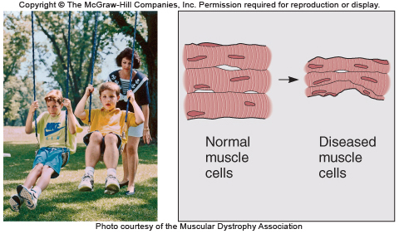
Introducing Cells
Cellular activities and abnormalities underlie our inherited traits, quirks, and illnesses
Understanding genetic diseases can suggest ways to treat the condition
Lack of
dystrophin
Figure 2.1

Slide 4
In Duchenne muscular dystrophy (MIM 310200), the reason the little boy’s calf muscles are overdeveloped is that he cannot stand normally because other muscles are week. These affected cells lack a protein called dystrophin that supports the cells shape during forceful contractions

Slide 5
Introducing Cells
Our bodies include more than 260 cell types
Somatic (body) cells have two copies of the genome and are said to be diploid
Sperm and egg cells have one copy of the genome and are haploid
Stem cells can both replicate themselves and give rise to differentiated cells
Notes:
5

Slide 6
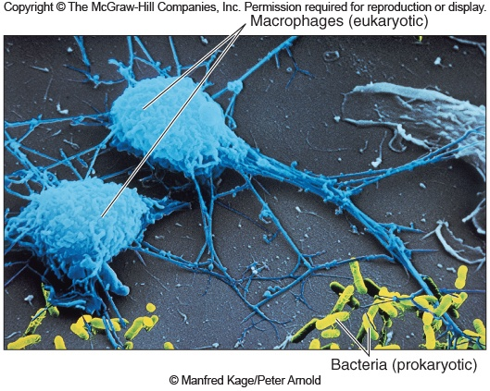
Types of Cells
All cells can be divided into two main types
Prokaryotic cells
- Lack a nucleus
Eukaryotic cells
- Possess a nucleus and other organelles
Figure 2.2
Notes:
6

Slide 7
Domains of Life
Biologists recognize three broad categories of organisms
Archaea – Unicellular prokaryotes
Bacteria – Unicellular prokaryotes
Eukarya – Includes both unicellular and multicellular eukaryotes
Notes:
7

Slide 8
Chemical Constituents
Cells contain four types of macromolecules
Type | Examples | Functions
Carbohydrates | Sugars, starches | Energy, structure
Lipids | Fats, oils | Membranes, hormones
Proteins | Myosin, collagen | Enzymes, structure
Nucleic Acids | DNA, RNA | Genetic information
Notes:
8

Slide 9
Inborn Errors of Metabolism: Carboydrates
The newborn yelled and pulled up her chubby legs in pain a few hours after each feeding. She had watery diarrhea.
Diagnosis: lactose deficiency due to missing lactose enzyme
Solution: switch to a soybean based formula

Slide 10
Inborn Errors of Metabolism: Lipids
A sudden sharp pain began in the man’s arm and spread to his chest. He was 36 and suffering a heart attack
Diagnosis: familial hypercholesterolemia
Reason: he had inherited a gene variant that halved the number of protein receptors for cholesterol on his liver cells so the arteries clogged with cholesterol

Slide 11
Inborn Errors of Metabolism: Proteins
Newborn Tim slept most of the time and he vomited so often that he hardly grew. His urine smelled like maple syrup
Diagnosis: Maple syrup urine disease
Reason: his body could not digest 3 types of amino acids which built up in the bloodstream
Treatment: diet very low in these 3 amino acids to control symptoms

Slide 12
Inborn Errors of Metabolism: Nucleic acids
From birth, Troy’s wet diapers contained orange, sand like particles, but otherwise seemed healthy. By age 6 months he was in pain when he urinated.
Diagnosis: Lesch-Nyhan syndrome cuased by a deficiency of an enzyme called HGPRT
Troy would probably die before age 30 from kidney failure or infection

Slide 13
An Animal Cell
Surrounded by the plasma membrane
Contains:
- Cytoplasm
- Organelles
- Divide labor by partitioning certain areas or serving specific functions
Figure 2.3

Slide 14
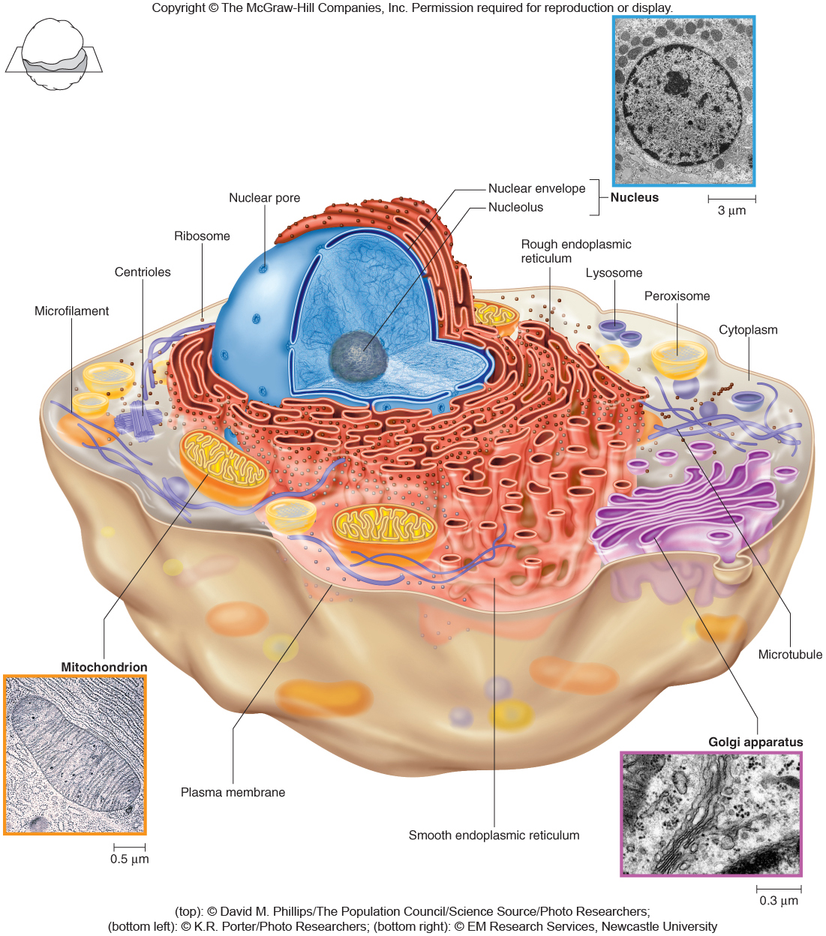
An Animal Cell
Figure 2.3
Figure 2.3

Slide 15
The Nucleus
The largest structure in a cell
Surrounded by a double-layered nuclear envelope
Contains:
- Nuclear pores that allow movement of some molecules in and out
- Nucleolus, which is the site of ribosome production
- Chromosomes composed of DNA and proteins
Figure 2.3

Slide 16
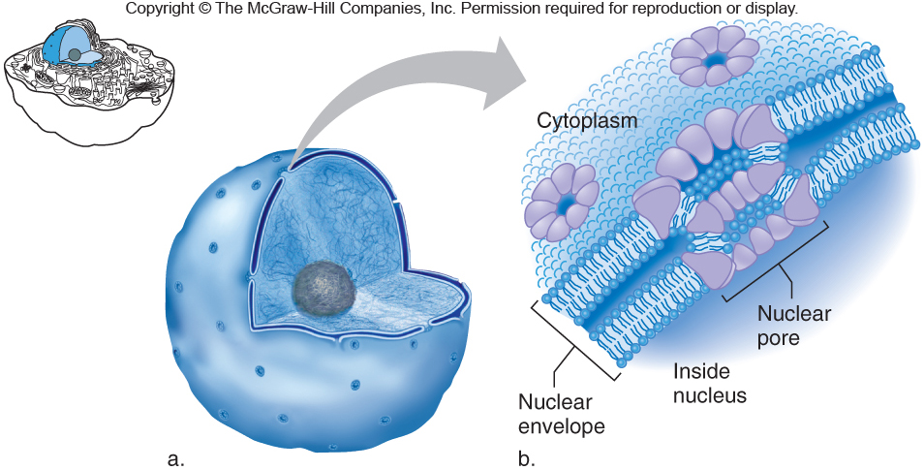
The Nucleus
Figure 2.4
Figure 2.3
Figure 2.4

Slide 17
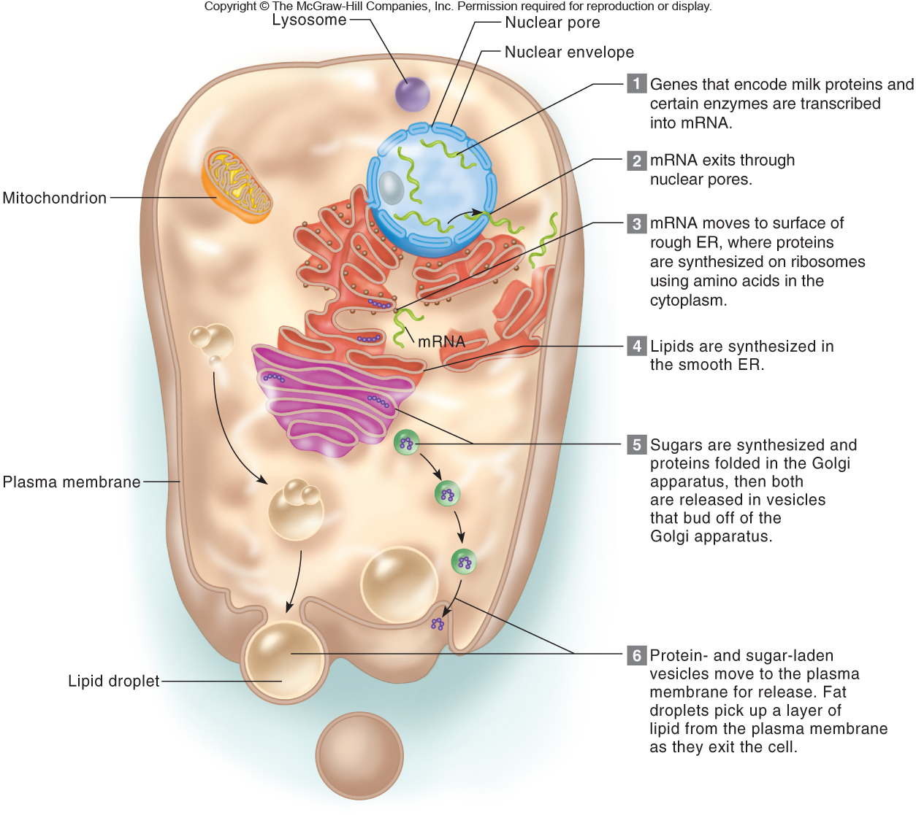
Secretion illustrates how organelles function together to coordinate the basic functions of life
Figure 2.5

Slide 18
Endoplasmic Reticulum (ER)
Interconnected membranous tubules & sacs
Winds from the nuclear envelope to the plasma membrane
Rough ER contains ribosomes and is involved in protein synthesis
Smooth ER does not contain ribosomes and is important in lipid synthesis
Figure 2.3

Slide 19
Golgi Apparatus
Stack of flat membrane-enclosed sacs
Processing center that adds sugars forming glycoproteins and glycolipids
Site of final protein folding
Products are released into vesicles that bud off to the plasma membrane
Figure 2.3

Slide 20
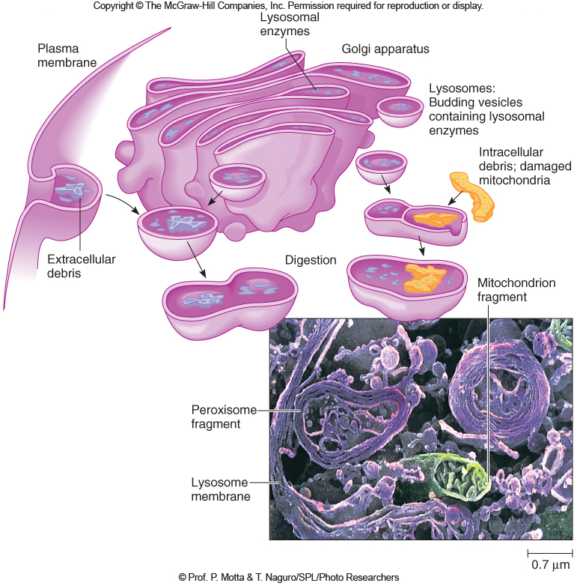
Lysosomes
Membrane-bound sacs containing > 40 types of digestive enzymes
Break down bacteria, cellular debris, and nutrients
Tay-Sachs is an inherited lysosomal storage disorder
Figure 2.3
Figure 2.6

Slide 21
Peroxisomes
Sacs with outer membranes studded with several types of enzymes
Break down lipids, rare biochemicals
Synthesize bile acids
Detoxify compounds from free radicals
Abundant in liver and kidney cells
Figure 2.3

Slide 22
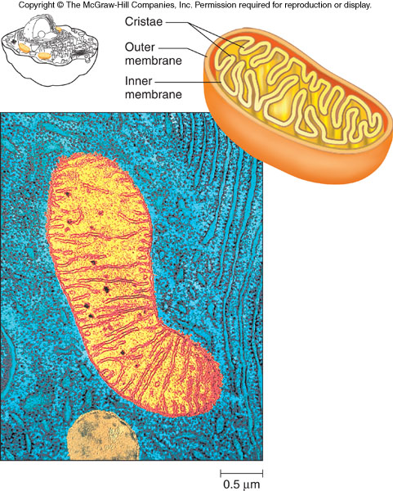
Mitochondria
Surrounded by two membranes
Site of ATP (energy) production
Contain their own circular DNA
Human mitochondrial DNA is inherited only from the mother
Figure 2.7
Figure 2.3

Slide 23
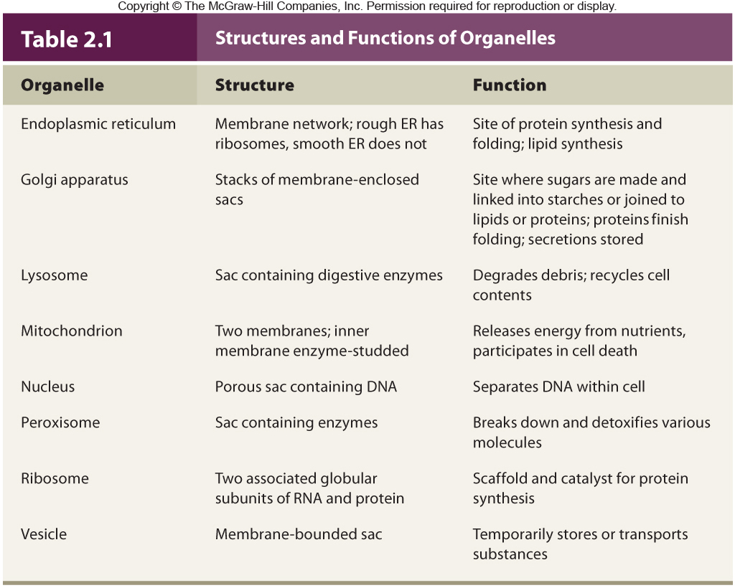
Structures and Functions of Organelles
Table 2.1

Slide 24
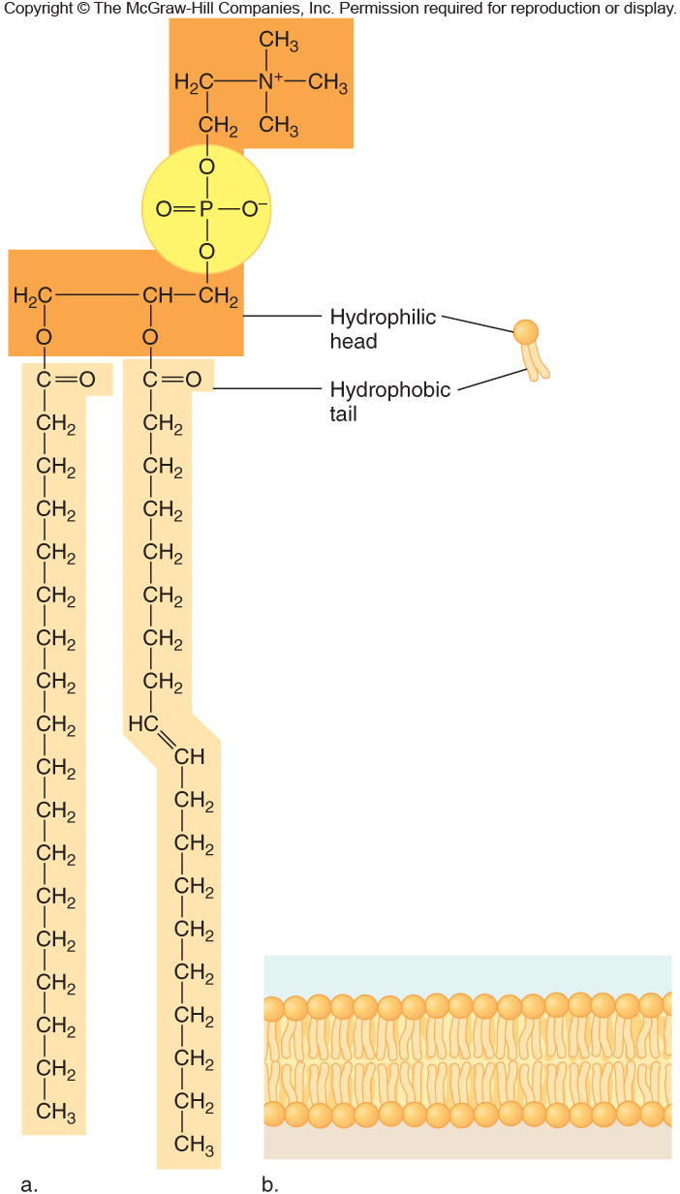
Plasma Membrane
Forms a selective barrier
A phospholipid bilayer
- Phosphate end (hydrophilic)
- Fatty acid chains (hydrophobic)
Figure 2.8
Figure 2.3

Slide 25
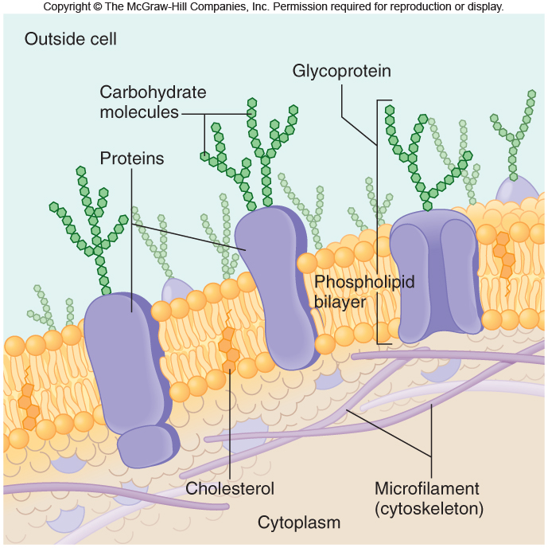
Plasma Membrane
Contains proteins, glycoproteins, and glycolipids
- Important to cell function and interactions
- May be receptors
- Form channels for ions
Figure 2.3
Figure 2.9

Slide 26
Faulty Ion Channels Cause Inherited Diseases
Sodium channels
- Mutations lead to absence or extreme pain
Potassium channels
- Mutations lead to impaired heart function and deafness
Chloride channels
- Mutations lead to cystic fibrosis
Figure 2.3

Slide 27
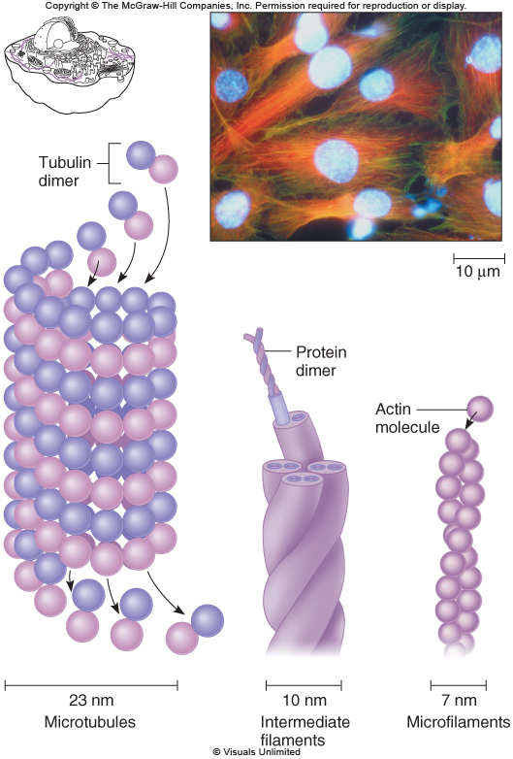
Cytoskeleton
A meshwork of protein rods and tubules
Includes three major types of proteins
- Microtubules
- Microfilaments
- Intermediate filaments
Figure 2.3
Figure 2.10

Slide 28
Cytoskeleton Functions
Maintain cell shape
Connect cells to each other
Transport organelles and small molecules
Provide cell motility (some cell types)
Move chromosomes in cell division
Compose cilia
Figure 2.3

Slide 29
Cells are constantly building up and breaking down the microtubules.
Some drugs used to treat cancer affect the microtubules by preventing them from assembling thus stopping cell division.

Slide 30
Intermediate filaments form a strong inner framework that attaches the cells to each other and to the tissue below.
IN an inherited condition called epidermolysis bullosa, the intermediate filaments are abnormal.
The skin blisters easily as tissue layers seperates.

