Slide 1
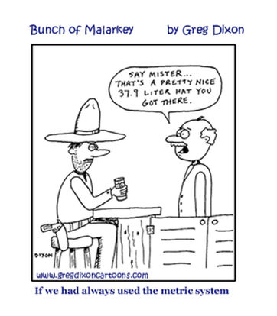
Unit 2 Metrics

Slide 2
Scientific Measurements
As you have learned experimenting is an important part of any scientific method.
Most experiments involve measurements
Measurements made during experiments must be reliable and accurate as well as easily communicated to others

Slide 3
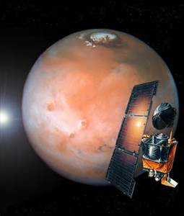
Mixed up measurements:
September 1999 americans got a nasty reminder of how the rest of the world measures weights and distances.
Nasa lost its $165 mars climate orbiter when one team of flight controllers had programmed the space craft with English units (pounds and feet) and the other had entered numbers using a metric scheme (newtons and meter)

Slide 4
si Measurements
The standard system used by all scientists ( for measurements) is the Metric system also called the International system of Units (SI)
Scientist use metric units to measure: length, volume, mass, density and temperature

Slide 5
Fundamental Units ( 7 in SI)
QUANITY | UNIT | SYMBOL
Length | meter | m
mass | kilogram | Kg
time | second | s
temperature | kelvin | k
Amount of substance | mole | mol
volume | liter | L
Electric current | ampere | A
Luminous intensity | candela | cd

Slide 7
Length
The distance from one point to another
The basic SI unit for length is the meter(m)
1 meter = 39.4 inches ( a little longer than 1 yard)
Smaller SI units for length include the centimeter (cm) and millimeter (MM)
Kilo= 1000 milli = 1/1000
Centi= 1/100

Slide 8
Conversion info
King Henry died Monday drinking chocolate milk
Kilo- hector- deca- meter- deci- centi- milli
liter
gram
GO over how to use these conversions

Slide 11
Mass
The measure of the amount of matter in an object
SI Unit is the kilogram (kg)
Other unit s are the gram and milligram
1 gram = about the weight of 1 paper clip
1 kg= 1000g
1g= 1000mg

Slide 12
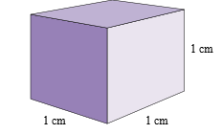
Volume
The amount of space an object takes up
SI unit for volume is the liter (L)
To measure volumes smaller than a liter, milliliters are used
The metric unit used to measure solids is the cubic centimeter (CM³)
A cubic centimeter is the volume of a cube measuring 1 cm b 1 cm by 1cm
1 cm³ = 1ml
1l=1000ml or 1000 cm³

Slide 13
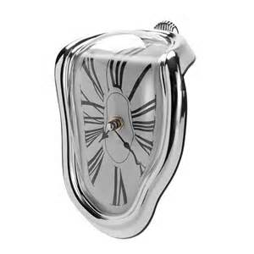
Time
The SI unit or time is the second
1 second = 1/60 minute
It may be confusing because the definition of a minute depends on the definition of an hour which is based on the duration of a day ( and day is not always 24 hrs long)
Day is the length of time it takes the earth t rotate exactly once on its axis
Problems:
1. Convert 2 hours to seconds given 1hr = 60 minutes
2. Convert 2 days to seconds

Slide 14
ENGLISH TO METRIC CONVERSIONS
LENGTH | VOLUME | MASS
2.54 centimeters= 1 inch | 1 LITER = 1.06 QUARTS | 1 KILOGRAM = 2.2 POUNDS
1 meter = 39.37 inches |  | 28.3 GRAMS = 1 OUNCE
1 meter =1.09 yards |  | 1 POUND = 453.6 GRAMS
1 kilometer = .062 miles
1 mile = 5280 feet

Slide 16
Density
The mass per unit volume of a substance
Density= mass/volume
Example: what is the density of an object if it has a mass of 10 grams and a volume of 10 milliliters?

Slide 17
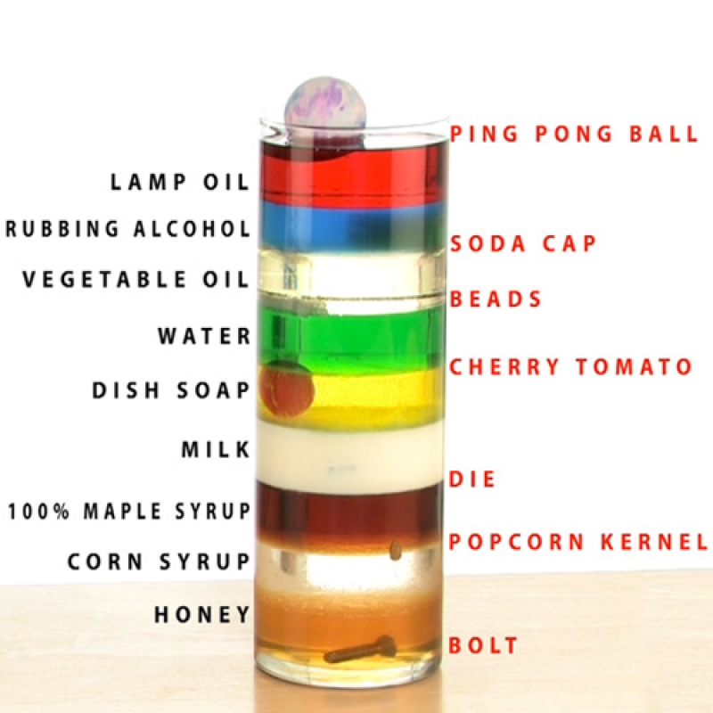
Density
As it turns out, this is the density of water
Objects with a density less than water will float, and those with a density greater than water will sink

Slide 19
temperature
The measure of the motion of molecules
Si unit is kelvin scale (k) formulas
F= Fahrenheit
C= Celsius c = .55 (f-32) c = k- 273
K= kelvin k= c + 273
f = 1.8( c) + 32

Slide 20
example
Convert body temperature from Fahrenheit to Celsius then to kelvin

Slide 21
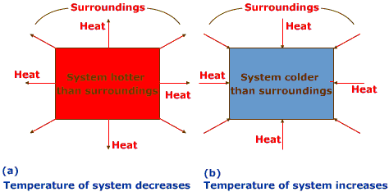
Heat and Heat Energy
It is the sum total of the kinetic energies of the particles in a sample of matter
At always flows spontaneously from matter at a higher temperature to matter at a lower temperature

Slide 22
Si unit for heat is the joule (j)
An older unit is the calorie which is the quantity of heat required to raise the temperature of 1 gram of water from 14.5 to 15.5 c
1 cal =4.184j
1000j = 1 kj (kilojoule)
Ex Convert 275 cal to joules then kilojoules

Slide 23
Specific heat and heat capacity
Heat capacity: The amount of heat energy needed to raise the temperature of a given sample of matter by one Celsius degree
Specific heat: the amount of heat energy needed to raise the temperature of 1 gram of a substance by 1 C

Slide 24
3 things that determine the quantity of heat lost or gained during a temperature change
nature of matter changing temperature
Mass of matter changing temperature
Size of temperature change

Slide 25
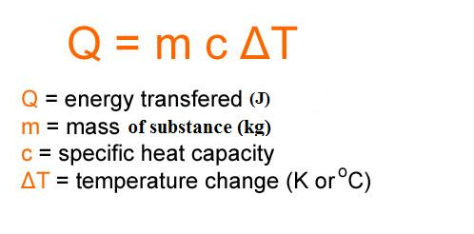
Specific heat
Heat lost or gained = mass x change in temperature x specific heat

Slide 26
Specific heat
Specific heat is measured in joules per gram degree Celsius (j/g C )
The specific heat of water is 1j/g c

Slide 27
example
a 4 gram sample of glass was heated from 1c to 41 c, a temperature change o 40c and was found to have absorbed 32 j of heat
What is the specific heat of this type of glass?
How much heat did the same glass sample gain when it was heated from 41 C to 71 c?

Slide 28
Scientific notation
In science, numbers can range from very small to very large
Example Avogadro’s number : 602 213 674 000 000 000 000 000
or the mass of an electron which is 0.0000000000000000000000000000009109
To make these numbers easier to read, we us scientific notation

Slide 29
Scientific notation

Slide 30
Scientific notation

Slide 32
Scientific notation

Slide 34
Significant figures

Slide 37
Using scientific measurements
The quality of a measurement depends on the instrument and the person making the measurement
Uncertainty in measurements an also result from limitations in accuracy or precision
Accuracy: refers to the closeness of a measurement to the true or accepted value of the quantity measured
Precision: refers to the agreement among the numerical values of a set of measurements of the same quantity made in the same way

Slide 38
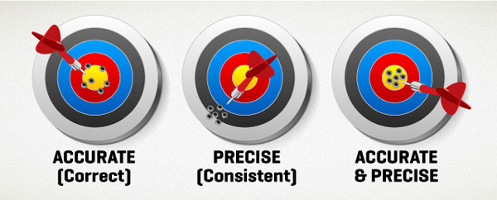
differences between accuracy and precision
on a dart board, the closer the darts are to the bull’s eye, the more accurate.
The closer the darts in a group are to each other, the more precise

Slide 39
Dimensional analysis
The skill of converting one unit to another
One of the most fundamental and important skills used in chemistry
Success in chemistry depends on your understanding and proficiency in this skill

Slide 42
