Slide 1
Unit 1 Lab Safety

Slide 3
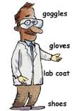
Laboratory Safety Rules
Wear proper eyewear wear when performing any dangerous lab activity. Consult with your instructor about your use of contact lenses.
Confine or securely tie hair that reaches to shoulders. Remember that hair is very flammable!!
Footwear that completely covers the foot is highly recommended. Footwear, at the very least, should be hard-soled sandals

Slide 4
Do not eat, drink, or chew gum in the laboratory. Never taste anything in the laboratory unless specifically instructed to do so by your teacher.
No chemicals are ever to be taken from the laboratory

Slide 5
Do only the experiments assigned and in the manner prescribed. Unauthorized experiments are prohibited.
Never engage in horseplay or practical jokes

Slide 6
Avoid inhaling chemical fumes; avoid filling pipets by using your mouth; consider ALL chemical dangerous unless they are known to be otherwise.
The teacher is to be notified immediately in case of an accident no matter how trivial it may appear
Notify instructor immediately of any spills on your clothing

Slide 8
Do not use the sink to discard matches, filter paper or insoluble solids. Use the waste jars that are provided
Do not return chemicals to their original containers unless you are specifically instructed to do so.
Never point the open end of a test tube being heated at yourself or others

Slide 9
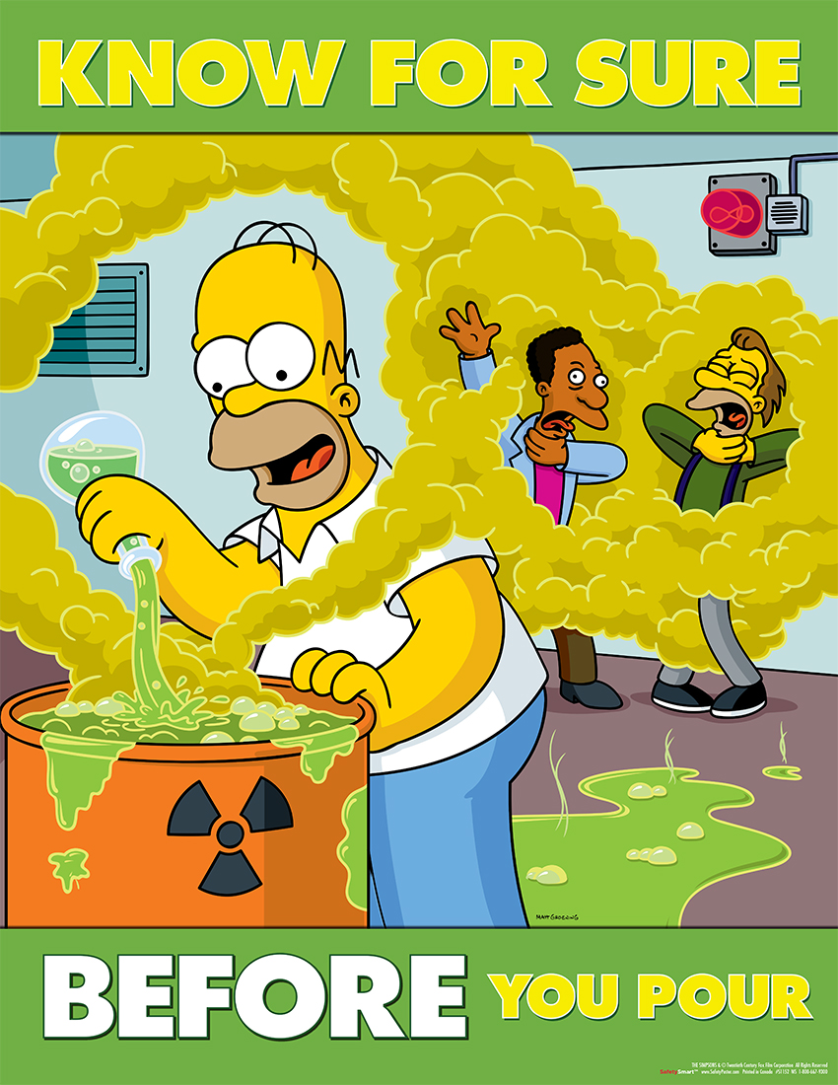
Always add acid to water. This is particularly true of concentrated sulfuric acid
Acid to water NEVER WATER TO ACID
Never work alone in the laboratory

Slide 10
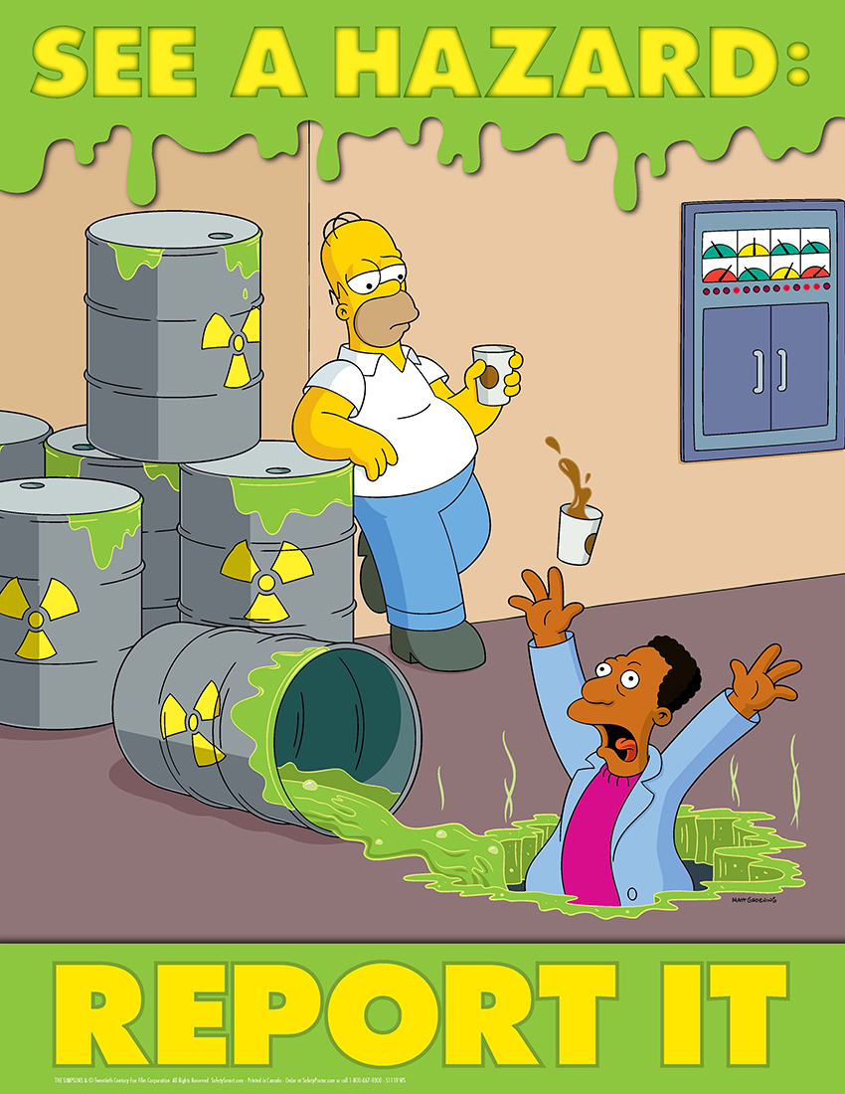
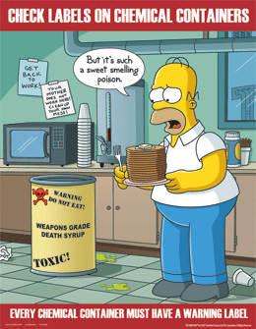

Slide 13
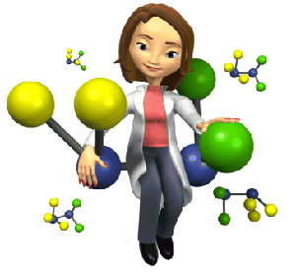
Safety equipment
Fire Extinguisher
Fire Blanket
Eyewash Fountain
First Aid Kit
The Fume Hood
Safety Shower
Broken Glass
Material Safety Data Sheets
Safety Warning Diamond

Slide 14
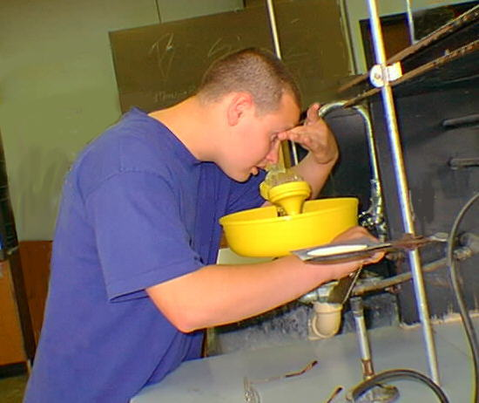
Eyewash Fountain
you get something from the lab in your eye—
GET IT OUT IMMEDIATELY!
Don't wait until lunch or the last period!
Run some water through the eyewash fountain before you use it.
Retract your eyelid (hold it open);
Don’t squint your eyes this restricts water access.
Run fresh water over your eye for several minutes.
INFORM THE INSTRUCTOR IMMEDIANTLY

Slide 15
FIRST AIDE: INFORM THE INSTRUCTOR IMMEDIANTLY
If blood is in evidence-- STAY AWAY!
Let the victim apply his/her own bandage.
If blood is on the floor or lab bench, let trained personnel do the clean-up

Slide 16
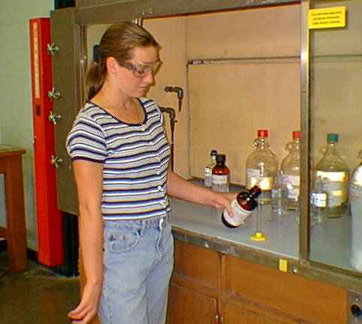
FUME HOOD
USE the HOOD for reactions that give off vapors, especially smelly vapors.
The draft of the HOOD will sweep away vapors so that the lab itself maintains reasonable air quality.

Slide 17
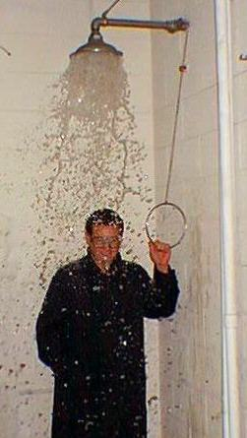
Safety Shower
Shower should be used for dire EMERGENCY only!
If you (or a lab mate) is ON FIRE, position yourself (or your lab mate) under the safety shower.
Pull the handle—a deluge of water will result.
Flames will be rapidly extinguished.
The safety shower should also be used if you suffer a massive spill of a dangerous chemical on yourself, and need to get it off rapidly
But: there is probably no floor drain.

Slide 18
Safety logos

Slide 19
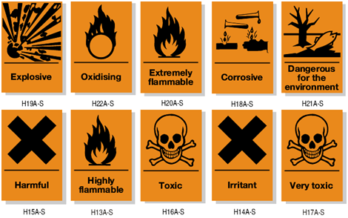

Slide 21
Know the significance of these symbols.
You will see these frequently in adult life.
RED is FIRE DANGER
rated on a 0-4 basis.
If, for example, ether is present, a very high rating of 4 would be indicated.
Yellow indicates REACTIVITY danger.
often "WATER REACTIVE" dangers
Sodium metal, if present, would require a 4 rating.
Sodium represents a danger to firemen, who might come busting into this area with a high pressure hose.
BLUE represents HEALTH HAZARDS,
WHITE signifies specific hazards, e.g. oxidizers, acids, bases, or corrosive materials.

Slide 25
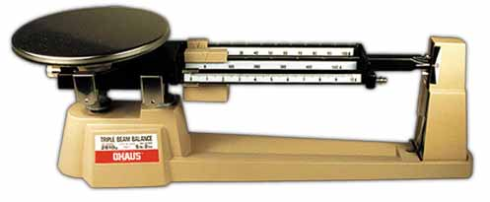
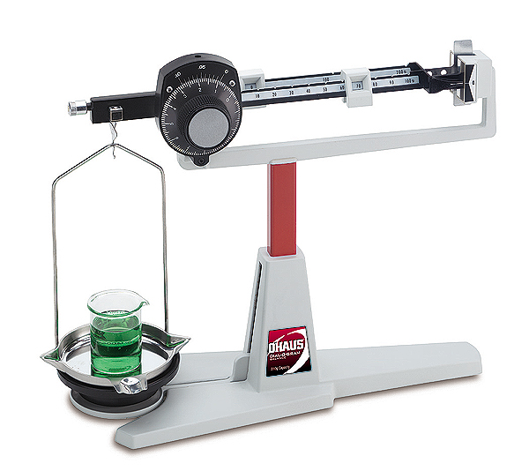
Balances Electronic Triple beam balance

Slide 26
Goggles

Slide 27
Bunsen Burner

Slide 28
Graduate cylinder

Slide 29
Spot plates (microwells)

Slide 30
Stirring Rods

Slide 31
Rubber policeman

Slide 32
Evaporating dish

Slide 33
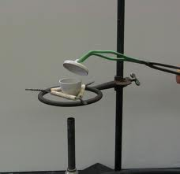
Crucible tongs

Slide 34
Forceps

Slide 35
Watch glass

Slide 36
Beaker: remember hot and cold glassware looks the same

Slide 37
Beaker tongs

Slide 38
Thermometers

Slide 39
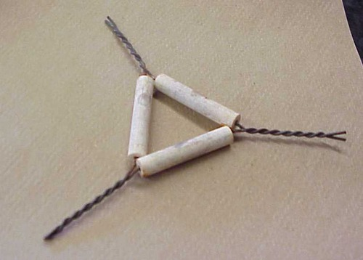
Crucible with lid clay triangle

Slide 41
Buret

Slide 42
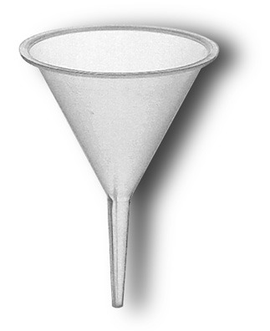
Dropper Funnel

Slide 43
Volumetric flasks (Florence flask)

Slide 44
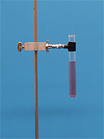
Utility clamp ( or test tube clamp)

Slide 45
pipets

Slide 46
Mortar and pestle: mix 1 chemical at a time

Slide 47
Stricker

Slide 48
Rubber stoppers Spatula

Slide 49
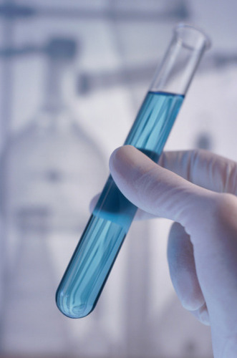
Test tube rack Test tubes

Slide 50
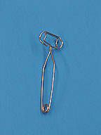
Test tube tongs

Slide 51
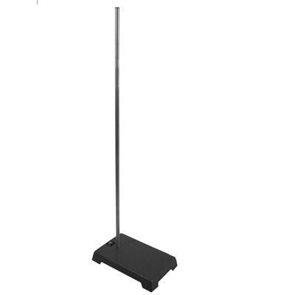
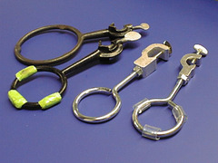
Wire gauze ring stand iron rings

Slide 53
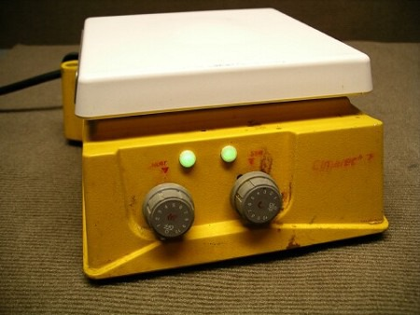
Wash bottles hot plate/stir plate

Slide 54
Erlenmeyer flask

Slide 55
Reagent bottle

Slide 56
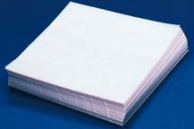
filter paper weighing paper

Slide 57
Separatory funnel

Slide 58
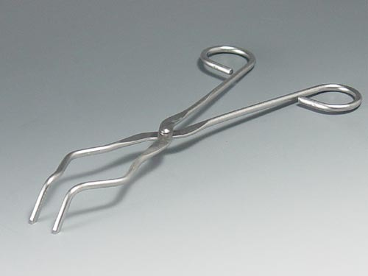
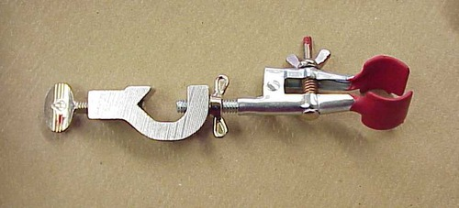
Do you know when to use each

Slide 59
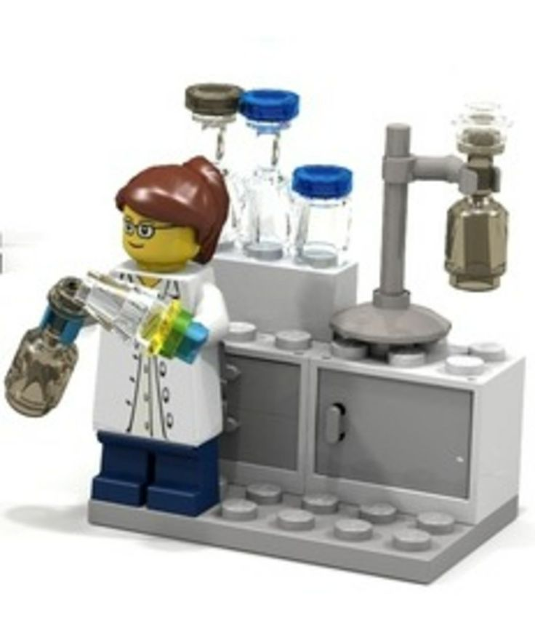
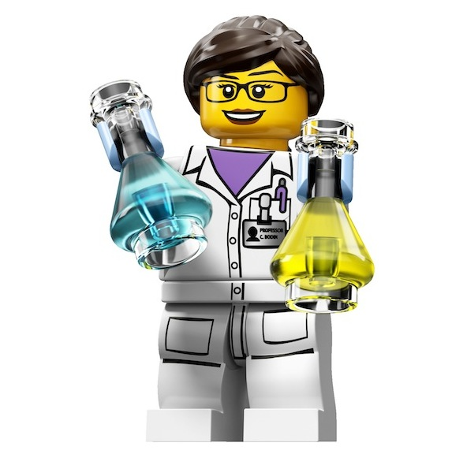
Chemical Safety

Slide 60
If you have an acid spill: clean it up with a base ( sodium bicarbonate)
If you have a base spill: clean it up with an acid ( vinegar)

Slide 61
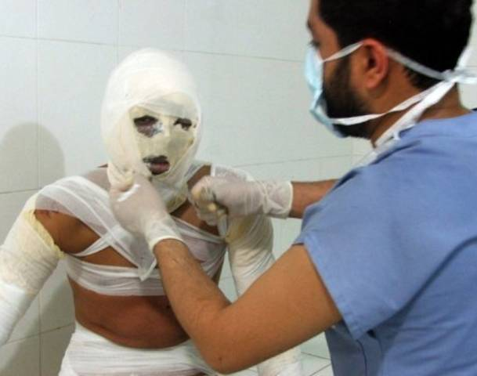
Always wear your safety glasses and aprons and gloves: There are worse pictures than these of students who did not follow safety rules: Please don’t let that be you

Slide 62
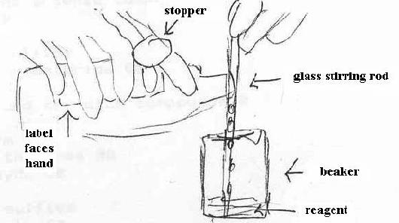
How to pour liquids

Slide 63
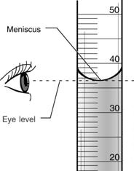
How to measure liquids

Slide 64
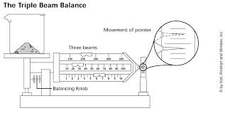
How to use balance

Slide 65
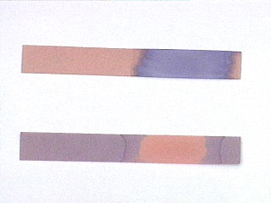
How to use indicator paper safely

Slide 66
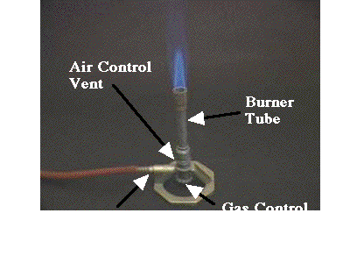
How to use Bunsen burner

